Slide 1
Increases in PrEP Awareness but not PrEP use among people who inject drugs
Hunter Spencer, DO; Matthew Town, PhD, MPH; Lauren Lipira, PhD, MSW, Tim Menza, MD, PhD
November 2024. AMERSA. PRESENTED BY: Hunter C. Spencer, DO, AAHIVS,

Slide 2
Disclosures
Dr. Spencer is supported by NCATS via (KL2TR002370); the views in this presentation are strictly of the authors.
NHBS is funded by CDC

Slide 3
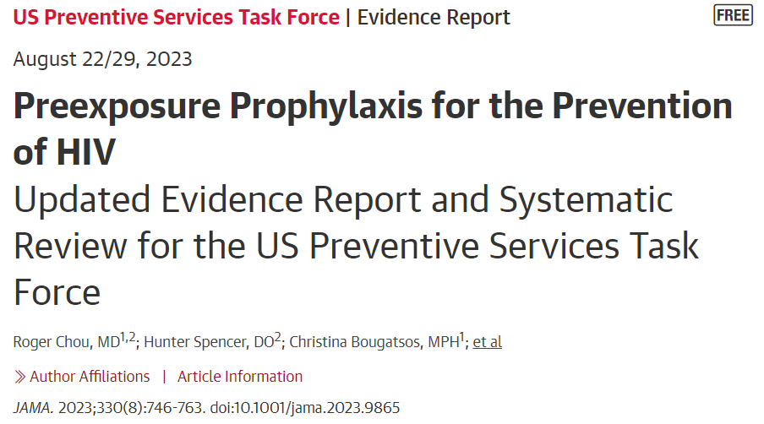
Background
Risk of HIV from injection and sex-related behaviors
HIV PrEP prevents HIV in PWID
Underutilized throughout the PrEP Care Cascade¹
PrEP use 0-3%
1. Mistler et al 2021

Slide 4
Background: Equity
Disparities in HIV in 2022 CDC HIV Surveillance Report¹
Disparities in PrEP use are unclear
Previous analysis of PrEP use in Portland showed disparities between groups with different HIV risk factors but not race
1. CDC, 2024, https://stacks.cdc.gov/view/cdc/156513

Slide 5
Methods
National HIV Behavioral Surveillance, PWID cycle, 2018 and 2022
Inclusion: HIV negative, Indicated for PrEP by adapted CDC criteria
Exclusion: missing HIV status
Outcomes: PrEP awareness, access, use
Three analyses
Outcomes by year, compared by χ²
Adjusted comparison of PrEP awareness by year, generalized linear model
Covariates of PrEP Awareness in 2022, generalized linear model

Slide 6
PrEP Indication Definition
Sex Indication
Condomless sex with a “non-main” partner
HIV+ partner and partner not on ART
Syphilis or Gonorrhea in the last 12 months
Injection Indication
Shared injection equipment

Slide 7
Results
2018
Total recruitment n=530
Analytic sample n=354
5 active “seed” participants
2-19 waves
2022
Total recruitment n=335
Analytic sample n=196
4 “seed” participants
3-14 waves

Slide 8
Characteristics of HIV negative respondents indicated for PrEP in the Portland, OR MSA in 2018 (n=354) and 2022 (n=196)
 | 2018 (%) | 2022 (%) | p
Mean age (years) | 37.2 | 43.2 | <0.001ª
Gender
Male | 63.3 | 62.2
Female | 35.9 | 36.7 | 0.089
Transgender | 0.8 | 1.0
Sexual Identity
Heterosexual | 79.6 | 83.7
Gay or Lesbian | 2.5 | 2.6 | 0.465
Bisexual | 17.8 | 13.8
Race/Ethnicity
White | 72.0 | 74.7
Black | 3.4 | 7.2 | 0.063
Hispanic | 7.9 | 5.7
Multiple | 14.4 | 8.8
Other | 2.3 | 3.6
 | 2018 (%) | 2022 (%) | p
Education <High School | 16.4 | 13.8 | .418
Currently Homeless | 76.8 | 79.5 | 0.544^{b}
Currently insured | 84.5 | 92.8 | 0.007
Usual Source of Care | 83.1 | 18.9 | 0.562^{b}
Methamphetamine Use | 89.5 | 95.9 | 0.009^{b}
Syringe Exchange | 86.7 | 81.1 | 0.201^{b}
Drug Treatment | 57.6 | 35.7 | <0.001^{b}
MOUD | 63.0 | 49.7 | 0.004
Gonorrhea or Syphilis | 5.6 | 7.1 | 0.580^{b}
Transactional Sex | 11.0 | 24.5 | <0.001
8

Slide 9
PrEP Indications, 2018 and 2022
Total Sample n= 865
Excluded
HIV Positive n=15
Status Unknown n =133
HIV Negative n= 717
PrEP Indicated n=550
2018
n=354
2022
n=196
n=322 (91%)
Injection Indication
n=164 (84%)
n=166 (47%)
Sex Indication
n=103 (53%)
9
n=134 (38%)
Both
n= 71 (36%)

Slide 10
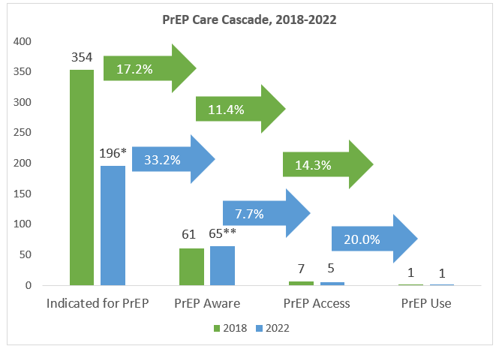
Analysis 1: PrEP Care Cascade, 2018 and 2022

Slide 11
Analysis 2: Adjusted prevalence ratio of PrEP awareness associated with year (n = 550)
Year aPR 95% CI
2018 REF -
2022 1.29 1.18-1.42
Adjusted for age, gender, sexual orientation, race/ethnicity, education, homelessness, insurance status, usual source of care, methamphetamine use, transactional sex, receipt of drug treatment, use of medication for opiate use disorder, and SSP utilization
Notes:
Adjusted for: age Gender sexual orientation race/ethnicity, education, homelessness, insurance status, usual source of care, methamphetamine use, transactional sex, receipt of drug treatment, use of medication for opiate use disorder, and SSP utilization

Slide 12
Analysis 3: Correlates of PrEP Awareness in 2022 (n=196)
Correlate aPR 95% CI
Hispanic Eth 1.62 1.19-2.19
Drug Tx 1.33 1.08-1.63
Non-significant associations for: age, gender, sexual orientation, education, homelessness, insurance status, usual source of care, methamphetamine use, transactional sex, use of medication for opiate use disorder, and SSP utilization

Slide 13
Discussion
Increased PrEP awareness, no change in PrEP access or use
Drug treatment may be an opportunity
Prominent missed opportunities: MOUD, SSP
Methodological strength

Slide 14
Limitations
Local geographic area
Non-precise matching to CDC definitions
Equity in recruitment

Slide 15
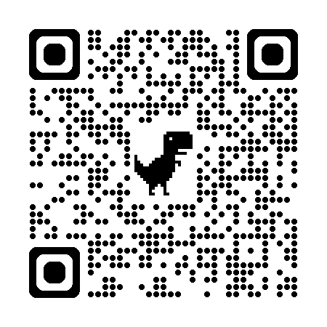
Thank you!
OHA
Chime in
Portland State University – School of Public Health
spencerh@ohsu.edu
Article describing 2018 analysis

