Slide 1




Increasing Buprenorphine Access for Homeless-Experienced Populations
Jacob D. Baylis, MPH
Informatics, Decision-Enhancement and Analytic Sciences (IDEAS) Center,
VA Salt Lake City Health Care System, Salt Lake City, UT, USA.
Program of Addiction Research, Clinical Care, Knowledge, and Advocacy (PARCKA), Department of Internal Medicine, Division of Epidemiology, University of Utah School of Medicine

Slide 2
Funding/Disclosures
Funding: Audrey Jones, PhD Career Development Award
  VA HSR&D IK2 HX003090
I have no financial disclosures, or any conflicts of interest
Views are my own and do not represent the policy or position of the Department of Veterans Affairs or U.S. government

Slide 3
Background
More than 32,000 Veterans experience homelessness on any given night
Persons with experiences of homelessness (PEH) bear a disproportionate share of opioid use disorder (OUD)
Limited information to improve PEH’s medication treatment for OUD (MOUD)
Stepped Care for OUD Train the Trainer (SCOUTT) Initiative funded in the spring of 2018 to increase prescribing of medication for OUD (MOUD)
Impact of SCOUTT and MOUD within PEH populations is unknown
Notes:
Within the VA, PEH account for 2 in 5 patients diagnosed with opioid use disorder
Less likely to receive treatment for OUD (aOR=0.69),
Only 38% of homeless experienced Veterans receive medication treatment for opioid use disorder
Limited information exists to guide health system interventions to improve PEH’s access to evidence-based medication treatment for OUD (MOUD)

Slide 4
SCOUTT Education and Resources
Began in 18 facilities (primary care, mental health, and pain clinics)
Monthly Facilitation – Virtual coaching, some site visits
Twice monthly calls
  Community practice
  Accredited didactic
SCOUTT SharePoint
Notes:
Twice monthly calls
1 community of practice call (VISN reports and open discussion)
1 accredited didactic presentation
All archived on the SCOUTT SharePoint Hub along with:
Links to resources in and outside the VA
Peruse FAQs
500+ presentations
Go through the steps

Slide 5
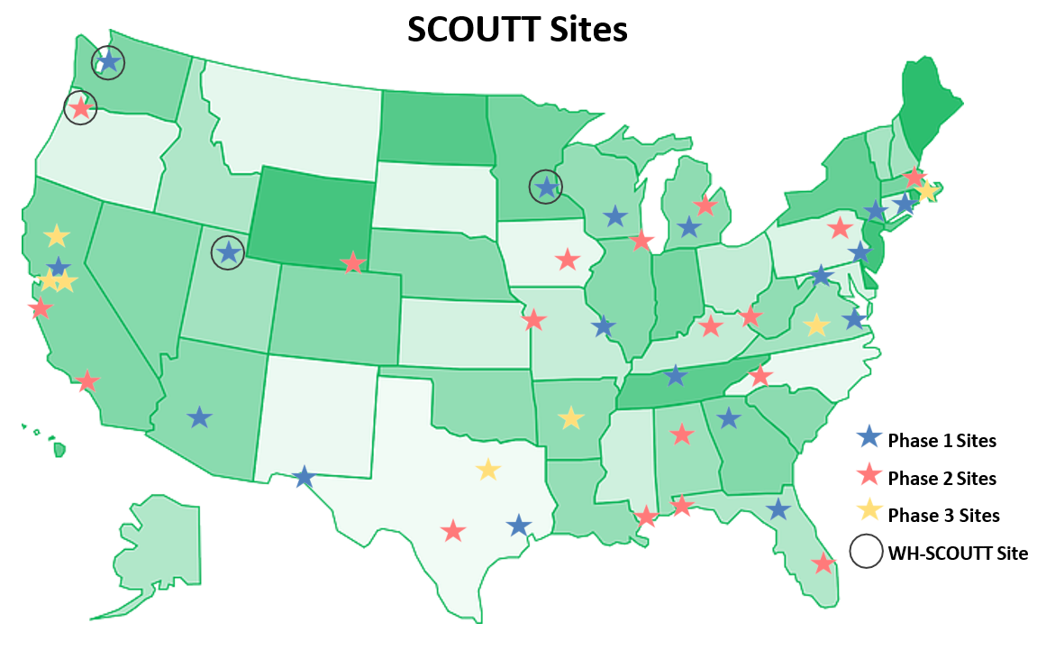

Slide 6
Objective
We sought to examine the effect of the SCOUTT initiative on B-MOUD among Veteran persons experiencing homelessness (PEH)

Slide 7
Study Design
Pooled cross-sectional data from fiscal years (FYs) 2016-2020
Veterans with homelessness identified in EHR
Enrollment in Primary Care (1+ visit per FY)
OUD diagnosis (in FY)
Buprenorphine prescription (MOUD)
FY16-FY20
Evidence of homelessness
Primary care visit
OUD diagnosis
MOUD prescribed
Notes:
Homelessness: ICD10 codes, outpatient stopcodes, inpatient CPT codes, and screened positive on homelessness screeners
Enrollment in PC determined by their PACT assignment.
Excluded data from sites outside the 50 states, missing Sta6a, or patients older than 85 years old
Excluded patients with missing data on covariates
MOUD use was defined by a Bup Rx

Slide 8


Methods
Difference-in-difference analysis comparing B-MOUD rates pre/post SCOUTT implementation by facility
Differences across VA facilities (SCOUTT vs non-SCOUTT)
Controlled for demographic and facility characteristics
Random effects of VA site (Sta3n) and individual
Notes:
Mixed effect Poisson regression

Slide 9
Population
N=40,608
  SCOUTT = 4,435
  Non-SCOUTT = 36,173
Total of 63,774 person years

Slide 10
Notes:
We see similar characteristics for our cohort and subgroups throughout.
Service-connected disabilities

Slide 11
Notes:
OTP_clinc is the division has an opioid treatment program

Slide 12
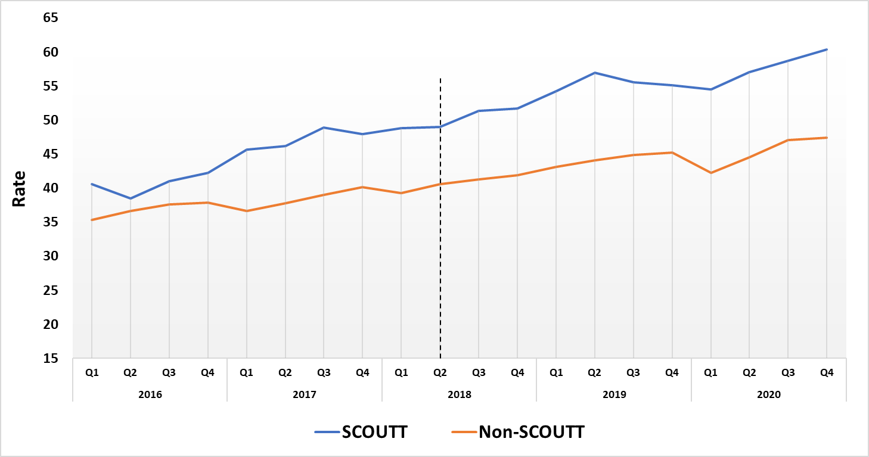
Results – Buprenorphine Prescription Rate
SCOUTT Intervention
Notes:
We do test the assumption of parallel trends on the following slide to see if the two groups had similar trends over time.

Slide 13
Results – Difference-in-Difference
Notes:
We conducted a mixed effect Poisson regression with random effects of Sta3n and individual to look at the marginal predicted means for individuals to receive any Bup, new Bup initiations, any Bup in PC/MH/Pain clinics, and a new Bup Initiation in a PC/MH/Pain clinic. We controlled for patient and facility characteristics, and you can see that rates increased throughout time for SCOUTT and non-SCOUTT sites, but
The interaction term of SCOUTT site and implementation, the predictive margins displayed significance in receiving Bup within SCOUTT sites post implementation compared to non-SCOUTT sites.
Looking at the predictive margins, we see a significant increased probability of individuals between pre and post implementation in receiving any Bup in the Scoutt facilities compared to the non-scoutt facilities
Random effects of Sta3n and individual – controlled for individual and VA facility characteristics (age, gender, race/ethnicity, chronic pain, Nosos score, - VAMC, urban/rural, OTP_clinic)
The random effects are accounting for variation beyond the fixed characteristic effects controlled for

Slide 14



Discussion
SCOUTT has shown to significantly increase B-MOUD for PEH with OUD
Regardless of site, buprenorphine treatment increased for all PEH with OUD
The expansion of the SCOUTT Initiative may continue to improve treatment opportunities for homeless Veterans with OUD
Future studies to look at community care data and Phase 2 and 3 SCOUTT sites

Slide 15
Limitations
Cohort inclusion
  Focused on Veterans with homeless experiences in the HER
  Engaged in Primary Care
Only counted Buprenorphine prescriptions within the VA
  Conservative estimate of B-MOUD
Other medications for MOUD (Methadone and Naltrexone)
Did not exclude Buprenorphine for pain

Slide 16
THANK YOU
Haojia Li
  - VA Salt Lake City Health Care System and University of Utah
A. Taylor Kelley, MD, MPH
  - VA Salt Lake City Health Care System and University of Utah
Ying Suo, MS
  - VA Salt Lake City Health Care System and University of Utah
Richard Nelson, PhD;
  - VA Salt Lake City Health Care System and University of Utah
Stefan G. Kertesz, MD, MSc
  - VA Birmingham and University of Alabama Birmingham
Eric J Hawkins, PhD
  - VA Puget Sound Health Care System and University of Washington
Hildi Hagedorn, PhD
  - Minneapolis VAMC and University of Minnesota
Adam J. Gordon
  - VA Salt Lake City Health Care System and University of Utah
Audrey L. Jones, PhD
  - VA Salt Lake City Health Care System and University of Utah
THANK YOU to all SCOUTT clinicians who exemplify transdisciplinary approach to Veterans with OUD in their unique environments
Jacob D. Baylis
Jacob.Baylis@va.gov

