Slide 1
INPATIENT ADDICTION TREATMENT FROM CONCEPTION TO REALITY TO SUSTAINABILITY
Emily Casselbury, FNP-BC; Angela Kerins, PharmD; JP Murray, MA, MD; Sophia Peng, MD, FASAM; Nick T Podjasek, Elisabeth A Poorman, MD; Aimee Potter, LCSW; Geoffrey Pucci, PharmD; Katherine Welter, MD
Notes:
Thank you all for being here and welcome to our workshop entitled Inpatient Addiction Medicine: From Conception to Reality to Sustainability. During this workshop we will review strategies for planning, operationalizing, and growing inpatient addiction medicine care. Presenters are from diverse Chicagoland hospitals including Northwestern, the VA, Rush, and University of Chicago and come from multidisciplinary backgrounds including social work, peer counseling, prescribing providers, and pharmacy. While drawing upon our lived experience we recognize and acknowledge both our individual and collective limitations—it will be difficult to characterize such an ambitious project in 90 short minutes—but perhaps no question is more germane to our contemporary medical moment than operationalizing the widespread uptake of medications to treat opioid and alcohol use disorders—particularly within the hospital setting—which remains a grievously missed opportunity for so many patients. We recognize that the cascade of care is extraordinarily complex as are our home institutions, patient populations, and stages of development. There is no one answer, solution, or path that will fit everyone’s needs. For that reason, this workshop we feature 4 breakout sessions meant to trouble shoot and creatively strategize a path forward best suited for your home institution.
More than anything, we hope to spark productive conversations, learn from one another, and plant seeds for addiction consult service lines to come or enhancements to existing teams. With that in mind we ask that each person refer to the supplemental document which will organize our discussion today and is meant to be filled out iteratively during each breakout session. It is available as an online Google doc with an expanded bibliography accessible via the QR code on your handouts. For those of you with laptops, feel to fill out the document using a word processor. Our hope is that every person will leave with an outline of a proposal for a new addiction medicine service line or for the enhancement of an existing one that they can return home with.

Slide 2
DISCLOSURES
Dr. Welter served as a key advisor for Indivior
No other presenter financial disclosures or conflicts of interest
“Drugs” by Barbara Tereshchenko
Notes:
We have one disclosure, that Dr. Welter served as an advisor for Indivior. No other presenters have any disclosures.

Slide 3
LEARNING OBJECTIVES
Review methods for performing a needs assessment for starting or sustaining inpatient addiction services that align with institutional priorities.
Describe the essential components, responsibilities, and benefits of an Addiction Consult Service (ACS).
Identify institutional formulary limitations for medications for opioid use disorder and identify avenues to expand formulary and medication access.
Interpret the DEA “3-day rule” and challenges associated with implementation of inpatient methadone dispensation.
Discuss common barriers for linkage to care and how to create effective partnerships with outpatient providers.
Notes:
We have five learning objective which will map onto the four breakout sections of this workshop.

Slide 4
THE HOSPITAL SETTING
Approximately 87% of all Americans with opioid use disorder (OUD) do not receive medication treatment (2019).
Study from 2020 at multiple VA hospital systems found only 15% of patients with OUD received opiate agonist therapy (OAT: buprenorphine or methadone) while hospitalized.
Only 2% of patients with OUD not already on OAT were started on medication with plans for linkage to care upon discharge
UNDER-RECOGNIZED AND UNDER-TREATED
Krawczyk N, Rivera BD, Jent V, Keyes KM, Jones CM, Cerdá M. Has the treatment gap for opioid use disorder narrowed in the U.S.?: A yearly assessment from 2010 to 2019". Int J Drug Policy. 2022 Dec;110:103786.
Notes:
Why does this matter: Briefly because hospital systems are failing patients with substance use disorders.
Arguably failing this group of patients more than any other that suffers from a treatable disease process in the history of modern medicine.
A recently published study showed that as of 2019, 87% of all American’s with opioid use disorder were not receiving pharmacotherapy.
Another 2020 study looking at multiple VA hospital systems found that only 15% of patients with OUD received opiate agonist while hospitalized.
Only 2% of hospitalized patients with OUD in this study were started on medications in the hospital with plans for linkage to care upon discharge.
I'll repeat that: only 2% of patients with this chronic, treatable disease (that is responsible for more potential life years lost than any other disease process in this country) were started on evidence-based therapy while hospitalized. If patients with diabetes can be consistently provided insulin while hospitalized, we can offer patients with opioid and alcohol use disorders evidence based care also.

Slide 5
OPIATE AGONIST THERAPY
MORTALITY BENEFIT
2021 Metanalysis reviewed 15 RCT and 36 cohort studies including over 750,000 patients with OUD.
Compared rates of all-cause mortality for patients receiving OAT to those not in treatment.
Relative risk for all-cause mortality for patients in cohort studies while receiving treatment compared to being out of treatment was 0.47 (95% CI, 0.42-0.53).
Santo, T., Clark, B., Hickman, M., Grebely, J., Campbell, G., Sordo, L., ... & Degenhardt, L. (2021). Association of opioid agonist treatment with all-cause mortality and specific causes of death among people with opioid dependence: a systematic review and meta-analysis. JAMA psychiatry, 78(9), 979-993.
Notes:
Why should we worry about starting patients on medications in the hospital? Because medications exist to treat many substance use disorders (particularly alcohol and opioid use disorder) that confer a powerful mortality benefit. A recently published 2021 meta-analysis reviewed 15 RCTs and 36 cohort studies involving over 750,000 patients with OUD.
The study compared rates of all-cause mortality for patients receiving OAT to those not in treatment. The relative risk for all cause mortality for patients in the cohort studies while receiving opioid agonist therapy was 0.47 compared to those not in treatment.
Let me repeat that number: the relative risk for all cause mortality while in treatment was 0.47! If you were to prescribe a single medication for the rest of your life to extend the lives of your patients, buprenorphine (and methadone to the extent it can be prescribed) would be that medication.
We have powerful tools to treat many of these diseases which are tragically being unused by providers and hospital systems at large.

Slide 6
WHAT IS A HOSPITAL?
Complex system
Non-linear output means unintended consequences
Internal and external stakeholders
Providers / staff / patients
Payers / regulatory bodies / community
Economic production system
Exists within a uniquely private insurance/capitalistic macroenvironment
Value based care increasingly shifts financial risk to providers / Affordable Care Organizations
COMPLEX, DYNAMIC, ECONOMIC PRODUCTION ECOSYSTEM
Notes:
When reflecting on enhancing addiction medicine services within hospital systems, it’s important to acknowledge fundamental features of this practice environment. Hospitals are complex systems, defined by nonlinear output and unintended consequences, ecosystems with innumerable internal and external stakeholders, and perhaps most importantly, hospitals are economic production systems. It’s important to remember that many hospitals’ primary function is to generate surplus value for shareholders and investors (not necessarily to provide optimal outcomes for patients); indeed, all hospitals exist within our uniquely American private health insurance and capitalist macroenvironment. Questions of economic viability lurk behind and in front of us at every turn. To successfully optimize inpatient addiction medicine care, we must develop proposals that satisfy the financial concerns of hospital administrators while simultaneously working to change the terms of engagement (perhaps now more than ever) as to how and why we justify our existence—moving from simple RVUs and line-item budgets to patient centered outcomes such as mortality benefit and medication uptake that better align with value-based care.

Slide 7
INSTITUTIONAL NEEDS ASSESSMENT
Notes:
Elissa, Katie, and Angela

Slide 8
DETERMINING INSTITUTIONAL NEEDS
ASSESS
What percent of patients admitted have a substance use disorder?
What are hospital leadership priorities that addiction services may address?
MEASURE
What tools can you use to collect data?
Consider EHR data, surveys, anecdotes, and testimonials.
DEFINE
How will you measure success?
Consider how you will balance priorities and achievability.
Notes:
Determining the needs of the institution and using data to get buy in for starting or
sustaining a program

Slide 9
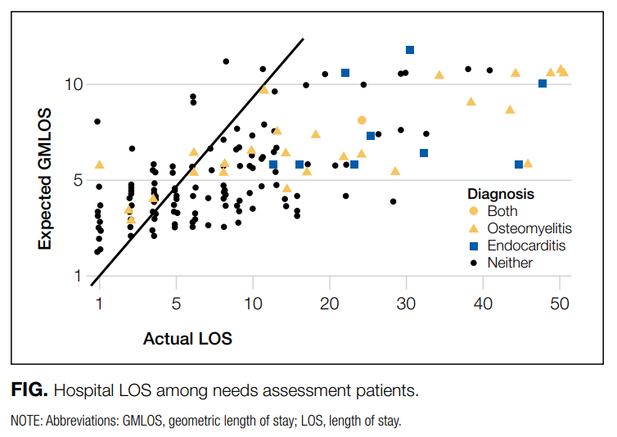
58% of alcohol users and 67% of drug users were interested in cutting back or quitting
Needs Assessment Finding | Program | Resources
Hospitalization reachable moment | Hospital-based addiction consultation | Physician, social worker, peer mentor
No pathway to outpatient treatment | “In-reach” liaison supports rapid access | Community partners provide support and linkage
IV abx with long LOS | Medically Enhanced Residential Treatment | Home infusion cost, RN, residential program coordinator
Englander, H et al. JHM, 2017.
Notes:
Translating data into programs specific for your need. Example from IMPACT implementation in 2017
Screened patients flagged for risky alcohol/drug use, then research assistant screen patients. Asked to indicate readiness to change on 3 point scale (no interest, cutting back, or interest in quitting). Then subset completed an in depth qualitative interview exploring patient perceptions.
Identified community partners for which had an relationship and common interest.
Mean LOS was 10.26 days (4 days more than average medicine patients) and high among those who required long term IV antibiotics, particularly those with endocarditis or osteomyelitis (21.76, range 1-51 days).
Used business case to discuss 10% reduction in LOS and readmissions.
Takes their specific needs and translates into program that works for their region.

Slide 10
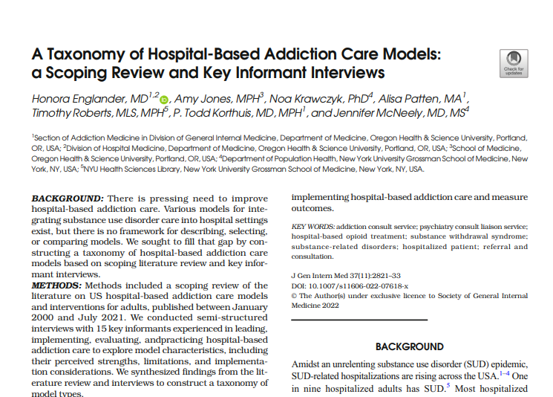

Slide 11
WHO ARE YOUR STAKEHOLDERS?
Patients
PHYSICIANS / APPs
Nurses
Pharmacists
Outpatient Partners
Division Leadership
Hospital Leadership
Others?
Notes:
consider including social work/care coordination, more info on external stakeholders (OTPs, external clinics, access to MOUD/MAUD in general, pharmacies able to provide access.)
Chart with boxes of different groups (pharmacy, nurses, division leadership, funding sources)
Adding something about mentorship and outside partners
1-2 people give story of how they actually did this. Consider doing a pilot.

Slide 12
WHAT METRICS CAN YOU TRACK?
Consult volumes / RVUs
Utilization: LOS, readmissions, patient-directed discharges
Workplace satisfaction
Medications for SUD: during admission and on discharge
Linkage to care
Harm reduction: counseling, naloxone, syringe, and test strip distribution
* data more likely to be mixed
Notes:
Elissa and all to add actual data points, initiation of MOUD/MAUD (rates), naltrexone dispensation. Do we need a few extra slides on this? More nuts and bolts about how to go about creating an institutional assessment.

Slide 13
THE PROCESS • NORTHWESTERN
YEAR 1 EXPLORATION
YEAR 2 PREPARATION
YEAR 3 IMPLEMENTATION
Met with Hospital Medicine Leadership
Secured resources for analytics support for SUD data in general med population
Identified team members and explored Addiction Medicine practice pathway plan
Discussed with external ACS directors for mentorship
Explored funding sources
Formalized partnership with Psychiatry CL team for ACS
Met with Social Work Leadership for onboarding process
Secured approval for Pilot Addiction Service with physician + SW team
Worked with billing to ensure notes would be captured
Created an interdisciplinary team to work on clinical and education goals
Active marketing of new service at meetings, emails, flyers
Manual and EHR data to track volumes and quality metrics
SW connected with community partners to build relationships
Developed electives for medical students and residents
Communicated with leadership on formal funding and grant opportunities
Calcaterra, S et al. JGIM, 2022.
EVERY JOURNEY WILL BE DIFFERENT
Notes:
If too busy, can also do in 2-3 slides
Calcaterra, Susan L et al. “The Development and Implementation of a Hospitalist-Directed Addiction Medicine Consultation Service to Address a Treatment Gap.” Journal of general internal medicine vol. 37,5 (2022): 1065-1072. doi:10.1007/s11606-021-06849-8

Slide 14
THE PROCESS • JESSE BROWN
YEAR 1 EXPLORATION
YEAR 2 PREPARATION
YEAR 3 IMPLEMENTATION
Jesse Brown for Black Lives Matter
Hospitalists sought out X-waiver
Hospitalists and pharmacists created the opioid use disorder orderset
Applied to hospital leadership for the creation of ACS
Search for medical director
Meetings with psychiatry department about the structure
Medical director conducted nationwide survey of existing services
Multiple meetings with hospitalists and psychiatry about staffing
Plan for consult service implementation
Started seeing patients September 2023
Concurrent protocol creation*
Staff training and leadership
Fellow training and leadership
Monthly talks to residents
Regular meetings with inpatient and outpatient departments to improve referrals and coordination of care
Calcaterra, S et al. JGIM, 2022.
EVERY JOURNEY WILL BE DIFFERENT
Notes:
If too busy, can also do in 2-3 slides
Calcaterra, Susan L et al. “The Development and Implementation of a Hospitalist-Directed Addiction Medicine Consultation Service to Address a Treatment Gap.” Journal of general internal medicine vol. 37,5 (2022): 1065-1072. doi:10.1007/s11606-021-06849-8

Slide 15
THE PROCESS • UNIVERSITY OF CHICAGO
YEAR 1 EXPLORATION
YEAR 2 IMPLEMENTATION
YEAR 3 CALIBRATION
Opioid Taskforce commissioned
Stakeholders from nursing, pharmacy, social work, medicine, and psychiatry meet iteratively using “Agile project management”
Buprenorphine added to inpatient pharmacy
Community partners (OTPs and FQHCs engaged) to develop linkage to care process
Nursing initiative to teach COWS
Launch of OUD consult service staffed by three providers
Quarterly meetings with referral partners to ensure process efficient
Methadone added to inpatient pharmacy for MOUD
Ongoing “Agile” cycle meetings at hospital level involving key stakeholders
Low dose buprenorphine induction protocols developed
Quarterly meetings with referral partners to ensure process efficient
Educational elective developed, launched following year
Monthly meeting schedules within provider group for case discussion and scholarship
EVERY JOURNEY WILL BE DIFFERENT
Notes:
If too busy, can also do in 2-3 slides
Calcaterra, Susan L et al. “The Development and Implementation of a Hospitalist-Directed Addiction Medicine Consultation Service to Address a Treatment Gap.” Journal of general internal medicine vol. 37,5 (2022): 1065-1072. doi:10.1007/s11606-021-06849-8

Slide 16
UCM METRICS
1,372 completed consults
Outcomes
30 day readmission rates
OUD Consult 15%
No Consult and MOUD 23%
90 day readmission rates
OUD Consult 24%
No Consult and MOUD 38%
Structural changes
Methadone, buprenorphine, buprenorphine/naloxone formulary changes
Micro dosing buprenorphine protocols
OUD order set
3 day dispense for methadone at discharge
Education
2021-2022: 11 residents & 4 students
2022-2023: 13 residents/fellows & 10 students
2023-2024: 28 residents/fellows & 14 students
Now required rotation for anesthesia fellows

Slide 17
UCM METRICS • ~36 PATIENTS PER MONTH STARTED ON MOUD OVER PAST YEAR

Slide 18
JESSE BROWN METRICS
550 completed consults
Outcomes
96% of those with OUD received MOUD
70% of those with AUD received MAUD
Structural Changes
Methadone, Sublocade, and Brixadi added to the inpatient formulary
3 day dispense for methadone
Harm reduction pathways for veterans not interested in abstinence
6 fellows trained, 7 residents, 3 medical students trained; all residents attend monthly morning report

Slide 19
RUSH SUBSTANCE USE INTERVENTION TEAM
Data from first year of operation showed that LOS shorter for patients with a SUD that received a consult.
After the first year that data were not reproducible.
What changed?
COVID
Word of mouth among PWUD
Conflict between readmission risk and LOS
Changes in chronic opioid prescribing
How we pivoted
Collaboration
Education
Institutional desire to address SDOH
Thompson 2020
Notes:
Thompson, H. et al., “Differences in length of stay and discharge destination among patients with substance use disorders: The effect of Substance Use Intervention Team (SUIT) consultation service ,” PLOS ONE, 2020; 15(10): e0239761.
COVID: changed a lot of the healthcare landscape. We were consulted on difficult sedation weans for example. Dispo options were limited (barriers to inpatient, SNF, etc). Rates of SUD, particularly AUD, rose dramatically during lockdown.
Word of mouth: PWUD told their community members that they were treated well and we became a “destination hospital.”
Readmission v LOS: in certain cases we would ask primary teams to hold discharge so that we can connect someone at high risk of readmission to treatment. Also began holding people so that they could receive depot injectables while admitted.
Chronic opioids: prescribers began recognizing signs of SUD and we began to be consulted on patients who in the past would have been seen by Palliative. These included patients with sickle cell disease
Collaboration: primary teams began to see us as indispensable. Other specialties saw our value (ie ID, transplant, heart failure)
COVID closed many clinical sites for students, we took them in. We now have AM fellows, psychiatry, EM/tox, anesthesia pain rotators, as well as med and PA students. Also ACGME began mandating addiction content.
Rush has a mission to address health inequities on the west side of Chicago, and a lot of our patients reside there.

Slide 21
SUSTAINABILITY: “A CREATIVE PATCHWORK”
Billing
Grants (SAMHSA, NIDA)
Quality Metrics, i.e. cost savings (readmissions)
Hospital Funding
State Funding (Medicaid)
Financing
“A common concern across services, was planning for and acquiring financial resources, which consistently constrained or facilitated AMC service existence and operation. The AMC services were financed through a creative patchwork of financial streams—grants, in-house funding, third-party billing revenue, state funding, and fellowship funding. Some AMC services operated as pilot programs with grand funding from the hospital or an external organization (eg, third-party payer). Many services received in-house funding, specifically for the salaries of the clinicians, an/or the funding of the addiction medicine fellowship slots—these funds were procured from either a specific department (eg, medicine or psychiatry) or from hospital operations. In addition, some of AMC service operating funds came through revenue generated through billing third-party payers: “We bill just like any other consultant.” Services also received funding from state health care.”
Notes:
We will wind this section down by discussing financial sustainability for addiction consult services—perhaps best described as “a creative patchwork” often dependent on multiple sources of revenue. Billing (RVU generation) will be central but grants, cost savings via improved CMS quality outcomes, and state Medicaid funding are all potential sources

Slide 22
MAKING THE CASE: COMMON THEMES
“Unfortunately, interest in improving hospital care for patients with OUD and other SUDs, by and large has not been driven by ethical, moral, and legal arguments. Our informants noted that these arguments were not sufficient for convincing most high-level hospital administrators to implement an AMC service. Garnering the support of high-level hospital leadership instead relied primarily on articulating how the service aligned with hospital goals and how the service could operate as a financially value-maximizing activity; thus, clinical champions pitched the service as a business proposition."
Priest KC, McCarty D. Making the business case for an addiction medicine consult service: a qualitative analysis. BMC Health Serv Res. 2019 Nov 8;19(1):822. doi: 10.1186/s12913-019-4670-4. PMID: 31703741; PMCID: PMC6842195.

Slide 23
SUSTAINABILITY: MAKING THE CASE FOR ACS
ASPIRATIONAL
Mortality benefit for patients
MOUD/MAUD initiation and uptake
Improved linkage to care
Decreased disease severity and self-reported abstinence
Decrease stigma for patients and within healthcare systems
FINANCIAL / PRACTICAL
Billing/RVU generation
Improved readmission rate/decreased healthcare utilization (ER visits)
Meeting educational requirements (ACGME)
Improved DRG coding/billing
Notes:
When we are developing a business case for an addiction consult services we would do well to blend both the financial or practical benefits with aspiration and patient centered outcomes.

Slide 24
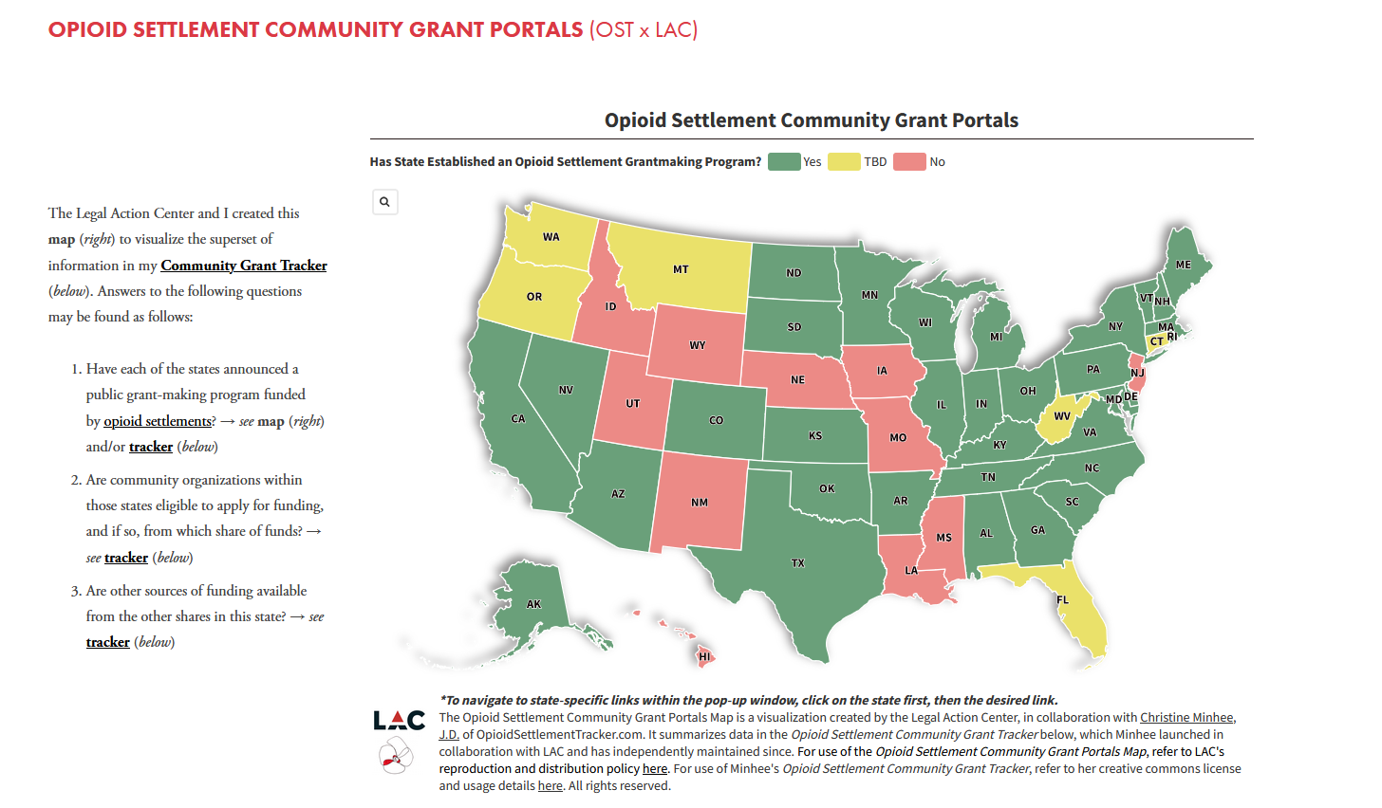
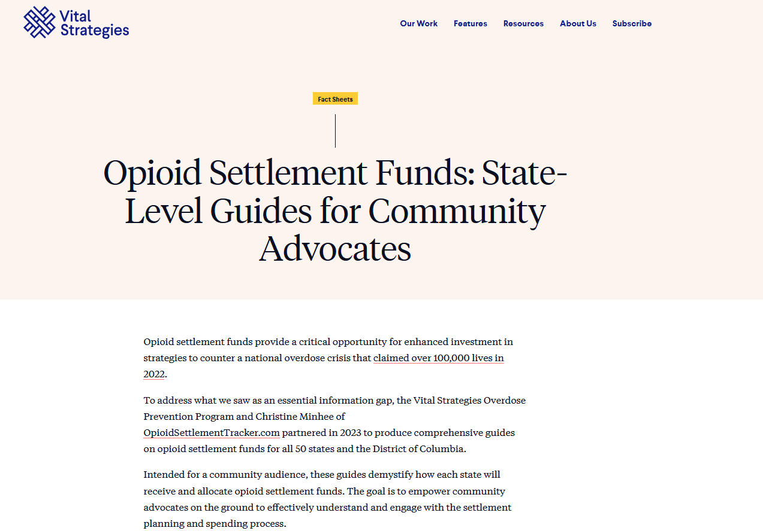
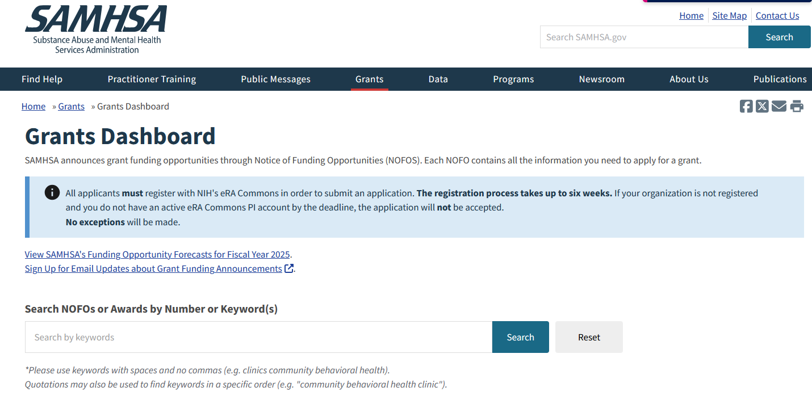
GRANT/SETTLEMENT TRACKING TOOLS

Slide 25
BREAKOUT
Consider the stakeholders to develop or sustain your inpatient addiction services.
What are 3 metrics that would be most relevant to them?
Brainstorm potential funding sources (billing, grants, hospital support) for your inpatient addiction team.
GOAL: Determine specific metrics and best methods for data collection.
Notes:
determine question/format of short breakout session. Could have a question to apply to new or existing addiction programs

Slide 26
ACS: COMPOSITION & MISSION
Notes:
JP, Cass

Slide 27
CORE ROLES IN ACS
Addiction medicine provider
Care coordinator/ social worker
Peer specialists/ patient engagement
Pharmacist
Nursing support/Specialist
Notes:
Lets turn to Addiction Consult Service team composition. There is certainly some heterogeneity in regards to how ACS teams are composed but core roles are often as above. A group of addiction medicine prescribing providers, care coordinators/social workers, peer specialists, pharmacist, and nursing specialists. Not every ACS team will or should look like this. Not every hospital system has the resources to build larger multidisciplinary teams. Every journey will be different.

Slide 28
WORKFLOW/RESPONSIBILITIES OF ACS SERVICE
Patient identification (universal screening)
Assessment/diagnosis of SUD
Laboratory testing
Initiation of pharmacotherapy (MAUD/MOUD)
Behavioral therapy
Linkage to care
History: Diagnosis, Risk Assessment, Treatment Readiness
Physical Examination & Laboratory Test
Withdrawal Management
Referral & Linkage
Long-term Medication Titration
Weinstein, Z. M., Wakeman, S. E., & Nolan, S. (2018). Inpatient addiction consult service: expertise for hospitalized patients with complex addiction problems. Medical Clinics, 102(4), 587-601.
Notes:
Core functions/responsibilities for ACS services include patient identification, assessment/diagnosis, appropriate lab/diagnostic testing, withdrawal management and initiation of pharmacotherapy, behavioral therapy (if you are so lucky), and linkage to care

Slide 29
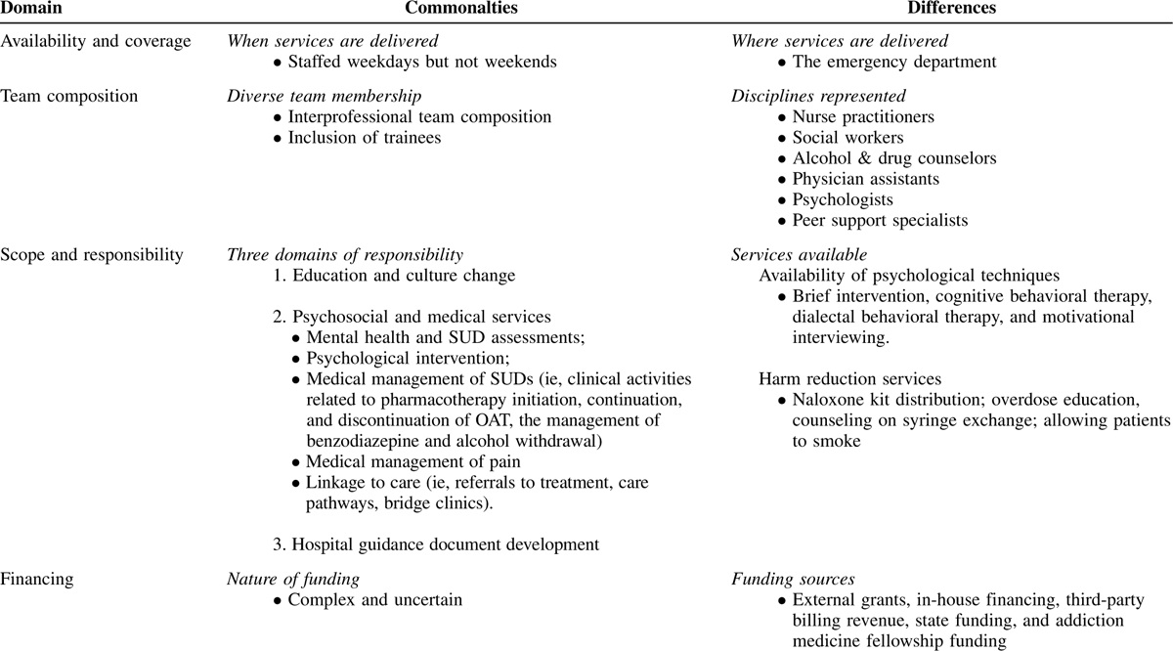
LOGISTICS/RESPONSIBILITIES OF ACS SERVICE
Availability / coverage
24-hour call?
Weekends?
Team composition
Services provided
Diagnosis/assessment
Pharmacotherapy
Behavioral therapy
Harm reduction
Linkage to care
Institutional structural improvements / education
Notes:
Logistical questions to be determined include coverage hours, weekend availability, team composition, as well as the aforementioned services provided. An additional—and essential part of the justification for ACS teams relates to more less measurable institutional or structural enhancements such as provider satisfaction, stigma reduction, and in some cases the fulfillment of ACGME requirements.

Slide 30
BENEFITS OF ADDICTION MEDICINE CONSULT SERVICE
Initiation of MOUD/AUD
Self-reported abstinence/ addiction severity
Decreased length of stay
Decreased readmission rate
Improved linkage to ouTpatient care
Mortality benefit
Improved provider trust & provider confidence
Notes:
What are then the known, proven benefits of ACS teams? In short they are abundant. From exponential increases in the initiation of MAUD/MOUD, to providing a clear mortality benefit to patients seen, to decreased patient readmissions/healthcare utilization, improvement in outpatient linkage to care, and decreased stigma, addiction consult services bring multivalent and self-perpetuating benefits to patients and healthcare systems alike.

Slide 31
INITIATION OF MEDICATIONS
Calcaterra SL, McBeth L, Keniston AM, Burden M. The Development and Implementation of a Hospitalist-Directed Addiction Medicine Consultation Service to Address a Treatment Gap. J GEN INTERN MED. 2022;37(5):1065-1072.
Englander H, King C, Nicolaidis C, et al. Predictors of Opioid and Alcohol Pharmacotherapy Initiation at Hospital Discharge Among Patients Seen by an Inpatient Addiction Consult Service. Journal of Addiction Medicine. 2020;14(5):415.
Jakubowski A, Singh-Tan S, Torres-Lockhart K, et al. Addiction Consult Service and Inpatient Outcomes Among Patients with OUD. J Gen Intern Med. Published online August 13, 2024.
Liebschutz JM, Crooks D, Herman D, et al. Buprenorphine treatment for hospitalized, opioid-dependent patients: a randomized clinical trial. JAMA Intern Med. 2014;174(8):1369-1376.
Kast KA, Le TDV, Stewart LS, et al. Impact of inpatient addiction psychiatry consultation on opioid use disorder outcomes. American Journal on Addictions. Published online 2024.
McNeely J, Wang SS, Rostam Abadi Y, et al. Addiction Consultation Services for Opioid Use Disorder Treatment Initiation and Engagement: A Randomized Clinical Trial. JAMA Intern Med. Published online July 29, 2024:e243422.
Muller M, Weyer G, Zakrison T, Ari M. Impact of an opioid use disorder consult service on hospitalized trauma patients with opioid use disorder. Journal of Trauma and Acute Care Surgery. 2023;95(2):226.
Nordeck CD, Welsh C, Schwartz RP, Mitchell SG, O’Grady KE, Gryczynski J. Opioid agonist treatment initiation and linkage for hospitalized patients seen by a substance use disorder consultation service. Drug Alcohol Depend Rep. 2022;2:100031.
Ober AJ, Osilla KC, Klein DJ, et al. Pilot randomized controlled trial of a hospital-based substance use treatment and recovery team (START) to improve initiation of medication for alcohol or opioid use disorder and linkage to follow-up care. Journal of Substance Use and Addiction Treatment. 2023;150:209063.
Singh-Tan S, Torres-Lockhart K, Jakubowski A, et al. Addiction Consult Service and Inpatient Outcomes Among Patients with Alcohol Use Disorder. J Gen Intern Med. 2023;38(14):3216-3223.
Suzuki J, DeVido J, Kalra I, et al. Initiating buprenorphine treatment for hospitalized patients with opioid dependence: A case series. The American Journal on Addictions. 2015;24(1):10-14.
Trowbridge P, Weinstein ZM, Kerensky T, et al. Addiction consultation services – Linking hospitalized patients to outpatient addiction treatment. Journal of Substance Abuse Treatment. 2017;79:1-5.
Wakeman SE, Kane M, Powell E, et al. A Hospital-Wide Initiative to Redesign Substance use Disorder Care: Impact on Pharmacotherapy Initiation. Substance Abuse. 2021;42(4):767-774.
ODDS RATIO RANGES FROM 2-7 FOR INCREASED MOUD/MAUD INITIATION WITH ACS CONSULT
Notes:
We’ll look at a few specific outcomes. For example, there are over 10 studies that show ACS teams increase the odds of patients with SUDs being started on life saving pharmacotherapy with odds ratio’s ranging from 2-7 for in house imitation of MAUD/MOUD.

Slide 32
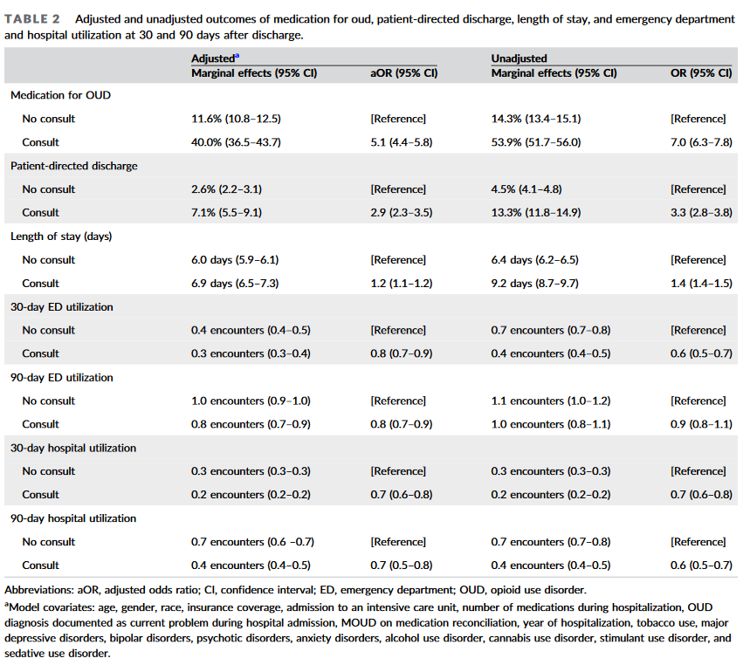
Kast KA, Le TDV, Stewart LS, et al. Impact of inpatient addiction psychiatry consultation on opioid use disorder outcomes. American Journal on Addictions. Published online 2024. doi:10.1111/ajad.13540
Notes:
This study by Klast shows an unadjusted odds ratio of 7 for increased MOUD imitation for patients seen by an ACS team—having an ACS team is the best way to ensure the that these urgent, life-saving medications are offered to patients suffering from a treatable disease process—one that is causing more potential life years lost in our country than any other.

Slide 33
READMISSIONS/UTILIZATION
Gryczynski J, Nordeck CD, Welsh C, Mitchell SG, O’Grady KE, Schwartz RP. Preventing Hospital Readmission for Patients With Comorbid Substance Use Disorder : A Randomized Trial. Ann Intern Med. 2021;174(7):899-909.
Kast KA, Le TDV, Stewart LS, et al. Impact of inpatient addiction psychiatry consultation on opioid use disorder outcomes. American Journal on Addictions. Published online 2024.
Pecoraro A, Horton T, Ewen E, et al. Early data from project engage: a program to identify and transition medically hospitalized patients into addictions treatment. Addiction Science & Clinical Practice. 2012;7(1):20.
Thompson HM, Hill K, Jadhav R, Webb TA, Pollack M, Karnik N. The Substance Use Intervention Team: A Preliminary Analysis of a Population-level Strategy to Address the Opioid Crisis at an Academic Health Center. J Addict Med. 2019;13(6):460-463.
Wakeman SE, Kane M, Powell E, Howard S, Shaw C, Regan S. Impact of Inpatient Addiction Consultation on Hospital Readmission. J GEN INTERN MED. 2021;36(7):2161-2163.
Wei J, Defries T, Lozada M, Young N, Huen W, Tulsky J. An Inpatient Treatment and Discharge Planning Protocol for Alcohol Dependence: Efficacy in Reducing 30-Day Readmissions and Emergency Department Visits. J GEN INTERN MED. 2015;30(3):365-370.
SIGNIFICANT REDUCTION IN 30- AND 90-DAY READMISSION FOR PATIENTS SEEN BY ACS TEAM (KAST)
Notes:
Other studies show measurable reduction in 30- and 90-day readmission rates, return visits to the ED, and overall healthcare utilization. These outcomes are often closely aligned with intuitional objectives related to improving value-based reimbursements from Medicare and Medicaid.

Slide 34
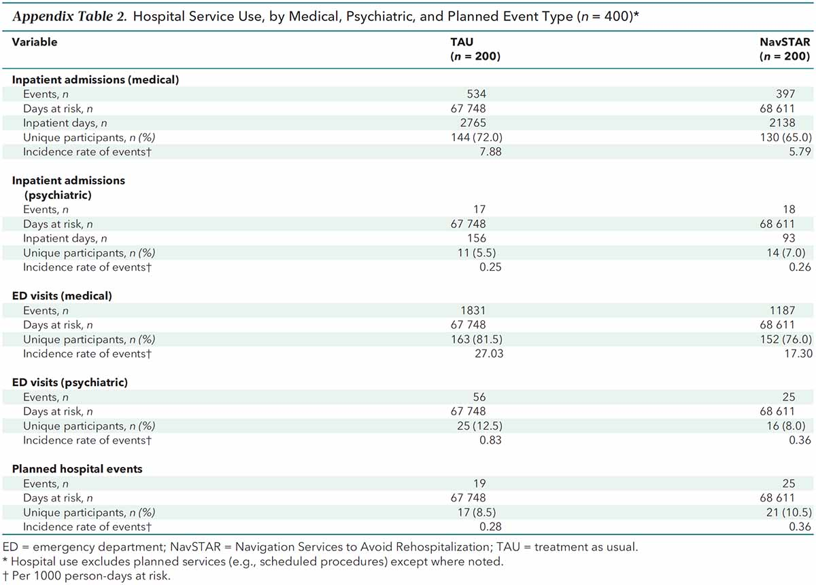
1. Gryczynski J, Nordeck CD, Welsh C, Mitchell SG, O’Grady KE, Schwartz RP. Preventing Hospital Readmission for Patients With Comorbid Substance Use Disorder : A Randomized Trial. Ann Intern Med. 2021;174(7):899-909. doi:10.7326/M20-5475
Notes:
This trial by Gryczyski (which admittedly studied an extremely enhanced addiction medicine linkage to care service) showed a significant reduction in inpatient readmissions and ED visits for patients seen by an ACS team.

Slide 35
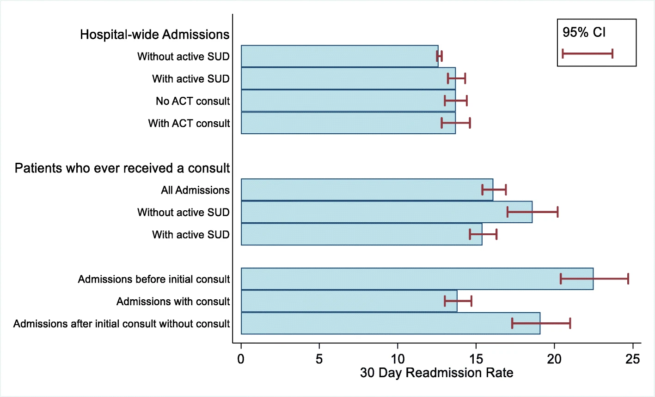
Wakeman SE, Kane M, Powell E, Howard S, Shaw C, Regan S. Impact of Inpatient Addiction Consultation on Hospital Readmission. J GEN INTERN MED. 2021;36(7):2161-2163. doi:10.1007/s11606-020-05966-0
Notes:
In her seminal JGIM study, Dr. Wakeman also shows how inpatient ACS consultation dramatically reduces hospital readmission. Patients seen by an ACS service had…a significantly lower rate of readmissions after they were seen be the ACS team than before as did matched patient who were not seen by consult service.

Slide 36
MORTALITY
Kimmel SD, Walley AY, Li Y, et al. Association of Treatment With Medications for Opioid Use Disorder With Mortality After Hospitalization for Injection Drug Use–Associated Infective Endocarditis. JAMA Network Open. 2020;3(10):e2016228.
Weiner SG, Little K, Yoo J, et al. Opioid Overdose After Medication for Opioid Use Disorder Initiation Following Hospitalization or ED Visit. JAMA Netw Open. 2024;7(7):e2423954.
Wilson JD, Altieri Dunn SC, Roy P, Joseph E, Klipp S, Liebschutz J. Inpatient Addiction Medicine Consultation Service Impact on Post-discharge Patient Mortality: a Propensity-Matched Analysis. J GEN INTERN MED. 2022;37(10):2521-2525.
SIGNIFICANT REDUCTION IN 90-DAY MORTALITY FOR PATIENTS SEEN BY ACS TEAM. (WILSON)
Notes:
Most importantly, addiction consult services have been shown to improve mortality, most vividly by Dr. Wilson in her seminal 2022 paper.

Slide 37
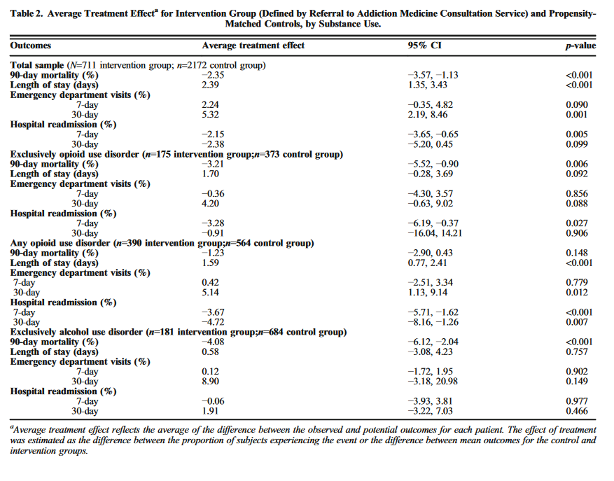
Wilson JD, Altieri Dunn SC, Roy P, Joseph E, Klipp S, Liebschutz J. Inpatient Addiction Medicine Consultation Service Impact on Post-discharge Patient Mortality: a Propensity-Matched Analysis. J GEN INTERN MED. 2022;37(10):2521-2525. doi:10.1007/s11606-021-07362-8
Notes:
This paper showed a significant treatment effect (i.e. improvement in 90-day mortality) for patients seen by an addiction consult service. I say to you all: we know that an ID consult has been demonstrated to improve mortality outcomes for patients with a staph bacteremia—we don’t question the economic arithmetic behind TEE’s or the ID service, we obtain them because they are medically indicated—they provide the best outcome for our patients. The same logic must apply for patients with SUDs and ACS services. All patients with active SUDs should have the opportunity to be seen by an ACS team and we have the data to prove it.

Slide 38
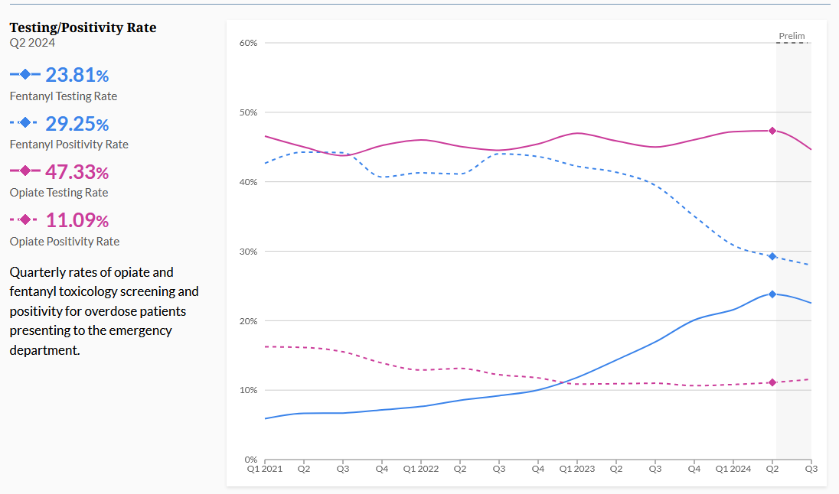
STRUCTURAL INSTITUTIONAL IMPROVEMENTS
Universal screening protocols
COWS/CIWA training
Fentanyl testing
Harm reduction interventions
Order sets for medication initiation
Bridge clinics
Education/stigma reduction
Notes:
A word (and some examples) of potential structural improvements you may consider when designing or improving an ACS service. Ask yourself: does my hospital have a universal screening protocol for SUDs? Does my hospital test for fentanyl (the leading cause of death for all Americans 18-45) in house. We notice here that less than 25% of hospitals using Epic for EHR have point of care fentanyl testing available. I suspect that many people in this room work a hospital that does not test for fentanyl. What harm reduction interventions whether it be test strips or needle exchange programs might we provide our patients? Are there order sets for pharmacotherapy initiation we might develop? Are there ACGME elective requirements we might fulfill by hosting trainees on the consult service?

Slide 39
ORDER SETS FOR MOUD/MAUD INITIATION
Low dose induction order sets: Allow buprenorphine to be started at any point during a hospitalization (by any provider) with low risk for precipitating withdrawal
Notes:
Providing a few more specific examples of enhancements from our own experience at the University of Chicago. We have created example of our own order set for low-dose buprenorphine initiation. This order set is accessible to everyone in our hospital system which means that inductions can be safely initiated day and night without waiting to contact an addiction medicine provider. Buprenorphine inductions are available and on demand 24 hours per day with negligible risk for precipitated withdrawal.

Slide 40
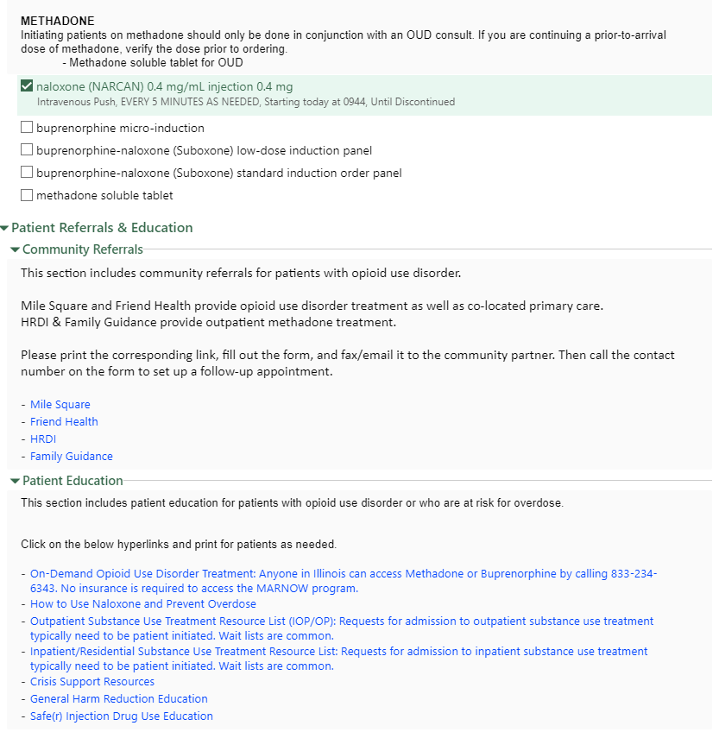
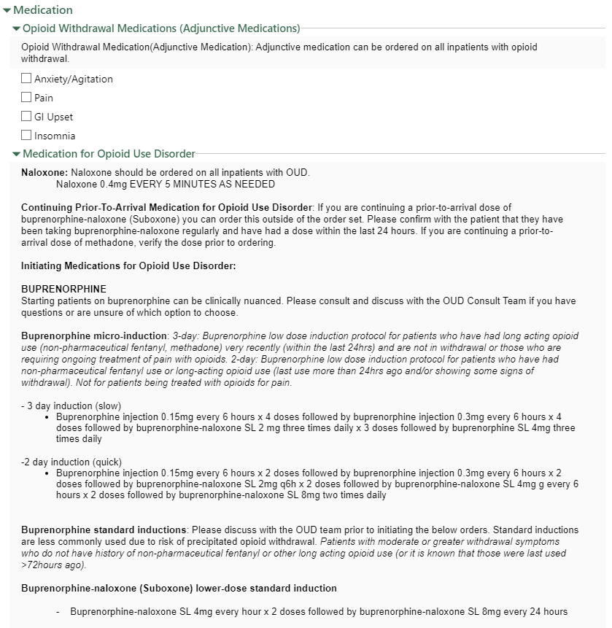
ORDER SETS FOR MOUD INITIATION/LINKAGE TO CARE
Notes:
This is another example of a broad order set which includes different types of buprenorphine inductions (both standard and low-dose), preferred adjunctive medications for opioid withdrawal, as well as community referral partners for linkage to care with referral documents that are available via a clickable hyperlink.

Slide 41
BREAKOUT
Outline the composition of your ACS service or describe expanded roles for an existing service.
Describe basic duties for the service (assessment, withdrawal management, medication administration) and how/when the service would be staffed.
List 3 systems-based improvements that might accompany the launch of such a service and potential benefits they might bring to your patients and hospital system.
10 minutes

Slide 42
PHARMACIST ROLE & 3-DAY METHADONE DISPENSE
Notes:
Angela and Geoff
Do we need specific

Slide 43
EVOLUTION OF METHADONE “3-DAY RULE”
“Not more than a one day’s medication may be administered to the person or for the person’s use at one time” → 1 day x 3 rule
Carried out for not more than 3 days
Emergency department visits x 3
40.4% of planned bridge participants presented for all three doses, 61.9% of whom were new linkages to OTPs
3 day dispense with DEA permission (the ACT)
“Practitioners who wish to dispense the full 3 days-worth of medication to patients at one time can make a request to DEA to receive permission to do so (beginning March 2022)”
How and where would you keep this emailed letter?
West J Emerg Med. 2024 Jul 1; 25(4): 477–482

Slide 44
REGULATION CHANGES: 3-DAY METHADONE
INCREASE ACCESS TO METHADONE
DEA update published 08/08/2023 - Provision of the ACT to revise 21 CFR § 1306.07(b)
“So that practitioners are allowed to dispense not more than a three-day supply of narcotics drugs to one person or for one person’s use at one time for the purpose of initiating maintenance treatment or detoxification treatment (or both).”
Intended methadone linkage to care
DISPENSE ONLY (NOT PRESCRIBE)
Challenging to operationalize
Inpatient dispense on discharge
Notes:
Specific challenges for operationalize

Slide 45
MOUD PHARMACY OPERATIONALIZATION
DISCHARGE
PHARMACY DEPT. BUY IN
DISPENSING
FORMULARY MANAGEMENT
INVENTORY & DISTRIBUTION
DRUG PROCUREMENT
Notes:
Add or update formulary
Inpatient initiation of MOUD
Purchasing/stocking/etc
Pharmacy buy in
Buprenorphine
Formulations: IV, SL
Methadone
Dispensing and discharging

Slide 46
UCHICAGO OUD TIMELINE
2020
Naloxone best practice alert (BPA)
Methadone expanded to for maintenance and detoxification
2022
Buprenorphine induction order panels created
2018
OUD consult service initiated
2019
Buprenorphine/naloxone indication expansion
2021
Agile MD OUD Pathway
2024
Take home methadone implemented
OUD rotation required for anesthesia fellows
Notes:
•methadone expanded to initiation for maintenance or detoxification
Should we add a slide/information about making methadone for MOUD available to inpatients?

Slide 47
TAKE HOME METHADONE OPERATIONALIZATION
STAKEHOLDERS
Leadership: Pharmacy, Physician, Nursing
Nursing staff
Pharmacy staff (technicians, pharmacists)
INFORMATICS & HEALTHCARE SOFTWARE
LEGAL REQUIREMENTS
Allows you to dispense and not prescribe - how do operationalize dispensing for outpatient use
Label needs to be a valid prescription
Inventory and regulatory management for controlled substance:
Track from inpatient dispensing to patient on discharge
CHAIN OF CUSTODY
EDUCATION
Dissemination:
Legality, safety, bias
Medication guide (Care notes)
ORDERING PROCESS & RESOURCES
Who can order
Institutions without an OUD team
Notes:
[ ] Make sure we talk about ordering process and who can order (ie, institutions that don’t have an OUD team)

Slide 48
OPERATIONALIZATION CHALLENGES
Must meet legal requirements of outpatient prescription
Dispensing with an inpatient driven model
Controlled substance chain of custody
Track from inpatient dispense to patient on discharge
Medication guide (care notes or other acceptable education resource)
Information and technology challenges
Order build/documentation
Correct dispensing and routing of medication
Front line staff education
Notes:
Specific challenges for operationalize

Slide 49
TAKE HOME METHADONE - PUSH BACK
“Refusal to dispense - patient can take all three doses at once and overdose”
“The law doesn’t allow us to dispense methadone, I am going to lose my license”
“Why are we doing this, they will just use anyway”
SUCCESSFULLY COMPLETED ON 50 PATIENTS FROM MARCH 23, 2024 TO JULY 31, 2024

Slide 50
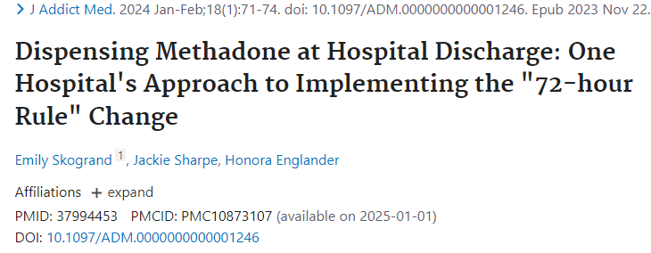
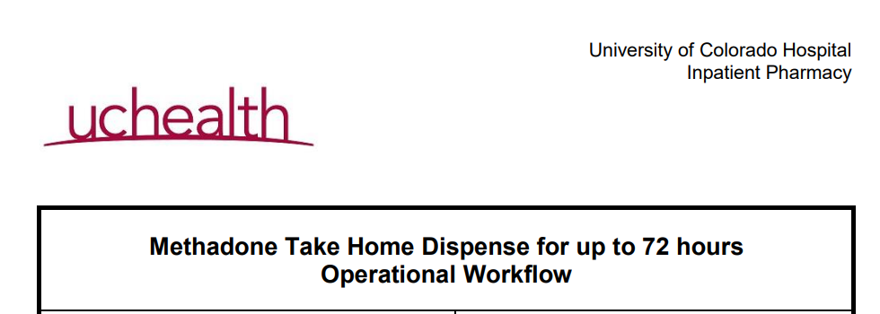
THE WORD IS OUT: METHADONE 3-DAY DISPENSE

Slide 51
BREAKOUT
GROUP 1: What stakeholders do you need to involve to obtain institutional buy in? What steps can you take to initiate discussion?
GROUP 2: How would you operationalize this at your institution (ie, formulary, dispensing, etc)? What challenges do you foresee with this process?

Slide 52
TRANSITION OF CARE
Notes:
Aimee, Nick, and Sophia

Slide 53
HOSPITAL SERVICE TRANSFERS
ACS ensures continuity of addiction care
Patient will interact with many healthcare workers and experience different levels of stigma
ED / DIRECT ADMISSION
MED/SURG UNIT
ICU
SURGERY / PROCEDURES
DISCHARGE

Slide 54
INTERDISCIPLINARY COLLABORATION BETWEEN PRIMARY AND CONSULTANT TEAMS
CLINICIAN PHYSICIAN & APP
Educate and collaborate with multidisciplinary clinicians on addiction care plan
PEER SUPPORT SPECIALIST
Facilitate patient communication and stigma reduction; post-dc followup
LSW
Assist unit social workers to offer treatment resources depending on disposition
Notes:
Ways AMCS interfaces with other services during transitions of care

Slide 55
REFERRAL NETWORKS: LSW & PEER SUPPORT SPECIALISTS
Build relationships with community partners to provide low-barrier access and a seamless handoff
Connect patient to post-discharge medical care, especially addiction/mental health treatment, and harm reduction resources
Maintain a network of community organizations that can that help patients navigate barriers to care, including medical insurance or lack thereof and other social determinants of health

Slide 56
TRANSITION OF CARE BARRIERS
Pharmacy barriers or interruptions in MOUD
Identifying community clinics with low-barrier treatment
Timely transition to appropriate level of addiction care
Access and comfort with harm reduction practices (Naloxone, SSPs)
Insufficient insurance coverage
Institutional policies limiting both treatment and harm reduction practices
SDOH and or co-occurring medical and mental illnesses —> difficulty managing their care
Post-acute care placement (skilled nursing or subacute rehab) limited by history of SUD or need for MOUD (methadone in particular)

Slide 57
CLINICAL SCENARIO
BLACK MALE VETERAN IN 70’s WITH OUD, USING FENTANYL AND HEROIN
On 50 mg methadone with spotty OTP compliance
Hospitalized due to poor mobility and failure to thrive
Due to difficulties with methadone compliance and placement, MOUD transitioned from methadone to depot buprenorphine
Discharged to subacute rehab (SAR) for mobility training, but facility discharged patient prematurely due to aggressive behavior
Re-hospitalized for placement
ACS social worker and peer support specialist worked with psychiatrists to develop behavioral interventions and medication therapy for PTSD
Depot buprenorphine was a barrier to SAR acceptance
Prolonged hospitalization before discharged to SAR
Doing well at 6 months: abstinent from illicit opioids, improved mobility with PT, and returned to independent living

Slide 58
WORKSHOP
BREAK INTO FOUR GROUPS:
Group I: Develop list of community partners and referral networks and strategies to build and strengthen relationships with community partners.
Group II: Facility placement barriers for methadone
Group III: Significant medical or co-occurring mental health illnesses, behavioral issues interfering with outpatient treatment
Group IV: Housing instability and/or lack of social support

Slide 59
QUESTIONS & COMMENTS
We honor and remember all the patients we have cared for.

Slide 60
WORK CITED
A Substance Abuse Consultation Service - McDuff - 1997 - The American Journal on Addictions - Wiley Online Library. Accessed August 1, 2024. https://onlinelibrary.wiley.com/doi/full/10.1111/j.1521-0391.1997.tb00405.x?sid=nlm%3Apubmed
Addiction consult services in hospitals show promise in facilitating ongoing care - Enos - 2019 - Alcoholism & Drug Abuse Weekly - Wiley Online Library. Accessed June 20, 2024. https://onlinelibrary.wiley.com/doi/10.1002/adaw.32221
Aszalos R, McDuff DR, Weintraub E, Montoya I, Schwartz R. Engaging Hospitalized Heroin-Dependent Patients Into Substance Abuse Treatment. Journal of Substance Abuse Treatment. 1999;17(1):149-158. doi:10.1016/S0740-5472(98)00075-0
Becker TD, Eschliman EL, Thakrar AP, Yang LH. A conceptual framework for how structural changes in emerging acute substance use service models can reduce stigma of medications for opioid use disorder. Front Psychiatry. 2023;14. doi:10.3389/fpsyt.2023.1184951
Beckett M, Hering R, Urbanoski K. Inpatient care provider perspectives on the development and implementation of an addiction medicine consultation service in a small urban setting. Subst Abuse Treat Prev Policy. 2022;17(1):70. doi:10.1186/s13011-022-00497-9
Bhatraju EP, Ludwig-Barron N, Takagi-Stewart J, Sandhu HK, Klein JW, Tsui JI. Successful engagement in buprenorphine treatment among hospitalized patients with opioid use disorder and trauma. Drug and Alcohol Dependence. 2020;215:108253. doi:10.1016/j.drugalcdep.2020.108253
Calcaterra SL, Lockhart S, Callister C, Hoover K, Binswanger IA. Opioid Use Disorder Treatment Initiation and Continuation: a Qualitative Study of Patients Who Received Addiction Consultation and Hospital-Based Providers. J Gen Intern Med. 2022;37(11):2786-2794. doi:10.1007/s11606-021-07305-3
Calcaterra SL, McBeth L, Keniston AM, Burden M. The Development and Implementation of a Hospitalist-Directed Addiction Medicine Consultation Service to Address a Treatment Gap. J GEN INTERN MED. 2022;37(5):1065-1072. doi:10.1007/s11606-021-06849-8
D’Amico MJ, Walley AY, Cheng DM, et al. Which patients receive an addiction consult? A preliminary analysis of the INREACH (INpatient REadmission post-Addiction Consult Help) study. Journal of Substance Abuse Treatment. 2019;106:35-42. doi:10.1016/j.jsat.2019.08.013
Englander H, Collins D, Perry SP, Rabinowitz M, Phoutrides E, Nicolaidis C. “We’ve Learned It’s a Medical Illness, Not a Moral Choice”: Qualitative Study of the Effects of a Multicomponent Addiction Intervention on Hospital Providers’ Attitudes and Experiences. J Hosp Med. 2018;13(11):752-758. doi:10.12788/jhm.2993
Englander H, Dobbertin K, Lind BK, et al. Inpatient Addiction Medicine Consultation and Post-Hospital Substance Use Disorder Treatment Engagement: a Propensity-Matched Analysis. J Gen Intern Med. 2019;34(12):2796-2803. doi:10.1007/s11606-019-05251-9
Englander H, Jones A, Krawczyk N, et al. A Taxonomy of Hospital-Based Addiction Care Models: a Scoping Review and Key Informant Interviews. J Gen Intern Med. 2022;37(11):2821-2833. doi:10.1007/s11606-022-07618-x
Englander H, King C, Nicolaidis C, et al. Predictors of Opioid and Alcohol Pharmacotherapy Initiation at Hospital Discharge Among Patients Seen by an Inpatient Addiction Consult Service. Journal of Addiction Medicine. 2020;14(5):415. doi:10.1097/ADM.0000000000000611
Englander H, Mahoney S, Brandt K, et al. Tools to Support Hospital-Based Addiction Care: Core Components, Values, and Activities of the Improving Addiction Care Team. J Addict Med. 2019;13(2):85-89. doi:10.1097/ADM.0000000000000487

Slide 61
WORK CITED
Englander H, Thakrar AP, Bagley SM, Rolley T, Dong K, Hyshka E. Caring for Hospitalized Adults With Opioid Use Disorder in the Era of Fentanyl: A Review. JAMA Intern Med. 2024;184(6):691-701. doi:10.1001/jamainternmed.2023.7282
Englander H, Weimer M, Solotaroff R, et al. Planning and Designing the Improving Addiction Care Team (IMPACT) for Hospitalized Adults with Substance Use Disorder. Journal of Hospital Medicine. 2017;12(5):339-342. doi:10.12788/jhm.2736
Fanucchi Laura, Lofwall Michelle R. Putting Parity into Practice — Integrating Opioid-Use Disorder Treatment into the Hospital Setting. New England Journal of Medicine. 2016;375(9):811-813. doi:10.1056/NEJMp1606157
Gryczynski J, Nordeck CD, Welsh C, Mitchell SG, O’Grady KE, Schwartz RP. Preventing Hospital Readmission for Patients With Comorbid Substance Use Disorder : A Randomized Trial. Ann Intern Med. 2021;174(7):899-909. doi:10.7326/M20-5475
Harris MTH, Peterkin A, Bach P, et al. Adapting inpatient addiction medicine consult services during the COVID-19 pandemic. Addiction Science & Clinical Practice. 2021;16(1):13. doi:10.1186/s13722-021-00221-1
Jakubowski A, Singh-Tan S, Torres-Lockhart K, et al. Addiction Consult Service and Inpatient Outcomes Among Patients with OUD. J Gen Intern Med. Published online August 13, 2024. doi:10.1007/s11606-024-08837-0
Kast KA, Le TDV, Stewart LS, et al. Impact of inpatient addiction psychiatry consultation on opioid use disorder outcomes. American Journal on Addictions. Published online 2024. doi:10.1111/ajad.13540
Kimmel SD, Walley AY, Li Y, et al. Association of Treatment With Medications for Opioid Use Disorder With Mortality After Hospitalization for Injection Drug Use–Associated Infective Endocarditis. JAMA Network Open. 2020;3(10):e2016228. doi:10.1001/jamanetworkopen.2020.16228
King C, Collins D, Patten A, Nicolaidis C, Englander H. Trust in Hospital Physicians Among Patients With Substance Use Disorder Referred to an Addiction Consult Service: A Mixed-methods Study. Journal of Addiction Medicine. 2022;16(1):41. doi:10.1097/ADM.0000000000000819
King C, Nicolaidis C, Korthuis PT, Priest KC, Englander H. Patterns of substance use before and after hospitalization among patients seen by an inpatient addiction consult service: A latent transition analysis. Journal of Substance Abuse Treatment. 2020;118:108121. doi:10.1016/j.jsat.2020.108121
Lindsay AR, Winkelman TNA, Bart G, Rhodes MT, Shearer RD. Hospital Addiction Medicine Consultation Service Orders and Outcomes by Patient Race and Ethnicity in an Urban, Safety-Net Hospital. J Gen Intern Med. 2024;39(2):168-175. doi:10.1007/s11606-023-08356-4
Martin M, Snyder HR, Coffa D, et al. Time to ACT: launching an Addiction Care Team (ACT) in an urban safety-net health system. BMJ Open Qual. 2021;10(1):e001111. doi:10.1136/bmjoq-2020-001111
McNeely J, Troxel AB, Kunins HV, et al. Study protocol for a pragmatic trial of the Consult for Addiction Treatment and Care in Hospitals (CATCH) model for engaging patients in opioid use disorder treatment. Addict Sci Clin Pract. 2019;14(1):5. doi:10.1186/s13722-019-0135-7
McNeely J, Wang SS, Rostam Abadi Y, et al. Addiction Consultation Services for Opioid Use Disorder Treatment Initiation and Engagement: A Randomized Clinical Trial. JAMA Intern Med. Published online July 29, 2024:e243422. doi:10.1001/jamainternmed.2024.3422

Slide 62
WORK CITED
Muller M, Weyer G, Zakrison T, Ari M. Impact of an opioid use disorder consult service on hospitalized trauma patients with opioid use disorder. Journal of Trauma and Acute Care Surgery. 2023;95(2):226. doi:10.1097/TA.0000000000003965
Murphy MK, Chabon B, Delgado A, Newville H, Nicolson SE. Development of a Substance Abuse Consultation and Referral Service in an Academic Medical Center: Challenges, Achievements and Dissemination. J Clin Psychol Med Settings. 2009;16(1):77-86. doi:10.1007/s10880-009-9149-8
Nordeck CD, Welsh C, Schwartz RP, et al. Rehospitalization and substance use disorder (SUD) treatment entry among patients seen by a hospital SUD consultation-liaison service. Drug and Alcohol Dependence. 2018;186:23-28. doi:10.1016/j.drugalcdep.2017.12.043
Nordeck CD, Welsh C, Schwartz RP, Mitchell SG, O’Grady KE, Gryczynski J. Opioid agonist treatment initiation and linkage for hospitalized patients seen by a substance use disorder consultation service. Drug Alcohol Depend Rep. 2022;2:100031. doi:10.1016/j.dadr.2022.100031
O’Toole TP, Conde-Martel A, Young JH, Price J, Bigelow G, Ford DE. Managing acutely ill substance-abusing patients in an integrated day hospital outpatient program: medical therapies, complications, and overall treatment outcomes. J Gen Intern Med. 2006;21(6):570-576. doi:10.1111/j.1525-1497.2006.00398.x
Ober AJ, Osilla KC, Klein DJ, et al. Pilot randomized controlled trial of a hospital-based substance use treatment and recovery team (START) to improve initiation of medication for alcohol or opioid use disorder and linkage to follow-up care. Journal of Substance Use and Addiction Treatment. 2023;150:209063. doi:10.1016/j.josat.2023.209063
Pecoraro A, Horton T, Ewen E, et al. Early data from project engage: a program to identify and transition medically hospitalized patients into addictions treatment. Addiction Science & Clinical Practice. 2012;7(1):20. doi:10.1186/1940-0640-7-20
Perera R, Stephan L, Appa A, et al. Meeting people where they are: implementing hospital-based substance use harm reduction. Harm Reduct J. 2022;19(1):14. doi:10.1186/s12954-022-00594-9
Pollini RA, O’Toole TP, Ford D, Bigelow G. Does this patient really want treatment? Factors associated with baseline and evolving readiness for change among hospitalized substance using adults interested in treatment. Addictive Behaviors. 2006;31(10):1904-1918. doi:10.1016/j.addbeh.2006.01.003
Priest KC, Englander H, McCarty D. “Now hospital leaders are paying attention”: A qualitative study of internal and external factors influencing addiction consult services. J Subst Abuse Treat. 2020;110:59-65. doi:10.1016/j.jsat.2019.12.003
Priest KC, McCarty D. Role of the Hospital in the 21st Century Opioid Overdose Epidemic: The Addiction Medicine Consult Service. Journal of Addiction Medicine. 2019;13(2):104. doi:10.1097/ADM.0000000000000496
Raven MC, Carrier ER, Lee J, Billings JC, Marr M, Gourevitch MN. Substance use treatment barriers for patients with frequent hospital admissions. J Subst Abuse Treat. 2010;38(1):22-30. doi:10.1016/j.jsat.2009.05.009
Rodger L, Cygler J, Pinto A. Quantitative and qualitative outcomes associated with inpatient addiction consultation: a scoping review. The American Journal of Drug and Alcohol Abuse. 0(0):1-32. doi:10.1080/00952990.2024.2350696

Slide 63
WORK CITED
Shanahan CW, Beers D, Alford DP, Brigandi E, Samet JH. A Transitional Opioid Program to Engage Hospitalized Drug Users. J GEN INTERN MED. 2010;25(8):803-808. doi:10.1007/s11606-010-1311-3
Singh-Tan S, Torres-Lockhart K, Jakubowski A, et al. Addiction Consult Service and Inpatient Outcomes Among Patients with Alcohol Use Disorder. J Gen Intern Med. 2023;38(14):3216-3223. doi:10.1007/s11606-023-08202-7
Thompson HM, Faig W, VanKim NA, Sharma B, Afshar M, Karnik NS. Differences in length of stay and discharge destination among patients with substance use disorders: The effect of Substance Use Intervention Team (SUIT) consultation service. PLOS ONE. 2020;15(10):e0239761. doi:10.1371/journal.pone.0239761
Thompson HM, Hill K, Jadhav R, Webb TA, Pollack M, Karnik N. The Substance Use Intervention Team: A Preliminary Analysis of a Population-level Strategy to Address the Opioid Crisis at an Academic Health Center. J Addict Med. 2019;13(6):460-463. doi:10.1097/ADM.0000000000000520
Trowbridge P, Weinstein ZM, Kerensky T, et al. Addiction consultation services – Linking hospitalized patients to outpatient addiction treatment. Journal of Substance Abuse Treatment. 2017;79:1-5. doi:10.1016/j.jsat.2017.05.007
Velez CM, Nicolaidis C, Korthuis PT, Englander H. “It’s been an Experience, a Life Learning Experience”: A Qualitative Study of Hospitalized Patients with Substance Use Disorders. J GEN INTERN MED. 2017;32(3):296-303. doi:10.1007/s11606-016-3919-4
Wakeman SE, Kane M, Powell E, et al. A Hospital-Wide Initiative to Redesign Substance use Disorder Care: Impact on Pharmacotherapy Initiation. Substance Abuse. 2021;42(4):767-774. doi:10.1080/08897077.2020.1846664
Wakeman SE, Kane M, Powell E, Howard S, Shaw C, Regan S. Impact of Inpatient Addiction Consultation on Hospital Readmission. J GEN INTERN MED. 2021;36(7):2161-2163. doi:10.1007/s11606-020-05966-0
Wakeman SE, Kanter GP, Donelan K. Institutional Substance Use Disorder Intervention Improves General Internist Preparedness, Attitudes, and Clinical Practice. Journal of Addiction Medicine. 2017;11(4):308. doi:10.1097/ADM.0000000000000314
Wakeman SE, Metlay JP, Chang Y, Herman GE, Rigotti NA. Inpatient Addiction Consultation for Hospitalized Patients Increases Post-Discharge Abstinence and Reduces Addiction Severity. J GEN INTERN MED. 2017;32(8):909-916. doi:10.1007/s11606-017-4077-z
Weinstein ZM, Cheng DM, D’Amico MJ, et al. Inpatient addiction consultation and post-discharge 30-day acute care utilization. Drug and Alcohol Dependence. 2020;213:108081. doi:10.1016/j.drugalcdep.2020.108081
Weinstein ZM, Wakeman SE, Nolan S. Inpatient Addiction Consult Service: Expertise for Hospitalized Patients with Complex Addiction Problems. Medical Clinics. 2018;102(4):587-601. doi:10.1016/j.mcna.2018.03.001
Whaley S, Sharfstein J, Rising J. Opioid Settlements: The Role for Addiction Medicine in Guiding Effective Spending. Journal of Addiction Medicine. 2023;17(6):629. doi:10.1097/ADM.0000000000001229
Wilson JD, Altieri Dunn SC, Roy P, Joseph E, Klipp S, Liebschutz J. Inpatient Addiction Medicine Consultation Service Impact on Post-discharge Patient Mortality: a Propensity-Matched Analysis. J Gen Intern Med. 2022;37(10):2521-2525. doi:10.1007/s11606-021-07362-8

