Slide 1
Interprofessional Perspectives on Caring for Hospitalized Patients with Opioid Use Disorder
Maggie Lowenstein, MD, MPhil, MSHP
AMERSA Annual Meeting
November 2, 2023
Notes:
Hi, I’m Maggie Lowenstein, assistant professor at Penn in GIM and faculty in penn’s CAMP working with many of my co-presenters from today
Excited to share our team’s work

Slide 2
I have no conflicts of interest to disclose
Notes:
No COI

Slide 3
Hospitalizations Related to OUD…
Are increasing
Are associated with increasing morbidity, mortality, and costs
Have high rates of discharge before medically advised
Singh, 2020; Capizzi, 2020; Coyle, 2020; McCarthy, 2020;Thakrar, unpublished
Notes:
As has been discussed in this session,
Hospitalized related to OUD and other SUDs are increating, esp those related to SIRIs, and they are occurring at younger ages and with greater seveity
These hospitalized are associated with high morbidity, mortality and costs
Patients frequently leave before tx complete as we just heard

Slide 4
Hospitalization as a reachable moment
Hospitalization is a critical touchpoint for addiction care
Growing number of models to support hospital-based addiction treatment
Ongoing work to understand best practices
D’Onofrio, 2015; Liebschutz, 2016; Englander, 2018; French, 2022
Notes:
We also know – thanks to important work from many of the folks at this meeting – that hpspitalization is a reachable moment
Growing models to support hospital-based addcition care
We’re learning the best ways to implement these models and to understand how to adapt to local context

Slide 5
Study Aim
To explore perspectives of interprofessional team members on improving care for patients with OUD during and after hospitalization.
Notes:
For this study and a couple from our group you’re about to hear, we sought to understand the context in our local environment prior to implementation of an inpatient addiction consult service

Slide 6
Methods
Semi-structured interviews with physicians, nurses, social workers
Single urban, academic hospital in Philadelphia without ACS
Conducted between 12/2022-3/2023
Focused on barriers and facilitators to care in the hospital and discharge planning
Thematic content analysis

Slide 7
Participant Characteristics (n=25)
Age, mean years (sd) | 37.6 (9.2)
Female Gender, n (%) | 20 (80%)
Race, n (%)
White | 14 (56%)
Asian | 6 (24%)
Black/AA | 5 (20%)
Hispanic Ethnicity, n (%) | 1 (4%)
Professional Role, n (%)
Nurse | 8 (32%)
Attending Physician | 7 (28%)
Resident Physician | 5 (20%)
SW/CM | 4 (16%)
APP | 1 (4%)

Slide 8
Key Themes
Providers + Staff
Patient outcomes
Staff moral distress
Patient Needs
System Level
Notes:
Patient Needs
Severity of pain and withdrawal
Medical, psych, social complexity
Providers + Staff
Inadequate knowledge and training
Discomfort with addiction care
System Level
Lack of system approach
Mismatch between patient needs + available services

Slide 9
Patient Level
Severity of pain and withdrawal; medical complexity
The pain and withdrawal piece of it definitely comes up as a big challenge … I’m seeing patients for detox and withdrawal but also cellulitis, wound infections - the very real physical manifestations of long-standing SUDs. And with that comes a lot of acute pain. Treating acute pain while initiating or maintaining someone on MOUDs can be very difficult.
Resident Physician

Slide 10
Provider and Staff Level
Gaps in knowledge and comfort
We’re behind. Fentanyl, xylazine … these are all things that have happened quickly here and we are just learning on the job. So it’s hard to know if we don’t know, right. It’s hard to know what to do if you don’t know.
Attending Physician

Slide 11
System Level
Mismatch Between Needs and Existing Resources
So one thing that comes up is that inpatient substance use rehab facilities often can’t take care of many medical problems. And so if a patient has, for example, wound care that they need to be performed, there’s very few facilities that will take those patients.
Resident Physician

Slide 12
System Level
Limited support for social determinants of health
People think we’re going to find a house for them. And I’m like, no, it just doesn’t really work. We can’t keep people for that long to do that type of stuff. That stuff takes months. So usually we send them somewhere and they’re still homeless.
Registered Nurse
Notes:
We heard a lot of frustration about how we continued to discharge into environments that led to poor outcomes

Slide 13
Impacts on Patients and Staff
Poor patient outcomes, moral distress among staff
It's hard when someone's withdrawing…They don't feel good …. There's only so much you can do, and people end up leaving. So it's hard because then you're like begging them to stay but you're not doing anything that's beneficial to them.
Registered Nurse

Slide 14
Study Limitations
Single hospital and single city
Social desirability bias

Slide 15
Equity
Study participants
Perspectives from Interprofessional care team members

Slide 16
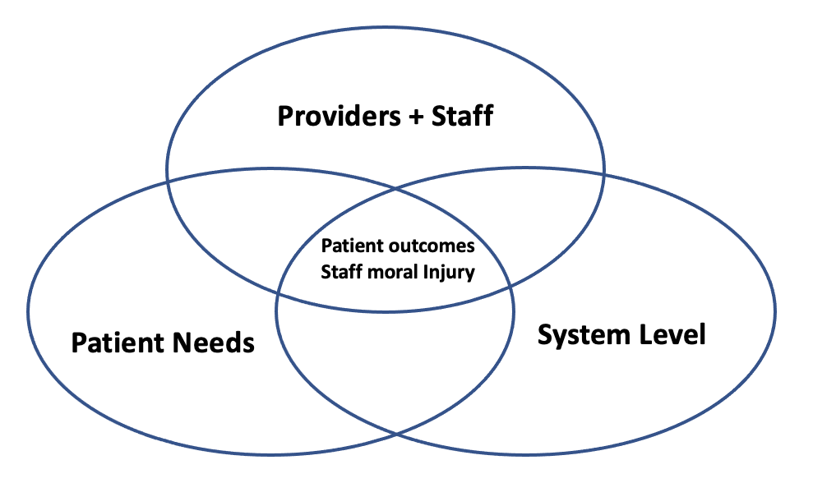
Conclusions
Interprofessional hospital staff identified barriers to care for patients with OUD at the patient, provider/staff, and system levels.
Consequences included poor patient outcomes and staff moral distress.

Slide 17
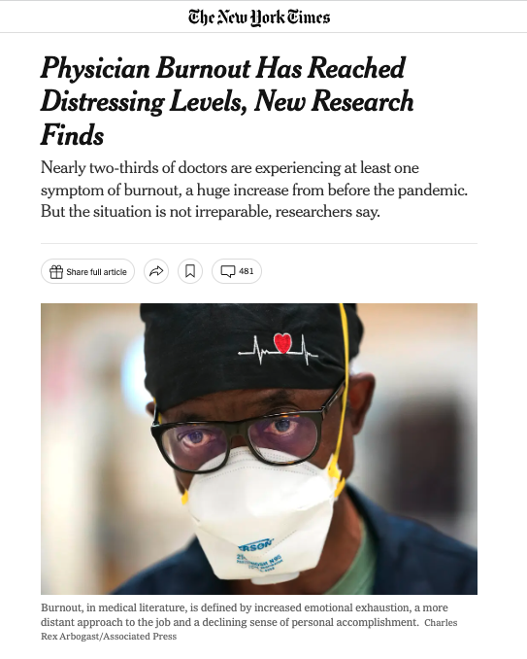
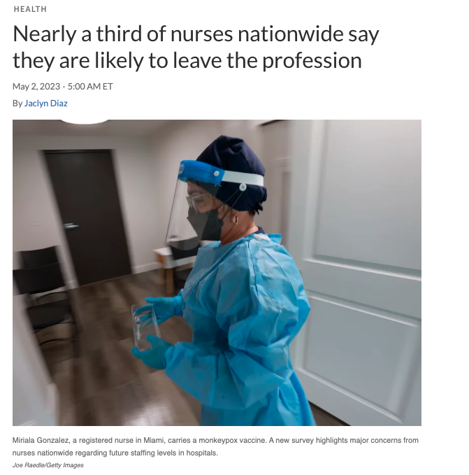
Implications
Improvements in addiction systems and services critical to improve patient outcomes
Workforce issues increasingly salient among hospital leadership

Slide 18
Acknowledgements
Research Team
M Holliday-Davis, MA Hons
Lilah Lesniak, BA
David S. Mandell, ScD
Judy A Shea, PhD
Jeanmarie Perrone, MD
Judy Chertok, MD
Ashish Thakrar, MD, MSHP
Shoshi Aronowitz, PhD, MSHP
Funding
NIDA K23DA055087
LDI-Penn Medicine Research Lab

Slide 19
Questions?
margaw@pennmedicine.upenn.edu
@mlowenstein
Notes:
With that, thank you and I would love to take your questions

Slide 20
Key Themes
Providers + Staff
Inadequate knowledge and training
Discomfort with addiction care
Patient outcomes
Staff moral Injury
Patient Needs
Severity of pain and withdrawal
Medical, psych, social complexity
System Level
Lack of system approach
Mismatch between patient needs + available services

Slide 21
Poor Patient Outcomes
Like nine times out of ten they leave AMA, and it’s a shame because they need help and they wanted help and they came to the hospital and they did everything they were supposed to do and then we failed them.
Attending Physician

