Slide 1
“It wasn’t to get high; it was just to get by”: A study of the experience of patients who use illicitly manufactured fentanyl during methadone treatment and recommendations to improve care delivery in Vermont and New Hampshire
Jesse Sara Boggis, MPH
PhD candidate, Predoctoral fellow
Geisel School of Medicine at Dartmouth

Slide 2
Disclosures
I have no conflicts of interests to disclose
Research supported by NIDA T32DA037202 (PI: Budney) and NIDA P30DA029926 (PI: Marsch)

Slide 3
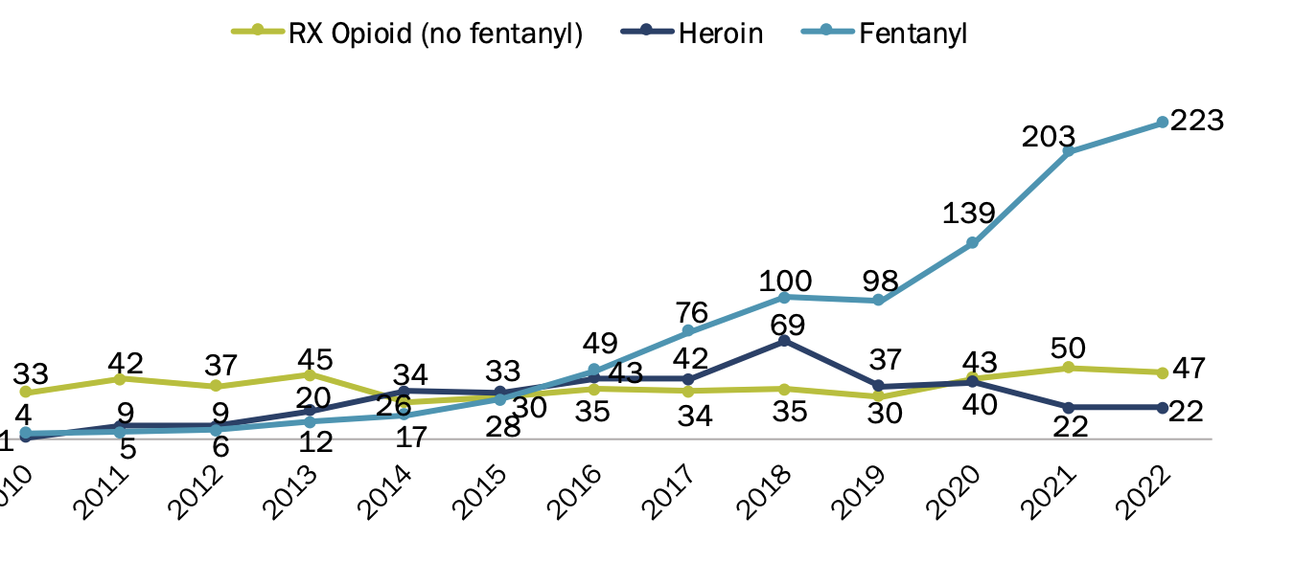
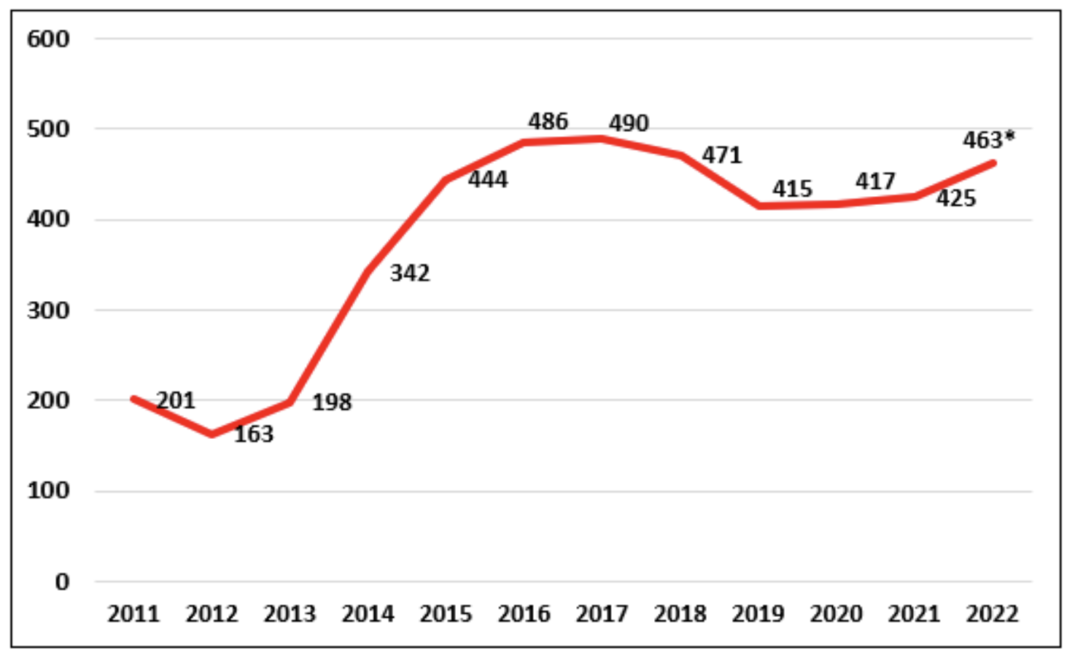
Background
Methadone significantly improves treatment outcomes and has proven highly effective in reducing opioid use and related harms (Rettig, 1995)
During COVID-19, federal regulations were updated to increase take home dosing allowances (SAHMHSA, 2022)
Up to 28 days for stable patients; Up to 14 days for less stable patients
Despite this, high rates of overdose involving illicitly manufactured fentanyl (IMF) persist in VT and NH
VT opioid overdose deaths
Vermont Department of Health Fatal Overdoses Among Vermonters 2022
NH opioid overdose deaths
New Hampshire Office of Chief Medical Examiner Drug Data 2022

Slide 4
Rationale
Conversations in our local community
A national call for a critical evaluation of methadone regulations
With the evolving nature of the illicit drug supply and overdose crisis, it was unknown if methadone treatment program dosing structures and protocols remain effective and if COVID-19 federal guidelines were adopted
Notes:
Half of our team works directly with clients or patients who are prescribed methadone

Slide 5
Objective: To explore the experiences of patients who use IMF during methadone treatment for opioid use disorder and develop recommendations to improve care delivery.

Slide 6
Methods
Participants completed semi-structured 1-hour interviews (in-person or by telephone) and a brief survey
Eligibility: English speaking, 18 years or older, and currently or had recently used fentanyl while receiving methadone treatment in VT or NH
Flyers posted at clinics, in community, word of mouth
Notes:
March 2023 – November 2024

Slide 7
Interviews and Analysis
Interviews examined patient experiences with previous medication for opioid use disorder (MOUD) treatment, methadone dosing and experiences, drug supply trends, overdose experiences, harm reduction access, and recommendations to improve care
Interviews were audio recorded, transcribed, and coded using ATLAS.ti.
Interviews were analyzed using general thematic analysis (mixed inductive deductive approach)

Slide 8
Participants
Characteristics, n (%) | (n = 30)
Female | 14 (47%)
Race, Ethnicity
American Indian and White, N-H | 2 (7%)
Black, N-H | 1 (3%)
White, N-H | 27 (90%)
Age (mean) | 40 years
State of clinic
New Hampshire | 16 (53%)
Vermont | 14 (47%)
Unemployed or disabled | 22 (73%)
Housing
Rent or own | 16 (53%)
Transportation to clinic
Public transportation | 15 (50%)
Commute time (one-way)
>30 minutes | 11 (37%)
Daily dose | 35-220 mg

Slide 9
Theme 1: Patients had higher IMF use prior to dose stabilization, and some discussed how an accelerated induction could have helped reduce their IMF use.
“I would probably start people on a higher dose than they do”
“They started off at a low dose. It cut my drug usage in half. But it didn't make me have no desire to use like they expect it to…I had to go for a few weeks and get my dose raised up a little bit before I got to that point.”

Slide 10
Theme 2: Most reported daily discomfort or withdrawal during induction and used IMF to prevent severe withdrawal.
“And then I’d go out to try and get some heroin, but the dose would last about 4 or 5 hours and after that I’d start getting sick. You start getting sick and you don’t want to be sick”
“At the point I was at it was just a chore, it wasn’t to get high, it was just to get by.”

Slide 11
Theme 3: No participants received the federally allowed 14-or 28-day take home doses.
“If you do get take homes that’s another stress issue …it's like walking on eggshells.”
“Everywhere else it's always been as long as you come back with clean tests we’ll give you take homes. And now I'm just stuck with only one take home waiting for them to call me for random bottle inspection.”

Slide 12
Theme 4: Participants who engaged in split dosing their take home methadone described how this dosing strategy mitigated their cravings.
“I'm just being honest, because I know they let pregnant girls do this, I don't know why they don't let other people do this. I'll take half my dose in the morning and then around, 12:00-1:00 0'clock, I'll take the other half and it actually gets me through the night better than if I take it all at once in a morning.”

Slide 13
Theme 5: Patients described high access to harm reduction materials at clinics and in the community.
“They're very good about making sure that you can get Narcan, making sure you're aware about the xylazine, there's quite a few posters warning you that's in there. They give you the proper tests to test for fentanyl in your stuff.”
A subset of participants described a heightened awareness and fear of tranquilizers in the drug supply and tranquilizer-involved overdose
“I’m afraid, I’m careful, I've lost a lot of friends that did the tranq dope”

Slide 14
Theme 6: Patients advocated for increased take home dosing, longer dosing windows, and additional supports for patients who use IMF, especially patients traveling long distances with inconsistent cellular service.
“I would offer morning and evening hours and split dosing.”
“The woods where I live on the weekends, there’s no bus…it’s not walking distance”
“I would try to make it more customizable for the person.”
“I would make the take home policies slightly more lax…Other people that come from distances, hour, two hours or more, like that's got to be really hard.”
“I know my primary care couldn't prescribe me methadone…but it would be nice if they could.”

Slide 15
Limitations
Data reflects two rural states in the Northeast
Sparse racial and ethnic diversity
Social desirability bias somewhat mitigated, though still a limitation
Notes:
No objective opioid withdrawal scale used, though this was considered and decided it may hinder trust in the research process

Slide 16
Conclusion
Patients who use IMF while in methadone treatment describe using IMF to supplement inadequate methadone dosing, especially during induction.
In the era of increasing synthetic opioid use, findings may help to guide the development of federal mandated treatment standards to supplement SAMHSA’s Final Rule, in addition to state and clinic policies to remove barriers to treatment access and success.
Notes:
Next steps: Share findings with community members and explore local advocacy

Slide 17
Thank you Research Team: Elizabeth Saunders, PhD; Tess Gallant, BA; Lisa Marsch, PhD; Kristina Wolff, PhD; Cheri Bryer, CRSW; Ryan Fowler; & Daisy Goodman, DNP, MPH & Everyone who participated in this study Contact: jesse.s.boggis.gr@dartmouth.edu

