Slide 1

Evaluation of a brief peer-facilitated cannabis education curriculum in high school health class
Emma Wilson (she/her/hers)
Prevention Educator II
Notes:
Intro to who I am, education background, what my typical day is as prevention educator/managing this program, certified as a prevention specialist with the state of MO
*explanation of title here? (lots of misinformation; state and federal laws differ, still so much we don’t know, etc.)
An effective 10-minute presentation typically consists of 10-14 slides; with no more than 6 lines of text per slide and font sizes no smaller than 24 points.

Slide 2
Disclosures
None

Slide 3
Background
Initiation of cannabis use often begins during the high school years.¹
High school students are at risk of experiencing various consequences from cannabis use.²
School-based interventions and programming have the potential to reduce risky cannabis use.³
Most of the existing programming did not reflect changes in the legal status of cannabis in many states across the U.S.^{4,5}
Notes:
For instance, in data from the National Survey on Drug Use and Health survey, annually reported by team at SAMSHA (substance abuse and mental health services admin) over 2.6 million people initiated cannabis use in 2021 and over 75% of these respondents were under the age of 26, 60% were under the age of 21
This is of concern because the brain is still developing; the brain is more vulnerable and susceptible to the deleterious effects of cannabis use. Various consequences including cannabis use disorder, overdose
17% of teens who use cannabis will develop a CUD (1 in 6); *should I mention that the primary substance in adolescent diagnosis is cannabis?
Of all youth age 12-17 in drug treatment, nearly 62% had a primary cannabis diagnosis; approx. half referred to treatment through criminal justice system and half through other sources including self-referral
Overdose or “greening out”, 11 hydroxy THC
Side effects: nausea/vomiting, psychosis, panic, rapid heartrate
Easier accessibility, they think the other methods of ingestion outside of smoking are “safer” when in reality these products have more THC
Likely to happen with THC concentrates such as carts (cartridges) that are vaped, dabbing waxes and oils, and edibles. These are the average THC levels:
Cannabis Plant: 10-35% THC
Cannabis Concentrates: 40-90% THC
*Should I mention that the potency is increasing? 1995=3.96% THC, 2021=15.34%
The attitudes then is not a resemblance of the risk today
*comparison to alcohol content programs, like TryPOD? In a meta-analysis of 17 studies analyzing school-based alcohol prevention programs, researchers found a significant decrease in alcohol consumption amongst adolescents who received the intervention or program; we expected a similar program but replaced with the topic of cannabis might yield similar results, minimizing cannabis use amongst teens
Last bullet point . . . curriculum has not been updated with the times; talk about the thick dusty binder
Last bullet point . . . Recreational: This study's findings suggest that although marijuana legalization advanced social justice goals, the small post-RML (recreational marijuana legalization) increase in risk for CUD among respondents aged 12 to 17 years → confounding variable could be there is more acceptability about being assessed
Normalizes, reduces perception of harm, eases access
Increased rates of intensity

Slide 4
Objectives
To examine youth cannabis use trends following medicinal and/or recreational legalization
To understand the benefits of implementing peer education programs among high school youth
To better utilize youth in prevention work

Slide 5
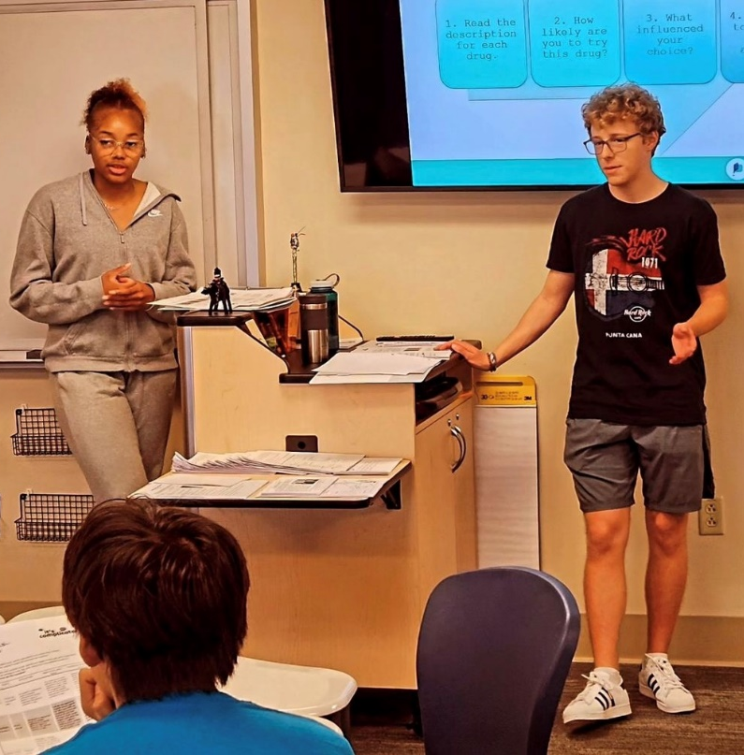
Curriculum Design
It’s Complicated Curriculum Design
Peer educator training
Delivered by peer teachers in health class
Support from PreventEd staff and the school sponsor (e.g., counselor, principal, local champion, favorite teacher)
Notes:
Originally planned as 4 sessions → consolidated to 3 sessions to improve fit with the class schedule.

Slide 6
Curriculum Design
Lesson 1: Navigating the Cannabis Dilemma
Lesson 2: What’s the Big Deal?
Lesson 3: Now What?
The science of cannabis (THC vs CBD)
Adult use vs medical use
Reality behind industry marketing strategies
Effects of cannabis on the teen brain
Mental health implications
Navigating risks (build appropriate coping skills)
Expressing concern about friends
It’s Complicated Curriculum Design
Notes:
Originally planned as 4 sessions → consolidated to 3 sessions to improve fit with the class schedule.

Slide 7
Evaluation Methods
Cluster-randomized, delayed intervention randomized trial.
At the beginning of each semester, health classes were randomized to receive It’s Complicated either: (a) Early, or (b) Later in the semester.
A series of surveys were conducted among all classes (three survey waves administered on the same schedule).
Notes:
After determining that a traditional RCT would be impractical, a cluster-randomized delayed intervention trial was chosen
In a traditional randomized trial, we randomly assign students to groups; randomization occurs at the individual level.
Not always practical in a school setting
Cluster-randomized trial simply means that we assign groups of students to the experimental or comparison groups
In schools, classrooms are a natural unit of clustering

Slide 8
Evaluation Methods (cont.)
Because the school adopted the curriculum as part of the standard health class and student surveys were de-identified, the Western IRB determined the study to be exempt.
Nevertheless, written consent was obtained from the students’ parent/guardian, and assent from the student.
Surveys were intentionally brief (one page front and back).
-Confidentiality protections
-Surveys were carefully proctored
-$20 gift card
Notes:
Confidentiality protections: Individually numbered surveys with detachable face page for student assent; names were kept separate from data.
PreventEd staff proctored the surveys with training from FRI evaluators.
All students received the curriculum (standard as part of health class – only those who had parental consent and youth assent were invited to participate in the evaluation;
There were a few instances of youth turning in surveys where a parent did not return a consent – these were removed from the analytical sample.

Slide 9
Sample Schedule
Notes:
Three semesters: Fall 2019, Spring 2020, Spring 2021.
Advantages:
All students would have access to the curriculum.
Avoids disruption of breaking up classrooms.
Greater acceptability to stakeholders
Drawbacks:
Required a very short follow-up period.
Measurement was limited to proximate effects and antecedents of behavior, but not cannabis use itself.

Slide 10
Analysis
Intention to treat (N= 195)
    Analyze students in the groups to which they were assigned.
Sequence per Protocol (N= 165)
    Drop cases if there were problems with the sequence of the curriculum and surveys (e.g., reported receiving It’s Complicated before they were supposed to).
Sensitivity
    Restricted sample with complete data for all three survey waves.
    N= 150 (Intention to Treat)
    N= 123 (Sequence per Protocol)
    Restricted sample to those who reported being ‘very truthful’
Notes:
Generalized linear mixed models
Dependent variables: Knowledge composite (mean of 7 knowledge items), individual knowledge items, risk perceptions, etc.
Explanatory variables:
Wave (1 vs. 2 vs. 3)
Curriculum Timing (Early vs. Late)
Wave X Curriculum Timing interaction
Random intercepts:
Students nested in classrooms
Accounts for both repeated measurement of the same student and the cluster-randomized design.

Slide 11
Sample characteristics (N= 195 students)
52% female
82% first or second year in high school
30% reported cannabis use in the past year
    Most of these youth (24% overall) met thresholds for needing intervention based on the CRAFFT screener.
57% thought “most” or “all” of their friends used cannabis
85% completed all three survey waves
> 95% reported being ‘very truthful’ in their responses at each survey.
Notes:
57% thought “most” or “all” of their friends used cannabis → recall that by 12th grade, roughly 15% have tried cannabis → suggests the emerging normalization of this substance

Slide 12
Post-Curriculum Survey Results
Notes:
The blue bars are actually great because it helps us recognize that hey, maybe students were being truthful; boring lessons are being addressed, could be attributed to an unprepared peer training who is reading off their script . . . But, even that was effective (*click next slide)

Slide 13
Summary of Outcomes
Notes:
Green indicates statistically significant results

Slide 14
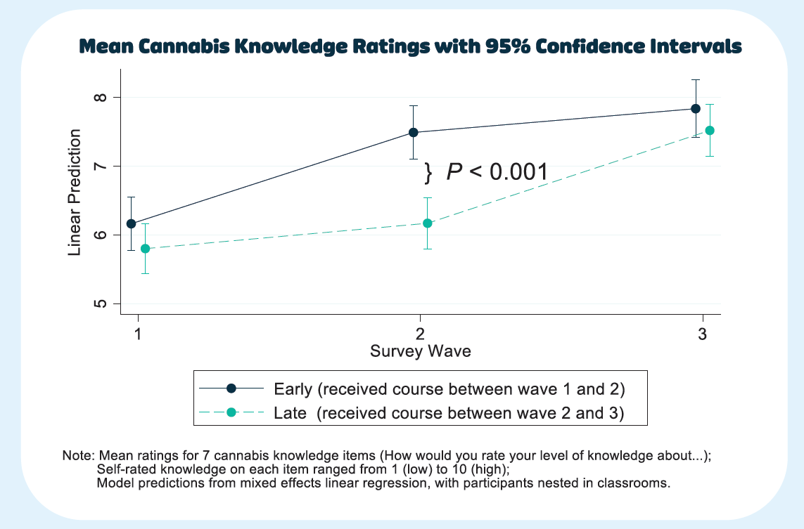
curriculum
curriculum
Notes:
Sustained intervention
Generalized linear mixed models
Dependent variables: Knowledge composite (mean of 7 knowledge items), individual knowledge items, risk perceptions, etc.
Explanatory variables:
Wave (1 vs. 2 vs. 3)
Curriculum Timing (Early vs. Late)
Wave X Curriculum Timing interaction
Random intercepts:
Students nested in classrooms
Accounts for both repeated measurement of the same student and the cluster-randomized design.

Slide 15
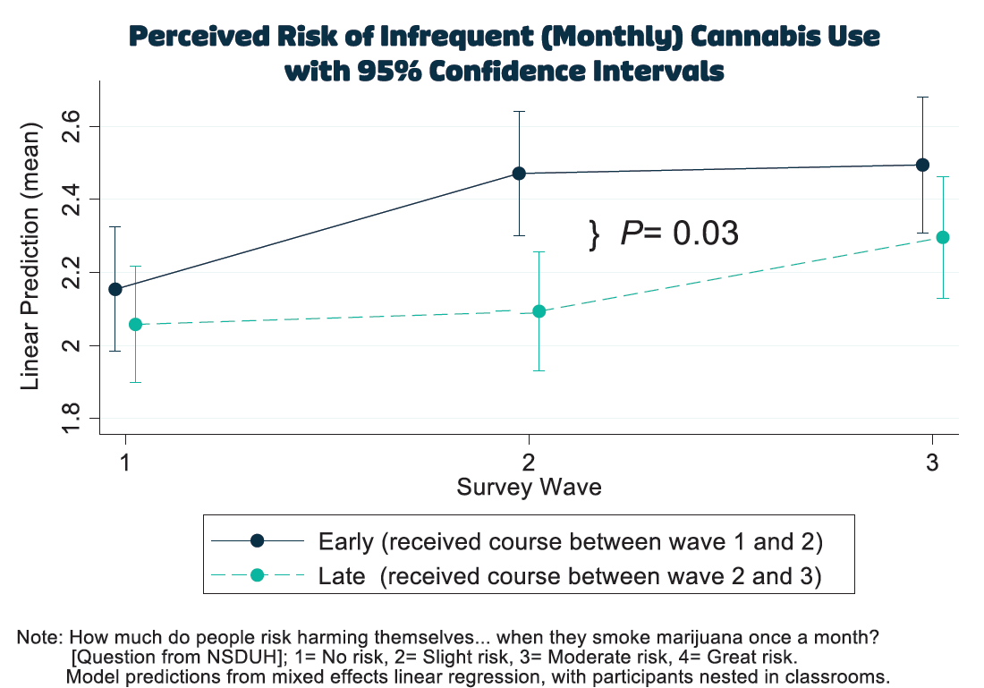
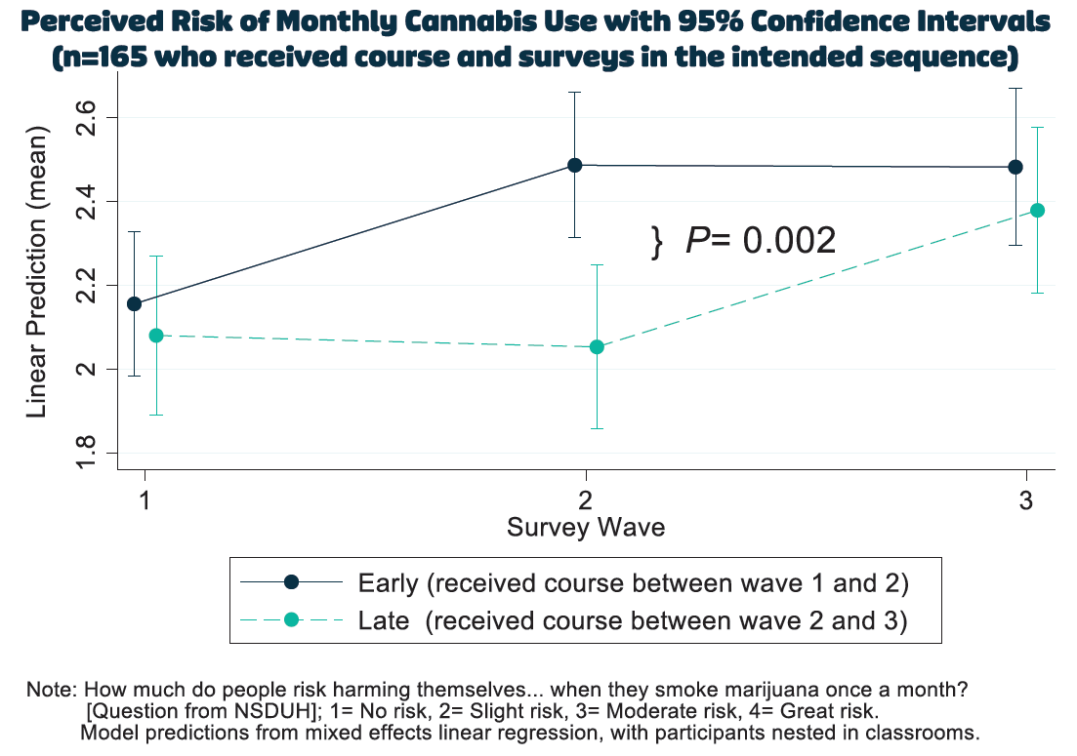

Slide 16
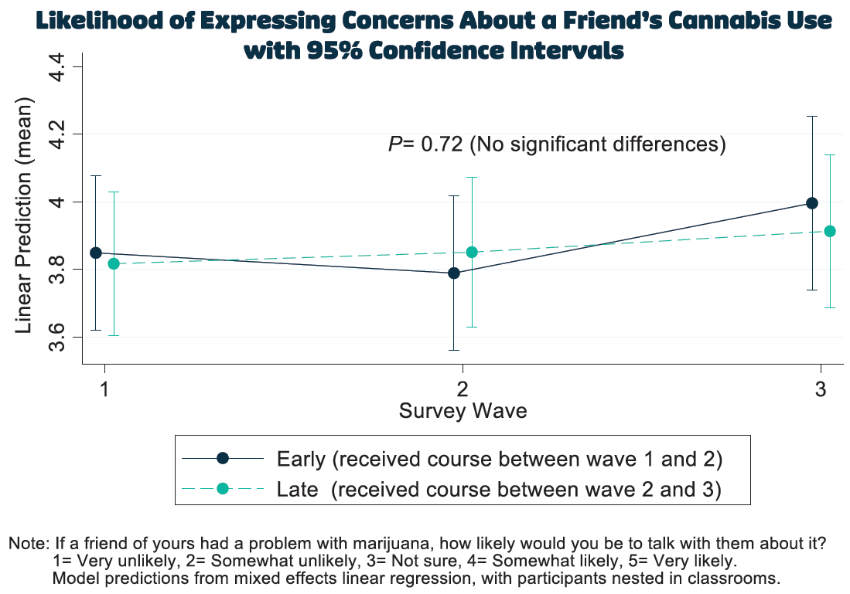
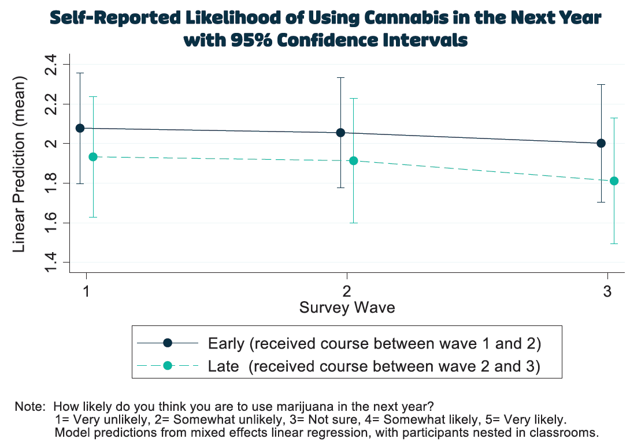

Slide 17
Discussion
  The evaluation of It’s Complicated found significant curriculum effects using a methodologically strong random assignment design.
  Significant curriculum effects for self-rated cannabis knowledge (overall and across multiple knowledge items) and perceived risks of infrequent cannabis use.
  No effects on behavioral intentions regarding cannabis use or expressing concern to a friend, perceived risk of frequent cannabis use, or perceived health risks.
  Findings were generally robust across different approaches to analysis (intention to treat, sequence per protocol) and sensitivity analyses.

Slide 18
Limitations
  Compromises to design in order to ensure feasibility.
  Relatively small sample, possibly underpowered to detect differences.
  Limited to self-report on proximal outcomes.
  Some protocol deviations regarding sequence.
  The COVID-19 pandemic and related closures were a significant disruption to delivering the curriculum and conducting the study.
Notes:
“Factors that affect health are often described as either “proximal” (downstream or directly affecting health) or “distal” (upstream or indirectly affecting health). For example, income is thought of as distal (upstream) because it doesn't directly affect health.”

Slide 19

What’s Next?
    Presentation of the findings at scientific and practitioner meetings
    Publication of the findings in the peer-reviewed literature
    Further refinement and expansion of It’s Complicated to other schools → Training of Trainers
    Larger trial of It’s Complicated to support statewide or national dissemination
Notes:
Despite these limitations, the study provides evidence to support the It’s Complicated curriculum, suggesting this is an effective approach to school-based education about cannabis.
Working with evaluator; how do we refine and expand, looking into learning management system; we need a larger sample size, the more we can around the state first before national dissemination
3 fold: really concentrate on our region, state, outside of state; across state working with PRCs for a reciprocal relationship

Slide 20
Racial Equity in Prevention Education
Meeting students where they are
Reflecting a wide range of experiences & identities in the materials we teach
Using language that is accurate & representative
Expanding the list of school districts we work with
Notes:
Our Prevention Educators are lifelong learners. We are committed to teaching both ourselves and our students, knowing that to best support young people in our community, we must first educate ourselves. This starts with the recognition that inequities are entrenched in the American education system. Schools are divided across racial and economic lines, intensifying the education gap between white students and students of color, and students experiencing financial stability and those who are not. Our educators are determined to close this gap in resources and support for our young people by:
Meeting students where they are. We recognize that students have a diversity of backgrounds, interests, and experiences that have shaped who they are and how they can be supported. We strive to provide all students with the necessary life skills and tools to make decisions that are healthy for them.
Reflecting a wide range of experiences and identities in the materials we teach. From the books we read, to the presentations we give; we want all our students to feel recognized, represented, and supported.
Staying up to date on laws, policies, and research pertaining to substance use and consequences, including but not limited to health disparities and disproportionate involvement in the juvenile and criminal justice system through the school-to-prison pipeline. In working with young people of all backgrounds and identities, we must understand how institutional racism and other forms of systemic oppression have disproportionately harmed the health and well-being of people with disabilities, and Black and Latinx folk.
Using language that is accurate, representative, and authentic to the individuals and communities with whom we work. We want to be thoughtful and intentional about our language, as well as willing to make mistakes and learn from these mistakes. As we work towards becoming an anti-racist organization, we will continue to educate ourselves and hold one another accountable to dismantle our own biases, prejudices, and assumptions.
Expanding the list of school districts we work with to be more inclusive and representative of racially minoritized students, particularly Black, Latinx, and Asian and Pacific Islander students, and students of lower socioeconomic status.

Slide 21
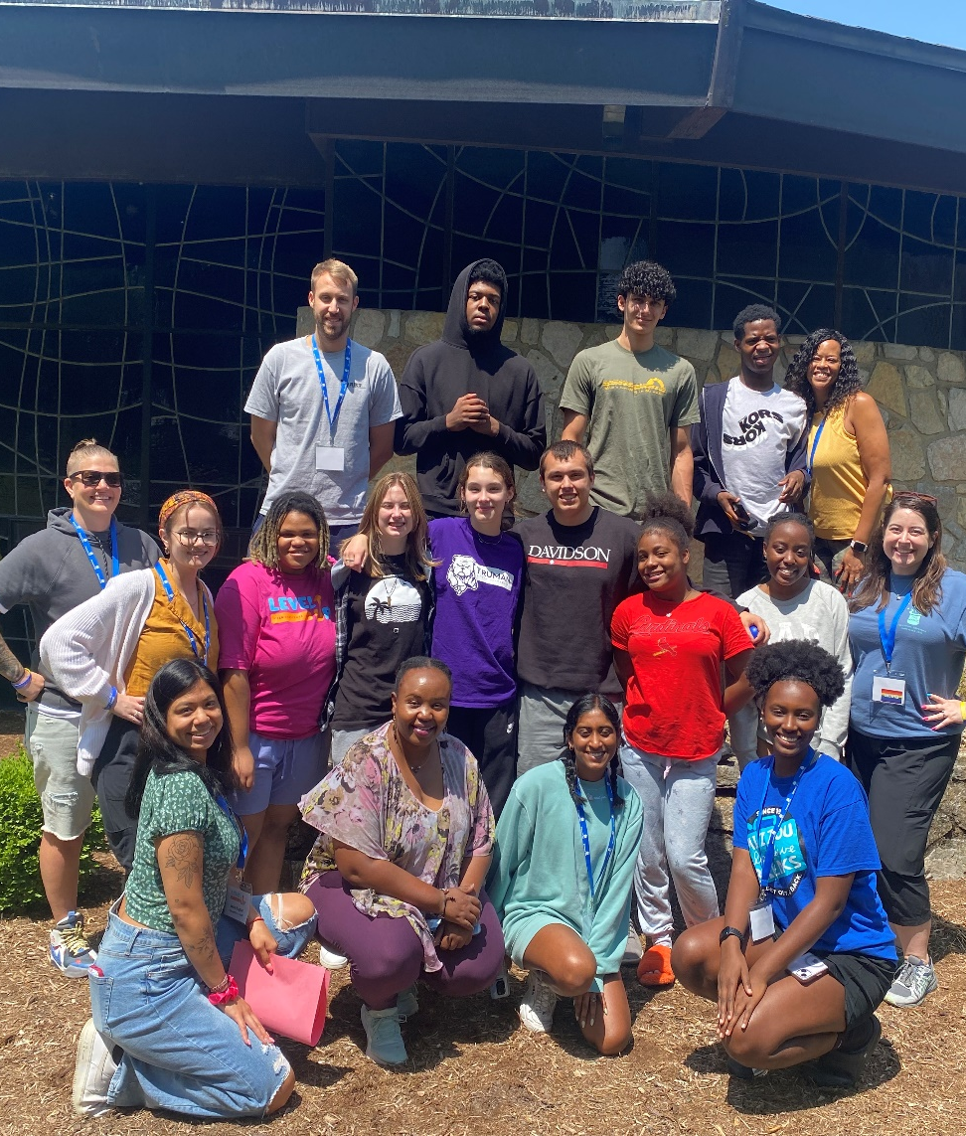
Ongoing Racial Equity Goals
    Assessing school materials annually to ensure that they are meeting the needs of all students
    Equitably serving school districts to provide prevention education to all communities, particularly those who have been most negatively impacted by racist practices and policies.
    Expanding our professional development efforts to incorporate a more thorough intersectional frame
Notes:
Some of our ongoing goals include:
Assessing school materials annually to ensure that they are meeting the needs of all students. This includes, but is not limited to:
Reviewing word choice and phrasing in lessons to remove anything that is outdated, discriminatory, stereotypical, or offensive.
Using examples, when writing, speaking, and displaying images, that reflect a broad range of identities and perspectives. All students, no matter race/ethnicity, age, gender, gender identity, sexuality, ability, religion, or socioeconomic status, should feel seen, heard, and respected.
Adjusting lessons to reflect best practices in prevention education.
Equitably serving school districts to provide prevention education to all communities, particularly those who have been most negatively impacted by racist practices and policies.
Conducting regular check-ins with the Prevention Education Staff to discuss how we are incorporating racial equity and equity more broadly into our work, what barriers we are facing, and how we can overcome these obstacles. Looking ahead, we are excited and determined to use an intersectional equity framework to address overlapping and interdependent systems of discrimination.
Expanding our professional development efforts to incorporate a more thorough intersectional frame. During our agency’s 2021 Staff Day Away, we had the opportunity to talk with Rabbi James Bennett from Congregation Shaare Emeth. What resulted was a powerful, informative, and engaging conversation about the Jewish faith and how to best support students of all religious backgrounds. We will continue to prioritize utilizing an intersectional frame to best understand, connect with, and support our students.

Slide 22
Acknowledgements
This project would not have been possible without the support and contributions of:
The Missouri Foundation for Health, which provided funding support for program delivery and the evaluation
Hillsboro High School (especially Counselor Sarah Dix)
Friends Research Institute for project evaluation and analysis (especially Jan Gryczynski and Kristi Dusek)
The peer teachers who delivered the curriculum
The Hillsboro High School students who participated in the evaluation
Nichole Dawsey
Leah Maniaci
Jaime Hoff

Slide 23
References
1. Substance Abuse and Mental Health Services Administration (SAMHSA).(2020). Key substance use and mental health indicators in the United States: Results from the 2019 National Survey on Drug Use and Health (HHS Publication No. PEP20-07-01-001, NSDUH Series H-55). Rockville, MD: Center for Behavioral Health Statistics and Quality. Retrieved from https://www.samhsa.gov/data.
2. Connor, J. P., Stjepanović, D., Le Foll, B., Hoch, E., Budney, A. J., & Hall, W. D. (2021). Marijuana use and marijuana use disorder. Nature Reviews Disease Primers, 7(1), 1-24.
3. Hennessy, E. A., & Tanner-Smith, E. E. (2015). Effectiveness of brief school-based interventions for adolescents: A meta-analysis of alcohol use prevention programs. Prevention Science, 16(3), 463-474.
4. Cerdá, M., Mauro, C., Hamilton, A., Levy, N. S., Santaella-Tenorio, J., Hasin, D., ... & Martins, S. S. (2020). Association between recreational marijuana legalization in the United States and changes in marijuana use and marijuana use disorder from 2008 to 2016. JAMA psychiatry, 77(2), 165-171.
5. Hasin, D. S., Wall, M., Keyes, K. M., Cerdá, M., Schulenberg, J., O'Malley, P. M., ... & Feng, T. (2015). Medical marijuana laws and adolescent marijuana use in the USA from 1991 to 2014: results from annual, repeated cross-sectional surveys. The Lancet Psychiatry, 2(7), 601-608.

Slide 24




Connect with Us
@Prevent_Ed
talkaboutitmo.com
9355 Olive Boulevard
St. Louis, MO 63132
314.962.3456
prevented.org
ewilson@prevented.org
(314)912-9190

