Slide 1
Learning Collaboratives in the HEALing Communities Study: A Community-Engaged Training and Technical Assistance (TTA) Approach in a Multi-Site Overdose Reduction Intervention
Maria Rudorf, MA
November 2, 2023

Slide 2
Disclosures
Research supported by the NIH Helping to End Addiction Long-term (HEAL) Initiative (UM1DA049406, UM1DA049412, UM1DA049415, UM1DA049417, and UM1DA049394, PI: Samet)
Authors have no financial conflicts to disclose

Slide 3
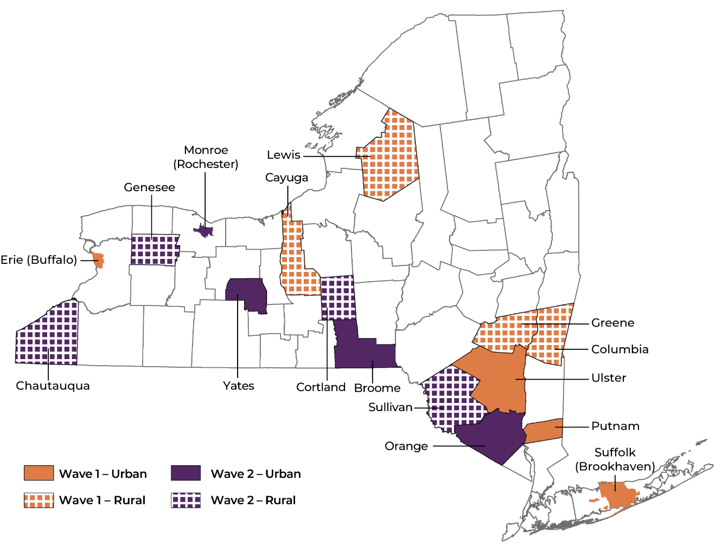
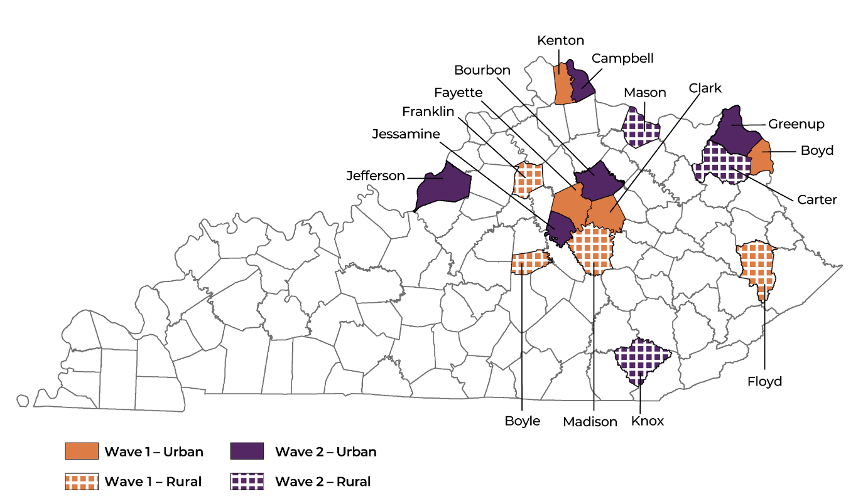
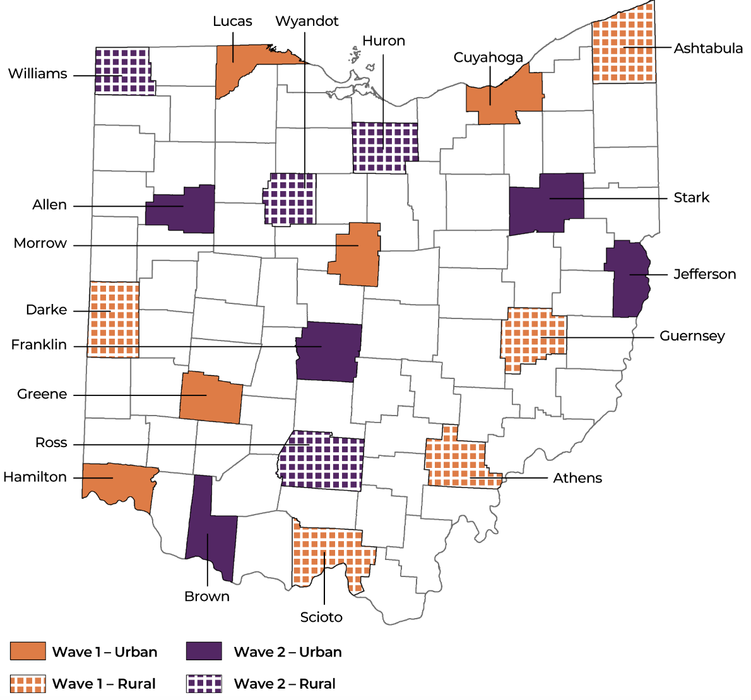
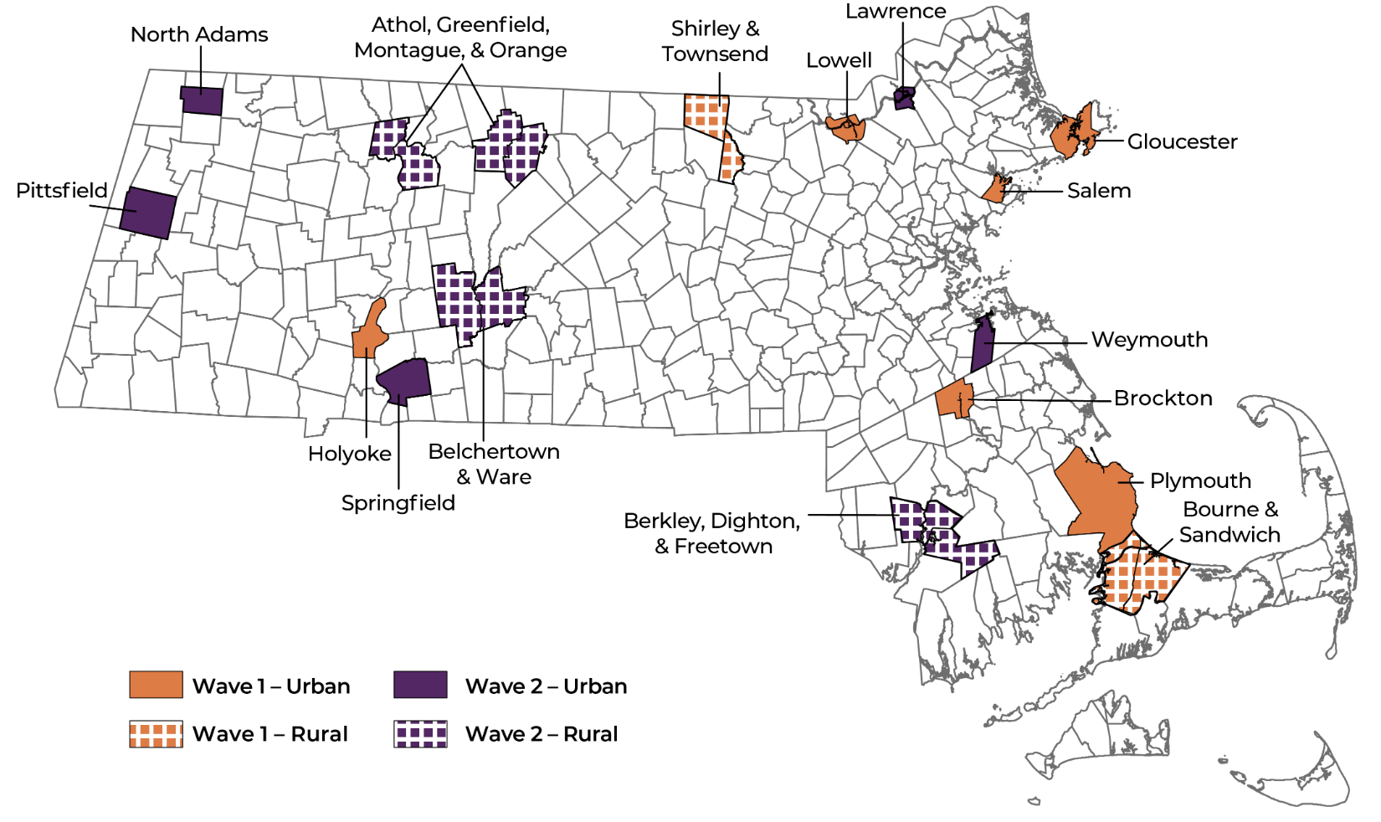
HEALing Communities Study (HCS)
Helping to End Addiction Long-term
4 State Sites (KY, NY, OH, MA)
67 communities
Community-engaged research study funded
by NIDA & SAMHSA aimed at implementing evidence-based strategies to reduce fatal opioid-related overdoses by 40%
Overdose Education & Naloxone Distribution (OEND)
Medication for Opioid Use Disorder (MOUD)
Safer Prescribing

Slide 4
HEALing Communities Study (HCS)
Helping to End Addiction Long-term
TTA
Community-engaged research study funded
by NIDA & SAMHSA aimed at implementing evidence-based strategies to reduce fatal
opioid-related overdoses by 40%
Technical Assistance
Trainings
Overdose Education & Naloxone Distribution (OEND)
Medication for Opioid Use Disorder (MOUD)
Safer Prescribing
Learning Collaboratives

Slide 5
Training & Technical Assistance (TTA)
Trainings
Technical Assistance
Learning Collaboratives

Slide 6
Learning Collaboratives

Slide 7
Learning Collaborative (LC) Definition
LCs strive to be community driven
Democratize resource and information sharing
LCs are a forum for TTA specifically designed for:
Peer-based learning and building professional networks to support with evidence- based practice (EBP) strategy implementation
7

Slide 8
Learning Collaborative Objectives for HCS:
Respond to HCS community needs
Leverage engagement and local, interprofessional expertise
Encourage multidirectional knowledge sharing within and across HCS communities

Slide 9
LC Development
MA site championed the use of LCs
Inspired by Project ECHO® and Boston Medical Center’s Grayken Center for Addiction Training and Technical Assistance
Didactic + Case Review + Discussion
Dates of LC Initiation:
MA – May 2020
NY – Dec 2020
OH – April 2021
KY – May 2021

Slide 10
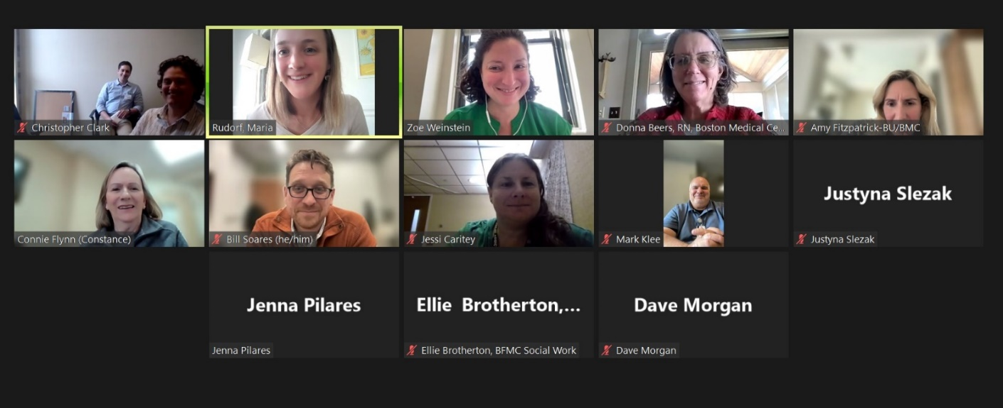
LC Design
1-2 hour sessions virtually
Diverse speakers
Interprofessional participants
Social, economic, and political intersections of opioid use disorder
Didactic, community case example(s), breakout groups, Q&A, discussion
Types:
Individual or series
Content- or community-specific

Slide 11
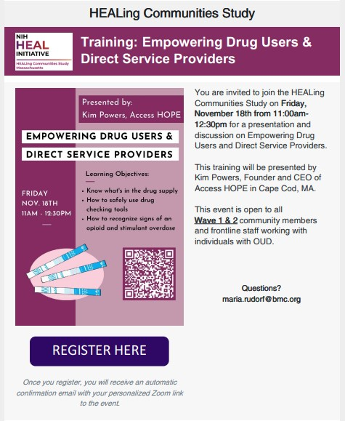
LC Topics

Slide 12
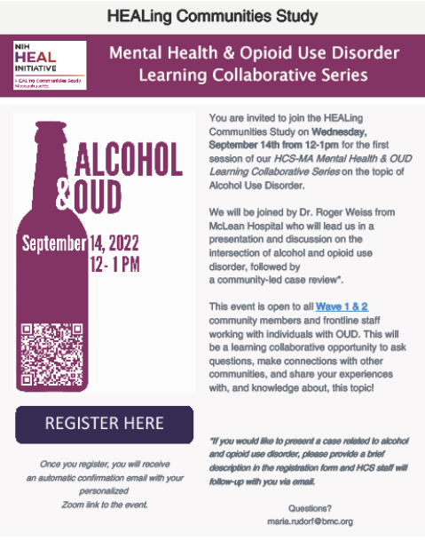
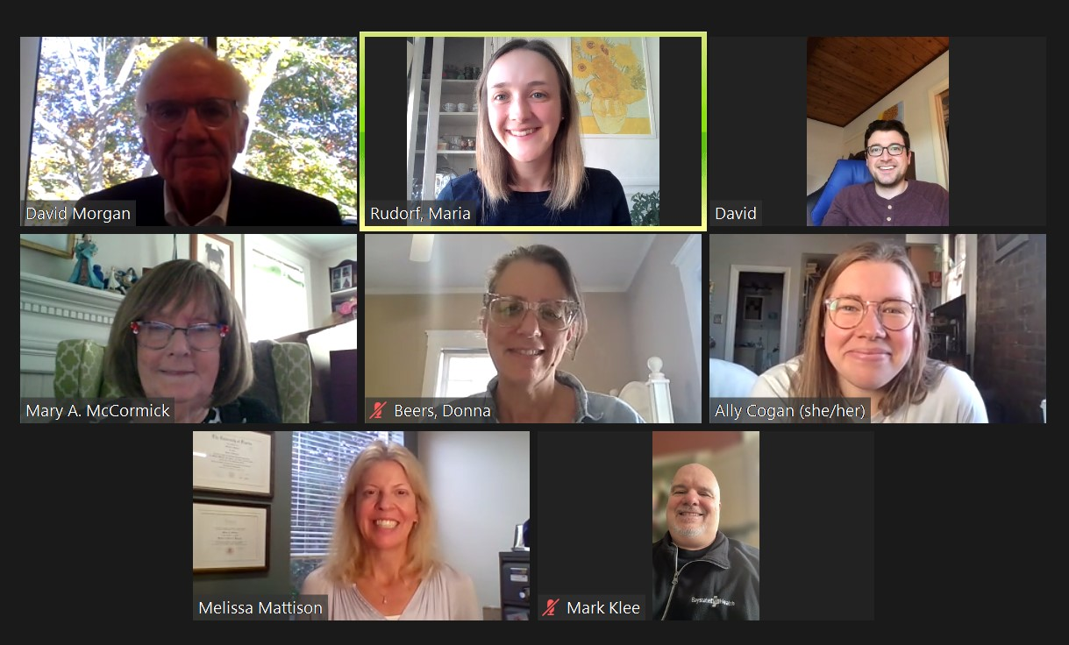
LC Series
Mental Health & OUD
Harm Reduction Outreach
Addiction Clinical Care
Transportation Interventions
Grants Management
Narratives and Numbers
Pharmacy Engagement
Peer Implementation
Communications Collaborative Hours

Slide 13
National Cross-Site LC
“Showcasing Models of Peer Support Across HCS” (11/12/2021)
Led by National LC Planning Group
Peer support staff from each state
81 attendees total

Slide 14
Racial Equity & Social Justice (RESJ)
Strove to address racism, stigma, racial/ethnic/gender, etc. disparities
Foster and guide incorporation of race/ethnicity data
Focus on intersections of opioid use disorder with social justice issues
Integration of harm reduction principles
LCs conducted through MA-RESJ Committee
RESJ Feedback Form question
Community driven and local expertise

Slide 15
Cross-Site Total LCs
May 2020 – October 2023
 | MA | OH | KY | NY | Total
Total # LCs | 173 | 25 | 33 | 147 | 379

Slide 16
Cross-Site Total Avg. LC Attendance
May 2020 – October 2023
 | MA | OH | KY | NY | Total Avg.
Total Avg. Attendance | 24 | 26 | 187 | 28 | 45

Slide 17
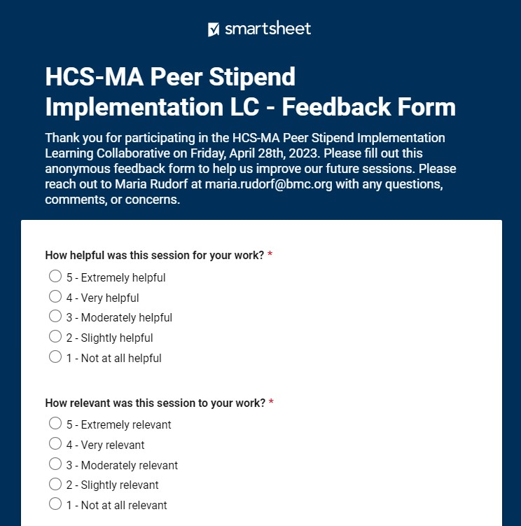
Tools Developed
LC Data Trackers
Registration & Feedback Forms
Internal Agenda Templates
Advertisement Flyers
Library of LC Recordings
Community Listservs

Slide 18
Lessons Learned
Convened interprofessional partners to address shared needs
Established and enhanced communication and collaboration between agencies across the state
Spotlighted local experts and programs
Opportunity to leverage/promote expertise of earlier participants
Responsive to current events
“I wasn't aware of how many [SSPs] have emerged in the past few years. I really appreciated hearing from a panelist who has used SSP services on all that it has provided for him.”
“It was helpful to see some of the documentation that Holyoke developed, and I would be interested to see what other communities are also developing.”

Slide 19
Limitations
Challenge with defining LCs
Challenge with ensuring people with lived and living experience and from underrepresented backgrounds are at the forefront
No standardized data tracker across research sites
Delayed start of LCs on HCS
Challenge with securing accreditation

Slide 20
Research Aims for Manuscript
Describe the design, implementation, and lessons learned from TTA delivery via LCs
Analyze LC data and process across research sites to identify the strengths and challenges of this approach

Slide 21
Summary
“I am appreciative of this [LC] opportunity because it allowed me to hear solutions and challenges other agencies face...”
LCs bring together people from all backgrounds
Encourage multidirectional engagement
Identify/promote local expertise and resource sharing
Enhance networks and collaboration across the care continuum
Low barrier and sustainable impact
Possibility to integrate LC model in other fields
“Very useful and relevant info and discussion. And addresses an important knowledge gap in helping folks with OUD struggling to move towards recovery.”

Slide 22
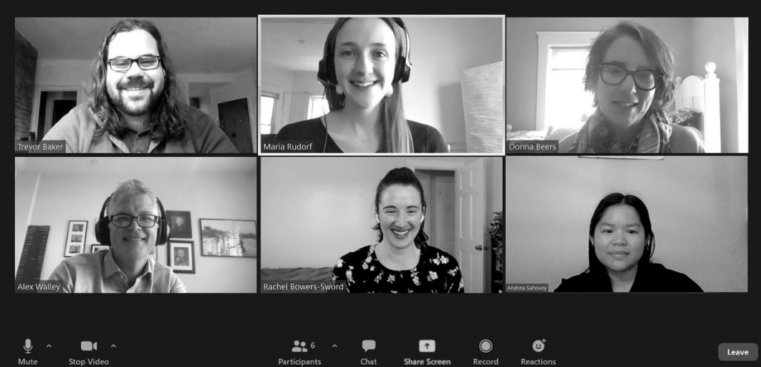
Acknowledgements
This presentation and the implementation of LCs would not have been possible
without the support of:
Alexander Walley
Curtis Walker
Lise Roemmele
Nicholas Bove
Dawn Gruss
Trevor Baker
Donna Beers
Gary Langis
Andrea Sahovey
Rachel Sword Cruz
Roxanne Anderson
Sarah Fielman
Vanessa Loukas
Roger Weiss
Jessica Taylor
Ken Feldstein
Karen Haessler
Avik Chatterjee
April Young
Carly Bridden

Slide 23
Thank You!
Maria Rudorf, MA
TTA Management Specialist, Boston Medical Center
Maria.Rudorf@bmc.org

Slide 24
References
Bunger AC, Doogan N, Hanson RF, Birken SA. Advice-seeking during implementation: a network study of clinicians participating in a learning collaborative. Implement Sci. 2018;13(1):101. Published 2018 Jul 28. doi:10.1186/s13012-018-0797-7
Komaromy M, Duhigg D, Metcalf A, et al. Project ECHO (Extension for Community Healthcare Outcomes): A new model for educating primary care providers about treatment of substance use disorders. Subst Abus. 2016;37(1):20-24. doi:10.1080/08897077.2015.1129388
Kroelinger CD, Addison D, Rodriguez M, et al. Implementing a Learning Collaborative Framework for States Working to Improve Outcomes for Vulnerable Populations: The Opioid Use Disorder, Maternal Outcomes, and Neonatal Abstinence Syndrome Initiative Learning Community. J Womens Health (Larchmt). 2020;29(4):475-486. doi:10.1089/jwh.2020.8303
Livet M, Richard C, Gangi EW. The Opioid Response Project: An Effective Learning Collaborative for Local Communities? [published online ahead of print, 2023 Mar 31]. Health Promot Pract. 2023;15248399231162378. doi:10.1177/15248399231162378
Massachusetts Office Based Addiction Treatment (OBAT) ECHO® https://www.bmcobat.org/project-echo/massachusetts-obat-echo/
Murray OB, Doyle M, McLeman BM, et al. Augmenting project ECHO for opioid use disorder with data-informed quality improvement. Addict Sci Clin Pract. 2023;18(1):24. Published 2023 Apr 28. doi:10.1186/s13722-023-00381-2
Nadeem E, Olin SS, Hill LC, Hoagwood KE, Horwitz SM. A literature review of learning collaboratives in mental health care: used but untested. Psychiatr Serv. 2014;65(9):1088-1099. doi:10.1176/appi.ps.201300229
Nadeem E, Weiss D, Olin SS, Hoagwood KE, Horwitz SM. Using a Theory-Guided Learning Collaborative Model to Improve Implementation of EBPs in a State Children's Mental Health System: A Pilot Study. Adm Policy Ment Health. 2016;43(6):978-990. doi:10.1007/s10488-016-0735-4
Project ECHO (Extension for Community Healthcare Outcomes). https://hsc.unm.edu/echo/
Ranmuthugala G, Plumb JJ, Cunningham FC, Georgiou A, Westbrook JI, Braithwaite J. How and why are communities of practice established in the healthcare sector? A systematic review of the literature. BMC Health Serv Res. 2011;11:273. Published 2011 Oct 14. doi:10.1186/1472-6963-11-273
Staton MD, Watson DP, Thorpe D. Implementation of peer recovery coach services for opioid overdose patients in emergency departments in Indiana: findings from an informal learning collaborative of stakeholders. Transl Behav Med. 2021;11(10):1803-1813. doi:10.1093/tbm/ibab031
Wenger-Trayner, E, & Wenger-Trayner, B. Communities of practice a brief introduction. https://wenger-trayner.com/wp-content/uploads/2015/04/07-Brief-introduction-to-communities-of-practice.pdf

Slide 25
Individual LC Examples
Eviction Prevention
Stigma in Media
Faith Leader Advocacy
Grant Writing
Racial Equity
Data Driven Decision-Making
Motivational Interviewing
Hiring Equity: Stories from the Frontline
Empowering Drug Users & Direct Service Providers
Partnerships with Criminal Justice/Law Enforcement
OEND/MOUD in the Criminal Legal System
First Responder Overdose Education and Leave Behind Program
Harm Reduction Vending Machines: Dispensing Life Saving Supplies
Homelessness, Harm Reduction & COVID-19
Hiring Equity: Stories from the Frontline
Effective Advocacy Tools
Innovative Strategies for Long-term Recovery Support
Berkshires Equity Toolkit
Embracing Harm Reduction: A Faithful Response to the Opioid Crisis
Substance Use Stigma: Lessons Learned and Future Directions for the Social Work Community
Evidenced-Based ideas for the Opioid Abatement Funds
Pharmacology, Misconceptions, and Myths; Harm Reduction for Pharmacists
Addiction Cultural Competency in Rural Settings
Peer Stipend Implementation
Naloxbox Implementation
Trauma Informed Self Care and Burnout
RIZE Know Your Rights Toolkit: Your Rights in Recovery
Syringe Service Programs
Opioids and the Law
Social Workers & Responding to the Overdose Crisis

