Slide 1
Leveraging Community Advisory Boards (CABs) to Enhance the Uptake of Harm Reduction Initiatives in West & Southwest Philadelphia
Desiree Harris, MPH, DrPH (c) (she/her),
Volunteer & Outreach Coordinator, Center for Addiction Medicine and Policy, University of Pennsylvania
Jasmine Barnes, MPH, CFRS (she/her)
Project Manager, Center for Addiction Medicine and Policy, University of Pennsylvania
AMERSA Annual Meeting
November 14, 2024
Notes:
Good Afternoon, my name is Jasmine Barnes, and I am co-presenting with my colleague, Desiree Harris and we are representing the Center for Addiction Medicine and Policy at Upenn and will be presenting on our work leveraging Community advisory boards to enhance the uptake of harm reduction initiatives in West and Southwest Philadelphia

Slide 2
Disclosure
We have no potential conflicts of interest to disclose
Notes:
Before we get started, I’d like to add that we have no conflicts of interest to disclose

Slide 3
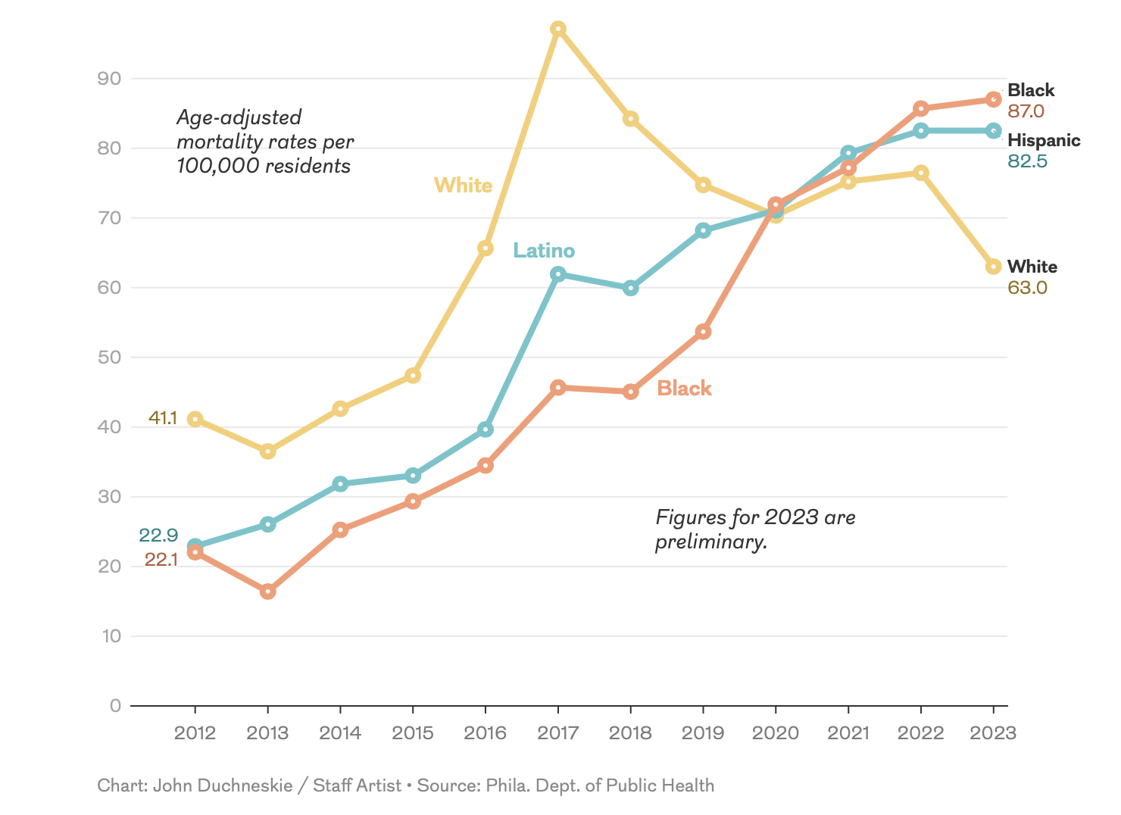
Background
Overdose Mortality Rate by Race/Ethnicity, 2012-2023
BIPOC communities face disproportionately high overdose rates, nationally and locally
Care gaps remain; fewer care touchpoints limit access
Building community partnerships are essential to inform and enhance harm reduction services in West and Southwest Philadelphia
Sources: Philadelphia Department of Public Health. Unintentional Drug Overdose Fatalities in Philadelphia, 2022. CHART 2023; 8(3):1-7
Notes:
To give a little context, BIPOC communities are facing disproportionately high overdose mortality rates, both nationally and locally. As these communities struggle to cope with these issues in their communities, there are limited opportunities for culturally appropriate harm reduction initiatives to address their needs.
Given this knowledge and in our efforts to bridge gaps and foster collaboration in our own backyard, we recognized a unique opportunity to partner with the community to design harm reduction initiatives with the hopes to increase uptake.

Slide 4
Objectives
Describe our process of convening our CAB to bolster community collaboration, enhance outreach, and implement culturally appropriate substance use interventions in West and Southwest Philadelphia and share lessons learned
Notes:
Our goals for this talk are to describe our process of convening our Community Advisory Board to bolster collaboration, enhance outreach and implement culturally appropriate substance use interventions in West and Southwest Philadelphia and share lessons learned as an outcome of this process

Slide 5
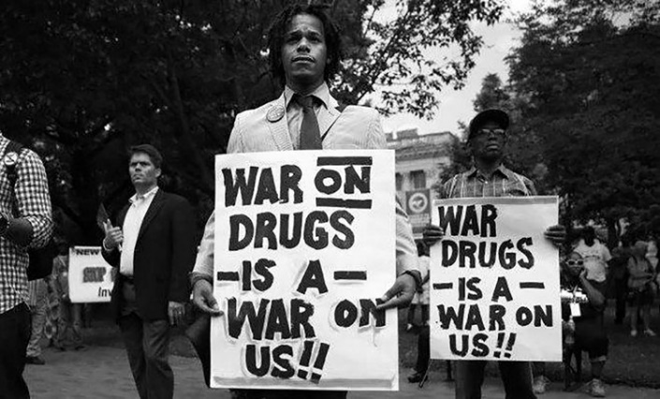
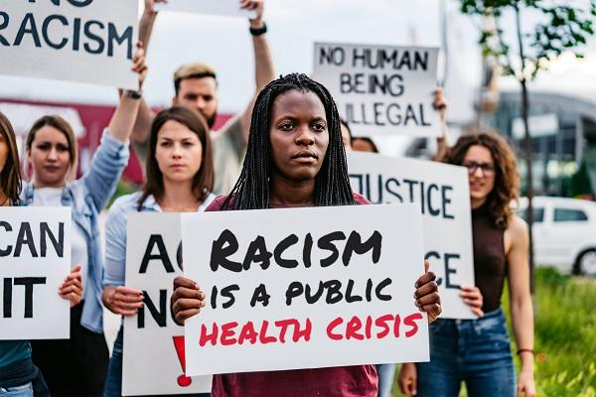
Community Needs Assessment
War on Drugs
Systemic
Racism
Generational
Trauma
"You cannot change any society unless you take responsibility for it, unless you see yourself as belonging to it and responsible for changing it." - Grace Lee Boggs
Notes:
To properly inform this work, our team conducted a community needs assessment to learn the community’s perception of substance use, people who use drugs and the barriers to building fruitful partnerships between the West and Southwest Philadelphia community and surrounding academic-healthcare institutions.
As a result of our community needs assessment, we learned:
#1: That the community is experiencing the lingering effects of the war on drugs, as this is something that never really ended and stalls uptake of harm reduction initiatives out of fear of increased police presence and resulting consequences.
#2: Participants also highlighted the mental, physical and emotional toll of systemic racism on BIPOC communities, producing generational trauma. For our participants, substance use is a clear sign of a broken system and a call for accountability and justice.
We recognized that in order to partner with the community and better serve them, we must first acknowledge the harms we’ve done and extend opportunities for the community to lead.
This sentiment is captured beautifully in this quote from Grace Lee Boggs, which states....
The resulting work is our teams’ response to join the community in developing solutions that center their needs and preferences.

Slide 6
CAB Formation
CAB formed in August 2022
10-member board.
83% identify as BIPOC and have Lived or Living Experience with SUD
All members live or work in West or Southwest Philadelphia
Bi-monthly meetings
Members are compensated for their attendance
Meetings are structured to express concerns, share updates, provide a forum for community leaders to share their work and build their networks
Notes:
As we concluded our community needs assessment, we offered participants who expressed interest in our work and who were passionate about driving change the opportunity to remain engaged with our team as part of our community advisory board.
We officially convened our CAB in August of 2022 with 10 members. Most CAB members identify as BIPOC and have lived or living experience with substance use disorder and all members either live or work in our target community.
Since inception, we have conducted meetings bi-monthly, members are compensated for their attendance and all meetings are structured to create space for members to express their concerns, share their work and network with other community leaders with share passion and a commitment to this work.

Slide 7
CAB Goals and Priorities
Enhance outreach tailored to BIPOC individuals.
Prioritized areas for community intervention (e.g., transportation hubs, libraries, food distribution sites, recreation center, etc.)
Building awareness of community resources to support BIPOC PWUD
Increase community presence and opportunities for harm reduction education
naloxone trainings (overdose reversal and drug checking resources)
Notes:
In early meetings, we strived to make sure our meetings were focused and productive, with our CABs guidance, we established goals and priorities to partner on, which included:
Enhancing our street outreach and ensuring that our messaging was tailored to the needs of BIPOC communities
Learning the ins and outs of the community, and most importantly where to dispatch our street outreach team
Socializing available and reliable substance use treatment resources and,
Increasing the availability of community education and drug checking resources…and now I will turn it over to Desiree to share more about our program activities

Slide 8
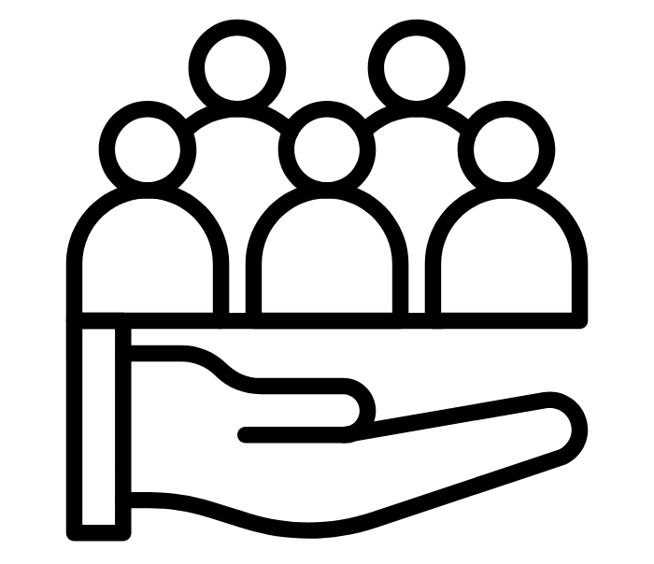
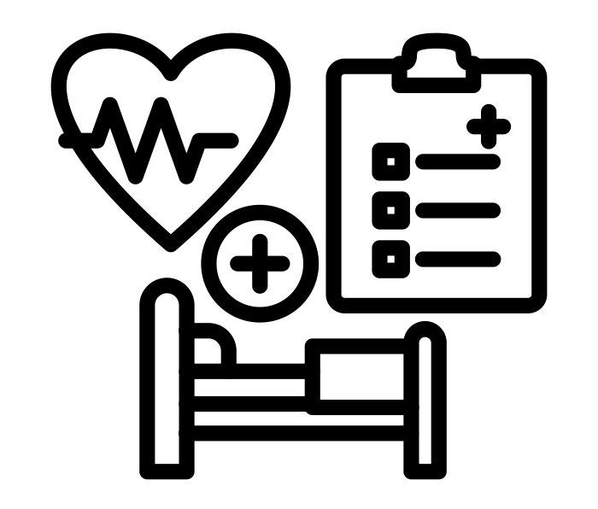
Activities
Community
Partnerships
Enhance SUD
Service Delivery
Expand Community Outreach
Notes:
With the input from the CAB. CAMP established the following initiatives to further increase SUD and harm reduction awareness

Slide 9
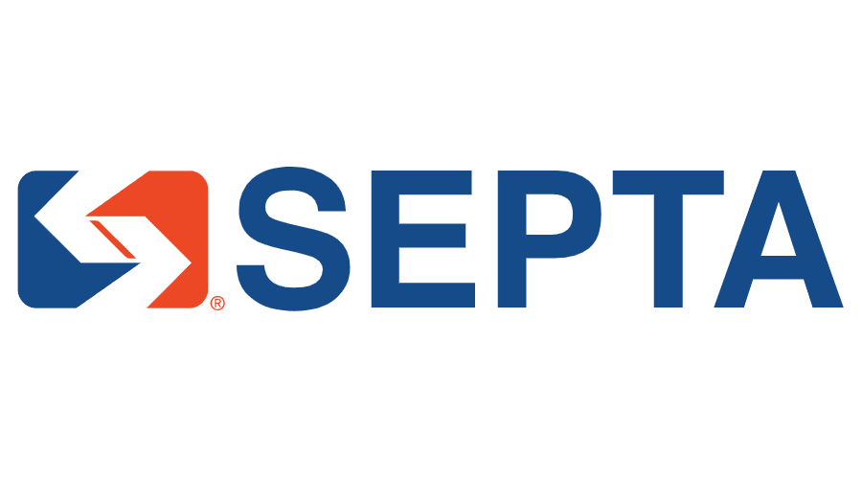
Community Partnerships & Outreach Expansion
Established partnerships with over 50 community-based organizations, including local transportation authority
Leveraged university resources to support CAMP's mission
Hosted over 20 naloxone trainings and attended over 50 community meetings to discuss best practices to conduct outreach and provide services
Notes:
So within the past year we (point one)
Some organizations we frequently partner with include the Free Libraries of Philadelphia (specifically in West and SW)
Point 2- collaboration w/ students and other departments across UPenn and Drexel University such as their Nursing, MPublic Health, MSocial Work, Medical school programs, and multiple harm reduction based student run organizations
Point 3- Hosted 20 Narcan trainings in various settings such as Schools, churches, and community townhalls
Our Narcan trainings comprise of an informal discussion on the safety, stigma, and resources for substance use disorders in Philadelphia. We share some background information on fentanyl, Xylazine, and its danger to our community. As well as also socializing our services available through CAMP such as our CareConnect Warmline (which I will be explaining later).
The Narcan trainings and community meeting presents the opportunity for community residents to learn in real time the resources available to them regarding SUD support.

Slide 10
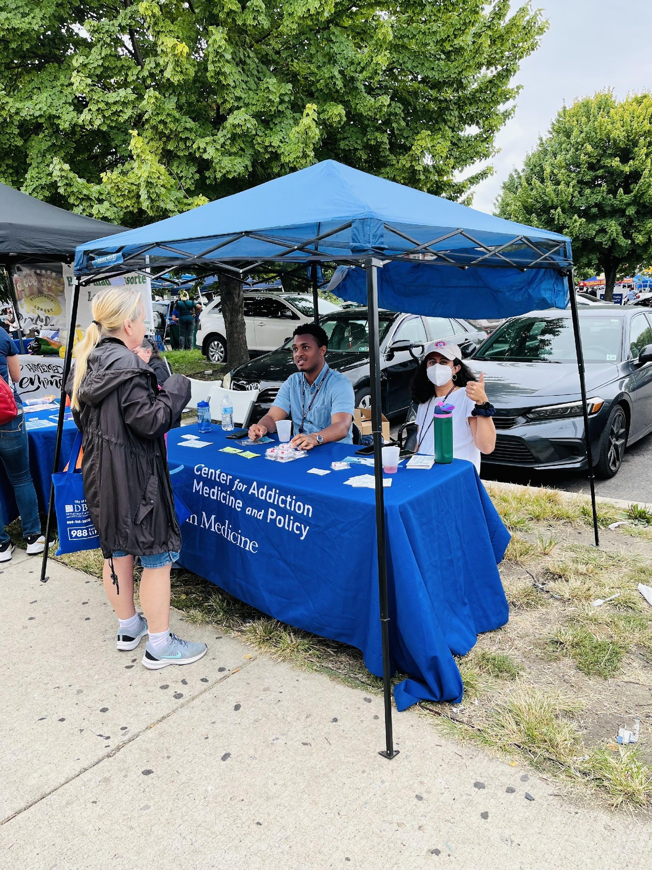
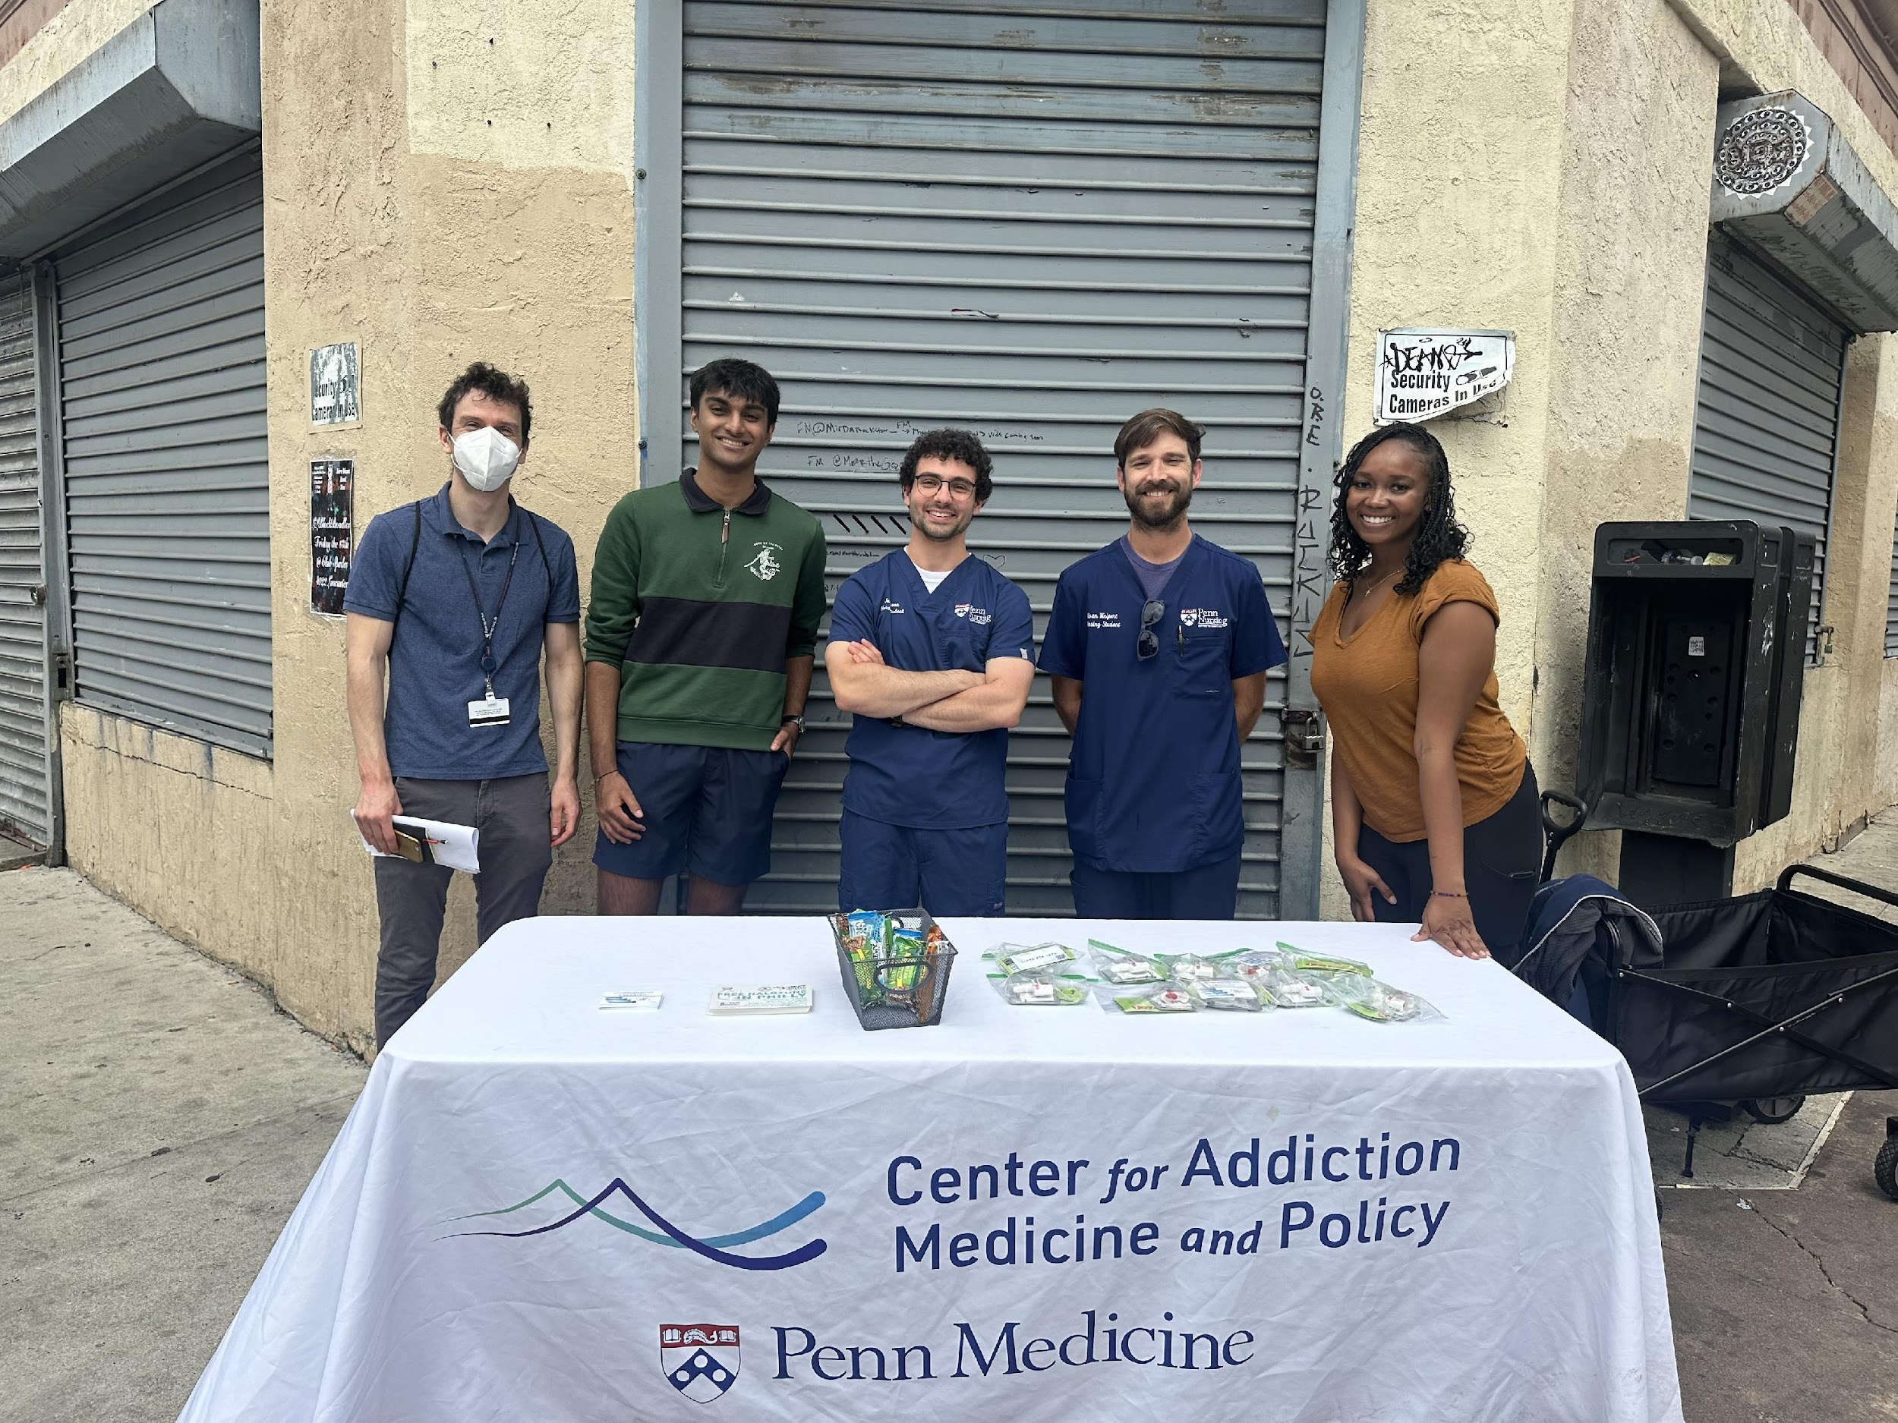
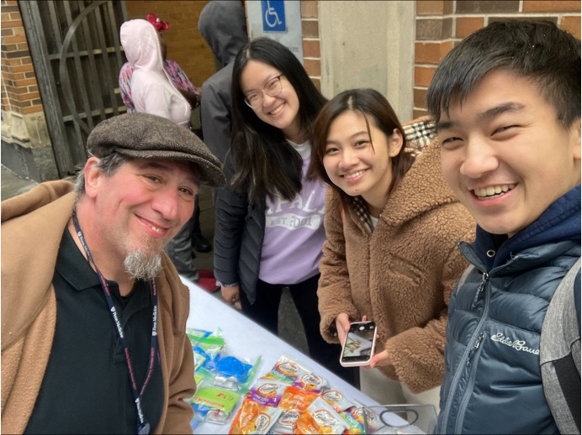

Slide 11
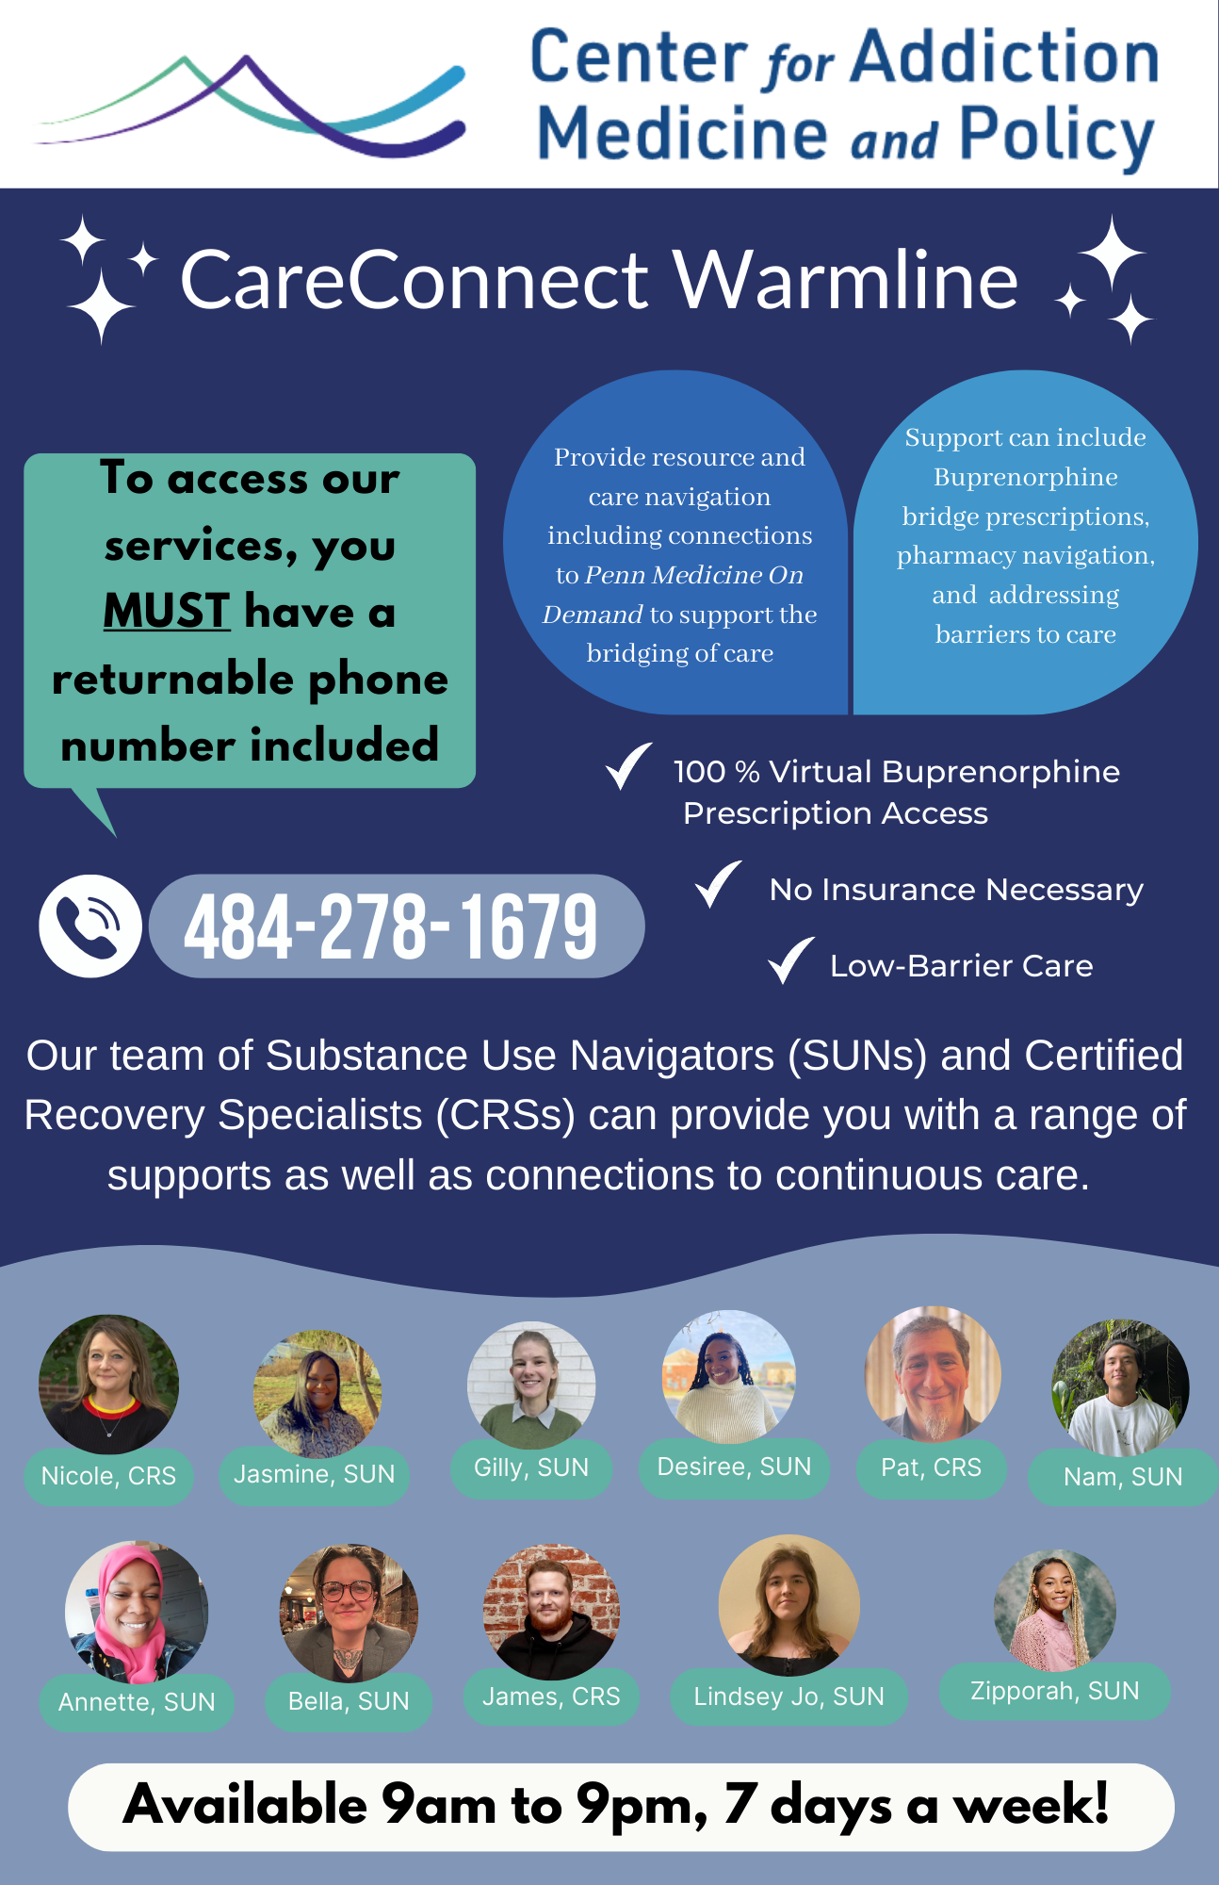
Enhance SUD Service Delivery
CAB input directly informed service delivery models
Focused on addressing social needs such as housing, food insecurity, and access to care
Centralized services at community hospitals within University of Pennsylvania Health System
Low-barrier, walk-in care via CareConnect Warmline and our West Philadelphia resource hub
Notes:
Based on the CAB input, we addressed social determining factors that influence a person's success in recovery outcomes such as (point two)
The CAB also aided in socializing the services we have available at CAMP, like our (point four)
Established in 2021, the CareConnect Warmline is a virtual telemedicine suboxone bridge clinic, running 7 days a week from 9a-9p, anyone needing a suboxone bridge, whether it be from lapse in care, a future appointment in care, missed appointment with their current provider, or those seeking substance use treatment. When someone calls they are directly connected to a substance use navigator who can provide general drug and alcohol resources or overall resource navigation (food, housing, mental health connections, etc). Anyone can call the number regardless of residency, insurance status, or relationship to Penn. For our tele-bupe patients, only requirement is a phone number that they can be called back on. To date, our program has connected over 2000 patients to substance use resources

Slide 12
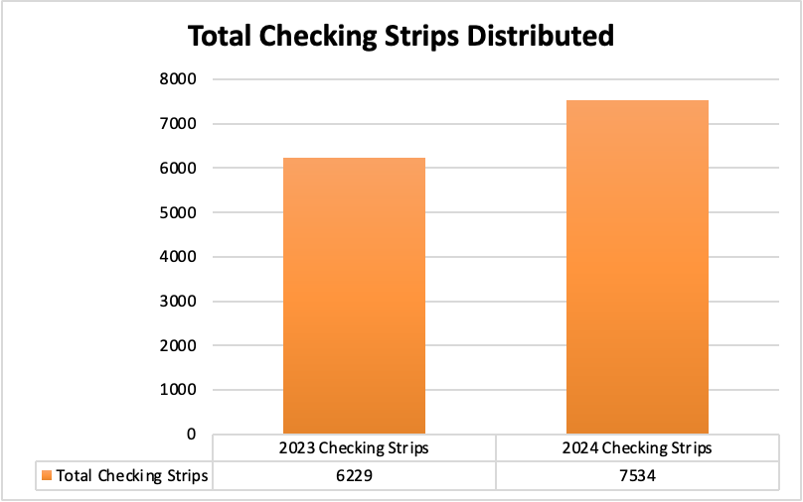
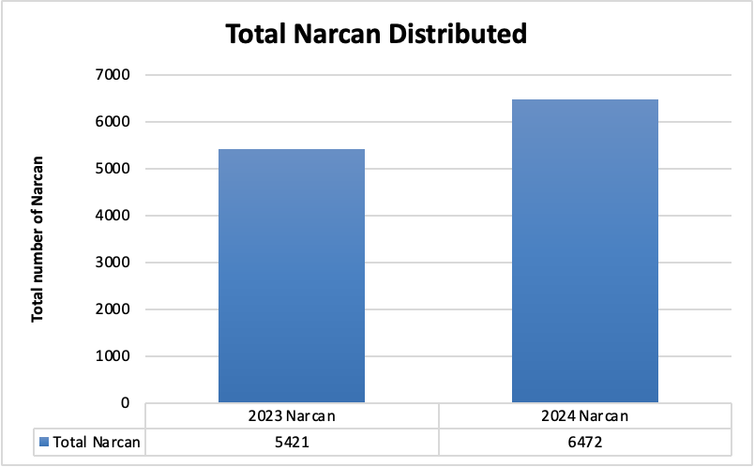
Community Outreach
Increased Drug Checking Strip distribution by 83% in the past year
Contribute to XTS becoming commercially available in March 2023
Increased Narcan distribution by 84% in the past year
Notes:
With the active engagement with CAB members, we were able to (point one and point 2)
CAB did an amazing job at socializing our agency and services, leading to an increase in partnerships and opportunities for CAMP.
The uptick in trainings and community events lead to the uptake in distribution.
We also felt it would be important to note the presence of XTS be marketed commercially beginning in March of 2023 aiding in the increase of distribution as well.

Slide 13
What have we learned?
01
02
03
04
Consulting community members throughout program design ensures relevance and acceptance
Community-driven leadership enhances the success of harm reduction efforts
Power-sharing is essential to program success, the community is the expert!
Community-driven partnerships encourage authenticity, accountability and fosters empowerment
Notes:
Point 1: Participatory research promotes inclusivity and presents a platform to invoke that change they wish to see in the community
Point 2: Through power sharing, we learned about the most in need neighborhoods
Point 3: Destigmatizing substance use, helping the community not only understand SUD but also how to best support those recovering from SUD
Point 4: Engaging with the community encourages authenticity, accountability and fosters empowerment

Slide 14
Conclusions & Future Implications
Early outcomes demonstrate the value of community-driven program design and implementation
Next steps include:
Expand CAB membership to include more diverse perspectives
Continue refining harm reduction services based on ongoing CAB feedback
Increase investment in CAB members’ work
Partnership with Philadelphia Department of Public Health (PDPH) outreach team to increase capacity and service availability
Notes:
Point 1: Because we stressed the importance of communication with community members, we were able to not only retain the members but also foster real and meaningful discussions.
Point 2:
We hope to continue offering more opportunities to network for our CAB Members in the future.
Understanding that space and opportunity promotes innovative ideas, We also are working to shift the CAB conversation facilitation from mainly Penn worker led to mainly community member led.
The ongoing partnership with PDPH

Slide 15
Contacts & Questions
Acknowledgements
CAB
West & Southwest Philadelphia community leaders and partners
Jeanmarie Perrone, MD, FACMT
Jeanmarie.Perrone@pennmedicine.upenn.edu
Margaret Lowenstein, MD, Mphil
lowenstm@pennmedicine.upenn.edu
Nicole O’Donnell, CRS
Nicole.o’donnell@pennmedicine.upenn.edu
Gilly Gehri, BA
Gilly.gehri@pennmedicine.upenn.edu
Desiree Harris, MPH, DrPH (c)
Desiree.harris@pennedicine.upenn.edu
Jasmine Barnes, MPH, CFRS
Jasmine.barnes@pennmedicine.upenn.edu
​
www.penncamp.org​
​
CareConnect Warmline 484-278-1679​
9am-9pm, 7 days/week​
​
Notes:
Contact and questions

Slide 16
Methods
Gathered community input to identify gaps in harm reduction and treatment services
Semi-structured interviews with community members
Purposive sampling to recruit stakeholders living and working in West Philadelphia
Interviews conducted from May-August 2022
Focused on strengthening the relationship between CAMP and local community members by convening a CAB to give program development and service delivery
Attended community meetings to socialize CareConnect program, educate the community on overdose crisis and build partnerships
Enhanced community engagement by expanding harm reduction street outreach, offering formalized overdose reversal trainings and socializing CAMP's services
Notes:
Buitd a Community Advisory Board (CAB) to improve collaboration between CAMP and the West Philadelphia community
Enhance and expand harm reduction street outreach efforts
Implement culturally appropriate substance use interventions

