Slide 1
Local Hot Topics: Improving Access to Addiction Treatment
Mistead Sai, LCSW
Anthony Strong, CRSS
Takara Wallace, RN, CARN
Ruchi Fitzgerald, MD (non-presenting)
Nicole Gastala, MD
Tondalaya Henry, LSW, CADC, MAR
Notes:
Welcome to Chicago!
Honored to be moderating this panel.
Each year we have one session focused on the great work happening in the host city
Before I introduce the panel will provide a little bit of background and context for the presentations you’ll be hearing today.

Slide 2
Local Context: Overdose Trends
2022 Drug Overdose Mortality Rates
United States: 32/100,000
Chicago: 48/100,000
Chicago Department of Public Health Preliminary Opioid Update: Chicago 2021-2023
HCHS Data Brief. DOI: https://dx.doi.org/10.15620/cdc:135849
Drug overdose mortality rate - Chicago Health Atlas
Notes:
Chicago started monitoring and reporting overdose deaths in a systematic way in 2015.
This graph shows opioid related deaths from 2016 to 2023 (data are prelim for 2023, with as many as 400 pending cases that could be opiod-related).
The overall trends look similar to those seen at the national level- though I would highlight that Chicago’s overdose death rates have consistently been higher than the national rates. In 2022, national mortality rate of 32/100,000 compared to Chicago’s rate of 48/100,000

Slide 3
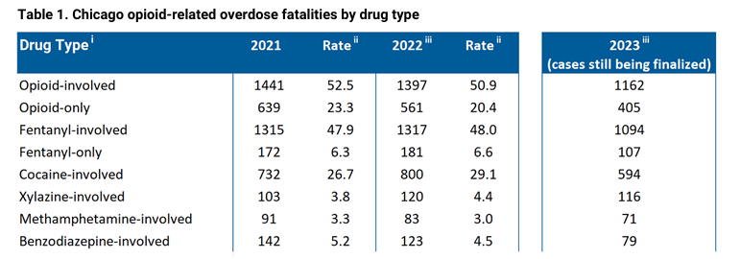
Local Context: Populations Affected and Substances Involved
Rate per 100,000 people
HCHS Data Brief. DOI: https://dx.doi.org/10.15620/cdc:135849
Drug overdose mortality rate - Chicago Health Atlas
Notes:
When we look at communities impacted, it will likely not be surprising to many in the audience that there are disparities in terms of which racial/ethnic groups are most impacted
The orange bars are Chicago drug overdose death rates by race/ethnicity and the blue bars are US rates in 2022.
You can see here that Black NH Chicagoans die at SIGNIFICANTLY higher rates of drug overdose than White NH, Hispanic or Asian Chicagoans.
This trend is not new, since we started reporting on this data in 2015, this disparity has persisted, and in recent years been even more pronounced.
Another important difference from national rates is that the population most likely to experience drug related overdose is older- 45-64 year olds have consistently had the highest rates of OD, which is an older cohort than what we see in many other parts of the country.
Again, for context, Chicago has long-standing heroin markets
When other cities and states across the country were seeing significant rates of overdose related to prescribed pills in the 90s and 2000s, Chicago had relatively low rates of prescribing and relatively low rates of Rx-related ODs. Fentanyl came into the drug markets in a substantial way in 2016, and the most common additional substance related in Ods has been cocaine.
You can see that xylazine and methamphetamine play a much smaller role in Chiago, at least in drug overdoses, compared to many other US cities.

Slide 4
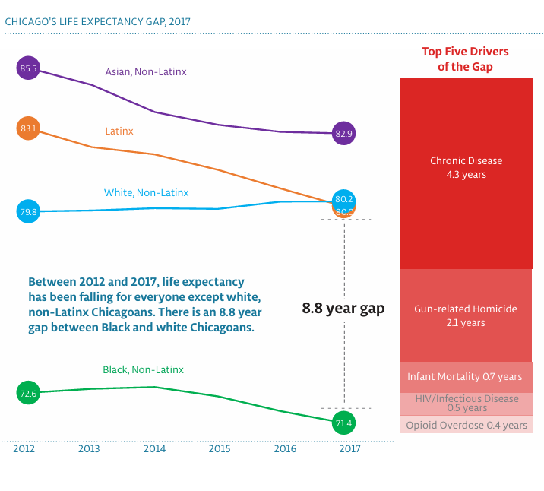
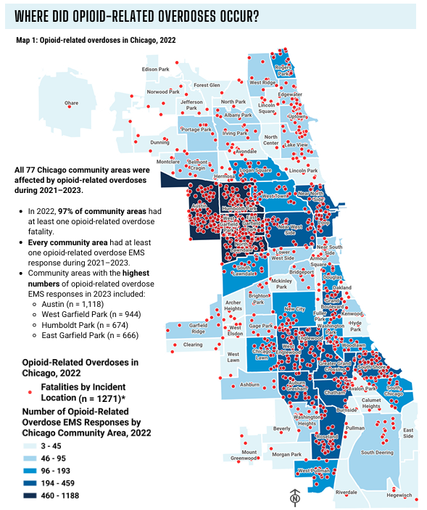
Local Context: Racism and Health Disparities
Chicago Department of Public Health Preliminary Opioid Update: Chicago 2021-2023 & Healthy Chicago 2025
Notes:
This is a map showing where opioid-related overdoses occurred and EMS responded to a call.
The darker colors on the map are community areas with higher rates of EMS calls for overdose, and the red dots are where the events occurred.
I’d like to highlight a few things on this map-
First, the community areas that are most impacted are on the west and south sides of the city.
These are predominantly Black and Latinx community areas, as Chicago his a highly racially and economically segregated city, with a long history of racist policies including redlining that have contributed to some of the disparities we see today.
Second, no matter what health outcome you are looking at in Chicago- infant mortality, maternal mortality, childhood asthma, cardiovascular disease, homicide- you will consistently see that the West and South sides of the city are disproportionately impacted. So while we will be talking programs that aim to address negative outcomes associated with substance use, the reality is that the communities in these areas are grappling with the outcomes of structural racism in a variety of ways.
The Healthy Chicago 2025 report describes the many drivers of the almost 9 year life expectancy gap between White NH and Black NH Chicagoans which includes chronic disease, gun related homicide, infant mortality, HIV and other ID, and overdose as the drivers of this disparity

Slide 5
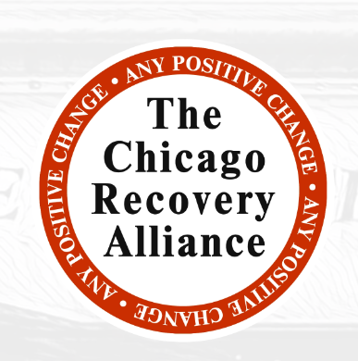
Local Context: Advocacy, and Community Resiliency
Notes:
And within all of these start statistics, I also want to highlight the tremendous community resiliency, advocacy and activism that is actively working to address these inequities.
There is powerful work happening in communities around the city- and way too much to highlight in a one hour presentation.
Yesterday we had 3 site visits to highlight some of this work- Lawndale Health Center, CRA, and UI Health

Slide 6
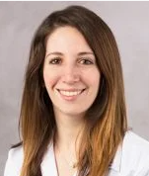
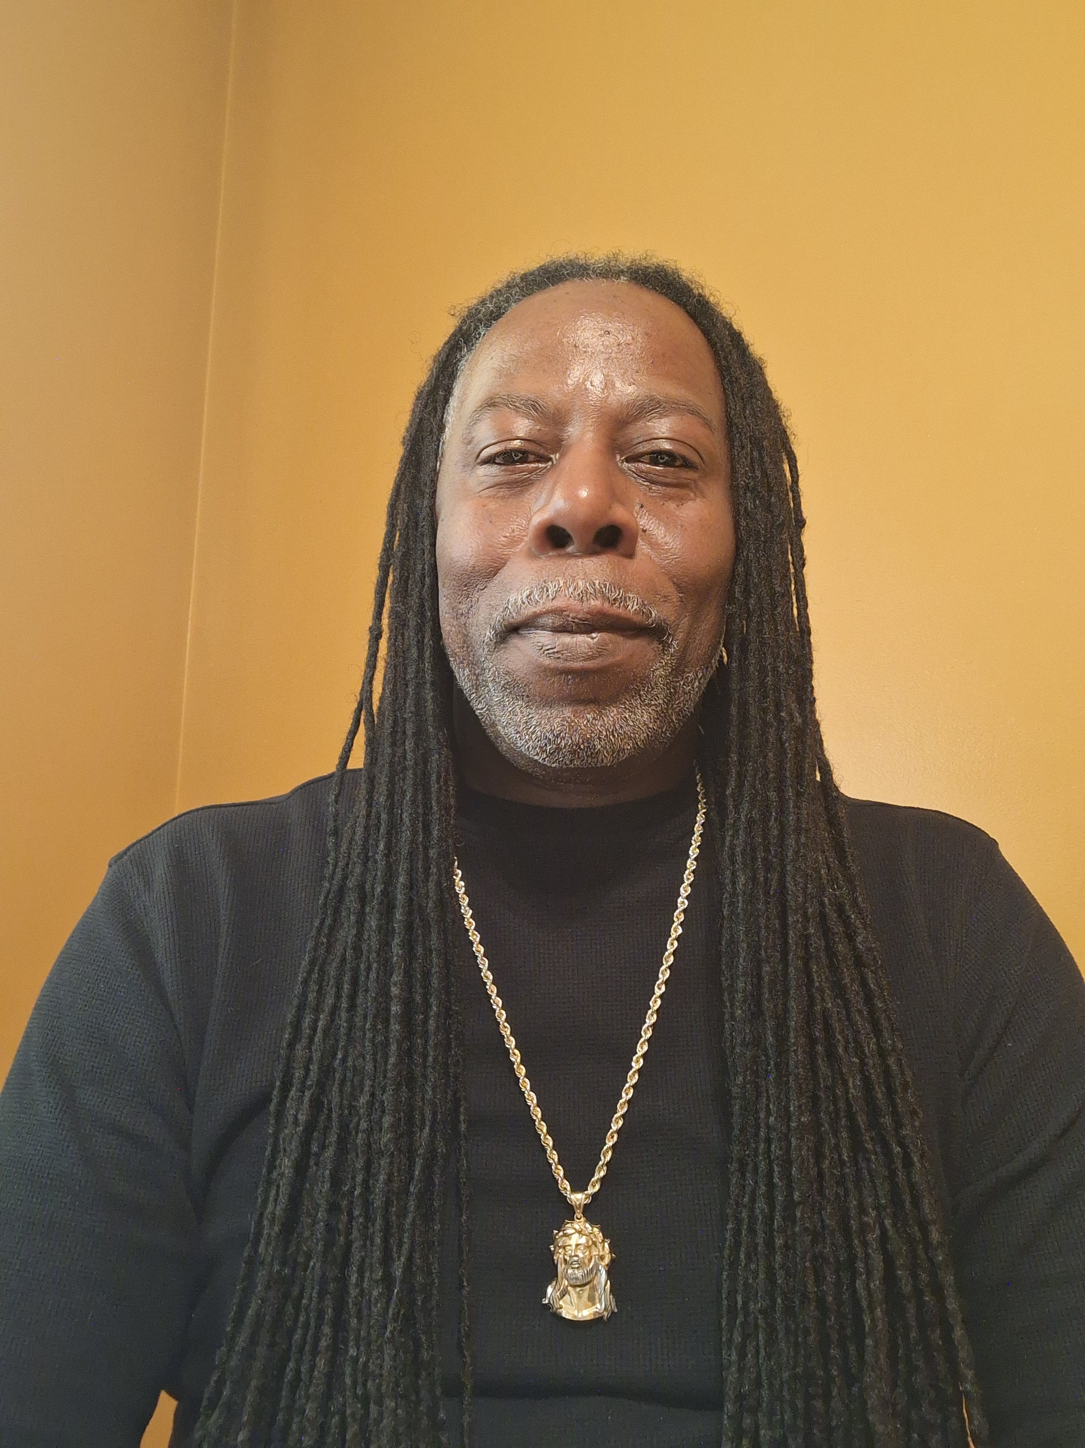
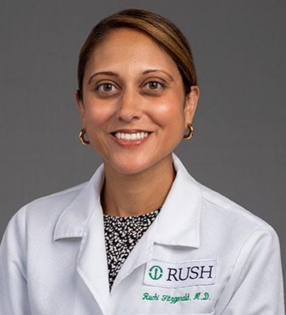
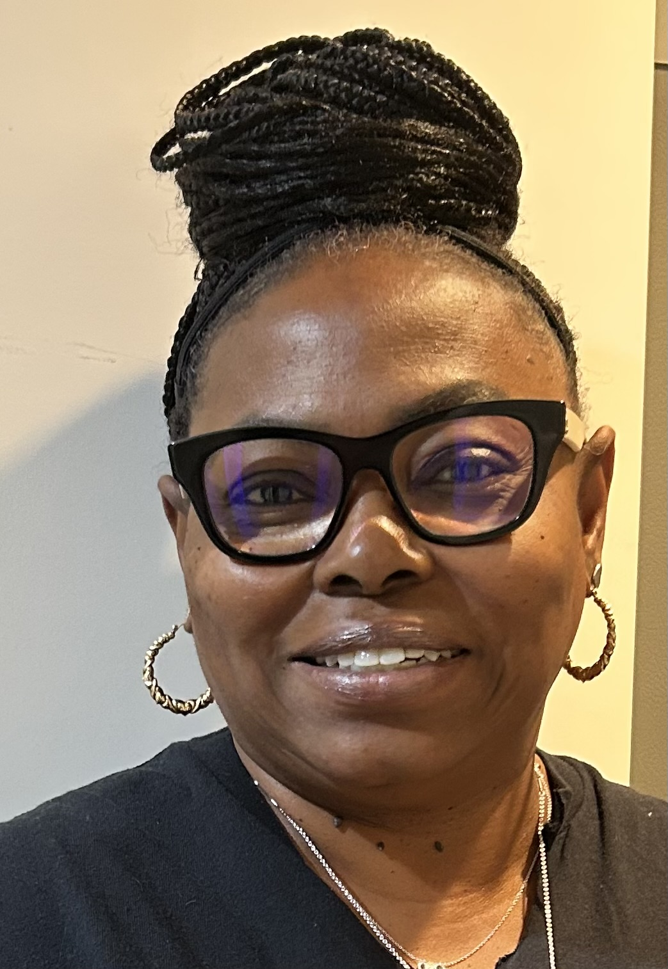
Mistead Sai, LCSW
Anthony Strong, CRSS, MHP
Nicole Gastala, MD
Takara Wallace, RN, CARN
Ruchi Fitzgerald, MD (non-presenting)
Tondalaya Henry, LSW, CADC, MAR
None of the presenters nor the moderator have financial disclosures.
Notes:
Today we will hear from 2 clinical teams- one at PCC Community Wellness Center and the other at UI Health There are numerous reasons we invited these teams to present today, but one of them is that they serve the communities most impacted by overdose and the many other structural traumas occurring in their communities.

Slide 7
Learning Objectives:
PCC Community Wellness Center:
List the steps required to create a sustainable hospital based long-acting injectable buprenorphine treatment for the treatment of severe opioid use disorder.
Describe how a multidisciplinary team approach can improve medication access and treatment engagement for patients at highest risk of overdose and death in an urban community setting.
UIC/Mile Square:
Describe the steps involved in developing and implementing a co-located and integrated methadone program in a full-service primary care clinic.
Explain possible approaches to partnering and implementing a co-located and integrated methadone program, including workflows, billing processes, and quality metrics.

Slide 8
INITIATING INJECTABLE EXTENDED-RELEASE BUPRENORPHINE IN A COMMUNITY HOSPITAL
OPPORTUNITIES FOR ADDRESSING EQUITY IN SUBSTANCE USE DISORDER TREATMENT IN OVERLOOKED POPULATIONS
Mistead Sai LCSW, Anthony Strong CRSS, Takara Wallace RN, CARN
PCC COMMUNITY WELLNESS CENTER
Notes:
Mistead

Slide 9
Objectives
Increase knowledge in the components required to create a sustainable hospital based long-acting injectable buprenorphine treatment for the treatment of severe opioid use disorder.
Describe how a multidisciplinary team approach can improve medication access and treatment engagement for patients at highest risk of overdose and death in an urban community.
Notes:
Mistead

Slide 10
Illinois Statewide Fatality Rate by Race/Ethnicity 2021
8.7x
Less likely to receive Buprenorphine after OD
Race | Fatality Rate (Per 100,000)
Non-Hispanic White | 20.5
Non-Hispanic Black | 60.8
Hispanic/Latinx | 16.6
Non-Hispanic Other | 3.0
Barnett ML, Meara E, Lewinson T, Hardy B, Chyn D, Onsando M, Huskamp HA, Mehrotra A, Morden NE. Racial Inequality in Receipt of Medications for Opioid Use Disorder. N Engl J Med. 2023 May 11;388(19):1779-1789. doi: 10.1056/NEJMsa2212412. PMID: 37163624; PMCID: PMC10243223.
Notes:
Takara

Slide 11
B
A
R
R
I
E
R
S
B
A
R
R
I
E
R
S
22%
Follow Up Rate
(First 2 Years of the AMC)
Notes:
Mistead
Barriers: housing, stigma, transportation, pharmacy, and easy access to drugs in the community.
Frequently readmitted for medical complications, overdose or withdrawal.

Slide 12
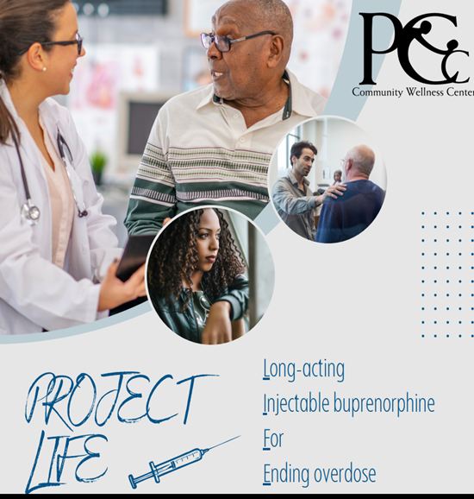
Inpatient rapid delivery and administration of long-acting depot buprenorphine for patients at high risk of overdose and death.
Easier than SL buprenorphine
Avoid rehospitalization for overdose and complications
Engage in continuity care
Notes:
big program to implement
successful?
Project LIFE: Long-acting Injectable buprenorphine For Ending overdose
Goal
Why Project life: easier than SL bup (daily med, difficulty with taste or aversion due to hx of precipitated withdrawal), Rehospitalization (protection from overdose for 30 days, decrease cravings), monthly follow ups move care from ED to CDC and PCP

Slide 13
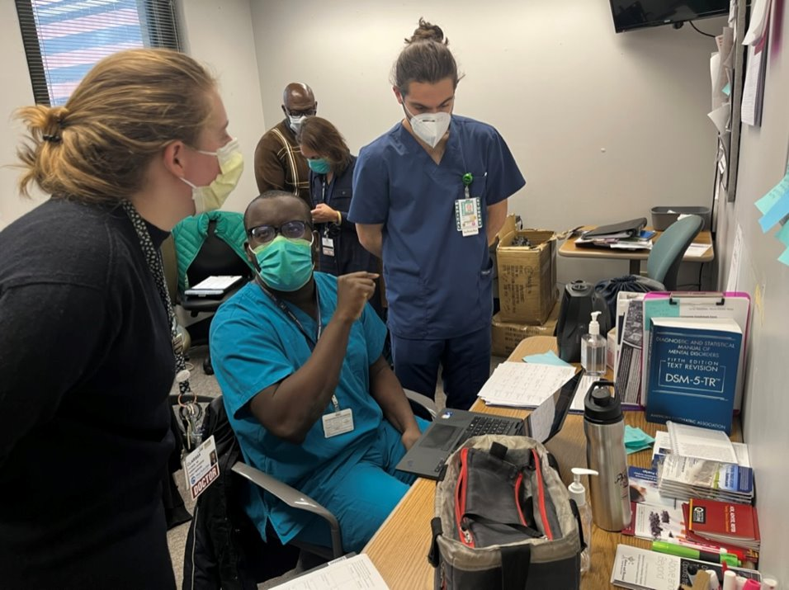
Our Team: Multidisciplinary Approach
Physicians
Nurses
Residents
Medical Students
Social Workers
Peer Support
Notes:
Mistead

Slide 14
Project LIFE Patients
Opioid withdrawal or at risk of opioid withdrawal
Persons with HIV who have unstable SUD
Older adults = target population
Unstable housing
Postpartum patients prior to discharge
Methadone transitions:
*Cannot take methadone anymore or
want to switch
SELECT pregnant patients –
must meet criteria
Post overdose patient s/p naloxone reversal
History of leaving before medical treatment completed
SNF Placement
Average age range of Project LIFE: 55 - 65 years old
Notes:
-Re-emphasize that’s the age range for mortality from an OD

Slide 15
Addiction Medicine Consult Service Patients
45-80 patients with OUD seen every month
Actively see patients in the Emergency Department; sometimes multiple patients with nonfatal overdose
Unable to see every patient with a nonfatal overdose
921 unique patients seen between 7/1/2022 and 6/30/2024 with OUD.
99 also with overdose diagnosis in the last year.
Notes:
Mistead

Slide 16
Trauma-Informed Care
Notes:
Tailoring TIC for older adults

Slide 17
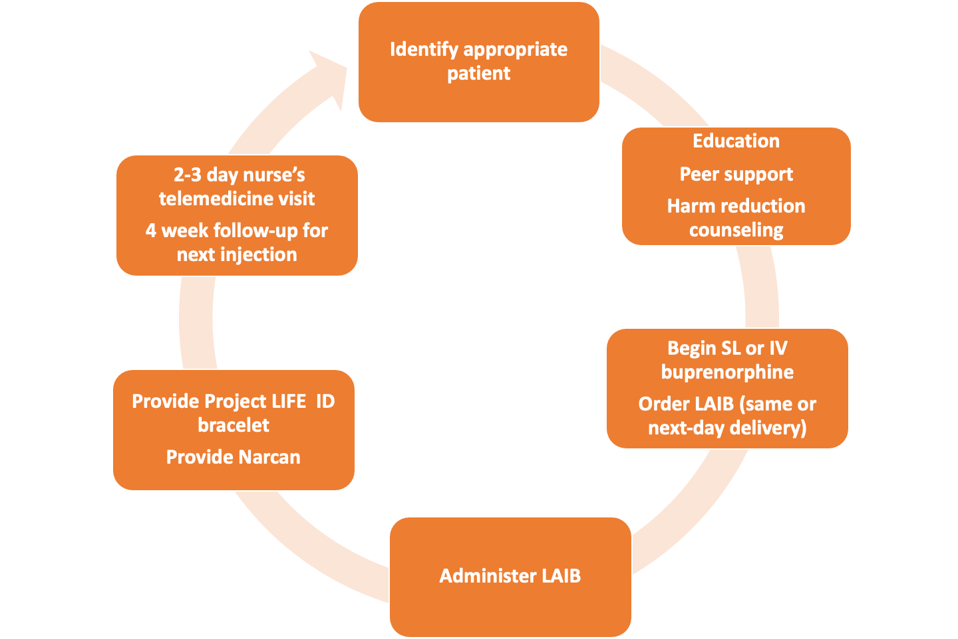
Project LIFE Workflow
Naloxone
Notes:
Mistead

Slide 18
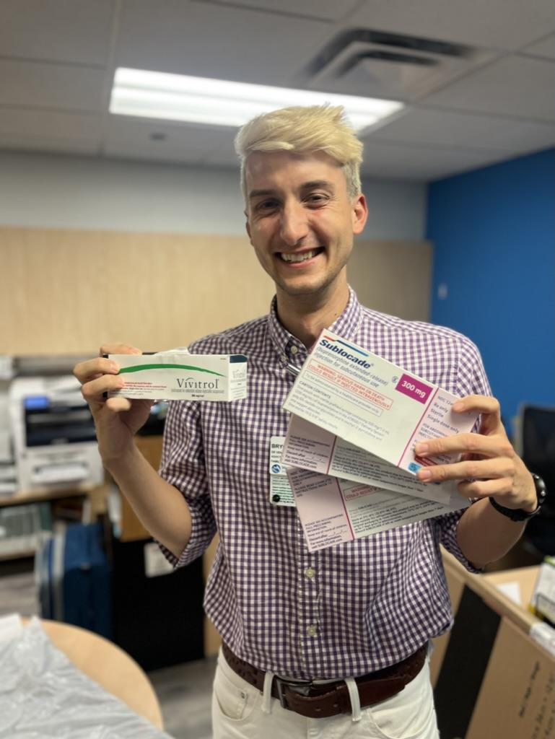
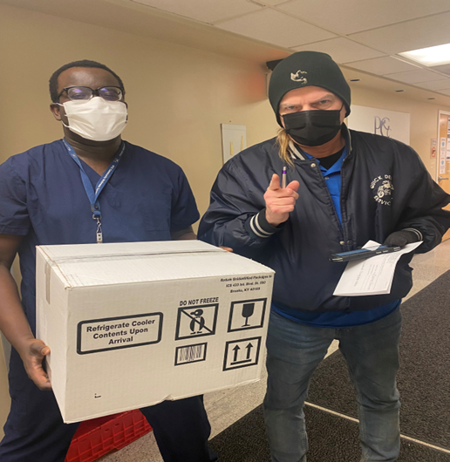
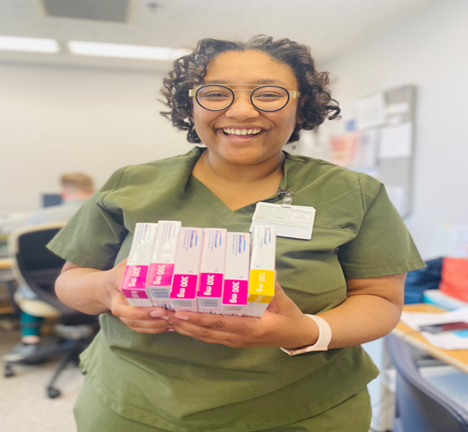
Daily Courier & Logistics
Notes:
Mistead

Slide 19
Pharmacy, Admin Nuts and Bolts
LAI Buprenorphine must come from a specialty pharmacy (due to REMS)
We found a local specialty pharmacy who does same daily delivery (Genoa Pharmacy)
Our process: (once a pt agrees to LAI Buprenorphine)
Order LAI Buprenorphine in outpatient EMR, sent to Genoa Pharmacy
1. DEA of prescriber address must match where LAI Buprenorphine is delivered to.
2. Order must come from that address as well (the address on EMR).
LAI Buprenorphine delivered to PCC clinic, co-located in hospital
LAI Buprenorphine picked up by Addiction Medicine team and brought to inpatient pharmacy. An order is placed in the hospital EMR for a "home med"
Inpatient pharmacy puts sticker on medication for inpatient administration
LAI Buprenorphine scanned by RN and administered to pt by AMC doctor
Hospital : Pharmacy & Therapeutics committee has approved policy on LAIB; Clinic also has policy on LAIB, storage, check out, and documentation procedures.
Notes:
340 (b) contract specialty (July 2024)
Specialty: Genoa
Documentation

Slide 20
Inpatient Long Acting Injectable Buprenorphine Program Considerations
Health Justice is not achievable without addressing:
Restricted distribution REMS medication | Requires specialized process to obtain med.
Cold storage - sometimes arrives warm (New LAIB products can be stored room temp) | Safety net settings unable to set up formulary or buy and bill due to cost
Prior Authorization or refusal to cover medication - Commercial insurance may not cover; very limited options for uninsured; unaffordable co-pays | Many Medicare pts; or patients on brink of going on Medicare→many patients go without the med.
Painful especially for the malnourished and thin person. New buprenorphine products on the market with different injection sites and less volume. | We often run out of injection sites for our thin patients
Dose may not be sufficient for IV fentanyl users or patients who are heavy users ; co-users. | Unable to give higher doses, or a second dose within 28 days. Seeing uptick in overdose with adulterants in supply
Delivery setting: Health care only | No mobile options; no home health options
Notes:
Takara
-This program was created as a health justice program
REMS: A Risk Evaluation and Mitigation Strategy (REMS) is a drug safety program that the U.S. Food and Drug Administration (FDA) can require for certain medications with serious safety concerns to help ensure the benefits of the medication outweigh its risks. REMS are designed to reinforce medication use behaviors and actions that support the safe use of that medication. While all medications have labeling that informs health care stakeholders about medication risks, only a few medications require a REMS.

Slide 21
Addiction Medicine Clinic Follow Up after First Hospital Injection, Year 1
Program began August 2022; date range 7/1/22-6/30/23
47% follow up rate; previous engagement rates for follow up for opioid use disorder were 22-25%
Follow up range: 60 days after first injection
Treatment modality | Follow Up Rate | # of consults for OUD
Sublingual Buprenorphine RX, or Harm Reduction only (naloxone + FTS/education) or methadone clinic referral | 17% | 387
Long acting injectable buprenorphine | 47% | 186
Notes:
Takara

Slide 22
Addiction Medicine Clinic Follow Up after First Hospital Injection, Year 2
Second year of Project LIFE; date range 7/1/23-6/30/24
44% follow up rate; previous engagement rates for follow up for opioid use disorder were 22-25%
Follow up range: 60 days after first injection
Treatment modality | Follow Up Rate | # of consults for OUD
Sublingual Buprenorphine RX, or Harm Reduction only (naloxone + FTS/education) or methadone clinic referral | 14% | 166
Long acting injectable buprenorphine | 44% | 311
Notes:
Takara

Slide 23
30 versus 60 day follow up:
Follow up goes up at 60 days.
 | Year 1 (7/1/22 – 6/30/23) | Year 2 (7/1/23 – 6/30/24)
# of injections | 224 | 387
# of Patients | 186 | 311
# of Injections with 31 day FU | 92 | 135
% of injections with 31 day FU | 41% | 35%
# of Injections with 60 day FU | 106 | 171
% of injections with 60 day FU | 47% | 44%

Slide 24
Challenges and barriers to treatment
Challenges of delivering a unique service in the community
Co-pays & prior authorization (Commercial, Medicare/Medicare Advantage plans)
Limited staff and burn-out/moral injury
Injection availability
Sustainability as program is grant funded
Poisonings
Xylazine
Medetomidine
Notes:
Talk about grant funds for uninsured patients and ER patients

Slide 25
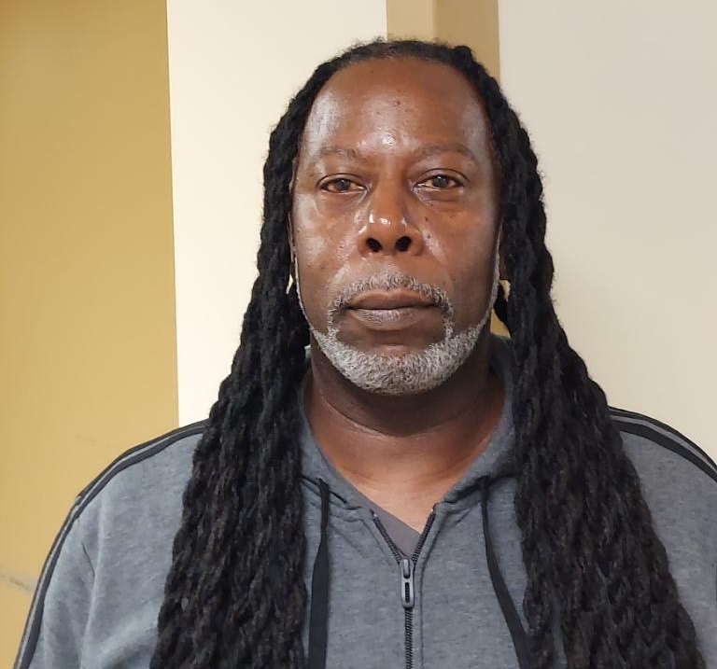
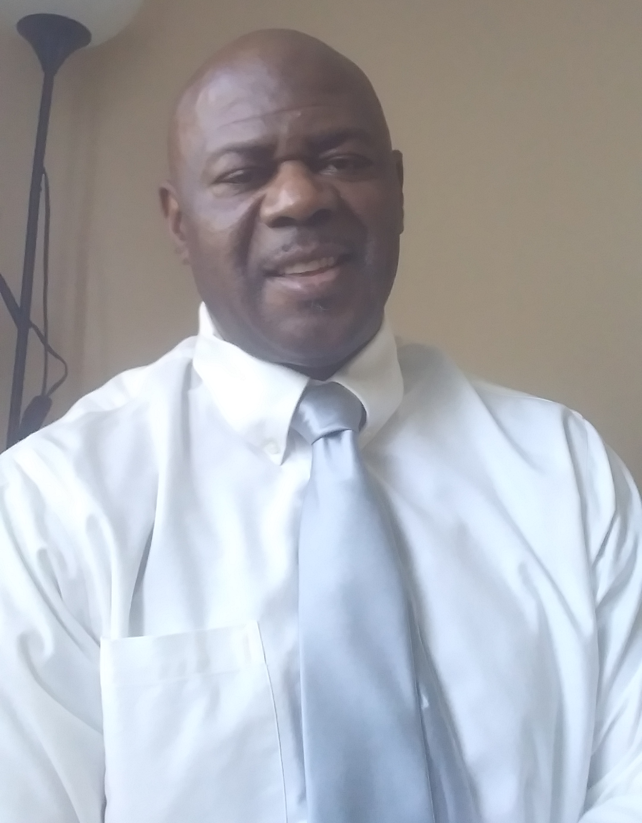
Peer Counselors' Perspective
“In my view, long acting buprenorphine has had the greatest impact in reducing deaths attributed to opiate related overdoses. It’s a game changer because you can’t recover from the grave.”
– Tony Strong
“Long acting injectable buprenorphine is an effective medication. That is a miracle changer. Changing individuals maladaptive behaviors for the better.”
– Darryl Clark

Slide 26
Patients Perspectives
“And now it's up to me to take advantage of the shot before the heroin kills me. And the shot trying to save me. And then I got a support team behind the shot. I don't have nothing behind the heroin, but the dope pusher, just trying to get my money from my pocket. Now with the shot, I'm keeping my money in my pocket.”
“This 30 day shot, it'll pick you up. It works wonders. It makes you feel whole and human again.”
“They told me what they expect and what it was gonna do. And I was like, he must have just came up with this because, uh, only times I been using for these 40 years, I never heard no physician tell me I got something that might help you from killing yourself. Furthermore, keep you alive and keep you from ODing and then will not have you craving, sitting there about to jump out your skin to get a fix. Okay. So I said, it can't be no worse than what you already been through. So I said, give it a drive.”
“You got a chance to basically feel normal for a change.”
“I feel like the shot is stronger. Like, I don't know how to explain it. I just like, I don't have like the thought like thoughts and cravings. Like I just feel good and energized and like I could do things and that's, that was my problem with the methadone. I had no motivation and I was tired all the time and depressed. So because I was so tired, I was, I couldn't do anything and it made me in a depressed mood and then I wanted to use. So it's nice just to have energy.”
“I was tired of being scared. Tired of going different places every day trying to find something. You spend your whole day trying to get high. And then when you get it, you don't get high or it's something that's man-made. And so I was getting tired of that, but I couldn't stand the illness. So that's what made me want to do something that I knew that I could handle.”
"It feels like I have never done drugs before"
Notes:
Mistead

Slide 27
Gratitude
Our patients and their families
AMC TEAM and Project LIFE/ PCC Chemical Dependency Center
Ruchi Fitzgerald, MD, Service Chief
Katie McDonough, MD , Outpatient Director
Francesco Tani, DO, Assistant Service Chief
Takara Wallace, Director of CDC Care Coordination
Clarissa O’Conor, MD
Lauren Harriett, MD
Mistead Sai, LSW (PCC)
Aria Armstrong, MS 2 (Rush)
Shai Farhi, MD (Rush)
Emma Klug MS 4 (Rush)
Ethan Cowan, MD (Mt Sinai)
Andrew Merker, Pharm D (Midwestern))
Tran Tran, PharmD (Rush/Midwestern)
Tipu Khan, MD (Ventura County)
Andrew Herring, MD (UCSF)
Erik Anderson, MD (Highlands Hospital)
Lauren Roller, PharmD (Highlands Hospital)
Dorothy Manuel, Sarah Hogue, Hannah Moore (PI Department, PCC Community Wellness Center)
Jerrard Walker, Chief of Population Health, PCC Community Wellness Center
Notes:
Bryce

Slide 28
Notes:
Bryce
Project LIFE: Long-acting Injectable buprenorphine For Ending overdose
Engages a multi-disciplinary approach including Peer Recovery Coaches, Social Workers and Addiction specialists
To educate and coach patients admitted to the hospital on long acting injectable (LAI) buprenorphine.
Built on inspiration of work done within Ward 86/Project SPLASH. SPLASH is (Special Program on Long-Acting Antiretrovirals to Stop HIV), a regimen of monthly injections to administer long-acting anti-retroviral therapies, with promising findings of using CAB/RPV LA is a combination of two injectable prescription medications used together to treat HIV-1 infection in adults and adolescents 12 years and older. CAB/RPV LA contains two different medications: cabotegravir, an integrase strand transfer inhibitor (INSTI), and rilpivirine, a non-nucleoside reverse transcriptase inhibitor (NNRTI) in non-virally suppressed patients.

Slide 29
Contact Information
For program-related inquiries:
Mistead Sai, LCSW - msai@pccwellness.org
Tony Strong, CRSS - astrong@pccwellness.org
Takara Wallace, CARN, RN - twallace@pccwellness.org
For any medical and buprenorphine induction inquiries:
Dr. Ruchi Fitzgerald, Inpatient Addiction Medicine Service Chief - rfitzgerald@pccwellness.org
Dr. Francesco Tani, Inpatient Addiction Medicine Assistant Service Chief - Francesco_tani@rush.edu

Slide 30
Integrating a Community Methadone Program Within a Federally Qualified Health Center

Slide 31
Needs assessment
Traditional OUD Treatment
Patients with OUD are directly referred to specialty services outside of their regular source of care.
Minimal engagement in primary care and communication between systems.
Difficulty in care coordination between the hospital system and SUD treatment systems
Integrated Model
Interprofessional model of care that is able to provide counseling and MOUD within an underserved primary care setting is needed to adequately address patients’ whole health including:
Preventive health care
Chronic disease management
Behavioral health care
Dental care
Special Supplemental Nutrition Program for Women, Infants, and Children (WIC)/SDOH
SUD care

Slide 32
Opioid Use disorder:
Treatment at UI Health Mile Square Health Center (MSHC) with Family Guidance

Slide 33
Our Community Partner: FAMILY GUIDANCE CENTERS, Inc. (fgc)
Not-for-profit organization that promotes the well-being of individuals and communities
Substance use prevention
Education
Treatment
Recovery support services
Leading opioid treatment program (OTP) in Illinois, providing MOUD at 12 locations across the state
Low-barrier access to MOUD is a key part of FGC’s program model, which includes:
Co-location and collaboration with community healthcare institutions
Mobile MAR units in Chicago and East Central Illinois.

Slide 34
TREATMENT AT mshc
Collaborative Primary Care-Behavioral Health Care Model
Primary care clinicians actively manage or co-manage patients with addiction and mental health disorders
Same day, warm hand-off services available for all patients by the onsite behavioral health consultants (LCSW/LCPC/CADC)
Medications for Opioid Use Disorder
MSHC’s addiction care model has historically only included buprenorphine and naltrexone
As a result of the partnership with FGC, MSHC is now also able to offer access to methadone for those patients with OUD within primary care

Slide 35
Methadone MSHC: Partnership with FGC
FGC provides:
MSHC provides:
Methadone clinic infrastructure
Appropriate documentation and program design
Counseling services
DEA licensing/communication
Nursing for dosing and evaluations
Peer support
Security
Access to methadone
FGC
Integrated behavioral health care (mental health)
Primary care
Preventative health services
Lab/imaging, Dental, WIC, Pharmacy
Physician/medical leads – daily availability with a medical provider
MSHC
Primary care services

Slide 36
Staffing model: Co-managed staffing matrix
Position | Responsibilities | FQHC | OTP
Medical Director (MSHC) | Requires a background and experience in behavioral, primary care, and addiction in healthcare, 1-4 hrs. per day. | X
Program Director (MSHC and FGC) | Provides program oversight and clinical supervision and can provide direct services. | X | X
Primary Care Clinicians (MSHC) | Provide physical exams, primary care services, preventive care services, and the prescription for OUD as decided by patient needs (methadone, buprenorphine/naloxone, or naltrexone). PCPs bill accordingly. | X
Nurses (FGC – minimum LPN or RN) | 1.5 FTE LPNs (Licensed Practical Nurses) per site to dispense methadone, record all state and federally required methadone accounting documentation and support MSHC/UIH physicians in both MAR service documentation and coordination for primary care needs. |  | X
Counselors (FGC – minimum CADC or state licensed) | Manage direct counseling services, treatment planning/continued stay and service note documentation, documentation of integrated services, monitors dosing attendance and toxicology compliance. |  | X
Recovery Support (MSHC or FG – RSS Certified)/Peer Support | Focuses mainly on individuals in the first six months of treatment to assist with stabilization and early recovery. However, the recovery support services are available to all patients. Recovery support staff paired with substance use counselors consult and identify individuals most in need of and most ready to take advantage of the services. | X | X
Intake Worker (FG – CARS Certified) | Greets new patients, collect their information, and determine their needs with regard to OUD and program eligibility. |  | X
Security System (FGC) | Provides the security system required by the DEA to safeguard the methadone. This includes motion detectors, contact switches, panic buttons, a floor safe, a closed-circuit camera and a 24/7/365 central monitoring station with Chicago Police linkage. FGC also provides security personnel staff to monitor patient traffic in the designated area. |  | X
Co-managed staffing matrix

Slide 37
Internal referral/walk-in
Internal hospital discharge referral
The patient and or PCP calls to schedule an appointment
Through shared decision-making, the FGC intake process is initiated
The patient receives initial dose
The patient is scheduled for follow-up as an established patient
Patient follows daily dosing workflow as outlined for established patients
Consents, releases & orientation to the dosing process is done when FGC receives the patient from in-patient hospitalization
The patient receives initial dose
Dosing is given that very day or the day of discharge
Follow-up with physician scheduled within days of discharge
Patient follows daily dosing workflow as outlined for established patients

Slide 38
Sustainability model
FGC – OTP Service | Minimum Unit of Service | Code | Rate
Admission and Discharge Assessment | Quarter Hour | AAS | $105.56 – Per Hour; $26.39 – Per Quarter
Level 1 (Individual) | Quarter Hour | OP | $100.36 – Per Hour; $25.09 – Per Quarter
Level 1 (Group) | Quarter Hour | OP | $38.04 – Per Hour; $9.51 – Per Quarter
Level 2 (Individual) | Quarter Hour | OR | $100.36 – Per Hour; $25.09 – Per Quarter
Level 2 (Group) | Quarter Hour | OR | $38.04 – Per Hour; $9.51 – Per Quarter
Case Management | Quarter Hour | CM | $77.72 – Per Hour; $19.43 – Per Quarter
Psychiatric Evaluation | Per Encounter/Per Day |  | $131.34 – Per Encounter/Per Day
Medication Assisted Recovery (Methadone for Opioid Use Disorder) | Weekly | OP | $113.06 – Weekly
Early Intervention (Individual) | Quarter Hour | EI | $100.36 – Per Hour; $25.09 – Per Quarter
Early Intervention (Group) | Quarter Hour | EI | $38.04 – Per Hour; $9.51 – Per Quarter
Community Intervention | Quarter Hour | CIH | $97.48 – Per Hour; $24.37 – Per Quarter
No change in MSHC or FGC staffing
Under the current SUPR/Medicaid system, FGC and MSHC are each able to bill their provided services.
MSHC bills for medical visit as chronic disease management, preventive health care, primary care, etc. are provided during the visit
The partnership is sustainable and improves patient access/care.

Slide 39
Data collection: Jan 11, 2021 – Aug 27, 2024
Begins after completing the intake process
Patient self-reported questionnaires
Retrospective chart review: EMR, EPIC, and SAMMS
SAMMS – Substance Abuse & Medication Management System Chart Review
RedCap and Excel Extraction, Analysis in SPSS
Variables
Age Race Ethnicity Gender Patient origin Previous MOUD treatment Previous overdoses Justice Involvement Incarceration history Social Determinants of Health Comorbidities Health Screenings and Immunizations Referral to Behavioral Health % with a completed PCP appt

Slide 40
Results

Slide 41
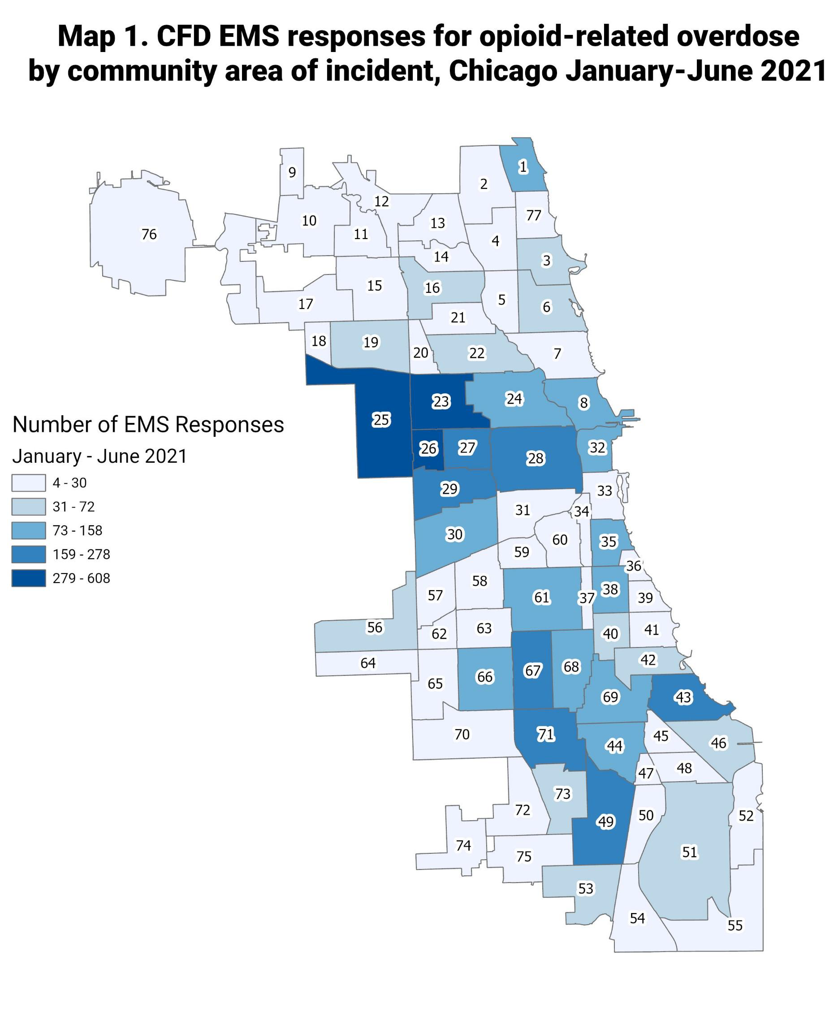
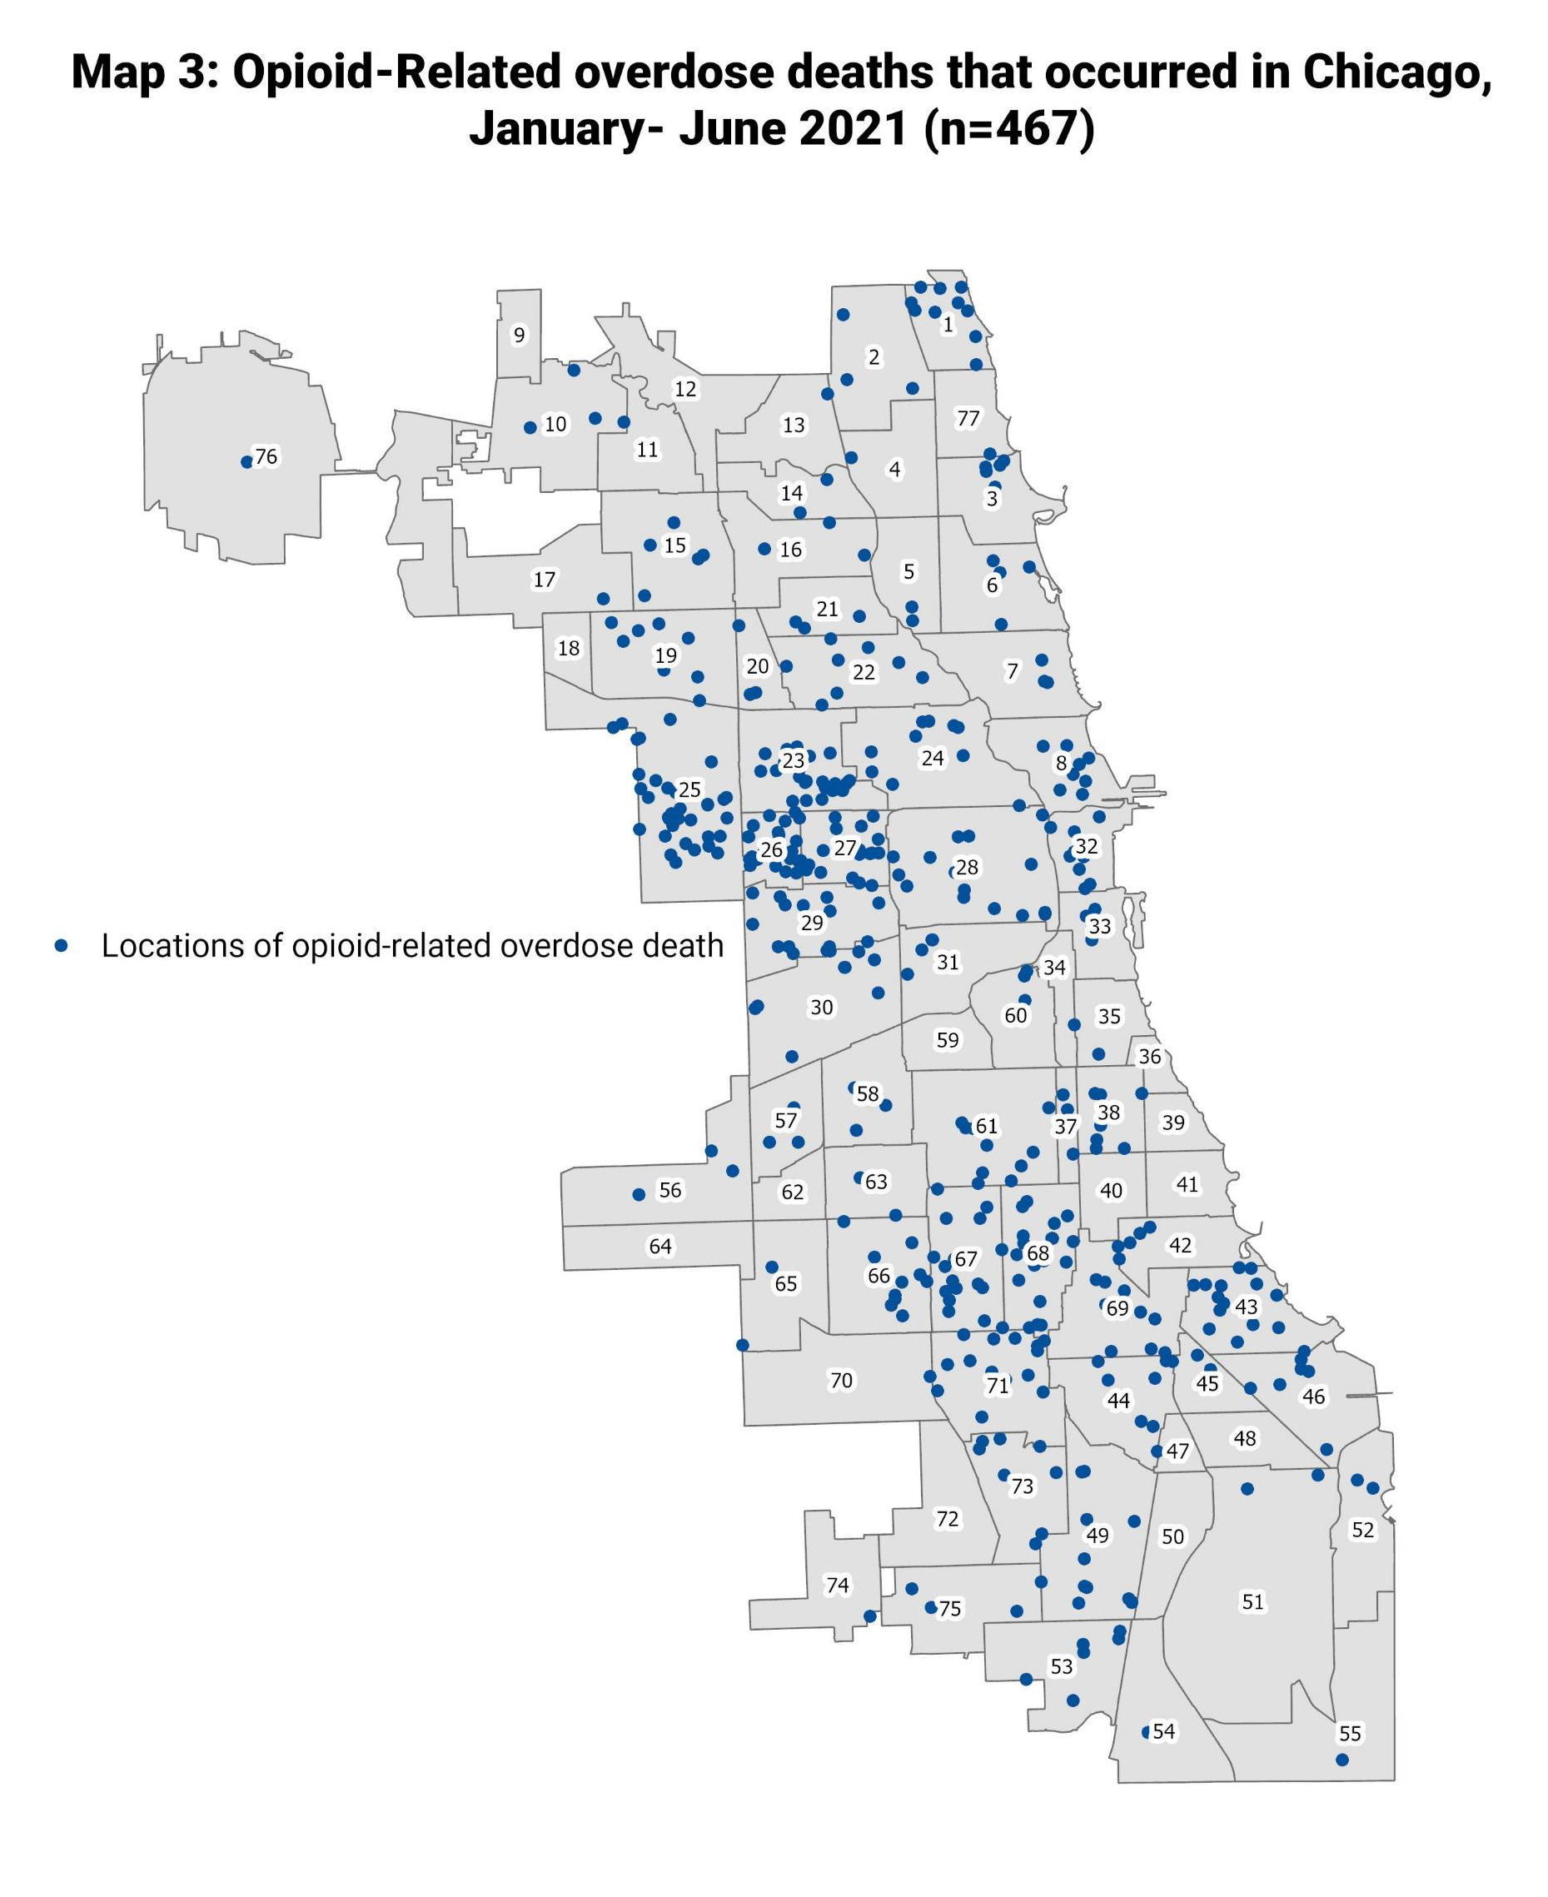
Results: demographics
Methadone Program Patient Reach in Chicago
The number of active patients is fluid, as new patients join the program, patients are lost to follow-up, and patients who were lost to follow-up are often re-instated.
341 patients entered the methadone program between January 2021 to August 27, 2024.
The methadone program patient population resided in 37 zip codes across Chicago and 25 zip codes that fall outside of Chicago.
60624

Slide 42
Results: demographics
Demographic | N (%)
Race
American Indian or Alaskan Native | 1 (0.3%)
Black or African American | 241 (70.7%)
White | 80 (23.5%)
Other/Unknown | 19 (5.6%)
Ethnicity
Not Hispanic/Latino | 302 (88.6%)
Hispanic/Latino | 27 (7.9%)
Other/Unknown | 12 (3.5%)
Sex
Male | 216 (63.3%)
Female | 124 (36.4%)
Other/Unknown | 1 (0.3%)
Population is majority African-American/Black Males
Average age: 54 years old
Range of ages: 23 to 82 years old

Slide 43
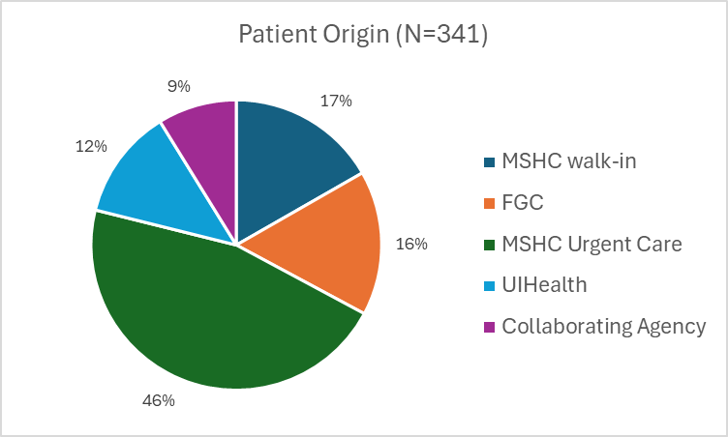
Results: referral and oud history
Received Previous MOUD Treatment | 250 (73.3%)
Suboxone | 96 (38.4%)
Methadone | 195 (78.0%)
Rehab | 7 (2.8%)
Residential | 18 (7.2%)
Withdrawal Management/Detox | 30 (12.0%)
Patients were referred to the methadone program primarily from:
MSHC Urgent Care or MSHC Walk-in (62.8%)
UI Health ED/Inpatient (12.3%)
FGC or a collaborating agency (24.9%)
Most patients (73.3%) received previous MOUD treatment and over 57% had been on Methadone in the past.
Nearly 53% of the population has had one or more opioid overdoses.

Slide 44
Results: social determinants of health
The population faces high rates of adverse social determinants of health markers:
69% have food insecurity
65% are unemployed
Over 43% experience housing insecurity
Nearly 48% experience transportation barriers

Slide 45
Results: Medical and behavioral health comorbidities
Most patients have one or more medical comorbidities; most commonly:
Over 27% have three or more chronic health conditions.
Almost all patients have a co-occurring behavioral health diagnosis such as:
Anxiety is the most prevalent Co-Occurring Diagnosis
Hypertension
Asthma
Hyperlipidemia
Hepatitis C
Bipolar Disorder
Post-Traumatic Stress Disorder
Depression
Anxiety
Schizophrenia

Slide 46
Results: preventative health
Nearly 100% of patients were scheduled for an appointment with a Primary Care Provider (PCP)
51% of patients were seen by a primary care provider within 4 weeks of admission to the program
The majority were screened for diabetes, hyperlipidemia, and pertinent infectious diseases including STIs, HIV, and Hepatitis C
Health Screenings N= 341
 | Number of patients screened | % patients screened
Hemoglobin A1C (n=166) | 130 | 78.3%
Lipid Panel (n=302) | 197 | 65.4%
Gonorrhea (n=327) | 204 | 62.4%
Chlamydia (n=327) | 204 | 62.4%
HIV (n=286) | 246 | 86.0%
Hep C (n=339) | 292 | 86.1%
Chest CT (n=196) | 32 | 16.3%
Pap Smear (n=107) | 31 | 29.0%
HPV (n=107) | 31 | 29.0%
Syphilis (n=327) | 235 | 71.9%
Prostate Specific Ag (n = 164) | 130 | 38.0%
Patient eligibility for screenings are based off United States Preventative Services Task Force (USPSTF) screening guidelines.

Slide 47
Results: immunizations
Immunizations N=341
 | Number of Patients Immunized | Percent of Patients Immunized
Hep B (n=341) | 75 | 22.0%
TDAP (n=341) | 163 | 47.8%
Zoster (Shingrix) (n=242) | 53 | 21.9%
Many clients may have had some preventive vaccinations prior to enrolling in the program which may not be reflected in the Electronic Medical Record (ie. TDAP – every 10 years).

Slide 48
Results: engagement with behavioral health and primary care
Almost all clients are referred to Behavioral Health
Over 34% have documented sessions in addition to the required substance use treatment counseling by FGC.
Over 50% of patients complete a primary care visit within four weeks of starting.
Utilizing an integrated model of care delivery reduces barriers to receiving mental health care as hot-handoffs can occur at any point
Engagement with Behavioral Health
N=341 | Number of patients | Percent of Patients
Engaged in Behavioral Health | 121 | 35.5%
Average number of sessions 2.7
Range of sessions 1-40
Engagement with Primary Care
Primary care visit complete within 4 weeks of starting methadone | 174 | 51.0%

Slide 49
Patient examples

Slide 50
complex patients: Medical and SDOH
67 y/o AA Male with PMHx of OUD, newly diagnosed rectal adenocarcinoma, unstable housing, requiring oncologic care including surgical and radiation treatment.
Local OTP would not allow patient to receive prescribed short acting opioids from palliative for cancer pain and remain in their program.
Patient was transferred to MSHC/FGC program, received curative oncological treatment, appropriate pain management, and continued methadone/OUD services.

Slide 51
complex patients: Justice involvement and sdoh
55 y/o AA Male patient with 20-year history of OUD, referral from Cook County Jail, the patient began MOUD treatment while incarcerated and transferred all care to MSHC at discharge.
He was maintained on a stable dose with no missed doses, completed follow-up and regular visits with primary care.
Patient was provided linkages to housing with actualized referral and is in stable housing.
Patient provided linkages to employment with actualized referral and is working full time.
Currently abstinent from opioids, completed all aspects of parole and remains in program on a therapeutic dose.

Slide 52
Complex patients: prenatal care and sdoh
32 y/o White Female with an 8-year history of opioid use who presented as a walk-in following connection from a community partner (Night Ministry) for OUD treatment. Determined to be 16 weeks pregnant and was experiencing homeless.
Discussed options with patient and she was admitted to the Family Medicine/OB service for an observed methadone induction, discharged to a family recovery home.
Patient participated in prenatal care, had an uncomplicated delivery, mild NAS, and discharged to family recovery home with infant in her custody.
She remains illicit drug free, stable on current methadone dose, has full parental rights, and returns for regular post-partum care, preventive care, and infant returns for well-child visits.

Slide 53
Next steps
These results pertain to program implementation and provide insight that can guide further development.
Further analyze additional patient data not included in this report pertaining to methadone program and integrated OUD care impact on health outcomes.
Continue evaluation of pre/post chronic disease management, screening, and preventive services to improve patients’ whole health.
Further evaluate the benefits and impact of co-located, co-managed partnerships for integrated continuity of patient care and access to care in disadvantaged populations with limited resources.
Quality improvement initiatives with both the FGC and Mile Square team to improve retention in treatment and re-engagement.

Slide 54
Final takeways
Collaboration between FQHCs and opioid treatment programs is financially sustainable and can increase access to treatment for opioid use disorder and primary care for high-risk patients
This co-location model allows for the care of medically complex patients that require a multi-disciplinary approach

