Slide 1
Long-Acting Injectable HIV Antiretroviral Treatment (LA-ART) Retention in People Who Use Drugs
Nicky Mehtani, MD MPH
Whole Person Integrated Care, SFDPH
Assistant Professor, UCSF
Sarah Strieff, RN
Whole Person Integrated Care, SFDPH
Notes:
Good afternoon, I'm Sarah Strieff (I work for the San Francisco Dept of Public Health) and will be presenting with Dr. Nicky Mehtani on retention rates and outcomes for people experiencing homelessness and people who use drugs with HIV on long-acting injectable antiretroviral treatment.
Please plan a 10-minute oral presentation allowing 5 minutes for questions. Please note, the abstract session moderators are under strict instructions to keep each speaker to 10 minutes.
An effective 10-minute presentation typically consists of 10-14 slides; with no more than 6 lines of text per slide and font sizes no smaller than 24 points.
Presentations should not include video or audio, as there may not be audio capability.
The room will be preset with a computer, LCD projector, screen and laser pointer. Presenters are responsible for bringing their presentation on a USB flash drive to the conference. Please plan to upload your presentation to the session computer 1-2 hours prior to the start of the session. We are unable to access presentations from the internet.

Slide 2
Disclosures
None
Notes:
No relevant disclosures

Slide 3
Background
Increased rates of HIV transmission in this population
PEH/PWUD face barriers to daily oral med adherence
Low rates of virologic suppression (HIV viremia)
Notes:
People who use drugs and people experiencing homelessness face disproportionate structural and psychosocial barriers in adhering to daily oral ART
This ultimately leads to LOWER rates of HIV virologic suppression and INCREASED rates of HIV transmission in this population—such that 1 in 4 NEW HIV diagnoses in San Francisco occur in people experiencing homelessness and people who use drugs – which represents an approximate DOUBLING in proportions over the past decade
Note: Tried to make text bigger/easier to read, and revised some of your notes text to be more straightforward.

Slide 4
Background
Increased rates of HIV transmission in this population
PEH/PWUD face barriers to daily oral med adherence
Low rates of virologic suppression (HIV viremia)
Long-acting injectable antiretrovirals (LA-ART) may meaningfully benefit PWUD by circumventing structural barriers to daily oral ARV adherence
Notes:
In this context, we can recognize that long-acting injectable formulations of ART—which are dosed once monthly, every other month (or, ideally, even less frequently)—could help CIRCUMVENT some of the structural barriers to medication adherence in this population.
Note: changed “mitigate” to “circumvent” to be more accurate in terminology

Slide 5
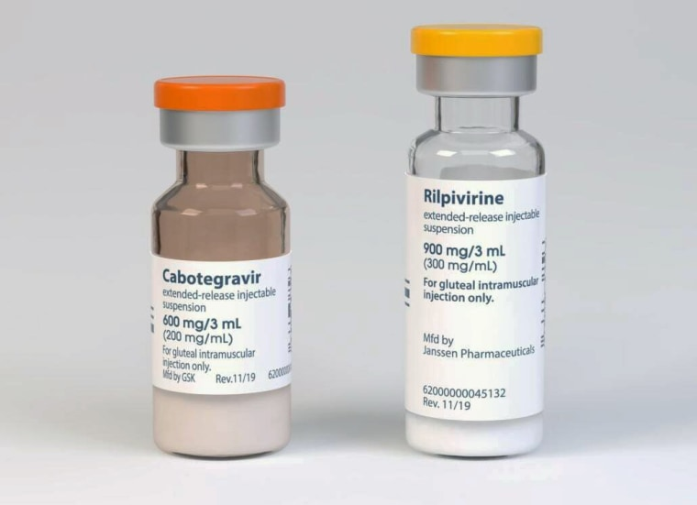
Currently Available LA-ART Medications
IM Cabotegravir/Rilpivirine (CAB/RPV)
Dosed q1-2mo
FDA-approved 2021
SQ Lenacapavir (LEN)
Dosed q6mo
FDA-approved 2022 in combination with other ARVs
¹ Orkin et al, 2022; ² Orkin et al, 2021; ³ Swindells et al, 2022; ⁴ Jaeger et al, 2021
Notes:
The primary ART regimen I’m referring to is injectable Cabotegravir + Rilpivirine, which is dosed every 1 or 2 months, and was FDA approved in 2021. HOWEVER → The clinical trials upon which its approval was based EXCLUDED patients who had detectable HIV viremia, were NOT on oral medications, and those with any history of virologic failure.
A second injectable ART medication (lenacapavir--dosed every 6 months), was approved the following year, but it MUST be given combination with other antiretrovirals.
Note: Changed some of the notes to make it more focused.

Slide 6
Currently Available LA-ART Medications
IM Cabotegravir/Rilpivirine (CAB/RPV)
Dosed q1-2mo
FDA-approved 2021
SQ Lenacapavir (LEN)
Dosed q6mo
FDA-approved 2022 in combination with other ARVs
Data in PEH and PWUD
None from the clinical trials
Observational studies limited to academic HIV medical centers
Major Concern: Long PK tail increases risk for emergent ARV resistance, as drug concentrations decline below minimum effective levels and patients become viremic
¹ Orkin et al, 2022; ² Orkin et al, 2021; ³ Swindells et al, 2022; ⁴ Jaeger et al, 2021
Notes:
While there is some emerging data of injectable ART implementation in patients with adherence challenges at academic HIV specialty clinics, there hasn’t been much in the way of data on people who use drugs who are receiving care from COMMUNITY-based clinics or homeless health centers, where care models and resources differ substantially from academic HIV clinics.

Slide 7
Objective
Evaluate LA-ART retention among people with HIV receiving care through a low-barrier clinic designated for PEH—the majority of whom have substance use disorders.
Notes:
Therefore, the objective of our current analysis was to evaluate rates of retention on injectable ART among people with HIV receiving care through a low barrier, community health center designated to serve people experiencing homelessness, the majority of whom have severe substance use disorders.
Note: I changed your notes slightly to match the actual objectives (what we are showing here is less strictly about feasibility, which we have already published about, but much more about retention on LA-ART).

Slide 8
Methods: Implementation of Low-Barrier LA-ART for PWUD
Off-label Use of IM CAB/RPV
No requirement for baseline VS
Low-Barrier Infrastructure
Drop-in visits 6-days/week
Enhanced Monitoring
Multi-D weekly panel mgmt. meeting
Injection reminders
Coordination w/ ICMs, ECM
RN/MD provider presence at syringe access, shelters, SF jail
On-site labs
*Consider palliative use in patients with CAB or RPV resistance who have been failed by PO ART
PRN mobile street outreach
Partner w/ local pharmacy to track orders
Streamlined Eligibility
Interested + med. eligible
Agree to protocol
Pre-existing clinical engagement ≥3 months
If no phone, consistent location
Incentivize ($10) on-time injections
*Limited patient census
Adapted LA-CAB/RPV guidelines to create a protocol tailored to meet unique needs of PWUD & PEH
Setting: Low-barrier (e.g., no-appointment), transitional primary care and urgent care clinic
Notes:
Our methods first involved modifying existing guidelines to create a protocol to better meet the needs of our population and training providers seeing patients in a low barrier community clinic, on the street, and in shelters. Key features are highlighted in red and included:
Some degree of off-label use of CAB/RPV—including exclusive use of a direct to inject approach, without the requirement for an oral lead in medication phase or baseline virologic suppression
NOTE: I re-formatted the image so that the size of the image stays the same size on each page, and so that it doesn’t look as though it’s a new figure on each page. Also, tried to make the language in your notes a bit more concise

Slide 9
Methods: Implementation of Low-Barrier LA-ART for PWUD
Off-label Use of IM CAB/RPV
No requirement for baseline VS
Low-Barrier Infrastructure
Drop-in visits 6-days/week
Enhanced Monitoring
Multi-D weekly panel mgmt. meeting
Injection reminders
Coordination w/ ICMs, ECM
RN/MD provider presence at syringe access, shelters, SF jail
On-site labs
*Consider palliative use in patients with CAB or RPV resistance who have been failed by PO ART
PRN mobile street outreach
Partner w/ local pharmacy to track orders
Streamlined Eligibility
Interested + med. eligible
Agree to protocol
Pre-existing clinical engagement ≥3 months
If no phone, consistent location
Incentivize ($10) on-time injections
*Limited patient census
Adapted LA-CAB/RPV guidelines to create a protocol tailored to meet unique needs of PWUD & PEH
Setting: Low-barrier (e.g., no-appointment), transitional primary care and urgent care clinic
Notes:
Streamlined eligibility criteria requiring that patients have at least 3 months of active clinical engagement prior to initiation of injections and would be amenable to mobile outreach if they don’t have an active phone number.
NOTE: We are NOT using ‘strict’ eligibility criteria, but actually in some ways the opposite, so would not say that. I think what you mean is strict adherence to our protocol (which has eligibility criteria that are EXTREMELY liberal compared to what trials would have used or other clinics would use).

Slide 10
Methods: Implementation of Low-Barrier LA-ART for PWUD
Off-label Use of IM CAB/RPV
No requirement for baseline VS
Low-Barrier Infrastructure
Drop-in visits 6-days/week
Enhanced Monitoring
Multi-D weekly panel mgmt. meeting
Injection reminders
Coordination w/ ICMs, ECM
RN/MD provider presence at syringe access, shelters, SF jail
On-site labs
*Consider palliative use in patients with CAB or RPV resistance who have been failed by PO ART
PRN mobile street outreach
Partner w/ local pharmacy to track orders
Streamlined Eligibility
Interested + med. eligible
Agree to protocol
Pre-existing clinical engagement ≥3 months
If no phone, consistent location
Incentivize ($10) on-time injections
*Limited patient census
Adapted LA-CAB/RPV guidelines to create a protocol tailored to meet unique needs of PWUD & PEH
Setting: Low-barrier (e.g., no-appointment), transitional primary care and urgent care clinic
Notes:
A low barrier infrastructure allowing for a variety of options of where to receive injections. Patients can drop into our low barrier clinic, which is open 6 days per week OR they can receive injections at partnering sites—including syringe access sites, shelters, in jail, or other community-based locations. They are also incentivized with a $10 gift card for on-time injections.
NOTE: Added part about incentives for injections and minorly edited your notes here.

Slide 11
Methods: Implementation of Low-Barrier LA-ART for PWUD
Off-label Use of IM CAB/RPV
No requirement for baseline VS
Low-Barrier Infrastructure
Drop-in visits 6-days/week
Enhanced Monitoring
Multi-D weekly panel mgmt. meeting
Injection reminders
Coordination w/ ICMs, ECM
RN/MD provider presence at syringe access, shelters, SF jail
On-site labs
*Consider palliative use in patients with CAB or RPV resistance who have been failed by PO ART
PRN mobile street outreach
Partner w/ local pharmacy to track orders
Streamlined Eligibility
Interested + med. eligible
Agree to protocol
Pre-existing clinical engagement ≥3 months
If no phone, consistent location
Incentivize ($10) on-time injections
*Limited patient census
Adapted LA-CAB/RPV guidelines to create a protocol tailored to meet unique needs of PWUD & PEH
Setting: Low-barrier (e.g., no-appointment), transitional primary care and urgent care clinic
Notes:
And, finally, enhanced multidisciplinary monitoring and follow up, which includes weekly team meetings and reminding patients about upcoming injections through a variety of communication modalities.

Slide 12
Methods: Retrospective Analyses (November 2021-October 2024)
Demographics & co-morbidities of patients on LA-ART
Rates of retention on LA-ART and HIV viral suppression
Cases of confirmed virologic failure (CVF)
Notes:
Today, Nicky will be presenting some of our retrospective analyses, including:
Descriptive statistics of demographics of patients on injectable ART;
Rates of retention and HIV virologic suppression,
And cases of confirmed virologic failure
15 sec (4:30 total)
NOTE: Minor changes to this slide and notes to make it more clear here that we are trying to highlight some cases of virologic failure

Slide 13
Results: Demographics & Co-morbidities of LA-ART Patients (Nov 2021- Oct 2024)
 |  | N = 23 (%)
Age, mean (SD) |  | 42 (11)
Race/Ethnicity | Black Native American Hispanic Non-Hispanic White | 11 2 7 5 | 48% 9% 30% 22%
Gender/Sex | Cisgender-male Cisgender-female Trans or Non-binary | 14 3 6 | 61% 13% 26%
Housing Status | Street homeless Sheltered homeless SRO (unstably housed) | 8 12 3 | 35% 52% 13%
Mental Health Comorbidity | Stimulant Use Disorder Opioid Use Disorder Bipolar or Schizophrenia | 18 6 8 | 78% 26% 35%
HIV Labs at Baseline | CD4 <50 c/mm3 CD4 <200 c/mm3 Viremic at 1st injection Lifetime outpatient viremia | 6 9 16 9 | 26% 39% 70% 39%
Notes:
This table describes baseline characteristics of our 23 patients currently receiving long-acting ART. And, as you can see, this cohort represents a patient population that is largely not getting their needs met through traditional models of 4-wall, clinic-based care. Over three quarters are of non-White race or ethnicity, a quarter are transgender or non-binary, and all were unstably housed. .

Slide 14
Results: Demographics & Co-morbidities of LA-ART Patients (Nov 2021- Oct 2024)
 |  | N = 23 (%)
Age, mean (SD) |  | 42 (11)
Race/Ethnicity | Black Native American Hispanic Non-Hispanic White | 11 2 7 5 | 48% 9% 30% 22%
Gender/Sex | Cisgender-male Cisgender-female Trans or Non-binary | 14 3 6 | 61% 13% 26%
Housing Status | Street homeless Sheltered homeless SRO (unstably housed) | 8 12 3 | 35% 52% 13%
Mental Health Comorbidity | Stimulant Use Disorder Opioid Use Disorder Bipolar or Schizophrenia | 18 6 8 | 78% 26% 35%
HIV Labs at Baseline | CD4 <50 c/mm3 CD4 <200 c/mm3 Viremic at 1st injection Lifetime outpatient viremia | 6 9 16 9 | 26% 39% 70% 39%
with mental health co-morbidities:
Notes:
A second point to highlight here is nearly 80% had an active stimulant use disorder, a quarter had opioid use disorder, and over a third have bipolar disorder or schizophrenia

Slide 15
Results: Demographics & Co-morbidities of LA-ART Patients (Nov 2021- Oct 2024)
 |  | N = 23 (%)
Age, mean (SD) |  | 42 (11)
Race/Ethnicity | Black Native American Hispanic Non-Hispanic White | 11 2 7 5 | 48% 9% 30% 22%
Gender/Sex | Cisgender-male Cisgender-female Trans or Non-binary | 14 3 6 | 61% 13% 26%
Housing Status | Street homeless Sheltered homeless SRO (unstably housed) | 8 12 3 | 35% 52% 13%
Mental Health Comorbidity | Stimulant Use Disorder Opioid Use Disorder Bipolar or Schizophrenia | 18 6 8 | 78% 26% 35%
HIV Labs at Baseline | CD4 <50 c/mm3 CD4 <200 c/mm3 Viremic at 1st injection Lifetime outpatient viremia | 6 9 16 9 | 26% 39% 70% 39%
Notes:
Finally, the over a quarter started with a CD4 count less than 50, and 9 patients had NEVER previously achieved HIV viral suppression on oral ART as outpatients in their lifetime

Slide 16
Results: Retention & On-Time Receipt of LA-ART injections
Of N=23 → 100% currently maintained on LA-ART and suppressed (VL <100 c/mL)
Mean follow-up: 18.4 months (range: 4-36 months)
n=19 → maintained on starting regimen (n=16 on CAB/RPV and n=3 on CAB/RPV+LEN)
n=4 → LEN added to starting CAB/RPV regimen due to HIV viremia (incl. n=3 with confirmed resistance*)
Of 385 total LA-ART doses administered to date, 92% on-time
8% delayed >7 days (i.e., outside of injection window)
3% delayed >14 days (i.e., required repeat loading dose per internal protocol)
Diverse locations of injections necessitated intensive outreach, coordination & collab
80% at central low-barrier clinic (MXM)
12% in tents, shelters, or supporting housing sites
7% at syringe access sites and 2% in jail or inpatient/hospital settings

Slide 17
Results: 3 cases of CAB or RPV resistance highlight importance of provider relationships + continued challenges posed by structural barriers
Transitioned to housing in setting of severe OUD
Exacerbation of PTSD
Increased opioid use
Declined CAB/RPV injections x4 months
Patient E:
Patient G:
Patient V:
After confirmation of CAB/RPV resistance, all were encouraged to start PO ART, but remained unable to adhere. Thus, initiated on LEN + CAB/RPV at later date.
Initiated w/ <3 months clinical engagement
Incarceration + loss of temp. housing
2 delayed injections (12 and 21 days)
Increased methamphetamine use
Patient with minimal active care engagement
Pt. declined full buttock exposure to outreach RN
CAB/RPV likely deposited subq (vs. IM)
CAB/RPV offered due to CD4 <50
Notes:
I want to HIGHLIGHT these 3 cases of confirmed virologic failure with resistance because OUR team learned a lot from their experiences, and they really ghih

Slide 18
Results: 3 cases of CAB or RPV resistance highlight importance of provider relationships + continued challenges posed by structural barriers
Transitioned to housing in setting of severe OUD
Exacerbation of PTSD
Increased opioid use
Declined CAB/RPV injections x4 months
Patient E:
Patient G:
Patient V:
After confirmation of CAB/RPV resistance, all were encouraged to start PO ART, but remained unable to adhere. Thus, initiated on LEN + CAB/RPV at later date.
Initiated w/ <3 months clinical engagement
Incarceration + loss of temp. housing
2 delayed injections (12 and 21 days)
Increased methamphetamine use
Patient with minimal active care engagement
Pt. declined full buttock exposure to outreach RN
CAB/RPV likely deposited subq (vs. IM)
CAB/RPV offered due to CD4 <50
Notes:
I want to HIGHLIGHT these 3 cases of confirmed virologic failure with resistance because OUR team learned a lot from their experiences, and they really ghih

Slide 19
Results: 3 cases of CAB or RPV resistance highlight importance of provider relationships + continued challenges posed by structural barriers
Transitioned to housing in setting of severe OUD
Exacerbation of PTSD
Increased opioid use
Declined CAB/RPV injections x4 months
Patient E:
Patient G:
Patient V:
After confirmation of CAB/RPV resistance, all were encouraged to start PO ART, but remained unable to adhere. Thus, initiated on LEN + CAB/RPV at later date.
Initiated w/ <3 months clinical engagement
Incarceration + loss of temp. housing
2 delayed injections (12 and 21 days)
Increased methamphetamine use
Patient with minimal active care engagement
Pt. declined full buttock exposure to outreach RN
CAB/RPV likely deposited subq (vs. IM)
CAB/RPV offered due to CD4 <50
Notes:
I want to HIGHLIGHT these 3 cases of confirmed virologic failure with resistance because OUR team learned a lot from their experiences, and they really ghih

Slide 20
Results: 3 cases of CAB or RPV resistance highlight importance of provider relationships + continued challenges posed by structural barriers
Transitioned to housing in setting of severe OUD
Exacerbation of PTSD
Increased opioid use
Declined CAB/RPV injections x4 months
Patient E:
Patient G:
Patient V:
After confirmation of CAB/RPV resistance, all were encouraged to start PO ART, but remained unable to adhere. Thus, initiated on LEN + CAB/RPV at later date.
Initiated w/ <3 months clinical engagement
Incarceration + loss of temp. housing
2 delayed injections (12 and 21 days)
Increased methamphetamine use
Minimal active engagement (only outreach)
At 1st injection, pt. declined full buttock exposure
CAB/RPV likely deposited subq. (vs. IM)
CAB/RPV offered due to CD4 <50
Notes:
I want to HIGHLIGHT these 3 cases of confirmed virologic failure with resistance because OUR team learned a lot from their experiences, and they really ghih

Slide 21
Results: 3 cases of CAB or RPV resistance highlight importance of provider relationships + continued challenges posed by structural barriers
Transitioned to housing in setting of severe OUD
Exacerbation of PTSD
Increased opioid use
Declined CAB/RPV injections x4 months
Patient E:
Patient G:
Patient V:
After confirmation of CAB/RPV resistance, all were encouraged to start PO ART, but remained unable to adhere. Thus, initiated on LEN + CAB/RPV at later date.
Initiated w/ <3 months clinical engagement
Incarceration + loss of temp. housing
2 delayed injections (12 and 21 days)
Increased methamphetamine use
Minimal active engagement (only outreach)
At 1st injection, pt. declined full buttock exposure
CAB/RPV likely deposited subq. (vs. IM)
CAB/RPV offered due to CD4 <50
Notes:
I want to HIGHLIGHT these 3 cases of confirmed virologic failure with resistance because OUR team learned a lot from their experiences, and they really ghih

Slide 22
Conclusions: Low-Barrier LA-ART for PWUD
In highly supportive settings, LA-ART can provide durable HIV viral suppression for PWUD facing adherence challenges to oral meds → expansion of such programs critical to Ending the Epidemic
Findings highlight importance of personal relationships + continued need to address psychosocial barriers to ART adherence, particularly related to methamphetamine use
Benefit-risk ratio most favorable for those with low CD4 & demonstrated inability to take oral ART
Notes:
So, overall conclusions:
In HIGHLY supportive and tailored clinical settings, LA-ART can offer durable HIV virologic suppression for PWUD with challenges to oral ART adherence.
However, I will note the caveat that this data also really highlights a continued need to better address psychosocial barriers to care among PWH—particularly related to methamphetamine use disorder—to support retention and optimize treatment outcomes
(2) Low-barrier implementation of LA-PrEP for PWUD was also feasible; however, several barriers were identified during pilot implementation that are likely to limit widespread uptake in this population
(3) And, definitely, larger & longer-term evaluations of LA-ARVs in real-world settings serving PWUD are warranted to better understand the safety, efficacy, and risks of this approach

Slide 23
Collaborators
Alix Strough, RN
Laura Cordoba, HW
Arcelia Gomez, HW
Maurice Jones, LVN
Rebecca Pfeifer-Rosenblum, RN
Katie O’Conner, HW
Sydney Yoon, HW
Andrew Bao, HW
Hannah Stowe, RN
Stephen Matzat, MD
Barry Zevin, MD
Joanna Eveland, MD
Monica Gandhi, MD
Thank You!
Questions?
Acknowledgements
SFDPH Whole Person Integrated Care
Ward 86 Positive Health Program
HHOME Case Management
Citywide Case Management
AIDS Healthcare Foundation Pharmacy

Slide 24
Supplemental Slides

Slide 25
Notes:
Here is a visualization of some of that data. On the x-axis we have months since initiating LA-ART and log HIV-1 RNA viral load is on the Y axis.
You can sort of see from this image that there are three outliers of patients who had viremia after starting injections—which are marked in solid blue lines—and this was due to virologic failure and resistance to the CAB/RPV regimen.

Slide 26
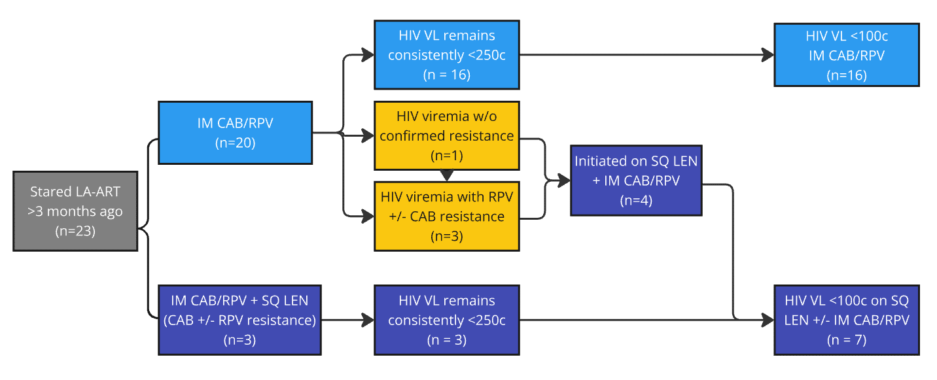
-ART Retention, Viremia & Resistance
Results: Variations in Treatment
100% currently on LA-ART
(mean 18.4mo; range: 4-36 mo)
Notes:
And at this point, 100% of patients are actually suppressed on LA-ART

Slide 27
Change in CD4 T cell counts among patients started on LA-ART with baseline CD4 <50 cells /mL

