Slide 1
Low-dose Buprenorphine Initiation With and Without 3 Days of Dispensed Methadone Among Patients at a Low-Threshold Addiction Clinic
Lysa Samuel PA, Erik Anderson MD, Lauren R. Sirey PharmD, Francesca Au PharmD, Monish Ullal MD, Andrew Herring MD
Notes:
Lysa Samuel, Physician Assistant Bridge Clinic low barrier, high volume, drop in addiction medicine clinic inside Highland Hospital a public hospital Oakland CA.My coworker Erik Anderson and I along with Lauren Sirey, Fran Au, Monish Ullal and Andrew Herring looked at Low dose Bup initiation with and without the addition of methadone.

Slide 2
Nothing to disclose.

Slide 3
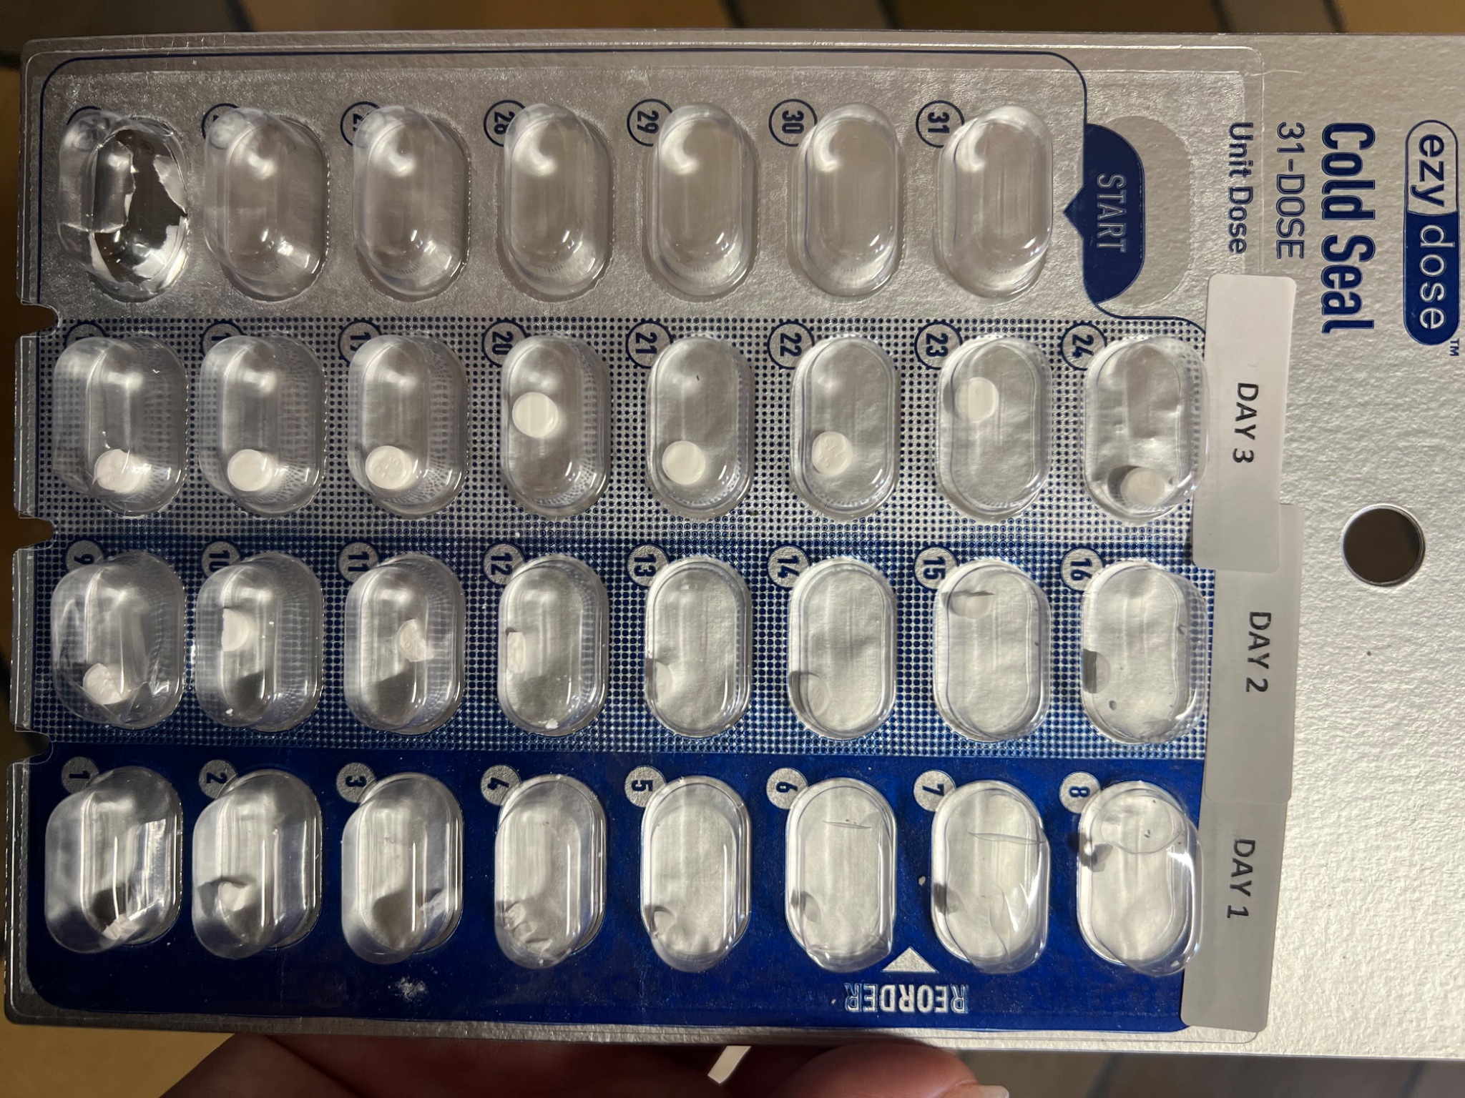
What is Low-dose Induction (LDI?)
Sometimes called“Microdosing”
Slow up-titration of buprenorphine with assumption of continued full agonist
Multiple protocols exist with SL, IV, or transdermal buprenorphine
Various case series describe using between 3-10 days in ambulatory settings
Notes:
For those of you who just learning or need a refresher low dose initiation, also called microdosing, is the slow uptitration of Bup in the setting of full agonist opioid use. Variety of possibilities: SL, patches, IV. We focused on SL in the form of a bubble pack at our outpatient clinic. At Highland we’re lucky enough to have specialized pharmacists Takes 45 minutes. Many patients are already doing some form themselves. You can prescribe a mix of 2s and 8s Can cut 2 and 8mg strips lay in out in a medi-set. This is a photo of one of our 3 day bubblepacks. If you look at Day 1 you can see teh small size of the initial doses.

Slide 4
Background
Several small case series
Two cases cohort studies looking at all patients initiated on LDI
Suen et al: 3-4 day LDI; 7/12 patients completed LDI, no severe PW
Jones et al: 4 and 7 day; 175 initiations, 8% POW; 33% lost to follow up
Unclear success rate
Notes:
Widely used method increasing prevalence as fentanyl becomes dominant opioid. Success rate was uclear from the article I read.

Slide 5
Highland Bridge Clinic Bubble Packs
7-Day LDI:
Day 1: 0.5mg SL Bup x 1
Day 2: 0.5mg SL Bup BID
Day 3: 0.5mg SL Bup AM, 1mg in PM and evening
Day 4: 2mg SL Bup BID
Day 5: 3mg SL Bup BID
Day 6: 4mg SL Bup BID
Day 7: 8mg SL Bup BID
3-Day LDI:
Day 1: 0.5mg q3h x 8 doses
Day 2: 1mg q3h x 8 doses
Day 3: 2mg q3h x 8 doses
Notes:
Starts w .5mg and builds up slowly over 7d

Slide 6
Patient Population: Who’s received LDI?
Default at HGH Bridge is a “Wait, Withdraw, Dose” approach for new starts
Patients considered for LDI:
Prior precipitated withdrawal with traditional starts
Failed traditional starts
Inability to tolerate withdrawal sx
Methadone to bup transition
Organized enough with clear enough vision to see the tiny pieces
Notes:
Which patients might you consider offering a LDI? At our clinic we default to wait, withdraw, dose. For some people this isn’t the best option. Prior precipitated withdrawal, people who have failed traditional starts, methadone to Bup transition,People who cant tolerate withdrawl sx; Parents, homeless people who cant tolerate diarrhea in their tent with no access to the restroom. Organized enough w clear enough vision to see these very very small pieces.

Slide 7
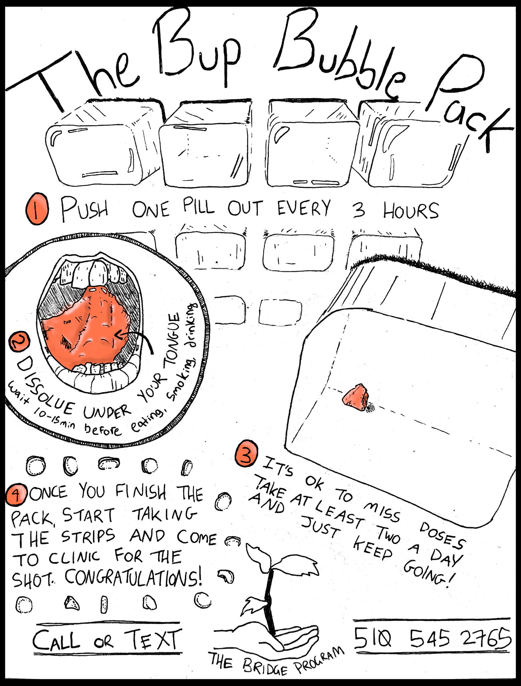
Notes:
Ragav Goyal. Most important thing and that i remind all of my patients it’s ok to go slower as long as you’re getting 2-3 doses a day and dont forget to start SL Bup as soon as you finish the bubble pack.

Slide 8
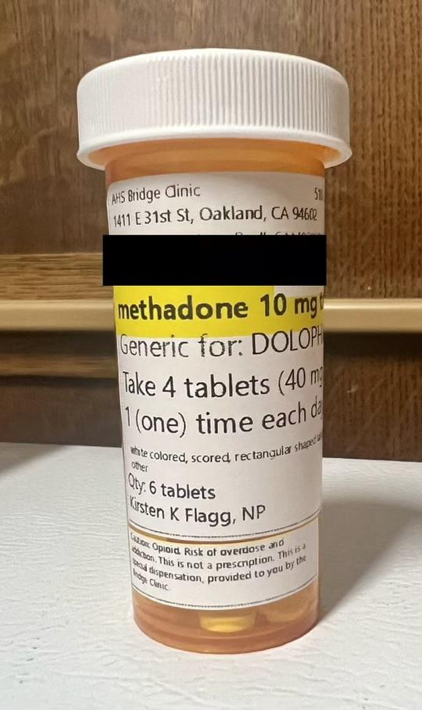
LDI Implies ongoing Full Agonist: Methadone or Illicit Opioids?
All patients advised to continue full agonist use
Patient offered methadone at discretion of clinician
Methadone dispensed using DEA exemption 21 CFR 1306.07(b) aligned with P&T Approved Protocol
Exemption to dispense up to three days of methadone to relieve acute withdrawal while referring to treatment
30-40mg QD max 3 day max without titration
When given methadone, patients had option to transition to OTP if desired
Notes:
Low Dose Initiation done in the setting of full agonist opioid use which in the outpatient space places the burden of harm to buy and consume drugs- with all the risk that entails– overdose, interactions with the criminal justice system etc onto our patients. We wondered what if we took that risk onto ourselves instead by dispensing methadone? DEA exemption 21CFR which has since changed, but in 2023 when our sample was pulled allowed dispensing of 30-40 mg methadone for up to 3d which lines up with 3d LDI dosing. Not enough methadone to control withdrawal sx but it is enough to take the edge off. Option to contiune methadone at OPT which 2 people did

Slide 9
Methods
Retrospective cohort study of 65 patients started on LDI in low-threshold bridge clinic with or without methadone
Primary outcome: On 16mg+ of SL bup or received XR bup within 14 days of initiation of LDI
Secondary Outcomes: Rate of precipitated withdrawal, ED visits, adverse events
Notes:
For those with multiple LDIs in 2023 we used the first one.

Slide 10
Results
65 total participants
28 got methadone
37 didn’t get methadone
Mostly patients using fentanyl (78%)

Slide 11
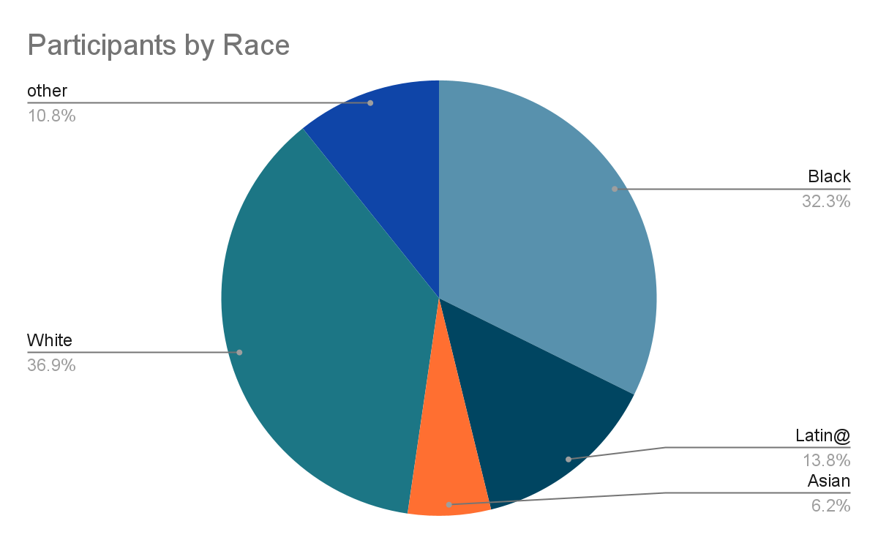

Slide 12
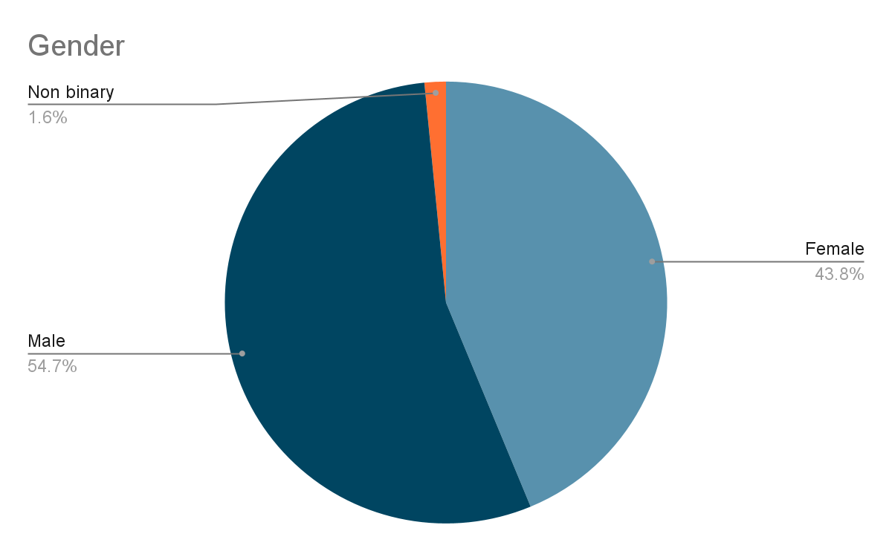
Notes:
More women than we see. Particular need of parenting people.

Slide 13
Primary Outcome
20 people (30.8%) successfully transitioned to bup within 14 days.
11/28 (39%) who received methadone
9/37 (24%) who did not receive methadone
Notes:
Majority were complicated starts with hx of precipitated withdrawal. Original 65 people Precipitated withdrawal “did it wrong”. OUr inability to explain instruction in a clear manner
Way more than ½ trickled back to try again

Slide 14
Secondary Outcomes
6 (9%) patients experienced precipitated withdrawal
2 with methadone
4 without methadone
3 ED visits related to precipitated withdrawal– none of whom received methadone
No hospitalizations or ICU stays
31 (47%) had clinic engagement at 30 days
Notes:
Of the 6 all were deviations from protocol instructions. Of note 47% had clinic engagement at 30 days, the longer we tracked out the more patients returned to clinic to try again.

Slide 15
Conclusion
Success rates at 14 days are low (20%) without a big difference between dispensing methadone or not.
However, for most patients LDI induction is not overly unpleasant which makes clinic engagement and re-engagement high.
LDI bup is a good option for those who want to stop opioids (medical and non) with significant concerns over precipitated withdrawal.

Slide 16
Questions?
lsamuel@alamedahealthsystem.org

