Slide 1
Lower the Barriers: Treatment of Hep C in an Opioid Treatment Program
Laura Pugh, MD
Soraya Azari, MD

Slide 2
Disclosures
None

Slide 3
Why Hep C in an OTP?
Treatment of Hepatitis C is simple, achieves cure, and is cost-effective
There is a high rate of HCV incidence for people who inject drugs (est 12 per 100 person-years)
Hepatitis C is a common etiology for liver failure, liver cancer, and need for liver transplant
Treatment of opioid use disorders with methadone and buprenorphine decreases the risk of infection with hepatitis C
An opioid treatment program represents an ideal setting for screening and treatment of hepatitis C infection

Slide 4
Disparities in HCV diagnosis and treatment
Prevalence of HCV is 1.8% among people who are Black and 0.8% among people who are not Black
Mortality rates due to chronic HCV are 5.01/100 000 among people who are Black and 2.98/100 000 among people who are White
American Indians/Alaska Natives again had the highest hepatitis C related death rate among all race/ethnic groups, at 9.05 deaths per 100,000 population
The odds of HCC screening were 14% lower in rural than in urban patients, lower in African Americans, but higher among Hispanics than in whites

Slide 5
Methods
Observational, quality-improvement study (2016-2023)
Located at opioid treatment program (OTP) based at Zuckerberg San Francisco General, which provides methadone or buprenorphine to people with opioid use disorder

Slide 6
Eligibility and Connection to Care
Every patient enrolled in the OTP is offered on-site hepatitis C screening at the time of enrollment, annually, and then, if requested.
Every patient who screens positive is referred to the hepatitis nurse lead who schedules them with the physician to start treatment
Once on treatment, the patient continues to meet with the nurse lead of DOT to track adherence, ensure tolerability, and schedule follow ups and labs
Labs are done through onsite phlebotomy. Labs and medications were covered by the patient’s primary insurer

Slide 7
Patient characteristics
Sex | Male: 72% (214/295) Female: 27% (80/295) Trans Female: 0.3% (1/295)
Race / Ethnicity | White: 57% (168/295) Black or African-American: 27% (80/295) Latine: 10% (30/295) Native American: 3% (9/295) Other Non-White: 1.6% (5/295) Asian or Pacific Islander: 1% (3/295)
Age | Mean: 46 years old (range 23 - 74 years old) Median: 49 years old
Active Substance Use* | 83% (246/295)
Genotype | 1A or 1B: 66% (200/303) 2: 11% (35/303) 3: 20% (61/303) 4: 0.6% (2/301) Mixed 1 & 2: 0.3% (1/303) Mixed 1 & 3: 0.3% (1/303) Indeterminate: 0.3% (1/303) Unknown: 0.6% (2/303)
History of Prior Treatment Episode | 3% (9/295)
Medications Prescribed and Started for Patients# | glecaprevir/pibrentasvir (Mavyret) 134/298 sofosbuvir/velpatasvir (Epclusa) 118/298 ledipasvir/sofosbuvir (Harvoni) 27/298 elbasvir/garoprevir (Zepatier) 14/298 sofosbuvir/velpatasvir/voxilaprevir (Vosevi) +Ribavirin 1/298 sofosbuvir/velpatasvir/voxilaprevir (Vosevi) 2/298 Sofosbuvir/daclatasvir 1 Sofosbuvir/daclatasvir/ribavirin 1

Slide 8
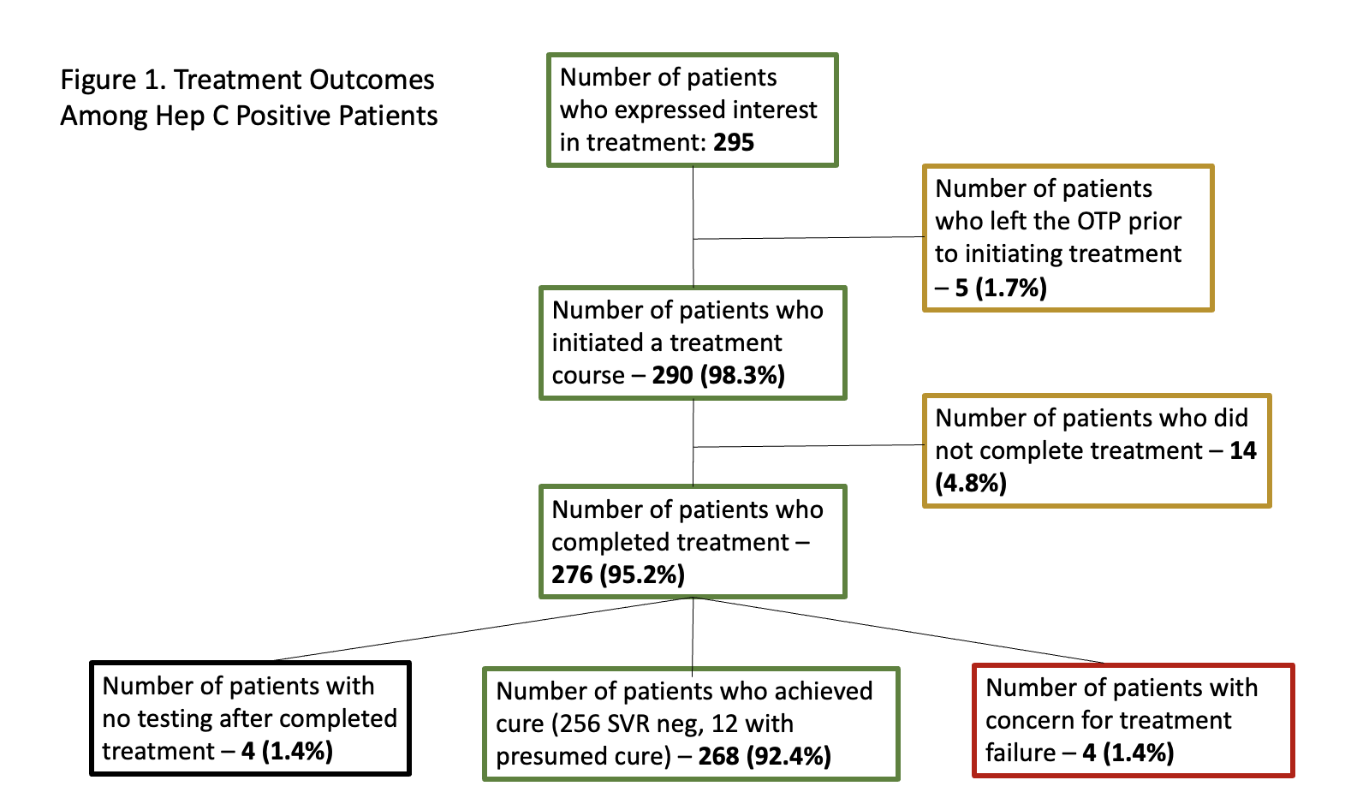
Results
Notes:
97% of those who completed

Slide 9
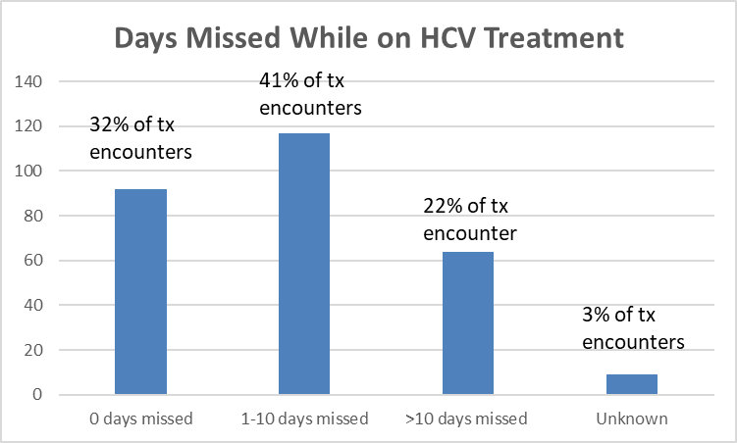
Notes:
Patients experienced high rates of cure with variable ability to adhere strictly to the treatment regimen. 32% of treatment courses were taken with no missed days. 41% of treatment courses had 1-10 missed days, 22% had greater than 10 days missed, and 3% of encounters had an unknown number of missed days. 268 (97.1%) of patients who completed treatment were cured, and 92.4% of patients who started treatment were cured. 4 patients (1.0%) were lost to follow up with no testing after treatment, and 4 patients (1.4%) had a positive SVR or post-SVR12 viral load concerning for treatment failure less likely versus reinfection.

Slide 10
Treatment failure
4 patients
All were men
1 was African American, 3 white/non Hispanic
Average age of 45.25
All were initially given 8 weeks of Mayvret
Missed days: 1, 2, 10, and 20 days. The patients who missed 10 and 20 days were given extended treatment courses

Slide 11
Discussion
Hepatitis C infection has a high prevalence and has historically been undertreated in patients who use substances due to challenges accessing healthcare and adherence concerns
Treatment of Hepatitis C among patients receiving care at an opioid treatment program is safe, effective, and able to achieve a high rate of cure
In a vulnerable patient population, high cure rates of over 95% are achievable, even in the setting of missed days
Treatment Hep C in OTPs represents a critical opportunity to provide low barrier care to the patients at highest risk of contracting and experiencing consequences of Hep C

Slide 12
Limitations
Single site
Lack of long term follow up
No reinfection data

Slide 13
Future directions
Develop more integrated treatment programs such as hepatitis C, HIV, and mental health medication into outpatient substance use programs
Continue to investigate resistance and reinfection rates among patients treated for HCV in opioid treatment programs

Slide 14
Thank you!

Slide 15
References
Litwin AH, Jost J, Wagner K, Heo M, Karasz A, Feinberg J, Kim AY, Lum PJ, Mehta SH, Taylor LE, Tsui JI, Pericot-Valverde I, Page K; HERO Study Group. Rationale and design of a randomized pragmatic trial of patient-centered models of hepatitis C treatment for people who inject drugs: The HERO study. Contemp Clin Trials. 2019 Dec;87:105859. doi: 10.1016/j.cct.2019.105859. Epub 2019 Oct 24. PMID: 31669450; PMCID: PMC7261375.
Amon JJ, Garfein RS, Ahdieh-Grant L, Armstrong GL, Ouellet LJ, Latka MH, Vlahov D, Strathdee SA, Hudson SM, Kerndt P, Des Jarlais D, Williams IT. Prevalence of hepatitis C virus infection among injection drug users in the United States, 1994-2004. Clin Infect Dis. 2008 Jun 15;46(12):1852-8. doi: 10.1086/588297. PMID: 18462109.
Leidner AJ, Chesson HW, Xu F, Ward JW, Spradling PR, Holmberg SD. Cost-effectiveness of hepatitis C treatment for patients in early stages of liver disease. Hepatology. 2015 Jun;61(6):1860-9. doi: 10.1002/hep.27736. Epub 2015 Mar 16. PMID: 25677072; PMCID: PMC5802336.
Tariq M, Shoukat AB, Akbar S, Hameed S, Naqvi MZ, Azher A, Saad M, Rizwan M, Nadeem M, Javed A, Ali A, Aziz S. Epidemiology, risk factors, and pathogenesis associated with a superbug: A comprehensive literature review on hepatitis C virus infection. SAGE Open Med. 2022 Jun 29;10:20503121221105957. doi: 10.1177/20503121221105957. PMID: 35795865; PMCID: PMC9252020.
Peles, Einat PhD; Schreiber, Shaul MD; Rados, Vera MD; Adelson, Miriam MD. Low Risk for Hepatitis C Seroconversion in Methadone Maintenance Treatment. Journal of Addiction Medicine 5(3):p 214-220, September 2011. | DOI: 10.1097/ADM.0b013e31820e13dd
Norton BL, Beitin A, Glenn M, DeLuca J, Litwin AH, Cunningham CO. Retention in buprenorphine treatment is associated with improved HCV care outcomes. J Subst Abuse Treat. 2017 Apr;75:38-42. doi: 10.1016/j.jsat.2017.01.015. Epub 2017 Jan 27. PMID: 28237052; PMCID: PMC5856469.
Tran L, Jung J, Feldman R, Riley T 3rd. Disparities in the quality of care for chronic hepatitis C among Medicare beneficiaries. PLoS One. 2022 Mar 10;17(3):e0263913. doi: 10.1371/journal.pone.0263913. PMID: 35271617; PMCID: PMC8912154.
Notes:
Qs for Soraya
For people that got take homes did they have their pills counted?
-> still giving out gift cards for lab draws? Funding now?

