Slide 1
Mapping Buprenorphine Access at Philadelphia Pharmacies
Rachel French, PhD, RN, MSHP
Allison Schachter, BS
Emily Seeburger, MPH
Nicole O’Donnell, BA, CRS
Jeanmarie Perrone, MD
Margaret Lowenstein, MD, MSHP
Shoshana Aronowitz, PhD, MSN, MSHP

Slide 2
Employed by Ophelia Health as a Registered Nurse.

Slide 3
Recent evidence has highlighted significant barriers to buprenorphine access at the pharmacy-level
In areas of the US with the highest overdose rates, one in five pharmacies do not stock buprenorphine, and 30% endorse some level of barrier, including no current stock of the medication
Access in some areas of the country is particularly scarce; a study of Texas pharmacies found that only 34% of pharmacies surveyed were prepared to dispense a one-week supply of buprenorphine and a dose of naloxone
Nearly 35% of patients at a rural OUD treatment program reported difficulties receiving buprenorphine at pharmacies, and pharmacy-level barriers to access was associated with an increased odds of acquiring non-prescribed buprenorphine from the street
Kazerouni NJ, Irwin AN, Levander XA, et al. Pharmacy-related buprenorphine access barriers: An audit of pharmacies in counties with a high opioid overdose burden. Drug Alcohol Depend. 2021;224:108729. doi:10.1016/j.drugalcdep.2021.108729
Hill LG, Loera LJ, Evoy KE, et al. Availability of buprenorphine/naloxone films and naloxone nasal spray in community pharmacies in Texas, USA. Addiction. 2021;116(6):1505-1511. doi:10.1111/add.15314
Winstanley EL, Thacker EP, Choo LY, Lander LR, Berry JH, Tofighi B. Patient-reported problems filling buprenorphine prescriptions and motivations for illicit use. Drug Alcohol Depend Rep. 2022;5:100091. doi:10.1016/j.dadr.2022.100091

Slide 4
Qualitative and survey research have highlighted the barriers patients face accessing buprenorphine, even at pharmacies that do stock it – including pharmacist refusal to fill prescriptions for new patients, patients who received care via telehealth, patients prescribed high dosages, or patients who live far from the pharmacy

Slide 5
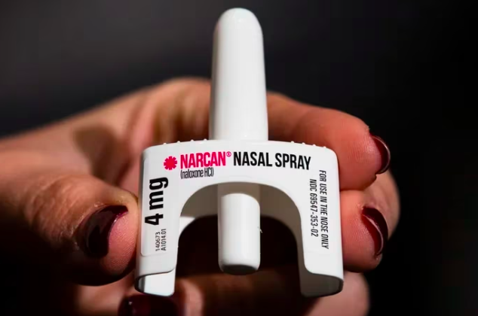
A 2021 survey found that only 38.5% of pharmacies in Philadelphia County had a one-week supply of buprenorphine in stock
Yeung M, Loera LJ, Peterson MR, et al. Buprenorphine/naloxone film and naloxone nasal spray pharmacy deserts in Harris County, Texas and Philadelphia County, Pennsylvania. Ment Health Clin. 2022;12(2):98. DOI: 10.9740/mhc.2022.04.089

Slide 6
To describe variation in buprenorphine access in pharmacies across Philadelphia Aim clinicians and patients in finding pharmacies by creating an interactive tool that identifies Philadelphia pharmacies that stock and dispense buprenorphine
Objective

Slide 7
Data Collection
Dataset purchased from Pennsylvania Bureau of Professional and Occupational Affairs containing the names, addresses, and phone numbers of all pharmacies in the City of Philadelphia (n=502) in April 2022.
Eliminated inpatient and hospital associated pharmacies (n=45) for a final sample of 457 retail pharmacies.
With approval from the University of Pennsylvania IRB, a research assistant (RA) called the 457 pharmacies and asked to speak with a pharmacist or pharmacy tech.
She used a standardized script that identified her as a research team from the University of Pennsylvania; the script included questions about whether the pharmacy stocked buprenorphine, whether the pharmacy would dispense to both established patients and new patients, if the pharmacy had dosage limits above which they would not dispense, and other requirements such a buprenorphine tapering plan and/or phone verification from the prescriber.
If the RA was unable to reach anyone at the pharmacy or the person asked to be called back, the RA called again later up to three times.
Data collection took place between 2/7/2023-3/23/2023.

Slide 8
Data Analysis
We used descriptive analyses and geographical information system (GIS) mapping to describe and visualize pharmacy buprenorphine access across the city
Pharmacy addresses were geocoded using the ggmap package in R
Pharmacies were mapped according to their corresponding latitude and longitude coordinates using the WGS 1984 coordinate system
We performed descriptive analyses with ArcGIS Pro 3.0.3
Data about overdose deaths was acquired from a publicly available report from the Philadelphia Department of Public Health, and zip code level race data was acquired from the Census Bureau

Slide 9
Results
The dataset contained 457 outpatient pharmacies – 351 were in the final study dataset (35 were permanently closed or out of service, 71 were marked unreachable after three attempts)
238 (68%) pharmacies regularly stock buprenorphine
6 (2%) indicated they would order it on an as-needed basis if a script is sent
91 (26%) pharmacies said they do not stock or order buprenorphine
16 (5%) were unsure or would not disclose.
156 (64%) of the pharmacies that dispensed buprenorphine reported that they did not have a set dosage maximum above which they would not dispense
64 (26%) did not know or would not share if there was a dosage maximum policy
24 pharmacies had a dosage maximum policy above which they would not dispense
Vast majority citing 3 films a day or 24mg as the maximum, although 4 pharmacies cited lower doses (8mg or 16mg) as the maximum.

Slide 10
Results
We identified 137 pharmacies that regularly stock buprenorphine, do not have known dosage maximums, and dispense to established and new patients without requiring a verbal verification from the prescriber; we labelled these pharmacies “easier-access”
Zip codes with predominantly white residents had a median (IQR) of 3 (2-4) easier-access pharmacies, and zip codes with predominantly Black residents a median (IQR) of 2 (1-4.5) easier-access pharmacies
9 zip codes had no easier-access pharmacies and 3 zip codes had one
All 3 of these zip codes are areas with primarily Black residents. Among these zip codes, one (19143) experienced an increase in fatal overdoses between 2020 and 2021, and nearly a doubling in fatal overdoses from 2017 (22 deaths) to 2021 (42 deaths)

Slide 11
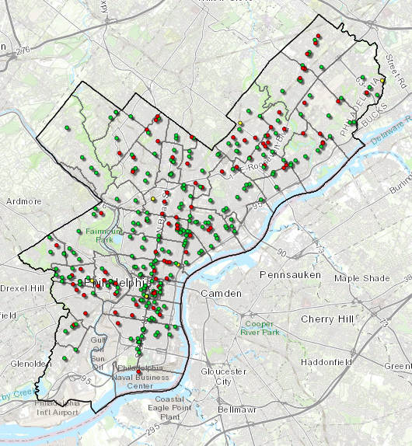
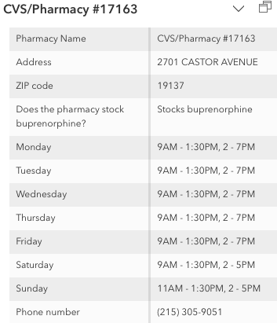

Slide 12
Discussion
Our findings mirror those of previous studies that have found a significant percentage of pharmacies do not carry buprenorphine, even in areas of the country with high opioid overdose rates
Uneven distribution of “easier-access” pharmacies across the city – i.e.: pharmacies that keep buprenorphine in stock and are willing to dispense to new patients
The West Philadelphia zip code 19143 experienced nearly a doubling in overdose deaths between the years 2017 and 2021, and 76% of the residents in this area identify as Black or African American.
This area only had 1 “easier-access” pharmacy; none of the other pharmacies in this zip code reported stocking buprenorphine
A large body of literature highlights how Black patients with OUD are less likely to receive evidence-based treatment with medication, and among those who do receive medication, Black patients are more likely than white patients to be offered methadone only, rather than a choice of methadone or buprenorphine -- inability to pick up medication at a pharmacy in one’s neighborhood is a serious barrier that needs addressing

Slide 13
Limitations
We were unable to reach and collect data from 71 pharmacies
Pharmacy techs and other staff may not be as knowledgeable as pharmacists about what is available in their pharmacy
We did not use secret shopper methodology; pharmacies that reported stocking and dispensing buprenorphine might refuse patients for a variety of reasons
A follow-up secret shopper study might help us more deeply understand the barriers that patients face

Slide 14
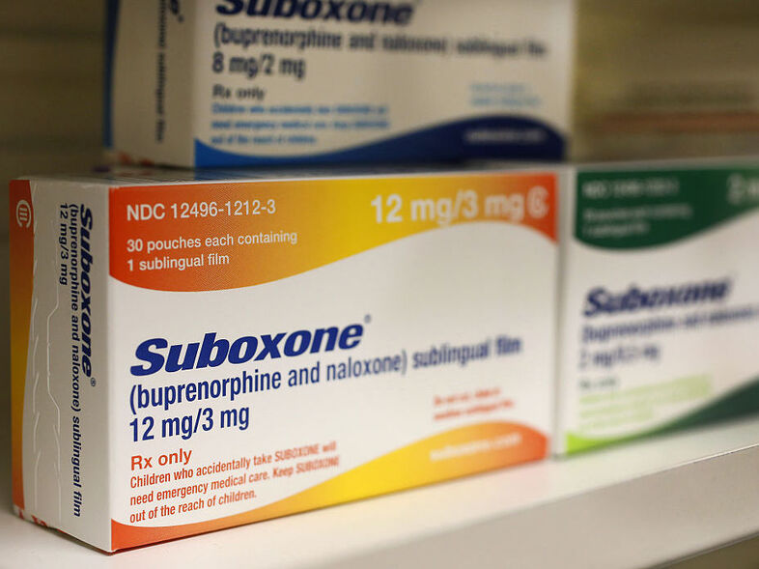
Conclusion
An important barrier to buprenorphine access lies at the pharmacy-level, where pharmacies may choose not to stock and dispense the medication
Our survey of Philadelphia pharmacies found that buprenorphine access is not equitable across the city and a quarter of pharmacies surveyed choose not to carry the medication

Slide 15
QUESTIONS & DISCUSSION

Slide 16
Further questions?

