Slide 1

Treatment of Opioid Use Disorder
Innovation and Discovery
Gail D’Onofrio MD, MS
Albert E. Kent Professor of Emergency Medicine
Professor of Medicine & Public Health
Core Faculty, Addiction Medicine
Yale University School of Medicine
November 14, 2024

Slide 2




Disclosure Statement
Current grant funding:

Slide 3

Imagine a disease…
With…an effective treatment…
and an annual economic cost exceeding 1 trillion….
that causes a death every 5 minutes
yet less than 20% receive it

Slide 4
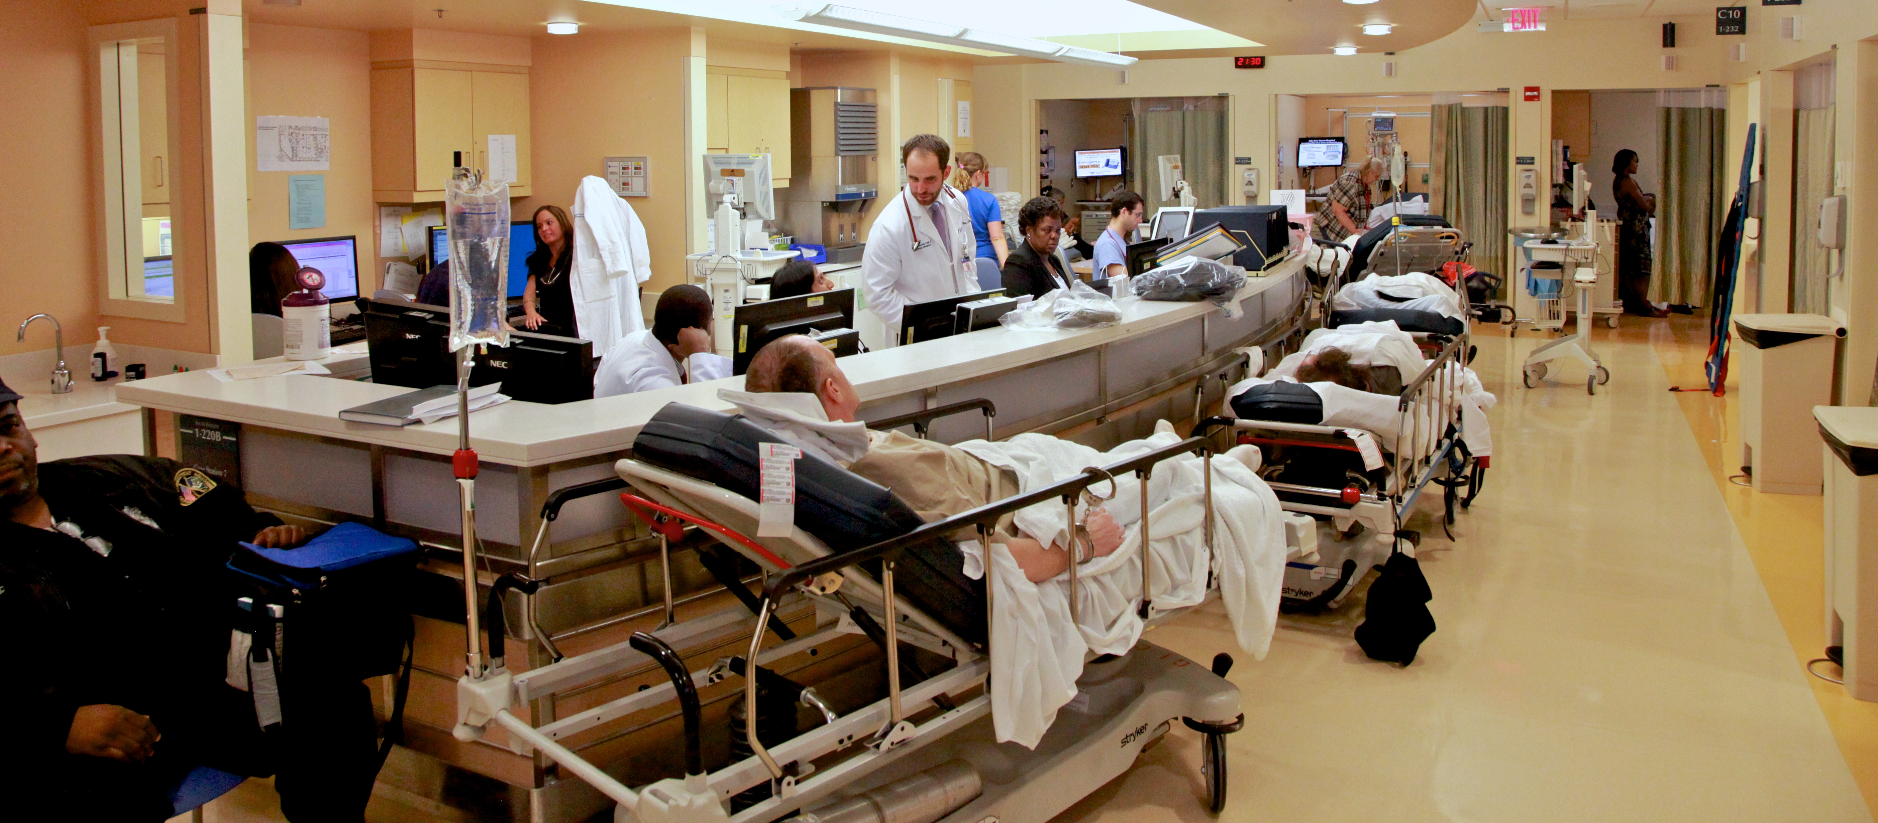
Why The Emergency Department ?
Because that’s where the patients are 24/7/365!
12.7% of drug related ED visits involved opioids in 2022
Preliminary Findings from Drug-Related Emergency Department Visits, 2022; SAMHSA/DAWN 2023

Slide 5

We know the
consequences…

Slide 6
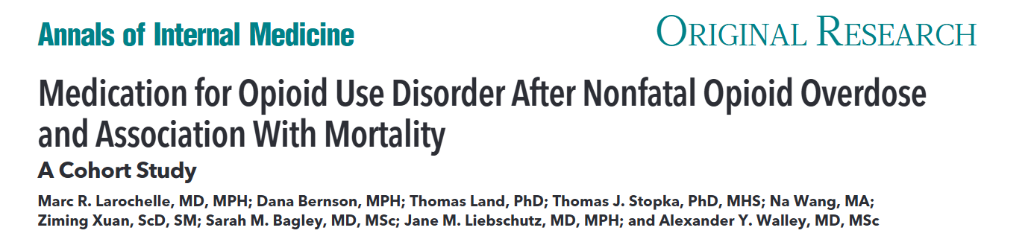
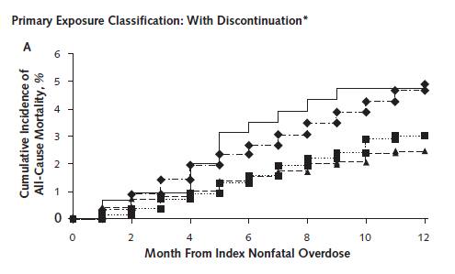
12-months after ED Visit for Non-fatal Overdose
  Only 30% received MOUD
  (11% MMT & 17% Bup)
  4.9% all-cause mortality
  BUP & MMT > 50% decreased in mortality
No MOUD
N=17,568 2012-2014
Naltrexone
Bup
MMT
Larochelle, Annals of Int Med 2018
Notes:
3% Bup and 2.5% MMT

Slide 7
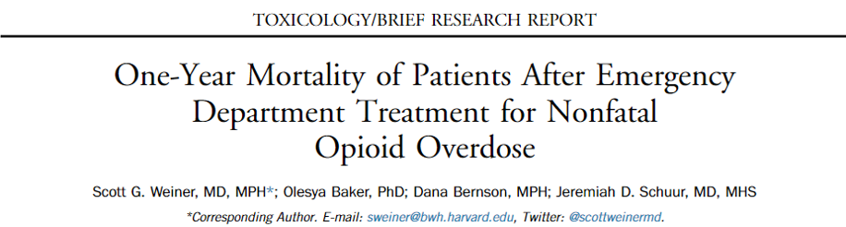
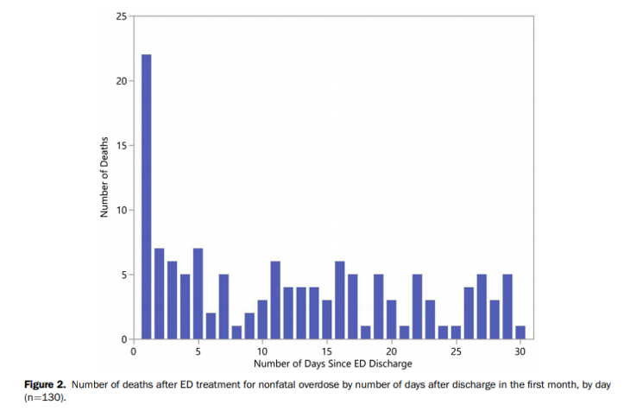
12-months after ED Visit for Non-fatal Overdose
2011- 2015
635/11,557 (5.5%)
died within 1-year
130 in first month
Greatest risk of death is within 2 days of ED discharge – 29
ED visit offers prime
opportunity for
intervention
29/130 (22%) died within 2 days
Weiner, Annals EM 2020

Slide 8
ED Clinician
Patient
    Logistical
      Insurance status, photo IDs or pre-authorization hurdles
      Transportation
      Pharmacy stocks buprenorphine
    50% of patients with OUD present with minimal withdrawal symptoms
    Treatment ambivalence
Barriers to
Adoption Exist
    Reticence among emergency providers to prescribe
    Lack of prompt access to community providers or treatment programs
    Risk of Precipitated Withdrawal

Slide 9


Imagine….
…a solution to overcome these barriers?

Slide 10






BREAKTHROUGH!

Slide 11
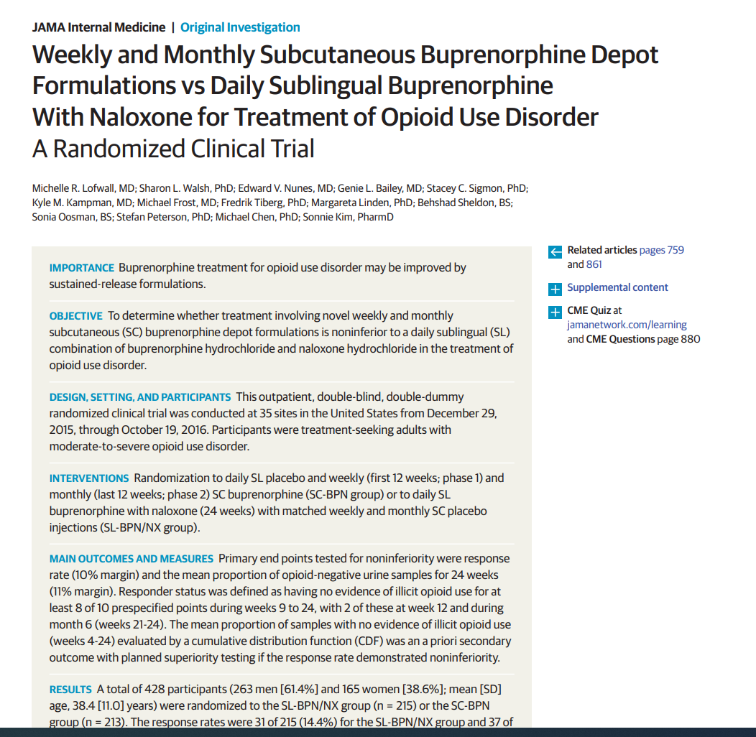
Extended-Release Buprenorphine Preparations
Extended-release buprenorphine preparations provide steady delivery without daily peaks and troughs
Well tolerated and
improve efficacy
Lofwall JAMA Int Med, 2018
Notes:
4 hours after SC injection, 24 mg XR-BUP = [plasma] = 1.6 ng/mL 24 week double blind double dummy phase 3 trial for
Associated with
μ-receptor binding/activation
Opioid craving suppression
Diminished reward from full μ-agonists
Viscous liquid crystalline gel encapsulates BUP
Biodegrades slowly
t_{1/2} = 70 – 107 hours

Slide 12
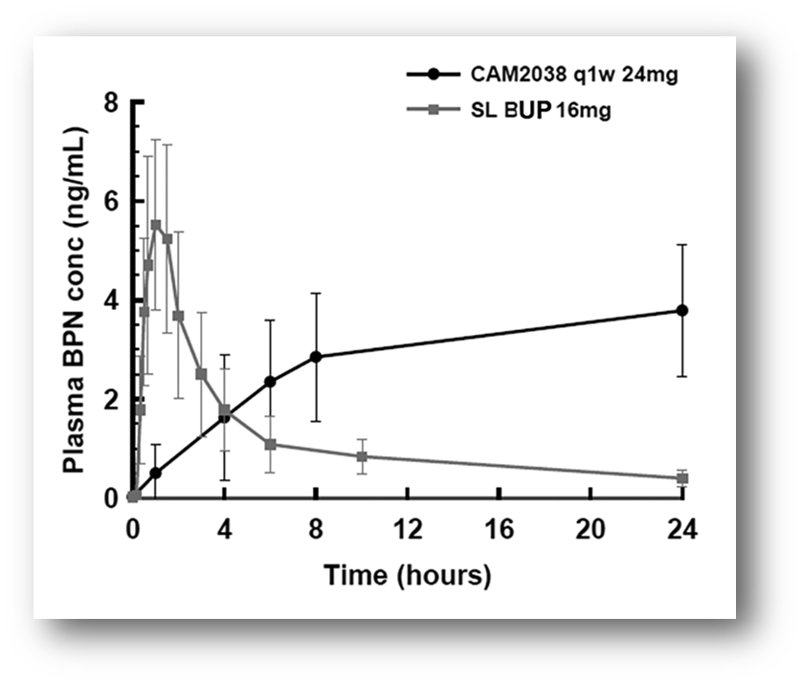

Pharmacokinetics: Sublingual & 7-day XR Buprenorphine
Plasma concentrations of XR-BUP rise slowly with 4 hours after SC injection = 1.6 ng/ml
μ-
Associated with
Μ-receptor binding/activation
Opioid craving suppression
Diminished reward from full μ-agonists
CAM2038, Investigators Brochure, Braeburn Inc., Edition 17, April 5,2023

Slide 13
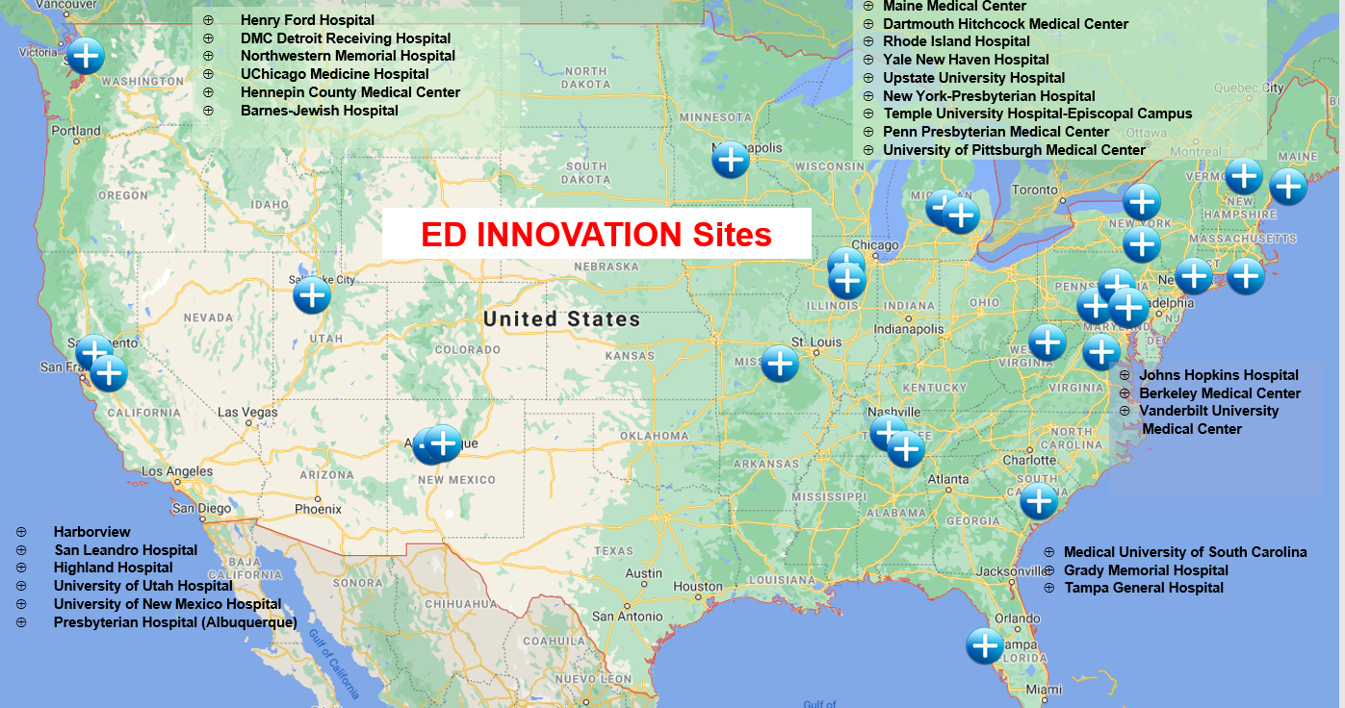
ED-INitiated BupreNOrphine VAlidaTION Network Trial
Parent Trial CTN 0099
Randomized trial comparing XR-BUP and SL-BUP induction in 2000 ED patients on outcome of engagement in treatment at 7 days
Enrollment completed 8/2024
D'Onofrio Contemporary Clinical Trials, 2021
Notes:
Explain that in a Hybrid Type 1 design, Effectiveness is the most important component - Type 1 hybrid designs rigorously test the clinical intervention and secondarily gather data to inform subsequent implementation research trials - I added a red box!

Slide 14
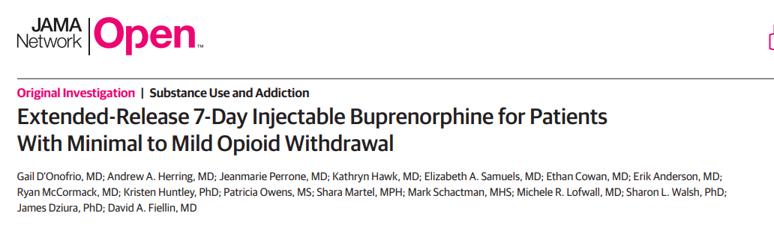

Ancillary Study CTN 0099A
A prospective study 7/2020 – 5/2023 in 4 geographically diverse urban, teaching EDs.
Assessing feasibility and safety of induction with 7-day XR buprenorphine in minimal to mild Opioid Withdrawal
COWS scores < 8

Slide 15
Study Population
Inclusion Criteria
Exclusion Criteria
DSM 5 Criteria for moderate/severe OUD
18 years or older in age
Treated in the ED during screening hours
COWS score < 8
urine toxicology test that is positive for opioids
Speak English sufficiently to understand the study procedures and provide written informed consent to participate in the study
Urine positive for methadone
ED presentation due to Overdose
Pregnancy
Receiving MOUD treatment within past 7 days
Medical/Psych condition requiring hospitalization
Actively suicidal or cognitively impaired
Require prescription for opioid analgesics
A prisoner or in police custody

Slide 16
Monitoring and Observation Pre & Post Injection
Assessments | Pre- Injection | Post-Injection Time Points
 |  | Immediately after Injection | 30 mins | 60 mins | 90 mins | 120 mins | 150 mins | 180 mins | 210 mins | 240 mins
Vital Signs | X |  | X | X | X | X | X | X | X | X
COWS | X |  | X | X | X | X | X | X | X | X
Objective Opioid Withdrawal Scale (OOWS) | X |  | X | X | X | X | X | X | X | X
Adjective Rating Scale for Withdrawal (ARSW) | X |  |  |  |  |  |  |  |  | X
Pupillary Diameter | X |  | X | X | X | X | X | X | X | X
Desire to Use | X |  |  |  |  |  |  |  |  | X
Bad Drug Effects | X |  | X |  |  |  |  |  |  | X
Post-Injection Medications |  |  | X | X | X | X | X | X | X | X
Pain Assessment Numerical Rating Scale |  | X | X |  |  |  |  |  |  | X
Local Tolerability Scale |  |  | X |  |  |  |  |  |  | X
Precipitated Withdrawal |  | Triggered based on clinical observation and COWS scores

Slide 17


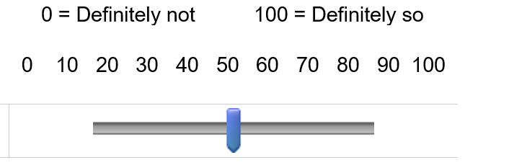
Patient self-report days 1-7
Qualtrics survey via telephone
1. Have you used any opioids not prescribed for you during the past 24 hours?
  If “yes” what did you use? (Drop down menu)
2. Have you used any other drugs not prescribed for you during the past 24 hours?
  If “yes” what did you use? (Drop down menu)
3. Use the slider to indicate how much you desire opioids at the moment
At this moment, I desire opioids: ()

Slide 18
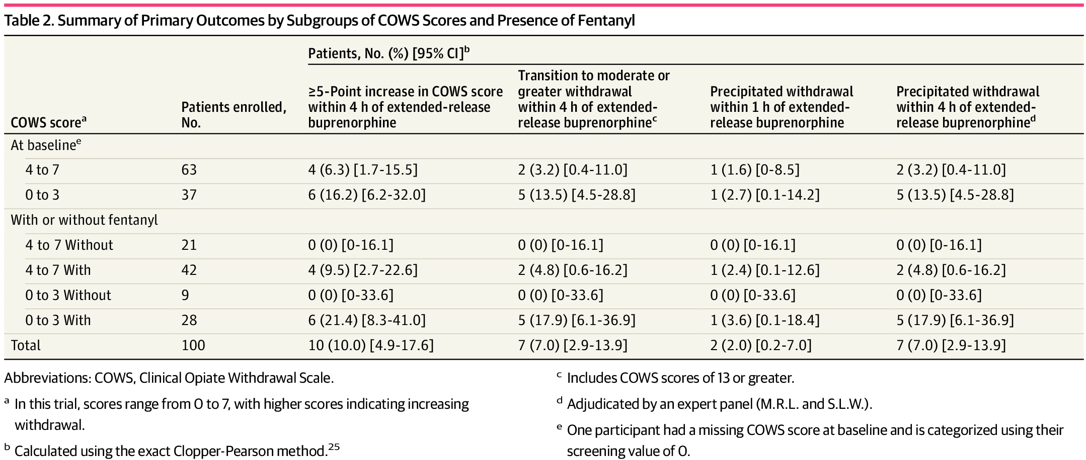
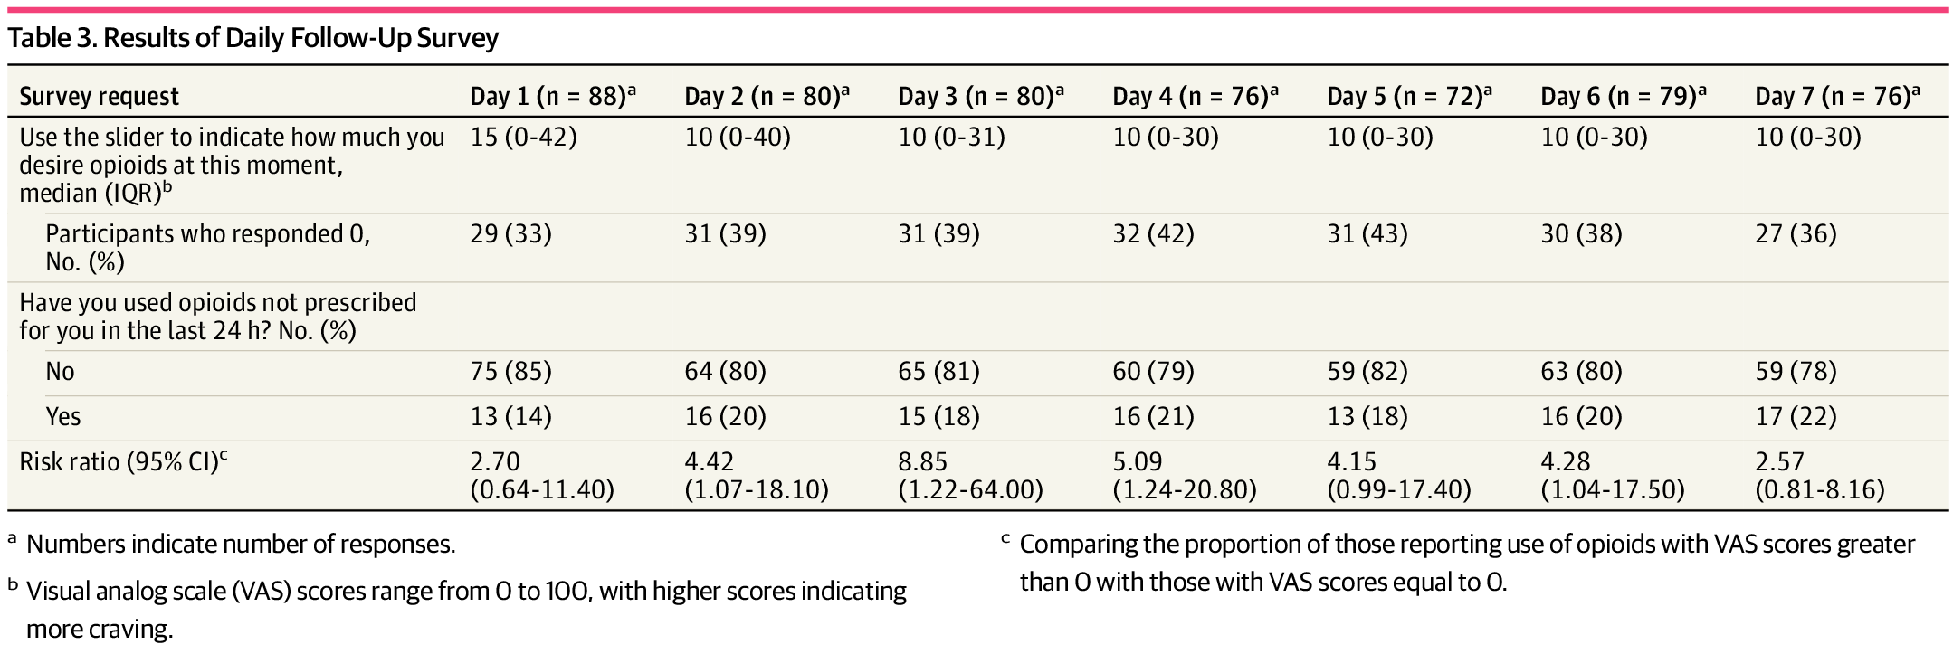
Outcomes
7 experienced PW
2 with COWS 4-7
5 with COWS 0-3
Desire for opioids was low; pain score 15-10 (scale 0-100) each day;
~1/3 reported “0” desire
Few patients reported using non prescribed opioids (14-22%)

Slide 19
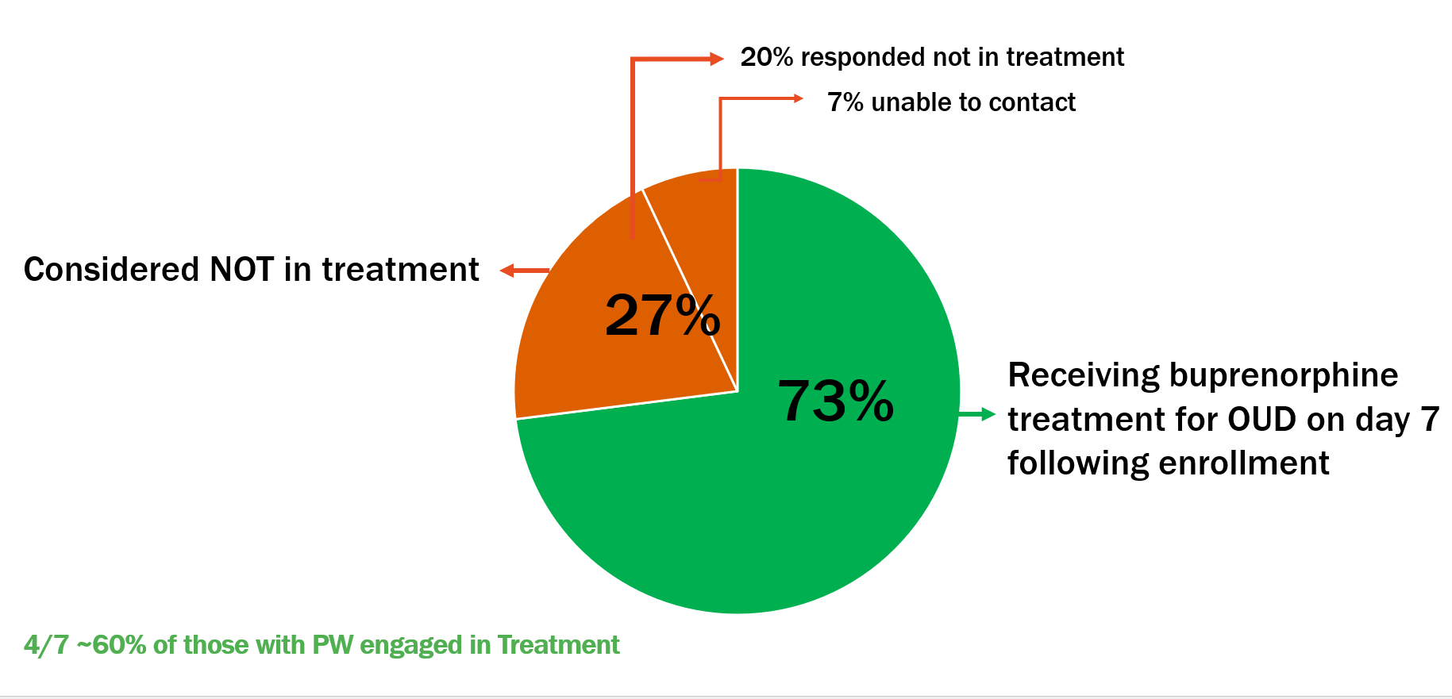
Secondary Outcomes
¾ of the sample engaged in treatment at 7 days
4/7 ~ 60% of those with PW engaged in treatment
6% reported non-fatal OD 7 days prior to enrollment
No patients reported non-fatal OD post injection
Engagement in Treatment Follow-up Rates
Overdose Events
At baseline 6 patients reported an overdose event 7 days prior
At 7 days, there were no reports of opioid overdose

Slide 20
Conclusion
XR-BUP in ED patients with low levels of opioid withdrawal, defined as COWS of 4-7, is feasible, safe, well tolerated and addresses some of the oft-cited barriers to initiating care in the ED
Thus, we expanded the eligibility criteria for ED INNOVATION comparing standard sublingual dosing to XR-BUP to include COWS scores of 4-7
Further research is needed to assess the criteria for use, and risk benefit analyses for individuals with COWS scores of 0-3, denoting little to no evidence of withdrawal.
A potential real game changer for initiation of buprenorphine in the era of fentanyl

Slide 21
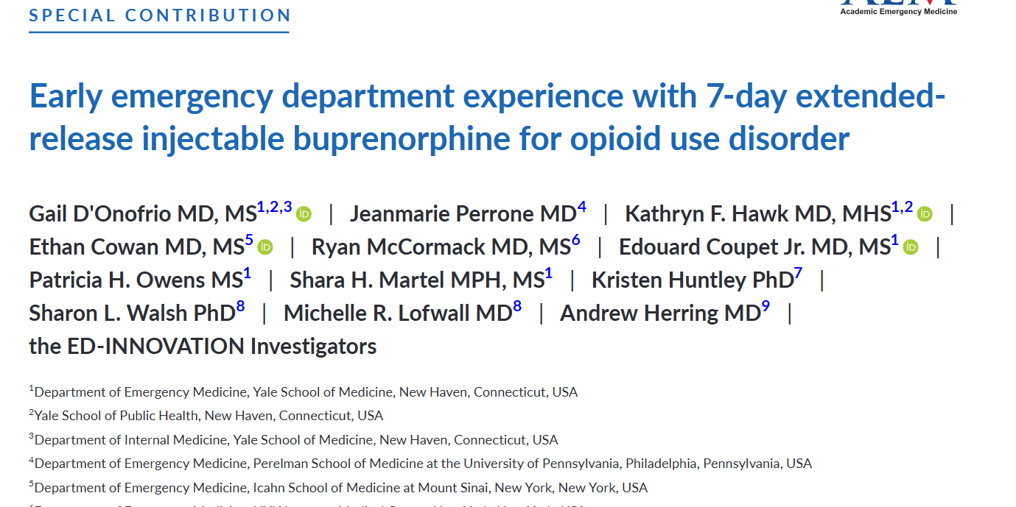

Our Experience with XR-BUP in the ED
COWS $≥$4
3% randomization refusal rate
One investigator has successfully transitioned 50 patients onto 30-day XR-BUP
Positive comments by patients, nurses, doctors
D’Onofrio et al. Acad Emerg Med. 2023
Notes:
One patient jailed in interim and was grateful to have had XR-BUP since there was no SL BUP in jail
Do this side by side
PUT paper in, no need for Quote

Slide 22

Everyone's biggest fear

Slide 23
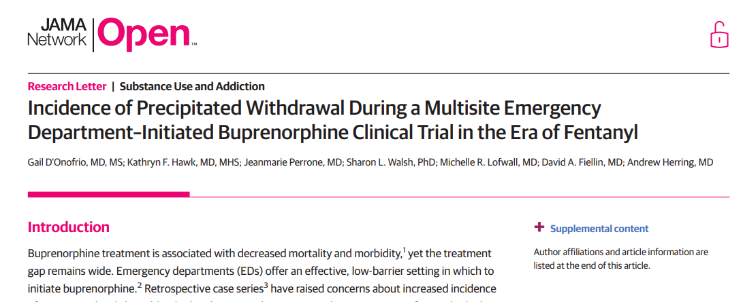
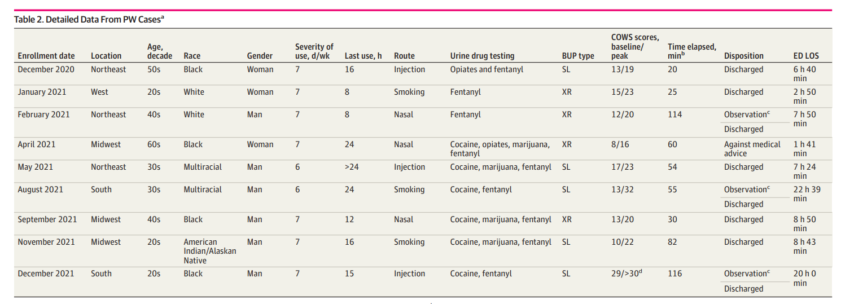
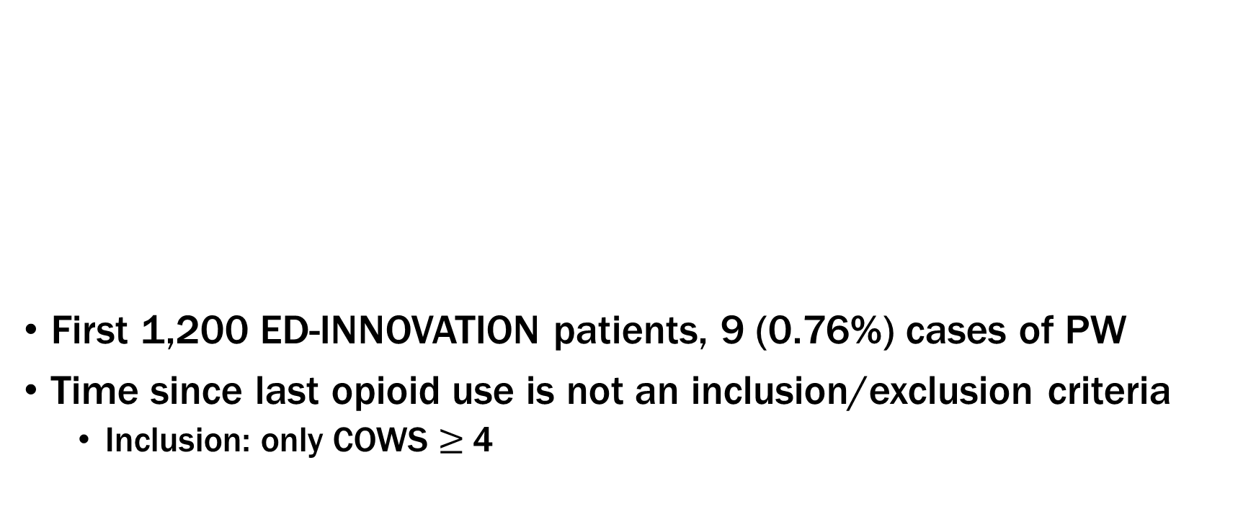
Precipitated Withdrawal
1,200 patients enrolled
9 (0.76%) PW
No consistent presentation
- Time since last
use (8->24 hrs)
- Route of use
All Discharged
D’Onofrio et al. JAMA Netw Open. 2023 Mar 1;6(3):e236108.

Slide 24

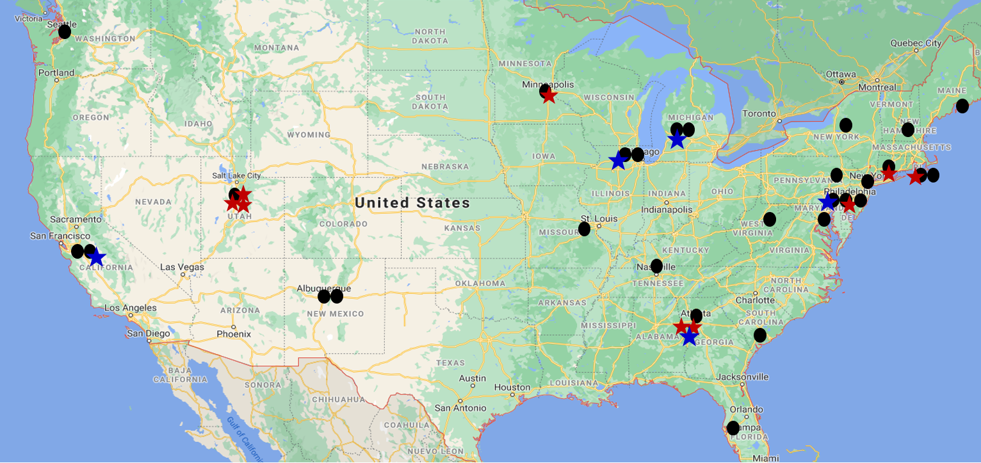
Precipitated Withdrawal ED INNOVATION Complete
Key
Location of enrolling sites (31)
Location of SL-BUP precipitated withdrawal (9)
Location of XR-BUP precipitated withdrawal (5)
Enrollment by sites that experienced withdrawal
Site Location | # PW
Northeast (11 sites) | 4
West (6 sites) | 4
Midwest (6 sites) | 3
South (6 sites) | 3
Totals | 14
14/2000 = 0.7%

Slide 25
Imagine….
Innovative Dosing Induction Strategies…

Slide 26
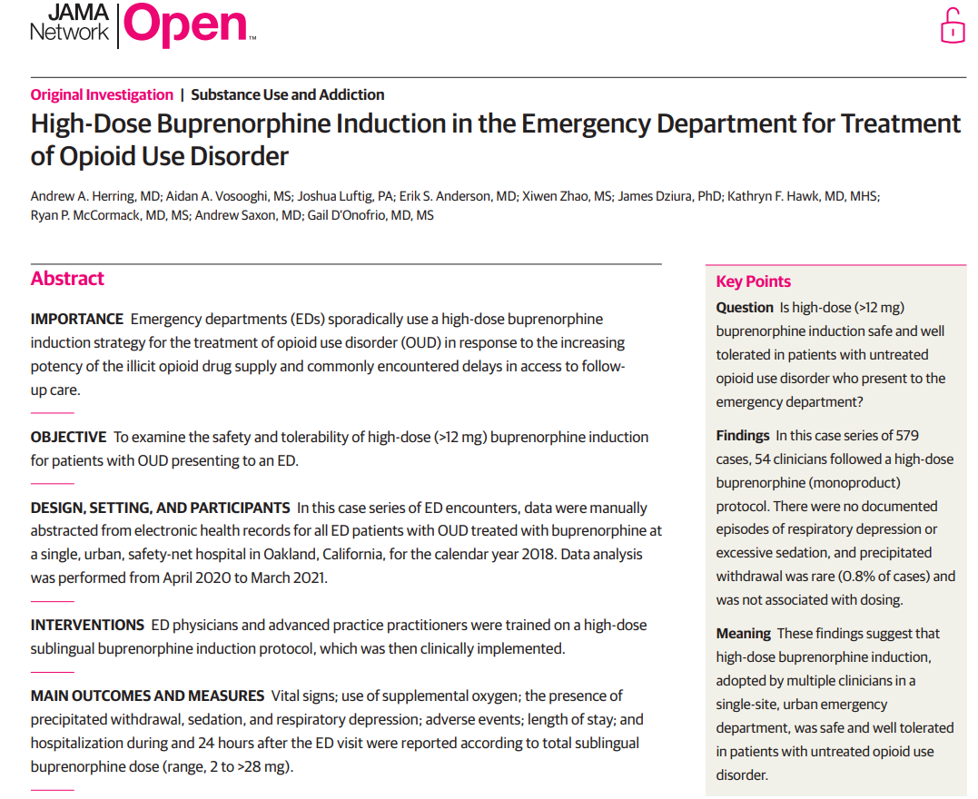
High-Dose Buprenorphine (>12mg) Induction
CTN 0069-A1
Retrospective case series –
Highland Hospital, Oakland CA in 2018
391 unique patients (579 encounters)
No cases of respiratory depression or sedation
Herring, JAMA Netw Open. 2021
Notes:
To date only retrospective study examining safety and tolerability.
No published clinical trials comparing high dose to other initiation protocols

Slide 27
Outcomes
ED Length of stay was less in higher doses
5 cases of precipitated withdrawal NOT dose related
No difference in return to ED within 24 hours or Time to return
Total Buprenorphine Dose (mg sublingual)
 | 2-6 n=55 | 8 n=136 | 10-12 n=22 | 16 n=106 | 20-24 n=122 | 28+ n=138 | p-value
Length of Stay hours | 3.5 (2.4-5.8) | 2.6 (1.7-4.4) | 2.6 (2.1-3.7) | 2.1(1.5-3.5) | 2.2 (1.4-3.3) | 2.3 (1.7-3.6) | 0.002
Precipitated Withdrawal | 0 | 4 (2.9%) | 0 | 0 | 0 | 1 (0.7%) | 0.20
Hospitalization | 5 (9.1%) | 4 (2.9%) | 1 (4.5%) | 3 (2.8%) | 8 (6.6%) | 4 (2.9%) | 0.26
Return to ED within 24 Hours | 2 (3.6%) | 10 (7.4%) | 3 (14%) | 9 (8.5%) | 6 (4.9%) | 15 (11%) | 0.32
Time to Return to ED Within 24 Hours | 13.8 (12-16) | 11.4 (5.9-14) | 17.8 (11-20) | 10.4 (6.5-23) | 15.1 (13-18) | 18.4 (14-22) | 0.52
High dose induction was safe and well tolerated

Slide 28
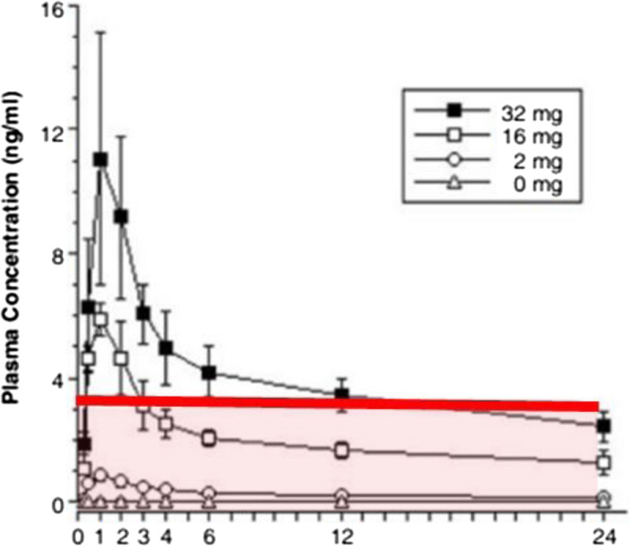
Bu
Buprenorphine Safety at Higher Doses
Higher doses of buprenorphine 24-32 mg suppress drug liking
BUP plasma concentration over 24-hour period after once daily dosing in 5 OUD volunteers Red line is level required to suppress drug liking of high dose hydromorphone challenge
Grande LA, J Addict Medicine 2023

Slide 29


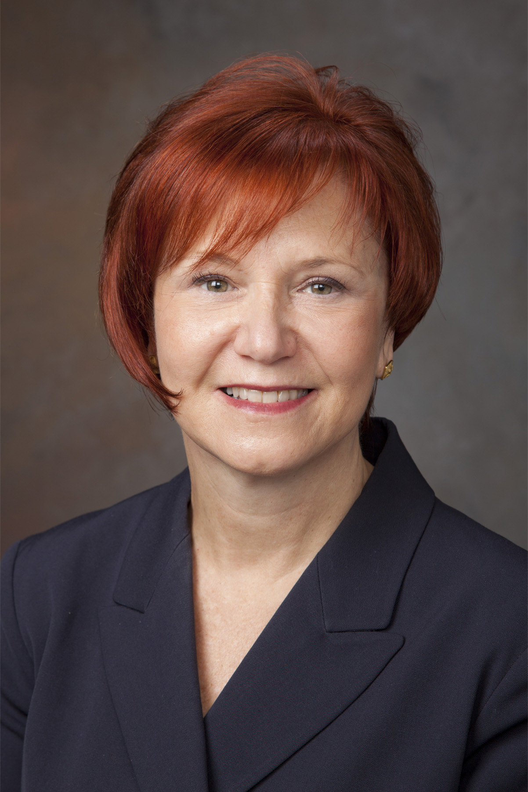
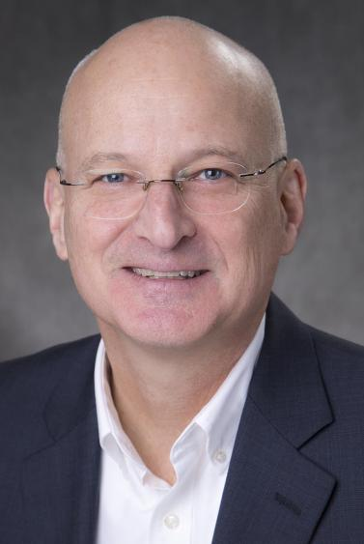
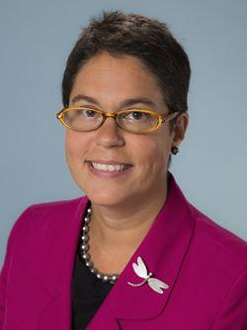

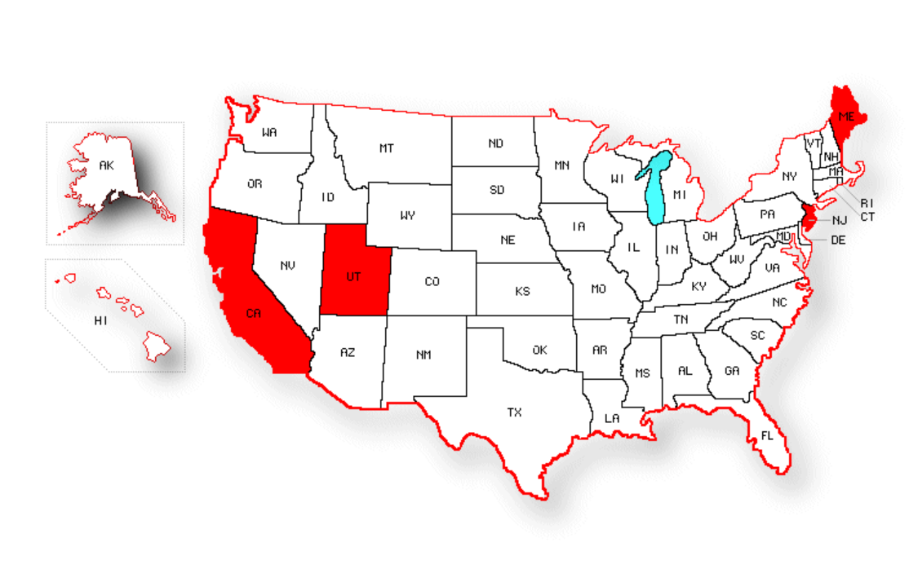






ED-Initiated Standard vs High Dose Buprenorphine Induction
Lead Investigators
ED–ENVISION
Randomized Trial in 4 sites across the US
Double-blind, double-dummy
Compares Standard SL dose (8mg) and High Dose (24mg) induction on rates of engagement in OUD treatment within 10 days
CTN 0145
Hawk
Herring
D’Onofrio
M. Baumann
T. Strout
E. Anderson
A. Dorey
C. Jones
Notes:
Have research infrastructure, patient volume, site PIs capable of supervising enrollment.

Slide 30
Imagine….
New Delivery Systems….

Slide 31

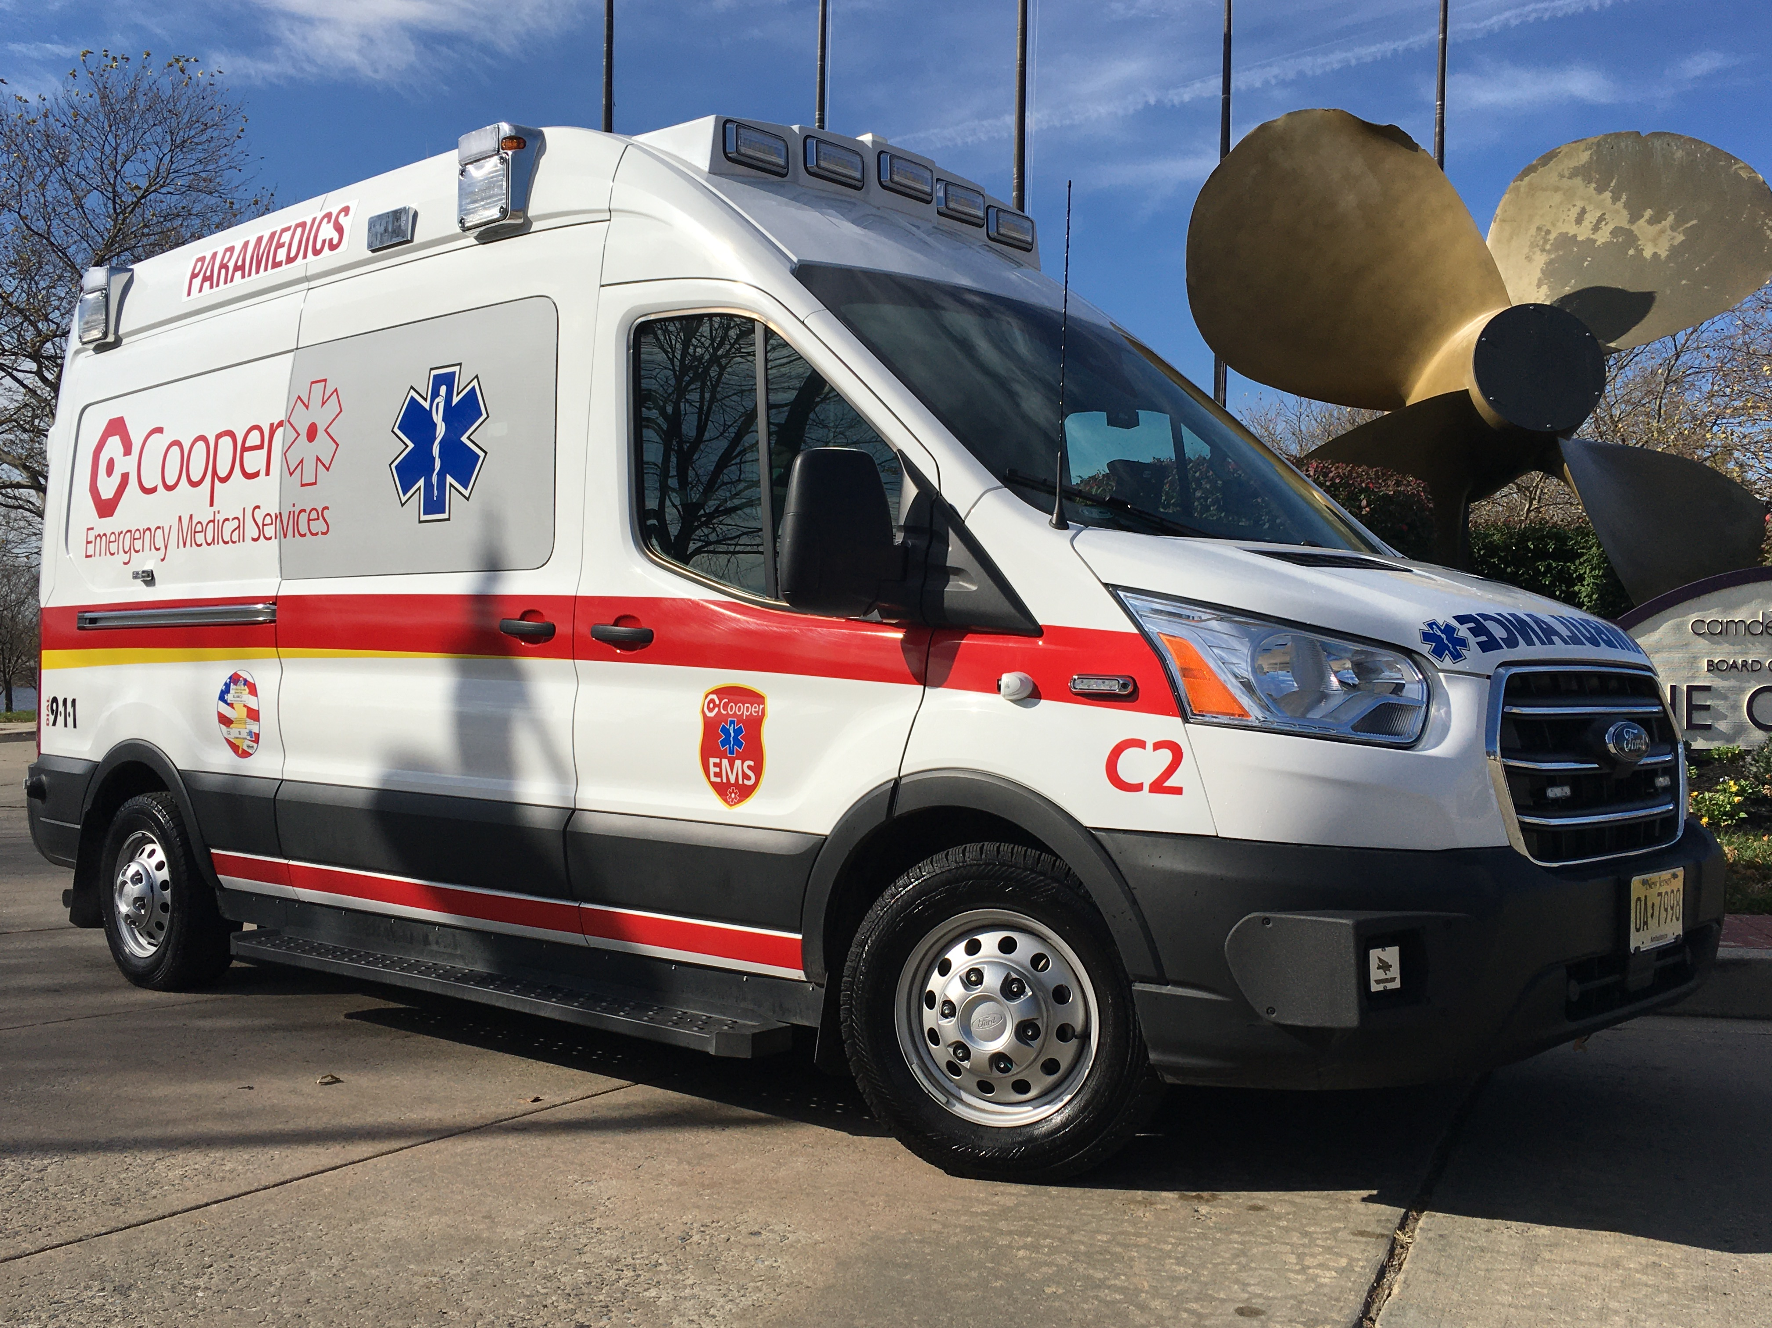


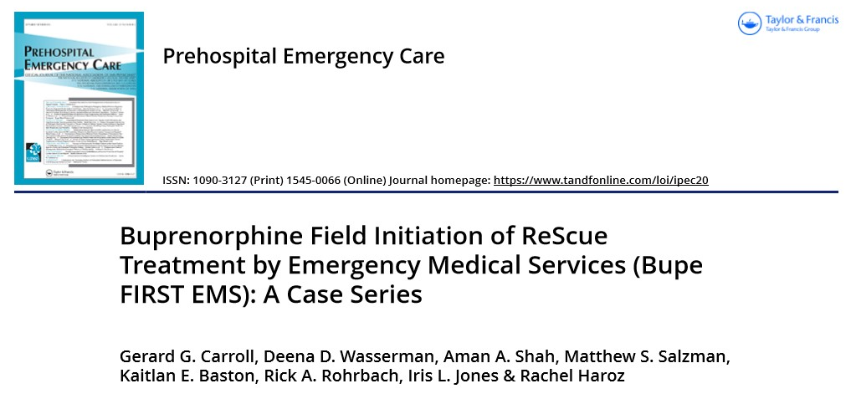
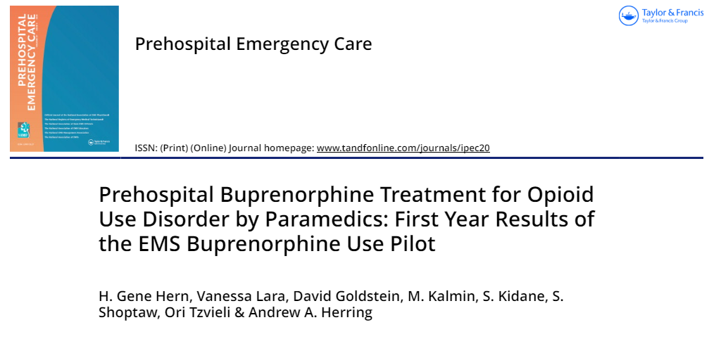
EMS – Prehospital Setting
BupeFirst-EMS
California Opioid Multi-agency Response Intervention project (Cal-OMRI)
Carroll GG. Prehospital Care 2020
Hern HG, Prehospital Care 2023

Slide 32




EMS Initiated Buprenorphine
 | Camden NJ N=174 | Contra Costa CA N=100
Dates | 8/1/2020 – 5/1/2024 | 10/9/2020 – 10/11/2023
Mean Age (range) | 44.3 (21-72) | 36.4 (17-82)
Sex # (%) Male Female Missing | 133 (76.4) 41 (23.6) --- | 65 (65.0) 34 (34.0) 1 (1.0)
Race/Ethnicity # (%) White Black Asian Multirace Other Hispanic | 80 (46.0) 77 (44.3) 1 (0.6) --- 14 (8.0) 28 (16.1) | 51 (51.0) 25 (25.0) 9 (9.0) 5 (5.0) 9 (9.0) 89 (89.0)
Presentation Overdose Withdrawal | 174 (100) --- | 33 (33.0) 67 (67.0)
COWS Score Mean (range) | 10.2 (2-30) | 16.1 (3-45)
BUP Dispensed – Mode # (%) Initial Dose Total Dose | 16mg 172 (99) 16mg 144 (83) | 16mg 87 (87) 16mg 69 (69)
Transport to ED | 82 (47.1) | 99 (99.0)
Follow-up Attended F/U Apt In treatment 30-day | 51 (21.3) 41 (23.6) | --- 30 (30.0)
An observational cohort of patients treated by EMS personnel for OD or withdrawal 8/20-5/24
Camden NJ & Contra Costa CA
EMS-initiated buprenorphine is feasible in the prehospital setting.
prospective studies are needed!
CTN 0154 is Born
G. Carroll
A. Herring
CTN 0154 Site PIs
N. Simpson

Slide 33
Imagine….
Electronic Health Record Screening for…

Slide 34

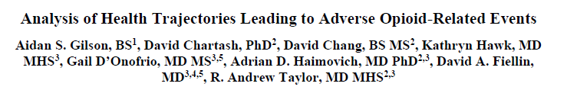


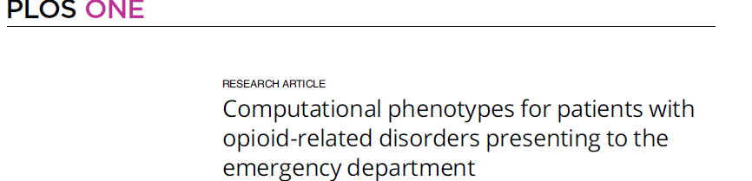
Surveillance & Research
EHR can be leveraged to extract risk factors for future research and to inform guidelines for clinicians prescribing opioids, need for further assessments and services
Retrospective study across 10 sites 2013-2020. Phenotypes derived pts >18 with > 1 opioid-related diagnosis. NLP extracted clinical entities from notes combined with EHR data
Distinct phenotypic clusters with varying patient-oriented outcomes exist, highlighting the heterogeneity of the population and need to develop targeted interventions for each population
Taylor RA, AMIA 2021
Taylor RA, PLOS One 2023

Slide 35
Imagine….
Clinical Pathways ….

Slide 36
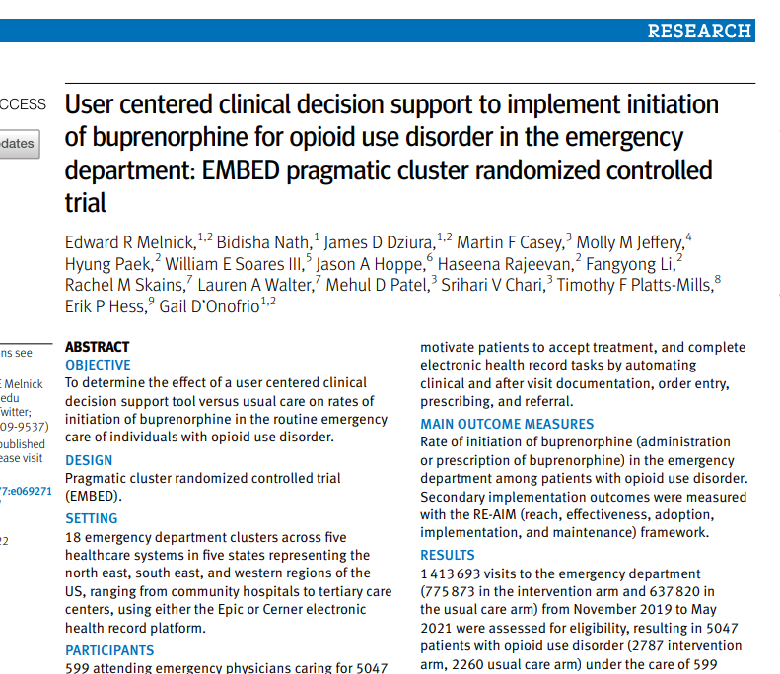
Clinical Decision Support
18 ED clusters across 5 health systems
No change in rates of initiation of buprenorphine in the emergency department
The number of unique physicians that provided buprenorphine in the ED and prescribed naloxone increased in the intervention arm
Melnick ER, bmj. 2022.

Slide 37

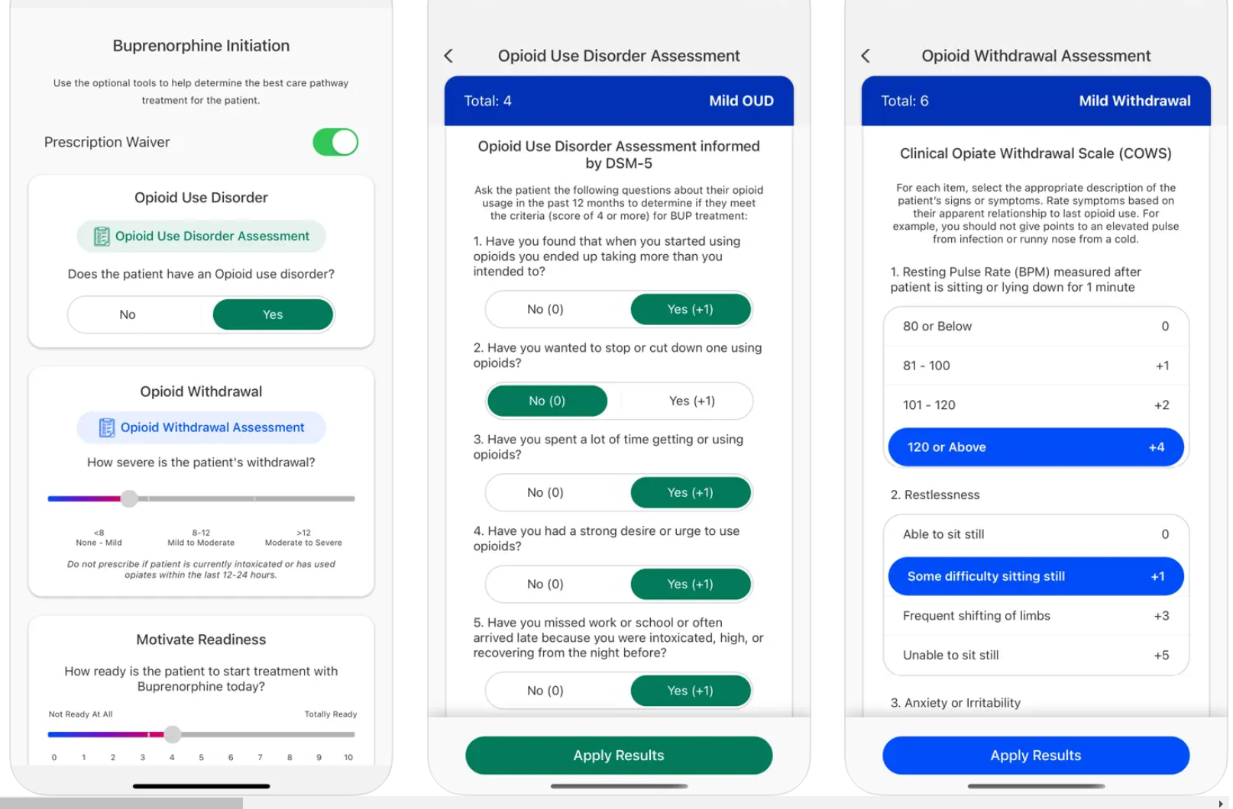
DSM-5 Diagnosis of OUD
COWS scores
Motivational Readiness

Slide 38

Epic Clinical Decision Support

Slide 39
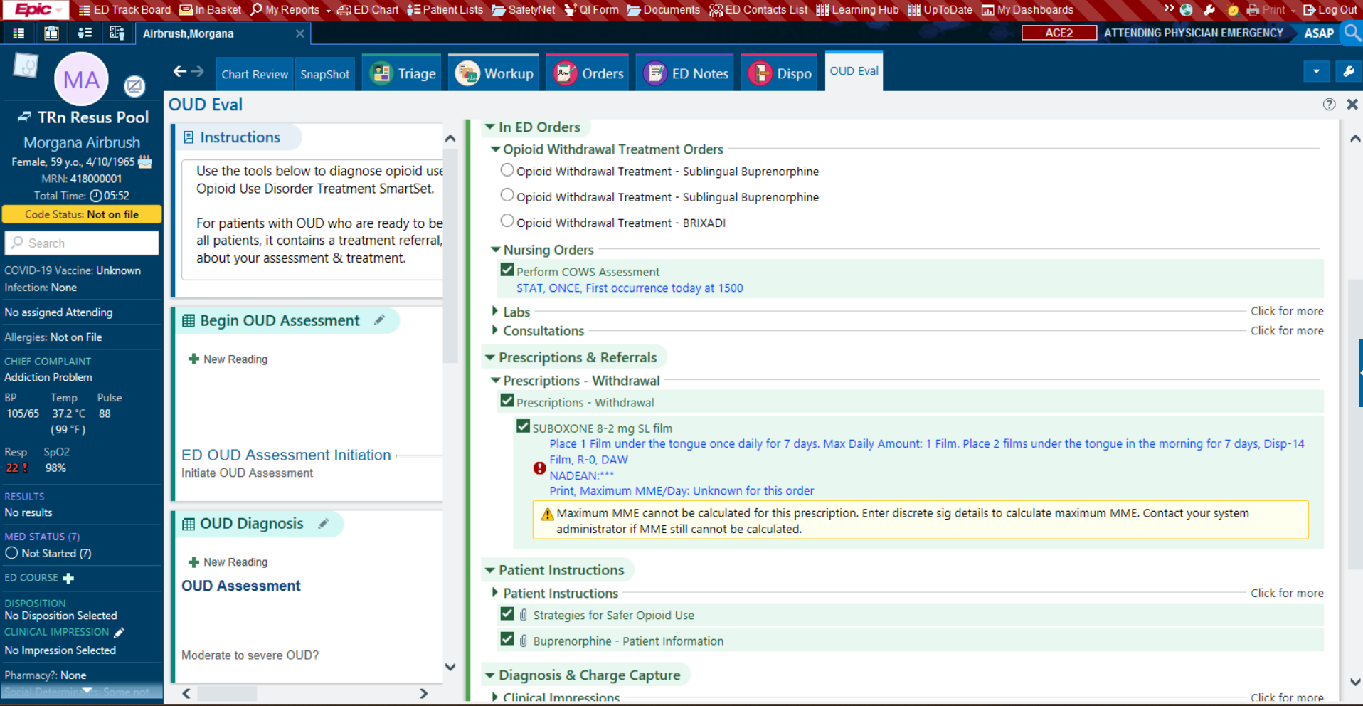
Pre-Defined Order Sets

Slide 40

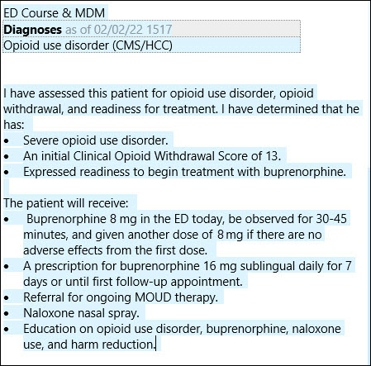
Emergency Clinician Note includes:
Diagnosis
Assessment
Medications
Administered
Prescribed
Harm reduction
Referral

Slide 41

When We Work Together!!!
Imagine… the possibilities to increase OUD treatment

Slide 42


