Slide 1


Mechanisms of overdose from unintentional fentanyl use among people who use stimulants: a qualitative study
UCSF School of Medicine
UCSF Department of Psychiatry and Behavioral Sciences
Bryson O. Gomez, Elyssa Y. Samayoa, Leslie W. Suen, Susan L. Ivey, Phillip O. Coffin, Alexander R. Bazazi

Slide 2
We have no conflicts of interest to disclose.
This work was funded by the UCSF OUD RAP
(NCATS #UL1 TR001872).

Slide 3
Background
Fentanyl implicated as major driver of overdose mortality nationwide and in San Francisco
31% of people who experienced a nonfatal overdose in San Francisco reported intending to use a stimulant
Drug testing in San Francisco often shows little to no adulteration of stimulants by fentanyl
Notes:
Citations for the epi. Kral, Ciccarone.
Context: UFU mostly studied in context of PWU heroin trying to avoid fentanyl
Expand racial disparities background
Sketch UFU setup: Figure: increasing OD deaths from fent + stim in SF figure (and stats for nationwide). Data from different sources: clusters, drug testing and DEA, concern of PWU drugs. (use image for each)

Slide 4
Research Question
How do people who use stimulants and avoid opioids end up overdosing via unintentional fentanyl use?
Notes:
Citations for the epi. Kral, Ciccarone.
Context: UFU mostly studied in context of PWU heroin trying to avoid fentanyl
Expand racial disparities background
Sketch UFU setup: Figure: increasing OD deaths from fent + stim in SF figure (and stats for nationwide). Data from different sources: clusters, drug testing and DEA, concern of PWU drugs. (use image for each)

Slide 5




Approach
Qualitative study of people who experienced an opioid overdose while intending to use a stimulant
Eligible participants were those who do not use fentanyl and experienced overdose attributed to UFU in past 120 days
Recruited people primarily from post-overdose outreach team, also some peer and hospital referral, 6/2023 - 7/2024
Semi-structured interview guide focused on eliciting detailed narrative of their overdose and risk reduction strategies

Slide 6
Results
Participant demographics (N = 17)
Notes:
@bryson – make this look better. Ask someone about whether to present demographics?

Slide 7
Results
Participant demographics (N = 17)
*Includes powder cocaine (1), crack cocaine (3), and both (2)

Slide 8
Results Overview
1. Fentanyl exposure occurred during different stages of drug use
Procurement
Storage
Consumption
2. Participants’ ability to reduce their risk of overdose is influenced by structural factors (e.g., drug supply, housing policies)

Slide 9
Results Overview
1. Fentanyl exposure occurred during different stages of drug use
Procurement
Storage
Consumption
2. Participants’ ability to reduce their risk of overdose is influenced by structural factors (e.g., drug supply, housing policies)

Slide 10
Drug Procurement:
Getting fentanyl when intending to get a stimulant
Procurement
Procurement
Storage
Consumption
Supplier mix-up
The person that I got it from when I OD’d, he didn’t know that it had fentanyl…I called [him], I said, “My baby daddy said you gave him some fentanyl.” [The supplier] said, “I might have, I didn’t do it intentionally, because he sells fentanyl, too, and crack and weed, but he didn’t know that he had mixed it, so I guess it was an accident. I called and told him what had happened to me, and he said he didn’t do it intentionally, if he did he apologized.”
Notes:
Add statements or summary about range of physical mechanisms

Slide 11
Drug Storage:
Fentanyl stored alongside stimulants
Storage
Procurement
Storage
Consumption
Syringe Mix-Up
Participant: [My boyfriend] does fentanyl, so he made one [syringe] for himself, and he made one for me. And so we got into an argument because I was mad... because he couldn't [find a vein on me for injecting]…so we separated and I was going to go and have somebody else do it, so I took both points with me…not realizing that one might be different than the other...I carried them in a little like pencil case…I got to my friend…he hit me perfectly and I knew I messed up right away, like I was like, oh no, that must have been the wrong one...
Interviewer: Do you also hit yourself?
Participant: No, I can’t hit myself…I don’t know how to.”
Notes:
Add more qual methods detail for DURG
Add statements or summary about range of physical mechanisms
Note: no demographics for this first quote – add?

Slide 12
Drug Consumption:
Same types of equipment used to smoke stimulants and fentanyl
Consumption
Procurement
Storage
Preparation & Use
"It was the same pipe"
And the reason this happened was because I have friends that do fentanyl and my stuff got mixed up with their stuff and it was in the [same kind of] pipe that I was using and I didn't know that so I overdosed because it was, I used the fentanyl instead of the meth.
We were sitting next to each other and all the stuff was just like on the floor and they look the same so it was the same pipe.

Slide 13
Drug Consumption:
Intentionally giving fentanyl to others
Consumption
Procurement
Storage
Preparation & Use
"Trying to steal"
I was smoking. I let this guy use my pipe and he put some fentanyl on there. I didn’t know what it was but I started feeling kind of funny. Next thing I know I woke up, I was in an ambulance…So basically what he was trying to do was steal my credit cards and he took, he took my food stamp card and my ATM card.
Notes:
Highlight social context

Slide 14
Fentanyl and stimulants are indistinguishable ​
Sensory identification of drugs difficult in fentanyl era
But I forgave them, I forgave that person [that gave me the fentanyl I overdosed on] because he didn't know he was buying [fentanyl] from the dealer…because you can’t decipher between meth and fentanyl now because it's all powder form.

Slide 15
Fentanyl is difficult to avoid
No safe space to use fentanyl
There wasn't really anything unusual about that day except for that this guy came over who I don't normally hang out with…he's living at a…it's sort of like a shelter, and so I felt bad for him because, you know…he doesn't have keys, like, he's kind of in a controlled environment…he can’t even bring people in his room…and so I felt bad for him so I let him come over and we were just watching TV and smoking, and he was doing fentanyl and I was doing meth, and then that's when it went haywire.
Notes:
Can we discuss tightening these quotes up at least for the presentation (if not the paper)
Wonder if we can connect this basic needs quote with the OD story (rushing to make ends meet)

Slide 16
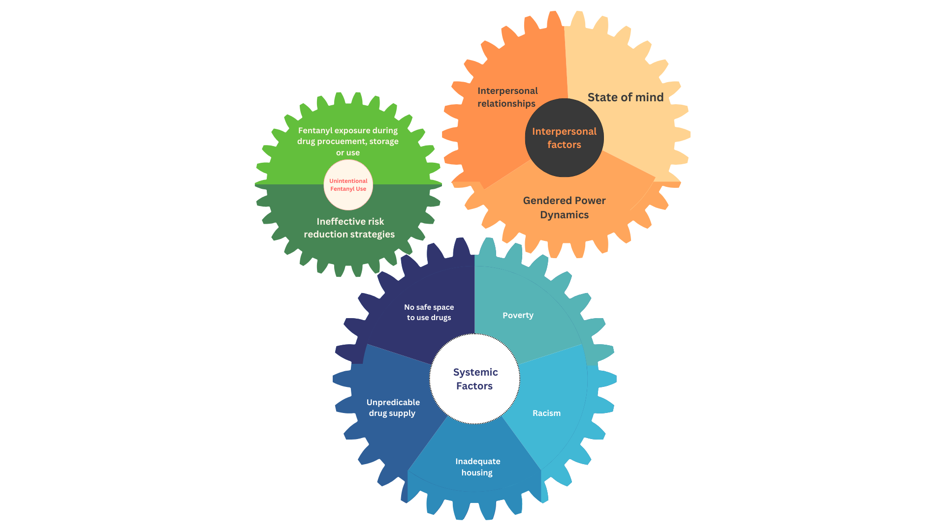
Conclusions
Notes:
Photos would be helpful somewhere
Ideally discuss implications for prevention of each mechanism

Slide 17
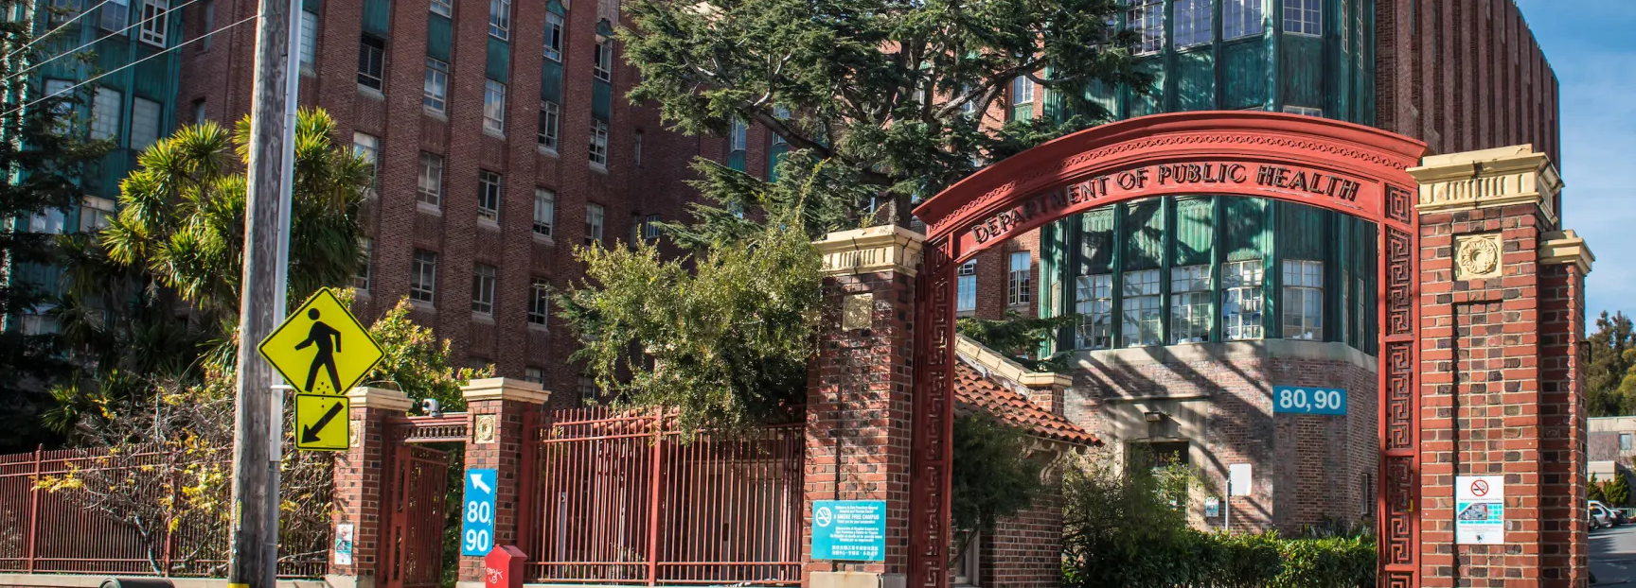
Questions?

Slide 18
Appendix

Slide 19
Poverty and criminalization influence safe use
Poverty / Basic needs unmet
Urgent use
[Using meth] also has to do with the kind of lifestyle you end up in when you have to pay sixteen hundred dollars in rent and you only get nine hundred dollars a month…for all of your expenses…everything included in your SSI isn’t enough to survive on in San Francisco, there's no way so you have to supplement your income somehow, and unless you steal or you deal drugs or you can get a job and not get caught by SSI you're going to end up doing what I did, which was prostitution. And so it's, it's really challenging to stay out of crime when you can't have a W-2 or lose your benefits.
…me and this guy were just talking and smoking a joint and he said, “Oh, I have some cocaine. Actually, I'm not sure if it's cocaine or fentanyl,” and I looked at it I said, “I think it's cocaine.” And I'd been up for a while on meth and so it wasn't working for me, I was like saturated, I couldn't really do anymore of that so I was like, oh, yeah, I really want to snort a line of coke. And I had to get rent money, too, so I was like trying to stay awake, okay. So I snorted a big line of it, or like, like the size of my pinky nail, you know, of cocaine, well, what I thought was cocaine, it turned out to be [fentanyl].
Notes:
Can we discuss tightening these quotes up at least for the presentation (if not the paper)
Wonder if we can connect this basic needs quote with the OD story (rushing to make ends meet)

Slide 20
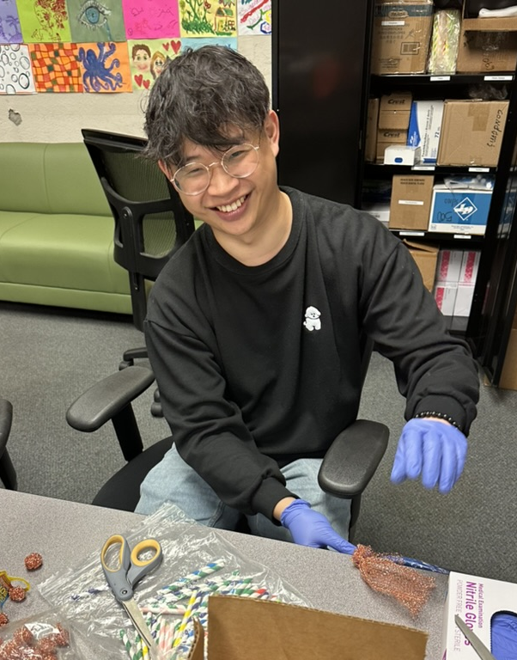
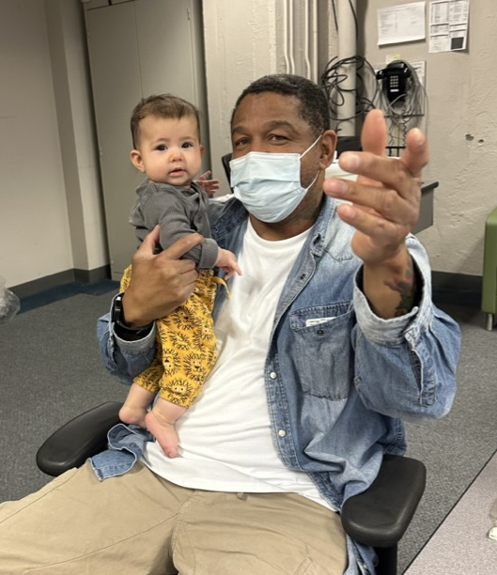
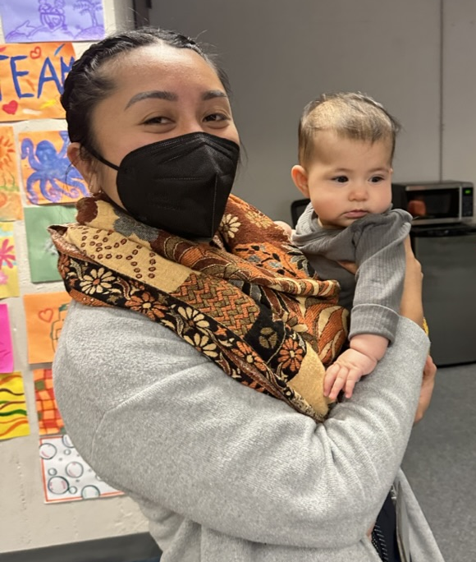
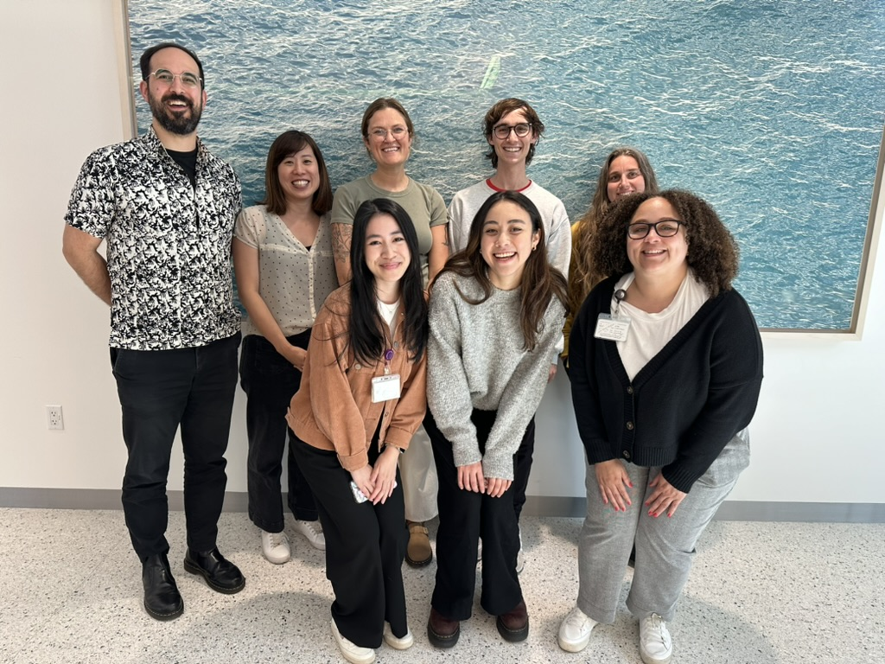
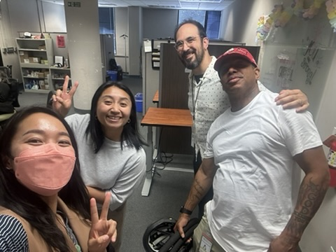
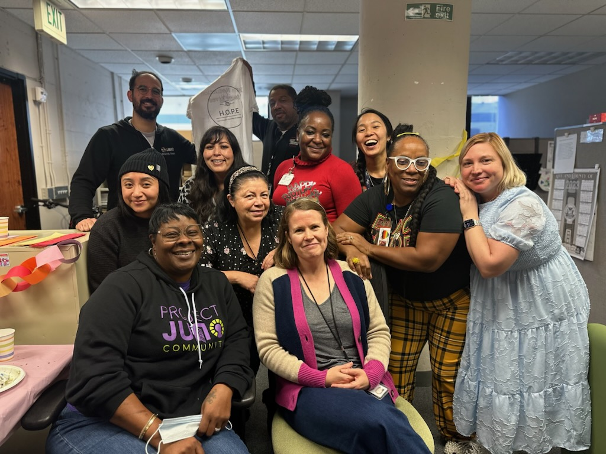
Acknowledgements
UCSF HOPE Post-Overdose Outreach Team & Clients
Patrick Low, Elyssa Samayoa
Primary Mentor: Phillip Coffin
McCuistian/Suen/Bazazi Lab, Kelly Knight
Andy Tompkins, Christy Soran
Partners: SFDPH (BHS/OOP, WPIC/Street Med/POET), SFFD

Slide 21
Potential interventions
Analysis ongoing
Intervention | Considerations
Naloxone | Gaps in knowledge and access
Never use alone | Some people want to use alone
Fentanyl test strips | Hard to use, limited knowledge
Drug testing sites | Inconvenient, concern about police
Pipe markers | More data needed
Behavioral interventions | More data needed
Treatment of StimUD | Only applicable to those seeking use reduction
Naltrexone | Acceptability concerns
Safe supply | What exactly would this look like?
Overdose prevention sites | Need to be acceptable to people who smoke
Notes:
General barrier – low perceived risk of repeat event
General: NLX, NLX, NLX... -- not everyone reported knowledge and experience w/naloxone; the work isnt done here
Never use alone? People want to use alone...especially after overdose attributed to dosing or mixup. Hotline?
Role of FTS, drug checking
Ways to identify pipes?
Education about appearance of fentanyl vs. Cocaine vs. Meth?
Broader reform: Safe supply? What even is that? OPS but have to be acceptable to PWU stimulants and smoke
Meds for OD prevention? NTX?
For people interested in use reduction: CM, other pharmacotherapy (NTX, bupropion, mirtazapine...)?

Slide 22
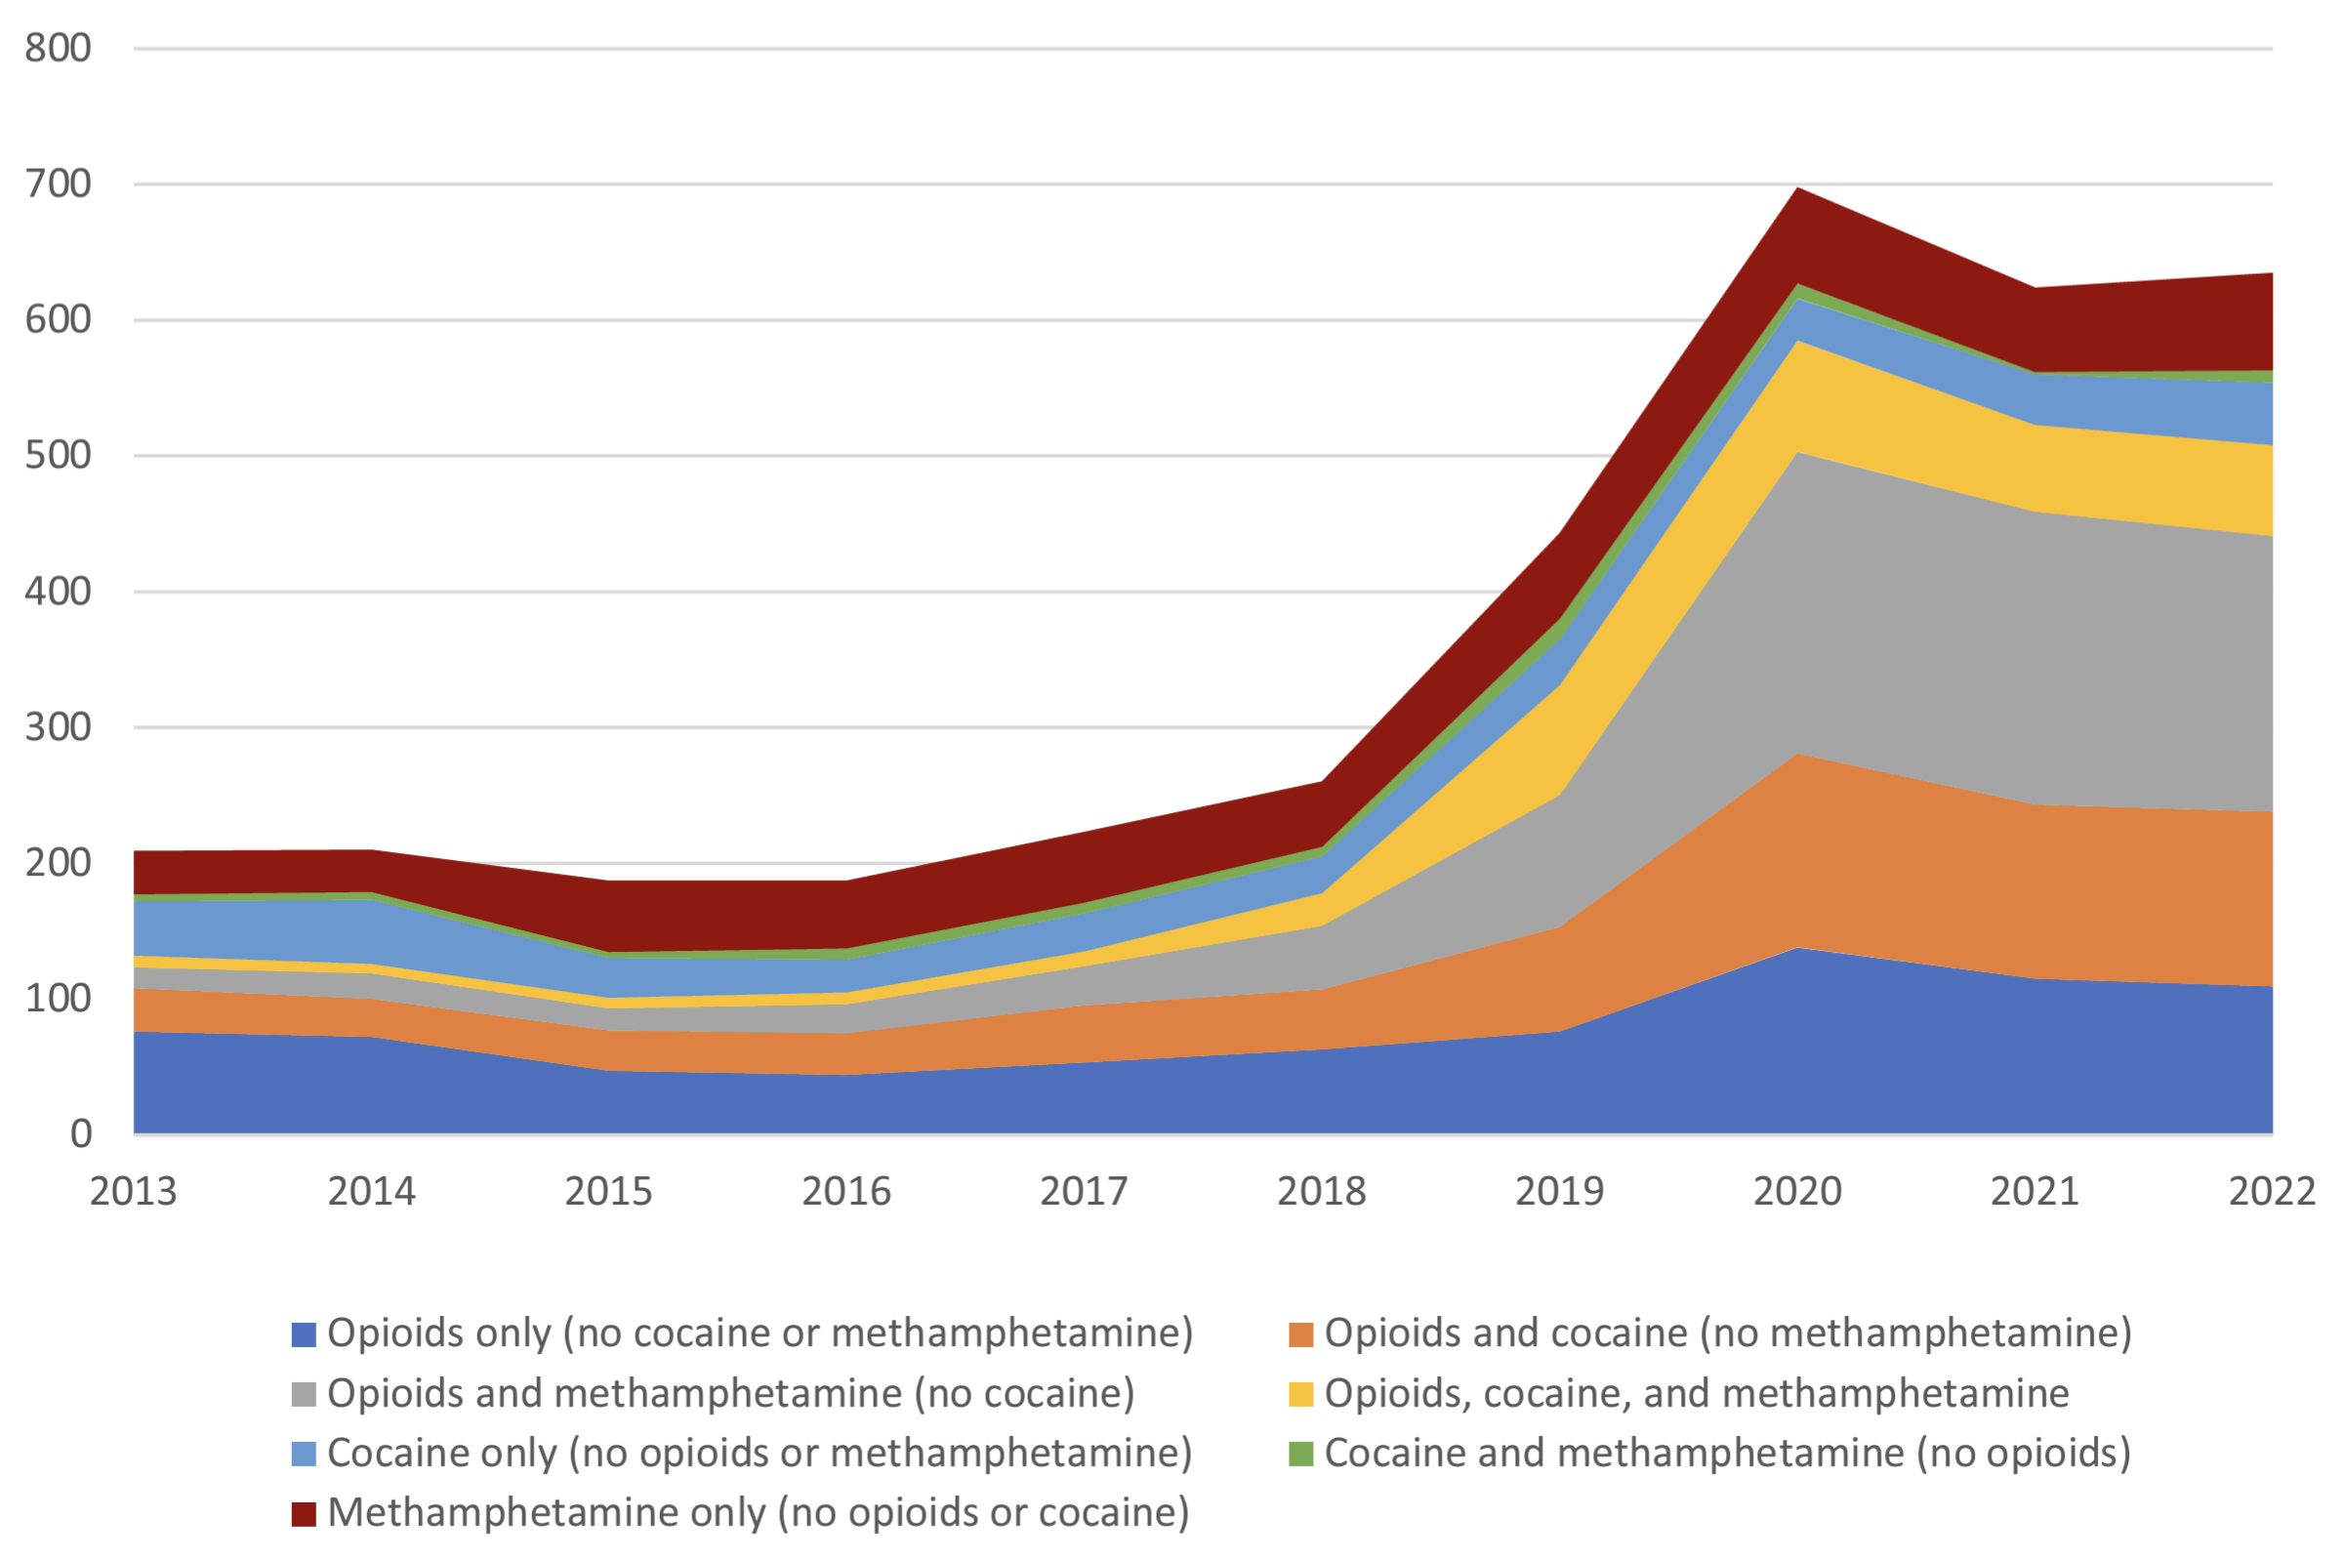
"Fourth Wave:" Fentanyl + Stimulants in Overdose Deaths
Overdose deaths, SF
Opioids +
Stimulants
CSUH, SFDPH 2023

Slide 23
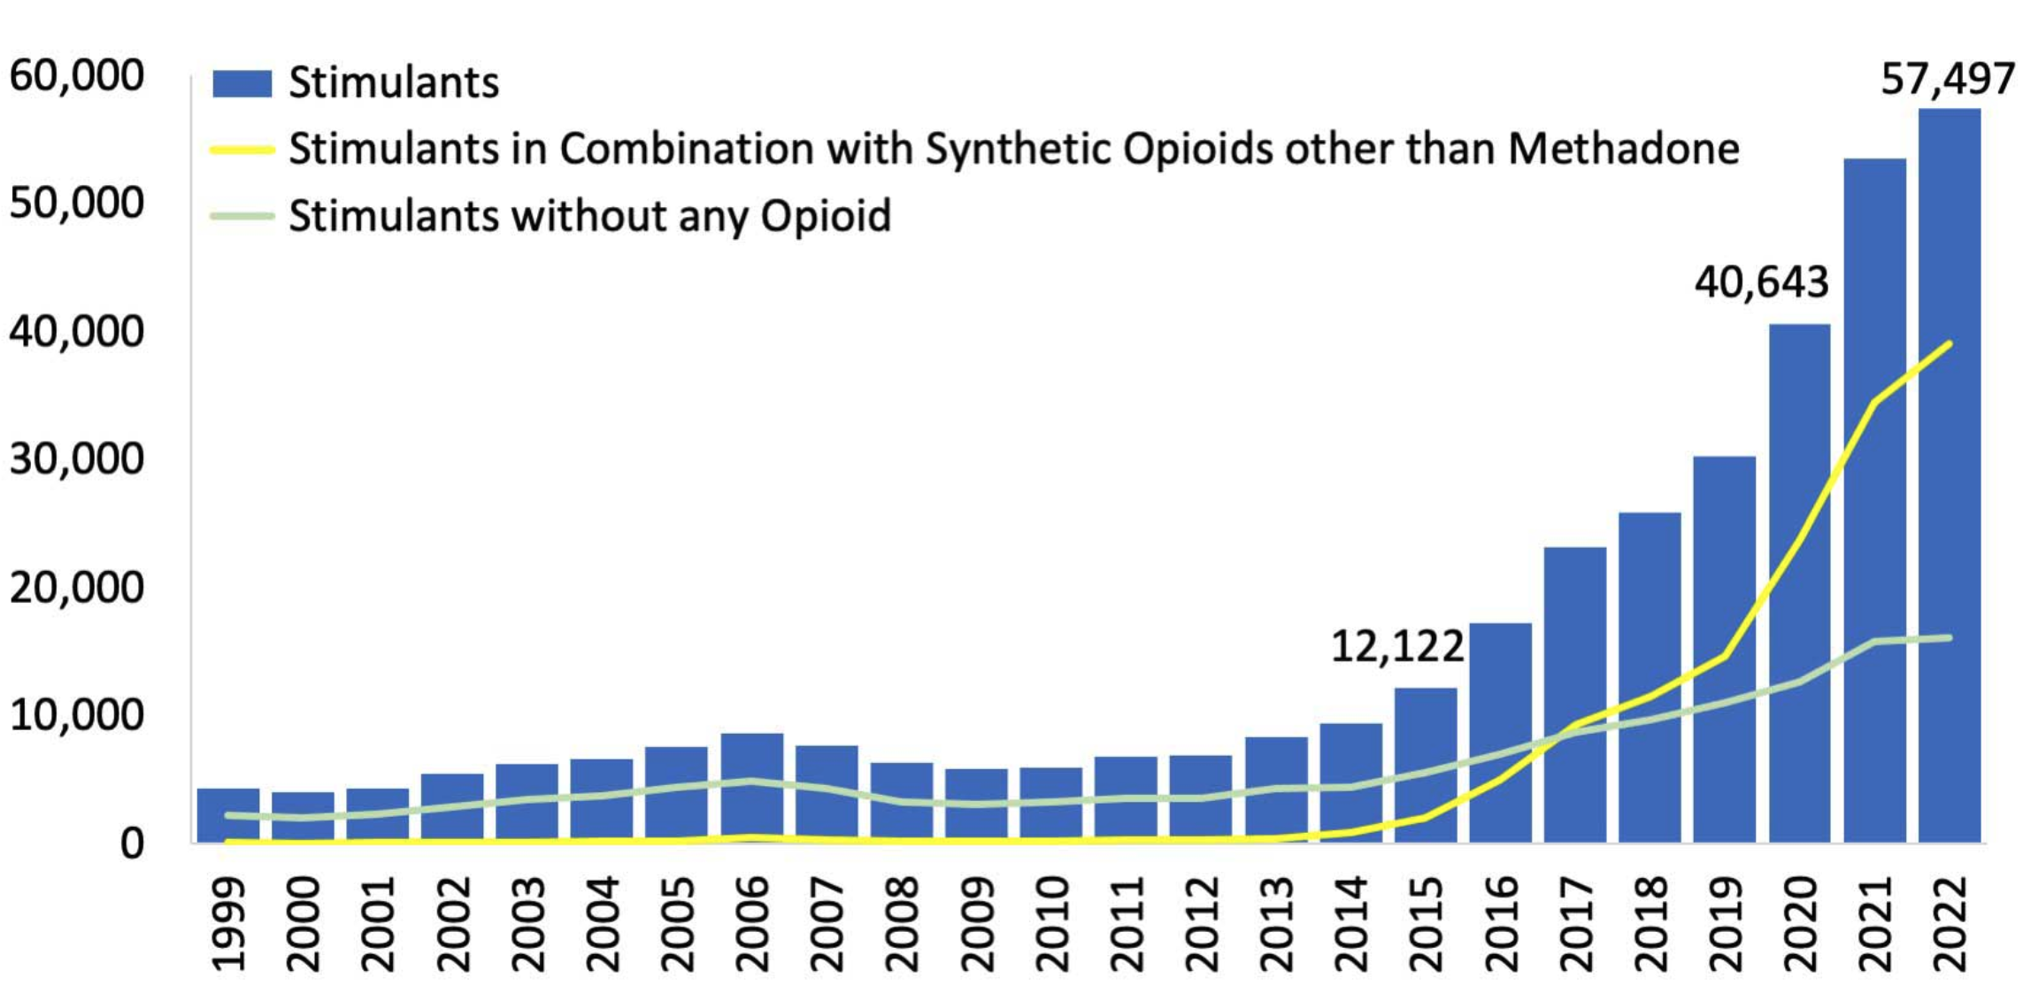
Fentanyl + Stimulants Involved in Most Overdose Deaths
Overdose deaths involving stimulants, US
Opioids +
Stimulants
Overdose deaths, SF
CDC, NCHS 2024
Opioids +
Stimulants
"Fourth wave"
Ciccarone 2021
CSUH, SFDPH 2023
Notes:
Add racial disparities for each (text?)

Slide 24
Open Questions and Next Steps
Are people who use stimulants and experience an unintentional fentanyl OD at risk of repeat OD and subsequent mortality? (How intensively should we outreach this population?)
What interventions should be deployed to reduce overdose risk from unintentional fentanyl use among people who use stimulants?
  Currently analyzing qualitative data on attitudes toward interventions
  HOPE team developing QI process for synthesizing and deploying best practices for this population

