Slide 1
Medical Students’ Perceived Value of Buprenorphine Waiver Training After Removal of Training Requirement

Slide 2
Disclosures
Funding to support medical student training was provided by SAMHSA (Grant 1H79TI081651).
The views expressed herein do not necessarily reflect the official policies of the Department of Health and Human Services nor imply endorsement by the U.S. Government.
No other financial disclosures
Notes:
These views are my own!

Slide 3
Recent legislation aimed to reduce barriers to prescribing buprenorphine
Buprenorphine FDA approved (2002)
MAT Act² (Dec 2022) eliminates the X-waiver
8-hour training
DEA registration
Patient limits
SAMHSA guidelines¹ (Apr 2021) remove training requirement, X-waiver still required
¹SAMHSA, 2021, 86 FR 22439
²Section 1262 of the Consolidated Appropriations Act, 2023
Notes:
MAT = Mainstreaming Addiction Treatment

Slide 4
Buprenorphine underutilized even by clinicians who complete training
Studies suggest that even clinicians who complete training underutilize buprenorphine.^{1,2}
Do regulatory changes influence clinicians’ readiness to prescribe buprenorphine?
¹JAMA. 2016;316(11):1211–1212
²JAMA Netw Open. 2020;3(8):e2014045
Notes:
JAMA citation = 22% of buprenorphine prescribers only treat 1-3 patient
JAMA ON citation = prescribers with 30 patient limit only treat ~3 patients, those with 100 patient limit treat ~24 patients and those with 275 patient limit treat ~102 patients

Slide 5
Objective
To understand medical students’ perceptions of the value of buprenorphine training in the context of changing regulatory requirements.

Slide 6
Curricula
In 2021 used the ASAM “half-and-half” curriculum
4 hours of asynchronous online content
4 hours of live, online content
In 2022 used the PCSS “half-and-half” curriculum
4 hours of asynchronous online content
4 hours of live content (delivered hybrid)

Slide 7
Methods
Medical students who participated in optional waiver training shortly before graduation in 2021 and 2022 were surveyed about their willingness to take the training despite it no longer being required to obtain a DATA waiver.

Slide 8
Methods, cont.
Students were also asked about the quality and usefulness of the training.
Questions were asked using a 5-point Likert scale.
Descriptive statistics were calculated using MS Excel.

Slide 9
Results – N=122, Response rate 74%
Residency Plans
 | n | %
Family medicine | 18 | 14.8%
Internal medicine | 20 | 16.4%
Pediatrics | 13 | 10.7%
Emergency medicine | 42 | 34.4%
Ob/Gyn | 6 | 4.9%
Psychiatry | 12 | 9.8%
Other | 10 | 8.2%
Notes:
Total participants = 166 (111 in 2021, 55 in 2022)

Slide 10
“The material presented in this training increased my knowledge of opioid use disorder and medication-assisted treatment”
 | n | %
Strongly agree | 64 | 52.5%
Agree | 54 | 44.3%
Neutral | 1 | 0.8%
Disagree | 1 | 0.8%
Strongly disagree | 0 | 0.0%

Slide 11
“This training was a useful supplement to the other opioid use disorder training I received during medical school”
 | n | %
Strongly agree | 67 | 54.9%
Agree | 50 | 41.0%
Neutral | 3 | 2.5%
Disagree | 2 | 1.6%
Strongly disagree | 0 | 0.0%

Slide 12
“I expect to use the information gained from this training to treat opioid use disorder”
 | n | %
Strongly agree | 52 | 42.6%
Agree | 54 | 44.3%
Neutral | 10 | 8.2%
Disagree | 2 | 1.6%
Strongly disagree | 0 | 0.0%

Slide 13
“If I had known about the new guidance allowing physicians to prescribe buprenorphine to < 30 concurrent patients without completing 8-hour training I would not have taken this course”
 | n | %
Strongly agree | 2 | 1.6%
Agree | 9 | 7.4%
Neutral | 22 | 18.0%
Disagree | 58 | 47.5%
Strongly disagree | 31 | 25.4%

Slide 14
Limitations
The study was conducted at a single site
Only students who chose to participate in this elective training program were included
Slightly different curricula each year

Slide 15
Conclusions
Most medical students felt training remained valuable and would still participate despite the regulatory changes.
Less than 10% of participants said they would not do the training had they known it wasn’t necessary.
Our results suggest educators should continue to prioritize buprenorphine training even with the removal of training requirements.

Slide 16
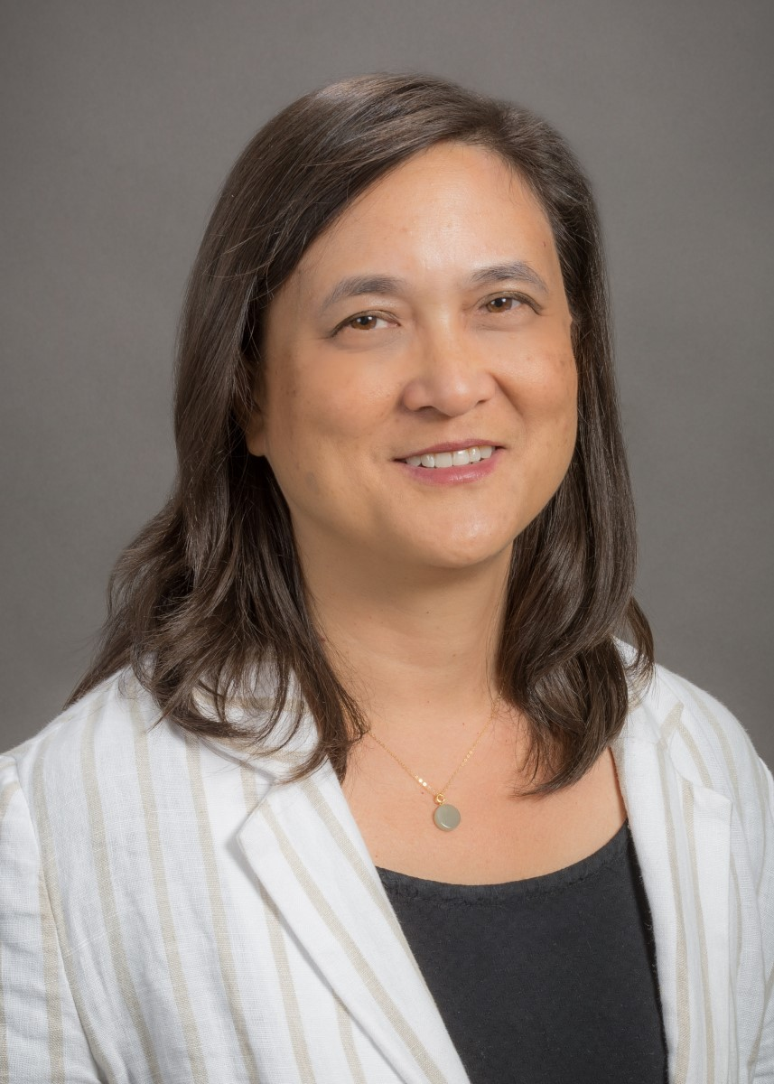
Acknowledgments
Co-authors: Drs. Judith Tsui, Jamie Darnton, Jocelyn James
Project Staff: Jesse Moritz
UW SOM medical students and faculty

Slide 17
Questions?

