Slide 1
Medication for Opioid Use Disorders (MOUD) Providers’ Perspectives on Working with Drug Courts
Ekaterina Pivovarova, Ph.D., Faye Taxman, Ph.D., Alexandra Boland, M.A., & Peter Friedmann, M.D., MPH
Presented at AMERSA 2023

Slide 2
Disclosures
This study was supported by the National Institute of Drug Abuse career development award to Dr. Pivovarova (K23 DA049953; K23 FS049953)
The authors declare that there are no known conflicts of interest.

Slide 3
MOUD Access in Recovery Courts
Drug courts are specialty courts that mandate substance use treatment in exchange for avoiding jail or remaining in the community.
Traditionally, drug courts have been resistant to allowing Medications for Opioid Use Disorder (MOUD), but recent changes in federal funding, national best practices, and lawsuits are reducing blanket prohibitions.
When drug courts do allow MOUD, they must collaborate with community providers to refer and retain individuals in treatment
Yet, many individuals with OUD do not receive MOUD, even when MOUD is allowed, suggesting there is a knowledge-to-action gap.

Slide 4
Understanding Inter-agency Collaborations
Collaboration with MOUD providers is limited by the availability of providers and relationships with those providers
Effective and sustainable inter-agency collaboration requires mutual benefit, respect, active intent, and continuous engagement
We sought to describe provider-reported experiences in collaborating with drug courts

Slide 5
Methods
Part of K23 to examine implementation strategies to improve access to MOUD in MA drug courts
MOUD agencies were nominated by recovery courts (enrolled from 11 agencies)
Semi-structured interviews, ~1 hour using CFIR framework
Redacted interviews were double-coded by master’s level research coordinators using deductive (CFIR) and inductive (ground-up) approaches

Slide 6
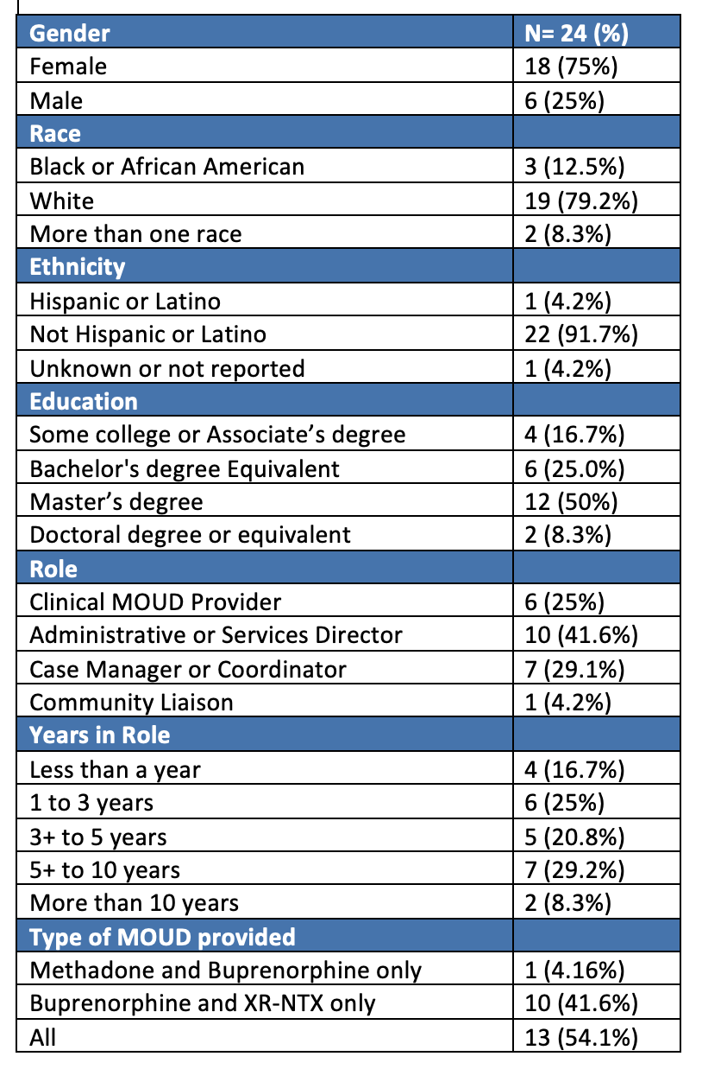
MOUD Provider Demographics

Slide 7
Barriers to Collaboration and Engagement with Recovery Courts

Slide 8
Individual Level (person specific) Barrier: Lack of knowledge about Recovery Courts
Providers often lacked knowledge about what drug courts are and thought of them interchangeably with other agencies (probation, parole, trial), even child services:
We want to know what the mission and the vision is of the drug court because that is a step down from being incarcerated…I don't know how drug court can handle a new person that is trying to get into recovery but is struggling.

Slide 9
Individual Level Barriers: Negative Impressions of Court and Criminal Legal System
Providers expressed discomfort in working with legal agencies due to injustices in the systems and the court’s punitive nature.
It's challenging for me to support a drug court when incarceration is what they're offering as their therapeutic intervention. It is my opinion that there's nothing, zero therapeutic about incarceration. It is only traumatic. It is not therapeutic

Slide 10
Inner Setting (MOUD agency) Barrier: Staffing and Financial Limitations
Staffing shortages in conducting agency-specific work, must less additional inter-agency work, even if there is interest in collaborating.
Reimbursement for clinical and administrative time. Agencies have billable requirements for each clinician.
I think where it gets tricky is that the clinicians…have like a certain level of productivity…If they were under a grant this [collaboration] was part of their responsibility, then I think it would be a little bit easier because some of their time would be carved out for that specifically and wouldn't go against them in terms of just productivity requirements.

Slide 11
Inner Setting Barrier: Responsibilities to the Patient and Need to Protect them from the Court
Concern that collaborations with courts will be misunderstood by patients.
Providers did not want clinical information to be used to punish their patients.
[It’s important]...to communicate without fearing that there’s going to be harm caused to the patient… if we could speak at ease and treat that patient as a whole, without having the severe consequence, and knowing that sometimes our patients are their own worst enemy, and there might be a consequence to their behavior.

Slide 12
Outer setting (Recovery Court) Barrier: Limited communication
Unresponsiveness by legal partners
Unrealistic requests for information day of court
Information necessary to provide treatment is not shared
Releases necessary to communicate can get pulled

Slide 13
Facilitators to Collaboration and Engagement

Slide 14
Inner Setting Facilitators: Direct Experience with Drug Courts changes perceptions
Providers who worked with Recovery Courts described how their experiences helped them understand the program and appreciate how different it was from other criminal legal involvement
Drug court is like a warm hug for patients that have a litany of trauma in their life, don’t have a lot of support…And then [drug court] is kind to you and they want to see you do well, and they support you. And they help you, and they advocate for you.
We got to sit in the backroom where the judge was, probation officers… everyone's just there, and they're putting out the names and the files, and ‘what can we do to help this person because this is the sixth time that they've been through this place?’ And it was nice to hear everyone just coming together.

Slide 15
Outer Setting Facilitator: Separation and Respect For Agency-Specific Roles
When drug courts and providers had mutual support for one another’s expertise and identified clear roles, collaboration was possible.
I think a lot of it has to do with understanding. I'm not an officer. I don't do their job. But they're also not medical. They don't do my job

Slide 16
Outer Setting Facilitator: Mission Alignment
[Recognizing that] everybody wants the best outcome. And so any way that we can collaborate on and make that happen is good.
Change in from within partnerships, rather than by not collaborating can change perceptions
I would rather work more with [drug Courts] and kind of advocate more for the medication piece if they're kind of not as willing. 'Cuz I feel like that's the only way that you're gonna get people to see that other side is to work with them and educate them, and kind of break down that stigma and those walls.

Slide 17
Limitations
Providers interviewed were largely white women and may not be representative of staffing for
Did not directly query about the impact of racial and ethnic health inequities on collaborations and different needs for historically marginalized patients
Massachusetts is a state with a high level of addiction resources and wide adoption of MOUD in carceral settings, accordingly may not be generalizable to states with fewer resources

Slide 18
Key Take Aways
Inner, individual, and outer setting barriers and facilitators were identified in MOUD providers’ experience of collaborating with drug courts
Findings reflect those by drug court staff, who observed hesitation by clinicians to work with them.
Yet, collaboration is essential, and arguable the responsibility of both agencies, to ensure that individuals with legal involvement receive proper community resources.

Slide 19
Thank you
Contact: Ekaterina Pivovarova, Ph.D.
ekaterina.pivovarova@umassmed.edu

