Slide 1
Medications for Alcohol Use Disorder and Withdrawal: A National Sample of Patients Discharged from the Emergency Department
AMERSA
November 15th, 2024
Kathryn Hawk MD, MHS
Department of Emergency Medicine

Slide 2
Disclosures
I have no conflicts of interest or
disclosures to report
Research Support:
Elevance Foundation (PI: Venkatesh)
NIAAA 1R01AA030568-01 (PI: Hawk)
NIDA 3UG1DA015831-22S3; CTN 0145 (PIs: Hawk/Herring/D’Onofrio)
NIDA 1R61DA059169-01 (PIs: Hawk/Venkatesh/Taylor)
NIDA 3UG1DA015831-19S1; CTN 0099 (PIs: D’Onofrio/Fiellin)
Foundation for Opioid Response (PI: Hawk)

Slide 3
ACEP E-Quality Network: SUD
Scott Weiner
Craig Rothenberg
Dhruv Sharma
Pawan Goyal
Prateek Sharma
Megan Sambell
Sam Shahid
Arjun Venkatesh

Slide 4
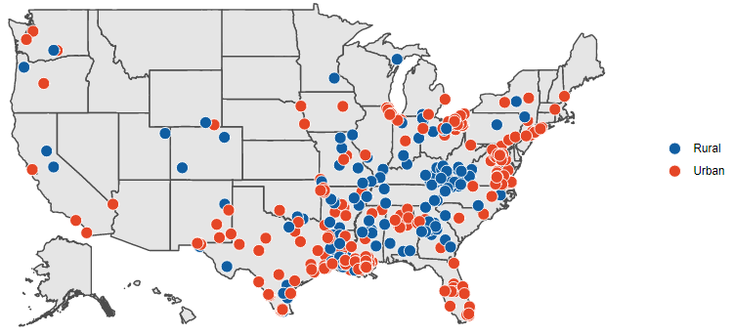
ACEP Emergency Quality Collaborative
“Engage emergency clinicians and leverage emergency departments to improve clinical outcomes and coordination of care”
Notes:
2015 – CMS
2018 – Opioid Initiative, generous funding from Addiction Policy Forum and Foundation for Opioid Response
2023 – Elevance Foundation – Added Alcohol

Slide 5
ACEP E-QUAL Opioid Collaborative
Enrollment
Enrollment questionnaire
Learning Collaborative
(6-9 months)
Online portal activities
Collect CME*
Wrap Up
Follow-up benchmarking data
Baseline benchmarking data
CMS MIPS credit
Webinars/toolkit*
* E-QUAL participation not required to access

Slide 6
Increased Alcohol-related Mortality

Slide 7
Background
In 2022, > 3.4 million alcohol related ED visits*
Emergency clinicians are well positioned to treat ambulatory alcohol withdrawal and initiate medications for alcohol use disorder (AUD).
FDA approved MAUD are underutilized.
There has been growing interest in the use of gabapentin for the treatment of ambulatory alcohol withdrawal and cravings.

Slide 8
Study Objective
To evaluate the practice of prescribing medications for alcohol use among a nationwide sample of ED patients with alcohol use.

Slide 9
Methods
EDs participating in the 2023 EQUAL SUD Initiative were requested to abstract charts from 30 randomly selected ED visits before (pre) and after (post) participation in the 6-month learning collaborative.
Charts selected based ICD-10 code of alcohol intoxication or withdrawal who are discharged from the ED
Pre: September 2022 - February 2023; Post: July 2023- October 2023
Abstract medication administration in ED or prescription at discharge associated with withdrawal or AUD:
benzodiazepines, phenobarbital, gabapentin, naltrexone, acamprosate, disulfiram, carbamazepine, or valproic acid.

Slide 10
Alcohol-related ED visits
9,989 ED visits from 301 participating US EDs
 |  | ED visit # | % Total Visits
ED location | Rural/Critical Access Hospital | 3,492 | 35.0
ED Volume | <20K/year | 3,670 | 36.7
 | 20-40K/year | 3,437 | 34.4
 | 40-60K/year | 1,232 | 12.3
 | >60K/year | 191 | 1.9
 | Missing | 1,459 | 14.6

Slide 11
Results: Medication Administration
Medications for alcohol withdrawal or AUD Tx were administered in 24.4% (2,438/9,989) ED visits
 | ED Visits with meds administered | % Visits with medication administration
Benzodiazepines | 2,213 | 90.7
Phenobarbital | 243 | 9.8
Gabapentin | 28 | 0.1
Naltrexone | 11 | 0.005
Disulfiram | 2 | 0
Valproic Acid | 7 | 0.003

Slide 12
Results: Medication Prescription
Upon discharge, medications for AUD or withdrawal were prescribed in 11.2% (1,123/9,989) of ED visits
 | ED Visits with Discharge Rx | % Visits with Discharge Rx
Benzodiazepines | 1,037 | 92.3
Phenobarbital | 37 | 3.3
Gabapentin | 33 | 2.9
Naltrexone | 25 | 2.2
Disulfiram | 2 | 0.002
Valproic Acid | 4 | 0.004
Rx = outpatient prescription

Slide 13
Limitations
Voluntary participation of a national group of EDs
Selection bias in charts reviewed/provided
Indication for each prescription was not collected
Existing prescriptions not captured
Community/critical access ED prescribing practices may reflect training outside of EM

Slide 14
Conclusions
Overall, benzodiazepines are the most commonly administered and prescribed medications for patients that present to the ED with alcohol intoxication and withdrawal.
FDA approved medications for alcohol use disorder, naltrexone, acamprosate and disulfiram, are were very rarely prescribed.
Opportunities to improve practice of ED clinician prescribing of FDA approved MAUD are widespread

Slide 15
SAEM GRACE-4 Guidelines: AUD Management in the ED
Borgundvaag et al, AEM 2024

Slide 16
kathryn.hawk@yale.edu
@kathryn_hawk

