Slide 1
Implementation of Medications for Opioid Use Disorder (MOUD) in Massachusetts’ County Jails: Effects on Post-release Care Continuity, Overdose, Reincarceration and Mortality
Peter D. Friedmann^{1,2}, Donna Wilson¹, Thomas J. Stopka³, Dana Bernson⁴, Ekaterina Pivovarova⁵, Warren Ferguson⁵, Randall Hoskinson Jr.¹, Rebecca E. Rottapel³, Benjamin Bovell-Ammon², Ayorkor Gaba⁶, Jake R. Morgan⁷, Thomas Senst⁸, Edmond Hayes⁹, Elizabeth A. Evans¹⁰ for the MassJCOIN Research Hub
^{No disclosures to report}

Slide 2
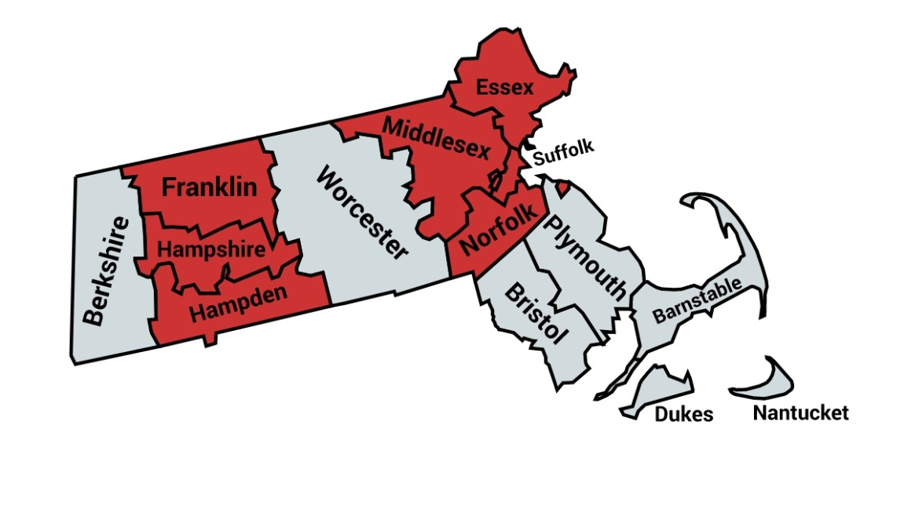
MA-JCOIN Background
Legislative mandate (CARE Act) created Massachusetts Chapter 208
Required jails* to implement a pilot program for all FDA-approved types of MOUD no later than 09/01/2019
medication maintenance at intake
induction w/in 30 days of release
Pilot program included 7 jails (in red)
*Includes jails and Houses of Correction

Slide 3
Type 1 hybrid effectiveness-implementation study
Aim 1. Longitudinal treatment outcome study
Incarcerated w/ OUD who receive XR-NTX, BUP-NX, methadone, or no MOUD
Primary outcome: post-release MOUD initiation
Secondary outcomes: fatal and non-fatal overdose; all-cause mortality; ED & hospital utilization; recidivism;
Aim 2. Implementation study
Community care coordination
Best practice strategies
Aim 3. Economic evaluation
Contextual factors that facilitate and impede delivery of MOUD in jail
Cost to the correctional system of implementing MOUD in jail
From state-policymaker and societal perspectives, compare the value of MOUD prior to release from jail to no MOUD among matched controls
Aim 4.
Post-release
self-report
Trajectory of post-incarceration opioid use
Impact of jail MOUD receipt on post-release self-reported substance use, overdose, HIV risk behaviors, crime

Slide 4
Sampling
7 Jails/HOCs
Probable OUD
Enrolled between Sept 2019--Dec 2020
Exited pre-July 2021 (i.e. >180 days of post-release community follow-up)
n= 6,460 jailed persons with OUD
Received MOUD while incarcerated: n=2,771; 43%
Did not receive MOUD while incarcerated: n=3,689; 57%

Slide 5
Probable OUD
Site | Source for determining Probable OUD
1. | Self reports recent opioid use or SUD during medical/mental health intake and/or Screened for OUD via TCUD
2. | Self report of recent opioid use during medical/ mental health intakes and/or, DAST-10 screening (>2-10)
3. | iCup drug screen and/or, OUD diagnosis assessed during mental health assessment
4. | Diagnosed with any SUD during Mental Health Evaluation and self-reported recent opioid use
5. | Self report of substance use history/disorder and OUD diagnosis during mental health assessment
6. | PHD algorithm due to inconsistent screening onsite.
7. | Self-report of history of substance use and/or MAT use during medical/ mental health intakes and/or Positive for OUD (TCUD), or recent reported opioid use

Slide 6
Data Source: Public Health Data Warehouse (PHD) 2.0
Analytic Environment
SAS datasets
Secure, remote server
Analysis via SAS Studio
System Attributes
Linkage at individual level
Longitudinal (2011-2020)
Data encrypted in transit & at rest
Datasets unlinked at rest
Linking and analytics “on the fly”
No residual files after querying
Analysts can’t see data
Automatic cell suppression
Early Intervention
PMP
Cancer Registry
Toxicology
Death Records
Data Sources
Public Health
Public Safety
Criminal Justice
Medical Claims & Hospital
Other State Agencies
Aggregate
WIC
Birth Records
OCME Intake
APCD Spine
Hepatitis A
Fetal Death Records
Jails
Prisons
Hepatitis C
MATRIS (EMS)
Hospital, ED, & Outpatient
Medical, Dental, & Pharmacy Claims
HIV
BSAS Treatment
DHCD
DTA: SNAP Benefits
Veteran’s Services
Worker’s Comp
DMH
Community
Level Data
Town & Zip Census
Naloxone Enroll
Naloxone Rescues
Naloxone Refills
First Responder Naloxone
Index of Concentration at the Extremes
Notes:
PHD is a collection of data sets sourced from inside and outside the Department of Public Health.
PHD enables the development of a longitudinal database to analyze population health trends.
Most data sets in PHD are linked at the individual level to the All Payers Claims Database, which serves as the spine for linking individual information across datasets.
We use 5 personal identifiers to perform this linkage: First name, Last name, Date of Birth, Gender, SSN and Zip Code of residence
After each dataset is linked, the personal identifiers (except for the Zip Codes) are dropped to protect the information. Also, dates of service included in some datasets are modified or masked so that we can retain this info for analytic purposes.
During the linkage process the personal identifiers and the analytic information remain segregated to provide an additional layer of protection.
Once a dataset is linked and tagged with a random number, the data is put at rest in a highly protected hosting environment.
The assigned random numbers can then be used at a later time to link the information to other data sets for analysis.
In the analytic environment, analysts do not have access to tables containing information. Instead, they are provided with data dictionaries that fully explain the available data elements in each dataset.
The only way analysts interact with PHD data is by submitting approved and verified queries and obtaining aggregate output.
For example an authorized analyst can submit a query to learn the rate of pregnant women during 2018 in Middlesex county; who had a history of OUD; who also at some point during that year received Emergency Medical Services; and who opted into a BSAS treatment program. Further, they can hypothesize and explore elements that may have an effect in how and why people in this group decided to opt into substance use treatment programs.

Slide 7
OUD Algorithm
Uses DPH’s Public Health Data Warehouse to find indicators for any of the above before the index jail intake
PHD Data Sources: SPINE overdose, BSAS, APCD (medical and pharmacy), Casemix (emergency dept, hospital discharge, outpatient observation), DMH, PMP
Defines 3 types of historical indicators to identify persons with probable opioid use disorder:
Indicator of opioid overdose
Indicator of opioid abuse or dependence
Indicator of MOUD treatment
https://www.mass.gov/lists/public-health-data-warehouse-phd-publications#legislative-reports- (Chapter 208 – 2024 Legislative Report )

Slide 8
Methods
Outcomes:
Post-release MOUD treatment
Initiation within 30 days of release
Engagement 75% of first 90 days
Retention at 180 days
Reincarceration
Non-fatal and fatal opioid overdose
All-cause mortality
Analysis: Propensity score (PS) weights adjusted for selection effects…
Age
Sex
Race
Educational attainment
HOC county
Adjudication status
Veteran status
Homeless history
Pre-incarceration overdose
MOUD at jail entry
Days incarcerated

Slide 9
Results – Baseline Differences
Table 1 | Received MOUD in Jail N=2711 | No MOUD in Jail N=3689 | Proportion Treated
Age, median [IQR] | 36 [31, 42] | 35 [29, 43] | …
Sex, N (%) Male | 2013 (74.3) | 2772 (75.1) | 0.42
Female | 698 (25.7) | 917 (24.9) | 0.43
Race/Ethnicity, N (%) White non-Hispanic | 2043 (75.4) | 2144 (58.1) | 0.49
Black non-Hispanic | 156 (5.8) | 607 (16.5) | 0.21
Hispanic | 492 (18.2) | 889 (24.1) | 0.36
Pre-incarceration OD, N (%) No | 1476 (54.4) | 2368 (64.2) | 0.38
Yes | 1235 (45.6) | 1321 (35.8) | 0.48
MOUD at entry, N (%) No | 713 (26.3) | 3058 (82.9) | 0.19
Yes | 1998 (73.7) | 630 (17.1) | 0.76
MOUD type in jail, N (%) Methadone | 696 (25.7) | … | …
Buprenorphine (Suboxone) | 1840 (67.9) | … | …
Naltrexone (Vivitrol) | 175 (6.5) | … | …
Adjudication status, N (%) Pre-trial | 1821 (67.2) | 3020 (81.9) | 0.38
Sentenced | 858 (31.7) | 487 (13.2) | 0.64
Days incarcerated , median [IQR] | 47 [14, 130] | 17 [2, 63] | …

Slide 10
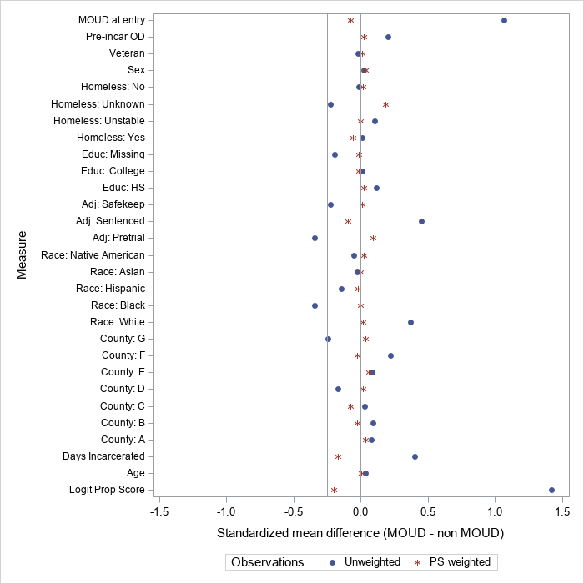
Results
Standardized mean differences before and after propensity score weighting
Propensity Score weights balanced baseline differences.
https://www.mass.gov/lists/public-health-data-warehouse-phd-publications#legislative-reports- (Chapter 208 – 2024 Legislative Report )

Slide 11
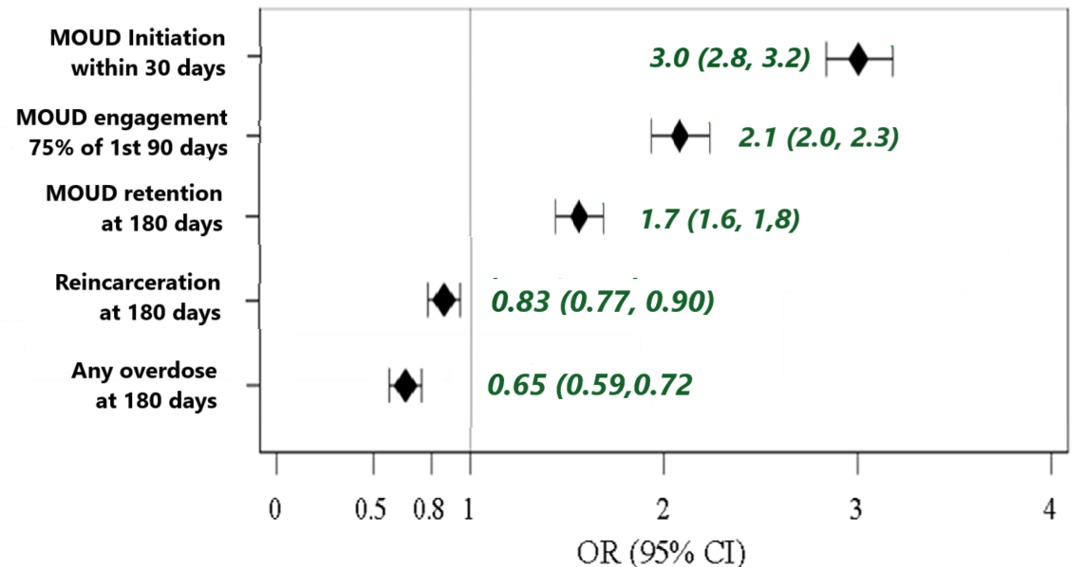
Results
MOUD vs. non-MOUD, PS weighted
Those treated with MOUD in jail had…
3x greater odds of initiation of MOUD in first 30 days post-release
~2x greater engagement & retention
Lower odds of reincarceration or any overdose within 180 days
https://www.mass.gov/lists/public-health-data-warehouse-phd-publications#legislative-reports- (Chapter 208 – 2024 Legislative Report )

Slide 12
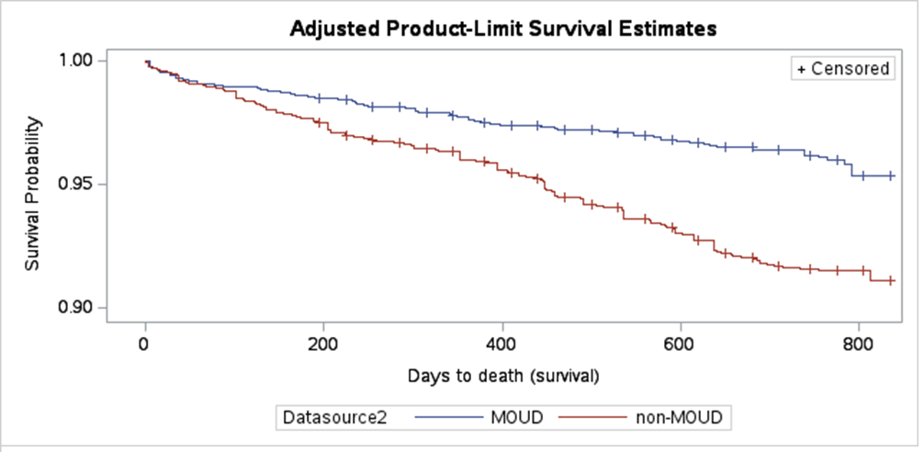
Results
MOUD vs. non-MOUD, PS weighted
No detected effect on 180-day overdose fatality
All-cause mortality significantly reduced
(adjusted hazard ratio 0.43, 95% 0.36-0.50).

Slide 13
Limitations
Identification of non-MOUD arm not standardized
Sensitivity analyses using OUD algorithm for all
Varied MOUD access in communities → jails
Entry disparities likely reflect community practices
Cannot r/o disparate jail practices
Data quality and matching challenges
Analyst unable to see data directly per PHD policy
COVID-19 may have distorted outcomes

Slide 14
Conclusion
Jail-based MOUD treatment →
↑post-release MOUD in the community
↓total opioid overdose
↓reincarceration
↓all-cause mortality
Racial and ethnic disparities in MOUD access merit further examination and intervention

Slide 15
Acknowledgments
Data analyst
Donna Wilson
Co-Investigators
Tom Stopka, PhD, MHS
Warren Ferguson, MD
Ekaterina Pivovarova, PhD
Claudia Santelices, PhD
Sean Murphy, PhD
Kathryn McCollister, PhD
MA Department of Public Health
Dana Bernson (Co-I)
Nicole Schmitt
Jen Miller
Hermik Babakhanlou-Chase
Christopher Massad
Devon Dunn
Project Management
Randall Hoskinson
Research Staff
Caitlin Tanski
Sam Tarplin
Madison Crawford
Elyse Bianchet
Lizbeth Del Toro-Mejias
Patrick Dowd
Jennifer Rossi
Nicole Calhoun
Daviana Englander
Morgan Ruggiro
Jen Cormier
Allison Manco
Shannon Fox
Julia Shannon-Grillo
Atsushi Matsumoto
Rebecca Rottapel
Danielle Ryan
Leah Shapiro
Makaela Press
Bridget Volk
Suzanne Cayer
Mary McPoland
Peter Balvanz
Alma Bartnik
Kiel McGowan
Elizabeth Delorme
Calla Harrington
Emily Moner
Natanael Velez
Pryce Michener
Rithika Senthilkumar
Correctional Partners
Essex: Sheriff Coppinger, Jason Faro, Dr. Christopher Gudas
Franklin: Sheriff Donelan, Ed Hayes, Dr. Ruth Potee
Hampden: Sheriff Cocchi, Cassandra Sarno, Dr. Thomas Lincoln, Sally Johnson Van Wright, Marty Lyman
Hampshire: Sheriff Cahillane, Mindy Cady, Bridget Szawlowski
Middlesex: Sheriff Koutoujian, Kashif Siddiqi, Dan Lee, Crystal Miske, Ashley Witts
Norfolk: Sheriff McDermott, Erika Sica, Tara Flynn
Suffolk: Sheriff Tompkins, Rachelle Steinberg, Marjorie Bernadeau-Alexandre
…and many more!
Funding: NIDA 1UG1DA050067-01 (Friedmann, Evans), K23DA049953 (Pivovarova)

Slide 16
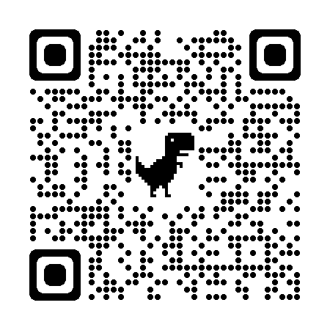
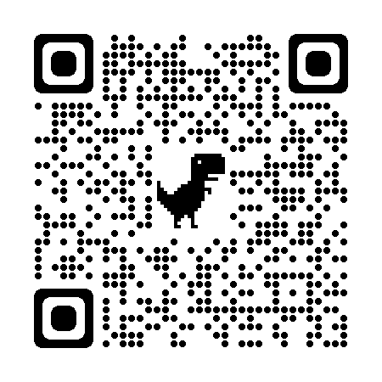
More Information
MASS. JCOIN Publications Library
‘Bonus’ Papers

