Slide 1
Meeting People Where They Are
Outcomes of a Mobile Medical Unit for Low-Threshold Buprenorphine Access targeting overdose hot spots in Chicago
Presenting Authors: Sarah Messmer, MD & Elisabeth Poorman, MD MPH
Co-Authors: Abigail Elmes, Jennie Jarrett, Eden Keller, Alex Infante, Kevin Whitfield, Albert Murphy, Stockton Mayer, Dennis Watson, Miriam Guzman, & Antonio Jimenez

Slide 2
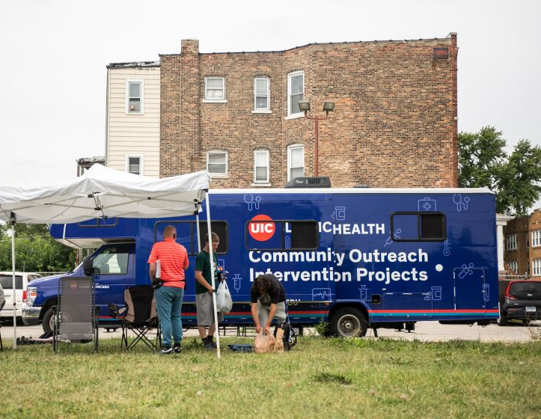
Mobile MOUD
Program Development
Notes:
First we will walk briefly through the development of the COIP mobile unit.

Slide 3
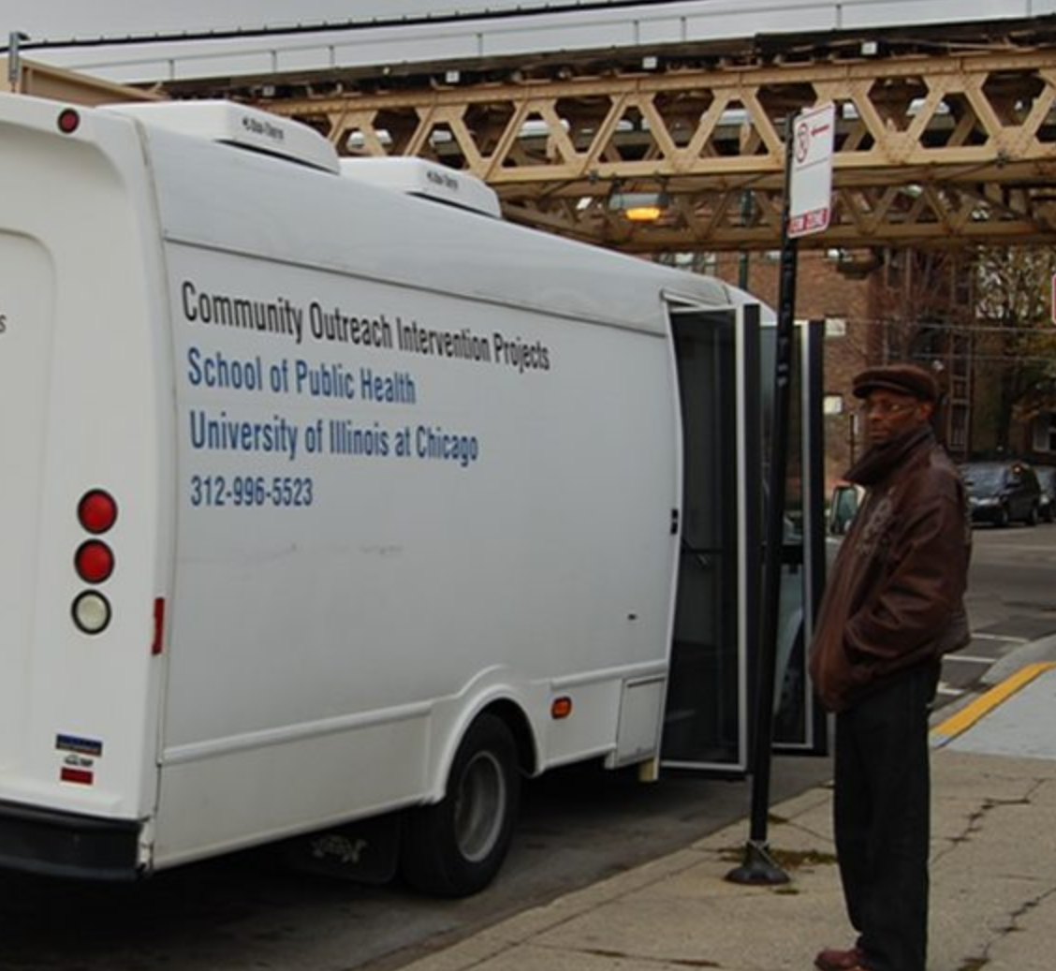
COIP Background
Founded in 1986 in the UIC School of Public Health to address HIV/AIDS among people who use drugs
Currently operates from storefront sites in Austin, West Englewood, South Chicago, and Uptown; also mobile units
Indigenous Leader Outreach Model
Harm reduction and peer recovery support services
Notes:
We have the fortune to work within the Community Outreach Intervention Projects, or COIP, which is a longstanding harm reduction and SSP run by the UIC School of Public Health. Go over background of COIP, emphasize longstanding relationships in the community and background of ILOM.

Slide 4
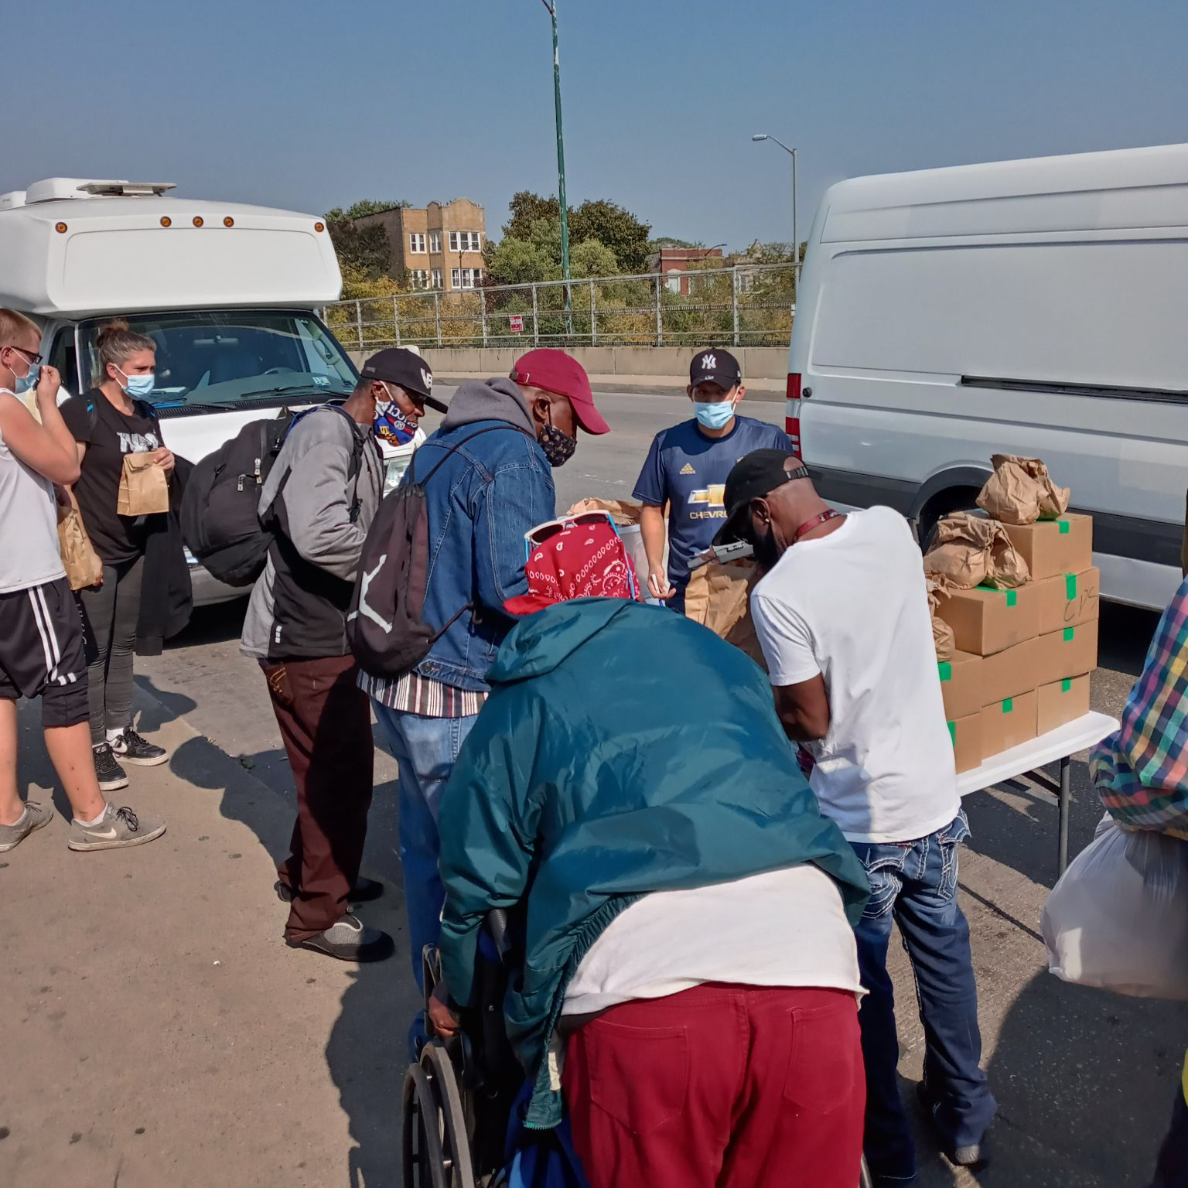
COIP Outreach Harm Reduction Services
Syringe exchange services
Overdose prevention education
Naloxone distribution
Food & clothing
Peer recovery coaches
Peer recovery case management services
Notes:
This is an example of the variety of services COIP has already been providing in the community for years, both at brick and mortar sites as well as via mobile unit

Slide 5
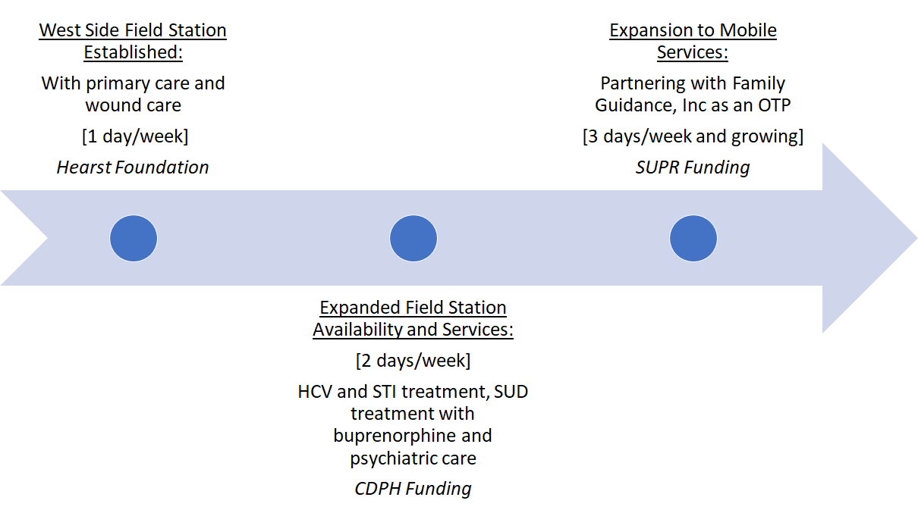
COIP Primary Care and SUD Treatment Access Expansion
[5 days/week]
Notes:
COIP has had integrated Ryan White funded HIV clinics operating out of their storefront sites for years; however, there were previously not medical services for people who did not have HIV. In 2018, one of the ID doctors at UIC (Stockton Mayer) applied for and received grant funding from the Hearst Foundation to begin a primary care and wound clinic at the west side COIP site, after a needs assessment revealed that clients of the SSP there wanted to access care at the COIP site. This clinic became very busy, and was then expanded to two days/week with additional funding from CDPH. In 2021 we applied for and received state funding from SUPR to be able to provide primary care and low-threshold bup access via mobile unit, including dispensing buprenorphine.

Slide 6
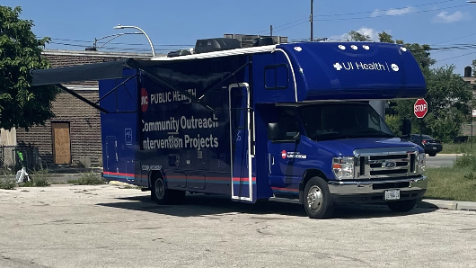
Notes:
This is what our current van looks like; it is a modified RV which includes an exam room in the back, a middle room that includes our safe to store buprenorphine. The van had to meet DEA requirements and pass inspection by the DEA before being able to carry buprenorphine for direct dispensing; this included requiring a bolted safe to store buprenorphine and a security system that needs to be plugged in nightly. The process to get DEA approval took an entire year; therefore our first year we were prescribing medications rather than dispensing.

Slide 7
Van Team Structure
Multidisciplinary team
Harm reduction team on separate van
Outreach team - also does registration
Pharmacy team – vaccinations and medication dispensing/counseling
Clinical team – provider with addiction experience, often trainees as well
Security – required by the DEA when carrying buprenorphine
Goal to address any medical needs encountered, with a focus on low-barrier treatment for OUD
Dispensing buprenorphine since summer 2022

Slide 8
CDPH Opioid-Overdose Maps from EMS Data
West Garfield Park
Humboldt Park
West Garfield Park
Humboldt Park

Slide 9
Program Outcomes

Slide 10
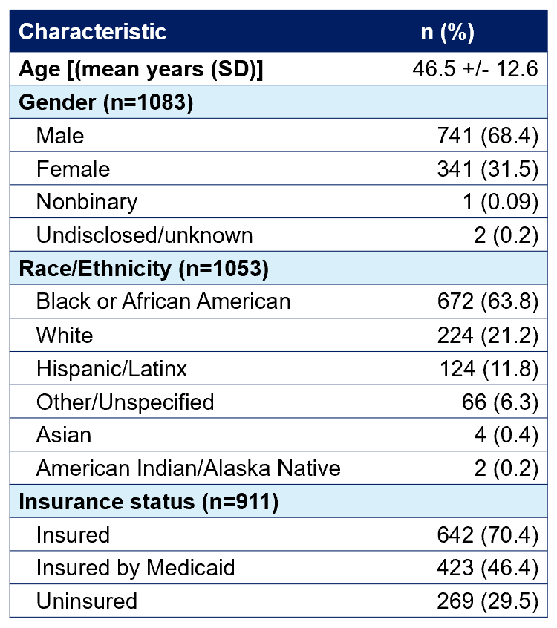
Patient demographics 7/2021 – 6/2023
Notes:
Highlight that this reflects the overdose data in Cook County

Slide 11
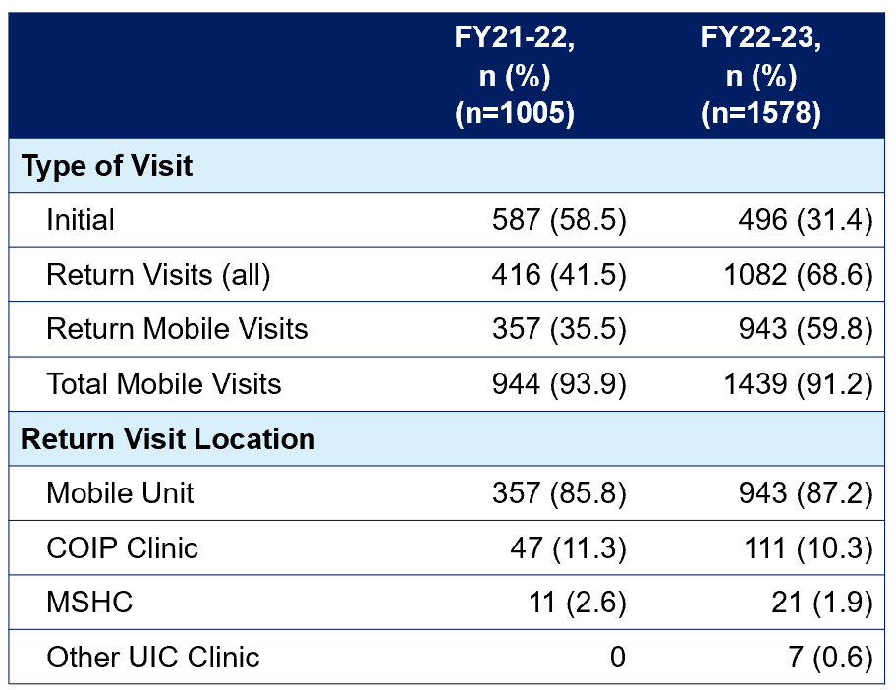
Types of visits 7/2021 – 6/2023
Notes:
Highlight that we are seeing more follow up visits; can discuss how we originally planned to serve as more of a bridge but often we do see follow ups for buprenorphine so we have had to ensure we can provide ongoing care.

Slide 12
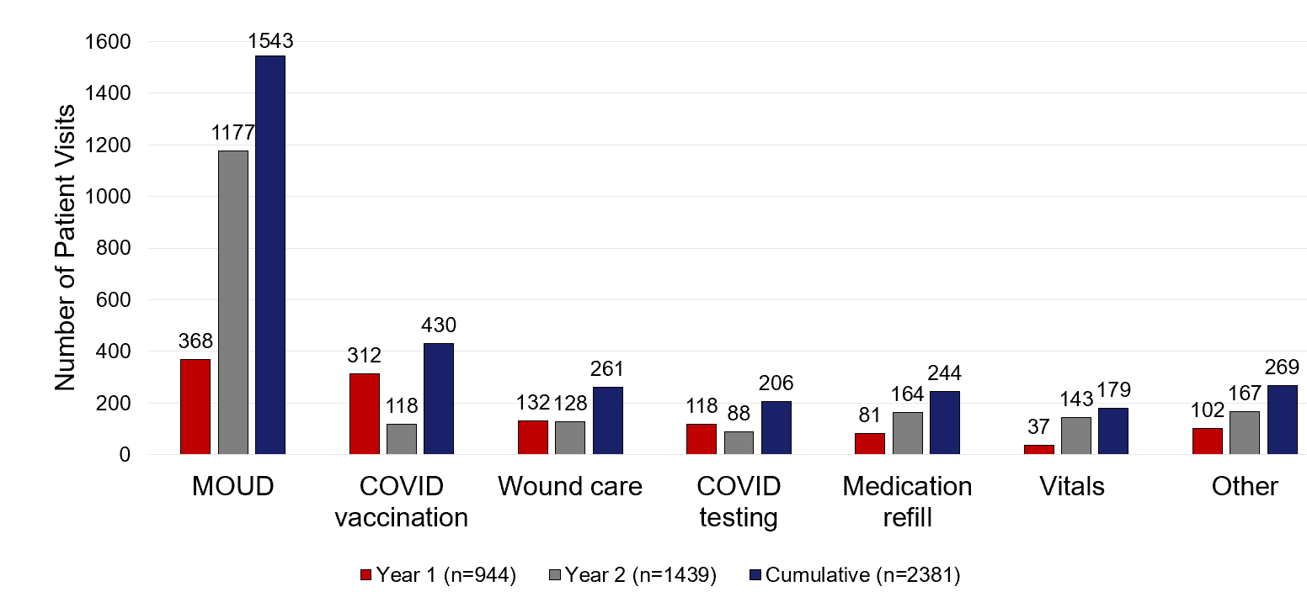
Reasons for visiting the mobile unit
Notes:
Highlight increase in visits for MOUD; in Year 1 COVID vaccines were one of the most common reasons for visits. We also have increased the number of total visits, with nearly 1500 visits in year 2.

Slide 13
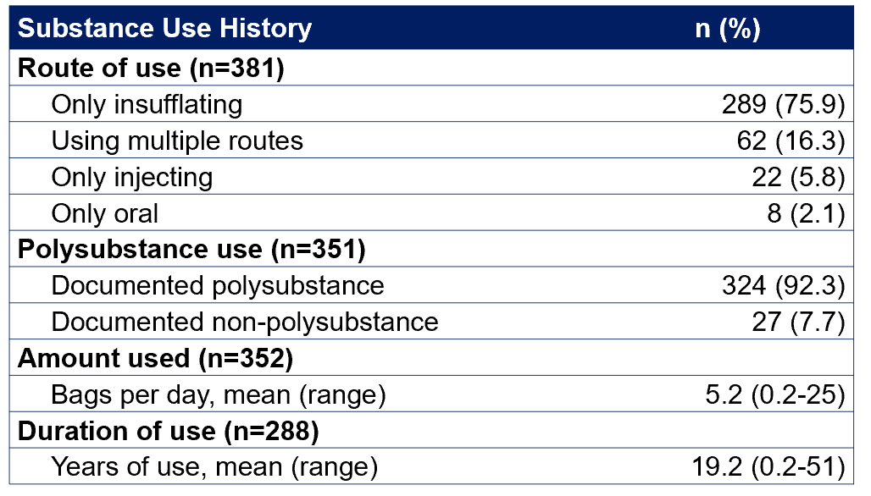
Substance Use History (n=571)
Notes:
Highlight that the majority of our patients insufflate; none of our patients endorse smoking opioids (some do smoke crack cocaine). Vast majority with polysubstance, with cocaine being the most common additional reported substance. Long duration of use, with an average of 19 years; many pts endorse seeking treatment now due to change in drug supply.

Slide 14
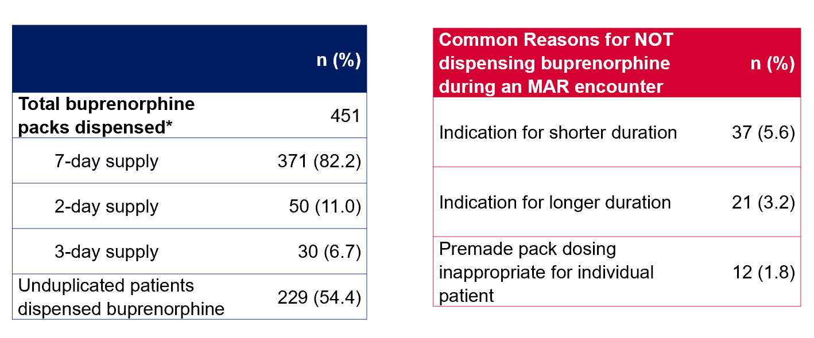
Buprenorphine Dispensing: Year 1
Notes:
Highlight that this data reflects roll out of dispensing, we started at 1 day/week and now dispense 5 days/week. Started slowly to refine protocols, particularly regarding UDS for follow ups.

Slide 15
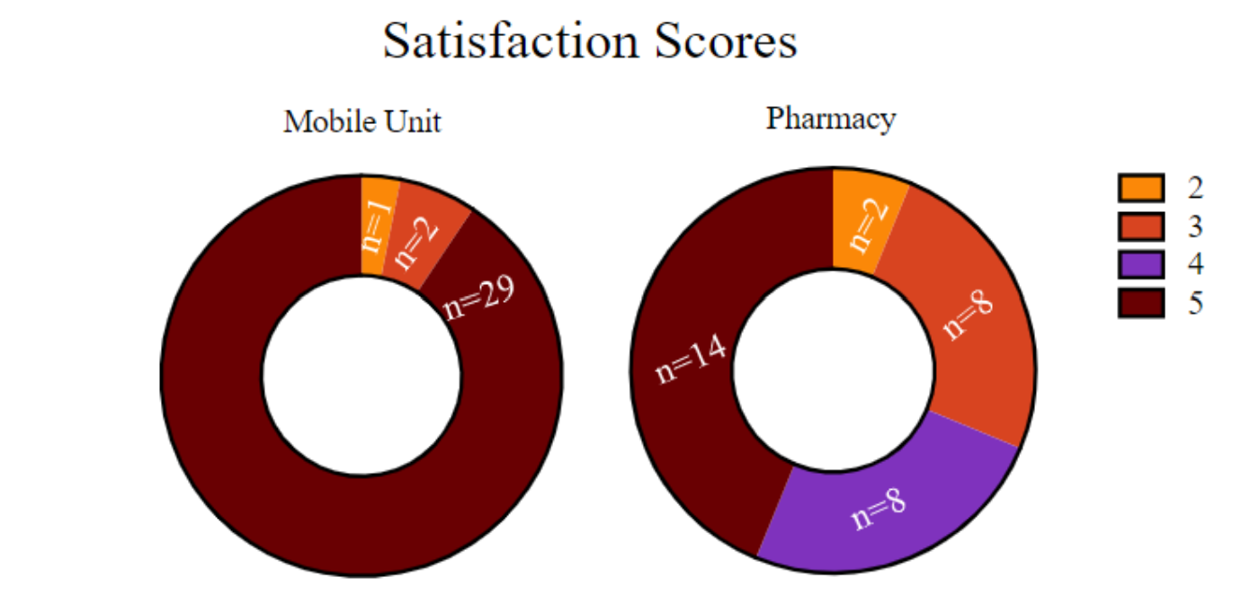
Patient survey: dispensing process
Survey of 54 individuals who were dispensed buprenorphine
Questions regarding satisfaction & barriers

Slide 16
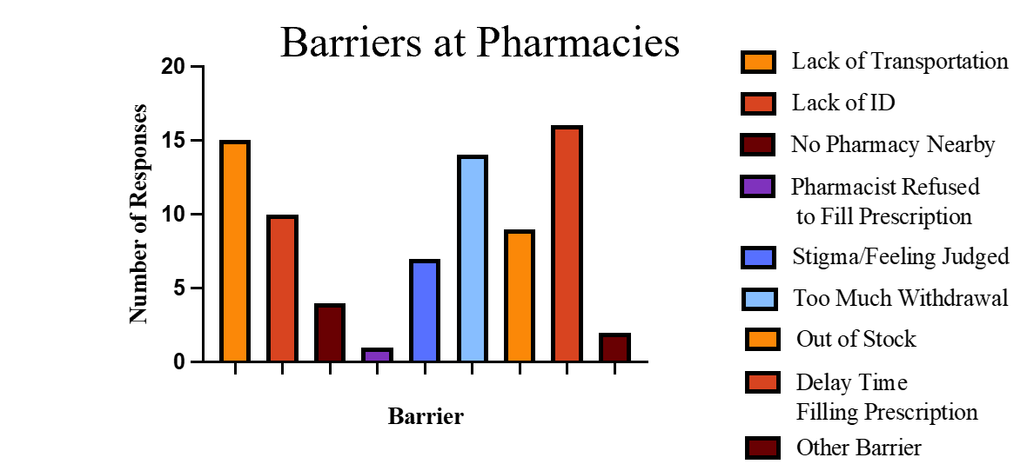
Patient survey: dispensing process

Slide 17
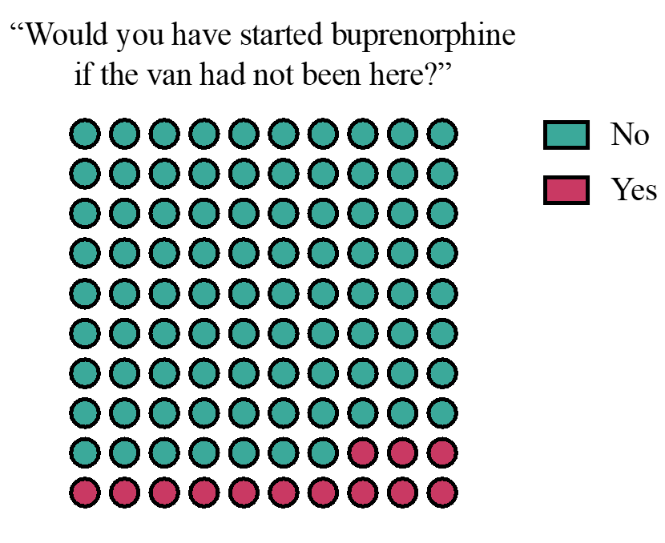
Patient survey: dispensing process

Slide 18
Questions?

Slide 19
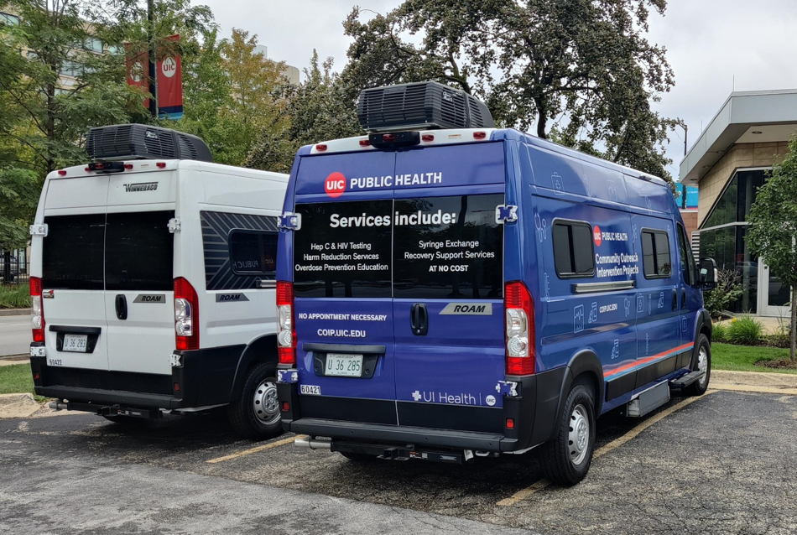
Future Directions
Received additional funding in April 2023 to add 3 more mobile units to the fleet
Pharmacist and nurse practitioner on site with attending physicians available via telehealth
Smaller vehicles for mobility
Target populations:
South Side of Chicago
Post-incarcerated populations
Rural Winnebago and Boone counties

Slide 20
Ongoing Research
Evaluating patient feedback to varying initiation protocols (“high dose” vs “low dose”)
Evaluation of resident addiction medicine rotation and impact on attitudes and stigma
Utilizing the Consolidated Framework for Implementation Research (CFIR) to guide mobile unit expansion

