Slide 1
Meeting 'em where they're at:
Aligning police and EMS practices with harm reduction goals through occupational safety training
Rachel Winograd, Leo Beletsky, Brad Ray, Liz Connors, Marc Doll, Joe Foege, & Melody Quinn
AMERSA Annual Meeting, November 2023

Slide 2
Introductions
a psychologist,
lawyer,
sociologist,
social worker,
paramedic,
peer specialist and
police officer…
Notes:
Rachel will hand off

Slide 3
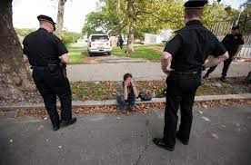
People who use drugs have frequent interactions with emergency responders
Overdose events, Property searches, Drug possession/distribution arrests, Traffic stops, Behavioral health crises, Police diversion programs
Can be harmful to people who use drugs
Most parties unsatisfied with status quo
Racial disparities in arrests & other negative outcomes
Notes:
Melody & Joe

Slide 4
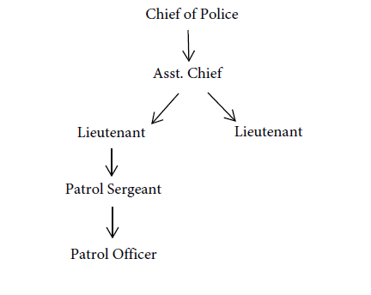
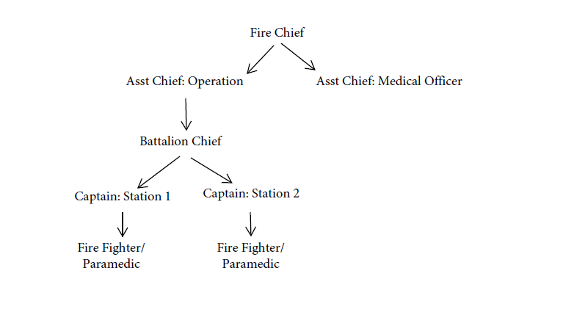
Law Enforcement & Emergency Medical Services Department Structures/Hierarchies
Police Department Hierarchy
Fire Department/EMS Hierarchy
Notes:
Marc & Melody

Slide 5
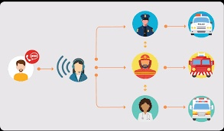
Typical 911 Dispatch Protocols
Strictly medical calls → fire/EMS dispatch only
Calls with (or without?) a safety risk → law enforcement is co-dispatched
Notes:
Highly variable (rurality, protocols, etc)
Role of discretion (indiv. decision-makers)
how that plays into who responds vs does not respond
Notes:
Marc & Melody

Slide 6
Effective emergency responder strategies -- THE ‘WHAT’
1. Overdose Education & Naloxone Distribution (recognizing and responding to ODs, naloxone leave-behind)
2. Establishing warm handoff and direct referral partnerships (with community-based harm reduction and “bridge” treatment services)
3. EMS-led buprenorphine induction programs (following overdose reversals)
4. Non-dispatch of LEOs to overdose scenes
Notes:
Rachel - will do verbally

Slide 7
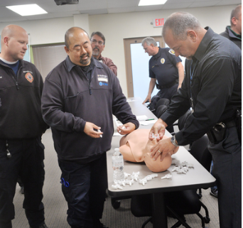
Progressive strategies to improve and then decrease interactions between emergency responders and PWUD -- THE ‘WHAT’
1. Overdose Education & Naloxone Distribution (recognizing and responding to ODs, naloxone leave-behind)
Notes:
Liz
- Umbrella phrasing we use to describe both naloxone administration and LBN
- Present together in one training with OD rates and emerging drug trends
- Helps secure buy-in with them realizing the value of them being part of OD response efforts
- In MO, start with basics and don't assume anyone has been OEND trained before.
- Signs and symptoms, what OD is and is not (fent risk exposure myth), how to administer, and how to talk to people after OD
- Then LBN kits

Slide 8
Progressive strategies to improve and then decrease interactions between emergency responders and PWUD -- THE ‘WHAT’
2. Establishing warm handoff and direct referral partnerships (with community-based harm reduction and “bridge” treatment services)
Notes:
Joe - Pick up on LBN, stress importance of not stopping there... connect to real people, real services next day
EPICC in Missouri - what it is, how it works, what you've seen, etc

Slide 9
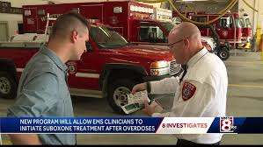
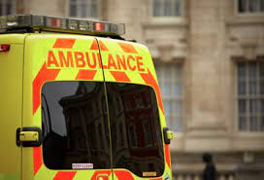
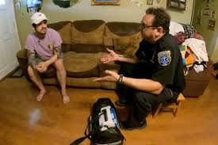
Progressive strategies to improve and then decrease interactions between emergency responders and PWUD -- THE ‘WHAT’
3. EMS-led buprenorphine induction programs (following overdose reversals)
Notes:
Marc & Brad
- what it is, why it works, gap it fills, why it's hard
Brad come in at the end for implementation side, talks with Gerry about it being easier when LEO are not there

Slide 10
Progressive strategies to improve and then decrease interactions between emergency responders and PWUD -- THE ‘WHAT’
4. Non-dispatch of LEOs to overdose scenes
Notes:
Brad & Melody
Melody - highlight how many different dispatch groups (and thus protocols) there are even within a given county - give the "here's where we're at now" perspective -- while keeping it optimistic still! :)
Brad - end by emphasizing this hasn't been studied, very hard to know exactly what's happening or what the impact would be of more or less LEO presence

Slide 11
Foundational skills most essential to effective substance use programming with emergency responders -- THE ‘HOW’
1. Using the internal structures of emergency responder departments
2. Alleviating common concerns held by first responders regarding harm reduction-oriented interventions
3. Framing harm reduction through the lens of occupational safety
4. Evaluate agency readiness to implement various overdose prevention and harm reduction-oriented programs
Notes:
Rachel will hit key points
1. Using the internal structures of emergency responder departments with particularly rigid and hierarchical cultures to engage them in harm reduction training and programming and promote officer discretion (in the case of LEOs);
2. Alleviating common concerns held by first responders regarding harm reduction-oriented interventions, including concerns of enabling drug use, personal bodily harm or danger, potential increases in local crime, personal liability, and departmental ‘return on investment’ associated with new programming;
3. Framing harm reduction through the lens of occupational safety, specifically regarding first responder workload, personal and community safety, and effectiveness of overdose response;
4. Evaluate agency readiness to implement various overdose prevention and harm reduction-oriented programs, as well as the effectiveness of these programs once implemented, using the Exploration, Preparation, Implementation, Sustainment (EPIS) framework as a promising implementation science model

Slide 12
Review and demonstration of skills to engage emergency responders -- THE ‘HOW’
1. Using the internal structures of emergency responder departments
Notes:
Liz
Refer back to hierarchy
Finding the right person at the right level within PD and EMS
Framing the ask using language that resonates with FR values
Close feedback loop with FR when possible --> assume repeat OD pts die
Best way to get first responder buy in is to learn what is important to them and start there

Slide 13
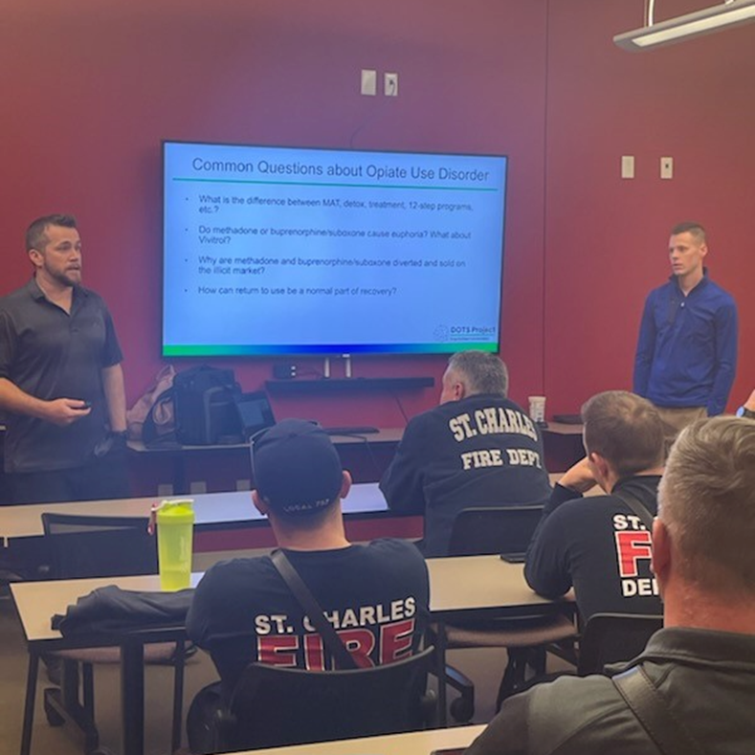
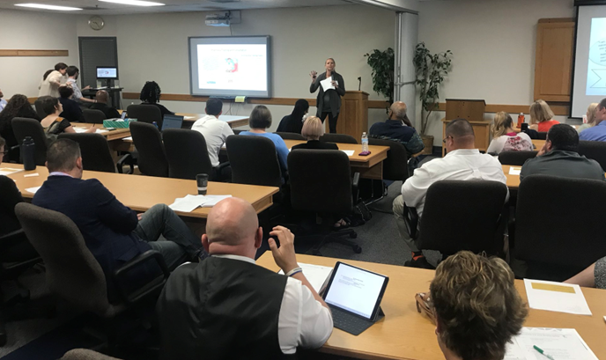
Review and demonstration of skills to engage emergency responders -- THE ‘HOW’
2. Alleviating common concerns held by first responders regarding harm reduction
Notes:
Joe & Melody
Joe & Melody - say what those concerns are most commonly, what do you hear, how do respond, what do you notice is effective vs not - to get ppl on board
Marc - speak about Fire dept
Melody - speak about Police
Joe - speak about being a non-first responder who trains first responders

Slide 14
Review and demonstration of skills to engage emergency responders -- THE ‘HOW’
3. Framing harm reduction through the lens of occupational safety
Notes:
Leo
. Framing harm reduction through the lens of occupational safety, specifically regarding first responder workload, personal and community safety, and effectiveness of overdose response;

Slide 15
Review and demonstration of skills to engage emergency responders -- THE ‘HOW’
4. Evaluate agency readiness to implement various overdose prevention and harm reduction-oriented programs
Notes:
Brad
4. Evaluate agency readiness to implement various overdose prevention and harm reduction-oriented programs, as well as the effectiveness of these programs once implemented, using the Exploration, Preparation, Implementation, Sustainment (EPIS) framework as a promising implementation science model

Slide 16
Interactive Experiential Small Group Work
Divide into 7 groups
Read the vignette you’re assigned
Vignette 1 - You’re an emergency med physician
Vignette 2 - You’re a clinical director of outpatient program
Use today’s ‘what’ and ‘how’ learnings to develop strategies for effective partnership
Identify the most promising and challenging elements
Notes:
Rachel -
Vignette 1 - You're an ER physician with a good relationship with a Fire Chief whose department frequently transports OD patients to your ER. You want to encourage the Fire Chief to adopt a leave-behind naloxone program for OD patients who refuse transport. The Fire Chief wants to do all he can to help his community members stay alive, but he has two concerns about a leave-behind naloxone program. First, he’s worried about liability to his department if something goes wrong with a patient. And second, he’s concerned that giving patients Narcan to have in their home will encourage them to use fentanyl more which might ultimately lead to more deaths. Discuss how you would approach the Fire Chief, both referencing possible strategies (naloxone leave behind, EMS-led buprenorphine, non-dispatch of LEO), as well as demonstrating skills (1-4) discussed in this workshop.
Vignette 2 - You’re the Clinical Director of an outpatient substance use treatment program seeking to partner with their local emergency responder agencies on an overdose response and referral program. The Chief of Police is resistant to moving forward, referencing increasing news coverage about implementing a leave-behind naloxone program, citing questions about legal liability as well as beliefs this would enable more drug use in his community. Discuss how you would approach the Police Captain, both referencing possible strategies (naloxone leave behind, EMS-led buprenorphine, non-dispatch of LEO), as well as demonstrating skills (1-4) discussed in this workshop.

Slide 17
Discuss & Share Out
Group sharing out (overall strategies + promising and challenging elements)
Notes:
Liz

Slide 18
Thank you!
Plus special thanks to Greg Boal & Josh Wilson from UMSL-MIMH for programmatic & presentation help!
Notes:
​

