Slide 1
Multi-Disciplinary Process for Patient-Centered Decisions on Take Home Medication in the Setting of Positive Toxicology in a Large, Urban Opioid Treatment Program
Hazel Barrett, LPN, Nurse Supervisor
Carissa Cutler, LICSW, Clinical Supervisor
Ari Kriegsman, MD, Medical Director
Behavioral Health Network Springfield Opioid Treatment Program

Slide 2
Disclosures
Hazel Barrett, Carissa Cutler, and Ari Kriegsman have no disclosures to report

Slide 3
Diversity, Equity, and Inclusion
The patient population we serve in Springfield, MA is diverse in racial/ethnic backgrounds, socioeconomic statuses, and gender identities.
The staff of the OTP closely reflects the population we serve.
Values of this project:
Promote patient autonomy by increasing their voice in clinical decisions regarding take home medication.
Create a clinic culture that values and incorporates the voices and perspectives of all members of the multidisciplinary team

Slide 4
Background: Prior to 2020
March 2020:
SAMHSA Blanket Waiver
27 THM for "stable patients"
13 THM for "less stable patients"

Slide 5
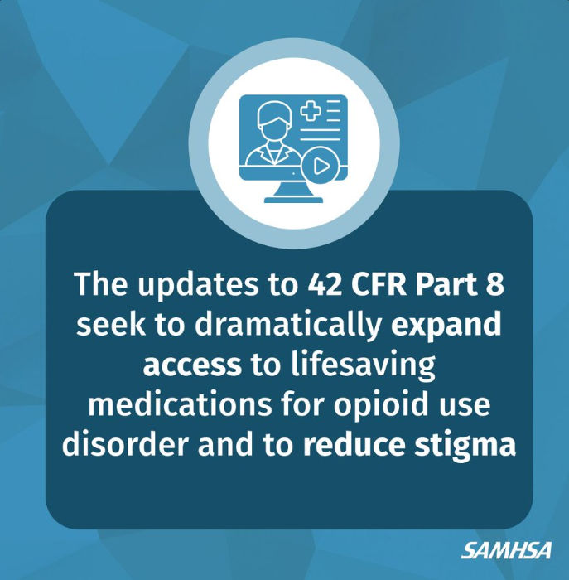
February 2024
Final Rule Take Home Medication Changes:
Before: “absence of any drug of abuse” Now: “absence of an active SUD”
Decisions based on clinical assessment not toxicology
Weigh risks and benefits
Individualize treatment

Slide 6
Objectives
Develop new tools and workflow that meets standards of the updated federal guidelines
Ensure staff comfort in the significant change of workflow and roles/responsibilities
Continuous evaluation of the effectiveness of the process
Notes:
highlight patient centered, individualized decisions careful considerations risk/benefit
with a focus on increased teamwork, collaboration, and understanding

Slide 7
Methods
Leadership Team Meetings
- 3 together, 2 subgroup
Step-by-step interdisciplinary workflow
Clinical Assessment tool
Rolling-out education to teams
Workflow
Assessment
Notes:
Initially our leadership team met to discuss the need for new process in response to the updated regulations. We looked at how many clients are currently receiving each quantity of take home medication to ensure feasibility, planned to consult with our toxicology lab regarding ability to expedite results with nursing, and discussed the need for a specific assessment tool for clinicians to use to individualize decisions. Sub groups of this team met to finalize documents such as the step-by step workflow and assessment tool.
We then planned a series of meetings amongst the interdisciplinary teams both together and separately – to ensure the proper education was provided. We initially focused on giving a thorough background as to reasons these changes are occurring and in what context, as well as teaching the material and listening to feedback from staff. We were thoughtful to incorporate multiple forms of teaching/learning such as visual, verbal, incorporating role plays, questions, and balancing data with real life examples.
We conducted surveys intermittently to elicit and monitor particular feedback regarding comfort levels and opinions – as our overall goal was to ensure staff were confident in the changes, and address any concerns as indicated in the surveys.

Slide 8
Methods
Interdisciplinary Staff Meetings
- 4 together, 2 subgroup
Providing background information / updated regulations
Presenting and teaching workflows
Hearing feedback
Surveys
Clinical and Nursing Staff opinions were assessed at:
Baseline, 1-month post-initiation, and 6months post-initiation
4 Statements with 5 point Likert Scales

Slide 9
I feel confident in my understanding of our take home policy as it applies to patients with positive toxicology screens.

Slide 10
I am happy with the role that I play in our clinic's take home process.

Slide 11
I believe that our take home policy is well aligned with what BSAS and SAMHSA have set forth.
2/14/24
4/22/24

Slide 12
My role and responsibilities in the clinic's take home policy is a good match for my training and qualifications.

Slide 13
Conclusions
At baseline OTP staff had neutral to positive opinions about our take home bottle policy and work-flows
Our intervention had a positive impact on staff's comfort levels 1 month post roll-out
Some of this effect persisted, but there was a decrease in comfort level 6 months post intervention

Slide 14
Q/A, QR Codes, Contact
hazel.barrett@bhninc.org
carissa.cutler@bhninc.org
ari.kriegsman@bhninc.org
Workflow
Assessment
Notes:
Initially our leadership team met to discuss the need for new process in response to the updated regulations. We looked at how many clients are currently receiving each quantity of take home medication to ensure feasibility, planned to consult with our toxicology lab regarding ability to expedite results with nursing, and discussed the need for a specific assessment tool for clinicians to use to individualize decisions. Sub groups of this team met to finalize documents such as the step-by step workflow and assessment tool.
We then planned a series of meetings amongst the interdisciplinary teams both together and separately – to ensure the proper education was provided. We initially focused on giving a thorough background as to reasons these changes are occurring and in what context, as well as teaching the material and listening to feedback from staff. We were thoughtful to incorporate multiple forms of teaching/learning such as visual, verbal, incorporating role plays, questions, and balancing data with real life examples.
We conducted surveys intermittently to elicit and monitor particular feedback regarding comfort levels and opinions – as our overall goal was to ensure staff were confident in the changes, and address any concerns as indicated in the surveys.

