Slide 1
Multi-Site Harm Reduction Kit
Implementation and Distribution
Presenters: Margaret Shang MD, MS, Raagini Jawa MD, MPH, FASAM
Co-Authors: Ariana Freund BS, Gary McMurtrie BA, Olivia Studnicki BS, Natalie Leonard BA, Meghan GaNung LCSW, Hannah Scears, Jane Liebschutz MD, MPH, FACP

Slide 2
Funding & Disclosures
Disclosures:
None
Funding:
TREETOP Branch Pilot
NIDA K12DA050607 (RJ, JL)

Slide 3
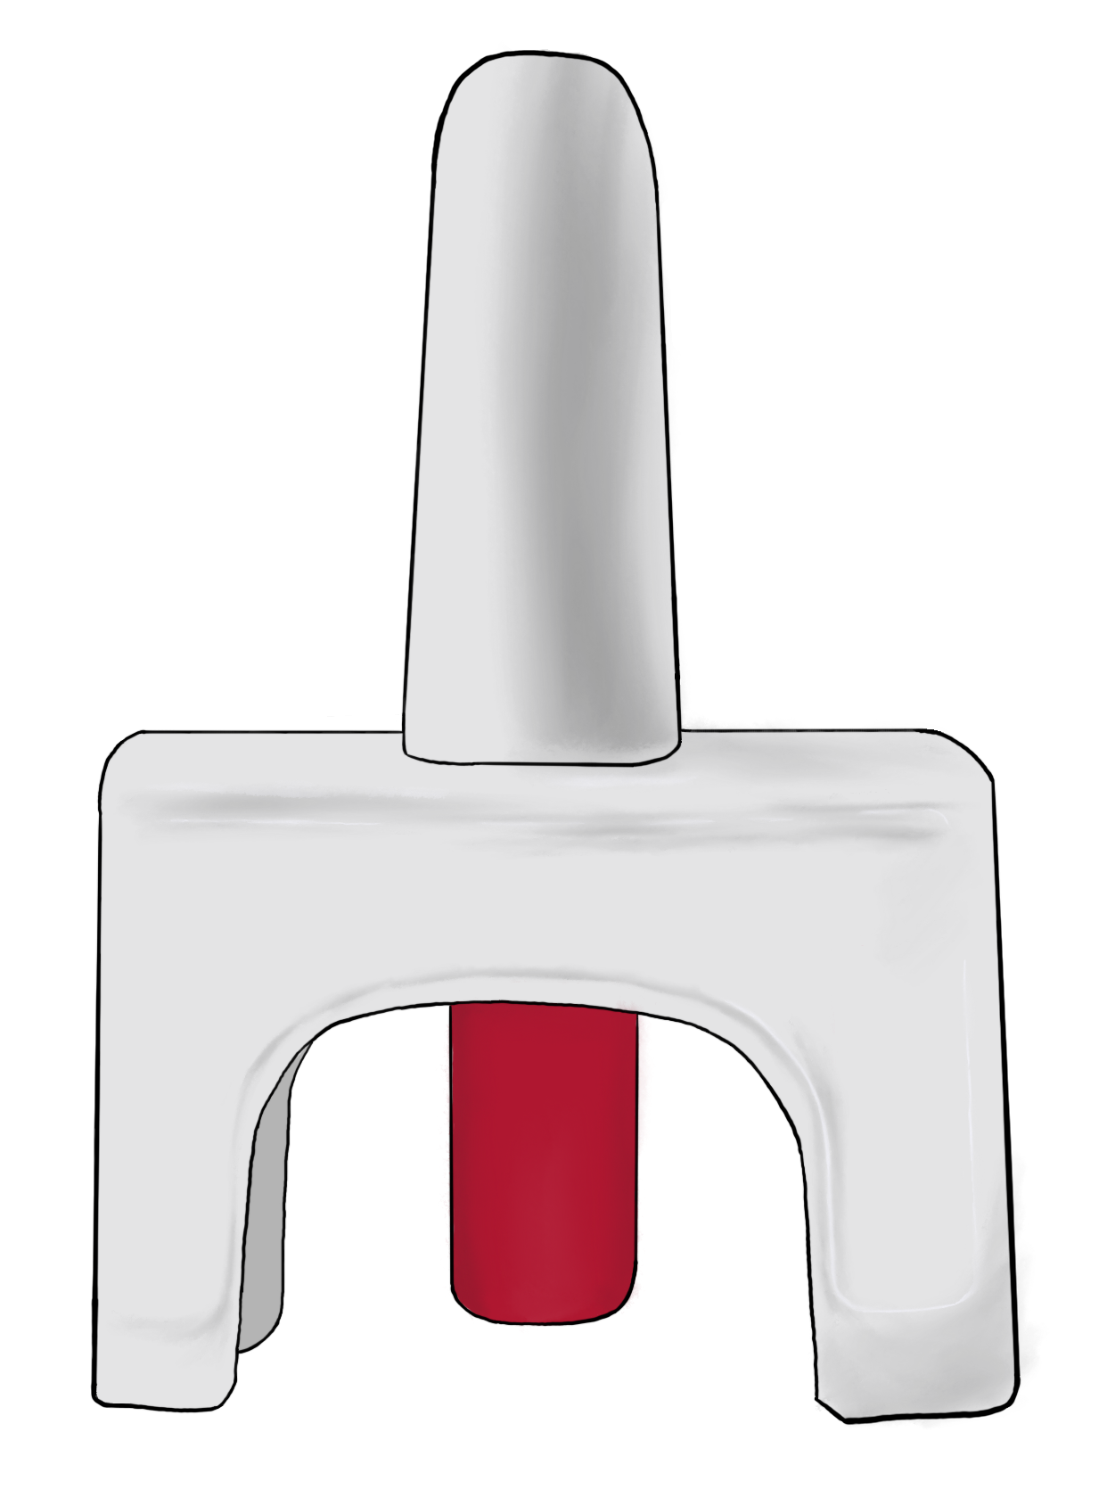

Slide 5
SSP

Slide 6
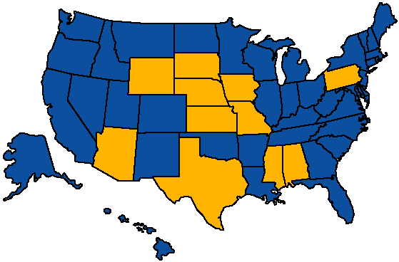
Chatterjee A, et al. J Gen Intern Med. 2023
SSPs in the US
Legal
Illegal

Slide 7
ODSMP 2024
CDC 2024
#13
9%
decrease compared to 2022
4,719
drug overdose deaths in 2023
2 hours
One Pennsylvanian died every

Slide 8
The Overdose Crisis
ODSMP 2024
Rates of Fatal Overdose in PA
Rate per 10,000 Population
Black
White

Slide 9
SSP
COE
Centers of Excellence for Opioid Use Disorder

Slide 10
Dual Diagnosis
Peripartum
Primary Care
Read implementation paper here (Shang M, et al. Harm Reduction Journal. 2023.

Slide 11
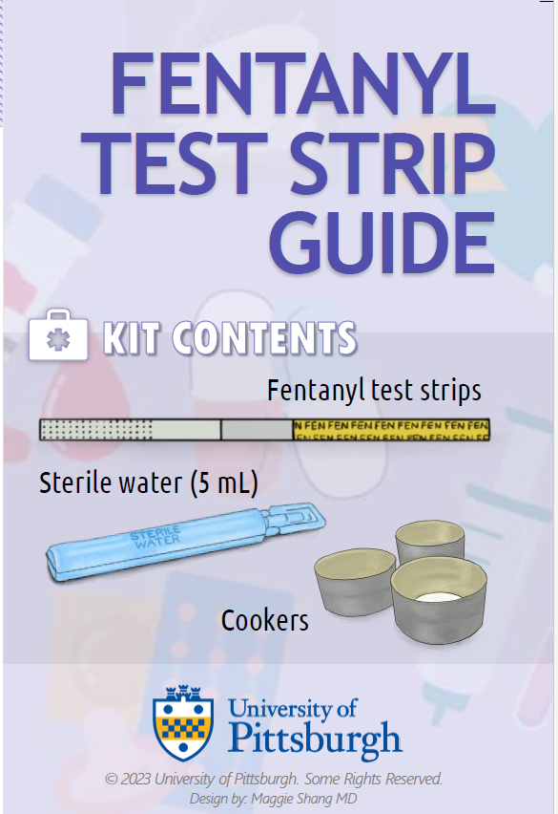
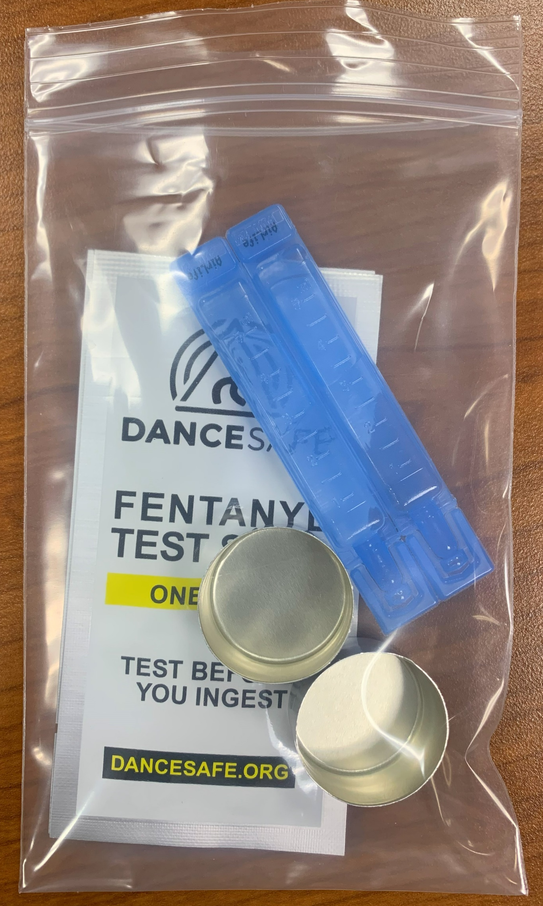
Kit Types
Fentanyl test strip
Naloxone
Safer injection
Safer smoking
Safer snorting
Safer boofing
Wound care
Xylazine test strip
Scan to see more guides

Slide 12
Objective
2-month post-implementation at all COEs:
1
Kit uptake
2
Implementation barriers & facilitators

Slide 13
Sept 2023 – Jan 2024
Pre-implementation
Identify site champions
Site-specific clinical workflows
Staff/provider trainings
Feb – Mar 2024
Implementation
Tracked kit number/type distributed
Weekly check-in with champion

Slide 14
Two Months Post-Implementation
Kits Distributed by Type (%)
483 Kits
(20 kits/week/site)
105 unique patients

Slide 15
Barriers
Two Months Post-Implementation
23 weekly check-ins
Implementation strategies
Facilitators
Site-specific workflow adaptations
Positive patient feedback on kit availability
Acceptability among staff
Opportunity for secondary distribution
Managing inventory
Encourage conversations on risk mitigation

Slide 16
Implementation strategies
Site champions
Site-specific workflows
Tailored harm reduction trainings

Slide 17
Key Points
Considerable demand for kits even when engaged in addiction treatment.
Harm reduction services need to be more accessible across the care continuum.

Slide 18
Acknowledgements
Research Team
Site Champions
Faculty Leads
Olivia Studnicki, BS
Gary McMurtrie, BA
Austen Markus, MPH
Sara Barač, BA
Ariana Freund, BS
Natalie Leonard, BA
Megan GaNung, LCSW
Hannah Scears
Brent Thiel, MD
Ilana Hull, MD, MSc
Jody Glance, MD
Heather Mikes, DO

