Slide 1
Nationwide Capabilities Assessment of Emergency Department Care of Patients with Opioid Use Disorder: 2022 to 2023
AMERSA
November 4, 2023
Kathryn Hawk MD, MHS
Department of Emergency Medicine

Slide 2
Disclosures
I have no conflicts of interest or
disclosures to report
Research Support:

Slide 3
ACEP E-QUAL Opioid Network
Scott Weiner
Craig Rothenberg
Dhruv Sharma
Pawan Goyal
Kimberly Rudowski
Megan Sambell
Arjun Venkatesh

Slide 4
Background
National trends of ED care for patients with OUD and opioid overdose are not well documented.
In 2018, the U.S. Surgeon General released an advisory supporting naloxone distribution/prescription to patients at risk of overdose
Despite evidence of improved outcomes with MOUD, the proportion of EDs initiating medications for OUD treatment nationwide is unknown.

Slide 5
ACEP E-QUAL Opioid Collaborative
Mission:
“Engage emergency clinicians and leverage emergency departments to improve clinical outcomes and coordination of care”
Enrollment
Enrollment questionnaire
Learning Collaborative
(6-9 months)
Webinars/toolkit
Collect CME
Wrap Up
Follow-up benchmarking data
Baseline benchmarking data
Online portal activities
CMS MIPS credit

Slide 6
Study Objectives
To assess the capabilities of EDs participating the E-QUAL Opioid Initiative to care for ED patients with OUD and overdose.
To evaluate quality improvement among participating EDs.

Slide 7
Methods
Measures:
Provision of naloxone after opioid overdose
Ability to refer to outpatient OUD treatment
Departmental protocol for OUD treatment initiation with buprenorphine (BUP)
Presence of any ED physician who prescribes BUP for OUD
Use of Clinical Decision Support to provide OUD care
Analysis:
Descriptive statistics and student’s t-test were used to evaluate responses from sites providing both pre and post data

Slide 8
Participating Emergency Departments
ED Patient volume | Number n=259 | Percent Total
<20K | 139 | 53.7%
20-60K | 111 | 42.9%
>60 K | 9 | 3.5%
ED Location
Rural | 129 | 49.8%
Critical Access | 49 | 18.9%

Slide 9
Results: OUD Care
 | 2022 EDs | Percent of Total (n=259) | 2023 EDs | Percent of Total (n=259) | Chi-square
Naloxone provision to patients after overdose | 173 | 66.8% | 194 | 74.9% | p=0.04
Warm transition of care to SUD treatment | 28 | 10.8% | 39 | 14.7% | p=0.15

Slide 10
Results: MOUD Capabilities
 | 2022 EDs | Percent of Total (n=259) | 2023 EDs | Percent of Total (n=259) | Chi-square
Protocol to initiate BUP in the ED | 21 | 8.1% | 23 | 8.9% | p=0.75
Use of Clinical Decision Support for OUD Tx | 119 | 45.9% | 129 | 49.8% | p=0.38
Proportion of EDs with Clinician that Prescribes BUP | 49 | 18.9% | 67 | 25.9% | p=0.06

Slide 11
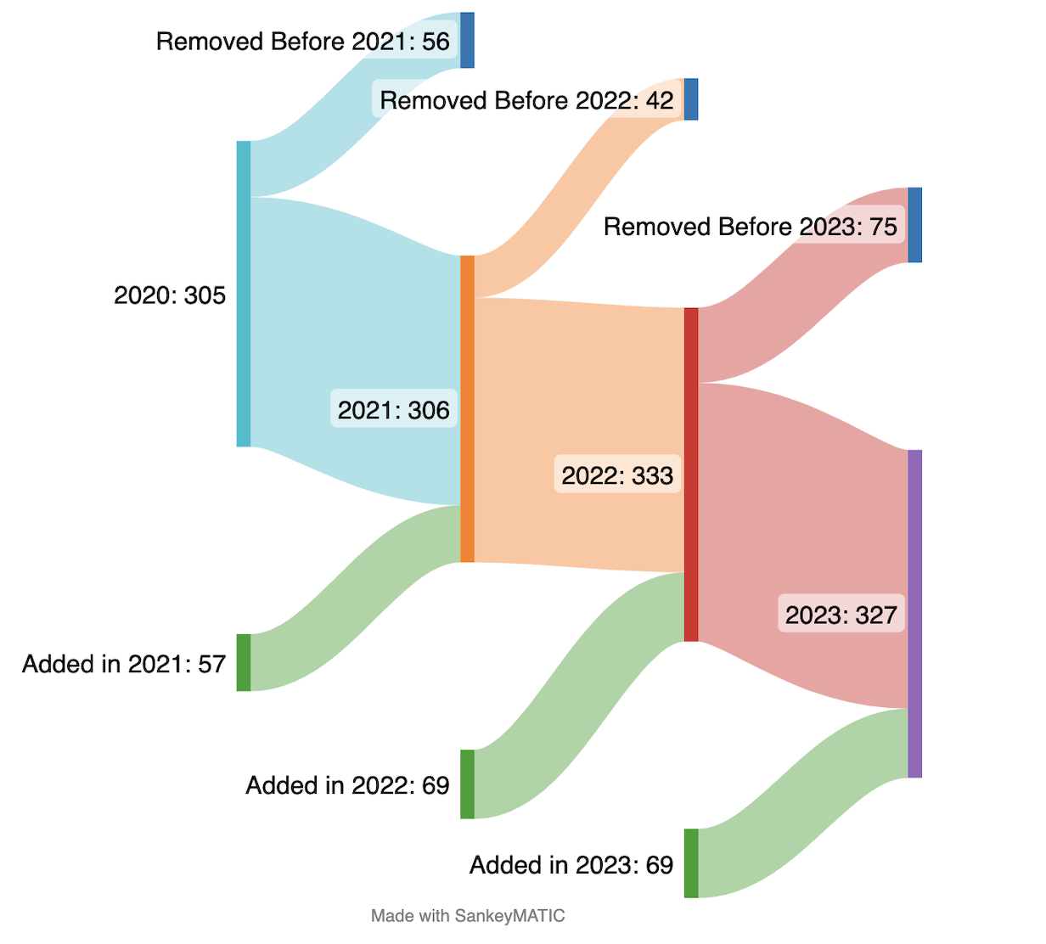
E-QUAL Opioid Initiative Enrollment 2020-2023
E-QUAL Opioid Initiative Enrollment 2020-2023
Notes:
Sankey diagram capturing enrollment in Opioid Initiative over the years. Overall, there were 23 sites with nonconsecutive years (dropped out for 1-2 years before returning).

Slide 12
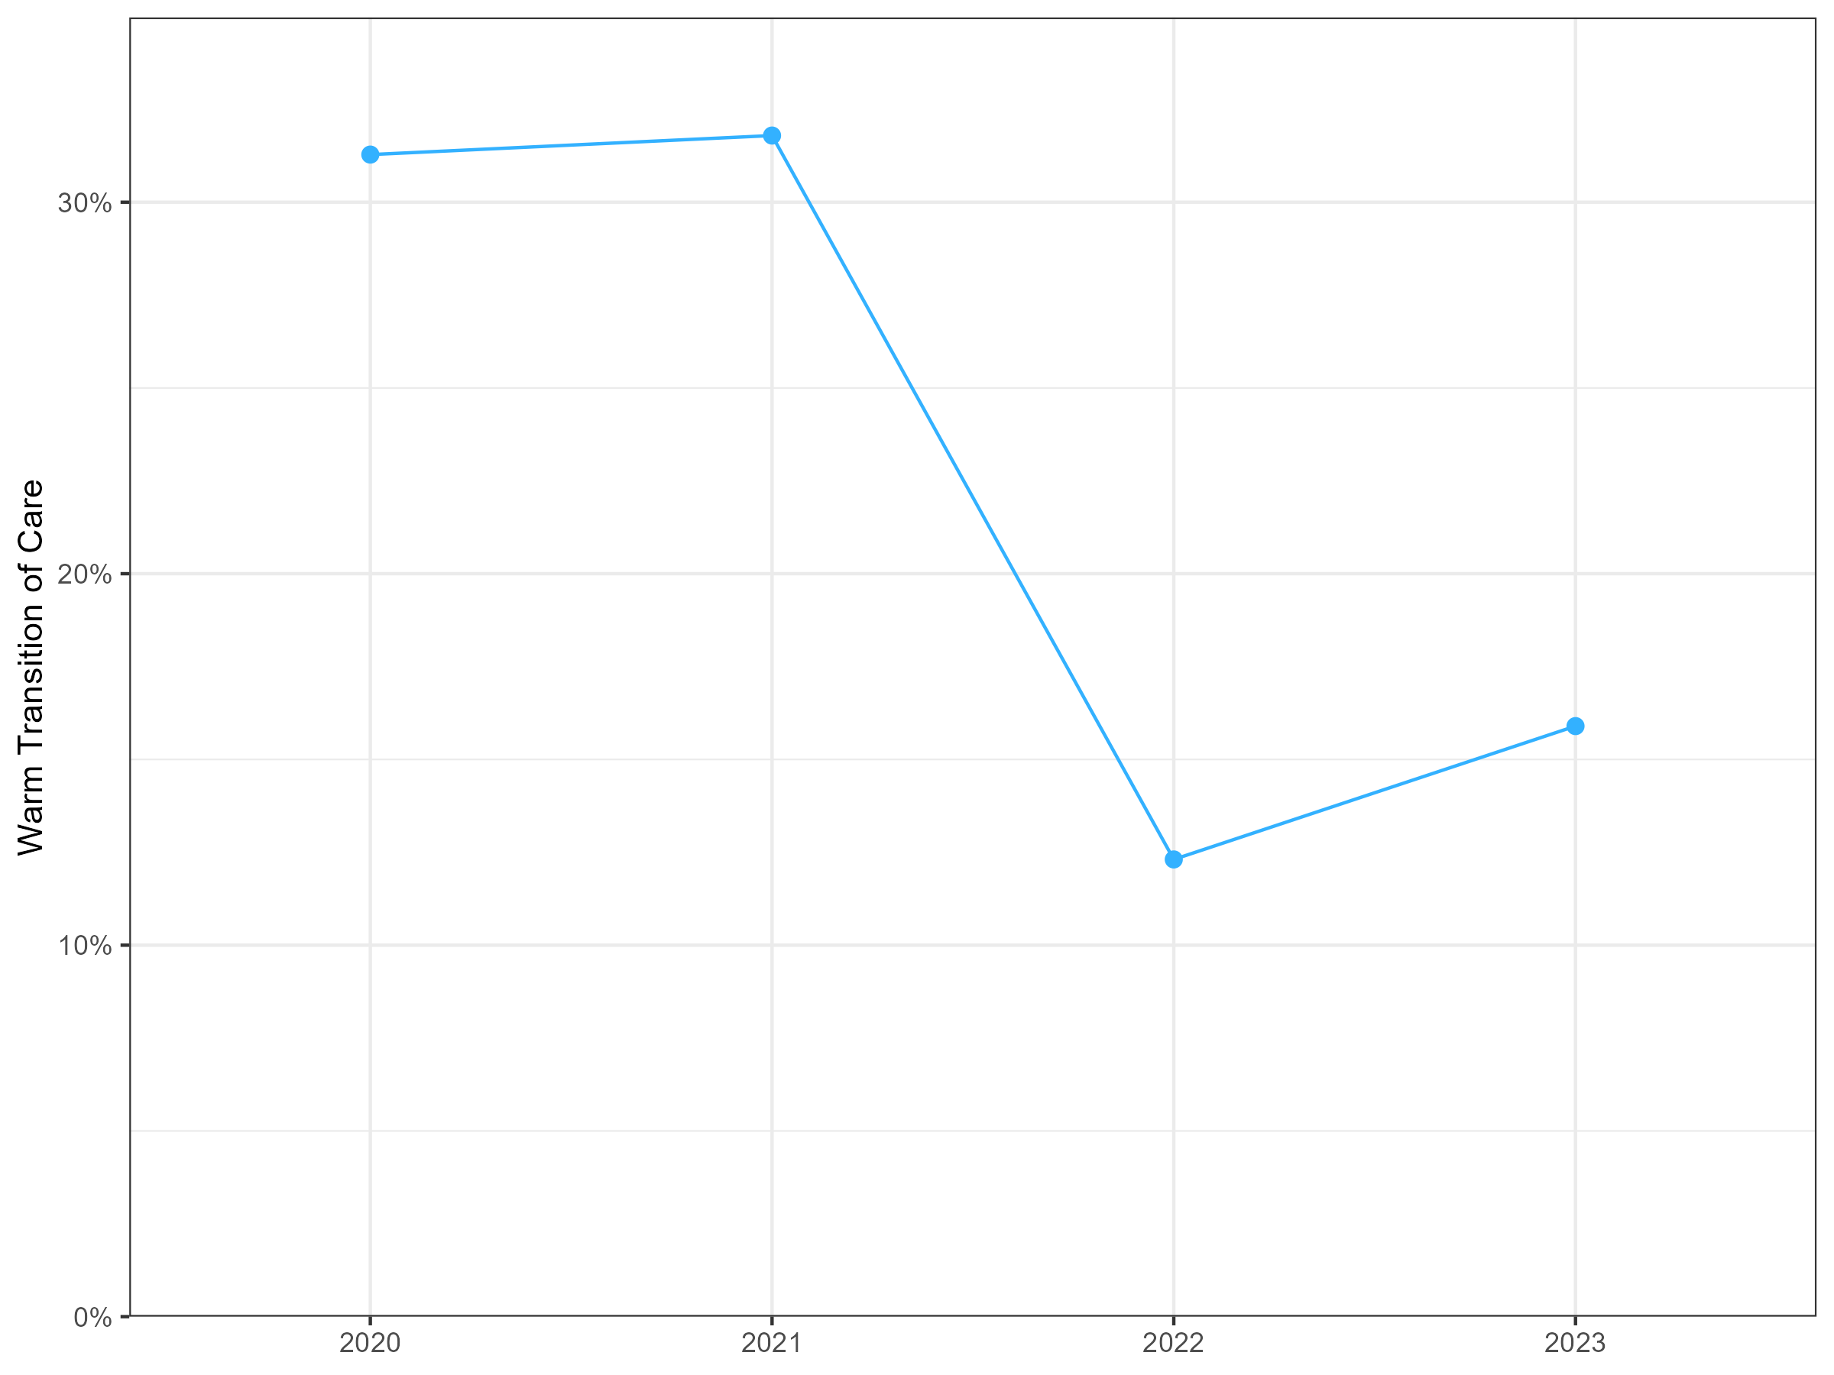
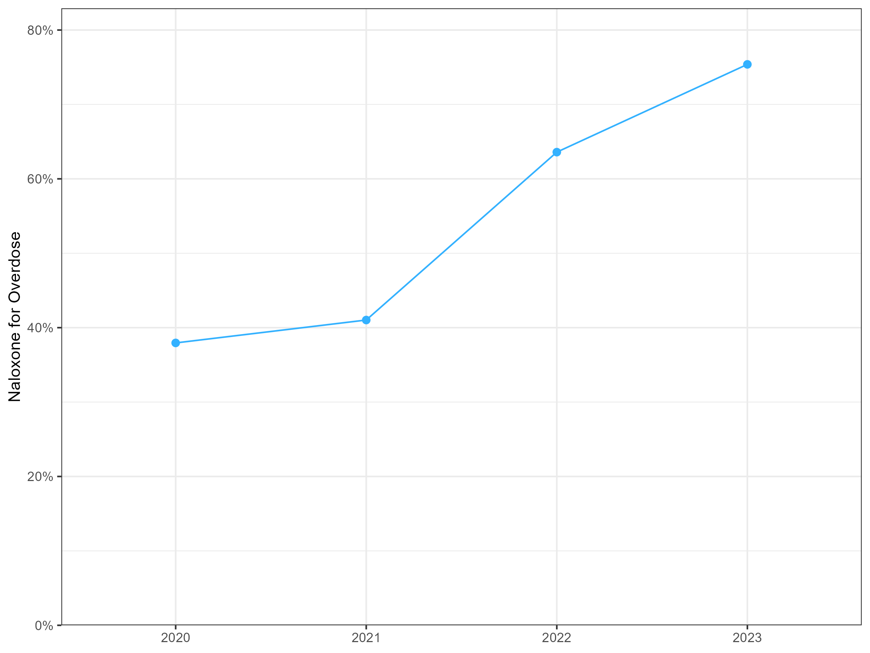
Capabilities Assessments 2020-2023
% EDs with Warm Transition of Care for OUD
% EDs that Provide Naloxone Post Overdose
Notes:
2020: 305
2021: 306
2022: 333
2023: 327

Slide 13
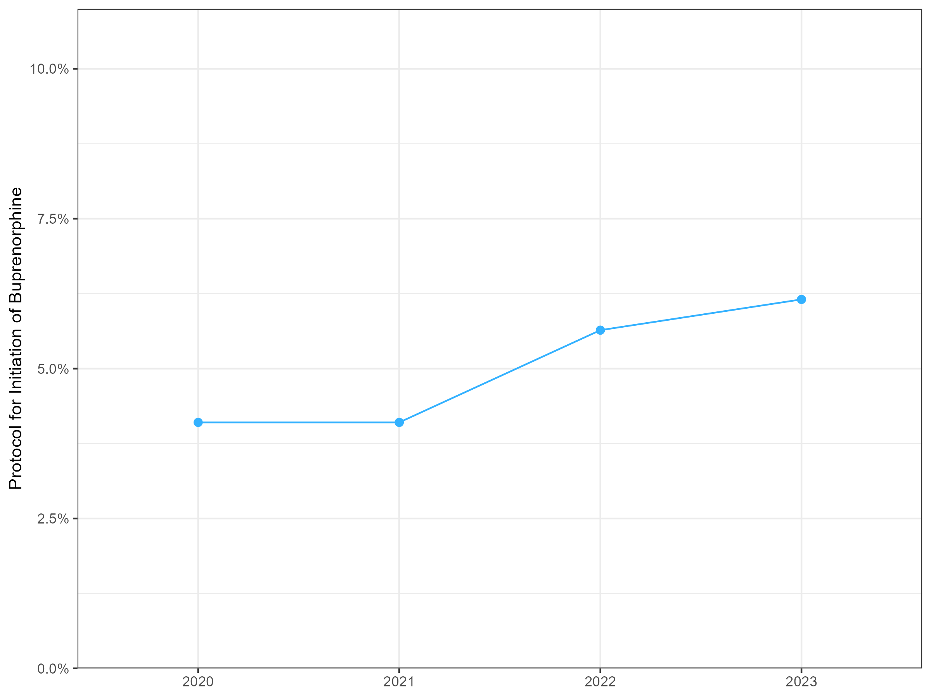
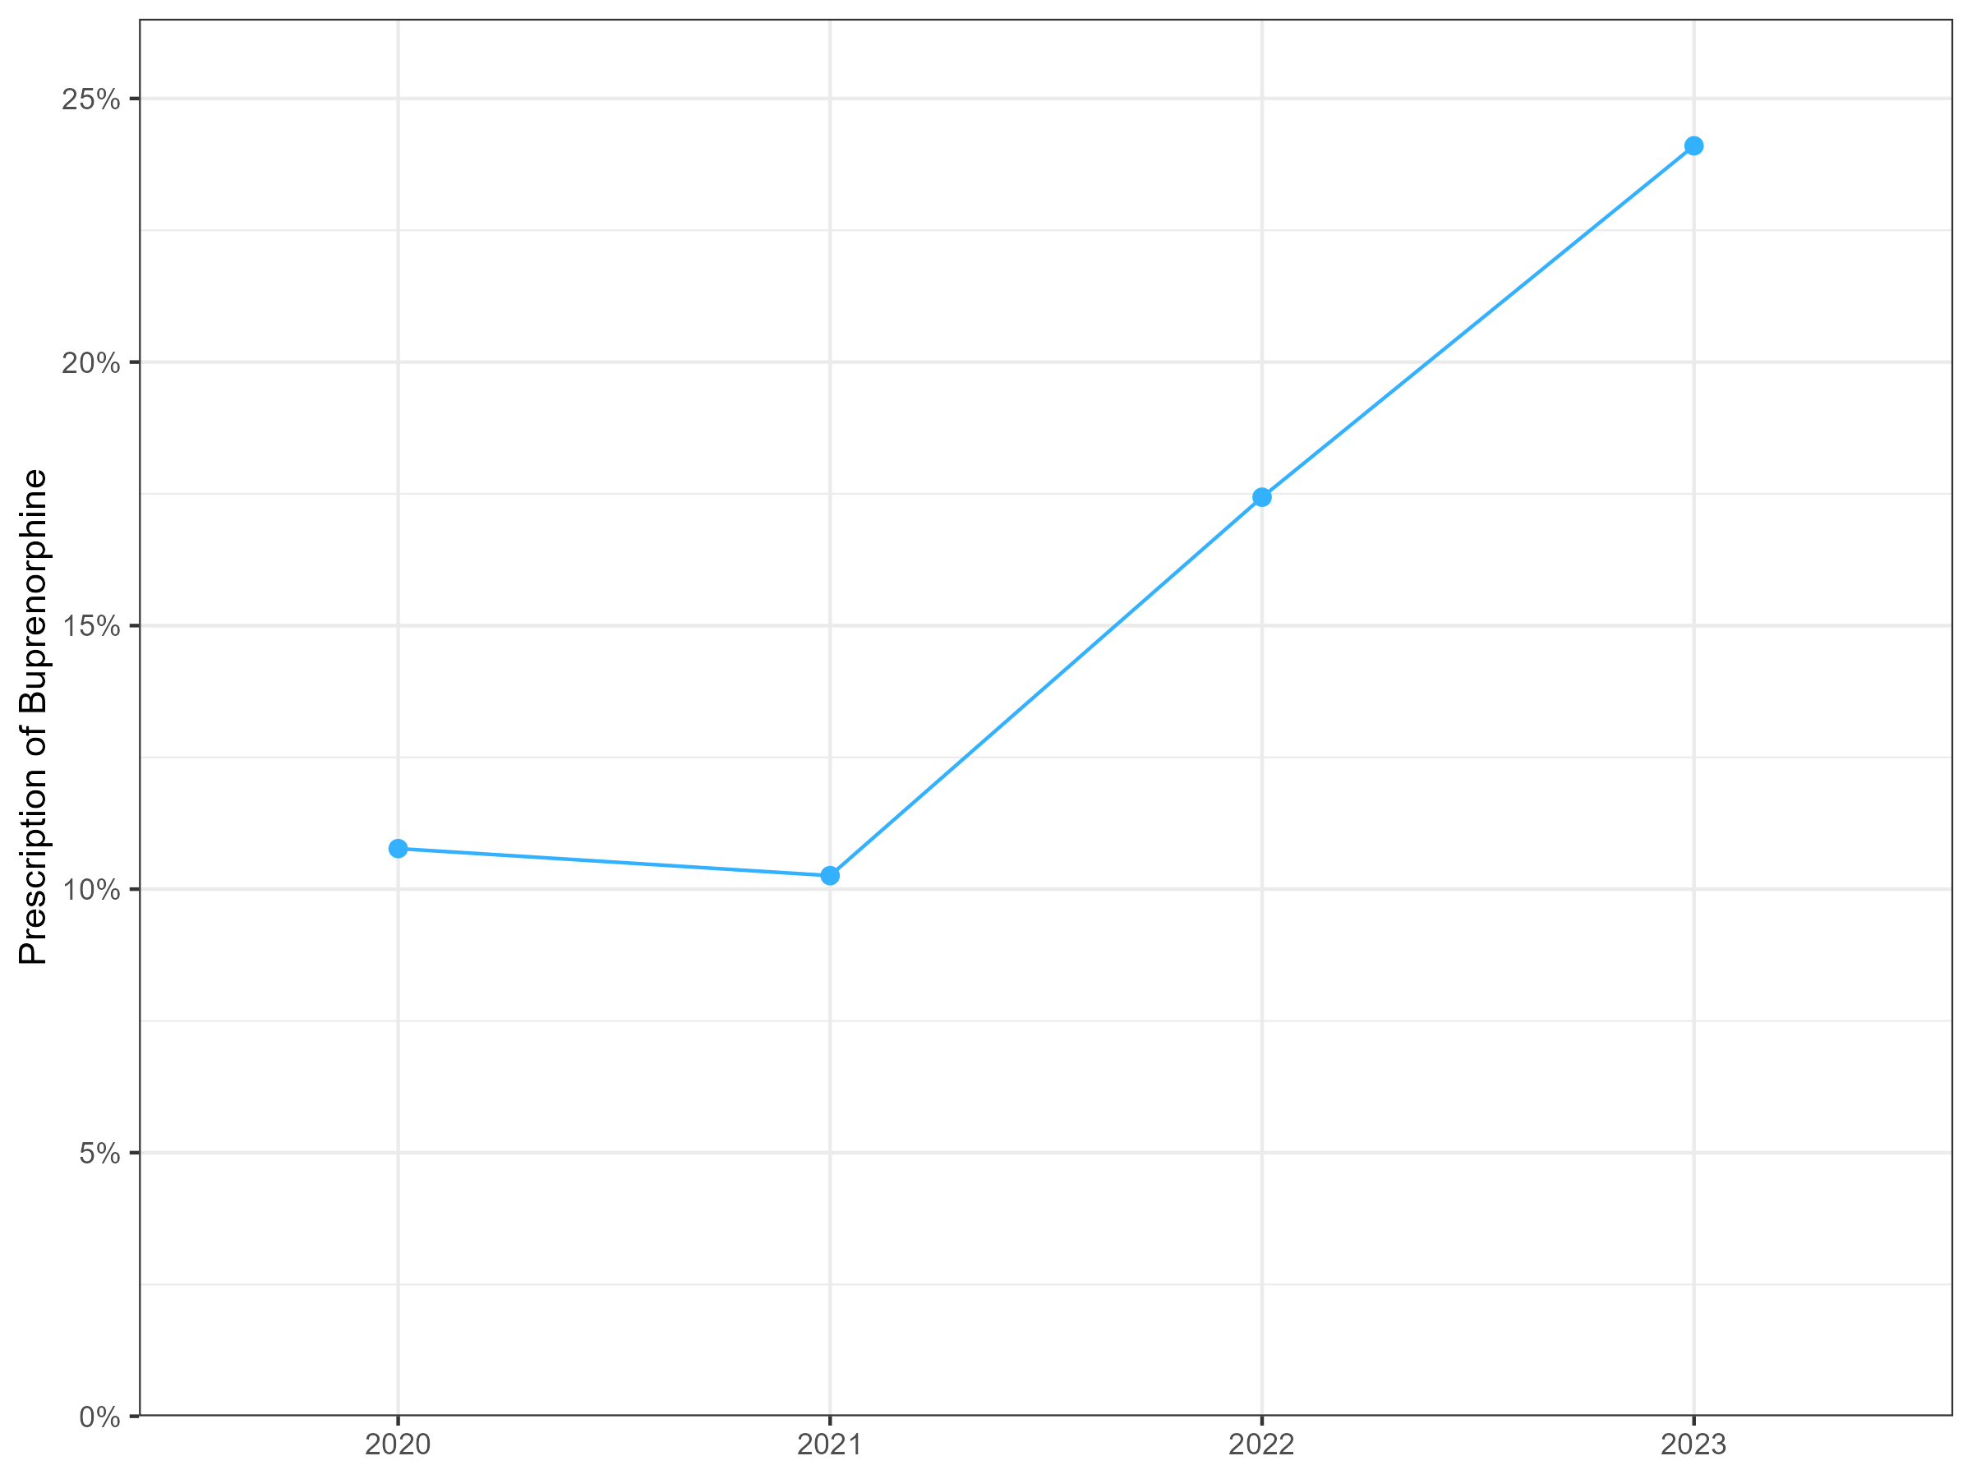
Capabilities Assessments 2020-2023
% EDs with BUP for OUD protocols
% EDs with BUP Prescribers
Notes:
2020: 305
2021: 306
2022: 333
2023: 327

Slide 14
Limitations
Changes likely reflect other influences in addition to just learning collaborative participation
Possible selection or reporting bias by sites

Slide 15
Conclusions & Next Steps
EDs participating in a national practice-based learning network demonstrated improvement in the proportion of EDs that provide naloxone to ED patients following opioid overdose.
Overall, rates of buprenorphine initiation remain low.
This study represents the first feasibility assessment of collection of OUD measures from a nationwide sample

Slide 16
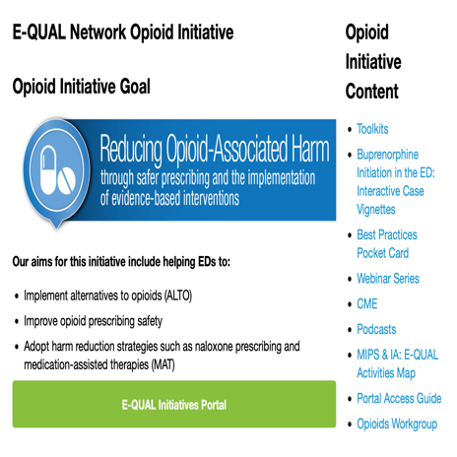
kathryn.hawk@yale.edu
@kathryn_hawk

