Slide 1
Non-abstinence Among US Adults in Recovery Findings from the 2022 National Survey on Drug Use and Health
Emily Pasman
Rebecca J Evans-Polce
Ty Schepis
Curtiss W Engstrom
Vita V McCabe
Tess K Drazdowski
Sean Esteban McCabe
Notes:
Thank you
Emily Pasman, Postdoc at UM, acknowledge co-authors at the UM, Texas State, Chestnut Health Systems
This study used data from the 2022 NSDUH to examine non-abstinence among adults in recovery

Slide 2
Funding and Disclosures
This study was supported by research awards from the National Institute on Drug Abuse (NIDA) and the National Institute on Alcohol Abuse and Alcoholism (NIAAA) of the National Institutes of Health (NIH, K23DA048161, R01AA030243, R01DA031160, R01DA043691, R24DA051950).
NIH/NIDA/NIAAA had no role in the design and conduct of the study; collection, management, analysis, and interpretation of the data; preparation, review, or approval of the manuscript; and decision to submit the manuscript for publication.
No conflicts of interest to report.
Notes:
Funded by NIDA and NIAAA
Funders are not responsible for the content
No conflicts to report

Slide 3
What is Recovery?
A process of change through which individuals improve their health and wellness, live a self-directed life, and strive to reach their full potential.
Substance Abuse and Mental Health Services Administration
A process of sustained action that addresses the biological, psychological, social, and spiritual disturbances inherent in addiction.
American Society of Addiction Medicine
The process of improved physical, psychological, and social well-being and health after having suffered from a substance-related condition.
Recovery Research Institute
An individualized, intentional, dynamic, and relationship process involving sustained efforts to improve wellness.
Recovery Science Research Collaborative
Notes:
Various definitions of recovery have been proposed over the years, most center around improved functioning.
Have some definitions from prominent organizations here – SAMHSA, ASAM, recovery researcher orgs – none mention stopping or even reducing substance use. Their emphasis is on overall health and quality of life.
So, recovery may involve abstinence, moderation, or substitution.
We have a good body of research that shows abstinence is not necessary for positive outcomes – improved health/social functioning can be achieved/maintained w/o abstinence. We also know ppl do better clinically when they choose their own tx/recovery goals

Slide 4
Reality of US Recovery Services
ABSTINENCE
Notes:
In reality most US recovery services have 1 goal: Anyone guess? Abstinence.
Most most tx and recovery services are abstinence-based, meaning stopping all substance use is promoted as necessary for success in recovery.
For example, more than 90% of US tx programs include abstinence-based 12-step programming.
Tx providers’ acceptance of non-abstinent goals remains low.
Recent years have seen increased calls for expansion of recovery services to accommodate non-abstinent pathways.

Slide 5
Research Questions
How prevalent is abstinence vs non-abstinence among US adults in recovery?
1
Are certain subgroups of recovering persons more likely to be non-abstinent?
2
Notes:
Having a clear understanding of what recovery looks like among the US population is key to designing acceptable tx and recovery services.
National data to assess:
How prevalent is abstinence v non-abstinence among ppl in recovery?
Are certain subgroups of recovering persons more likely to be non-abstinent?

Slide 6
Methods
Data were from the 2022 National Survey on Drug Use and Health (NSDUH).
Adults were asked:
“Do you think you ever had a problem with your own drug or alcohol use?”
“At this time do you consider yourself to be in recovery or recovered from your own problem with drugs or alcohol use?”
N=3,763 adults in recovery (71% of those with a self-perceived AOD problem).
Logistic regression was used to identify factors associated with past month AOD use.
Notes:
2022 NSUDH data – weighted to be nationally representative of all non-institutionalized civilians
Adults 18+ were asked “Do you think you ever had a problem with your own drug or alcohol use?” Those who said yes were asked, “At this time do you consider yourself to be in recovery or recovered from your own problem with drugs or alcohol use?”
N = 3,763 adults who considered themselves in recovery from an AOD problem.
Descriptives & logistic regression to ID sociodemographic and SU factors associated with past-month AOD use

Slide 7
Sample Characteristics (N = 3,763)
Age
18 – 25
26 – 49
50+
Sex
Male
Female
Race-ethnicity
Asian
Black
Hispanic
Indigenous
Multiracial
White
Sexual Identity
Straight
Lesbian/gay
Bisexual
Community
Urban
Rural
Employment
Employed
Unemployed
Not looking
Insured
Probation
Child in home
Religiosity (2–8) | M=5.2, SD=2.0
Health (1–5) | M=3.3, SD=1.0
Psych distress
Early use
Past-year SUD
None
1 mild
1 mod/severe
Multiple
Service use
Specialty
Non-specialty
Mutual aid
Medication
Notes:
Characteristics of our sample of US adults in recovery:
We examined age, sex, race/ethnicity, sexual identity, urbanicity, employment, insurance status, PY probation/parole, whether respondents had a child in the home
We included continuous measures of religiosity and self-reported health
Dichotomous indicators of past-year serious psychological distress, early initiation of AOD use
DSM5 criteria was used to assess past-year SUD, we created a 4-category variable characterizing the number/severity of SUDs
Respondents reported any past-year use of specialty tx, non-specialty tx, mutual aid groups, and medication for alcohol or OUD.

Slide 8
Past-Month AOD Use
Among those in non-abstinent recovery…
Alcohol
Cannabis
Cocaine/meth
Heroin
Hallucinogens
Rx stimulants
Rx opioids
Rx benzos
Past-year SUD
Notes:
An estimated 65.2% of adults in self-identified recovery reported past-month AOD use
Of those who were non-abstinent, most reported past-month alcohol use and half reported past-month cannabis use. Smaller proportions reported past-month use of cocaine or methamphetamine, hallucinogens, heroin, and nonmedical use of prescription drugs
More than half met criteria for past-year SUD

Slide 9
Substance Use and SUD Type
 | Past-Month Alcohol and Other Drug Use
 | Alcohol (N=2,056) | Cannabis (N=1,414) | Cocaine or meth (N=154) | Heroin (N=39) | Hallucinogens (N=143) | NM Rx stimulants (N=92) | NM Rx opioids (N=105) | NM Rx benzos (N=88)
Past-year SUD type | No. (%) | No. (%) | No. (%) | No. (%) | No. (%) | No. (%) | No. (%) | No. (%)
Alcohol UD | 919 (42.7) | 543 (33.5) | 64 (35.4) | 5 (11.2) | 70 (39.8) | 48 (52.4) | 32 (37.6) | 37 (44.0)
Cannabis UD | 586 (23.7) | 824 (52.0) | 67 (33.3) | 11 (36.0) | 91 (48.2) | 41 (56.3) | 37 (28.5) | 39 (34.9)
Cocaine or meth UD | 113 (6.2) | 111 (9.3) | 106 (79.0) | 23 (70.2) | 26 (32.8) | 24 (35.3) | 33 (28.5) | 26 (20.5)
Heroin UD | 22 (0.8) | 27 (1.8) | 24 (13.5) | 34 (82.0) | 4 (4.2) | 7 (15.6) | 17 (12.0) | 15 (18.9)
Hallucinogens UD | 31 (1.0) | 27 (1.3) | 4 (0.8) | 2 (2.9) | 18 (6.3) | 7 (4.9) | 4 (0.7) | 5 (3.5)
Rx stimulants UD | 55 (2.4) | 44 (2.3) | 14 (10.4) | 4 (29.2) | 12 (6.3) | 44 (53.8) | 14 (13.7) | 16 (21.7)
Rx opioids UD | 74 (3.8) | 70 (4.4) | 28 (18.7) | 12 (28.0) | 8 (3.2) | 16 (17.0) | 60 (54.7) | 24 (22.7)
Rx benzo UD | 30 (1.7) | 32 (2.0) | 17 (9.2) | 10 (37.6) | 8 (3.4) | 10 (18.0) | 13 (8.3) | 33 (40.4)
None | 836 (42.9) | 360 (29.6) | 13 (8.6) | 1 (1.4) | 25 (15.6) | 14 (12.5) | 19 (19.3) | 20 (28.9)
Of those who were non-abstinent, 55.2% reported use of a substance for which they met past-year SUD criteria. Percentages indicate column percent.
Notes:
This table shows the proportion of people with past-month use of each substance who met SUD criteria for that specific substance in the past year.
Overall, of those in non-abstinent recovery, 55.2% reported use of a substance for which they met past-year SUD criteria
By substance, there was a good bit of variability – estimates ranged from 6.3% of people who used hallucinogens in the past month met criteria for a past-year hallucinogen use disorder, to 82.0% of people who used heroin in the past month met criteria for a past-year heroin use disorder.

Slide 10
Characteristics Associated with AOD Use
Females had lower odds of use than males.
Gay/lesbian-identified individuals had greater odds of use than straight-identified.
Greater religiosity was associated with lower odds of use.
Past-year SUD was associated with greater odds of use.
Past-year mutual aid attendance was associated with lower odds of use.
Notes:
In the multiple logistic regression model:
Females had lower odds of use than males
Lesbian/gay-identified individuals had greater odds of use than straight-identified
Greater religiosity was associated w lower odds of use.
Relative to those without a past-year SUD, odds of non-abstinence were greater among those with any number/severity of SUDs
Past-year mutual aid attendance was associated with lower odds of use.

Slide 11
Key Takeaways
2/3 US adults in recovery were non-abstinent.
Adults in abstinent vs non-abstinent recovery did not differ on several measures of functioning, but most had a past-year SUD.
Availability of non-abstinent services may improve engagement and outcomes.
Notes:
This study is one of the first to use nationally representative data to estimate abstinence vs non-abstinence among people who considered themselves to be in recovery.
We found 2/3 of adults in recovery were non-abstinent.
Adults in abstinent and non-abstinent recovery did not differ significantly on several measures of functioning (e.g., employment, psych distress, self-reported health) – but non-abstinent recovery was associated with increased odds of past-year DSM-5 SUD.
NSDUH does not have a measure of time in recovery, we cannot say whether SUD symptoms occurred prior to or following recovery initiation. It could be that those in non-abstinent recovery were more likely to be in early recovery than those who were abstinent. Possible bc research has shown recovering persons become more likely to adopt abstinence goals over time. However, there may be people who identified as in recovery and who were using AOD symptomatically.
Results highlight subpopulations of recovering persons who may benefit from a harm reduction approach, such as lesbian/gay-identified individuals.
We also found that ppl who attended mutual aid groups were more likely to be abstinent – likely related to the availability and accessibility of 12-step groups relative to alternative forms of mutual aid.
Findings really highlight a need for greater availability of non-abstinent RSS.

Slide 12
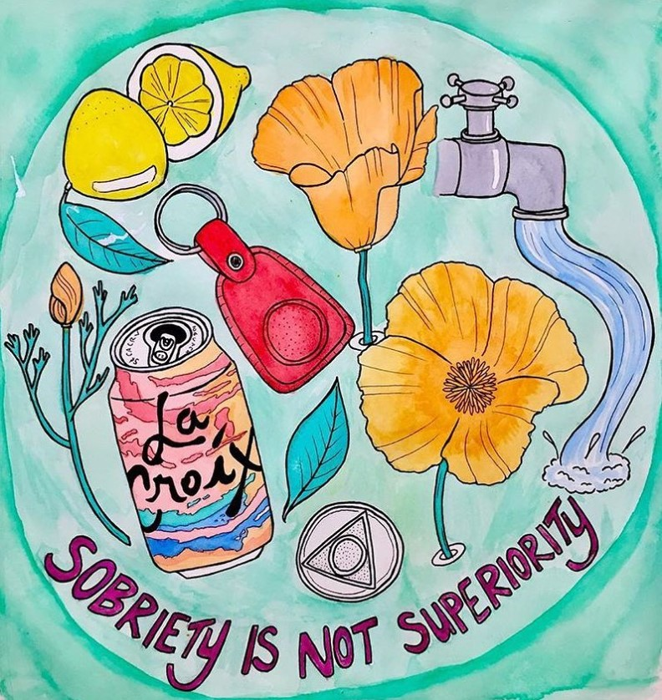
Future Directions
Study changes in SUD symptomology and abstinence status over time.
Examine abstinence vs non-abstinence among recovering adolescents.
Explore motives and service preferences of people in non-abstinent recovery.
Art by @plantneighbor, Instagram
Notes:
Close by noting some limitations and potential areas for future research.
This study was cross-sectional and lacked a measure of time in recovery. Longitudinal studies are needed to examine how SUD symptoms, abstinence status, and recovery identity change over time.
Lifetime AOD problems and current recovery were assessed among adults only – regional data suggest adolescents may be more interested in non-abstinent approaches. Future national studies are needed to explore this area among adolescents
This study did not distinguish between people pursuing non-abstinent recovery and those attempting abstinence who experienced a return to use. Research should explore the motives and service preferences of people in abstinent and non-abstinent recovery.
This line of research is needed to inform the development of services that engage/support the full spectrum of ppl in recovery.

Slide 13
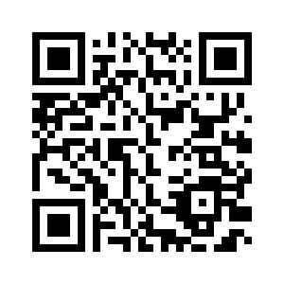
Questions?
pasman@med.umich.edu
Pasman, E., Evans-Polce, R. J., Schepis, T. S., Engstrom, C. W., McCabe, V. V., Drazdowski, T. K., & McCabe, S. E. (2024). Non-abstinence among US adults in recovery from an alcohol or other drug problem. Journal of Addiction Medicine. https://doi.org/10.1097/ADM.0000000000001408

