Slide 1
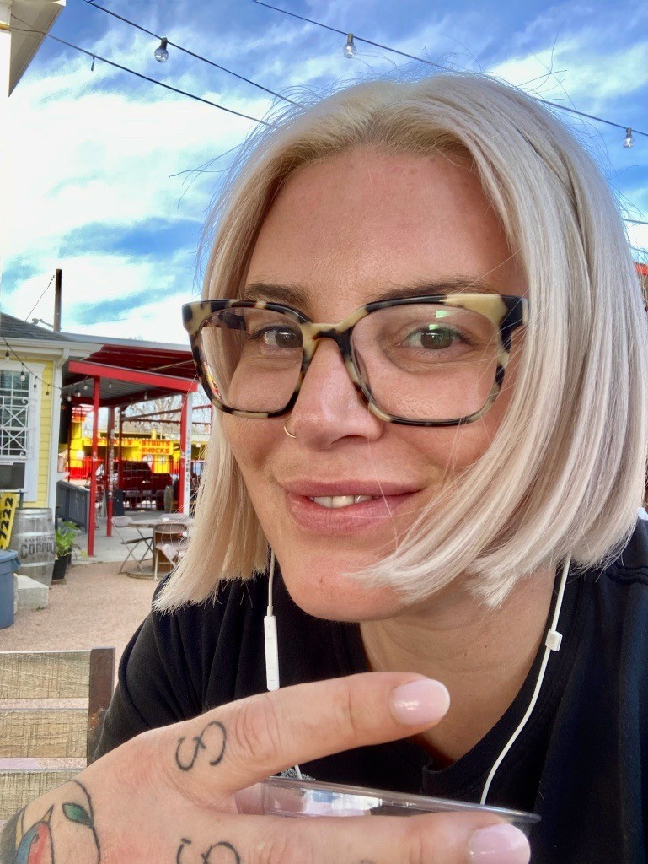
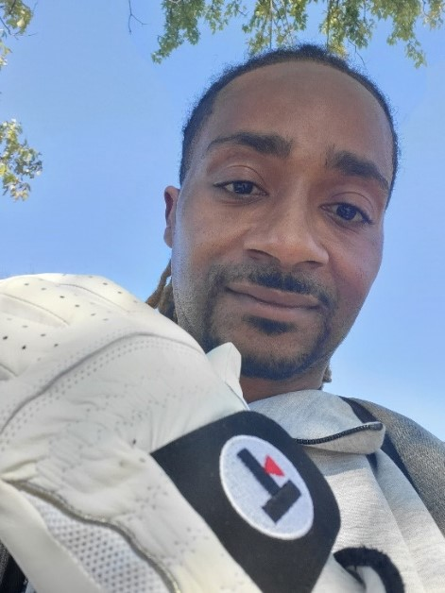
Creating a Harm Reduction Veteran Engagement Board
Beth Dinges, PharmD, VA Illiana Healthcare System
Tessa Rife-Pennington, PharmD, BCGP, San Francisco VA Health Care System
Minh Q. Ho, DO, VA Orlando Healthcare System
Garry Hayes
Aaron Ferguson, BSW
National Survivor’s Union, Leadership Team
Methadone Liaison
Community Medical Services
Franklin Taveras
Community Education Navigation
Support CENS
Veteran Health Outreach
NYU School of Global Public Health
Nikketa Burges
CU Denver graduate student
Juan Cortez
OnPoint NYC
Aaron M. Laxton, MSW, LCSW
Saint Louis University, Ph.D. student
Mark Jenkins
CT Harm Reduction Alliance, CEO & Founder
Consent and ROI on file. For pictures and quotes throughout presentation..

Slide 2
“Nothing about us without us, is for us.”
Nikketa Burges
U.S. Army Medic
Mark Jenkins
U.S. Air Force
Garry Hayes
U.S. Marine Corp
Franklin Taveras
U.S. Marine Corp
Juan Cortez
U.S. Army Reserves
Aaron Ferguson
U.S. Navy Aviation
HR-VEB Members
Notes:
Here are some of our members

Slide 3
Background
CDC: “public policies should not be written or put into place without the direction and input of the people who will be affected by that policy”.
Evidence-based harm reduction interventions, like syringe service programs and peer-delivered naloxone, were created by people who use drugs (PWUD).
Harm reduction increasingly being integrated into VHA, but there is a concerning lack of involvement of PWUD in programming.
Notes:
CDC puts into writing a very basic principle of harm reduction that you involve the ppl you’re looking to affect
HR was started by PWUD for PWUD.
My colleagues started syringe access in 2017, a very bottom up movement
There’s been a troubling lack of involvement of PWUD, especially as the SSPs have VA national uptake.
HC is hierarchal and those voices get left behind. And so does a very basic principle of harm reduction
Vets want to help other Vets and there’s limited opportunity to do that. One of the motivators to create this group.

Slide 4
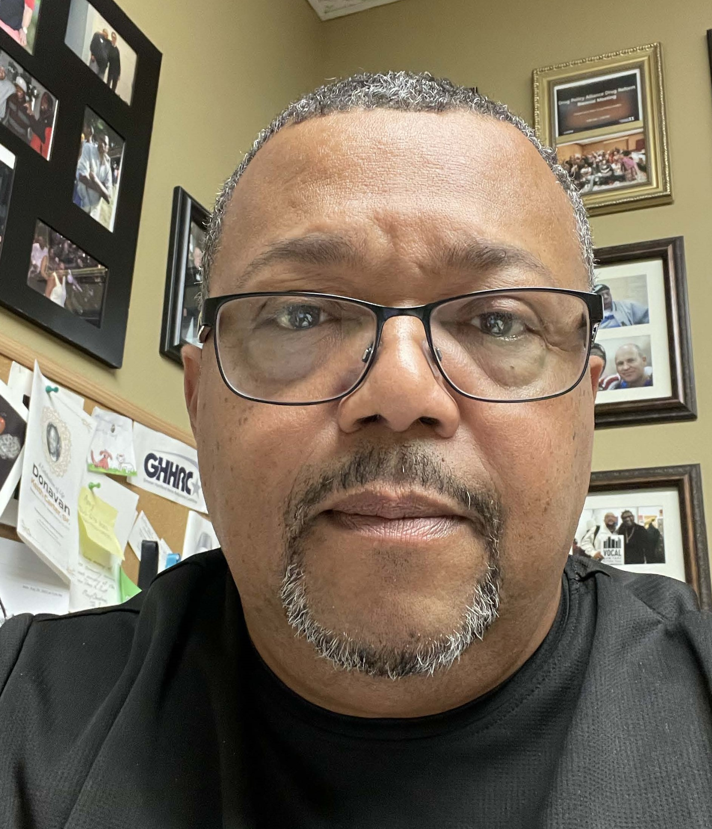
Overview
Approximately 8 members with lived or living experience around:
Substance Use, Homelessness, Infection, Incarceration, Sex Work
Harm Reduction Expertise
Consultative:
To inform VA harm reduction efforts
Collaborative:
Members as co-investigators on research
Facilitating community events
-- “VA needs peers who actually buy into the programs they’re working for.”
Notes:
Intentional on living experience
A lot of feedback to say we shouldn’t include living experience – that they’d be sending the wrong message or couldn’t show up. Couldn’t disagree more.
Ppl with living experience have relevance to today’s drug supply and unfortunately, get left behind in favor of those in long term abstinence, which can reinforce messaging of my way should be your way and almost, don’t come here unless you’re seeking sobriety. Feedback → realizing the need for this board
Members self-disclose substance use. Expectations are the same for members who use or don’t use – that you should up as contributing member.
Project teams and facilities present their work for feedback
Members are co-authors on this work I’m presenting today
Disabled Vet, Mark Jenkins, founder of CT Harm Reduction Alliance

Slide 5
Timeline
January 2023 – February 2024:
Member recruitment through mutual contacts and Veteran to Veteran
March 2024 – ongoing: Monthly meetings
“Let’s help reduce harm to those that have kept us safe from harm.”
Notes:
Juan Cortez
OnPoint NYC

Slide 6
Themes
Substance use in military:
Culture of secrecy and don’t ask/don’t tell
Substance-related discharges
Need for harm reduction
VA Challenges:
Referral requirements, Wait Times, Documentation requirements
Peer Specialists:
Not all receptive to harm reduction
Functional limitations, e.g. can’t distribute supplies
--'Wish I was told about safer use and they didn't demand abstinence...came close to dying for a lack of it. VA needs a community for these Veterans."
Notes:
Aaron Ferguson, BSW
National Survivor’s Union, Leadership Team
Methadone Liaison
Community Medical Services
“VA needs peers who actually buy into the programs they’re working for.”

Slide 7
Themes
Creating safe space for group:
Particularly for those with living experience
Avoiding tokenism
Need for VA Collaboration with Community
Stigma and Discrimination
Heightened in Healthcare?
Reluctancy of Veterans to receive harm reduction through VA
-- “VA SSPs need community partnerships, staff education, signage that’s pragmatic and not fear based.”
Notes:
Not looking to check off boxes in terms of gender, race/ethnicity, age, although I’m extremely pleased with our end product
Veteran Non-profits, Harm Reduction Organizations
In order to succeed…
Stigma & discrimination
Access barriers – such that you can’t access VA naloxone or even condoms w/o a patient specific Rx. We don’t have peer delivered naloxone, an intervention started by PWUD.
Can’t enter and exit quickly w/ what you need

Slide 8
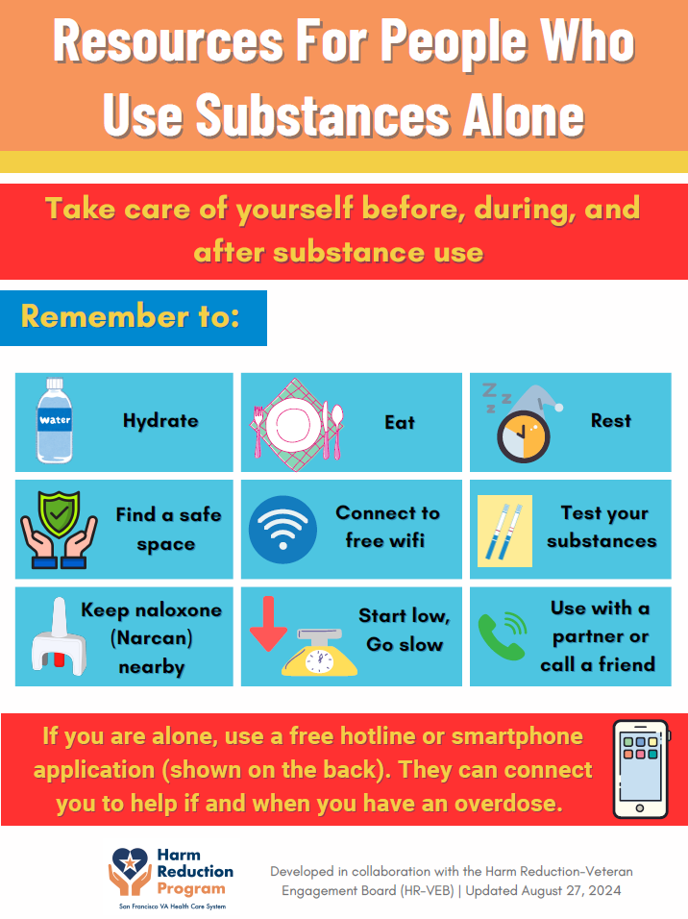
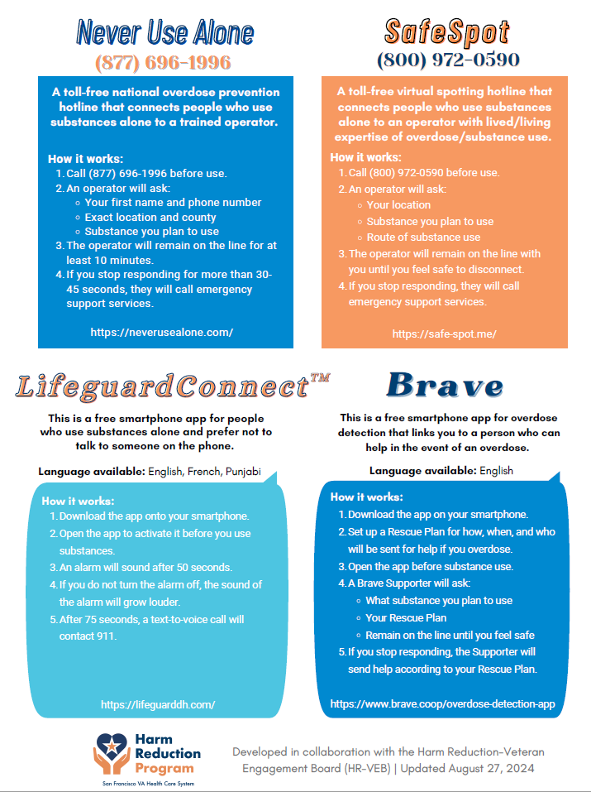
Patient Education Handouts
Notes:
Resources out of VA SF which were co-developed with our board. Copies I brought with me today.

Slide 9
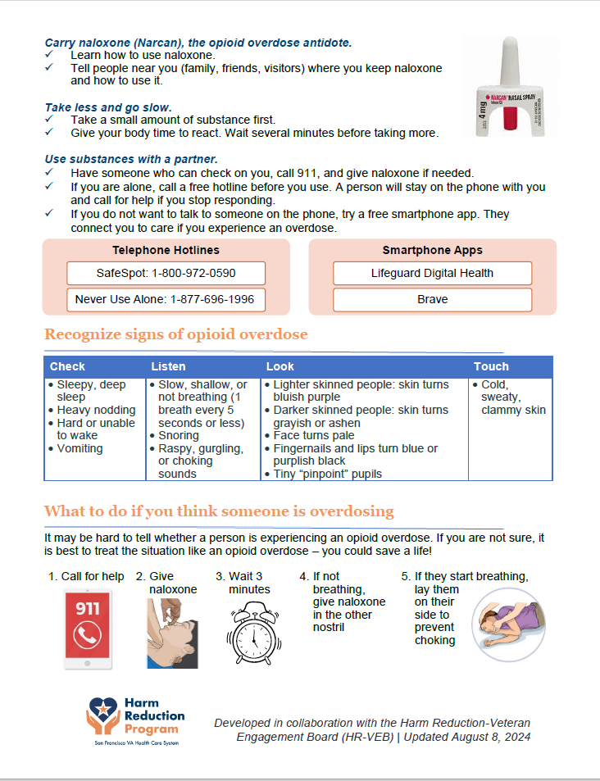
Patient Education Handouts

Slide 10
Challenges
Lack of precedent
Existing Veteran Boards play passive “informative” role and member’s lack professional expertise
Member Compensation
-- “ ‘lived experience’ is essential in creating a pathway to health and community in this very stigmatized veteran population. ”
Notes:
Franklin Taveras who does Veteran street outreach thru NYU

Slide 11
Current Focus
Seeking research opportunities
Building a network of other Veterans
Leaflet recruitment flyer for conferences
Internal/external website about board
Newsletter development
-- “We must accept that people will use drugs and give lifesaving info. Saving lives looks different than we often think. ”

Slide 12
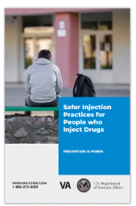
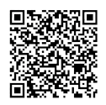
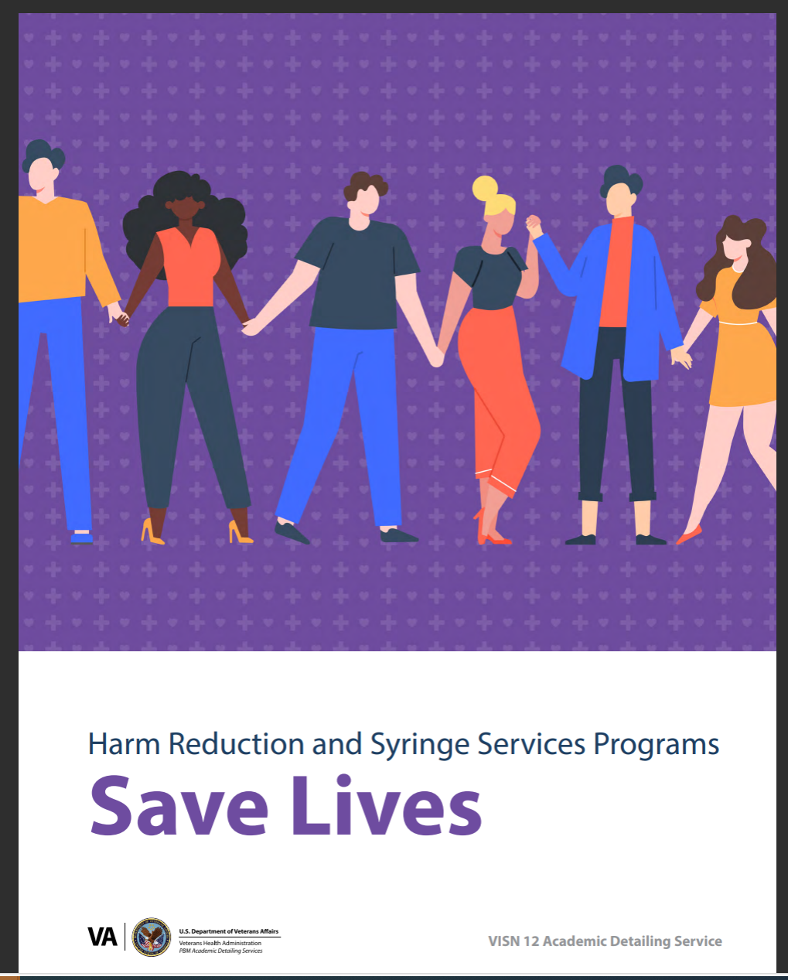
Other Education
External Facing Access
Graphic Medicine co-designed by team of Veterans, Clinicians, Community Harm Reduction Specialists, and Researchers.*
*Principal Investigators: Justeen Hyde, PhD and Westyn Branch-Elliman, MD, MPH.

