Slide 1
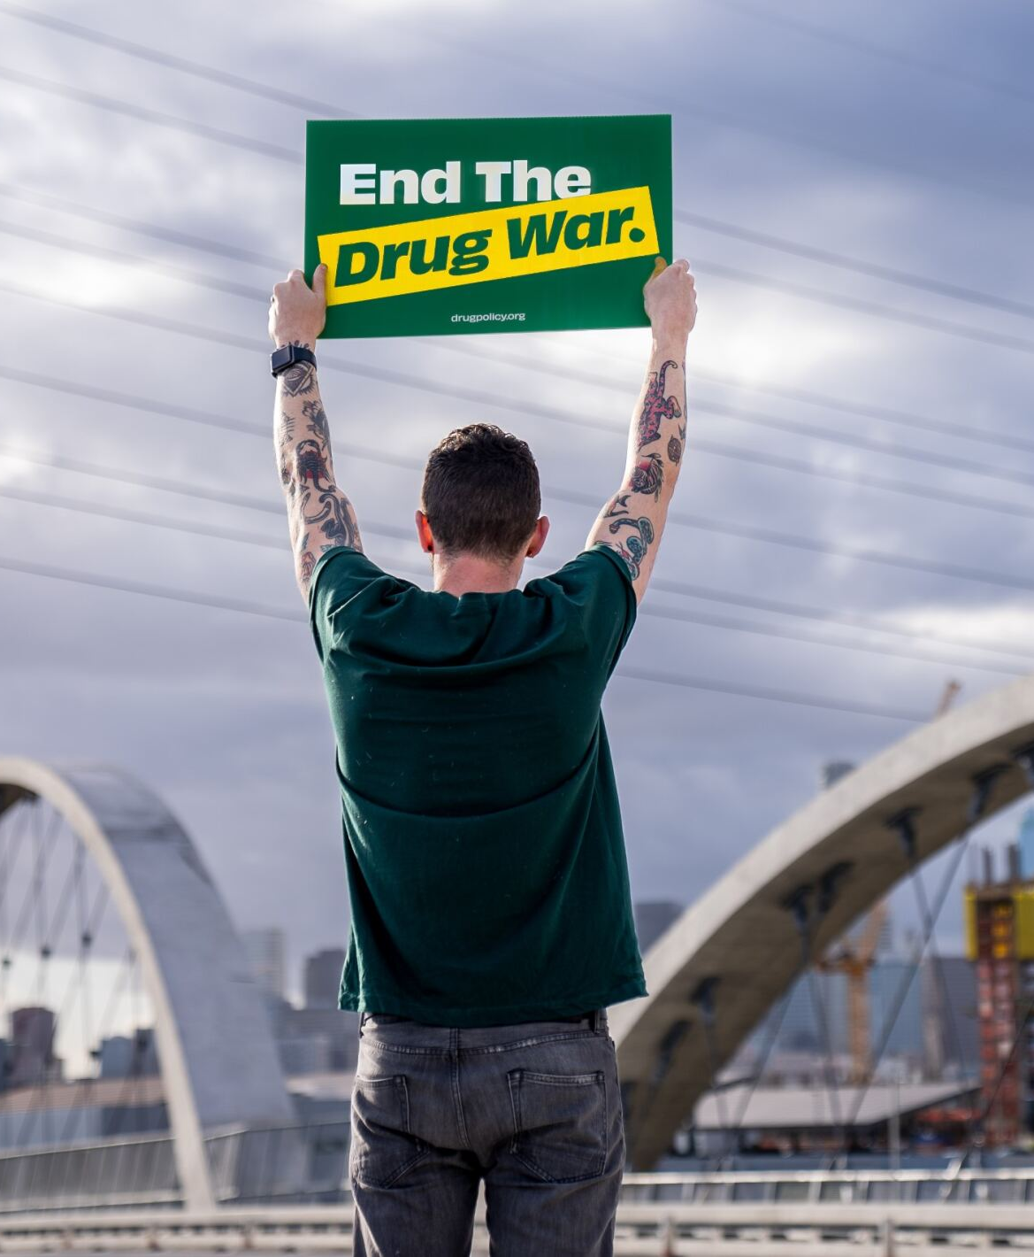
Moving towards biopsychosocial justice
Notes:
Thanks to HH and SV and AMERSA
As HH described, racial capitalism has resulted in two tiers of drug policy – a medicalized response for white people
But the massive WOD apparatus of militarized police and law enforcement strategies is still in play and still targeting communities of color

Slide 2
Individualizing social problems
Notes:
What these two approaches share -- criminalization and health solutions – is that they intervene at the level of the individual.
But we know – as HH has explained -- these problems are deeply structural and systemic and are rooted in decades of disinvestment in low income communities of all races, but especially in low income communities of color
And that. Means there are no easy fixes --- we have to start looking upstream for our solutions
IMAGE SOURCE: http://www.diagnoziz.com/wp-content/uploads/2013/05/doctor.jpg

Slide 3
Addiction as biosocial
Notes:
And science also suggests we need to broaden our focus and start looking at social context.
As Helena notes… emerging models of neuroplasticity, epigenetics, and the microbiome have underscored that human biology is not fixed or genetically predetermined but rather dynamically shaped in interaction with environment.
So we advocate for biosocial justice - acknowledging that the overdose crisis and problems of substance use are rooted in environments – environments shaped by social inequalities, harmful drug policies and biocapitalism, including racial capitalism.
And that means that the treatment for these problems must also address these issues of inequality and injustice.

Slide 4
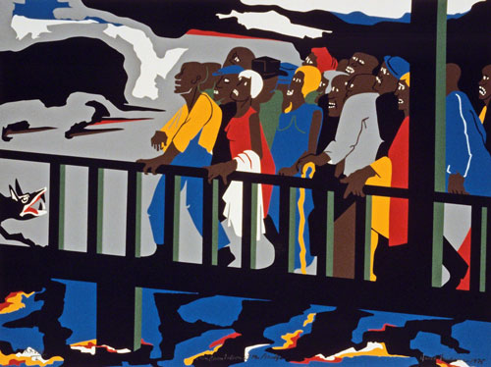
End racial capitalism?
Notes:
What are we suggesting then? And end to racial capitalism? Ideally.
But we also want to offer solutions that are more actionable.
I want to start with structural solutions, then discuss specific drug policy reforms, and end with what you as clinicians, researchers and folks who care about PWUD can do.
Jacob Lawrence (1918–2000 US) Confrontation at the Bridge, 1975, screenprint on paper, 49 x 66 cm (19-5/16" x 25-15/16"). The Cleveland Museum of Art, Anne Elizabeth Wilson Memorial Fund, © 2020 The Jacob and Gwendolyn Knight Lawrence Foundation / Artists Rights Society (ARS), New York (CL-946lwars)

Slide 5
Structural Solutions
Notes:
We do believe that we need to focus on upstream structural issues, and not assume that a narrow focus on a technological fix, like bup, can address these problems or redress decades of racism. So much of our attention and money are on promoting solutions that focus on – and often blame – the individual for what are really systemic problems often ones with deep roots in our racist history.
Can we leverage concern about the current opioid crisis to invest in real structural solutions that our country has needed for so long?

Slide 6
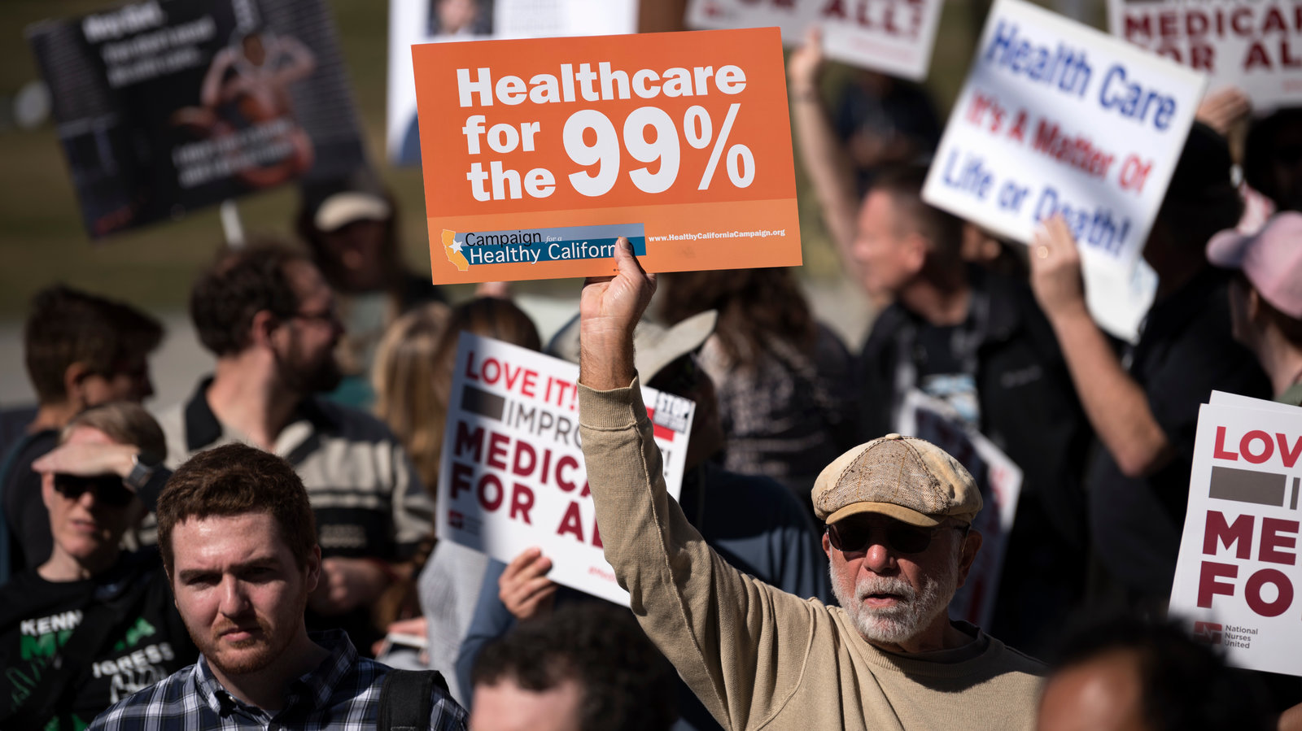
Universal healthcare
Notes:
One of the first structural solutions we need is Universal healthcare with the components necessary to address social determinants of health and psychosocial needs, including integrated harm reduction services, trauma informed psychotherapy, treatment for psychiatric comorbidity, peer navigation and community health workers, and recovery networks of support
We also need access to affordable housing, employment, education and income.
In short, we need a robust social safety net allows everyone to have their basic needs met.
Image source NYT

Slide 7
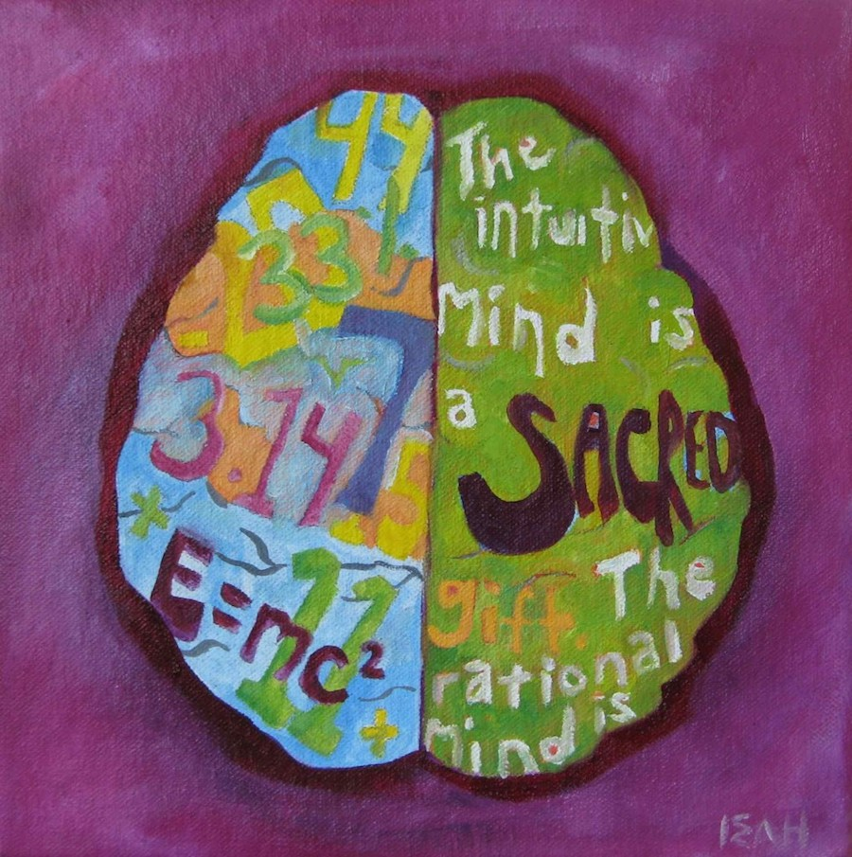
Research on social structures and processes
Notes:
We also need to focus on the development of, and research on, the social structures and biosocial processes that mitigate addiction and overdose.
By that we mean innovations, such as peer-based recovery networks, the use of the arts, urban gardening, and community-based organizations including spiritual or religious organizations.
Such social strategies currently receive almost no public research and addiction response funding; these are left to private foundations and donors as isolated demonstration projects, limiting their reach
Serious public investment in these kinds of programs would establish such interventions as “evidence based” among health and human services administrators and give all of us more tools to help those struggling with problematic drug use.
Image sources: art therapy assoc of america

Slide 8
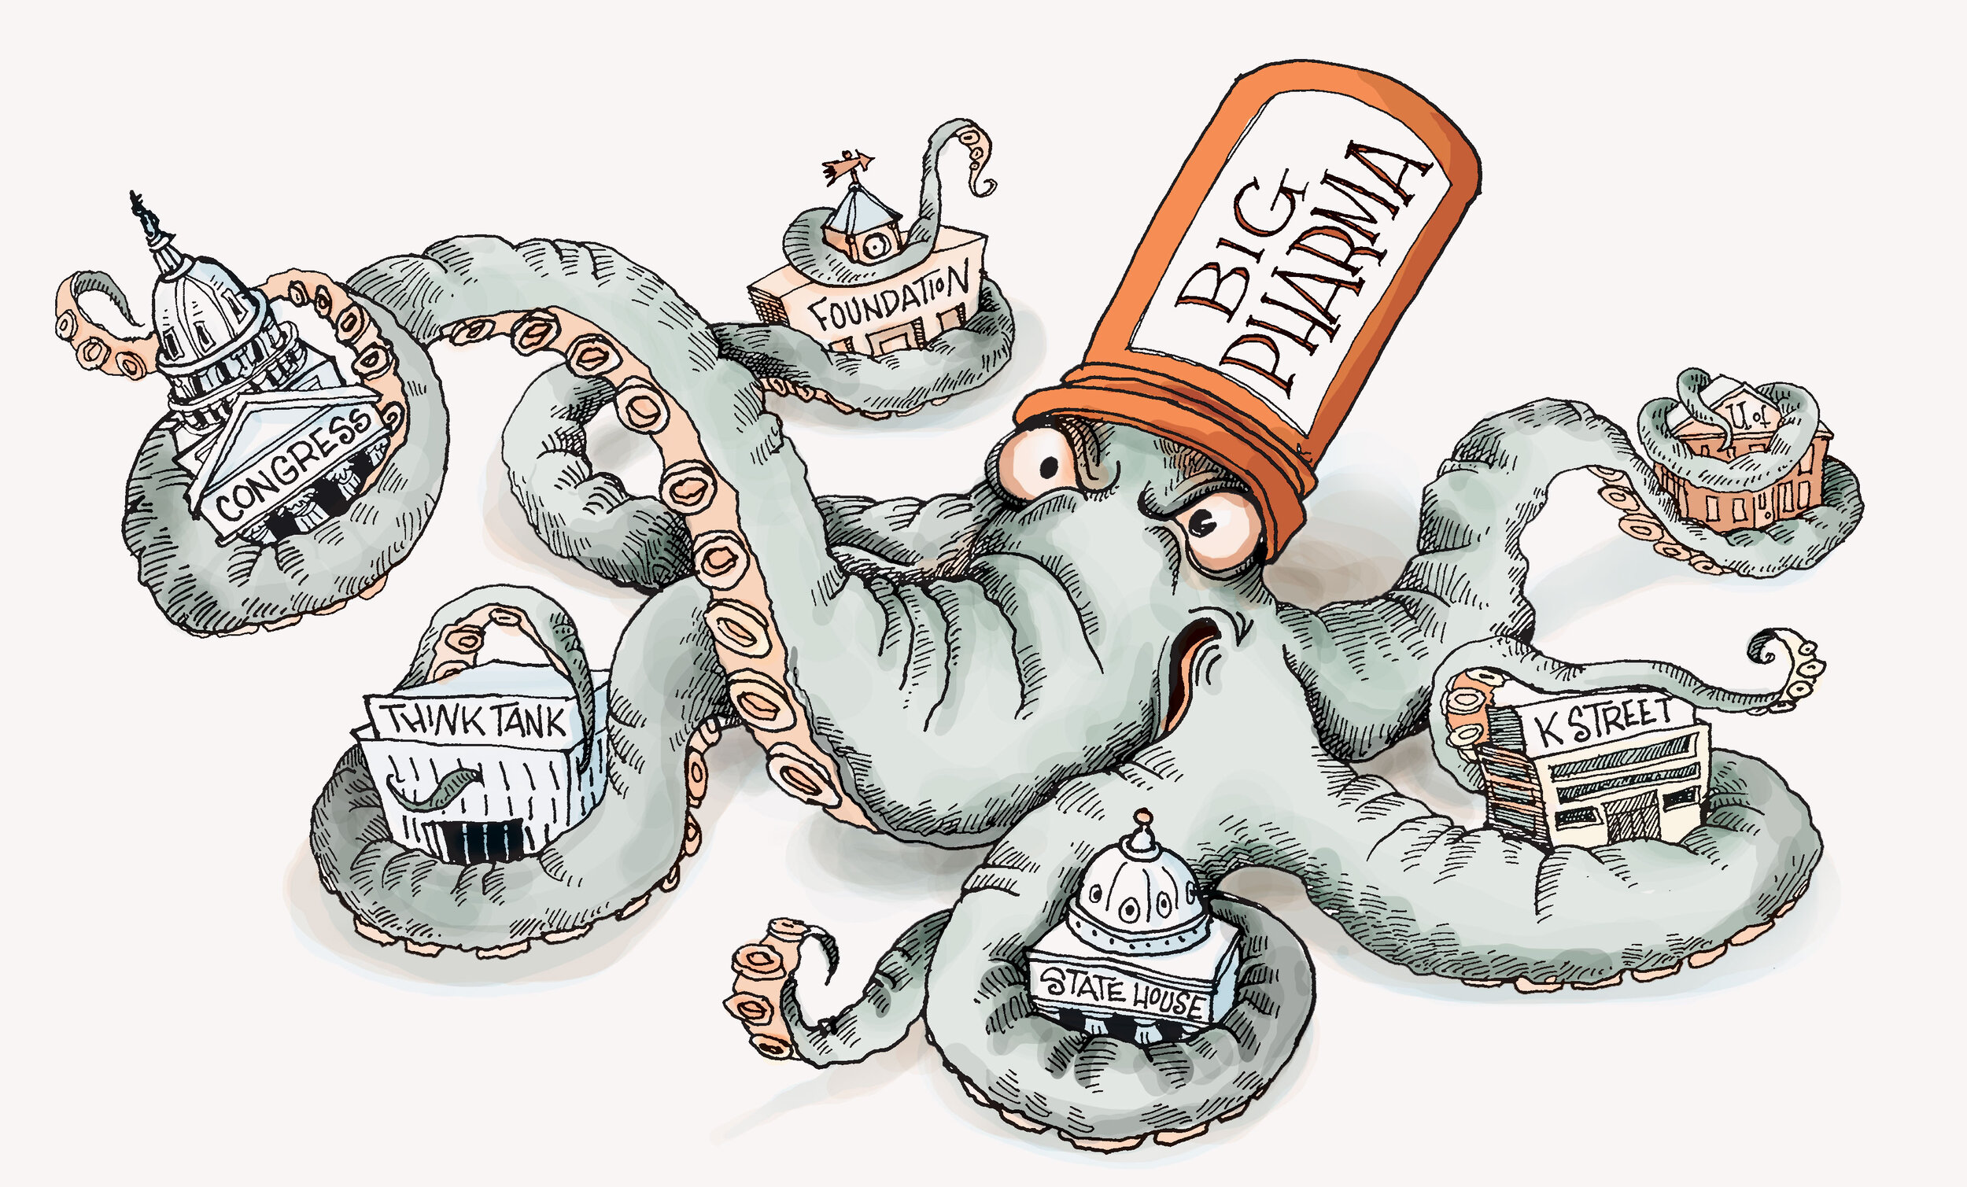
Better regulation & fewer conflicts of interest
Notes:
We need to strengthen the regulation of pharmaceutical manufacturers and disentangle regulatory officials from industry interests, not only during safety reviews but throughout the federal research and purchasing systems.
This includes the folks that set NIH research priorities and that review Veterans Affairs, Medicare and Medicaid pharmaceutical benefits.
Image source: https://www.opioidsettlementtracker.com/blog/why-do-we-blame-big-pharma

Slide 9
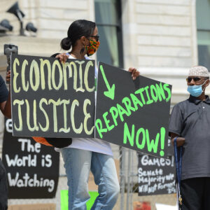
Racial justice initiatives
Notes:
we need racial justice initiatives and redress for the decades of harms the WOD has wrought in low income communities of color.
One such strategy includes racial impact assessments of new drug policies, modeled from the environmental impact assessments of the federal Environmental Protection Agency. These require legislative bodies to assess if and how policies will mitigate or exacerbate racial disparities prior to passing a law.
Our policies must also include explicit repair of the harms to Black, Latinx and Indigenous communities that have been targeted for decades by the War on Drugs through heightened policing and incarceration. That means expanded investment in economic development and public services in neighborhoods that have faced systemic disinvestment.
The New York and California marijuana legalization legislation are examples of one such approach. These laws allow those with low level marijuana convictions to have their records expunged, re-qualifying them for a host of housing, education and small business loan programs for which a criminal record made them ineligible. In addition, through cannabis social equity programs, low-income people who live in neighborhoods disproportionately affected by drug law enforcement and those who have been convicted of marijuana related crimes are given preference in newly legalized marijuana-related business ventures, as business owners or employees of such businesses.
Image source: https://corporateaccountability.org/blog/local-reparations-initiatives/

Slide 10
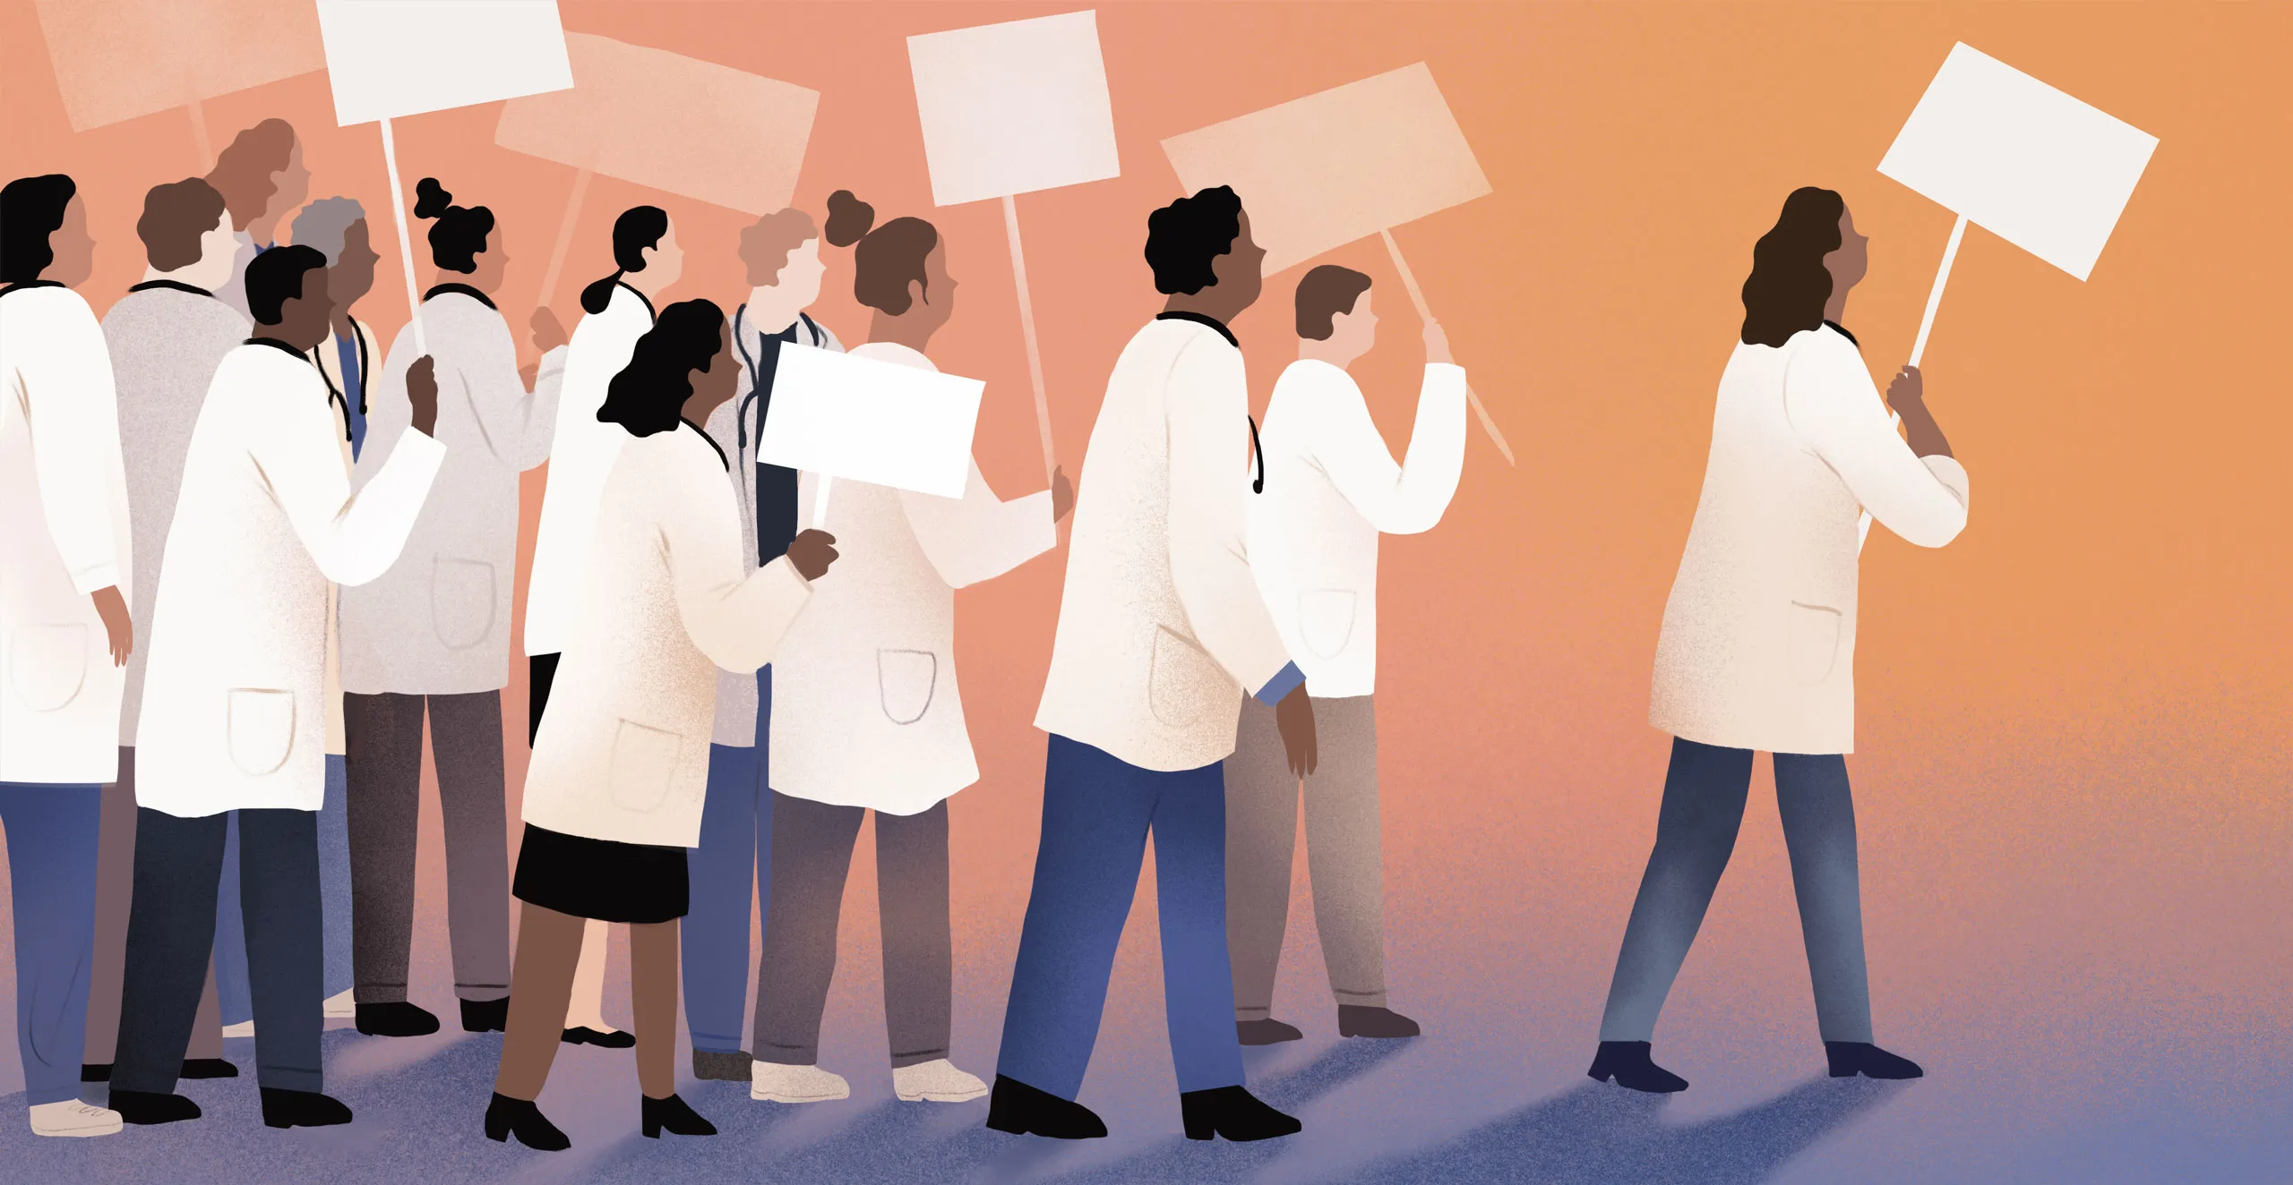
Structural competency
Notes:
I want to talk about structural solutions in healthcare, and here I am relying on Helena’s work with Jonathan Metzl and others on structural competency
Structural competency calls for reorienting clinicians to a structural way of intervening in the lives of their patients and the communities their patients live in.
It also requires a shift from social determinants of health, a term borrowed from public health that clinicians use to describe patients’ risk factors for disease, toward structural drivers of health, which refers to institutional or policy-level causes of these risk factors, such as drug law enforcement and sentencing that target poor Black and Brown neighborhoods.
Some examples include social prescribing, which means partnering with social service organizations or community health workers who can take a “prescription” that a clinician writes a patient for a social need, such as helping someone apply for Social Security Disability benefits to address income precarity.
Another level of intervention involves clinicians partnering with non-health sectors such as housing agencies, legal aid organizations, parks and recreation, or schools in order to address medical and social needs together in the community, and also to redesign public services so that they promote health.
And another level of structutal intervention is for clinicians to advocate for health-promoting public policies, which I’ll touch on more in just a moment.

Slide 11
Drug policy solutions
Notes:
We need these broader structural solutions that get at root causes, but we also need to reform drug policy in the interim. And more and more we are trying pass drug policies that address some of the deeper structural problems
For example, DPA worked to pass a decrim initiative in OR that included explicit reinvestment of more then $300 million in the communities and systems that have faced decades of disinvestment (those moneies are directed at treatment but also as housing, healthcare, and HR).

Slide 12
End criminalization
Notes:
So top of DPA's drug policy agenda is ending criminal penalties for personal use because of course it also ends all the collateral consequences that comes with an arrest record and incarceration, but we believe that decrim needs to accompanied – as is happening in OR – with significant investments to help people who use drugs

Slide 13
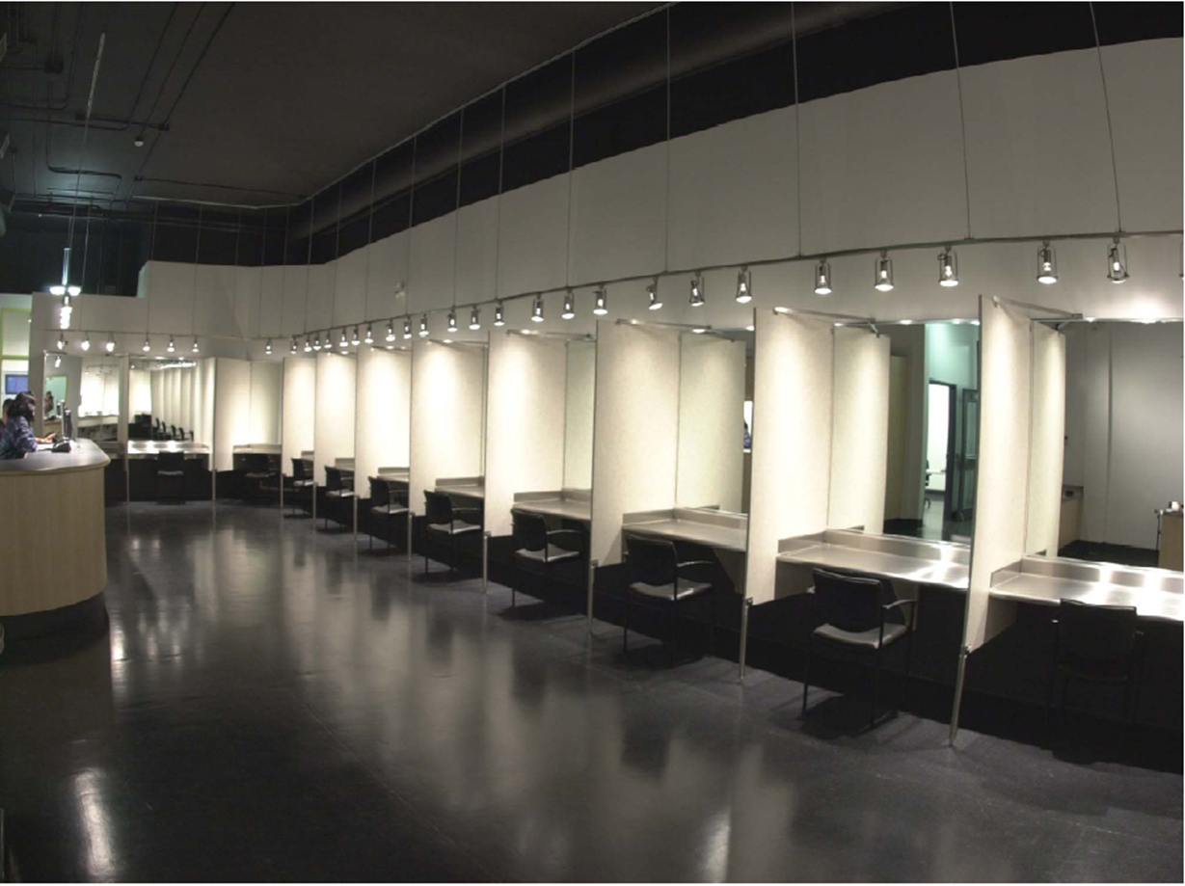
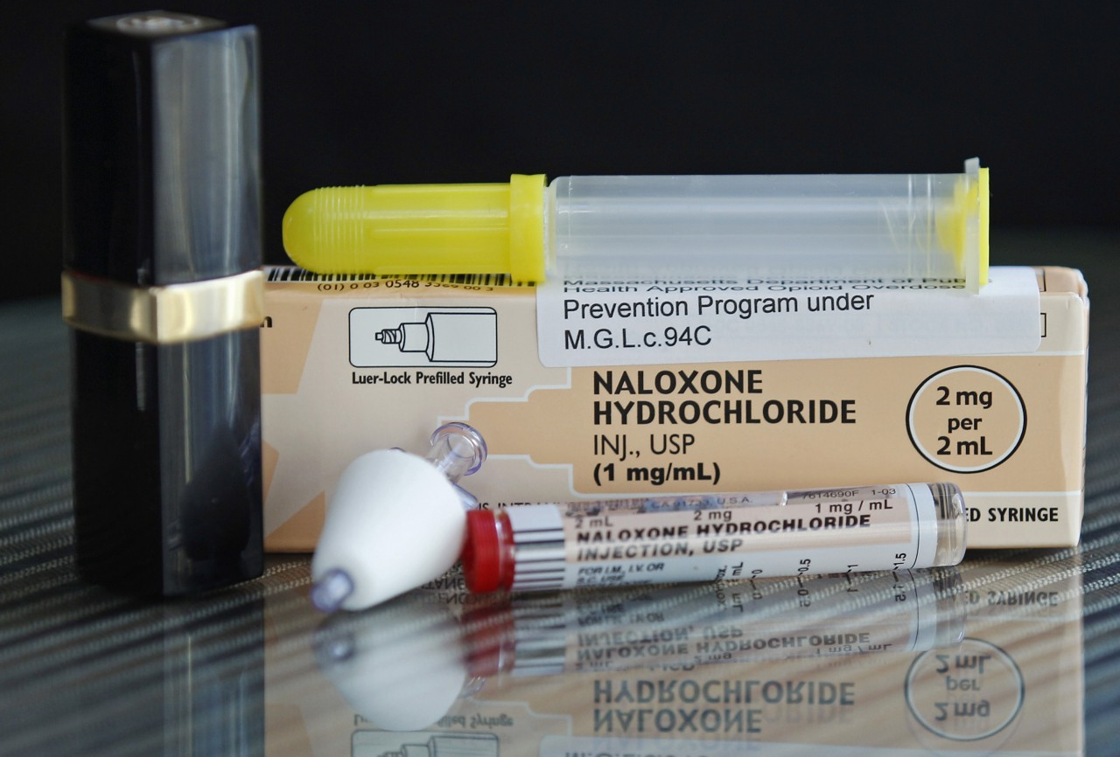
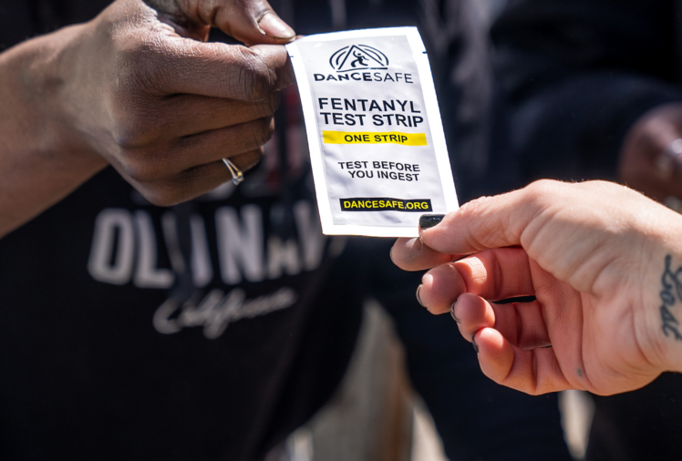
Invest in harm reduction
Notes:
Syringe services and peer support
Education
Good Samaritan
Naloxone Access funding and implementation
OPCs or Safe Consumption Services
Drug Checking
Opioid Agonist Therapy

Slide 14
Great new resource coming: Feb 2023

Slide 15
Create a safer supply
Notes:
Ultimately, we have to address the poisoned drug supply that is a direct result of prohibition.
There are lots of ways to think about how we can create a safe supply from prescribed heroin -- which has been happening for decades in Canada and parts of Europe -- to compassion clubs where people can safely access drugs that have been checked for contaminents and potency – happening in Vancouver BC
Ultimately we must create systems for regulating substances so that consumers can be protected and make informed decisions; we cannot afford to lose another 100K t o/d each year; it’s unconscionable

Slide 16
Doing drug policy differently
Notes:
We know a lot of what needs to happen in drug policy reform, but I want to suggest that we also need to approach doing it differently
People of color, PWUD and others directly impacted by the WOD, should be driving our movements for reform. That is how we avoid unintended consequences; that is how we develop policies that meet the needs of our communities; that is how we innovate.
We need to be engaging with other reform movements. Drug policy affects housing, employment, immigration, child welfare, health care, education, and public welfare. People who use drugs face barriers in all those systems; so we need to partnering with the folks working to reform those systems as well.
Our drug policies need to reject race-neutral policies and be explicitly anti-racist, and we need to deal with the decades of harm our drug policies have done to communities of color and think about what reparative justice looks like.

Slide 17
Call to action
Notes:
Physicians and healthcare providers can play a significant role in promoting individual and community health by thinking about their individual practices, promoting institutional change, and engaging in policy reform

Slide 18
Individual level
Institutional level
Policy level
Notes:
At the individual level,
Understand that drug-related harms often stem from lack of resources – like housing and food precarity, economic insecurity, and insufficient healthcare – rather than from drugs themselves and do what you can to help patients with those needs
Recognize treatment as one option among on array of health services, resources, and support that might be higher priorities for the people you serve
Ensure that patients who use drugs have access to evidence-based, non-coercive harm reduction and treatment options in addition to robust and supportive primary healthcare
Support your local drug user unions and harm reduction organizations
Show up with humility and ask what they need
Give money if you can!
At the institutional level…
Healthcare professionals involved with medical education and licensure can work to ensure that all students graduate with a deep understanding of SDOH and the impact of the drug war on individual and community health.
Second, healthcare providers can advocate to shift hospital and programmatic policies around drug testing, mandatory reporting, and collaborations with law enforcement that may reinforce stigma and cause harm
Look around the institutions you work in and ask what can you do to ensure PWUD are treated with dignity and respect at every encounter?
And of course, I want to encourage all of you to get involved in….policy change
For any policy change, we should be following the leadership and expertise of people who use drugs, but there is no shortage of reforms to work on…
You can get involved with policy-level changes to end drug testing, mandatory reporting, zero-tolerance policies in schools, coerced treatment, and denial of services and resources based on arrest or conviction records at the municipal, state, and federal levels
You can get involved with advocacy efforts to increase access to methadone and buprenorphine or support drug checking (like fentanyl test strips), increased funding for harm reduction, decrim of personal possession…. The list goes on.
And you can gauge your involvement based on the capacity that you have. We know you are all busy:
Draft and join sign-on letters
Speak to media
Write op-eds
Lobby your professional organizations to release policy statements

Slide 19
A world without a drug war?
Notes:
Finally, we need to get visionary and we need to be innovative. I want to ask you to dream with me for just a moment.
Can you imagine a world where our loved one are not dying of overdose?
Can you imagine a world where people of color can walk down the street in safety and have equal access to resources and opportunities?
Can you imagine a world where people who use drugs are not just surviving but thriving? Where they live in dignity, have their basic needs met, have access to a legal safe supply, where they are free to experience autonomy and joy?
So yes, we have tried to offer concrete solutions that you – we all – should work on for now. But we also want to invite you to envision and help build a better world where we do the hard work of exposing whiteness and white supremacy and dismantling racial capitalism. The WOD and the overdose crisis are symptoms of a system that needs deep transformation. So please take time imagine that better world and ask yourselves what would it take to get us there?
Cropped image from cover of Art for People’s Sake: Artists and Community in Black Chicago, 1965-1975

Slide 20
Read the book!
Discount code: UCPSAVE30
Notes:
There is a lot more analysis and suggestions in the book, so we encourage you to get a copy if you haven’t done so

Slide 21
DISCUSSION

Slide 22
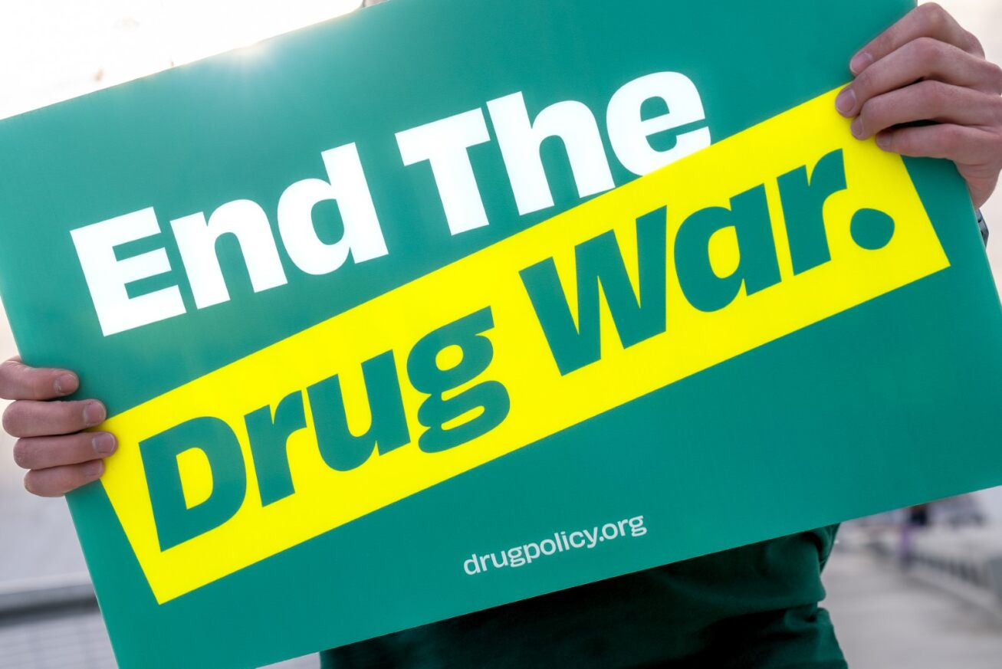
THANK YOU!

