Slide 1
Operationalization of Long-Acting Pre-Exposure Prophylaxis for Socially Vulnerable Populations
Sydney Yoon, BA; Whole Person Integrated Care | SFDPH
AMERSA Annual Meeting | Chicago, IL | November 15, 2024
Kathleen O'Connor, BA; Alix Strough, RN; Sarah Strieff, RN; Barry Zevin, MD; Joanna Eveland, MD; Nicky Mehtani, MD, MPH

Slide 2
Disclosures
No Conflicts of Interest
Notes:
There are no conflicts of interest to disclose at this time.

Slide 3
Background- Disparities in HIV Prevention
People who use drugs (PWUD) and people experiencing homelessness (PEH) discouraged from consistent adherence to daily oral PrEP¹
Housing insecurity
Food insecurity
Competing health risks
Healthcare trauma/disconnect
Potential advantages to long-acting cabotegravir (CAB-LA) as PrEP
Improved adherence- q2mo injection circumvents challenges related to daily pill taking
Confidentiality risks mitigated by in-clinic injections
¹Ni et al, 2021
Notes:
First, I want to give some background on the benefits of providing long-acting PrEP to our patient population.
People who use drugs and people experiencing homelessness experience disproportional psychosocial and systemic hurdles that discourage them from adhering to daily oral PrEP. Among these factors are housing insecurity, food insecurity, comorbidities such as mental health disorders, and trauma or disconnect from healthcare systems.
Long acting cabotegravir, or CAB-LA, can circumvent these challenges. It is an injection given every 2 months, so patients who have trouble adhering to daily pills could benefit from this alternative. Another advantage is that, for daily PrEP, there is the risk that another community member could see you take the medication. Going to a clinical space to receive LA-CAB could mitigate potential issues with confidentiality and help people avoid stigma.

Slide 4
HIV Rates among PWUD and PEH (SF, 2023)
PEH accounted for 23% of total new HIV diagnoses¹
47% of PEH were PWUD
40% of cis women diagnosed with HIV (2014-2023) were PWUD¹
Newly diagnosed trans women were more likely to be PWUD than other genders (28%)¹
PrEP use has increased from 2015-2023¹
2015: 22%-27% of MSM not diagnosed with HIV
2023: 71%-78%
¹SFDPH, 2023 HIV Epi Report
Notes:
The Annual HIV Epidemiology Report from the city of San Francisco indicated that PEH and PWUD were significantly at-risk of HIV infection. In 2023, PEH accounted for roughly a quarter of total new diagnoses, nearly half of whom were also PWUD. In addition, 40% of cis women diagnosed with HIV from 2014-2023 were PWUD. Trans women diagnosed in 2023 were also more likely to be PWUD than other genders.
However, the good news- PrEP use has been steadily increasing from 2015 to 2023. In 2015, only 22-27% of men having sex with men who were not diagnosed with HIV were on PrEP. Compare that to 2023, when 71-78% of MSM were on PrEP.

Slide 5
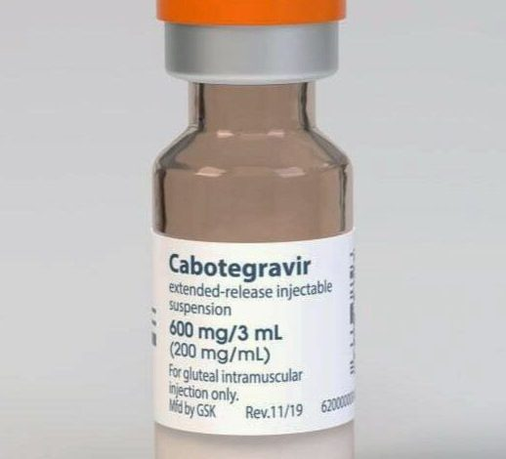
First FDA-approved in December 2021¹
Given as two initiation injections administered q1mo; then q2mo thereafter
¹ FDA, 2021
Notes:
Some information about the medication. Cabotegravir extended release injectable was first FDA approved in December of 2021. Injections are initiated with two shots given 1 month apart, then subsequent injections are 2 months apart thereafter.
Importantly, for its use as PrEP, CAB-LA does NOT need to be refrigerated, unlike cabotegravir-ripilvirine, which is used for HIV treatment. This is very fortunate for our program, as it can be given outside of clinic – something I’ll talk about a little bit later.

Slide 6
CAB-LA as PrEP
Two Phase III clinical trials → High efficacy, tolerability, and non-inferiority to oral PrEP^{1,2}
CAB-LA was superior to daily oral PrEP (TDF-FTC) in preventing HIV
Decreased risk of HIV infection by 66-90%
High adherence to q2mo injections at >90%
Little published data on CAB-LA use for PrEP specific to:
Patients with known substance use disorders
Implementation in community-based clinics serving PEH
Program Highlight: Prevention Point Philadelphia³
CAB-LA was first choice among WWID over oral PrEP
55 of 62 WWID at community-based syringe site; 51/55 received a first injection.
¹ Landovitz et al, 2021
² Delany-Moretlwe et al, 2021
³ Roth et al, 2024
Notes:
The phase III trials for CAB-LA demonstrated high efficacy, tolerability, and non-inferiority to daily oral PrEP. It was superior to oral PrEP in preventing HIV.
It decreased the risk of HIV infection in participants by 66-90%. Patients also demonstrated high adherence to the injections, at 91.5% and 93% for the two trials.
As of now, there is little published data on CAB-LA as PrEP, especially for patients with known SUDs or in community based clinics serving people experiencing homelessness.
I want to highlight one of the few implemented programs across the country. A program in Philadelphia found that women who inject drugs preferred CAB-LA over daily oral PrEP. So there is precedence that, given the choice, patients may choose the long-acting injectable.

Slide 7
Objectives of SFDPH Program
Offer a novel HIV prevention option to patients at high risk of infection
Assess the feasibility of administering CAB-LA to patients receiving care at a low-barrier public health clinic serving a high proportion of patients with SUDs and/or experiencing homelessness
Notes:
This is where the program at the SF department of public health comes in.
The objective of the program is to offer a novel HIV prevention option to patients at high risk of infection. And as we have operationalized CAB-LA, we are assessing the feasibility of administering the medication to our specific patient population, a high proportion of which are experiencing homelessness or are using drugs.

Slide 8
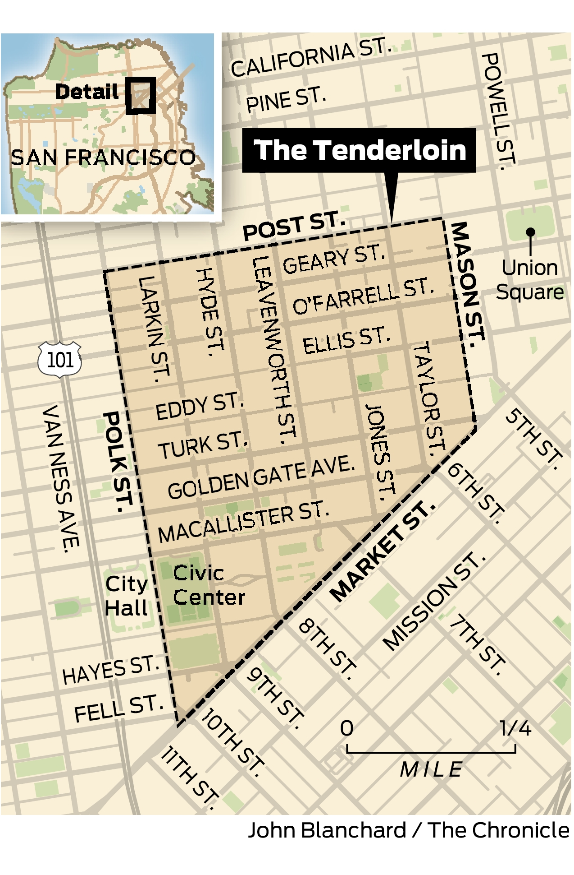
Methods of Implementation
Multi-disciplinary care coordination: MD/NPs, RNs, HWs, local pharmacy, CBOs
Tailored to PWUD & PEH receiving care at low-barrier clinic in the Tenderloin district
Map by John Blanchard, SF Chronicle
Notes:
We have a multidisciplinary team for with physicians, NPs, RNs, and health workers working on care coordination. The program partners with a local pharmacy and community based organizations for medication delivery and patient outreach.

Slide 9
Strategies Tailored to Local PEH, PWUD
Patient Eligibility, Initiation
Infrastructure and Access
Support and Retention
Notes:
And we tailored our strategies to the lived experiences of PWUD and PEH who receive care at our four wall clinic.
First, patient eligibility and initiation
Infrastructure and access to injections
And finally, patient support and retention

Slide 10
Strategy 1: Patient Eligibility and Initiation
Initiation visit(s) with clinic providers
Assess patient interest, eligibility & understanding of expectations
Capacity to adhere to protocol
Regular engagement with staff
Initiation: baseline labs, order CAB-LA
Medication delivery from specialized pharmacy
In-service education to providers, RNs, and other staff
Expedites chart review and initiation visits
Notes:
The first strategy was centered around identifying which patients would be the best fit to initiate on CAB-LA. All patients received initiation visits, where providers would assess interest, willingness to return for the first injection, and understanding of program expectations. They also communicated with staff at community organizations and shelter clinics to gauge patient capacity to adhere to the protocols.
Once initiated, patients have baseline labs drawn, and the medication is ordered.

Slide 11
Strategy 2: Infrastructure and Access
Low-barrier, drop-in visits in clinic, 6 days per week
On-site lab draws
Medication availability at community sites - shelters, syringe access sites, street medicine
Notes:
The program also sought to improve access to the medication. Patients had the option of low barrier, drop in visits at the clinic, 6 days a week.
Lab draws were all on-site, so the clinic was a one stop shop.
For patients who had difficulty coming into the clinic, CAB-LA could also be administered at community sites, such as shelters, syringe access sites, and street medicine visits.

Slide 12
Strategy 3: Support and Retention
Weekly multi-disciplinary huddle- physicians, RNs, HWs
Track patient due dates, needed labs, and triage
Mobilization of as-needed street-based outreach
Q2mo drop-in RN visits for injections and lab draws
Injection reminders through multiple modes of outreach
Small monetary incentives to support adherence
Protocol for late injections
Notify support network/emergency contacts
Order late doses if >14d
Notes:
To ensure that patients have proper support, the team engages in weekly huddles to discuss patient due dates, upcoming lab draws, and triage.
Injection reminders are given through multiple modes of outreach, such as community organization staff, health workers, and street medicine nurses.
There are small monetary incentives give to support adherence.
And we also have a protocol in place for late injections. We notify the patient’s support network, brainstorm additional modes of outreach. Providers order late doses if a patient is more than 14 days late, and we verify the patient’s HIV status through lab draws.

Slide 13
Results- Baseline characteristics of initiated CAB-LA PrEP patients
 |  | Initiated on CAB-LA, N=19 (%)
Age, mean (SD) |  | XXXXXX
Race/Ethnicity | Black or Native Hispanic Non-Hispanic White | 8 3 8 | 42% 16% 42%
Gender/Sex | Cisgender-male Cisgender-female Trans or non-binary | 10 4 5 | 53% 21% 26%
Housing Status | Street homeless Sheltered homeless SRO (Unstably housed) | 3 7 9 | 16% 37% 47%
Mental Health Comorbidity | Stimulant Use Disorder Opioid Use Disorder Bipolar or Schizophrenia | 12 6 6 | 63% 32% 32%
October 2022-May 2024
27 patients referred for CAB-LA initiation, 24 were prescribed, and 19 ultimately initiated
6 initiated patients experienced a >7 day delay between initial lab draw and first CAB-LA injection
Delay necessitates a repeat HIV VL
Notes:
From October 2022 to May 2024, 27 patients were referred for CAB-LA, and 19 were ultimately initiated. 6 initiated patients experienced a delay of more than 7 days between the initial lab draw and their first injection, meaning that they needed a repeat draw.

Slide 14
Results- Baseline characteristics of initiated CAB-LA PrEP patients
 |  | Initiated on CAB-LA, N=19 (%)
Age, mean (SD) |  | XXXXXX
Race/Ethnicity | Black or Native Hispanic Non-Hispanic White | 8 3 8 | 42% 16% 42%
Gender/Sex | Cisgender-male Cisgender-female Trans or non-binary | 10 4 5 | 53% 21% 26%
Housing Status | Street homeless Sheltered homeless SRO (Unstably housed) | 3 7 9 | 16% 37% 47%
Mental Health Comorbidity | Stimulant Use Disorder Opioid Use Disorder Bipolar or Schizophrenia | 12 6 6 | 63% 32% 32%
October 2022-April 2024
27 patients referred for CAB-LA initiation, 24 were prescribed, and 19 ultimately initiated
6 initiated patients experienced a >7 day delay between initial lab draw and first CAB-LA injection
Delay necessitates a repeat HIV VL
Notes:
Of the initiated patients, 5 were trans or non-binary. All 19 were experiencing housing instability; 3 were street homeless, and 7 were sheltered homeless. 12 patients were using stimulants, and 6 were using opioids. Additionally, a high proportion of patients were black or native – 8 out of those initiated.
Something to note if there is time: The patients who were referred but never initiated was not more destabilized (experiencing street or sheltered homelessness) than those who were initiated successfully.

Slide 15
Results
Results
All enrolled patients remained HIV negative at the time of their latest injection (mean 7.0 months, SD 4.1 months)
As of May 2024, fourteen patients (74%) continue to receive CAB-LA
One transitioned to primary care-based administration, and four discontinued.
89 total doses of CAB-LA administered (as of May 2024)
12% were delayed >1 week
42% were administered outside of clinic (36% within shelters or supportive housing and 1% in jail)
Notes:
As of May of this year, 14 patients are continuing to receive CAB-LA through the clinic. One transitioned to primary care-based administration, and four discontinued.
All enrolled patients remained HIV negative at the time of their latest injection.
Over the initial 18 months of the program, 89 total doses of CAB-LA were administered. 12% of doses were delayed by more than 1 week. 42% of doses were administered outside of the central clinic. 36% of doses were given in shelters or supportive housing, and 1% was given in jail. If you recall, CAB-LA does not require refrigeration, making this sort of administration possible.

Slide 16
Conclusions
CAB-LA as PrEP was feasible and effective for PWUD and PEH
Challenges with patient outreach and decision making
Targeted recruitment based on housing status, comorbidity could improve retention
Longer-term evaluations necessary
Notes:
Some conclusions from the implementation of the program:
CAB-LA was feasible and effective as PrEP for people who use drugs and people experiencing homelessness.
However, there were significant challenges with outreach and decision-making.
One way to improve implementation is to more targeted recruitment based on housing status, comorbidities like substance use disorders, and other factors.
And finally, we simply need longer term evaluations!

Slide 17
Acknowledgements
Co-authors:
Kathleen O'Connor, BA
Alix Strough, RN
Sarah Strieff, RN
Barry Zevin, MD
Joanna Eveland, MD
Nicky Mehtani, MD, MPH
Organizations:
Whole Person Integrated Care: Street Medicine & Shelter Health (SFDPH)
HIV Homeless Outreach & Mobile Engagement (HHOME) Case Management Program
Ward 86 Positive Health Program (ZSFG/UCSF)
AIDS Healthcare Foundation Pharmacy
Notes:
Thank you!

Slide 18
Works Cited
Cairns, G. (2024, March 29). Why is the roll-out of injectable PrEP taking so long? Aidsmap. https://www.aidsmap.com/news/mar-2024/why-roll-out-injectable-prep-taking-so-long
Delany-Moretlwe, S., Hughes, J. P., Bock, P., Mensch, B., Etima, J., & the HPTN 084 Study Team. (2022). Cabotegravir for the prevention of HIV-1 in women: Results from HPTN 084, a phase 3, randomised clinical trial. The Lancet, 399(10337), 1779–1789. https://doi.org/10.1016/S0140-6736(22)00458-1
Landovitz, R. J., Donnell, D., Clement, M. E., Hanscom, B., Cottle, L., Coelho, L., Cabello, R., Chariyalertsak, S., Dunne, E. F., Frank, I., Gallardo-Cartagena, J. C., & Panchia, R. (2021). Cabotegravir for HIV prevention in cisgender men and transgender women. New England Journal of Medicine, 385(7), 595-608. https://doi.org/10.1056/NEJMoa2101016
Ni, Z., Altice, F. L., Wickersham, J. A., Copenhaver, M. M., DiDomizio, E. E., Nelson, L. E., & Shrestha, R. (2021). Willingness to initiate pre-exposure prophylaxis (PrEP) and its use among opioid-dependent individuals in drug treatment. Drug and alcohol dependence, 219, 108477. https://doi.org/10.1016/j.drugalcdep.2020.108477
Roth, A. M., Bartholomew, T. S., Ward, K. M., Groves, A., Mazzella, S., Bellamy, S., Amico, K. R., Carrico, A. W., Ironson, G., & Krakower, D. (2024). Preferential initiation of long-acting injectable versus oral HIV pre-exposure prophylaxis among women who inject drugs. Clinical Infectious Diseases. https://doi.org/10.1093/cid/ciae450
Schmidt, H. A., Rodolph, M., Schaefer, R., Baggaley, R., & Doherty, M. (2022). Long-acting injectable cabotegravir: implementation science needed to advance this additional HIV prevention choice. Journal of the International AIDS Society, 25(7), e25963. https://doi.org/10.1002/jia2.25963
U.S. Food and Drug Administration. (2021, December 20). FDA approves first injectable treatment for HIV pre-exposure prevention. FDA. https://www.fda.gov/news-events/press-announcements/fda-approves-first-injectable-treatment-hiv-pre-exposure-prevention

Slide 19
Results- Baseline characteristics of patients referred but not initiated
 |  | Referred but not initiated, N=8 (%)
Age, mean (SD) |  | XXXXXX
Race/Ethnicity | Black or Native Hispanic Non-Hispanic White | X X 3 | X% X% 38%
Gender/Sex | Cisgender-male Cisgender-female Trans or non-binary | X X 2 | X% X% 25%
Housing Status | Street homeless Sheltered homeless SRO (Unstably housed) | 0 4 X | 0% 50% X%
Mental Health Comorbidity | Stimulant Use Disorder Opioid Use Disorder Bipolar or Schizophrenia | 3 6 2 | 38% 63% 25%
Notes:
Tentatively keep, but depends on whether data is available. Edit as column in slide 13 table
Take out- this population is not more destabilized than those who were initiated
Takeaway: project needs more targeted recruitment based on housing status, comorbidity, etc

Slide 20
LA-CAB as PrEP
First FDA-approved in December 2021¹
Apretude- cabotegravir extended-release injectable suspension
Given as two initiation injections administered q1mo; then q2mo thereafter
High efficacy, tolerability, and non-inferiority to oral PrEP
Two Phase III clinical trials
LA-CAB was superior to daily oral PrEP (TDF-FTC) in preventing HIV among MSM and transgender women.²
600 mg CAB given q2mo vs. oral TDF-FTC given qd, 4566 total participants followed for 153 weeks
Risk of HIV infection lower by 66% in LA-CAB group
Adverse reactions led to withdrawal of 6% of participants.
LA-CAB was superior to TDF-FTC in preventing HIV in cisgender women. ³
5 weeks of daily TDF-FTC followed by 600 mg CAB q2mo vs. oral TDF-FTC qd, 3224 total participants
Risk of HIV infection lower by 90% in LA-CAB group
Adverse reactions led to withdrawal of 1% of participants.
High adherence to bi‐monthly injections at 91.5% and 93% for the two trials, respectively
¹ FDA, 2021
² Landovitz et al, 2021
³ Delany-Moretlwe et al, 2021
Notes:
Second point: take out all except phase 3 demonstrated high efficacy, etc. For add’l information, create supplementary slide with phase 3 data for questions.
Include high adherence data (change bi-monthly wording).
Highlight decreasing risk of HIV by 66-90%, no need to include population demographics.

