Slide 1
Optimizing Pregnancy Treatment Intervention (OPTI) for MOMS 2.0
Jerry Cochran, MSW, PhD

Slide 2
Conflicts and funding
No conflicts
OPTI-Mom 2.0 was funded by the Centers for Disease Control and Prevention

Slide 3
Background
Recent data continue to show consistent increases in the number of cases of reported opioid-related diagnosis among pregnant persons at delivery.^{1,2}
Pregnant persons with opioid use disorder (OUD) have elevated rates of HIV/HCV infection,³ psychiatric conditions,⁴⁻⁹ non-opioid substance use disorder (SUD);^{3,5,7,10} and social determinants of health related problems.^{7,11,12}
Postpartum return to opioid use rates among individuals with OUD who achieved abstinence during pregnancy have been documented to be as high as 59-99%,¹³⁻¹⁶ which return to use events following abstinence are potentially fatal.¹⁷⁻¹⁹
A standard of care for pregnant persons with OUD involves medication for opioid use disorder (MOUD, i.e., methadone or buprenorphine), combined with behavioral health services.^{20,21}
The field is not clear regarding which additional behavioral health services are optimal for promoting MOUD treatment egagement.^{7,22-29}
Retention in care is paramount
One promising approach is patient navigation (PN).³⁰⁻³⁵

Slide 4
background
What is PN?
Strengths based case management + motivational clinical support
10 prenatal sessions and 4 postnatal sessions (manualized)
Targets overcoming barriers inherent in navigating and staying engaged in health care and social service systems
Focuses on addiction, mental health, physical health, and social services goals with patients

Slide 5
Study objective
This study aimed to demonstrate preliminary benefit of a PN intervention compared to usual care (UC) for facilitating linkage/retention in OUD treatment among pregnant persons

Slide 6
Methods
2 group, multisite, randomized, small scale clinical trial: recruitment April 2019-February 2022
Magee-Women’s Hospital, UPMC
University of Utah Health
Consented pregnant persons randomized 1:1
Patient Navigation
Usual Care (UC)
Participant assessments
Baseline, pre-delivery (~14wks); 8 weeks and 6 months after delivery
Primary outcomes: Days of MOUD
Secondary outcomes: Days of Tx attendance, illicit use, and overdose
Last assessment conducted August 2022

Slide 7
Inclusion exclusion
Inclusion
18 years and older
Pregnant, confirmed by ultrasound
Opioid use disorder
Plan to carry the baby to delivery
English speaking
Exclusion
Serious mental health problems in the last 30 days
Cannot provide contact information for 2 additional people
Intend to move from the area within 6 months after delivery
Currently receiving cancer treatment
<=MOUD 6 weeks

Slide 8
Analyses
Descriptive
Mixed effect model with repeated measures (MMRM)
Intent to treat (ITT) and Per Protocol (PP, defined as ≥6 sessions [median number of sessions])
Compared baseline scores to percentages of days
Prenatal
2 month postnatal
6 month postnatal

Slide 9
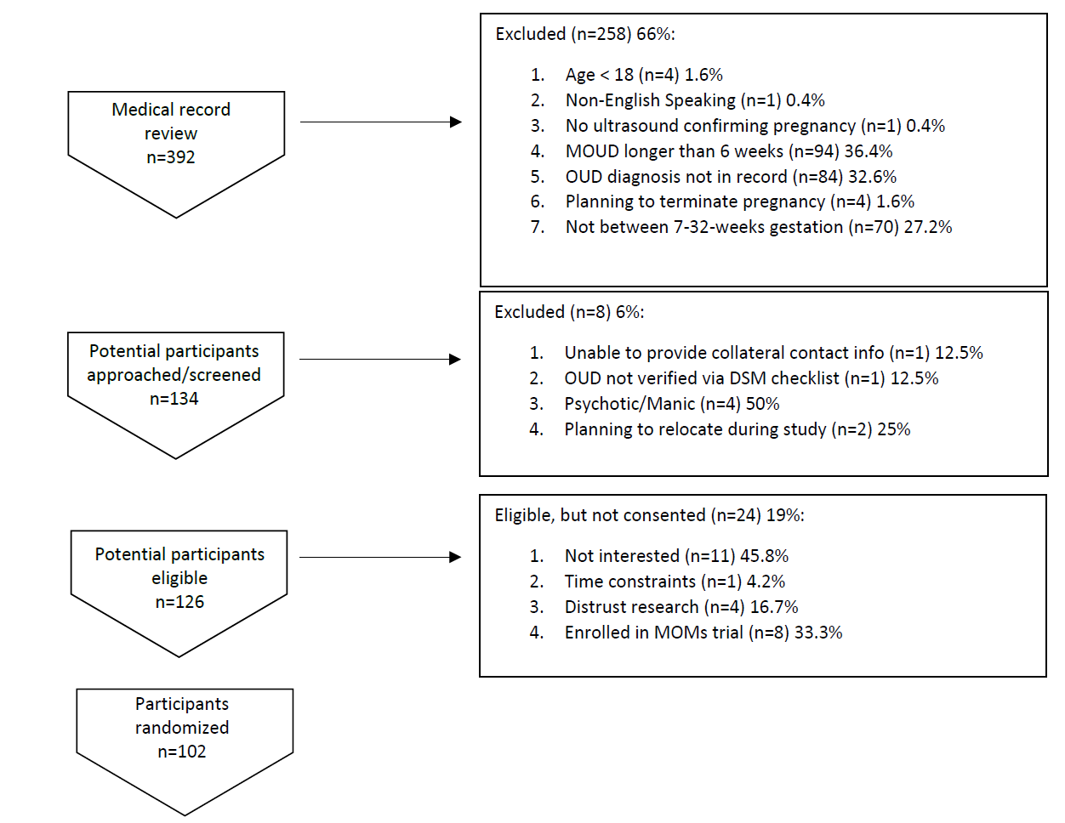
Results

Slide 10
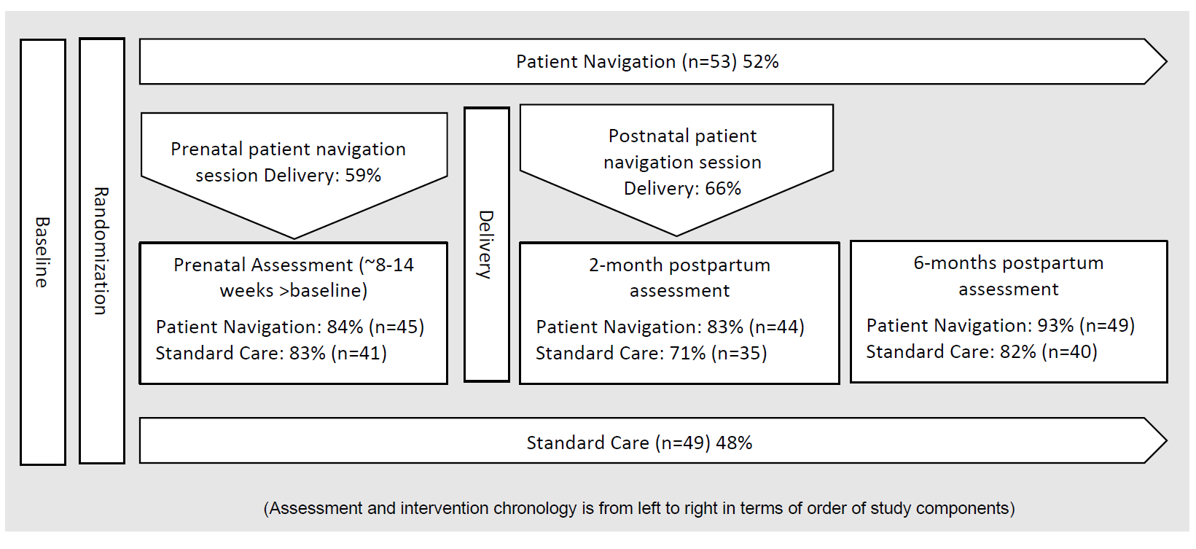
Results
Usual Care:
Usual Care:
Usual Care:
Usual Care:

Slide 11
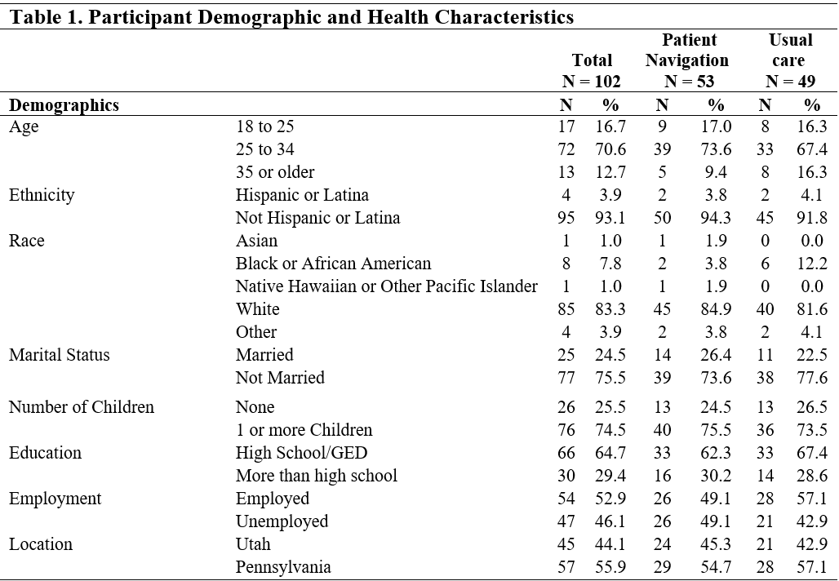
Results

Slide 12
Results

Slide 13
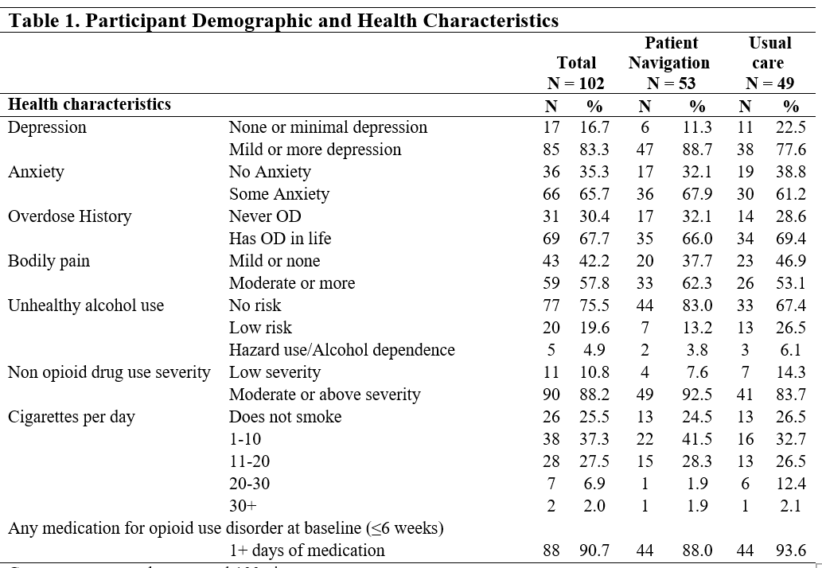
Results

Slide 14
Results

Slide 15
Results
Lots of the right signals
MOUD, Tx attendance, illicit use, and overdose—all in anticipated directions

Slide 16
Results
MOUD
PP Sample
Baseline to 2-months postpartum
PN=28% vs. UC= -10.9% (p<0.01)
Baseline to 6-months postpartum
PN=45.4% vs. UC=23.4%, (p=0.05)

Slide 17
Results
Tx attendance
PP Sample
Baseline to prenatal assessment
PN=10.9%/UC= -14.6% (p=0.04)

Slide 18
Results
Illicit use
ITT sample
Baseline to 2-months postpartum
PN= -61.5% vs. UC= -48.5% (not statistically significant)
Baseline to 6-months postpartum
PN= -56.2% vs. UC= -47.7% (not statistically significant)

Slide 19
Results
Overdose
2-months post partum
PN=11.9% vs. UC=16.1% (not statistically significant)
6-month postpartum
PN=3.8% vs. UC=6.2% (not statistically significant)

Slide 20
Conclusion
Provisional improvements in MOUD, treatment engagement, illicit use, and overdose rates following the PN intervention and warrant further evaluation.
Next steps is powered efficacy trial
Possible to explore factors related to implementation for planning

Slide 21
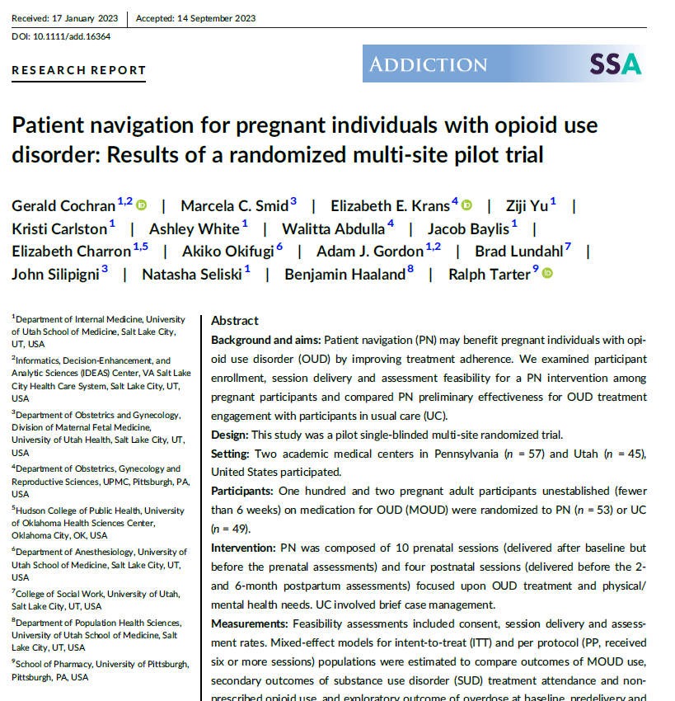
Read the full results or listen to the addiction podcast

Slide 22
References
1.Hirai AH, Ko JY, Owens PL, Stocks C, Patrick SW. Neonatal Abstinence Syndrome and Maternal Opioid-Related Diagnoses in the US, 2010-2017. JAMA. 2021;325(2):146-155.
2.Haight SC, Ko JY, Tong VT, Bohm MK, Callaghan WM. Opioid Use Disorder Documented at Delivery Hospitalization - United States, 1999-2014. MMWR Morbidity and mortality weekly report. 2018;67(31):845-849.
3.Cleary BJ, Donnelly JM, Strawbridge JD, et al. Methadone and perinatal outcomes: a retrospective cohort study. American journal of obstetrics and gynecology. 2011;204(2):139.e131-139.
4.Benningfield MM, Dietrich MS, Jones HE, et al. Opioid dependence during pregnancy: relationships of anxiety and depression symptoms to treatment outcomes. Addiction. 2012;107 Suppl 1:74-82.
5.Chisolm MS, Acquavita SP, Kaltenbach K, et al. Cigarette Smoking and Neonatal Outcomes in Depressed and Non-Depressed Opioid-Dependent Agonist-Maintained Pregnant Patients. Addictive disorders & their treatment. 2011;10(4):180-187.
6.Holbrook A, Kaltenbach K. Co-occurring psychiatric symptoms in opioid-dependent women: the prevalence of antenatal and postnatal depression. The American journal of drug and alcohol abuse. 2012;38(6):575-579.
7.Ordean A, Kahan M, Graves L, Abrahams R, Boyajian T. Integrated care for pregnant women on methadone maintenance treatment: Canadian primary care cohort study. Canadian family physician Medecin de famille canadien. 2013;59(10):e462-469.
8.Unger A, Metz V, Fischer G. Opioid dependent and pregnant: what are the best options for mothers and neonates? Obstetrics and gynecology international. 2012;2012:195954.
9.Cavanaugh CE, Hedden SL, Latimer WW. Sexually transmitted infections among pregnant heroin- or cocaine-addicted women in treatment: the significance of psychiatric co-morbidity and sex trade. International journal of STD & AIDS. 2010;21(2):141-142.
10.Lacroix I, Berrebi A, Garipuy D, et al. Buprenorphine versus methadone in pregnant opioid-dependent women: a prospective multicenter study. European journal of clinical pharmacology. 2011;67(10):1053-1059.
11.Benningfield MM, Arria AM, Kaltenbach K, et al. Co-occurring psychiatric symptoms are associated with increased psychological, social, and medical impairment in opioid dependent pregnant women. The American journal on addictions / American Academy of Psychiatrists in Alcoholism and Addictions. 2010;19(5):416-421.
12.Heil SH, Sigmon SC, Jones HE, Wagner M. Comparison of characteristics of opioid-using pregnant women in rural and urban settings. The American journal of drug and alcohol abuse. 2008;34(4):463-471.
13.Jones HE, O'Grady KE, Malfi D, Tuten M. Methadone maintenance vs. methadone taper during pregnancy: maternal and neonatal outcomes. The American journal on addictions / American Academy of Psychiatrists in Alcoholism and Addictions. 2008;17(5):372-386.
14.Bell J, Towers CV, Hennessy MD, Heitzman C, Smith B, Chattin K. Detoxification from opiate drugs during pregnancy. American journal of obstetrics and gynecology. 2016;215(3):374.e371-376.
15.Frawley PJ, Smith JW. One-year follow-up after multimodal inpatient treatment for cocaine and methamphetamine dependencies. J Subst Abuse Treat. 1992;9(4):271-286.
16.Forray A, Merry B, Lin H, Ruger JP, Yonkers KA. Perinatal substance use: a prospective evaluation of abstinence and relapse. Drug Alcohol Depend. 2015;150:147-155.
17.Tagliaro F, De Battisti Z, Smith FP, Marigo M. Death from heroin overdose: findings from hair analysis. Lancet (London, England). 1998;351(9120):1923-1925.
18.Binswanger IA, Nowels C, Corsi KF, et al. Return to drug use and overdose after release from prison: a qualitative study of risk and protective factors. Addiction science & clinical practice. 2012;7(1):3-3.
19.Krinsky CS, Lathrop SL, Brown P, Nolte KB. Drugs, detention, and death: a study of the mortality of recently released prisoners. The American journal of forensic medicine and pathology. 2009;30(1):6-9.
20.Amato L, Minozzi S, Davoli M, Vecchi S. Psychosocial and pharmacological treatments versus pharmacological treatments for opioid detoxification. The Cochrane database of systematic reviews. 2011(9):Cd005031.
21.Amato L, Minozzi S, Davoli M, Vecchi S. Psychosocial combined with agonist maintenance treatments versus agonist maintenance treatments alone for treatment of opioid dependence. The Cochrane database of systematic reviews. 2011(10):Cd004147.
22.Brigham G, Winhusen T, Lewis D, Kropp F. Incentives for retention of pregnant substance users: a secondary analysis. Journal Of Substance Abuse Treatment. 2010;38(1):90-95.
23.Jones HE, Haug N, Silverman K, Stitzer M, Svikis D. The effectiveness of incentives in enhancing treatment attendance and drug abstinence in methadone-maintained pregnant women. Drug And Alcohol Dependence. 2001;61(3):297-306.
24.Svikis DS, Lee JH, Haug NA, Stitzer ML. Attendance incentives for outpatient treatment: effects in methadone- and nonmethadone-maintained pregnant drug dependent women. Drug And Alcohol Dependence. 1997;48(1):33-41.
25.Jones HE, O'Grady KE, Tuten M. Reinforcement-based treatment improves the maternal treatment and neonatal outcomes of pregnant patients enrolled in comprehensive care treatment. The American journal on addictions / American Academy of Psychiatrists in Alcoholism and Addictions. 2011;20(3):196-204.
26.Tuten M, Svikis DS, Keyser-Marcus L, O'Grady KE, Jones HE. Lessons learned from a randomized trial of fixed and escalating contingency management schedules in opioid-dependent pregnant women. The American journal of drug and alcohol abuse. 2012;38(4):286-292.
27.Jones HE, Haug NA, Stitzer ML, Svikis DS. Improving treatment outcomes for pregnant drug-dependent women using low-magnitude voucher incentives. Addictive Behaviors. 2000;25(2):263-267.
28.Hutchinson ML, Chisolm MS, Tuten M, Leoutsakos J-MS, Jones HE. The efficacy of escalating and fixed contingency management reinforcement on illicit drug use in opioid-dependent pregnant women. Addictive disorders & their treatment. 2012;11(3):150-153.
29.Bickel WK, Amass L, Higgins ST, Badger GJ, Esch RA. Effects of adding behavioral treatment to opioid detoxification with buprenorphine. Journal of consulting and clinical psychology. 1997;65(5):803-810.
30.Koester KA, Morewitz M, Pearson C, et al. Patient navigation facilitates medical and social services engagement among HIV-infected individuals leaving jail and returning to the community. AIDS Patient Care And Stds. 2014;28(2):82-90.
31.Farrisi D, Dietz N. Patient navigation is a client-centered approach that helps to engage people in HIV care. HIV Clinician / Delta Region AIDS Education & Training Center. 2013;25(1):1-3.
32.Goff SL, Pekow PS, White KO, Lagu T, Mazor KM, Lindenauer PK. IDEAS for a healthy baby--reducing disparities in use of publicly reported quality data: study protocol for a randomized controlled trial. Trials. 2013;14:244.
33.Lasser KE, Kenst KS, Quintiliani LM, et al. Patient navigation to promote smoking cessation among low-income primary care patients: a pilot randomized controlled trial. Journal Of Ethnicity In Substance Abuse. 2013;12(4):374-390.
34.Esperat MC, Flores D, McMurry L, et al. Transformacion Para Salud: a patient navigation model for chronic disease self-management. Online Journal Of Issues In Nursing. 2012;17(2):2-2.
35.Battaglia TA, McCloskey L, Caron SE, et al. Feasibility of chronic disease patient navigation in an urban primary care practice. The Journal Of Ambulatory Care Management. 2012;35(1):38-49.

