Slide 1
Overcoming Pharmacy Barriers to Buprenorphine Access through Education and Communication
Presented By: Sorina Torrez, PharmD.
& Members of the PhARM Program
The University of Texas at Austin College of Pharmacy
Notes:
45 minutes (15 for introductions + polling, 30 minutes for presentation)
PhARM: conducts innovative research to identify and address gaps in access to substance use disorder treatment and harm reduction resources

Slide 2
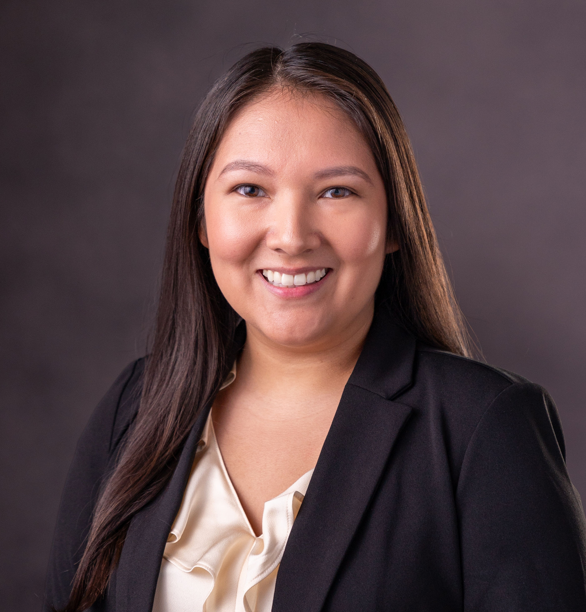
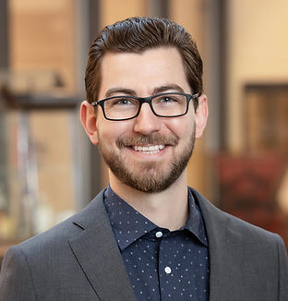
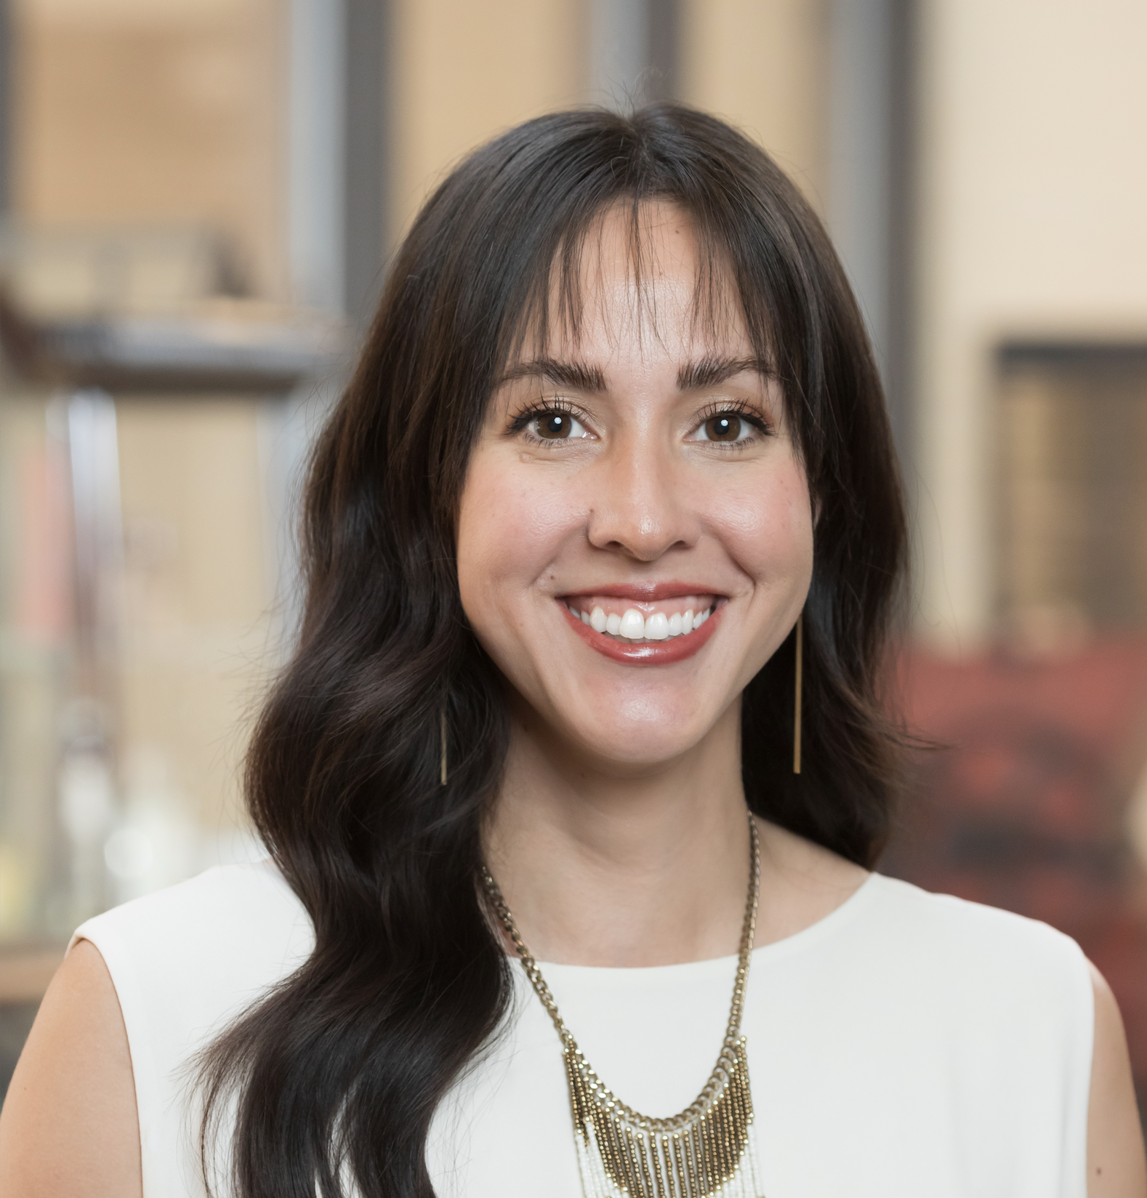
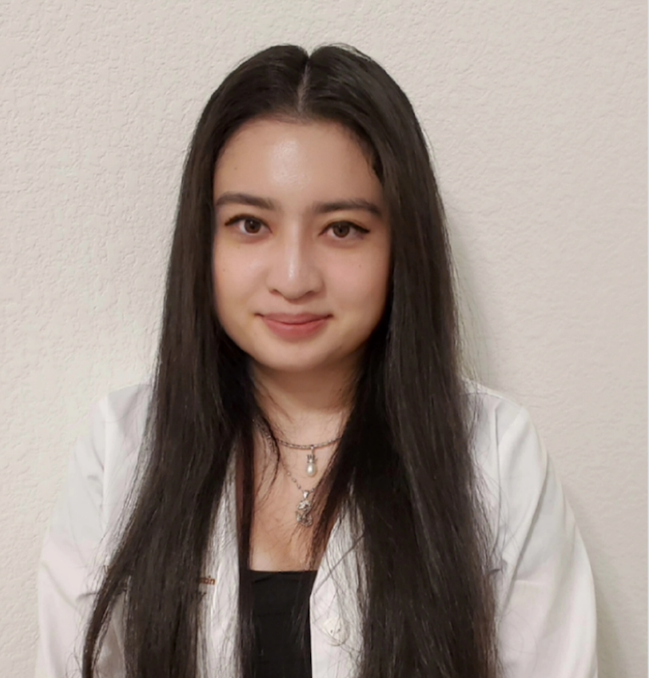
PhARM Team Members
Notes:
Director – Lucas
Assistant director – Lindsey
Project director – Jen
2024 pharmD candidates and research assistants – Grace & Amber

Slide 3
DEAI Statement
Today’s presentation highlights our commitment to ensuring equitable access to evidence-based treatments for all individuals, regardless of their background.
We acknowledge that systemic barriers, stigma, and healthcare disparities can disproportionately impact marginalized communities, hindering their access to life-saving medication. Our research strives to address these disparities.

Slide 4
Learning Objectives
Explore challenging experiences with pharmacies related to buprenorphine (BUP) dispensing
Describe
Learn
Practice
Explore
Describe research findings related to pharmacy barriers to BUP access
Learn how to address common pharmacy barriers
Practice effective proactive and reactive communication with pharmacy staff related to BUP

Slide 5
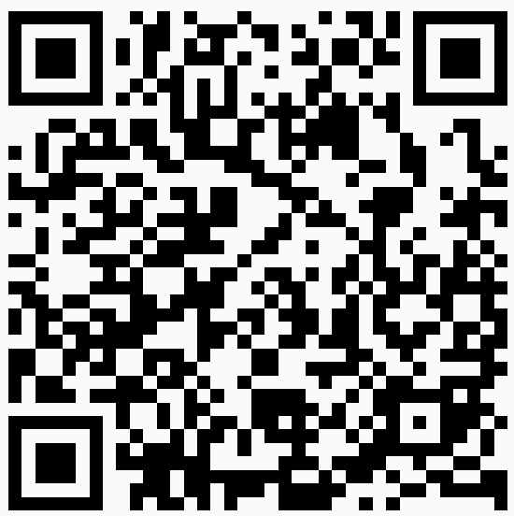
Polling Questions
Scan to participate in polling
Or go to: PollEv.com​/sorinatorrez413
QR Code
Here

Slide 6
Question 1:
What is your profession?
Scan above or go to: PollEv.com​/sorinatorrez413
QR Code
Here

Slide 7
Question 2:
Which best describes your practice setting?
Scan above or go to: PollEv.com​/sorinatorrez413
QR Code
Here

Slide 8
Opioid Use Disorder Treatment
Methadone
Buprenorphine
Naltrexone
Pew Charitable Trusts, 2016.
Notes:
Before we begin, I’d like to quickly note there are other medications that are FDA-approved for the treatment of OUD besides BUP.
Methadone, a full opioid agonist, is not available in community pharmacies when prescribed specifically for OUD.
Naltrexone is an opioid antagonist - so it completely blocks the receptor. The intramuscular formulation– which is the only formulation approved for OUD - is often administered in clinics – and it is not carried by community pharmacies.
Buprenorphine on the other hand, is a partial mu opioid receptor agonist and it is carried in community pharmacies.

Slide 9
Buprenorphine
Schedule III drug
Formulations
Sublingual, buccal, injectable
Available in combination with naloxone
Ex: Sublingual buprenorphine/naloxone (BUP/NX)
Ability to prescribe affected by:
Recission of the X-waiver
Telehealth regulations
Partial mu-opioid agonist
Buprenorphine HCl tablet [package insert]. Pew Charitable Trusts, 2016.
Notes:
This is a controlled medication, it’s classified as schedule III.
It comes in many different formulations – including sublingual (which is a common ROA), buccal (where the drug is placed between the gums and the cheek), as well as injectable.
BUP comes both by itself and in combination with naloxone. For example – SL bup/nal is a commonly prescribed formulation for OUD.
The ability to prescribe BUP is affected by recent updates to laws and regulations.
For example –recision of the X-waiver occurred at the beginning of this year – and this greatly increased the number of providers able to prescribe BUP for OUD.
Also telehealth regulations are in flux – currently, providers can prescribe BUP for OUD through telehealth services without first seeing their patienst in person – this has also increased access to patient care – but as I mentioned, these regulations still in flux. The current telehealth rule is set to expire at the end of next year in 2024.
###########
When is formulation is used appropriately buprenorphine is absorbed into the bloodstream, while NAL is not. If someone tries to administer the drug in an alternative way, naloxone may be absorbed, which would counteract BUP, and this is meant to counteract misuse of the product.
For example – recission of the x-waiver. Prior to this year, prescribers were prev required to attain an x-waiver to prescribed BUP for OUD. However, the only thing required now is a DEA license.
There have also been recent changes in telehealth regulations. Prior to the pandemic, providers could only prescribe controlled substances to patients they had evalutated in-person. During the pandemic, this rule was temporarily lifted – and as a result, providers were able to prescribe BUP for OUD via telehealth without seeing the patient in person first. As you can imagine, this increased access to care for our patients!
Unfortunately, this temporary change was set to expire this year – but fortunately, it was recently extended

Slide 10
What challenges have you experienced with pharmacies related to BUP?
BUP: buprenorphine
Notes:
OR if you’re a pharmacist – what challenges have you encountered that have prevented you from being able to dispense BUP?
Thank you for sharing!

Slide 11
Learning Objectives
Explore challenging experiences with pharmacies related to buprenorphine (BUP) dispensing
Describe
Learn
Practice
Explore
Describe research findings related to pharmacy barriers to BUP access
Learn how to address common pharmacy barriers
Practice effective proactive and reactive communication with pharmacy staff related to BUP
BUP: buprenorphine

Slide 12
Limitations in BUP Availability
BUP: buprenorphine
Notes:
As you may or may not know, there are limitations in the availability of BUP on many levels. We briefly touched on the prescriber level when discussing the X-waiver and telehealth regulations. Between 2020 and 2022, our research team looked at BUP availability in community pharmacies.

Slide 13
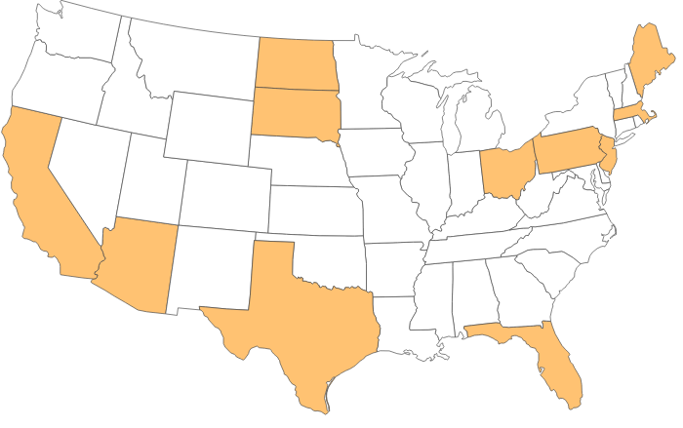
Hill, et al. (2022)
Availability of BUP/NX films and naloxone nasal spray (NNS) in community pharmacies in 11 U.S. states
BUP/NX: buprenorphine/naloxone
Hill, et al. Drug Alcohol Depend. 2022;237:1059518.
Notes:
11 states were involved in this study – including ND, SD, CA, TX, FL, MA to name a few.

Slide 14
Hill, et al. (2022)
Primary Outcome
Secondary Outcomes
Availability of a one-week supply of generic 8/2 mg sublingual BUP/NX and a single unit of NNS
Willingness to order BUP/NX if it was unavailable
Estimated timeframe to order if BUP/NX was unavailable
BUP/NX: buprenorphine/naloxone; NNS: naloxone nasal spray
Hill, et al. Drug Alcohol Depend. 2022;237:1059518.
Notes:
We specifically looked at the availability of a one week supply 8/2 mg BUP/NX films and a single unit of naloxone nasal spray in these pharmacies.
We also looked at …..

Slide 15
BUP/NX Availability in Community Pharmacies
Primary Outcomes | Overall (n=4984) | Chain (n=3902) | Independent (n=1582) | P-value
BUP/NX + NNS available | 41.2% | 47.9% | 26.7% | <0.0001
BUP/NX available | 48.3% | 54.6% | 34.6% | <0.0001
BUP/NX: buprenorphine/naloxone; NNS: naloxone nasal spray
Hill, et al. Drug Alcohol Depend. 2022;237:1059518.
Notes:
And here are our results. Looking at the last row on the bottom, we see that ALMOST half (48.3%) of pharmacies stocked BUP – there was a big difference in stocking between chain and independent pharmacies.

Slide 16
BUP/NX Availability in Community Pharmacies
Secondary Outcomes | Overall (n=2578) | Chain (n=1544) | Independent (n=1034) | P-value
Willingness to order BUP/NX if unavailable | 64.0% | 75.1% | 47.5% | <0.0001
Order time, median (IQR), days | 2 (1-3) | 2 (1-4) | 2 (1-3) | <0.0001
BUP/NX: buprenorphine/naloxone
Hill, et al. Drug Alcohol Depend. 2022;237:1059518.
Notes:
We also saw that 64% of pharmacies who did not stock it were willing to order it, and it would take anywhere from 1-3 days to come in.

Slide 17
BUP/NX Availability in Community Pharmacies
BUP/NX: buprenorphine/naloxone
Hill, et al. Drug Alcohol Depend. 2022;237:1059518.
Notes:
This shows us BUP availability by state – so if you’re from any of these states – I’d encourage you to take note of your states availability compared to the other states. For example, we’re from Texas – so we’ve got a lot of work to do!

Slide 18
Kazerouni, et al. (2021)
Primary Outcome
BUP/NX availability by pharmacy type, county, and sampling characteristics
Objective
Assess BUP/NX availability in pharmacies in U.S. counties with higher-than-average opioid overdose rates
BUP/NX: buprenorphine/naloxone
Kazerouni, et al. Drug Alcohol Depend. 2021;224:108729.
Notes:
Another study – one by Kazerouni et al - had similar but different findings.
Their objective was to _______ and they looked at [PRIM OUTCOME]

Slide 19
Kazerouni, et al. (2021)
Primary Outcomes | Overall (n=921) | Chain (n=467) | Independent (n=454) | P-value
Could NOT dispense | 19.9% | 14.6% | 25.3% | <0.0001
Could dispense | 73.3% | 75.0% | 71.6%
Could NOT disclose information | 6.8% | 10.5% | 3.1%
Kazerouni, et al. Drug Alcohol Depend. 2021;224:108729.
Notes:
Here are their findings – about 73% of pharmacies reported that they COULD dispense, meaning it was either in stock or able to be ordered
So these numbers are a little more positive than our prev study, but that’s because the prev study assessed if pharmacies had at least a 1 week supply of BUP already in stock and ready to be dispensed.
So the outcomes are slightly different, which may account for some of the differences in numbers that we see here.

Slide 20
How does lack of BUP availability affect patients?
BUP: buprenorphine
Notes:
So know we’ve determined that they is some lack of availability of BUP in community pharmacies. So I’d like to pose this question to the audience – how do you think a lack of BUP availability affects patients?

Slide 21
What are patient-specific factors that might influence someone’s accessibility to BUP?
BUP: buprenorphine
Notes:
Location, disability, finances (ability to afford), access to a provider, education of the system/ability or willingness to engage.

Slide 22
Barriers and Solutions
Notes:
Next, I’d like to discuss barriers to dispensing, as well as solutions/ or facilitators to dispensing more BUP

Slide 23
Barriers to Dispensing BUP
Lack of
trust
Ordering
limits
Knowledge gaps
Poor communication
Insurance issues
Concerns about diversion
Insufficient stock
Stigma
BUP: buprenorphine. 1. Cooper, et al. Int J Drug Policy. 2020;85:102701. 2. Hill, et al. J Am Pharm Assoc. 2023;63(1):252-60.
3. Ostrach, et al. J Am Pharm Assoc. 2023:63:1044-48. 4. Winstanley, et al. Drug Alcohol Depend. 2022;5:100091.
Notes:
Things that might prevent dispensing BUP in a timely manner include
There being a lack of trust between pharmacists and prescribers
Ordering limits on controlled substances; pharmacies fear that increased dispensing may lead to punishment by warehouses or the DEA – and while this seems like a legitimate concern – the DEA denies having these limits.
Other barriers include: insufficient stock, poor communication between pharmacists, patients and providers, insurance issues, concerns about BUP being diverted or misused.
As well as stigma and knowledge gaps – RPhs may not know about these issues with availability and maybe there are misconceptions that can be addressed by filling these knowledge gaps.

Slide 24
Barriers to Dispensing BUP
Common policies include:
Checking prescription drug monitoring programs
Validating X-waivers
Accepting only local prescribers
Prohibiting refills >1 day early
Outright refusal to dispense
BUP: buprenorphine
1. Hill, et al. J Am Pharm Assoc. 2023;63(1):252-60. 2. Winstanley, et al. Drug Alcohol Depend. 2022;5:100091.
Notes:
Studies have identified these common policies by pharmacists, which includes ________

Slide 25
Facilitators of Dispensing BUP
Increase
Trust
Communication
Education
Decrease
Stigma
Barriers
BUP: buprenorphine
Notes:
Now it’s time to address those barriers –right! We can do so by working to increase trust, communication and education. While breaking down stigma and additional barriers.

Slide 26
Key Takeaways
Both legitimate and unsubstantiated concerns and policies exist
Targeted education can address these barriers
There are barriers to BUP dispensing in pharmacies
BUP: buprenorphine
Ostrach, et al. J Am Pharm Assoc. 2023:63:1044-48.
Notes:
Overall from this section, I want you to take away 3 key points: 1 ______ 2_______ 3________
And we hope to address these barriers though targeted education – such as workshops like this! Continuing education, academic detailing, etc.

Slide 27
Learning Objectives
Explore challenging experiences with pharmacies related to buprenorphine (BUP) dispensing
Describe
Learn
Practice
Explore
Describe research findings related to pharmacy barriers to BUP access
Learn how to address common pharmacy barriers
Practice effective proactive and reactive communication with pharmacy staff related to BUP
BUP: buprenorphine
Notes:
Our next objective is ________.

Slide 28
Addressing Common Pharmacy Barriers
Notes:
We’re going to look at this from a prescriber POV and briefly discuss RPh-specific education.

Slide 29
Pharmacy Barriers & Proposed Solutions
Pharmacy Barriers | Proposed Solutions
Delay in dispensing due to insurance issues | Prescribers may include diagnosis code and rationale explaining any prescribing irregularities Medical team made aware of how to process prior authorizations in a timely manner Patients should be made aware of medication assistance programs
Pharmacy has difficulty contacting prescribers when questions arise | Prescribers may include direct contact information on prescription Medical team made aware that communication from pharmacies regarding BUP is a high priority
BUP: buprenorphine
Notes:
Here are pharmacy barriers and proposed actions for prescribers.
When there is a delay….. It may help speed up the process if __________

Slide 30
Pharmacy Barriers & Proposed Solutions
Pharmacy Barriers | Proposed Solutions
Lack of trust | Proactively outreach via phone, email or mail, to pharmacies and communicate your intention to prescribe BUP Include OUD-related qualifications and pertinent information about processes of care
Pharmacist identifies potential concerns in the PMP | Prescribers note if PMP was previously reviewed and preemptively explain irregularities or perceived “red flags”
BUP: buprenorphine; OUD: opioid use disorder; PMP: prescription monitoring program
Notes:
And also including information about your patient care plan, by doing so, you’re making the Rph part of action plan, which is appropriate because they’re also a provider for your mutual patient.
Another barrier is when the Rph identifies potiential concerns in the PMP, or prescription monitoring program. Often times, prescribers will view the PMP before sending out controlled RXs – it may even be legally required for some of you. If you notice any irregularity or perceived red flag, it’s best to note that on the prescription. Otherwise, if the RPh checks it separately and finds irregularities, they are obligated to pause and make sure the prescriber is aware.

Slide 31
Pharmacy Barriers & Proposed Solutions
Pharmacy Barriers | Proposed Solutions
Prohibits prescription from being filled >1 early | If needed early, prescriber states they are aware and would like medication to be dispensed early
Pharmacist only accepts prescriptions from local prescribers | Prescriber can explain reasons why they are not local Prescriber can remind pharmacy staff about telehealth regulations
Notes:
Some pharmacies have policies that they will not fill BUP early. But this may be needed if the patient lost their medication or if they’re going out of town. If the patient tells a RPh this, the first thing the Rph is going to do is try to contact the prescriber to make sure they’re aware. So if you’re a prescriber and you need your pt needs their BUP early, go ahead and write the reason for needing it early and that you approve an early fill. this all goes back to communication and building trust.
Lastly some pharmacists will only accept>>>>>>>. If you are not local, try preemptively explaining why, maybe the pharmacist is not uptodate with the most recent telehealth regulations – which is understandable right? It’s changed a few times already this year.

Slide 32
Educational Material for Pharmacists
Pharmacist outreach to educate about:
Lack of availability
Buprenorphine FAQs
Updated laws and regulations
Vitality of pharmacists’ role
Pharmacist are encouraged to take action by:
Increase stocking
Accept new patients
Dispense with urgency
Work with prescribers
Notes:
Our research team has developed educational material specifically for RPhs and I’d like to briefly review some key points. This material aims to education on the lack of availability of BUP, address FAQs regarding different things like BUP induction and duration of use. We also aims to update them on recent laws and regulations related to BUP, as well as highlight the importance of their role in breaking down this access barrier.
We encourage them to take action by ________.

Slide 33
Learning Objectives
Explore challenging experiences with pharmacises related to buprenorphine (BUP) dispensing
Describe
Learn
Practice
Explore
Describe research findings related to pharmacy barriers to BUP access
Learn how to address common pharmacy barriers
Practice effective proactive and reactive communication with pharmacy staff related to BUP
BUP: buprenorphine
Notes:
Next we’re going to move ________
Which will be done in small groups – with the people at your table.

Slide 34
Small Group Activity
10 minutes per scenario (3 total scenarios)
Notes:
We will have you work through 3 scenarios and you will be given 10 minutes for each scenario. After that, we’ll go through each scenario together and share ideas and responses. As you go through the scenarios, please feel free to make notes on your papers and engage with our facilitators if you have any questions. Each scenario has two parts – please work through ONE at a time! Don’t read the second portion until your done with the first. So we’ll pass those out now, and please let us know if you have any questions.

Slide 35
Scenario 1

Slide 36
Scenario 2

Slide 37
Scenario 3

Slide 38
Large Group Debrief
15 Minutes
Notes:
The presentation also would be strengthened by a wrap-up section before Slide 39 in which participants can verbalize what skill/s they will bring home and any other action items they can commit to for putting new skills into future practice.

Slide 39
Thank you for attending today’s workshop!
Contact information:
Email: sorinatorrez@utexas.edu
www.PhARMprogram.org

Slide 40
Overcoming Pharmacy Barriers to Buprenorphine Access through Education and Communication
Presented By: Sorina Torrez, PharmD.
& Members of the PhARM Program
The University of Texas at Austin College of Pharmacy

