Slide 1
Pairing XYLAZINE EDUCATION AND HOME TESTING AS HARM REDUCTION Strategy FOR PREGNANT And POSTPARTUM PERSONS WHO USE ILLICIT OPIOIDS
AMERSA Annual Conference – 11/16/2024
ILANA HULL*
ELLEN STEWART*
RAAGINI JAWA
MARGARET SHANG
Corey Davis
Maya Patterson

Slide 2
Conflict of interests
No conflicts of interest to disclose

Slide 3
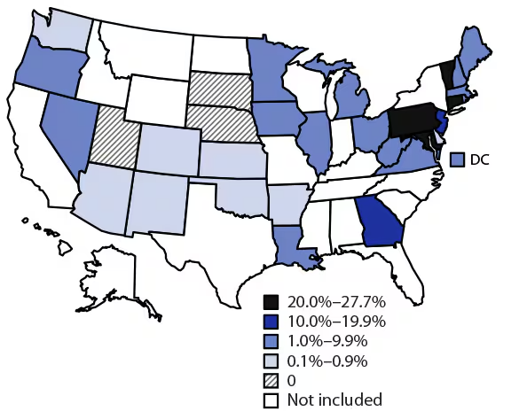
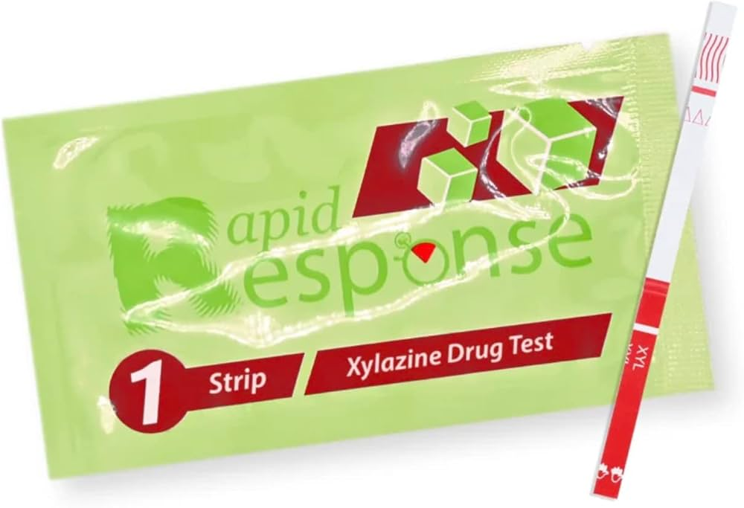
Percentage of IMF-involved overdoses with xylazine detected January 2021-June 2022
Pittsburgh
PA
Act 1111 (effective Jan 2023) amendment to the Pennsylvania Controlled Substance, Device, and Cosmetic Act of 1972 decriminalized possession of drug test strips
Notes:
Kelly -- Magee is a large, tertiary care, safety net hospital in Pittsburgh, draw patients from around Western PA with ~10,000 births occurring each year
Area that has been hit really hard by the opioid epidemic, pregnant population has not been spared
~2-3% of individuals who deliver at Magee have diagnosis of OUD, which is significantly greater than the national rate of OUD in pregnancy (1%), does not include individuals with other use disorders

Slide 4
Specific AIMS
Two-pronged harm reduction intervention targeting pregnant and postpartum persons (within one year of live birth) consisting of:
Structured education about xylazine and xylazine test strips
Distribution of free xylazine test strip testing kits
AIM 1: Understand the feasibility of delivering the harm reduction intervention in the target population
AIM 2: Understand the acceptability of delivering a harm reduction intervention to the target population
AIM 3: Explore the provisional effect of the harm reduction intervention on risk behaviors among persons receiving the intervention
Notes:
Hospital awarded grant of $50,000

Slide 5
Recruitment
Study sites: Pregnancy and Women’s Recovery Center (outpatient), UPMC Magee-Women’s Hospital, UPMC Presbyterian Hospital
Inclusion criteria:
>18 years of age
intrauterine pregnancy (confirmed by ultrasound) OR within one year of delivery of live infant
Meets DSM-V criteria for OUD and endorses illicit opioid use in the past three months
Exclusion criteria:
Pending legal action that could prohibit or interfere with participation
Residence or discharge to a facility that bans possession of drug checking supplies
Acute, severe psychiatric condition
Notes:
Ellen – We recruited from the Pregnancy and Women’s Recovery Center in the outpatient setting and from inpatient floors at UPMC Magee Women’s Hospital. Inpatient vs outpatient recruitment
Our inclusion criteria included being at least 18 years old, currently pregnant or within 1 year PP, had a dx of OUD and endorsed illicit opioid use in the past 3 months. We could not recruit anyone involved in the legal system, in acute mental health crisis, or apart of a residence/facility that banned the use of drug checking supplies

Slide 6
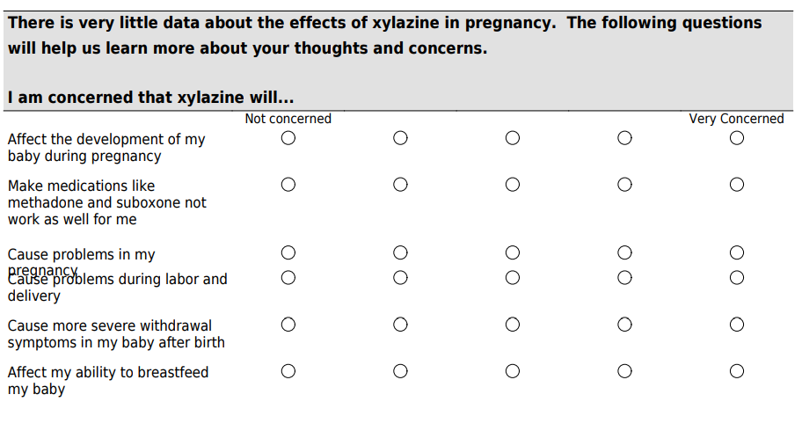
Study Protocol –Enrollment
Participants completed presurvey:
Demographic information
Substance use hx and MOUD hx
Knowledge about xylazine
Knowledge about xylazine test strips (XTS)
Concerns about xylazine
Notes:
Our first visit included a presurvey asking demographic info, SUD/MOUD hx, knowledge about xylazine and test strips, current concerns surrounding xylazine. The questions about concern did include pregnancy concerns, effects on their baby after birth, withdrawal concerns.

Slide 7
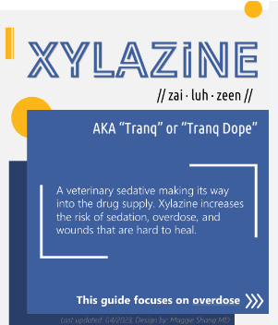
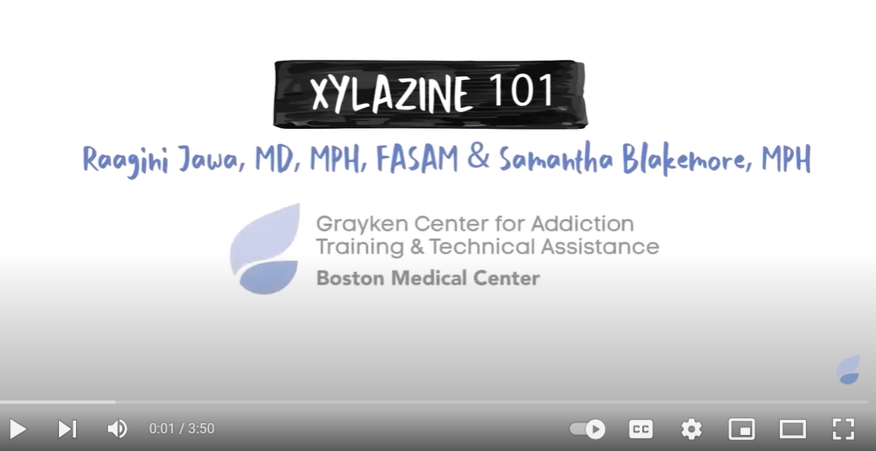
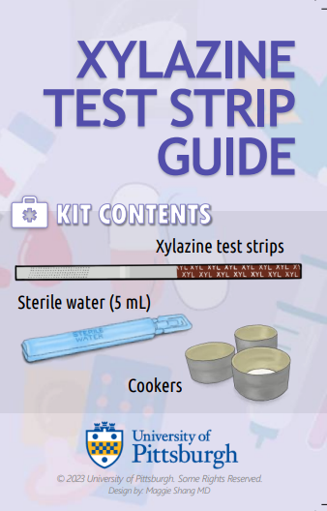
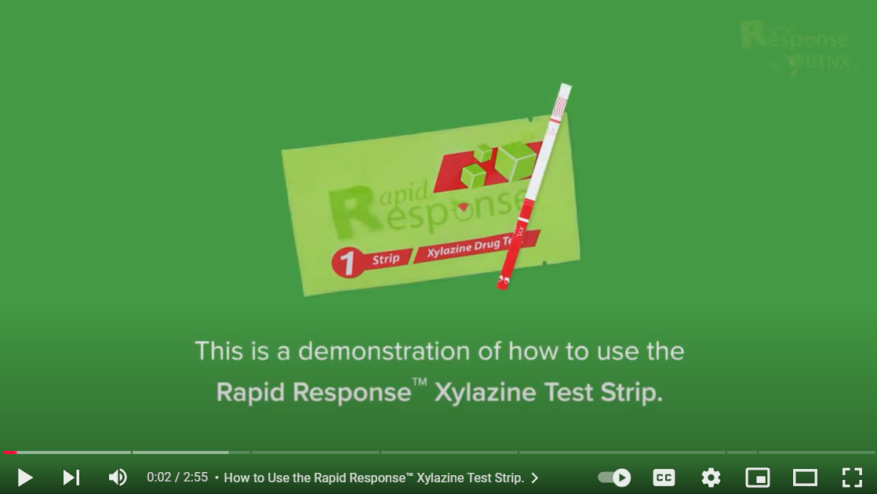
Study protocol - ENROLLMENT
Participant education:
Reviewed one video and one pamphlet about xylazine
Reviewed one video and one pamphlet about XTS
Teachback about proper use of XTS
XTS Distribution
Participants were given 5 xylazine testing kits (each with 2 XTS, 2 cookers, two sterile water)
Participant Reimbursement: $50
Notes:
Ellen – Participants were asked to watch a short video about xylazine and xylazine testing strips, as well as pamphlets about xylazine and the testing strips. Ppts were asked to do a verbal teachback of how to use the testing strips kits. Before the end of the first visit, ppts were given 5 xylazine testing kits that included, 2 small containers of sterile water, 2 XTS, and 2 cookers. Ppt were compensated $50 for their time.

Slide 8
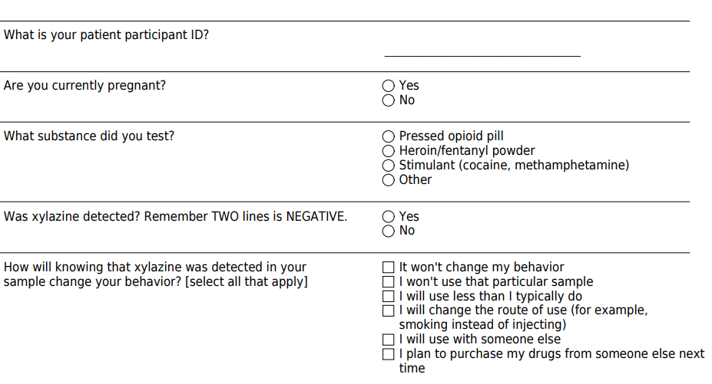
Study protocol:REAL-TIME SURVERYS
XTS kits had QR code – participants were asked to scan the code and complete a short survey each time they used a kit
2-month window
Only one survey could be completed per day
Total of 5 surveys/participant
Reimbursement: $10/survey
Notes:
Ppt were asked to scan the QR code that was on the outside of each XTS kit if they did use and wanted to test their supply. The QR code took them to a short survey asking them if they were pregnant, what substance they tested, if xylazine was detected, and if the ppt changed any patterns in their use knowing xylazine may be in their sample. These surveys could only be submitted once a day. Ppts were given a 2-month window to submit 5 surveys if they chose. The compensation of each submitted survey was $10.

Slide 9
Study protocol: Completion
Window for completion starting 2 months after enrollment visit, remained open for 1 month
Post-intervention survey
Repeated questions about knowledge about xylazine
Repeated questions about xylazine test strips (XTS)
Repeated questions about concerns about xylazine
Reimbursement: $25
10-20 min qualitative interview
Reimbursement: $50
Notes:
2 months post enrollment visit, ppts were asked to complete a post survey and 10-20 min interview. The survey repeated questions from the presurvey including knowledge about xylazine, XTS, and concerns. Total compensation was $75 or $25 for the survey and $50 for the interview.

Slide 10
Response from Patients
Participants felt safer using the strips in their own supply
Several expressed how they felt "empowered"
Some shared they felt "more in control"
Several participants shared how scared they were of the supply in the community
The strips and acknowledgement of xylazine became a motivator for some to seek or maintain treatment
Several participants shared how different their experience of withdrawal was due to xylazine exposure
Notes:
Many participants mentioned in the interview that they felt safer using the testing strips. Some felt empowered knowing what was in their supply and others shared they felt more in control.
Several ppts shared their fear of xylazine in the supply but also shared the strips and acknowledgement of xylazine became a motivator for some to seek/maintain treatment
Several ppts noted how different their withdrawal felt due to xylazine rather than what they have experienced just from fentanyl

Slide 11
Results - DEMOGRAPHICS
Demographics, n=38
 | n=38 (%)
Median age, years (IQR) | 30.5 (28.0-35.0)
Race
White | 36 (94.7%)
Black | 5 (13.2%)
American Indian or Alaska Native | 2 (5.3%)
Ethnicity
Non-Hispanic | 36 (94.7%)
Prefer not to answer | 2 (5.3%)
Insurance
Public | 38 (100%)
Income
Less than $30,000 | 24 (63.2%)
$30,000-$60,000 | 8 (21.1%)
Greater than $60,000 | 0 (0%)
Unsure | 6 (15.8%)
Pregnancy Status at Enrollment
Pregnant | 32 (84.2%)
In postpartum period | 6 (15.8%)

Slide 12
RESULTS-ACCEPTABILITY/FEASIBILITY
# Participants = 38
# Participants who appropriatey demonstrated use of XTS = 38
# Participants who submitted at least one real-time survery = 15
# Participants who demonstrated improved knowledge about xylazine = 22
# Participants who completed the education = 38
56 individuals met criteria for enrollment and were approached by recruitment team
38 chose to enroll in the study
36/38 (94.7%) were familiar with xylazine prior to the study
20/38 (52.6%) reported using XTS prior to the study

Slide 13
INTERIM SURVEY RESULTS
Real Time Survey Results
 | Participants (n=15) | Real time-surveys (n=62)
Substances tested
Pressed opioid pills | 2 (13.3%) | 2 (3.2%)
Heroin/fentanyl powder | 15 (100%) | 53 (85.5%)
Stimulant | 3 (20%) | 7 (11.3%)
Positive xylazine result reported | 12 (80%) | 29 (46.8%)
Behavioral change reported
Won't use that sample | 4 (26.7%) | 8 (12.9%)
Would use less | 8 (53.3%) | 14 (22.6%)
Change route of use | 2 (13.3%) | 3 (4.8%)
Use with someone else | 2 (13.3%) | 2 (3.2%)
Plan to purchase drugs elsewhere | 6 (40%) | 10 (16.1%)
No change in behavior | 3 (20%) | 5 (8.1%)

Slide 14
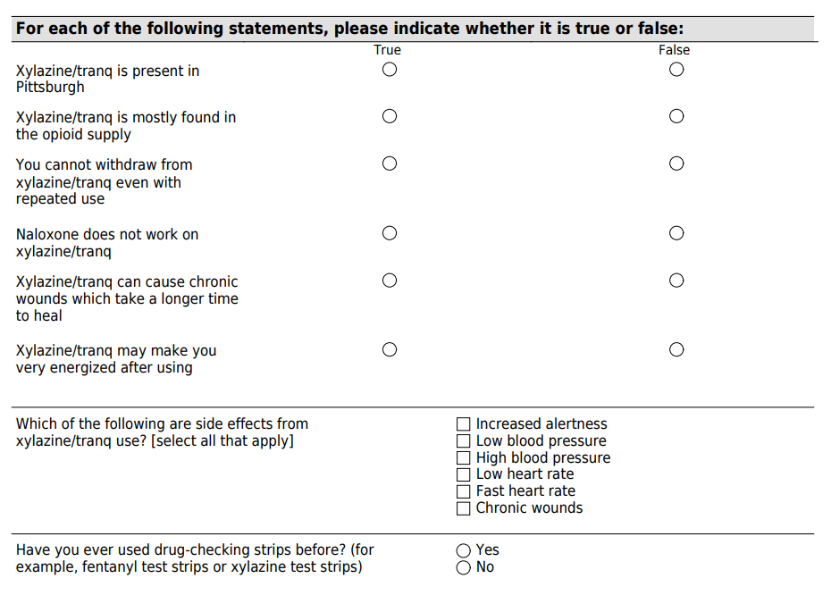
Xylazine Knowledge
Knowledge Scores Summarized, n=28
 | n=28 (%)
Scored higher on post-survey | 22 (78.6%)
Scored the same on post-survey | 0 (0%)
Scored lower on post-survey | 6 (21.4%)

Slide 15
Xylazine Concern results
Concerns around Xylazine (end of study)
 | Not at all concerned | Slightly/somewhat concerned | Moderately/Extremely concerned
Affect the development of a baby during pregnancy | 1 (3.6%) | 5 (17.9%) | 22 (78.6%)
Make medications like methadone and suboxone not work as well | 3 (10.7%) | 7 (25%) | 18 (64.3%)
Cause problems in pregnancy | 1 (3.6%) | 4 (14.3%) | 23 (82.1%)
Cause problems during labor and delivery | 1 (3.6%) | 4 (14.3%) | 23 (82.1%)
Cause more severe withdrawal symptoms in babies exposed to opioids after birth | 2 (7.1%) | 3 (10.7%) | 23 (82.1%)
Affect a mother's ability to breastfeed | 2 (7.1%) | 4 (14.3%) | 22 (78.6%)

Slide 16
Xylazine Concern results
Concerns around Xylazine (end of study)
 | Not at all concerned | Slightly/somewhat concerned | Moderately/Extremely concerned
Affect the development of a baby during pregnancy | 1 (3.6%) | 5 (17.9%) | 22 (78.6%)
Make medications like methadone and suboxone not work as well | 3 (10.7%) | 7 (25%) | 18 (64.3%)
Cause problems in pregnancy | 1 (3.6%) | 4 (14.3%) | 23 (82.1%)
Cause problems during labor and delivery | 1 (3.6%) | 4 (14.3%) | 23 (82.1%)
Cause more severe withdrawal symptoms in babies exposed to opioids after birth | 2 (7.1%) | 3 (10.7%) | 23 (82.1%)
Affect a mother's ability to breastfeed | 2 (7.1%) | 4 (14.3%) | 22 (78.6%)

Slide 17
CHALLENGES/LIMITATIONS
Concern of hospital staff intervention with harm reduction materials
Participants submitting consecutive real time surveys for compensation
Narrow focus of testing strips vs wound care approach
Balance of harm reduction and encouraging participants to use materials without jeopardizing their recovery
Our population primarily identified as white
People using strips to test stimulants
Notes:
Some of our limitations and challenges included concern of hospital staff intervening due to harm reduction materials but thankfully that was not an issue. We even met with nurses at the hospital to include them so they were aware of what we were doing.
We did experience a few ppts submitting consecutive real time surveys, sometimes it was an accident, so we did have to remind them of the protocol and they understood. Sometimes it was more obvious they were submitting more surveys for more compensation
We did get feedback from ppt that they would have appreciated more information around wound care but the study did have a narrow focus of access to testing strips rather than wound care but it is definitely a consideration for future research.
We also had to navigate the conversation of the harm reduction approach without making participants feel like they needed to use to submit the real time surveys as to not jeopardize their recovery. We had ongoing conversations with participants to ensure this was not happening as their recovery and what they wanted was the most important. Ethical challenge
Population primarily identified as white – know of limited access for people of color for healthcare and resources, and that could limit ppt recruitment

Slide 18
TAKEAWAYS
Pregnant people are aware and concerned of xylazine and the effects
Many participants with ongoing substance use were willing to use testing strips and many changed their behaviors based on the results
Participants are very interested in understanding the impacts of xylazine in their community, on their pregnancy, their baby, and what they can do to learn more
Different level of engagement from participants, person centered
Notes:
From this pilot study, we learned that pregnant people are aware and very concerned of xylazine and the effects. We learned that many ppts with ongoing use were willing to use the testing strips which then changed their behaviors based on the result. Participants were very interested and engaged with this research because they want to understand the impacts of xylazine on them, their babies, and their community. These women were very engaged in their own care and

