Slide 1
Treatment for Opioid Use Disorder in Philadelphia: Access and Retention Barriers to Care

Slide 2
I have no conflicts of interest to disclose.

Slide 3
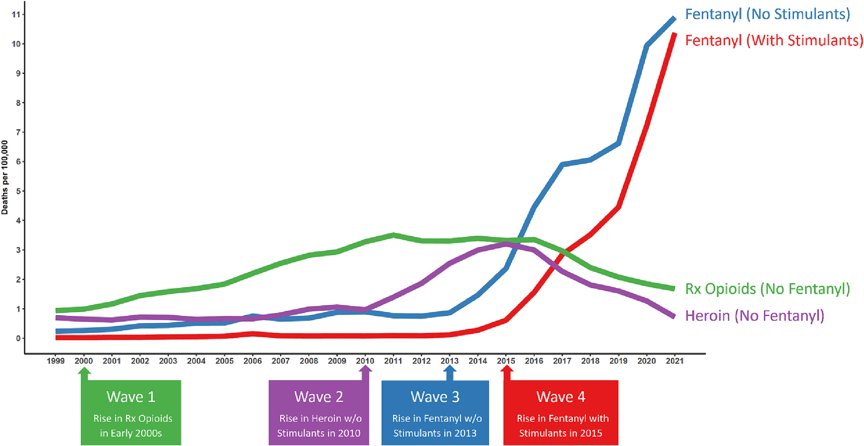
Four Waves of the Overdose Crisis
CDC
Friedman & Shover, 2023
Notes:
To begin with, I’m only going to spend a minute on background to get us set up.
The overdose crisis is often contextualized as occurring in 4 waves…
Each wave has complicated treatment implications for OUD
Locally, there were 1,413 overdose deaths in 2022
Xylazine now in over 99% of dope samples in Philadelphia

Slide 4
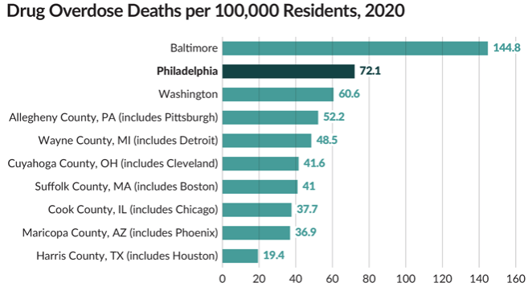
Pew Charitable Trusts

Slide 5
Mapping the OUD Treatment System in Philadelphia
Research Questions:
What are the barriers and facilitators to treatment entry and retention?
What treatment services are available to individuals with public insurance within Philadelphia?
Are there racial/ethnic differences in neighborhood access to substance use services within Philadelphia?
Philadelphia is 40% Black, 40% White
Multimethod study (November 2022 – August 2023)
GIS mapping of treatment centers
Focus groups with people with lived or living experiences of opioid use
Monthly meetings with community advisory board to help develop instruments and interpret findings
Methadone provider survey
Notes:
The project we’re talking to you about today is called Mapping the OUD Treatment System in Philadelphia. The fragmented opioid use disorder (OUD) treatment system is not reaching or retaining many people who need and want to engage in treatment, particularly those using fentanyl and xylazine. This multimethod project was intended to better understand the status and capacity of the current treatment system.
To do this, we conducted GIS mapping of the treatment landscape, directly engaged individuals with lived experience of OUD in focus groups and community advisory board meetings, and surveyed providers of methadone services. Our goal was to provide insights into the accessibility of services, the reasons and timing of early treatment exit, and to identify modifiable policy-related factors related to treatment. Data were collected in 2022 and 2023 and used to develop these recommendations.
We also took a close look at race during our mapping and focus groups. For the past few years, the numbers of overdose deaths for Black and Latino people have been increasing, and now more Black people die of an overdose in Philadelphia than White people.
We’re going to start off with our qualitative results…

Slide 6
Focus Groups
Groups: certified recovery specialists (x2), methadone (x2), buprenorphine, outpatient, inpatient, pregnant and parenting people, harm reduction, Black men, Black women (x2), Latino men
Demographics:
95% had been in some form of past-month treatment
61% had used a drug in the past month (heroin/fentanyl and crack cocaine)
60% had ever overdosed
¼ used ED last time they accessed OUD treatment
Notes:
We conducted 13 focus groups with 70 people. The first two groups were with certified recovery specialists, because they could orient us to the project as both consumers or services and navigators of services for others.
…I’m going to go deeper into some of these themes, mostly through the use of quotes from the focus groups.

Slide 7
Assessment Process
So, first of all, the procedure to get an assessment to even be able to be considered for an available bed in the city of Philadelphia is grueling to say the least. Twelve, 15, 18 hours people sit in a waiting room just to get them done to find the bed to hopefully get placement. Which does not always happen. So, you just waited 15, 18 hours while you’re withdrawing and you’re sick. And at the end of it, you may or may not get the bed that you went there seeking.
-Hospital CRS focus group
Notes:
Quotes
Participants said the assessment process is complex, takes too long, and involves too much paperwork. Many left before they could be assessed due to withdrawal. As I’m sure you know, withdrawal has been complicated by the combination of xylazine and fentanyl which is making it much harder for people to get into treatment.
CRS really emphasized that the assessment process is a major chokepoint for people to get into treatment.

Slide 8
Treatment Types
Inpatient: anxiety about insurance approval for length of stay
Buprenorphine & methadone: feeling “stuck” by daily requirements, punitive programming
With the methadone it was a big hassle. Every day you get home you go to the frigging clinic and sit there for hours and deal with people you didn't want to have to deal with, you know what I mean? It was like an everyday all day thing. It's a job, that's what it is, going to the methadone clinic is a job.
-Buprenorphine focus group
Notes:
People in inpatient treatment talked about the anxiety of not knowing how long of a stay would be covered. CRS noted that this was particularly stressful for those who were unhoused and might be discharged into homelessness without proper planning.
Most participants had been on methadone and/or buprenorphine at some point and spoke to both types of treatment in focus groups. There were conflicting views about the most effective form of MOUD, with some participants stating buprenorphine was effective and others endorsing methadone
Quotes
Here, we’re seeing how the punitive approach can mean taking people out of treatment entirely.

Slide 9
Locations of Care and Transportation
Barrier, especially for unhoused participants
Need for monthly transportation passes
Reliance on public transportation
Location as trigger to use
The guy who’s been using dope and fentanyl for the last 10 years and is trying to get it together doesn’t want to go back on the [subway] to the spot where he was getting high. Like, there’s a lot of studies that show, like, that muscle memory, right? …. He had every intention on going to the clinic. But he wound up in the shooting gallery. -Community CRS focus group
Notes:
Locations of care and transportation came up a lot.
People often talked about difficulties getting to treatment, especially for those who needed to attend regular medication appointments or groups.
This was especially true for unhoused participants.
Many noted a need for monthly transportation passes, not just for getting to treatment, but also to get back to a “normal” life of getting to the store, getting to work, and seeing family.
But many relied on public transportation which could be unpredictable, especially for those who had to take the bus.
And location could be a trigger to use – a lot of treatment programs are located in Kensington which is where many people had purchased and used drugs previously.
Quote

Slide 10
Culturally-Competent Care
Language:
Lack of bilingual staff as major barrier to Spanish-speaking participants
Multiple instances of discrimination
Race:
Some believed programs were more permissive of White participants
Code switching
Racial concordance in staffing important to about half
Notes:
Next I’d like to talk about culturally competent care.
In our Latino focus group, which was conducted in Spanish, a lot of the men talked about language barriers when accessing treatment. A few non-Latino participants also brought up examples of discrimination against people who spoke limited or no English that they had witnessed.
We also asked Black participants about their experiences accessing the treatment system as people of color.

Slide 11
Staffing
I don’t care what degrees you have. First off, to be honest, the average addict has one of the highest IQs. So, it doesn't matter what degrees they have. Like our survival literally depends on our life … when I'm in group, I don't be wanting to share about [expletive] that I've been through because they’re gonna look at me different because they haven't had to struggle. They never been through this stuff. So, when we go into group, we're just in here to [meet program requirements] and bounce.
-Black women focus group
People that don't give a [expletive], they don't understand what you're going through so they just be, like, ‘Ah, you're just being a baby’ or you're just – you know, they treat you like [expletive] and it's, like, what's the point of it? If I'm going through pain or something, that's your job to actually come out and actually give a [expletive] about what's going on with me. Why don't you? If you don't, then get the [expletive] out this job.
- Harm reduction focus group
Notes:
The most consistent theme by far that came up was staffing of programs. In most, if not all, focus groups, people noted staff turnover, lack of empathy, “in it for a paycheck”
Quote 1
This second person was from the harm reduction focus group and had a lot to say about negative experiences with staff at OUD treatment programs.
Quote 2

Slide 12
Policy Recommendations
Based on the full study data, we created a list of policy recommendations to improve access and retention in services
Developed with our CAB stakeholders and based on their experiences as well as integrating the findings from our GIS analysis and methadone program director survey
Met monthly with city stakeholders about this project for over a year, which Pew facilitated
Worked with Graphics Design class to create more visually appealing report to share broadly
Notes:
Erin
Go over bullet
…Our recommendations can fit into 5 buckets – I’ll review them now.

Slide 13
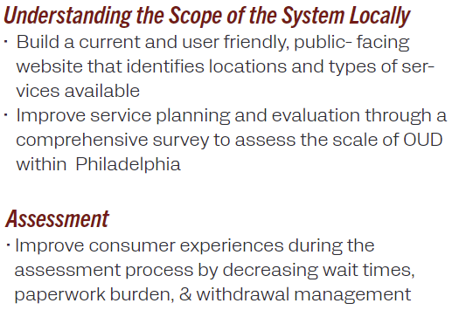
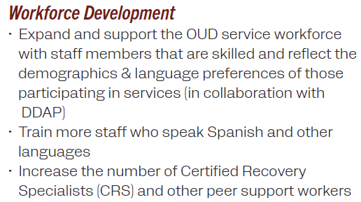
Policy Recommendations
Notes:
Erin
Our recommendations can fit into 5 buckets – I’ll review them now.
We spent all this time trying to understand the need for treatment in Philadelphia and the capacity and the information simply isn’t there in a comprehensive way. That’s a huge barrier to knowing how much of each type of treatment we need to be able to offer and makes it so difficult for people needing treatment to navigate.
Assessment
Workforce development

Slide 14
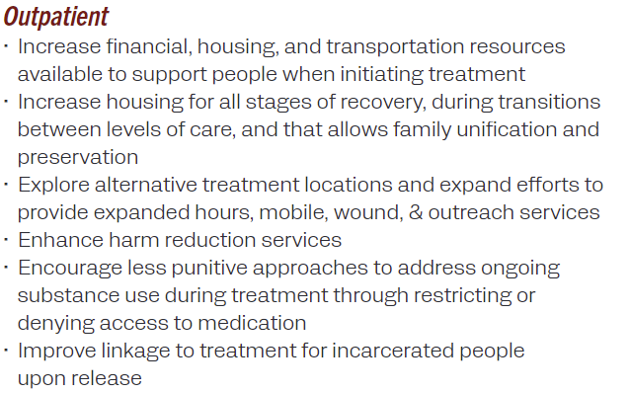
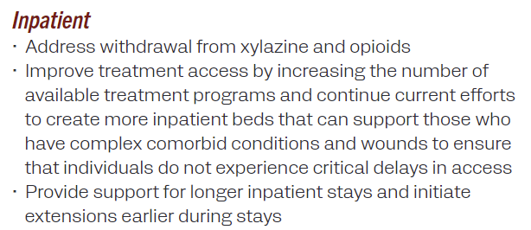
Policy Recommendations
Notes:
Megan
Inpatient second bullet:
We didn’t have space to fully discuss this, but a lot of people who need treatment are considered too “medically complex” to go into existing programs. We need more beds of all types, but especially more beds for these folks so they can have their physical needs addressed with accessing OUD treatment.

Slide 15
Thank you
Megan K. Reed, PhD, MPH
Center for Connected Care
Department of Emergency Medicine
College of Population Health
Megan.k.reed@jefferson.edu

