Slide 1
Patient and Staff Perspectives on Transitions of Care from a Low-Threshold Buprenorphine Program to Clinic-Based Care
Noelle G. Martinez, Ashley Q. Truong, Courtney D. Nordeck, Deborah Agus, Becky L. Genberg, Megan E. Buresh

Slide 2
Conflict of Interest
The authors report no conflict of interest

Slide 3
Diversity, equity, and inclusion
The authors acknowledge that their societal privilege contrasts the lived experiences of the study’s patient population, which is largely comprised of Black patients with criminal legal system involvement

Slide 4
Background
Buprenorphine treatment is accessed in a wide range of care settings that vary in program structure, accessibility, and philosophy

Slide 5
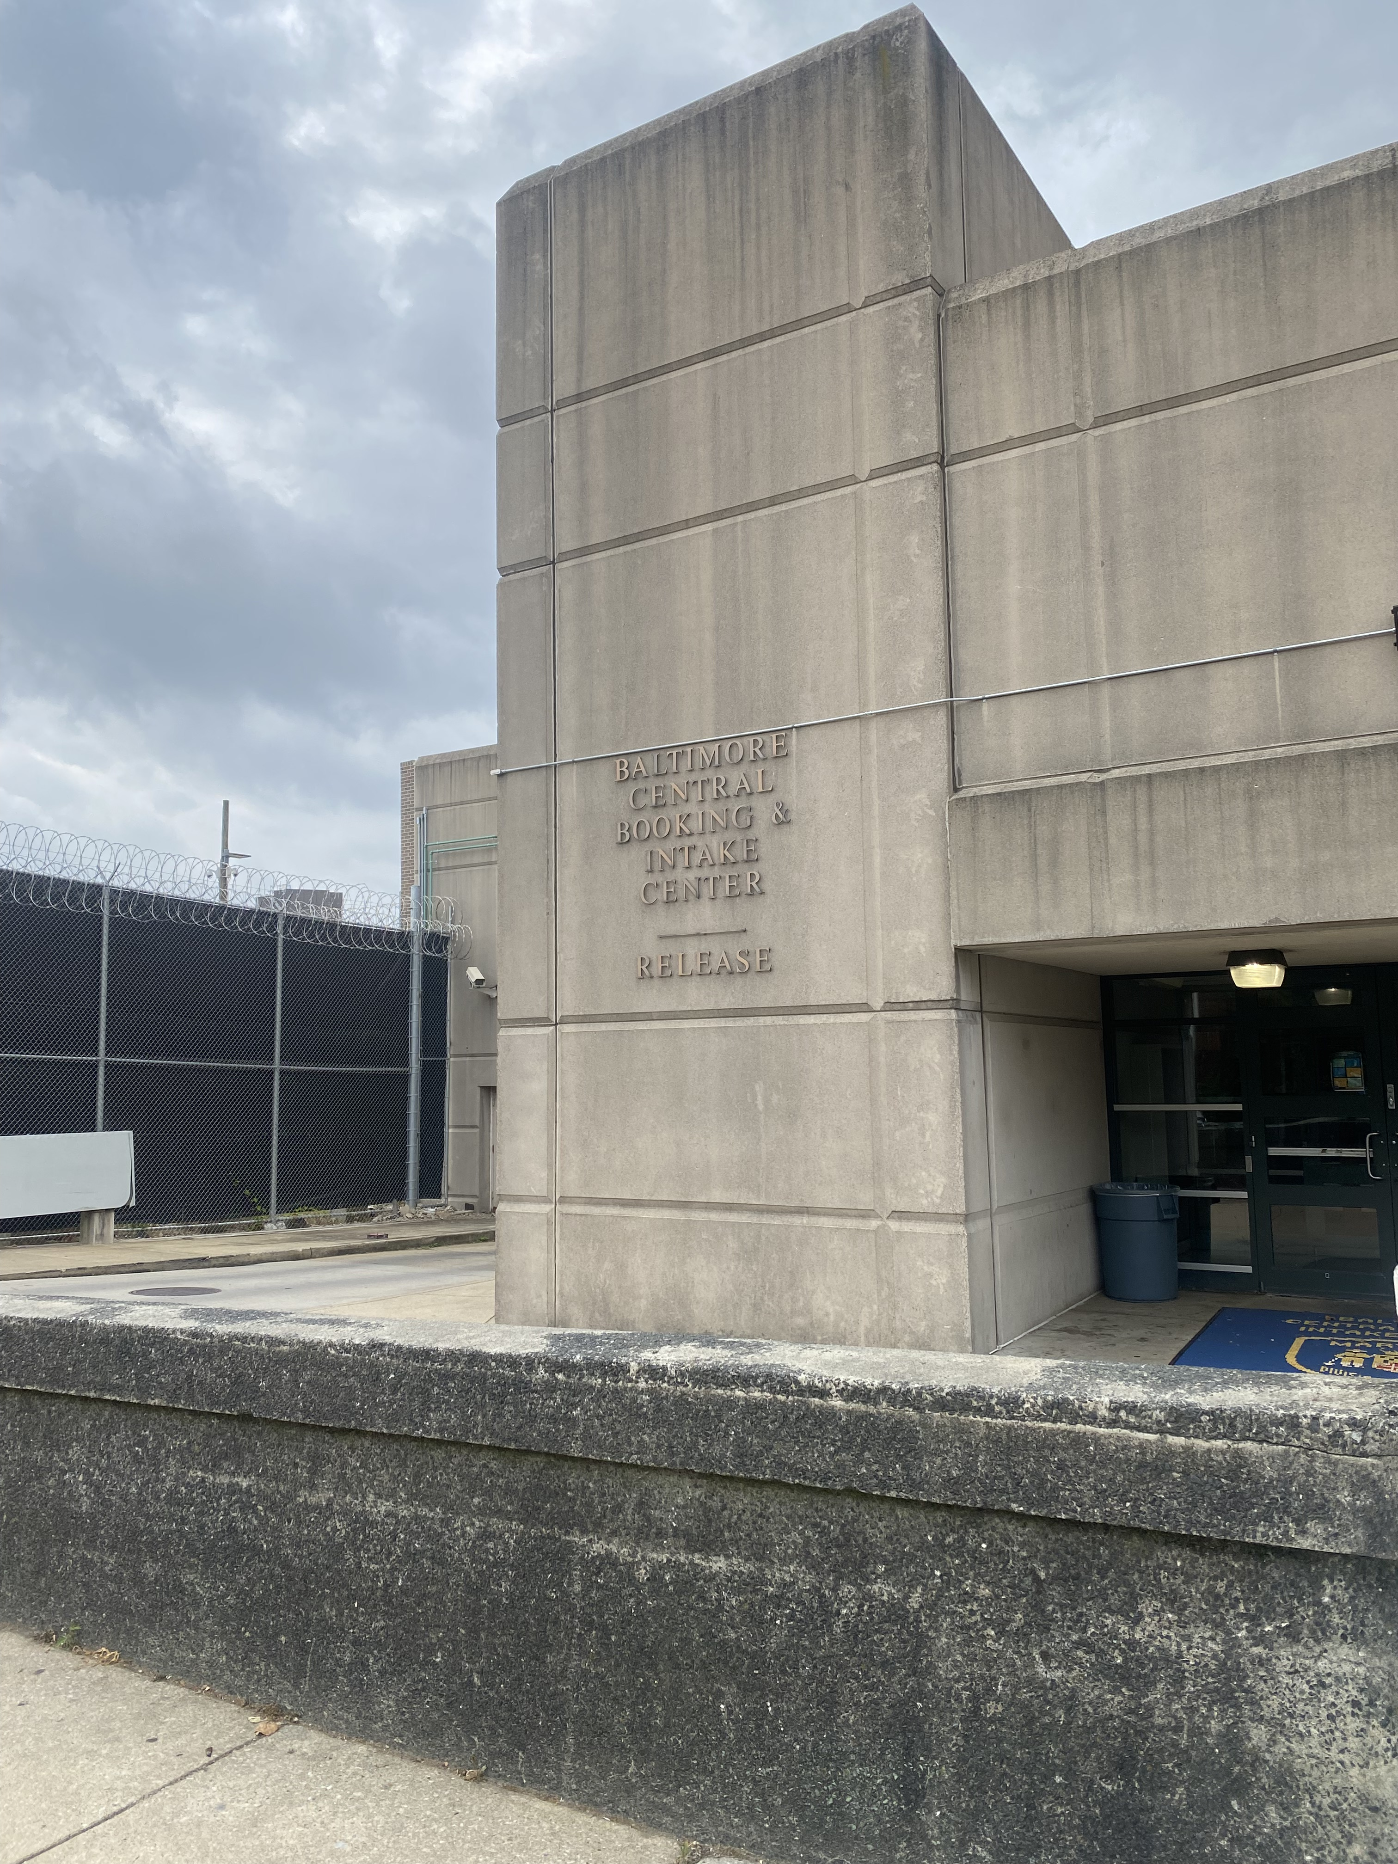
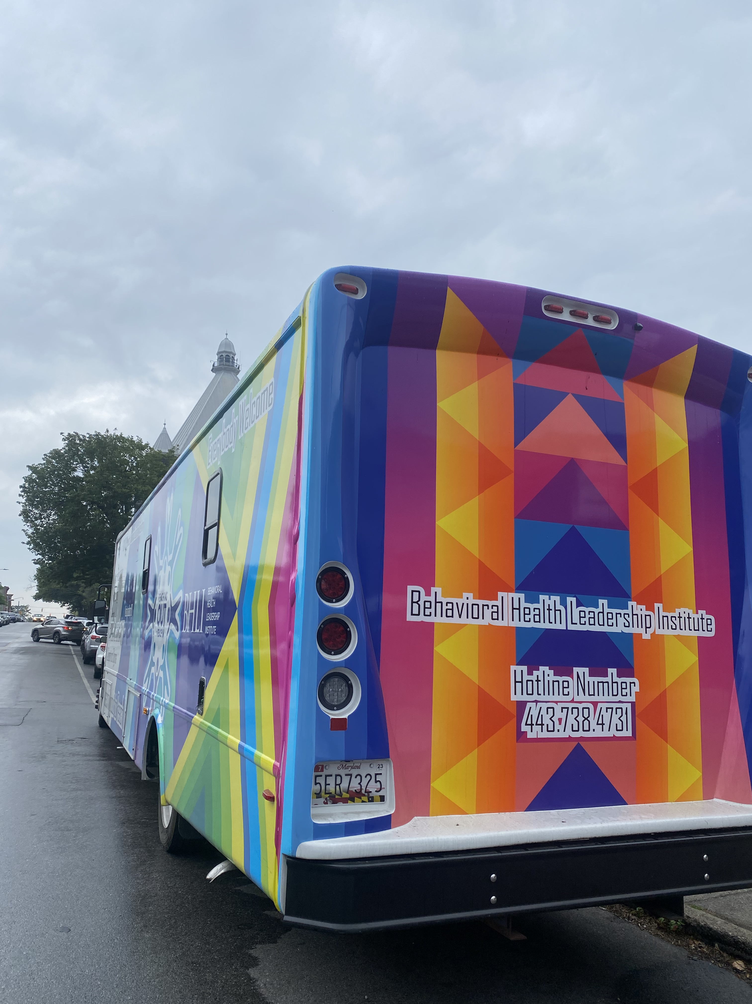
Background
The Project Connections At Re-Entry (PCARE) Van is a low-threshold buprenorphine treatment program which has operated outside the Baltimore City Detention Center since 2017.

Slide 6
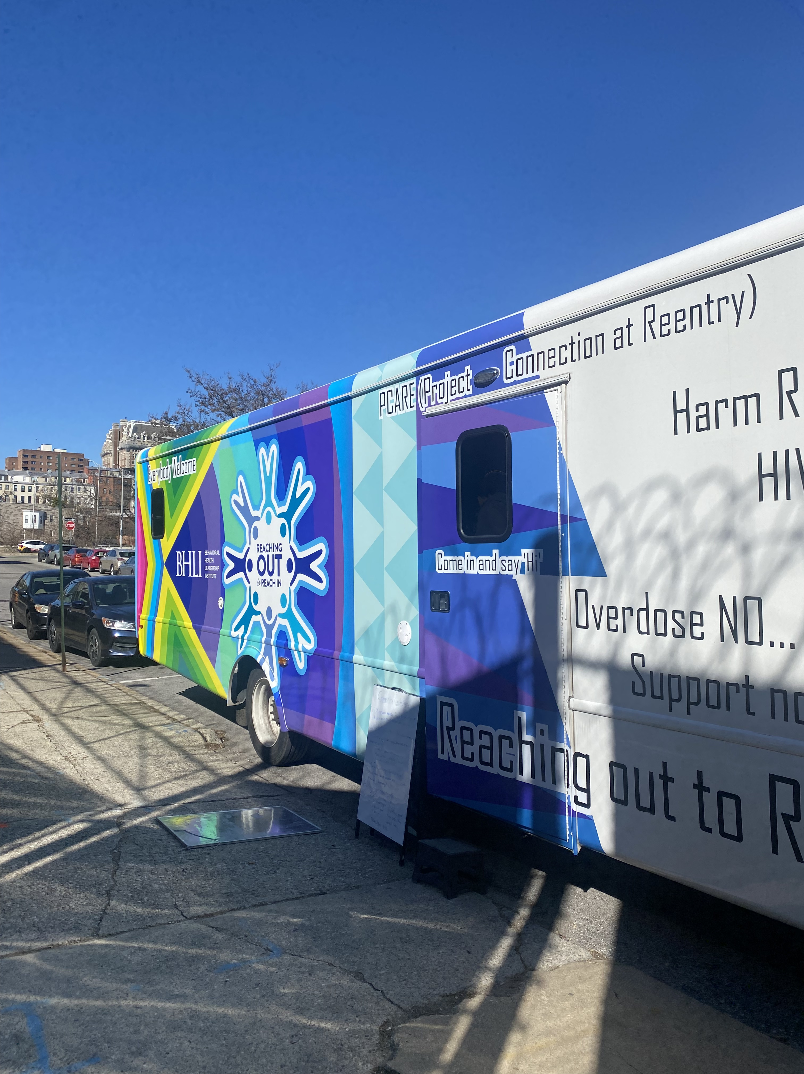
Background
Like other low-threshold programs, PCARE seeks to engage a vulnerable population in care for opioid use disorder, stabilize patients, then transition patients to longer-term treatment programs
Notes:
However, of the patients who received treatment services at the van in 2022, just 6% transitioned to clinic-based buprenorphine treatment.
Similar low-threshold programs in Seattle and Boston have reported transition rates under 30% despite also having a stated goal of transitioning patients to longitudinal clinic based care

Slide 7
Objective
To better understand low rates of transition from low-threshold to clinic-based buprenorphine care and ensure that patient perspectives guide future low-threshold program design.

Slide 8
Methods
Between December 2022 to June 2023, we conducted
20 semi-structured interviews with former and current patients of the PCARE Van, as well as 6 semi-structured interviews with van staff
We used deductive and inductive coding followed by thematic content analysis to identify themes around treatment experiences and care preferences.

Slide 9
Patient Participant Demographics
Median age 46 (range 25-74)
70% Male
90% Black
61% reported having a primary
care provider

Slide 10
Long-term preference
Nearly all patient participants stated that
if given the choice, they would stay at the van for as long as they were on buprenorphine
“When you got a good thing going, why should you transfer to a place that’ll take you off course?”

Slide 11
Low-threshold care model conveys respect for the patient
Show respect, like…even if somebody come in here high… you don’t go attack that… you still, you know, talk… not “Bye see you later”… “Let’s see how we’re going to do this differently so we could prevent that.” And that’s one thing that I see that they do here.
Notes:
And there were 3 major themes around the reason for that preference
“Respect” was defined beyond the tone and temperament of staff members, rather by the overall structure of care, defined by flexibility and nonjudgment

Slide 12
Patient preference for familiarity
I would like to stay here, because it’s where my bond I built at. So, they’re pretty much like,
the van is family to me.
You already know what’s going on there. But you don’t know, when you’re going somewhere else, how it’s going to be. Their rules and all of that.
Notes:
Second, patients described their connection with the program over time
…and not just the people but the procedures and predictability is comforting

Slide 13
Perceived harms associated with rigid or punitive care models
You send ‘em back to the wolves…
I got caught one time and you just kicked me out and you won’t even hear my side?
Notes:
Thirdly, participants described rigid rules and requirements in traditional clinic-based programs as not just dismissive of their needs, but as direct threats to their safety and survival.
One patient described a clinic kicking him out due to a positive urine drug test

Slide 14
Tensions of limited system capacity
When it's just, like, one nurse and one provider, and there’s, like, 50 people scheduled, and then all these new people crowding around, too, it's just like it turns into a mess. We had to turn away quite a few people yesterday.
Notes:
We supplemented the patient interviews with staff perspectives, and staff consistently remarked at the experience of working within such a limited resource

Slide 15
Tensions of limited system capacity
If you have Medicaid… good luck seeing the same person, having consistency, having the right kind of Medicaid… But the most immediate is [local managed care organization], and they don't seem to be doing any opioid use treatment or, really, for that matter, large-scale mental healthcare or navigation services.
Notes:
But not only was the van a limited resource – the options for partners to transition to was also limited – creating this feeling of being “stuck”
One provider described a patient trying to establish at a clinic

Slide 16
Patient altruism
Because somebody else need that spot… I understand that it is important, that somebody that really, really – I could have saved somebody’s life that day, giving them my spot.
Notes:
When asked about their perspective on the limited capacity of the van -- many respondents noted that while it wouldn’t be their preference, if the program was over capacity, they would transition to a clinic for altruistic reasons, stating that giving someone their spot could save that person’s life.

Slide 17
Low-threshold care as a reflection of system inadequacies versus individual shortcomings
“I have no problem treating patients for 3-4 years on the van if that’s what their goal is and is helpful in reducing harm… it means that they're alive.”
“I know we’re enabling them”
“Be an adult, make your appointments,
promote independence.”
Notes:
Lastly –when asked whether low-threshold care should be offered longitudinally many staff members expressed two things simultaneously
1) the traditional clinic-based treatment system is not serving our patients adequately but our program keeps people safe – let them stay
2) concern that low-threshold care “enables” them

Slide 18
Conclusions
Though most low-threshold care settings are designed as transitional bridge models, this research highlights patient preference for long-term care at low-threshold programs
This work supports framing care transitions in terms of structural context (primary care infrastructure, punitive treatment models), not just as an individual patient behaviors.

Slide 19
Future Work
1) Adapt low-threshold programs to be sustainable as longitudinal care
2) Expand harm reduction values and flexible program features across care settings
3) Consider the metrics we use to assess programmatic success
4) Acknowledge and explore the judgments about personal responsibility which emerge when discussing low-threshold care

Slide 20
Thank You!
Funding for this initiative was made possible (in part) by grant no. 5H79TI081358-04 from SAMHSA. The views expressed in written conference materials or publications and by speakers and moderators do not necessarily reflect the official policies of the Department of Health and Human Services; nor does mention of trade names, commercial practices, organizations imply endorsement by the U.S. government

Slide 21
Reactions and questions?

