Slide 1
Patients Perceptions of Physical Therapists Addressing Hazardous Drinking
Jake Magel, PT, PhD, DSc, FAAOMPT

Slide 2
Disclosures
Nothing to disclose

Slide 3
introduction

Slide 4
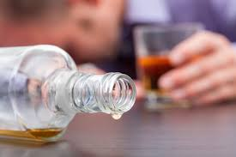
Background – Hazardous Drinking
Heavy drinking
Male >14 drinks/week or 5/day
Female > 7 drinks/week or 4/day (NIAAA)
National Survey on Drug Use and Health (2023)
62.5% consumed alcohol in past year age 12 and older
Heavy drinking
5.8%
Notes:
#1. example of sample for THA #2. duration of prostheses v. return to play after an ankle sprain

Slide 5
Heavy drinking DEI Considerations
White = 6.7%
Black = 4.7%
Native American or Alaska Native = 5.6%
Hispanic or Latino = 4.5%
Asian = 2.0%
2 or more races = 7.6%
Notes:
The Utah Legislature prevents me from even mentioning DEI in any materials at the U. But here it important to point out that …
Note that transgender may engage in grater amounts of binge drinking

Slide 6
Risks
Cardiovascular disease
Liver disease
Cancers
Accidental injury
Death
Relationship problems

Slide 7
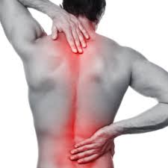
Pain and alcohol use
28% of people with chronic pain use alcohol to relieve pain (NIAAA 2024)
Binge drinking
38% may drink to relieve pain (Alford, et al 2016)
Inverse relationship between chronic pain and alcohol use (Karimi, et al 2022)
Notes:
Why amm I here as s physical therapist?
Noted that in a systematic review and metaanalysis of chhort and case control studies found that people who drink are not at increased risk for chronic pain

Slide 8
physical therapists
Physical Therapists
300 million visits per year (APTA, 2023)
Manage patients with painful conditions (Blanpied, et al 2017; Oliveria, et al, 2017)
Multiple visits (Magel, et al, 2018; Leibertz, et al, 2020)
Physical therapist develop trusting relationship with patients (Kinney, et al, 2020)
Notes:
Physical therapists are members of the health care team that manage patients in pain.
The sheer numbers of patients who attend PT make it likely that some that attend PT will consume alcohol
And that some people sefl-medicate with alcohol to control pain make it likely that PTs will come in contact with patients with hazardous dcrinking.

Slide 9
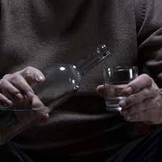
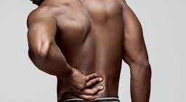
+
Notes:
Creates an opportunity for physical therapists to play a role in screening for harmful behaviors related to the use of substances.
Given that 5.8% of the population in the US drink alcohol exhibit heavy alcohol use and the nearly universal experience of pain, some of these patients will likely end up in physical therapy. whether or not their drinking is an attempt to control their pain

Slide 10
purpose
Quality improvement
Physical therapy at the University of Utah
How can physical therapists play a greater role in helping patients who may misuse
Alcohol
Opioids
Cannabis
Aim 1: Explore patients’ impressions of physical therapists addressing hazardous drinking
Aim 2: Compare the impressions of patients with and without hazardous drinking
Notes:
Creates an opportunity for physical therapists to play a role in screening for harmful behaviors related to the use of substances.
At the University of Utah, this notion caused ue to embark on a serios of QI projects

Slide 11
methods

Slide 12
Methods
Physical therapy (outpatient) clinics at University of Utah Health
7 clinics
Email invitations sent to all patients attending at least 1 outpatient physical therapy visit
12 consecutive weeks
May 30, 2022 – August 20, 2022

Slide 13
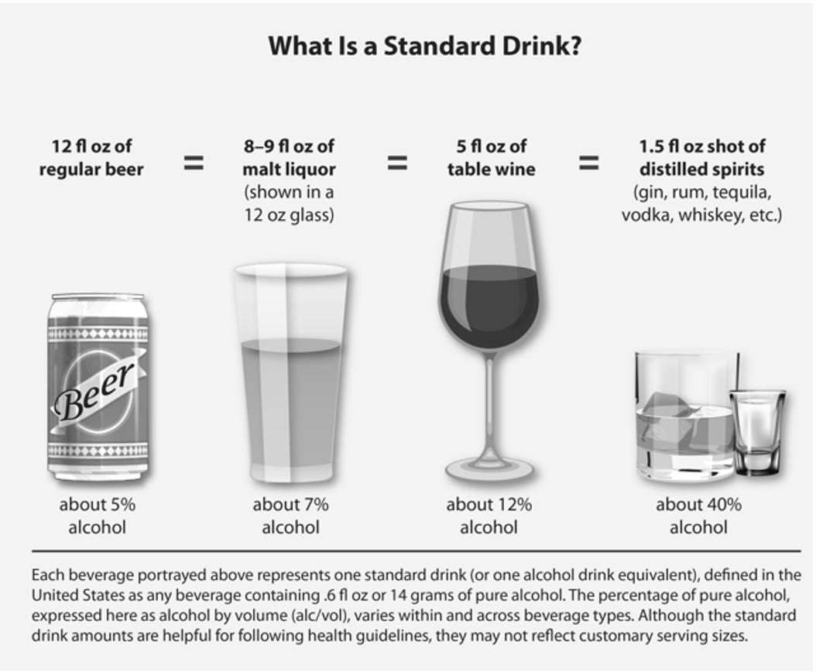
survey
Females
More than 3 alcoholic drinks during an episode of drinking or more than 7 drinks during the week
Males
More than 4 alcoholic drinks during an episode of drinking or more than 14 drinks during the week
Centers for Disease Control and Prevention, 2024
Notes:
We usesd the CDCs definiaion of hazardous dringking

Slide 14
Categorizing hazardous drinking
During the past year, I have consumed alcohol in a manner that meets the definition of hazardous drinking
During the past year, I have not consumed alcohol in a manner that meets the definition of hazardous drinking
During the past year, I have not consumed alcohol

Slide 15
Nine item survey (examples)
It is OK for physical therapists to ask their patients questions about whether they are currently engaging in hazardous drinking.
It is OK for physical therapists to ask their patients why they engage in hazardous drinking.
It is OK for physical therapists to refer their patients with hazardous drinking to a specialist to address the hazardous drinking
Notes:
These are questions that were taken from xxx. In another project we published the results of similarly worded question but focused on opioid missue.
Modified from D’Onofrio 2002 survey to assess health care providers confort in address problematic alcohol use

Slide 16
Data analysis
Descriptives
Logistic regression
Dependent Variable
Response on survey Item (i.e., It is OK for physical therapists to refer their patients with hazardous drinking to a specialist to address the alcohol misuse).
Independent variable
Have/have not engaged in hazardous drinking
Control variables
Age, gender, race

Slide 17
results

Slide 19
Table 1. Respondent Characteristics
Characteristics | All Respondents n = 585 |  | Hazardous Drinking n = 81 (13.8%) |  | No Hazardous Drinking n = 504 (86.2%)
Age, y, (sd) | 56.8 | (16.6) | 47.2 | (16.1) | 58.4 | (16.21)
Sex (Female) | 372 | (63.7%) | 46 | (56.8%) | 326 | (64.8%)
Race and Ethnicity
American Indian or Alaska Native | 10 | (1.7%) | 1 | (1.2%) | 9 | (1.8%)
Asian | 17 | (2.9%) | 2 | (2.5%) | 15 | (3.0%)
Black or African American | 4 | (0.7%) | 1 | (1.2%) | 3 | (0.6%)
Hawaiian or Other Pacific Islander | 5 | (0.9%) | 1 | (1.2%) | 4 | (0.8%)
White | 538 | (92.0%) | 76 | (93.8%) | 462 | (91.7%)
Hispanic or Latino | 24 | (4.1%) | 3 | (3.7%) | 21 | (4.2%)
Other | 5 | (0.9%) | 0 | (0.0%) | 5 | (1.0%)

Slide 20
Table 2. Results of Hazardous Drinking -Related Survey Items
Survey Items | All Respondents n = 585 |  | HD (+) n = 81 |  | HD (-) n = 504
It is OK for physical therapists to ask their patients questions to find out if they have engaged in hazardous drinking in the past. | 5.2 | (2.1) | 4.7 | (2.0) | 5.3 | (2.1)
It is OK for physical therapists to ask their patients questions about whether they are currently engaging in hazardous drinking. | 5.3 | (2.0) | 4.9 | (2.0) | 5.4 | (2.0)
It is OK for physical therapists to use questionnaires to determine if their patients are engaged in hazardous drinking. | 5.3 | (2.0) | 4.8 | (2.1) | 5.4 | (2.0)
It is OK for physical therapists to ask their patients why they engage in hazardous drinking. | 4.6 | (2.2) | 4.2 | (2.0) | 4.7 | (2.3)
It is OK for physical therapists to ask their patients about the frequency of their hazardous drinking. | 5.2 | (2.1) | 4.8 | (2.1) | 5.3 | (2.0)
It is OK for physical therapists to assess their patient’s readiness to change their hazardous drinking behaviors. | 4.8 | (2.2) | 4.3 | (2.2) | 4.8 | (2.2)
It is OK for physical therapists to discuss/advise their patients to change their hazardous drinking behaviors. | 4.9 | (2.2) | 4.4 | (2.1) | 4.9 | (2.2)
It is OK for physical therapists to refer their patients with hazardous drinking to a specialist to address the alcohol misuse. | 5.2 | (2.2) | 4.7 | (2.3) | 5.3 | (2.1
If the physical therapist asked me about hazardous drinking, regardless of whether I was engaging in hazardous drinking, I would answer truthfully. | 6.1 | (1.6) | 5.8 | (1.6) | 6.1 | (1.6)

Slide 21
Logistic regression
After controlling for age, sex, race
Compared to patients without hazardous drinking
Patients with hazardous drinking had less favorable perceptions of physical therapists addressing patients with hazardous drinking
Exception “telling the truth”
Variable | It is OK for physical therapists to ask their patients why they engage in hazardous drinking. n = 577
 | β (95% CI) |  | P
Hazardous drinking | -0.62 | (-1.16 to -0.08) | .03*
Age | 0.01 | -0.02 to 0.00) | .13
Gender | 0.20 | (-0.17 to 0.56) | .29
Race | 0.11 | -0.57 to 0.78) | .76
Variable | It is OK for physical therapists to refer their patients with hazardous drinking to a specialist to address the alcohol misuse. n = 573
 | β (95% CI) |  | P
Hazardous Drinking | -0.83 | (-1.34 to -0.31) | .002*
Age | -0.02 | (-0.03 to -0.01) | <.001*
Gender | 0.19 | (-0.16 to 0.53) | .296
Race | -0.02 | (-0.66 to 0.63) | .961

Slide 22
Conclusion/discussion

Slide 23
Conclusion/discussion
Single health care system in Utah
Biased sample
Will physical therapists agree to be trained
How to have conversations about alcohol
SBIRT
Will physical therapists feel that it is part of their job
Notes:
Not meant to be generalizable
Cancer: Increases the risk of cancer in the mouth, throat, larynx, esophagus, breast, liver, and bowel
Heart disease: Binge drinking can increase the risk of heart disease by 68% for women
Liver disease: A chronic disease that can develop from excessive alcohol consumption
Stroke: A serious health problem that can develop from excessive alcohol consumption
Alcohol use disorder: A condition that affects both mental and physical health
Weakened immune system: Increases the chances of getting sick
Mental health conditions: Can lead to depression, anxiety, and other mental health conditions
Memory problems: Can lead to dementia and short-term memory loss
Learning problems: Can cause issues at school or work
Relationship problems: Can strain relationships with family and friends
Pancreatitis: Inflammation of the pancreas that can cause abdominal pain and serious complications
High blood pressure: Binge drinking can cause long-term rises in blood pressure
Excessive alcohol consumption can also lead to short-term effects such as injuries, violence, alcohol poisoning, and overdose.

Slide 24
Next steps
Develop a training program for physical therapists to screen and address hazardous drinking
Already developed
Training program for opioid misuse

Slide 25
Acknowledgments
Paul Hartman, PT, DPT
Adam Gordon, MD, MPH, FACP, DFASAM

Slide 26
QUESTIONS

