Slide 1
Patterns of Opioid Misuse and Related Clinical Signs among Veterans with Subsyndromal Opioid Use Disorder: A Latent Class Analysis
Jayden Henneman, BA; Colin Macleod, MA; Kyle Kumbier, MS; Jeremy Sussman, MD, MSc; Victoria Powell, MD; Mary Jarzebowski, MD; Amy Bohnert, PhD, MHS; Pooja Lagisetty, MD, MSc

Slide 2
Conflicts of Interest
The study team currently receives funding from the Veterans Health Administration (VHA), NIH, CDC, SAMHSA, and the Michigan Health Endowment Fund
The project was funded by the VHA
The study team has no personal conflicts of interest to disclose
The views of the study team do not reflect the views of the University of Michigan or Michigan Medicine

Slide 3
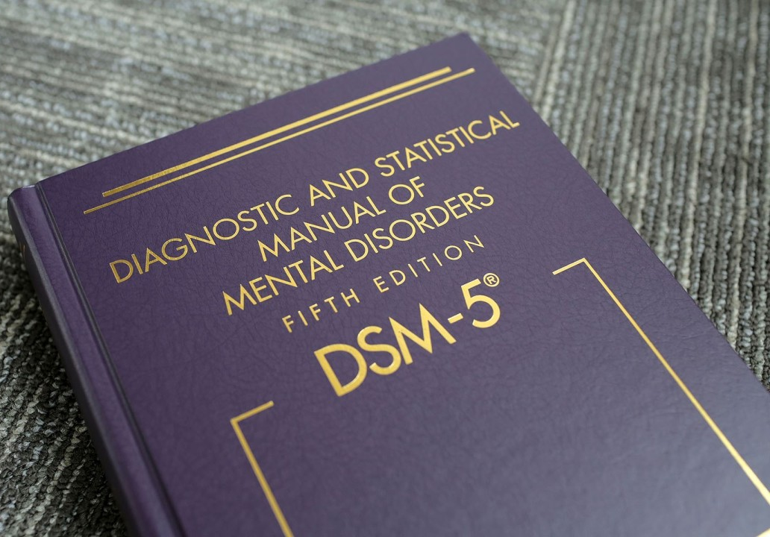
Background
An estimated 14 million U.S. adults are on long-term opioid therapy (LTOT) for chronic pain (defined as being on opioids at least 3 months)^{1,2}
Many LTOT patients eventually stop seeing improvements in pain or functioning, but struggle to taper even when risks outweigh benefits^{3,4}
Clinically concerning, but not true opioid use disorder (OUD) as defined by the DSM-V – do not meet 2-3 criteria (out of 9 possible), may be unclear if they meet criteria
These patients do not fit into an existing diagnostic category: diagnostic “gray zone”
Sources:
1. Mojtabai R. National trends in long-term use of prescription opioids.
2. Ogunwole S, Rabe M, Roberts A, Caplan Z. Population Under Age 18 Declined Last Decade.
3. Manhapra and Becker 2018. “Pain and Addiction: An Integrative Therapeutic Approach.
4. Edmond et al., 2023. “Delphi study to explore a new diagnosis for ‘ineffective’ long-term opioid therapy…”
Notes:
“Gray zone” – harms are exceeding benefits (worsening pain and function, difficulty tapering), but they do not clearly meet criteria for opioid use disorder. It’s ambiguous which DSM-V criteria they do meet. Is “use for longer than intended” from the provider or patient perspective? For “unsuccessful efforts to cut down use,” does it truly make sense to conceptualize patients who have trouble tapering as meeting criteria for a substance use disorder?
For treatment, an opioid partial agonist such as buprenorphine may be helpful in these patients… however, many buprenorphine formulations are only approved for OUD.
For patients taking opioids as prescribed, it is unclear when certain DSM-V opioid use disorder (OUD) criteria apply
“Use for longer than intended”
“Unsuccessful efforts to cut down use”

Slide 4
Background
Because these patients are not clearly described by existing diagnostic labels, their characteristics, prognosis, and treatment needs have not been well studied⁵
Prior expert panel suggested 18 criteria for a new diagnosis for these patients – not yet widely adopted⁴
For this study, we collectively describe patients on LTOT for chronic pain as “subsyndromal OUD” patients
Sources:
4. Edmond et al., 2023. “Delphi study to explore a new diagnosis for ‘ineffective’ long-term opioid therapy…”
5. Becker 2023. “When harms outweigh benefits of long-term opioid therapy for pain: Need for a new diagnostic entity…”
Notes:
Study Objective: to identify classes among subsyndromal OUD patients in order to more clearly characterize “gray zone” patients for whom risks likely outweigh benefits.

Slide 5
Study Objective
To identify classes of subsyndromal OUD patients – to more clearly characterize “gray zone” patients for whom risks likely outweigh benefits.
“Subsyndromal OUD” defined as meeting 3 or fewer DSM-V criteria for OUD
Examined predictors of classes
Examined pain and mental and behavioral health outcomes in each class
Notes:
Study Objective: to identify classes among subsyndromal OUD patients in order to more clearly characterize “gray zone” patients for whom risks likely outweigh benefits.

Slide 6
Methods: Overview
Data collection: Patient medical chart review
Analysis: Latent Class Analysis
Descriptive Statistics, Logistic Regression

Slide 7
Methods: Data Collection (Medical Chart Review)
Identified Veterans in the national VHA electronic medical record with chronic pain on long-term opioid therapy (LTOT)
LTOT: ≥15 MEDD for ≥84 of 90 days before diagnosis
Defined diagnosis date as the first date on which an ICD-9 or ICD-10 code for opioid use, abuse, or dependence was entered
Entry of any of these codes often indicates that clinicians are concerned about patients’ opioid use
More data on patients’ opioid use patterns is available when these codes first appear
Notes:
Outcomes – captured outcomes relevant to pain management and mental and behavioral health.

Slide 8
Methods: Data Collection (Medical Chart Review)
Peri-diagnosis, risk factors: captured DSM-V OUD criteria + other potential signs of opioid misuse
“Peri-diagnosis:” 1 month prior to and 2 weeks following diagnosis
Included patients met ≤3 DSM-V criteria for OUD
Other misuse signs: aberrant urine drug screens, other substance use, hospitalizations/ED/urgent care visits relating to pain or opioid use, etc.
12 months following diagnosis, outcomes: pain and mental and behavioral health outcomes (e.g., uncontrolled pain, insomnia, worsened opioid use disorder, worsened substance use disorder, anxiety, depression)
Notes:
9 total DSM-V criteria; potential signs included aberrant urine drug screens, simultaneous prescribing of other psychoactive medications, non-prescribed substance use, and opioid overdose.

Slide 9
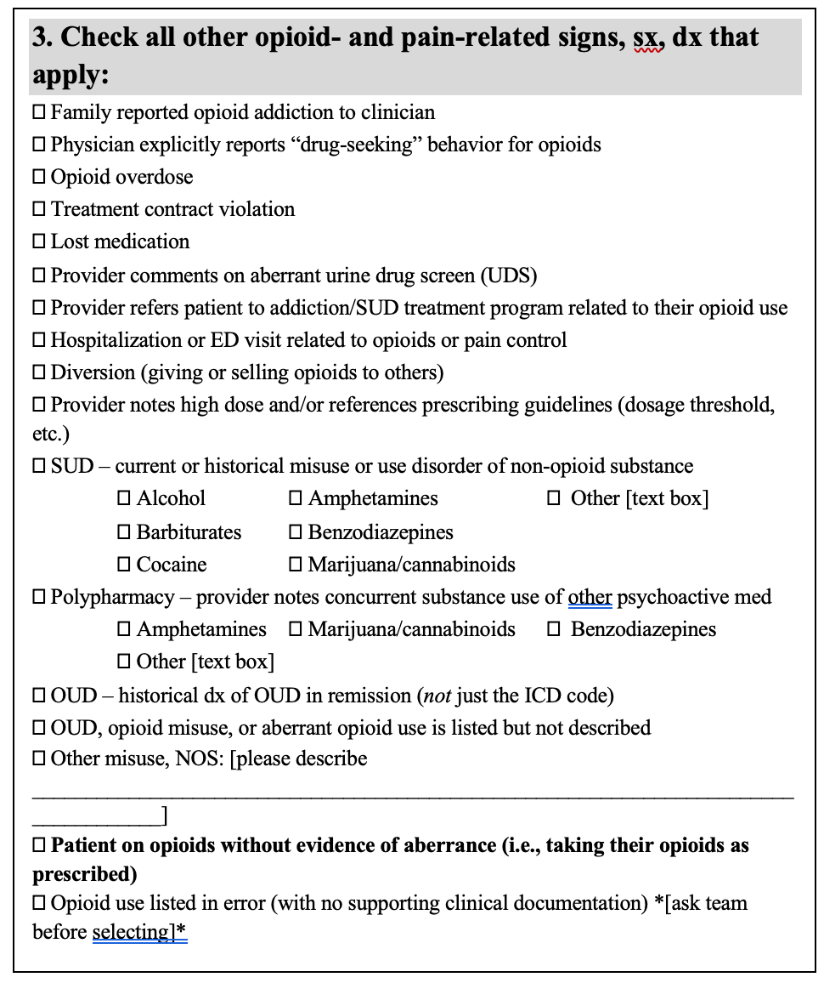
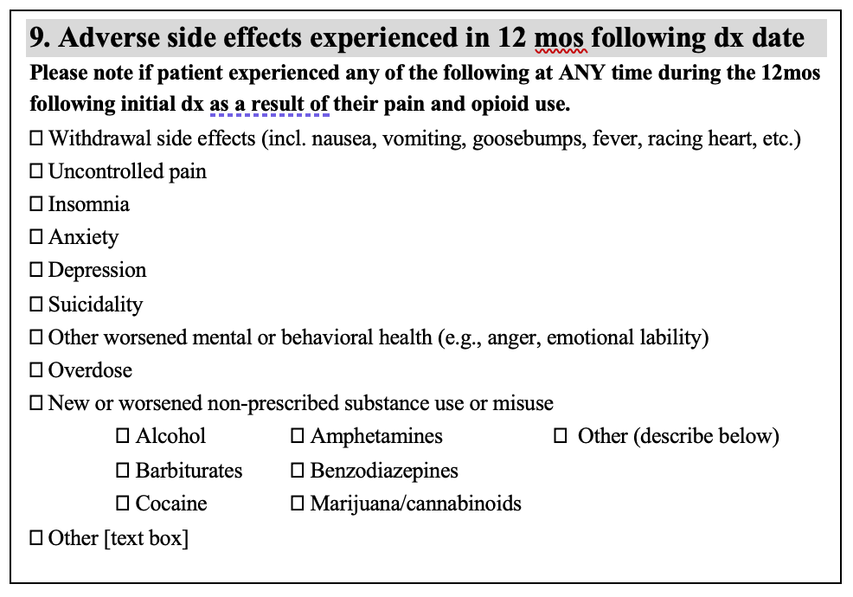

Slide 10
Methods: Analysis
Latent Class Analysis
Peri-diagnosis risk factors/signs of misuse used as indicator variables (i.e., used to define the classes)
Descriptive Statistics
% of patients with specific adverse pain and mental and behavioral health outcomes
Logistic Regression
Predictors of membership in each class

Slide 11
Results: Study Sample
615 U.S. Veterans
Mean age: 58 (SD:12)
91% male
79% White, 12% Black
Average opioid dose:
90 MEDD (SD: 97)
Total patient records abstracted
(n=868)
Excluded for moderate-to-severe OUD
(n=253)
Patients included in study (n=615)
Notes:
Expected demographics for an older U.S. Veteran population.
27% were concurrently prescribed benzodiazepines

Slide 12
Results: Latent Class Analysis (2 Classes)
Classes
Class 1 (36.7%)
Class 2 (63.3%)
Class 1, more opioid use risk factors (36.7%)
Class 2, fewer risk factors (63.3%)
Great deal of time spent using, obtaining, or recovering from use
Opioids used in larger amounts or for a longer period of time than intended
Withdrawal
Hospitalization, ED, or urgent care visit
Non-opioid SUD
Non-opioid substance use disorder (SUD)
Prescriptions for other psychoactive medications (e.g., antidepressants, anxiety medications)
Notes:
Peri-diagnosis risk factors and signs of misuse were used as indicator variables (x-axis).
Great deal of time spent obtaining/using/recovering from use
Use of more than intended
Withdrawal
Hospitalization, ED, or urgent care visit related to opioid control or pain
Substance use history of a non-prescribed substance

Slide 13
Results: Predictors of Class Membership
Predictors of membership in Class 1 (higher risk factor group)
Class 1 tended to include individuals with
Younger age
Homeless/unhoused
Common mental health disorders
Non-opioid substance use disorder
Notes:
Common Mental Health Disorders: 3 most common in Veterans not including substance use disorder: PTSD, major depressive disorder, and generalized anxiety disorder

Slide 14
Results: Adverse Outcomes within Classes
Adverse Outcome | Class 1, N (%) | Class 2, N (%) | p-value | Adjusted p-value
Withdrawal | 82 (37.3%) | 64 (16.2%) | 0*** | 0***
New or worsened anxiety | 47 (21.4%) | 37 (9.4%) | 0*** | 0.001**
New or worsened SUD | 63 (28.6%) | 50 (12.7%) | 0*** | 0***
New or worsened OUD | 82 (37.3%) | 70 (17.7%) | 0*** | 0***
Suicidality | 27 (12.3%) | 20 (5.1%) | 0.002** | 0.016*
Uncontrolled pain | 161 (73.2%) | 264 (66.8%) | 0.122 | 0.243
Insomnia | 87 (39.6%) | 140 (35.4%) | 0.338 | 0.338
Depression | 47 (21.4%) | 53 (13.4%) | 0.012* | 0.061`
Worsened mental or behavioral health | 42 (19.1%) | 47 (11.9%) | 0.017* | 0.068`
Overdose | 10 (4.6%) | 7 (1.8%) | 0.069` | 0.207
Other adverse outcome | 50 (22.7%) | 55 (13.9%) | 0.007** | 0.043*
Notes:
Adverse outcomes in the 12 months following diagnosis.
P-values adjusted using Holm correction.

Slide 15
Study Limitations
Did not look at how different treatments impact class outcomes (e.g., continuing same opioid dose, taper, rotation to buprenorphine)
Generalizability
Sample limitations: lack of racial and gender diversity

Slide 16
Discussion and Future Work
Class 1 (group with more risk factors) had significantly worse outcomes than Class 2
Our study’s data-driven approach to “gray zone” patients was concordant with experts’ clinical observations of this group in prior expert panel
Notable overlap between Class 1 characteristics and the 18 criteria proposed by the Delphi panel to identify “gray zone” patients (e.g., withdrawal, some misuse without a regular pattern, LTOT is ineffective at managing pain)⁴
Sources:
4. Edmond et al., 2023. “Delphi study to explore a new diagnosis for ‘ineffective’ long-term opioid therapy…”

Slide 17
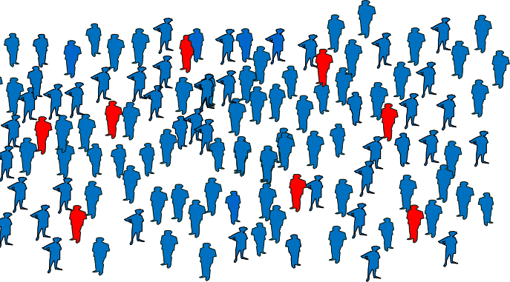
Discussion and Future Work
Future directions:
Prevalence studies – estimating how many people nationally fall into this higher risk group that is on opioids, but does not meet opioid use disorder criteria
Examine whether higher risk of adverse outcomes in Class 1 can be mitigated with specific treatment management
Notes:
Prevalence studies – define the scope of the problem. How many patients fall into this group that has approximately twice the risk of experiencing withdrawal, new or worsened anxiety, new or worsened SUD, and new or worsened OUD?

Slide 18
Sources
1. Mojtabai R. National trends in long-term use of prescription opioids. Pharmacoepidemiology and Drug Safety. 2018;27(5):526-534. doi:10.1002/pds.4278
2. Ogunwole S, Rabe M, Roberts A, Caplan Z. Population Under Age 18 Declined Last Decade. Census.gov. Accessed November 12, 2024. https://www.census.gov/library/stories/2021/08/united-states-adult-population-grew-faster-than-nations-total-population-from-2010-to-2020.html
3. Manhapra A, Becker WC. Pain and Addiction: An Integrative Therapeutic Approach. Med Clin North Am. 2018;102(4):745-763. doi:10.1016/j.mcna.2018.02.013
4. Edmond SN, Snow JL, Pomeranz J, et al. Delphi study to explore a new diagnosis for “ineffective” long-term opioid therapy for chronic pain. Pain. 2023;164(4):870-876. doi:10.1097/j.pain.0000000000002783
5. Becker WC, Frank JW, Edmond SN, Starrels JL. When harms outweigh benefits of long-term opioid therapy for pain: Need for a new diagnostic entity, research and improved treatments. Addiction. 2024;119(1):4-5. doi:10.1111/add.16348

