Slide 1
Peer Led Substance Use Disorder Navigation to Support Reentry for Returning Citizens
Nicole O’Donnell, BA, CRS
Jeanmarie Perrone, MD, FACMT
Jasmine Barnes, MPH
Gilly Gehri, BS
AMERSA Annual Meeting, 2024

Slide 2
Disclosures
I have no potential conflicts of interest to disclose

Slide 3
Learning Objective
Explore the impact of a collaborative initiative between a peer-led telehealth program with a carceral system in establishing a safety net for individuals initiated on buprenorphine and transitioning from incarceration to the community

Slide 4
Current State
Those leaving incarceration without MOUD are at 40X higher risk of fatal overdose within two weeks in comparison to the general population
Black and Latinx people are overrepresented within the carceral system, more likely to have their treatment interrupted by incarceration and less likely to be offered MOUD.
In 2023, 456 individuals with SUD were released from incarceration to the 5 zip codes surrounding our health system
2023= 160 post release calls
Forced withdrawal discourages engagement in community treatment, increases the risk for substance use during incarceration, and increases the risk of death after discharge
Sources: Brinkley-Rubinstein et al., 2018; Moore et al., 2018; Rich et al., 2015
Notes:
Would it be helpful to also add the number of returning citizens to our community and the number we are missing and the need for all of this service?

Slide 5
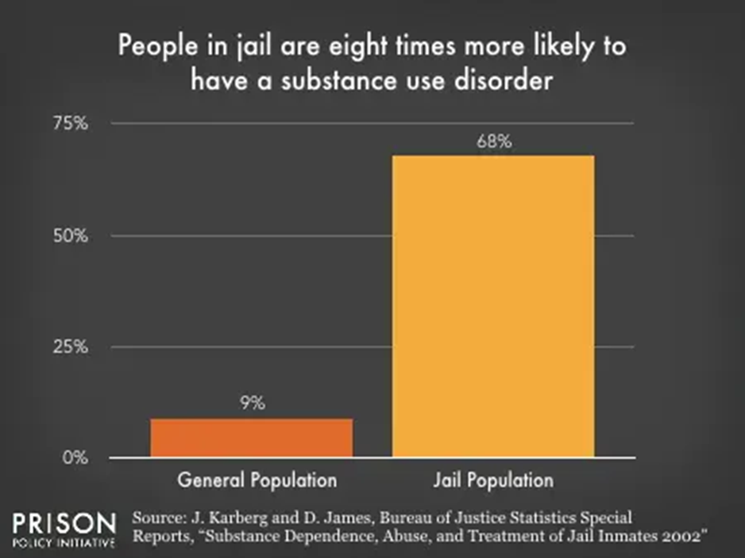
Substance Use Disorder in Incarcerated Persons (IP)
Source: Prisonpolicy.org
Notes:
Can you get the original slide instead of cutting and pasting someone else’s presentation?– although this one is not as problematic as the next one which should definitely be changed.

Slide 6
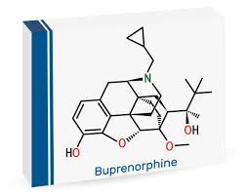
Local Barriers Which Result in No Bupe
History of diversion while previously incarcerated – while currently incarcerated
Released from court—no bupe
Bailed out—no bupe

Slide 7
Case Example
29Y M in recovery for 2 years released from jail with 0 days of medication. On house arrest and does not have a confirmed follow up appointment to continue MOUD, no transportation, or co pay. He is also required to provide 7 days written notice to probation officer to attend any appointments.
What should he do?

Slide 8
Solutions

Slide 9
Reentry Partnership
Notes:
Talk about addiction med doc inside and warmhandoff to team

Slide 10
CareConnect Warmline
Available to patients, providers, family members
Same day access to telehealth buprenorphine
New starts or continuation of treatment
Short-term case management (ID, transportation, etc.)
Support navigating to other services (methadone, wound care)
Tailored referral to longitudinal treatment
Staffed by a group of trained, compassionate professionals (SUNs and CRSs)
Notes:
Peers!!

Slide 11
Peer Support Safety-Net Services Provided:
HR Counseling and Supplies
Housing Resources
Shelter Referrals
Transportation
Insurance Navigation
Pharmacy Assistance
PCP Referrals
Mental Health Resources
ID Assistance
Telephone Assistance
Peer Support
Notes:
Peers!

Slide 15
Case Example Outcome
He contacts Warmline to receive buprenorphine. Warmline peer staff support him in scheduling an appointment for MOUD care, providing documentation to PO, and prescribing medication to last until appointment. He is able to continue his medication and is now connected with a PCP to address chronic health issues.

Slide 16
Summary
The incarcerated population has a high rate of substance use history and unmet treatment needs
MOUD in carceral settings can mitigate other challenges and should be expanded and supported
Transitions to and from incarceration need amplified opportunities for warm handoffs, care coordination and support

Slide 17
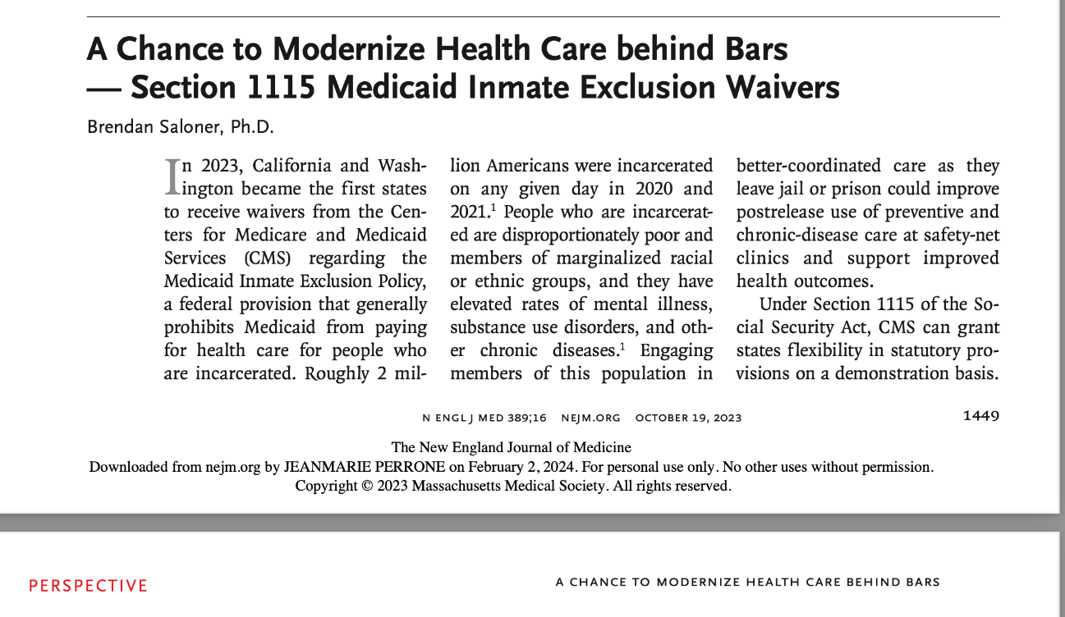
Future State
Community Liaison to enhance warm hand-offs
Comprehensive care for incarcerated individuals
Safety net access to address social determinants of health
Access to resources immediately upon release
Increase the amount of patients referred to the CareConnect Warmline.
An auto enroll opt out model as opposed to an opt in model to facilitate more inclusivity

Slide 18
Contacts & Resources
Jeanmarie Perrone, MD, FACMT
jeanmarie.perrone@pennmedicine.upenn.edu
Nicole O’Donnell, CRS
Nicole.o’donnell@pennmedicine.upenn.edu
Jasmine Barnes
Jasmine.barnes@pennmedicine.upenn.edu
Gilly Gehri
Gilly.Gehri@pennmedicine.upenn.edu
www.penncamp.org

