Slide 1
Peer Recovery Coach as an Intervention for Incarcerated Individuals with Opioid Use Disorder (OUD): Perceptions from Staff
Elizabeth Haberkorn, DNP, FNP-BC, Ken Lemons, Whitney Ludwig, MPH, Chin Hwa (Gina) Dahlem, PhD, FNP-C, FAANP
Notes:
‹#›

Slide 2
No conflict of interest or disclosures to declare
Notes:
‹#›

Slide 3
Introduction
2.7 million people in the United States suffered from an OUD in 2021 ¹
>80,000 deaths from opioid overdoses ¹
Projected cost: 504 billion dollars ²
Positive correlation between the likelihood of criminal justice involvement by increasing severity of OUD ³
62% met the criteria for drug abuse or dependence ⁴
40-fold increase in overdose deaths in the two weeks following release ⁵
Need for more opportunities for treatment to reduce the impact of OUD and prevent opioid overdose deaths
Notes:
There's a positive correlation between the likelihood of criminal justice involvement by increasing severity of OUD
40% of incarcerated individuals, who were serving sentences associated with property offenses, committed crimes to maintain their drug habit
40-fold increase in opioid overdose deaths in the two weeks directly following one’s release from prison. The risk of overdose is higher, in part, because of a lack of resources and treatment options provided to individuals immediately released from incarceration
Despite this, in 2019 SAMHSA reported in only 30 of the 5,100 prisons and jails in the United States offer treatment to currently incarcerated people
While MOUD is the mainstays for medical treatment; counseling, peer support, recovery coaches and mentors can play an integral role in influencing how a person who struggles with OUD maintains their sobriety.
‹#›

Slide 4
Problem Statement
Given the lack of support experienced by many currently incarcerated and recently released from prisons and jails, the addition of peer support could provide the direction and tools necessary for recovery and sobriety after incarceration.
Generative, longitudinal peer support interactions can provide sustainable solutions that affect the health of this population, recidivism rates, and overall cost to the public.
Notes:
Peer recovery caoches are frequently employed in emergency departments, homeless shelters, behavioral health, and primary care clinics
Given the lack of support experienced by many currently incarcerated and recently released from prisons and jails, the addition of peer support provides the direction and tools necessary for recovery and sobriety after incarceration.
‹#›

Slide 5
Purpose and Objectives
The purpose is to evaluate and measure the experiences and impacts of a peer support program through the Greater Flint Health Coalition (GFHC) Reach.Inspire.Serve.Empower. (RISE) initiative on Genesee County inmates with OUD.
Project objectives include:
Identify barriers and facilitators to implementation, using semi-structured interviews of RISE stakeholders
Provide a set of recommendations to improve RISE processes
Notes:
The purpose of this project is to evaluate and measure the experiences and impacts of stakeholders of a peer support program for inmates with OUD. Overall, this included collecting perspectives of key stakeholders and staff members of the program to provide further insight into program evaluation.
Eval includes:
identify barriers and facilitators to implementation
Provide a set of recommendations to improve RISE processes.
‹#›

Slide 6
Project Description
Setting
Participants
RISE Overview
Notes:
The population of interest was non-pregnant adults experiencing incarceration and opioid use disorder at Genesee County Jail (GCJ) in FLint, MI. Genesee County, fifth-most populous county in Michigan, has a population estimate of 401,983 in 2022, estimated 16.3 percent of persons in poverty
Opioid overdose deaths in Flint and Genesee County increased by 31% from 2013 to 2015 .
GCJ has a maximum capacity of 580 inmates, but frequently surpasses capacity with daily populations of 620 inmates
Prior to the initiation of RISE, no peer support services were available and inmates receive minimal substance use treatment or support while incarcerated. In the jail, medical and social work staff members are absorbed by crisis intervention and immediate medical concerns. Stakeholders involved in the project include managers, directors, and staff of GFHC, members of the Genesee County Sheriff’s Office including medical and social work staff, and community partners such as Genesee Health System, Reach the Forgotten Jail Ministries, and New Paths Inc..
GFHC is a 501(c)3 designated non-profit organization, established in the early 1990s. GFHC works in conjunction with many community partners with the mission of improving the quality of life and health of community residents, while lowering health care costs.
The RISE program began with a partnership with the Genesee County Sherriff’s Office, Genesee Health System, and New Paths, Inc to address mental health support, social determinants of health, and embedded PRC within the GCJ.
‹#›

Slide 7
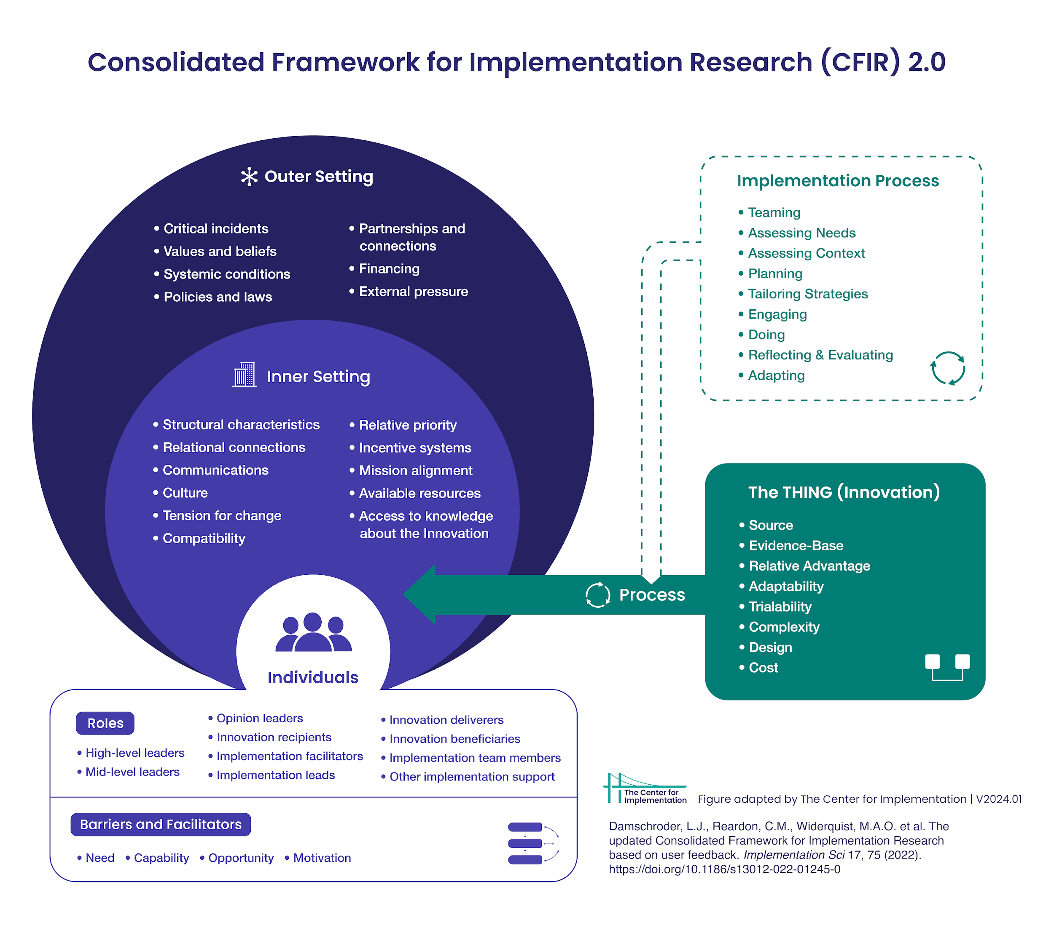
Framework
The Consolidated Framework for Implementation Research (CFIR)
Focused evaluation with concurrent assessment of implementation
Allowance for ongoing adaptation
Notes:
The Consolidated Framework for Implementation Research (CFIR) provided a set of constructs and domains that are used to identify barriers and facilitators to implementation
The CFIR Framework project as it allowed for a focused evaluation with concurrent assessment of implementation and the allowance for ongoing adaptation.
‹#›

Slide 8
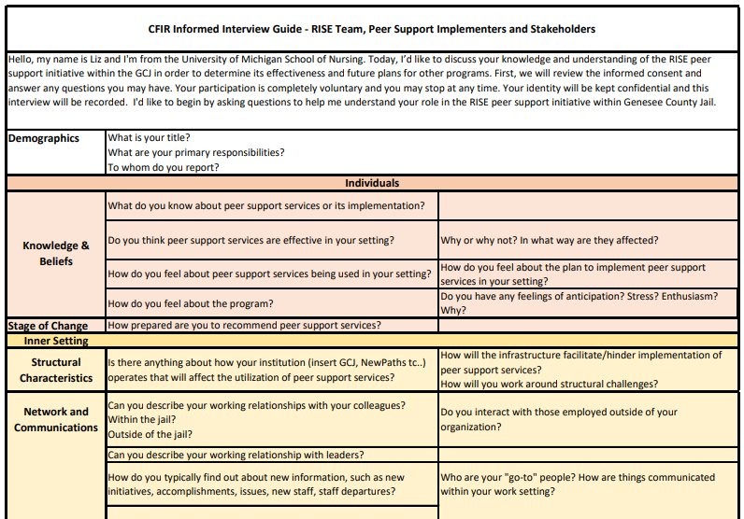
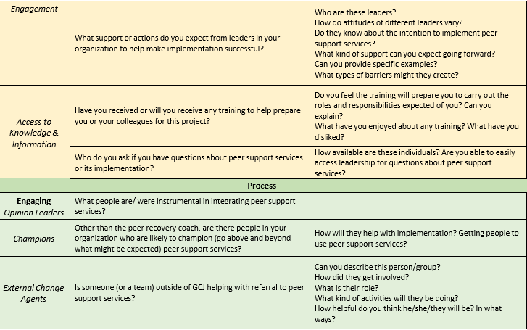
Project Description cont'd
Timeline - May 2023 – February 2024
Intervention/ Methodology of Evaluation
Semi-structed qualitative interviews under the CFIR framework interview guide
Measures/ Analysis
Interviews recorded and coded - CFIR rapid qualitative analysis
Secondary analyst verified
Themes and patterns emerged using inductive and deductive approaches
Notes:
Timeline
The project began in May 2023 with introductions to stakeholders and tours of GFHC, New Paths, and GCJ. Shadowing experience continued through the Fall of 2023. The RISE PRC program was officially introduced in GCJ in September 2023.
Recruitment for interviews began in January 2024 with the conclusion of interviews in February 2024.
Intervention/ Methodology of Evaluation
The evaluation of the PRC programming within RISE was implemented using semi-structed qualitative interviews under the CFIR framework interview guide
EXAMPLE: Snipit of Interview Guide tool I developed under CFIR framework
Measures/ Analysis
In the CFIR rapid qualitative analysis approach, notes were recorded and directly coded following the interview.
A secondary analyst then verified the coding via audio recordings and transcripts of the interview.
. Themes and patterns were structured based on coded data.
‹#›

Slide 9
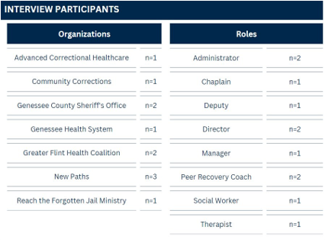
Results
Notes:
Eleven interviews were conducted with RISE stakeholders across six organizations.
Table 2 provides the characteristics of the participant roles and their organizations.
‹#›

Slide 10
Intervention Characteristics
Barriers
Grant funding
Physical restrictions of correction setting
Facilitator
Leadership commitment to secure future funding
Notes:
Domain 1: Intervention Characteristics
Barrier: Grant Funding. At this time, the RISE program is primarily funded by grant dollars with a set duration of funding.
Barrier: Physical restrictions of correction setting. The Genesse County jail setting is physically restrictive as it was not designed for programming like PRC interactions. At times, space is limited for all available programming and contacting recipients around programming, court appearances, codes, and lockdowns can be difficult.
Facilitator: Leadership commitment to secure future funding. Despite the program being grant funded, there is sufficient positive feedback and buy-in from stakeholders insomuch that leaders are willing to fund the program, through additional revenue streams, even if grant dollars were to cease to exist.
‹#›

Slide 11
Intervention Characteristics
Barriers
Grant funding
Physical restrictions of correction setting
Facilitator
Leadership commitment to secure future funding
Outer Setting
Barrier
Additional rules, laws, and regulations
Facilitator
Community collaboration and outreach
Notes:
Domain 2: Outer Setting
Facilitator: Community collaboration and outreach. GFHC is well-connected to the community, operating in different spaces to build partnerships and address diverse needs. All participants recognized the importance of community collaboration and communication.
Barrier: Additional rules, laws, and regulations. The program operates within existing correctional policies and procedures. Those interacting with inmates are required to abide by these correctional facility policies, i.e. no paperclips or staples in handouts, security screening upon entrance etc.. Furthermore, GCJ staff must maintain a level of authority and control as is necessary for safe operations in the jail setting.
‹#›

Slide 12
Intervention Characteristics
Barriers
Grant funding
Physical restrictions of correction setting
Facilitator
Leadership commitment to secure future funding
Inner Setting
Barriers
Dissemination of program information
Knowledge deficiency within support staff
Multiple processes for referrals
Time constraints
Facilitators
Acknowledging the complexity of justice-involved OUD individuals
Compatibility
Improved information technology infrastructure
Communication within organizations
Outer Setting
Barrier
Additional rules, laws, and regulations
Facilitator
Community collaboration and outreach
Notes:
Domain 3: Inner Setting
Barrier: Dissemination of program information. beginning stages and many parties are aware of PRC services, entities within the jail, like the medical team, who do not know how to make a RISE referral. In the case where an inmate divulges an SUD history to the medical team, a referral is made to the mental health department.
Barrier: Knowledge deficiency within support staff. Those who are not in the recovery community may have knowledge deficits regarding opioid use disorder. Those who do not normally work in the correction setting may lack knowledge about criminally justice impacted individuals.
Barriers: Various ways in which referrals are delivered and received. Referrals are made via a self-referral on a kiosk (internally within the jail), emails, paper handoffs, and word of mouth. Recognizing that the many entities utilize different software, there is duplication of referrals and repetition of efforts.
Barrier: Time Constraints. Staff within GCJ and NewPaths expressed a wanting for additional time to spend with current or potential clients.
Facilitator: Acknowledging the complexity of justice-involved OUD individuals. Most recognized the need for additional services, especially to address SDOH issues. Those with OUD typically have vast others needs, apart from OUD treatment. .
Facilitator: Compatibility. programming did not disrupt the participating organizations in terms of space, processes, or structure. Participating organizations - Limited adjustments or extra work to ensure an inmate receives services. RISE is not duplicating services.
Facilitator: Improved information technology infrastructure. EverLake has the potential to standardize many processes and give access to those who need the information.
Facilitator: Communication within the participating organizations. There are high-quality formal and informal sharing practices within the participating organizations. Feedback is well received from the many participating organizations.
‹#›

Slide 13
Intervention Characteristics
Barriers
Grant funding
Physical restrictions of correction setting
Facilitator
Leadership commitment to secure future funding
Individual Setting
Inner Setting
Facilitators
Strong leadership support and engagement
Highly motivated implementers
Participants are requesting services
Provide services to individuals in multiple stages of change
Barriers
Dissemination of program information
Knowledge deficiency within support staff
Multiple processes for referrals
Time constraints
Facilitators
Acknowledging the complexity of justice-involved OUD individuals
Compatibility
Improved information technology infrastructure
Communication within organizations
Outer Setting
Barrier
Additional rules, laws, and regulations
Facilitator
Community collaboration and outreach
Notes:
Domain 4: Individual Setting
Facilitator: Individuals providing services are highly motivated. The excitement and dedication to RISE was evident throughout the interviews. There was a clear desire to invoke positive change not just at the individual level, but community-wide.
Facilitator: Provide services to individuals in multiple stages of change. PRCs are reaching some individuals with OUD in the precontemplation stage of change. This may be unique to the jail setting and may provide an opportunity to reach those who would not naturally encounter PRC services outside of the incarceration setting.
Facilitator: Strong leadership support and engagement. The interviews suggest that leadership holds accountability for program success, performance, and are champions of programming.
Facilitator: Participants are requesting services. Participants are hearing about the program and self-referring based on positive things they are hearing from other inmates.
‹#›

Slide 14
Intervention Characteristics
Barriers
Grant funding
Physical restrictions of correction setting
Facilitator
Leadership commitment to secure future funding
Individual Setting
Inner Setting
Facilitators
Strong leadership support and engagement
Highly motivated implementers
Participants are requesting services
Provide services to individuals in multiple stages of change
Barriers
Dissemination of program information
Knowledge deficiency within support staff
Multiple processes for referrals
Time constraints
Facilitators
Acknowledging the complexity of justice-involved OUD individuals
Compatibility
Improved information technology infrastructure
Communication within organizations
Process Setting
Barriers
Data aggregation
Lack of program awareness
Not available to all justice-involved individuals
Follow-up post-incarceration
Outer Setting
Barrier
Additional rules, laws, and regulations
Facilitator
Community collaboration and outreach
Notes:
Domain 5: Process Setting
Barrier: Data Aggregation. Many participants spoke about the desire for more comprehensive data on program outcomes to inform decision-making and demonstrate individual, community and financial value.
Barrier: Program awareness. Although purposefully, not advertised, to allow for process improvement, many organizations are not aware of the RISE programming. For instance, the involvement of the court systems is just beginning.
Barrier: Not available to all justice-involved individuals. Missing participants in community corrections. Individuals may be in jail for a very short time before being released on tether, or never enter the jail at all. Because there is not always sufficient time to reach these individuals while in the jail, there is a potential to miss an entire group of individuals.
Barrier: Follow-up post-incarceration: There is a need for additional follow-up for the individuals released from jail. If the client did not attend outpatient New Paths treatment programs, there are likely lost to follow-up. There is a need for those not entering treatment to continue PRC services. Interviewees stressed the need to expand PRC services to those who may not want, or be ready for, the specific treatment that the program is attached to.
‹#›

Slide 15
Intervention Characteristics
Outcomes Addendum
Barriers
Grant funding
Physical restrictions of correction setting
Facilitator
Leadership commitment to secure future funding
Facilitators:
Improve relationships with law enforcement agencies
RISE is accepted and seen as a feasible program
Perception of positive impacts to community
Potential for enhancing SUD treatment outcomes and reducing recidivism
Individual Setting
Inner Setting
Facilitators
Strong leadership support and engagement
Highly motivated implementers
Participants are requesting services
Provide services to individuals in multiple stages of change
Barriers
Dissemination of program information
Knowledge deficiency within support staff
Multiple processes for referrals
Time constraints
Facilitators
Acknowledging the complexity of justice-involved OUD individuals
Compatibility
Improved information technology infrastructure
Communication within organizations
Process Setting
Barriers
Data aggregation
Lack of program awareness
Not available to all justice-involved individuals
Follow-up post-incarceration
Outer Setting
Barrier
Additional rules, laws, and regulations
Facilitator
Community collaboration and outreach
Notes:
Outcomes Addendums
Facilitator: Perception of positive impacts to community There are remarks of destigmatization of OUD and stopping generational OUD challenges. Addressing SDOH issues with the families of those justice impacted has the potential to stop the cycle of addiction within families.
Facilitator: Improve communal relationships with local law enforcement agencies. Because PRCs are working with GCJ staff there is a potential to improve the community relationship with the law enforcement agencies.
Facilitator: RISE PRC programming is accepted and seen as a feasible program. There is resource availability, organizational capacity, and infrastructure necessary for continued integration and expansion open-mindedness that will allow for creative solutions
Facilitator: Potential for enhancing SUD treatment outcomes and reducing recidivism. All saw the potential for RISE to impact an individual’s substance use once released and thus reduce recidivism for drug-related incarcerations.
‹#›

Slide 16
Discussion/ Recommendations
Themes
High support and engagement from leadership
Motivated implementers
Expansion of program
Openness to change
Communication
Recommendations​
Formal referral process​
Expansion of services​
Courts, electronic monitoring​
Increase staffing probability​
Training
Notes:
Discussion
While the facilitators and barriers are specific to this location, the identified themes may be more broadly generalizable to other like programs.
Based on these themes:
Recommendations:
As RISE evolves, referral processes need to be formalized, with buy-in from deliverers and recipients. This will prevent duplication and ensure long-term sustainability of RISE. Standardizing the administrative aspect of RISE has the potential to free up more time for client interaction,
mental health and SDOH challenges faced by individuals with OUD suggests a potential expansion of PRC services beyond the confines of the jail setting.
This would include expansion of PRC programming post-incarceration as the two weeks post-incarceration are such a critical time for relapse prevention.
including the courts expand PRC services in the community to those on electronic monitoring. It may also lead to judicial recommendations to meet with a RISE coach.
These initiatives have the capacity to enhance community relations with law enforcement agencies but also align with GCJ's overarching objective of reducing recidivism associated with OUD complications.
However, such community expansion efforts will necessitate additional staffing and resources in the near future to effectively meet the growing demand for services.
It may be beneficial for training to occur for inexperienced staff entering the jail.
the individuals involved in OUD PRC services, SUD recovery, and RISE programming are generally very competent about addiction, treatment and recovery. It would be beneficial for GCJ staff to also be trained (perhaps a informal training with PRC staff) in the basics of addiction and treatment options.
‹#›

Slide 17
Conclusion
The opioid crisis's alarming overdose and fatality risk have prompted creative solutions to mitigate health consequences and reduce incarceration due to drug use.
Peer recovery coaching in correctional facilities provides incarcerated individuals with OUD a unique connection to trained peers who guide them through treatment options, introduce them to recovery communities, and link them with mental health and social services.
RISE program in GCJ, led by GFHC, consists of motivated organizations aiming to enhance community health, quality of life, and reduce healthcare and municipal costs.
Together, GFHC and its partners can elevate RISE to significantly impact not only those individuals with OUD and experiencing incarceration, but the broader health of the community.
Notes:
The RISE program in GCJ consists of a highly motivated and invested group of organizations, led by GFHC with the common goal to improve the health of the community, increase quality of life, and lower healthcare and municipal costs.
RISE has staunch support from its leaders, motivated personnel, excellent community engagement, and the trust of the partners involved.
Expanding PRC services to encompass community-based initiatives, providing additional staff training, and standardizing policies and protocols are essential steps for the success and expansion of the program.
The addition of new software holds promise to alleviate many of the identified barriers, provided effective utilization and implementation..
Together, GFHC and its partners can elevate RISE to significantly impact not only those individuals with OUD and experiencing incarceration, but the broader health of the community.
‹#›

Slide 18
"I think that our management, the ownership is all very forward thinking, especially when it comes to things like harm reduction education and peer support."
"If you can help one person to not come back to jail and to make it through recovery, and to know there is somebody there that will help you every step of the way, that's a benefit to not just one, but everybody."
"The opposite of addiction is connection."
"And so we just constantly are finding partners that say we need to be involved. And we want to work as a team. So, it's getting a lot bigger than our original vision of just having peer coach support in the jail."
"The culture here is beautiful. I've never seen anything like it. People who care a lot and work really, really hard for the betterment of people. And we're not in it for money. We're not in it for billing. We're focused on people, and that that makes a big difference."
Notes:
‹#›

Slide 19
Thank you! Questions?
Acknowledgements:
GFHC, GCSO, and New Paths
Dr. Gina Dahlem Whitney Ludwig
Notes:
‹#›

Slide 20
References
NIDA. (2021). Medications to Treat Opioid Use Disorder Research Report. Retrieved September 5, 2023 from https://nida.nih.gov/publications/research-reports/medications-to-treat-opioid- addiction/overview
Substance Abuse and Mental Health Services Administration. (2022). Key Substance Use and Mental Health Indicators in the United States: Results from the 2021 National Survey on Drug Use and Health.
Scott, C. K., Dennis, M. L., Grella, C. E., Kurz, R., Sumpter, J., Nicholson, L., & Funk, R. R. (2020). A community outreach intervention to link individuals with opioid use disorders to medication-assisted treatment. Journal of Substance Abuse Treatment, 108, 75–81. https://doi.org/10.1016/j.jsat.2019.07.001
Bronson, J., Stroop, J., Zimmer, S., & Berzofsky, M. (2017). Drug Use, Dependence, and Abuse Among State Prisoners and Jail Inmates, 2007- 2009.
Ranapurwala, S. I., Shanahan, M. E., Alexandridis, A. A., Proescholdbell, S. K., Naumann, R. B., Edwards, D., & Marshall, S. W. (2018). Opioid Overdose Mortality Among Former North Carolina Inmates: 2000–2015. American Journal of Public Health, 108(9), 1207– 1213. https://doi.org/10.2105/AJPH.2018.304514
Martin, R. A., Stein, L. A. R., Rohsenow, D. J., Belenko, S., Hurley, L. E., Clarke, J. G., & Brinkley-Rubinstein, L. (2021). Using implementation interventions and peer recovery support to improve opioid treatment outcomes in community supervision: Protocol. Journal of Substance Abuse Treatment, 128, 108364. https://doi.org/10.1016/j.jsat.2021.108364
Howell, B. A., Puglisi, L., Clark, K., Albizu-Garcia, C., Ashkin, E., Booth, T., Brinkley- Rubinstein, L., Fiellin, D. A., Fox, A. D., Maurer, K. F., Lin, H.-J., McCollister, K., Murphy, S., Morse, D. S., Shavit, S., Wang, K., Winkelman, T., & Wang, E. A. (2021). The Transitions Clinic Network: Post Incarceration Addiction Treatment, Healthcare, and Social Support (TCN-PATHS): A hybrid type-1 effectiveness trial of enhanced primary care to improve opioid use disorder treatment outcomes following release from jail. Journal of Substance Abuse Treatment, 128, 108315. https://doi.org/10.1016/j.jsat.2021.108315
Pho, M., Erzouki, F., Boodram, B., Jimenez, A. D., Pineros, J., Shuman, V., Claypool, E. J., Bouris, A. M., Gastala, N., Reichert, J., Kelly, M., Salisbury-Afshar, E., Epperson, M. W., Gibbons, R. D., Schneider, J. A., & Pollack, H. A. (2021). Reducing Opioid Mortality in Illinois (ROMI): A case management/peer recovery coaching critical time intervention clinical trial protocol. Journal of Substance Abuse Treatment, 128, 108348. https://doi.org/10.1016/j.jsat.2021.108348
Swarbrick, M., Bohan, M.-C., Gitlitz, R., & Hillis, M. (2019). Peer health navigators support individuals with an opioid use disorder transitioning from prison. Drug and Alcohol Dependence, 203, 88–91. APA PsycInfo. https://doi.org/10.1016/j.drugalcdep.2019.07.006
Notes:
‹#›

Slide 21
References cont'd
10. Enich, M., Treitler, P., Swarbrick, M., Belsky, L., Hillis, M., & Crystal, S. (2023). Peer Health Navigation Experiences Before and After Prison Release Among People With Opioid Use Disorder. Psychiatric Services, appi.ps.20220310. https://doi.org/10.1176/appi.ps.20220310
11. Tillson, M., Fallin-Bennett, A., & Staton, M. (2022). Providing peer navigation services to women with a history of opioid misuse pre- and post-release from jail: A program description. Journal of Clinical and Translational Science, 6(1), e106. https://doi.org/10.1017/cts.2022.441
12. Kaplowitz, E., Truong, A., Macmadu, A., Berk, J., Martin, H., Burke, C., Rich, J. D., & Brinkley-Rubinstein, L. (2023). Anticipated Barriers to Sustained Engagement in Treatment With Medications for Opioid Use Disorder After Release From Incarceration. Journal of Addiction Medicine, 17(1), 54–59. https://doi.org/10.1097/ADM.0000000000001029
13. Parekh, T., Cuellar, A. E., Farina-Morse, M., Spencer, N., & Sutter, R. E. (2022). Where it really counts: Feasibility and potential of the peer engaged empowered recovery program for substance-dependent jail inmates. Journal of Addictions Nursing, 33(3), 137–143. APA PsycInfo. https://doi.org/10.1097/JAN.0000000000000478
14. Martin, M., Phillips, M. A., Saxon, M., Love, K., Cessna, L., Woodard, D. L., Page, M., Curry, K.,Paone, A., Pennington-Stallcup, B., & Riley, W. (2021). Recovery support specialists inside the jail: A program description of treatment engagement for opioid use disorder. International Journal of Prisoner Health, 17(4), 497–508. APA PsycInfo. https://doi.org/10.1108/IJPH-12-2020-0102
15. BJA. (2022, May 1). Peer Recovery Support Services in Correctional Settings. Bureau of Justice Assistance. https://bja.ojp.gov/library/publications/peer-recovery-support-services- correctional-settings
16. Scott, C. K., Dennis, M. L., Grella, C. E., Kurz, R., Sumpter, J., Nicholson, L., & Funk, R. R. (2020). A community outreach intervention to link individuals with opioid use disorders to medication-assisted treatment. Journal of Substance Abuse Treatment, 108, 75–81. https://doi.org/10.1016/j.jsat.2019.07.001
Notes:
‹#›

