Slide 1
Perspectives of mothers with substance use disorder on naloxone education: “I'm ready to have those conversations about who I was, because that's not who I am”
Jessica B Calihan¹, Gina Liu, Katie Raftery, Latisha Goullaud, Jenna LaFleur, Galya Walt, Barbara H Chaiyachati, Davida M Schiff
1. Division of Health Services Research, Dept of Pediatrics, Chobanian & Avedisian School of Medicine and Boston Medical Center
Notes:
Hi everyone! I am excited to share this qualitative project that I worked on with the team listed here from Massachusetts General Hospital entitled "Perspectives of mothers with substance use disorder on naloxone education"
My name is Jessie Calihan and I am a General Academic Pediatrics fellow in the Division of Health Services Research at Boston Medical Center.
I had the priviledge of working with the team listed here from Massachusetts General Hospital on this qualitative work analyzing perspectives of mothers with substance use disorder on naloxone education.

Slide 2
Disclosures
We have no disclosures.
Notes:
I and the rest of the team have no disclosures to share.

Slide 3
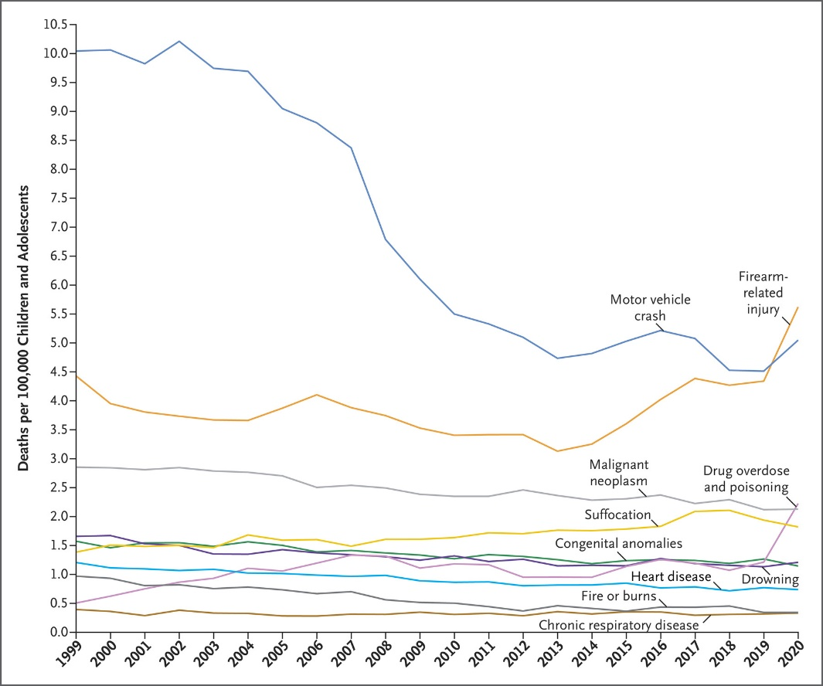
Drug overdose & poisoning now 3rd leading cause of death in US children & adolescents
Motor vehicle crash
Deaths per 100,000
Children and Adolescents
1 2 3 4 5 6 7 8 9 10
Firearm-related injury
Drug overdose & poisoning
Goldstick et al., Current Causes of Death in Children and Adolescents in the United States. NEJM. 2022;386(20).
Notes:
Our team’s interest in understanding mothers’ perspectives on naloxone education was motivated by two trends that are related to the overall increase in opioid overdose fatalities over the last few decades.
The first trend is an increase in pediatric overdose deaths.
In this graph, which was published in the New England Journal of Medicine in 2022, we are looking at the number of deaths per 100,000 children and adolescents in the United States on the y-axis and years from 1999 to 2020 on the x-axis. Each colored line represents a different cause of pediatric death, including drug overdose & poisoning, which you can see here in a brown-orange.
Drug overdose was stable for 20 years before jumping to the third leading cause of death among US children in 2020.
This is primarily attributable to a dramatic rise in adolescent opioid overdose deaths, mostly due to fentanyl, since 2019.
I also want to note here that pediatricians provide risk reduction counseling, or anticipatory guidance, about multiple other topics shown here to families and parents. We talk about safe sleep to prevent suffocation, car seats to prevent fatal motor vehicle accidents, and recently, safe gun storage to prevent firearm—related injury.
But with the exception of medication lock-boxes, we have no equivalent anticipatory guidance to provide to families around overdose.
Just a note here that I am going to use the term “overdose” throughout the presentation to refer to accidental and purposeful ingestion of opioids leading to respiratory depression and altered mental status.

Slide 4
Youth affected by parental death due to drug poisoning
Schluter BS et al., Youth experiencing parental death due to drug poisoning and firearm violence in the US, 1999-2020. JAMA. 2024;331(20).
Notes:
The second motivation was a recognition that overdose deaths of parents and family members deeply affect children.
This graph is a from a 2024 paper published in JAMA. The x-axis is years from 1999 to 2020, so the same time frame as the last slide, and the y-axis is the estimated number of children per 1000 who lost a parent to overdose.
Each color line represents a race/ethnicity as indicated in the square.
As you can see, there has been a dramatic increase – a 345% increase across all racial/ethnic groups - in the number of children who lost a parent to overdose from 1999 to 2020. In 2020, almost 73,000 children lost a parent due to drug poisoning.
Although this trauma has been the most common among white non-Hispanic children, the dramatic rise in non-Hispanic black children who have lost a parent since 2015 mimics racial trends in the overall population.
This modeling analysis used publicly available data from multiple sources: population estimates from the US Census Bureau,11 male fertility rates from the Human Fertility Collection,12 mortality data from the National Center for Health Statistics (NCHS),13 and female fertility rates from the NCHS

Slide 5
Study objective
Long-term goal: To explore opportunities to educate youth about overdose prevention.
Study Objective: To assess knowledge and attitudes of mothers with a history of substance use disorder (SUD) about discussing overdose prevention, particularly naloxone administration, with their young children.
Notes:
Given these two trends, my long-term goal is to explore opportunities to educate youth about overdose prevention so they can appropriately respond in their homes, schools, and communities.
As a first step, the objective of this study was to assess knowledge and attitudes of mothers with a history of substance use disorder about discussing overdose prevention, particularly naloxone administration, with their children.
We explicitly wanted to interview mothers with a history of substance use disorder because they offer a unique perspective on how to ideally facilitate these conversations and may have insights into using developmentally appropriate and non-stigmatizing terminology at various ages.
In addition, children exposed to family substance use are at elevated risk of potentially witnessing an overdose, so it is particularly important to incorporate their parents’ perspectives.

Slide 6
Methods
Recruitment:
Mothers recruited from 4 programs caring for people with SUD
Interviews
Peer recovery coaches co-led four semi-structured virtual focus groups
Coding & Analysis
Codebook developed using an inductive approach
Thematic analysis conducted
Transcripts were double-coded using Nvivo; κ coefficient 0.84.
Notes:
For this study, we recruited people who identified as mothers from 4 substance use programs using flyers, EHR outreach, a social media post, and a research study website.
Interested and consented mothers participated in semi-structured virtual focus groups led by women with lived experience.
We used an inductive thematic analysis approach to transcripts, create codes, and apply those codes to subsequent transcripts.
A co-coder and I independently coded transcripts using Nvivo and after meeting to discuss and reconcile discrepancies, our kappa coefficient was 0.84.
4 programs: two programs caring for pregnant and parenting people with substance use disorder, one opioid treatment program, and one recovery community center

Slide 7
Participants
15 mothers participated in 4 focus groups.
Mean age 33 years (range 27-54 years).
Most identified as white (60%), non-Hispanic (80%), single (47%) or married (20%).
Mean number of children 2 (range 1-5 children).
13 participants (87%) had at least one child under 10yo.
Notes:
15 mothers participated in 4 focus groups.
The mean age was 33 years, and most identified as white, non-Hispanic
On average mothers had 2 children and the majority had at least one child under 10.
Most had children currently living with them (73%) but had prior experience with custody loss (67%).

Slide 8
Mothers were familiar with naloxone use for adults, not youth
When asked, 8 (53%) mothers reported knowing how to use naloxone to respond to an overdose.
No one reported receipt of prior education on administering naloxone to children
Six mothers said they would feel comfortable using it on child if necessary.
No mothers had taught their young children about naloxone.
Notes:
Although over half of the mothers reported knowing how to use naloxone to respond to an overdose, no one had been educated about administering naloxone to their children.
Despite this lack of education, 6 said they would feel comfortable using it on their children if necessary.
None of the women reported teaching their young children about naloxone.

Slide 9
Theme 1
Most mothers had not discussed naloxone use with their children, yet felt it was important to prepare youth to respond to a potential overdose in their home, school, or community.
Notes:
Our analysis of focus group transcripts revealed 4 themes.
First, most mothers had not discussed naloxone use with their children, yet felt it was important to prepare youth to respond to a potential overdose in their home, school, or community.

Slide 10
Mothers felt naloxone education was important
“I absolutely would because even if I’m sober, you could save anyone’s life. I feel like there’s such a stigma…but there’s drugs in schools now. There’s drugs everywhere. The sooner my kids are able to learn how to use it, I’m going to teach them, because not just for me but for anyone.” _{30-year-old mother of 2}
Notes:
This mom said “I absolutely would because even if I’m sober, you could save anyone’s life... There’s drugs everywhere.The sooner my kids are able to learn how to use it, I’m going to teach them, because not just for me but for anyone.”

Slide 11
Theme 2
Normalizing naloxone education through comparisons to other emergency responses (e.g., fire safety) may reduce stigma and
open opportunities for children to learn
a life-saving skill.
Notes:
Second, mothers shared that normalizing naloxone education through comparisons to other emergency responses (e.g., fire safety) may reduce stigma and open opportunities for children to learn a life-saving skill.

Slide 12
Naloxone education can be normalized
“Once they know stop, drop and roll, appropriate to understand danger, I think
it’s appropriate to [teach about naloxone].”
39-year-old mother of 3
Notes:
This mom said “Once they know stop, drop and roll, appropriate to understand danger, I think
it’s appropriate to [teach about naloxone].”

Slide 13
Theme 3
Overdose response involves multiple skills – overdose recognition, naloxone administration, and emotional response management – learned at different stages of child development.
Notes:
Third, mothers noted that overdose response involves multiple skills – overdose recognition, naloxone administration, and emotional response management – learned at different stages of child development.

Slide 14
Overdose response involves different developmental skills
“Honestly, I feel like the earliest that a child would be able to grasp using naloxone appropriately would probably be around five or six. They might not understand the concept of substance use disorder… but if you simplify concerns…I known kids to do some pretty amazing things.” 40-year-old mother of 1
Notes:
This mom shared that a child could probably grasp using naloxone appropriately around 5 or 6. She said “They might not understand the concept of substance use disorder, but if you simplify concerns…I known kids to do some pretty amazing things

Slide 15
Overdose response involves different developmental skills
“Teaching these kids how to use these [medications], it’s not just about teaching them. You literally have to tell them how and when to use it.” 34-year-old mother of 2
Notes:
Conversely, this mom felt that administering naloxone is more complicated. She noted that naloxone education was more than just teaching someone how to physically use the medication and that you “literally have to tell them how and when to use it”. She went on to point out that a child would have to recognize an overdose in order to administer naloxone, which required a later developmental stage.
”Teaching these kids how to use these [medications], it’s not just about teaching them. You literally have to tell them how and when to use it. A child has to know how you would behave when you [have] an overdose before he or she can decide oh, you need that [medication] at that point.”

Slide 16
Theme 4
Mothers felt that naloxone discussions often require disclosing their own SUD, which was identified as a challenging conversation that parents were variably ready to navigate.
Notes:
Lastly, Mothers felt that naloxone discussions often require disclosing their own SUD, which was identified as a challenging conversation that parents were variably ready to navigate.

Slide 17
Mothers are variably ready to navigate disclosure
“I'm ready to have those conversations about who I was, because that's not who I am. My child has never seen me under the influence of any substances... It's definitely scary to have to feel like these conversations would happen.” 38-year-old mother of 1
Notes:
This mom shared that while she was ready to have conversations about who she was, “because that’s not who I am (and) my children has never seen me under the influence of any substances”, she still felt it was “definitely scary” to have conversations around naloxone and her children potentially needing it to reverse an overdose.

Slide 18
Naloxone education requires innovative strategies
Mothers want their children to learn about naloxone.
Mothers are variably ready to navigate SUD disclosure.
Identifying developmentally-appropriate spaces, tools, and language to discuss naloxone may improve education opportunities.
Schools and community centers could provide non-stigmatizing, normalized education for all youth.
Notes:
In these focus groups, we heard from moms that naloxone education requires innovative strategies.
The mothers in this study thought it was important that their children learn about naloxone so they were prepared to potentially reverse an overdose at home, school, or in their communities.
However, they were variably ready to disclose their substance use history, which may be related to internalized and externalized addiction-related stigma and lack of guidance when attempting to navigate this conversation with their children.
These findings, paired with mother’s emphasis on the different skills required for the various components of overdose response, suggest that identifying developmentally-appropriate spaces, tools, and language to discuss naloxone, and SUD, may improve education opportunities.
Schools and community centers could tailor non-stigmatizing and normalized education to different stages of youth development. This would ensure youth, regardless of family history and/or parental readiness for disclosure, would be prepared to respond in an overdose emergency.
ORIGINAL
Mothers with history of SUD and familiar with naloxone want their children to learn about naloxone.
Mothers are variably ready to navigate SUD disclosure, potentially due to addiction-related stigma.
Identifying developmentally-appropriate spaces, tools, and language to discuss naloxone, and SUD, may improve education opportunities.
Schools and community centers offer opportunities to provide non-stigmatizing, normalized education for all youth without necessitating parent disclosure.

Slide 19
Calls to improve youth naloxone access
Letter, October 2023
Sincerely,
Perspective, April 2024
Notes:
We feel this work lends an important parental perspective to an emerging conversation on the importance of improving naloxone access and knowledge for all youth.
There have already been calls to bring naloxone education into schools. In this letter from October 2023, the US Secretary of Education and Director of the Office of National drug Control Policy emphasized the importance of bringing youth naloxone access and education into schools. In 2023, three bills were introduced to incentivize schools to maintain naloxone in schools; none of them have yet passed.
There have also been calls to bring naloxone education to pediatric settings. This perspective was published in Pediatrics last April and argues that pediatricians should offer all patients and families overdose prevention anticipatory guidance regardless of risk status.
Hadland et al:
“Pediatricians typically offer all patients and families anticipatory guidance regardless of risk status, and because many fentanyl-related deaths occur in adolescents without previously identifiable risk factors, pediatricians should apply a universal approach to discussing overdose prevention.”
Cardona & Gupta:
“In the midst of this fentanyl overdose epidemic, it is important to focus on measures to prevent youth drug ue and ensure every school has naloxone and has prepared its STUDENTS and faculty to use it.
There is no time to waste when responding to an overdose, and it is critical that youth and school personnel can access naloxone on school ground during and after school.” Miguel Cardona (US Secretary of Education) & Rahul Gupta (Director, Office of National Drug Control Policy)
Access to naloxone in US schools may improve with the passage of the recently proposed School Access to Naloxone Act of 2023 (S.2946, H.R.3065) or the proposed Stop Overdose in Schools Act (H.R.5652), which would incentivize schools to maintain opioid overdose reversal agents that can be administered by trained personnel under civil liability protection law.^{11,12,21} The Helping Educators Respond to Overdoses (HERO) Act (H.R.6251) would establish grants to fund the development and implementation of overdose prevention curricula for students and community members in addition to the purchase of opioid overdose reversal agents.¹³

Slide 20
Thank you!
We are grateful to the women who participated in the interviews and emphasize the importance of understanding their perspective.
Jessica Calihan, MD MS
Jessica.Calihan@bmc.org
Notes:
We want to end by thanking the women who participated in and led the interviews. We are so grateful for their time and want to emphasize how important it is to understand the perspective of parents, particularly those who have personal knowledge of addiction and understand the related stigma. These voices are crucial and should be centered when developing interventions and considering policy initiatives.

