Slide 1
Pilot Evaluation of a Novel, Cooperative Opioid Use Disorder Board Game
Molly A. Nichols, PharmD, MS; Carolanne C. Wartman, PharmD; Elizabeth G. Riley, PharmD; Alli D. Harrison, PharmD; Zachary A. Weber, PharmD
November 14, 2024

Slide 2
Disclosure
Dr. Nichols intends to establish a business in the future to sell the game discussed in this presentation. However, no business currently exists.

Slide 3
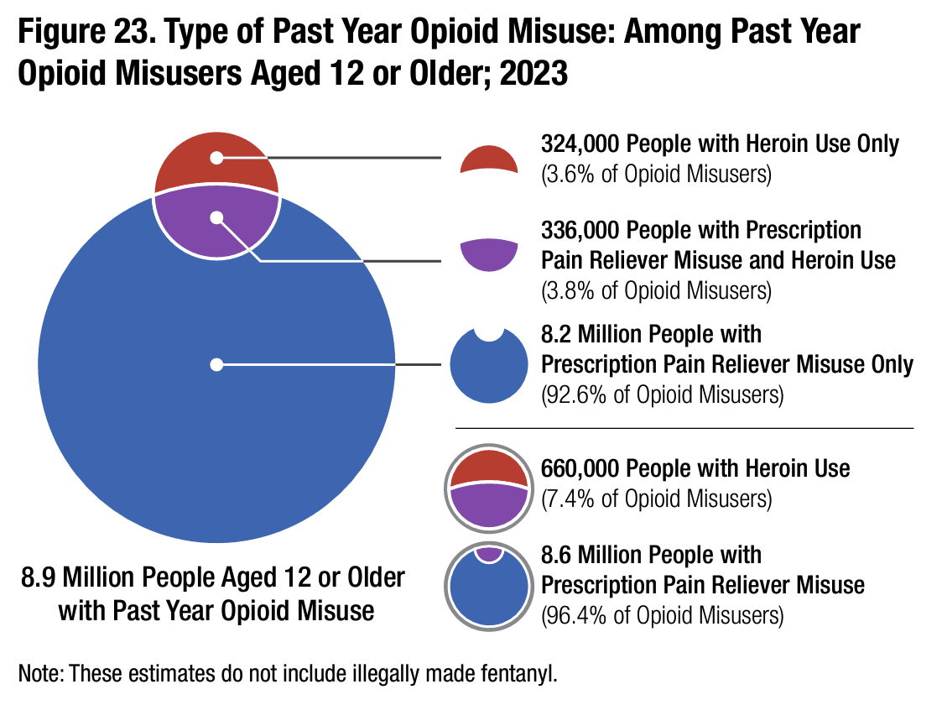
Background
Insufficient education, lack of collaboration, and stigma in healthcare contribute to barriers to care and poor outcomes for opioid use disorder (OUD)
Interprofessional education in healthcare curricula prepares future professionals for effective team-based care and improves health outcomes
Gamification is a unique strategy to enhance learning engagement and has been used with success in healthcare education settings
Figure from the National Survey on Drug Use and Health (2023)
Notes:
5.7 million had an opioid use disorder

Slide 4
An educational, cooperative board game
Notes:
Enter: Journey to Recovery
Educational, cooperative game designed to expose healthcare learners to lived experiences of people with OUD, demonstrate how life events influence capacity to engage in health care, and simulate interprofessional collaboration in care

Slide 5
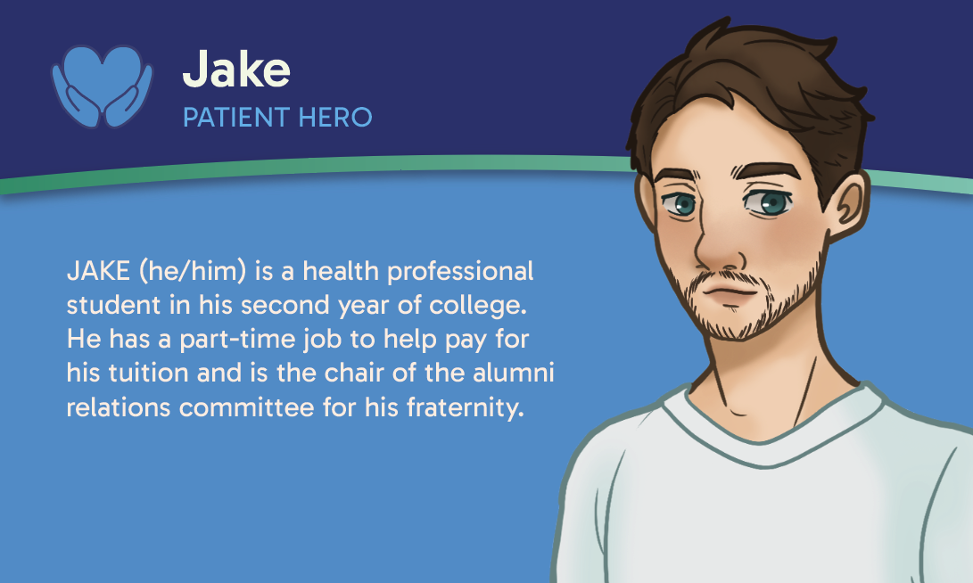
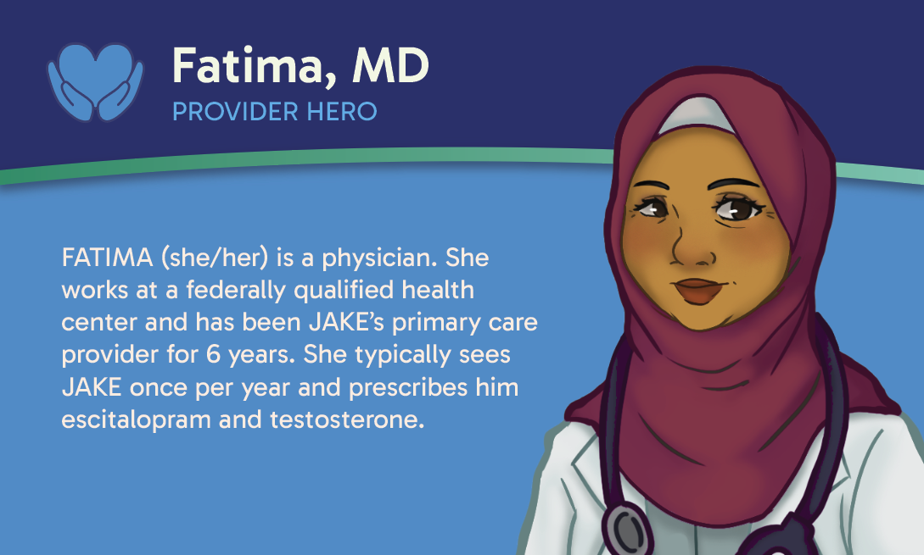
Hero Team
Notes:
In the game, you work in a team of 6 healthcare Heroes:
Patient, physician, pharmacist, nurse, licensed clinical social worker, and physical therapist
Very intentional to create Heroes diverse in age, gender, race, and sexual orientation
Team presented with patient history for Jake at start of game – JAKE is a 20-year-old, white, transgender man in his second year of college as a health professional student. When JAKE was 17, he sustained a serious back injury playing football that ended his athletic career. He was prescribed oxycodone, an opioid medication, for pain and instructed to take 10 mg every four hours. JAKE felt “right with the world” when he took his medication and quickly started using to “detach from life’s problems.” When his prescription ran out, JAKE found oxycodone through illicit routes and from there began using heroin, fentanyl, and other drugs. While at first JAKE took opioids to chase a euphoric feeling, now he must take them every day to function and prevent feeling sick.

Slide 6
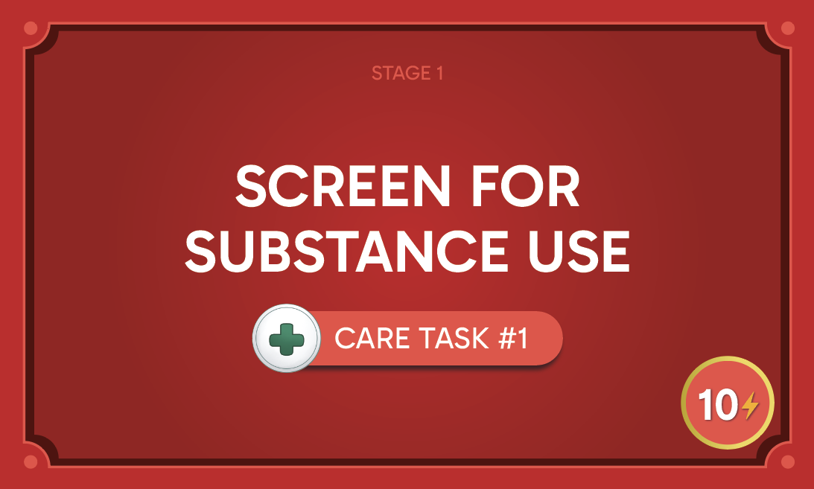
Care Tasks
Notes:
Objective of game is to complete a series Care Tasks that progress the patient player from active OUD to recovery
Each Care Task requires a certain # Energy tokens to complete
As soon as the required energy is contributed, players flip the card over to reveal a narrative story for that Care Task

Slide 7
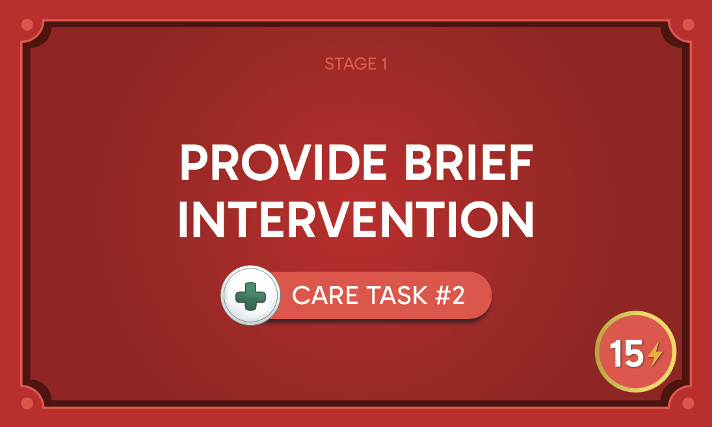
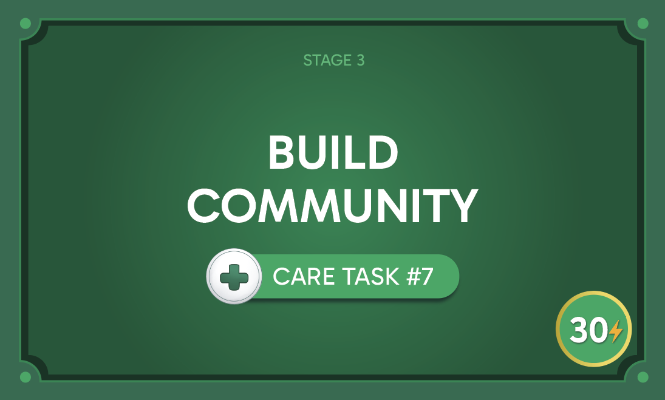
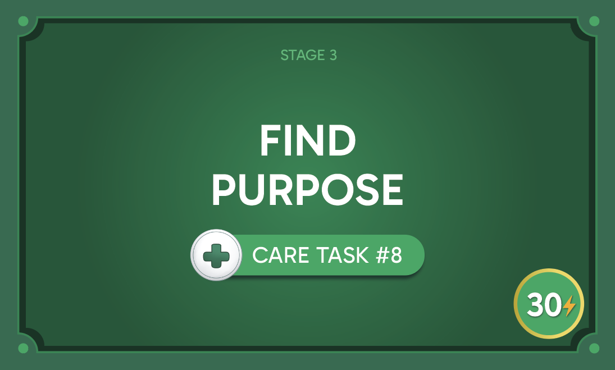
Care Tasks
Notes:
8 Care Tasks in total, each grouped in a “stage” of OUD:
Stage 1 (red) = active OUD; notice these tasks reflect SBIRT
Stage 2 (yellow) = OUD treatment; all evidence-based interventions for OUD and pain mgmt
Stage 3 (green) = recovery; based on 2 of the 4 pillars of recovery
Each Care Task involves a member of your Hero team
Players win the game after finishing the last Care Task

Slide 8
Events
Notes:
At the start of each player’s turn, you draw and resolve an Event card
Events can have positive or negative impacts on players
Some Events are in play throughout the game (blue) while others are Stage-specific

Slide 9
Additional Important Elements
Energy (All Heroes)
Heroes with zero Energy experience Burnout and must skip two turns
Wellness (Patient Hero)
Heroes lose the game if the Patient Hero’s Wellness hits zero
Notes:
Players have to keep an eye out for two things as they play:
Their Energy
Patient Hero’s Wellness
To avoid these outcomes, players can choose two alternate actions instead of spending energy towards a Care Task: (1) Replenish 2 Energy from a community Energy bank, or (2) “Show Empathy” to another player to increase their Energy or Wellness by 1

Slide 10
Pilot Test
Game implemented in Spring 2024 semester with first-year PharmD students (n=149) in PHRM 839 Interprofessional Education course at Purdue University
Electronic pre- and post-survey instruments developed to evaluate (1) reactions to the game and (2) changes in knowledge, skills, attitudes, confidence, and stigma before and after playing the game
5-point Likert items (1=Strongly Disagree, 5=Strongly Agree) assessing reactions, knowledge, skills, attitudes, and confidence developed using Kirkpatrick Model
5-point Likert items (1=Strongly Disagree, 5=Strongly Agree) assessing stigma modified and incorporated from Brief Substance Abuse Attitudes Survey
Descriptive statistics and paired t-tests performed with Microsoft Excel for data from respondents who fully completed both a pre- and post-survey

Slide 11
Results
Respondent Demographics (n=143)
143 (96.0%) first-year PharmD students fully completed a pre- and post-survey
Respondents had a mean age of 21.2 years and were mostly female (73.4%), white (76.9%), not Hispanic/Latin-x (91.6%), and had some kind of personal experience with substance use disorders through themselves, family members or friends, community members, and/or patients (55.9%)
Notes:
39.9% had no personal experience
4.2% preferred not to answer

Slide 12
Results
Reactions to the Game (n=143)
I enjoyed playing the game.
I would recommend the game to other learners.
The game was relevant to my future practice.
The game helped me learn about providing comprehensive care to patients with OUD.
3.50%
95.9%
0.70%
5.59%
92.4%
2.10%
4.90%
93.8%
1.40%
5.59%
92.4%
2.10%
Agree or Strongly Agree
Disagree or Strongly Disagree
Neutral

Slide 13
Results
Changes in Knowledge, Skills, Attitudes, and Confidence (n=143)
Item | Average (SD) Pre- | Average (SD) Post- | t-value | p-value
I am knowledgeable about…
…what a patient’s journey can look like from active OUD to recovery. | 2.70 (0.82) | 4.31 (0.33) | -19.79 | <0.001*
…the impact of stigma on health outcomes for patients with OUD. | 3.59 (0.68) | 4.38 (0.36) | -10.85 | <0.001*
…community resources available to patients with OUD. | 2.85 (0.83) | 4.13 (0.48) | -16.32 | <0.001*
…what other health professionals can do to provide care to patients with OUD. | 2.92 (0.74) | 4.31 (0.31) | -17.00 | <0.001*
Notes:
Remember: all items assessed on 5-point Likert scale with 1=strongly disagree and 5=strongly agree; lower average scores indicate lower agreement
Asterisk indicates statistically significant difference pre- to post-

Slide 14
Results (cont’d)
Changes in Knowledge, Skills, Attitudes, and Confidence (n=143)
Item | Average (SD) Pre- | Average (SD) Post- | t-value | p-value
I have the skills needed to…
…show genuine empathy to patients with OUD. | 4.01 (0.51) | 4.41 (0.34) | -6.34 | <0.001*
…talk to patients about potential OUD treatment options or care plans. | 3.01 (0.81) | 4.22 (0.50) | -14.34 | <0.001*
…direct patients to appropriate resources or health professionals to help manage their OUD. | 3.13 (0.70) | 4.23 (0.47) | -14.65 | <0.001*
…work collaboratively with other health professionals to provide care to patients with OUD. | 3.55 (0.81) | 4.44 (0.33) | -11.13 | <0.001*

Slide 15
Results (cont’d)
Changes in Knowledge, Skills, Attitudes, and Confidence (n=143)
Item | Average (SD) Pre- | Average (SD) Post- | t-value | p-value
Attitudes
Providing care to patients with OUD will be worth my time in my professional practice. | 4.20 (0.53) | 4.53 (0.28) | -5.32 | <0.001*
I am willing to collaborate with other health professionals to address different aspects of OUD. | 4.41 (0.37) | 4.61 (0.28) | -3.53 | <0.001*
Working on interprofessional teams can result in better treatment outcomes for patients with OUD. | 4.41 (0.37) | 4.59 (0.29) | -3.10 | 0.002*

Slide 16
Results (cont’d)
Changes in Knowledge, Skills, Attitudes, and Confidence (n=143)
Item | Average (SD) Pre- | Average (SD) Post- | t-value | p-value
Overall, I am confident in my ability to provide care to patients with OUD. | 3.39 (0.97) | 4.38 (0.42) | -11.88 | <0.001*
Overall, I am committed to providing care to patients with OUD in my professional practice. | 4.22 (0.43) | 4.54 (0.31) | -5.85 | <0.001*
Notes:
Observed statistically significant changes in ALL items that assessed knowledge, skills, attitudes, and confidence

Slide 17
Results
Changes in Stigma (n=143)
Item | Average (SD) Pre- | Average (SD) Post- | t-value | p-value
OUD is associated with a weak will. | 1.84 (0.53) | 1.43 (0.47) | 7.43 | <0.001*
People with OUD cannot be helped until they’ve hit rock bottom. | 1.63 (0.43) | 1.33 (0.29) | 4.91 | <0.001*
Opioids are so addicting that no one can really recover once they develop OUD. | 1.75 (0.53) | 1.43 (0.47) | 4.56 | <0.001*
People with OUD should only be treated by specialists in that field. | 2.92 (0.89) | 1.94 (0.93) | 10.30 | <0.001*
Health professionals who identify OUD early improve the chance of treatment success. | 4.23 (0.49) | 4.22 (0.98) | 0.08 | 0.937
Notes:
Observed statistically significant changes in 9 out of 14 items that assessed stigma

Slide 18
Results (cont’d)
Changes in Stigma (n=143)
Item | Average (SD) Pre- | Average (SD) Post- | t-value | p-value
A person with OUD who has relapsed several times probably cannot be treated. | 1.79 (0.29) | 1.48 (0.43) | 5.48 | <0.001*
Long-term outpatient treatment is necessary for OUD treatment. | 3.41 (0.65) | 3.36 (1.36) | 0.39 | 0.696
Lifelong abstinence is a necessary goal in OUD treatment. | 3.70 (0.94) | 3.66 (1.21) | 0.43 | 0.670
OUD is a treatable illness. | 4.36 (0.39) | 4.55 (0.33) | -3.77 | <0.001*
Group therapy is very important in OUD treatment. | 3.94 (0.44) | 4.22 (0.51) | -5.06 | <0.001*

Slide 19
Results (cont’d)
Changes in Stigma (n=143)
Item | Average (SD) Pre- | Average (SD) Post- | t-value | p-value
A hospital is the best place to treat a person with OUD. | 2.70 (0.48) | 2.57 (0.63) | 1.83 | 0.069
Most people with OUD are unpleasant to work with as patients. | 2.21 (0.65) | 1.82 (0.67) | 5.42 | <0.001*
Coercive pressure, such as threat or punishment, is useful in getting resistant patients to accept treatment. | 1.78 (0.61) | 1.68 (0.71) | 1.53 | 0.128
Active participation in a program such as Narcotics Anonymous is essential for patients to recover from OUD. | 3.45 (0.70) | 3.87 (0.79) | -5.22 | <0.001*

Slide 20
Next Steps
Game content modifications based on pilot test feedback and additional play testing
Interprofessional pilot tests planned for Spring 2025 semester at Purdue University, University of Texas at Austin, and University of Mississippi
Future pursuit of grant funding for national dissemination and train-the-trainer workshops
Notes:
Modifications: condensing/abbreviating text; adding more Event cards

Slide 21
References
Substance Abuse and Mental Health Services Administration. 2023 NSDUH Annual National Report. Published July 30, 2024. Accessed November 11, 2024. https://www.samhsa.gov/data/report/2023-nsduh-annual-national-report.
National Academies of Sciences, Engineering, and Medicine; Health and Medicine Division; Board on Health Sciences Policy; Committee on Medication-Assisted Treatment for Opioid Use Disorder. Barriers to Broader Use of Medications to Treat Opioid Use Disorder (Chapter 5). In: Medications for Opioid Use Disorder Save Lives. 1st ed. Mancher M, Leshner AI, eds. Washington (DC): National Academies Press (US); March 30, 2019.
Interprofessional Education Collaborative. IPEC Core Competencies. No date. Accessed November 11, 2024. https://www.ipecollaborative.org/ipec-core-competencies
Aynsley S, Crawford R. Pilot evaluation of medical student perception of a novel pharmacology-based role-play game: Braincept. Educ Health (Abingdon). 2017; 30(1):97-98.

Slide 22
References (cont’d)
Do M, Sanford K, Roseff S, et al. Gamified versus non-gamified online educational modules for teaching clinical laboratory medicine to first-year medical students at a large allopathic medical school in the United States. BMC Med Educ. 2023; 23(1):959.
Kirkpatrick Partners. The Kirkpatrick Model: What is the Kirkpatrick Model? No date. Accessed November 11, 2024. https://www.kirkpatrickpartners.com/the-kirkpatrick-model/
Chappel JN, Veach TL, Krug RS. The substance abuse attitude survey: an instrument for measuring attitudes. J Stud Alcohol. 1985; 46(1):48-52.
Russolillo A, Guan M, Dogherty EJ, Kolar M, Du J, Brynjarsdóttir E, Carter M. Attitudes towards people who use substances: A survey of mental health clinicians from an urban hospital in British Columbia. Harm Reduct J. 2023; 20(1):7.

Slide 23
Questions?
molly.nichols@austin.utexas.edu

