Slide 1
Piloting a Hospital-Based Rapid Methadone Initiation protocol in the Fentanyl Era
Patricia Liu, MD, Eleasa Sokolski, MD, Alisa Patten, MA and Honora Englander, MD
Oregon Health & Science University
Portland, OR

Slide 2
Disclosures
No disclosures

Slide 3
Background
The introduction of illicitly manufactured fentanyl has made the drug supply deadlier and has complicated the way patients and providers approach OUD treatment¹
Higher opioid tolerance has caused traditional therapeutic doses of medications for opioid use disorder to be insufficient^{2,3}
Methadone initiation schedules in the OTP settings are still conservative and can result in weeks of titration to achieve effective doses⁴
1: Adhmed et al. National Center for Health Statistics. 2023
2: Silverstein, SM et al. Int J Drug Policy, 2019
3: Buresh, M et al. J Subst Abuse Treat, 2022
4: Bromley, L et al. Meta: Phi, 2021

Slide 4
BACKGROUND
Trends in hospitalization related to opioid use have been significantly increasing⁵
Hospitalization provides a unique opportunity for a reachable moment to engage with patients and begin treatment⁶
Hospitalization is also an opportunity to closely monitor patients to potentially shorten the methadone titration period
5: Ronan et al. Health Affairs. 2016
6: Weinstein et al . Treating Opioid Use Disorder in General Medical Settings. 2021
Notes:
Ronan, M. V., & Herzig, S. J. (2016). Hospitalizations related to opioid Abuse/ Dependence and associated serious infections increased sharply, 2002–12. Health Affairs (Project Hope), 35(5), 832–837.
Weinstein, Z.M., Englander, H. (2021). Reachable Moment: Hospital-Based Interventions. In: Wakeman, S.E., Rich, J.D. (eds) Treating Opioid Use Disorder in General Medical Settings. Springer, Cham. https://doi.org/10.1007/978-3-030-80818-1_4

Slide 5
Racial inequalities in hospital care
Studies have found a negative relationship between the availability of hospital-based OUD programs and the racial make up of the surrounding community⁸
After an ED-visit or hospitalization, black and Hispanic patients received MOUD less frequently than white patients⁹
8: Change et al. J Subst Abuse Treat. 2022
9: Barnett et al. N Engl J Med. 2023
Invoca.com
Notes:
However, there still a lot of racial inequalities in hospital care. Studies have found a negative relationship between the availability of hospital-based OUD programs such as prescriber guidelines, targeted risk education and harm reduction services and the racial make up of the surrounding community⁷
Chang JE, Franz B, Cronin CE, Lindenfeld Z, Lai AY, Pagán JA. Racial/ethnic disparities in the availability of hospital based opioid use disorder treatment. J Subst Abuse Treat. 2022 Jul;138:108719. doi: 10.1016/j.jsat.2022.108719. Epub 2022 Feb 1. PMID: 35125254.
Barnett ML, Meara E, Lewinson T, Hardy B, Chyn D, Onsando M, Huskamp HA, Mehrotra A, Morden NE. Racial Inequality in Receipt of Medications for Opioid Use Disorder. N Engl J Med. 2023 May 11;388(19):1779-1789. doi: 10.1056/NEJMsa2212412. PMID: 37163624; PMCID: PMC10243223.

Slide 6
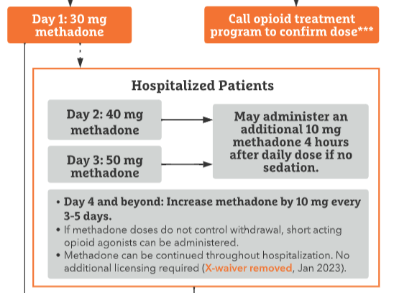
Traditional initiation recommendations
Snyder., H., et al. Methadone Quick Start. CA Bridge 2023
Notes:
*talk about the traditional guidelines*
This shortens the time to reach an effective dose but may still be inadequate to control withdrawals and craving, especially in someone who is hospitalized and may be in acute pain. which can lead to higher rates of patient directed discharge from the hospital

Slide 7
objectives
Our interprofessional addiction medicine consult service, the Improving Addiction Care Team (IMPACT), developed a rapid methadone initiation protocol
We describe our experience with the first 9 months following protocol implementation.
Notes:
Right now, there is little empiric evidence ot help guide addiction medicine providers on how to more rapidly initiate methadone in the hospital setting.

Slide 8
Methods: Rapid Methadone protocol
 | Eligibility Criteria
☐ | Routine non-prescribed fentanyl use
☐ | IMPACT consult

Slide 9
Methods: Rapid Methadone protocol
 | Clinical Contraindications
☐ | End organ failure such as pulmonary disease, cirrhosis, ESRD, heart failure
☐ | Ventricular arrhythmia, QTc>500
☐ | Concurrent use of benzodiazepines, alcohol
☐ | Medications that may affect methadone metabolism
☐ | Age >65

Slide 10
Methods: Rapid Methadone protocol
Day | Max TDD Methadone | Recommended Dosing
1 | 60mg | 30 or 40mg x1 + 10mg q3hrs PRN x 2 or 3 doses
2 | 70mg | 50mg x1 + 10mg q3hrs PRN x 2 doses
3 | 80mg | 60mg x1 + 10mg q3hrs PRN x 2 doses
4-7 | 100mg | 70mg (or average of TDD from prior days) x1 10 mg q3h PRN x 3 doses
*We allowed patients to receive full opioid agonists during rapid methadone initiation
Notes:
So for our guideline, we recommend initial doses of methadone plus additional as needed methadone doses but it’s easier just to focus on the max total daily doses that the guideline recommends.
*we allowed patients to receive short acting full opioid agonists…

Slide 11
Methods
Design/setting: Registry study of hospitalized patients who received the rapid methadone protocol at a single academic center
Participants:
Patients seen by IMPACT with OUD who received the rapid methadone protocol
Patients were excluded if they received methadone maintenance from OTP within 7 days of admission or less than 3 doses of methadone during admission
Data source:
We abstracted patient characteristics from the electronic health record.
Manual chart review was performed for methadone daily dose, adverse events attributable to methadone and MME’s of other opioid agonists received
Outcomes:
Primary outcome was daily methadone dose received.
Secondary outcomes included safety events attributable to methadone, daily MME’s of other opioid agonists received
Notes:
-Design/setting: Registry study of patients who received the rapid methadone protocol at a single academic center
-Participants: Patients seen by IMPACT with OUD who received the rapid methadone protocol. Patients were excluded if they received methadone maintenance from OTP within 7 days of admission or less than 3 doses of methadone during admission.
-Data source: We abstracted patient characteristics from the electronic health record. Manual chart review was performed for methadone daily dose, adverse events attributable to methadone and MME’s of other opioid agonists received
-Outcomes: Primary outcome was daily methadone dose received. Secondary outcomes included safety events attributable to methadone, daily MME’s of other opioid agonists received

Slide 12
Results: Patient Characteristics
Unique Individuals | 25
Age (mean±SD) | 37.5±11.2
Female (n, %) | 9 (36%)
Admission Diagnosis Type (n, %)
Obstetrics | 3 (12%)
Infection | 17 (68%)
Trauma | 4 (16%)
Vascular | 1 (4%)
Houseless | 16 (64%)
Active Fentanyl use | 25 (100%)
Substance Use History (n, %)
Opioid use disorder | 25 (100.0%)
Methamphetamine use disorder | 14 (56%)
Alcohol use disorder | 0 (0%)
Benzodiazepine use disorder | 2 (8%)
MOUD history (n, %)
Prior methadone | 20 (80%)
Prior buprenorphine | 12 (48%)
LOS, days (mean±SD) | 13.7±10.5
Patient directed discharge | 3 (12%)
Notes:
As for our results, we had 26 patients meet criteria for the rapid methadone initiation guideline in the first 9 months
*how much fentanyl people were using*
LOS and AMA on separate slide

Slide 13
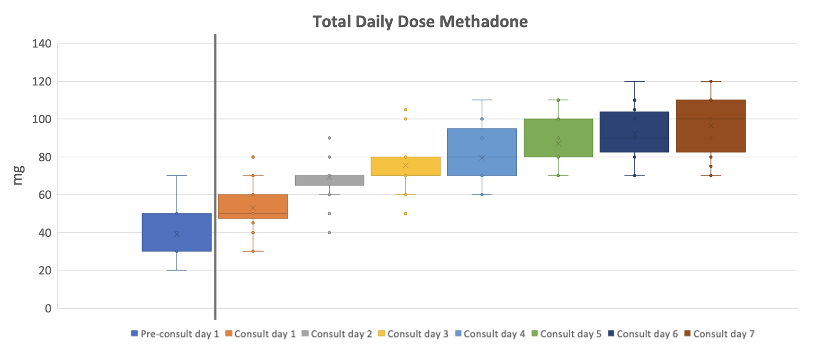
Results: Methadone doses received
IMPACT Consulted
97mg
87mg
92mg
75mg
80mg
69mg
53mg
39mg
Notes:
This box and whisker plot shows the average and upper and lower quartile range of total daily doses of methadone received.
12 patients received methadone one day prior to receiving an IMPACT consult
Here, the average methadone dose received pre-consult was 45mg
Day 1: 56mg, day 2: 73, day 3 79, day 4 82, day 5 89, day 6 94, day 7 97

Slide 14
Results: Methadone doses received
IMPACT Consulted
97mg
87mg
92mg
75mg
80mg
69mg
53mg
39mg
= Expected dose of methadone received based on traditional inpatient schedules
Notes:
This box and whisker plot shows the average and upper and lower quartile range of total daily doses of methadone received.
12 patients received methadone one day prior to receiving an IMPACT consult
Here, the average methadone dose received pre-consult was 45mg
Day 1: 56mg, day 2: 73, day 3 79, day 4 82, day 5 89, day 6 94, day 7 97

Slide 15
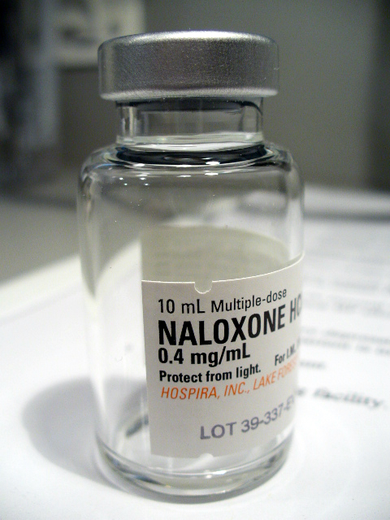
Results: Adverse Events
No patients experienced adverse events requiring holding a dose of scheduled methadone, naloxone administration or transfer to higher level of care
Notes:
*in methods, describe how we collected data*
AMA data could be here as well

Slide 16
Results: Other full opioid agonists
Day of IMPACT Consult | Average TDD methadone (mg) | Patients who received methadone | Average MME of other full opioid agonists
-1 | 39.1±14.5 | 11 | 71.4±72.0
1 | 53.0±12.9 | 25 | 118.6±122.1
2 | 69.2±11.2 | 25 | 160.2±190.3
3 | 75.4±14.5 | 23 | 219.2±324.4
4 | 79.5±15.6 | 21 | 195.5±273.7
5 | 87.1±13.6 | 17 | 155.4±123.0
6 | 92.2±14.9 | 16 | 154.8±56.8
7 | 96.6±16.6 | 16 | 82.8±82.7
Notes:
We also characterized the morphine milligram equivalent needs of other full opioid agonists for our patients undergoing the rapid initation. As per recommendations, short acting full opioid agonists, in addition to methadone were used to treat withdrawal and pain ina ll patients in our cohort. All patients in our study received short acting full opioid agonists during their hospital stay. As the high standard deviations here suggest, the amounts and duration varied widely in our patients.

Slide 17
Discussion
We introduced a hospital based rapid methadone initiation protocol with strict inclusion and exclusion criteria
Patients reached a therapeutic dose of methadone more quickly with the rapid methadone protocol than traditional dosing schedules
We observed no adverse events attributable to methadone
Short acting full opioid agonists, in addition to methadone, were used to treat withdrawal and pain in nearly all patients in our cohort but the amounts and duration varied.

Slide 18
Implications
As we develop and evaluate new methadone dosing schedules, emphasis should be made on appropriate patient selection in order to mitigate risk.
Our study highlights the importance of using short acting opioid agonists to treat pain and withdrawal while up-titrating methadone in the hospital.
The literature suggests that by more effectively treating patients’ withdrawals, cravings and pain, we can improve the likelihood of patients staying in the hospital to complete their recommended treatment course^{10, 11}
10: Alrawashdeh, M., et al. J Gen Intern Med. 2023
11: Ti L et al. Am J public Health. 2015
Notes:
Ti L, Ti L. Leaving the Hospital Against Medical Advice Among People Who Use Illicit Drugs: A Systematic Review. Am J Public Health. 2015 Dec;105(12):e53-9. doi: 10.2105/AJPH.2015.302885. Epub 2015 Oct 15. PMID: 26469651; PMCID: PMC4638247.

Slide 19
Limitations
Limitations include small sample size and lack of matched controls
We did not follow patients long term/after discharge, specifically to continue monitoring for adverse events
We also did not assess the qualitative patient experience
Notes:
Traditional methadone initiation schedules are often inadequate to treat withdrawal and cravings in most patients with very high opioid tolerance. By more effectively treating patients’ withdrawals, cravings and pain, we improve the likelihood of patients staying in the hospital to complete their recommended treatment course **we did not do this**
I think that the biggest limitation is that we don't follow patients long term. The big concern would be that if we go up quickly and then 3 days later someone might overdose/ experience adverse event. I would acknowledge this and say that we tried to mitigate this by patient selection (choosing patients with very high tolerance, low risk of oversedation (e.g. no bzd)

Slide 20
Conclusion
Rapid methadone initiation protocol for hospitalized patients with OUD is feasible and patients reached a therapeutic dose of methadone more quickly than with traditional methods
This provides another tool for clinicians to respond to the unprecedented opioid tolerances seen in the fentanyl era
Appropriate patient selection may be crucial to avoid adverse events
Notes:
Reduce number of words

Slide 21
Questions?

Slide 22
References
1. Ahmad, F., J. Cisewski, L. Rossen, and P. Sutton. Provisional drug overdose death counts. US Department of Health and Human Services, CDC, National Center for Health Statistics 2023 [cited 2023 September 11]; Available from: https://www.cdc.gov/nchs/nvss/vsrr/drug-overdose-data.htm.
2. Silverstein, S.M., et al., "Everything is not right anymore": Buprenorphine experiences in an era of illicit fentanyl. Int J Drug Policy, 2019. 74: p. 76-83.
3. Buresh, M., S. Nahvi, S. Steiger, and Z.M. Weinstein, Adapting methadone inductions to the fentanyl era. J Subst Abuse Treat, 2022. 141: p. 108832.
4. Bromley, L., et al. Methadone treatment for people who use fentanyl: Recommendations. . META:PHI 2021 [cited 2023 September 14]; Available from: https://www.metaphi.ca/wp-content/uploads/Guide_MethadoneForFentanyl.pdf.
5. Ronan MV, Herzig SJ. Hospitalizations Related To Opioid Abuse/Dependence And Associated Serious Infections Increased Sharply, 2002-12. Health Aff (Millwood). 2016 May 1;35(5):832-7. doi: 10.1377/hlthaff.2015.1424. PMID: 27140989; PMCID: PMC5240777.
6. Weinstein, Z.M., Englander, H. (2021). Reachable Moment: Hospital-Based Interventions. In: Wakeman, S.E., Rich, J.D. (eds) Treating Opioid Use Disorder in General Medical Settings. Springer, Cham. https://doi.org/10.1007/978-3-030-80818-1_4
7. Snyder., H., et al. Methadone Quick Start. CA Bridge 2023 [cited 2023 September 19]; Available from: https://bridgetotreatment.org/resource/methadone-hospital-quick-start/.
8. Chang JE, Franz B, Cronin CE, Lindenfeld Z, Lai AY, Pagán JA. Racial/ethnic disparities in the availability of hospital based opioid use disorder treatment. J Subst Abuse Treat. 2022 Jul;138:108719. doi: 10.1016/j.jsat.2022.108719. Epub 2022 Feb 1. PMID: 35125254.
9. Barnett ML, Meara E, Lewinson T, Hardy B, Chyn D, Onsando M, Huskamp HA, Mehrotra A, Morden NE. Racial Inequality in Receipt of Medications for Opioid Use Disorder. N Engl J Med. 2023 May 11;388(19):1779-1789. doi: 10.1056/NEJMsa2212412. PMID: 37163624; PMCID: PMC10243223.
10. Alrawashdeh, M., et al., Association of Early Opioid Withdrawal Treatment Strategy and Patient-Directed Discharge Among Hospitalized Patients with Opioid Use Disorder. J Gen Intern Med, 2023. 38(10): p. 2289-2297.
11. Ti L, Ti L. Leaving the Hospital Against Medical Advice Among People Who Use Illicit Drugs: A Systematic Review. Am J Public Health. 2015 Dec;105(12):e53-9. doi: 10.2105/AJPH.2015.302885. Epub 2015 Oct 15. PMID: 26469651; PMCID: PMC4638247.

