Slide 1
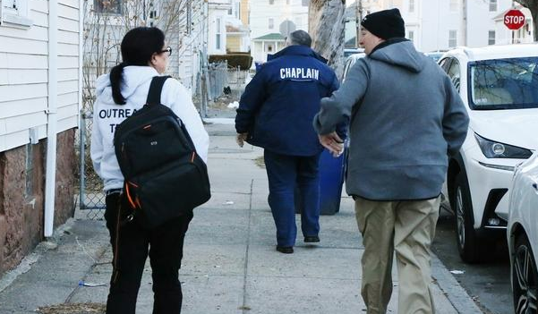
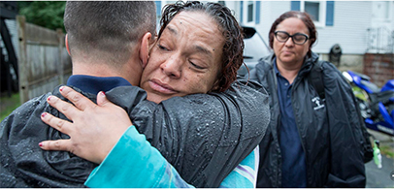
Post-Overdose Outreach Programs in Massachusetts Since the Onset of COVID-19
Alexander Y. Walley, MD, MSc; C To, MSPH; Jiayi Wang, MS; Shapei Yan, MPH; Stephen Murray, MPH, NRP; Sarah Kosakowski, MPH; Sarah Bagley, MD, MSc; Ziming Xuan, ScD, SM; Justeen Hyde, PhD; Moriah Wiggins, BS; Andrew Rolles, BA; Scott W. Formica, PhD
AMERSA Conference 2023
Oral Abstract Presentation Session 2
Notes:
AW: C – be sure to introduce yourself and your role and why you are excited to be working on this project.

Slide 2
Conflicts of Interest
There are no conflicts of interest
This study is funded by the National Institute on Drug Abuse (R21DA053307) and the Centers for Disease Control and Prevention (R01CE003357)

Slide 3
Post-Overdose Outreach Programs in Massachusetts

Slide 4
PRONTO ADAPT Study Objective
To identify post-overdose outreach program practices and adaptations during the COVID-19 pandemic

Slide 5
Timeline & Methods
11-Item Screener
45-Item Survey
September 2022 – April 2023
Survey sent to 245 screener-identified active programs
Analysis
280 responses (273 programs in 257 municipalities)
Descriptive statistics, qualitative analysis
April – August 2022
Screener sent to 829 individuals
478 responses representing 342 of 351 municipalities in MA
Analytic sample included 256 programs in 240 municipalities
Notes:
SWF: Be prepared to describe who the 829 individuals were who received the screener.

Slide 6
Survey Domains
Program Goals and Evaluation Metrics
Training
Ex: How has COVID-19 resulted in sustained adaptations to staff training?
Identification of Potential Outreach Recipients
Virtual and In-Person Post-Overdose Outreach
Ex: Does the outreach team contact the survivor before the in-person visit?
Outreach Activities
Ex: What services does the team directly provide?
Mandated Treatment
Notes:
Program Goals and Evaluation Metrics
Training
Ex: How has COVID-19 resulted in sustained adaptations to staff training? On what topics?
Identification of Potential Outreach Recipients
Virtual and In-Person Post-Overdose Outreach
Ex: Does the outreach team make any attempts to contact the overdose survivor before the initial in-person visit?
Outreach Activities
Ex: What services does the team directly provide?
Mandated Treatment

Slide 7
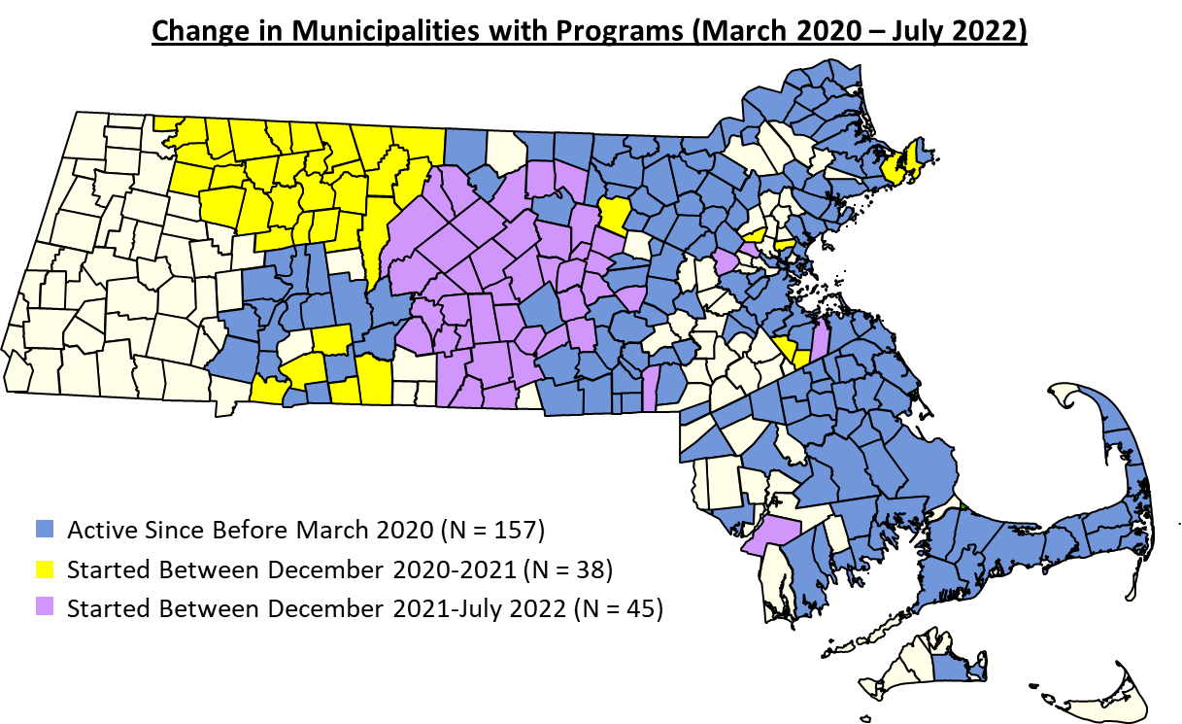
157 Municipalities Covered in March 2020

Slide 8
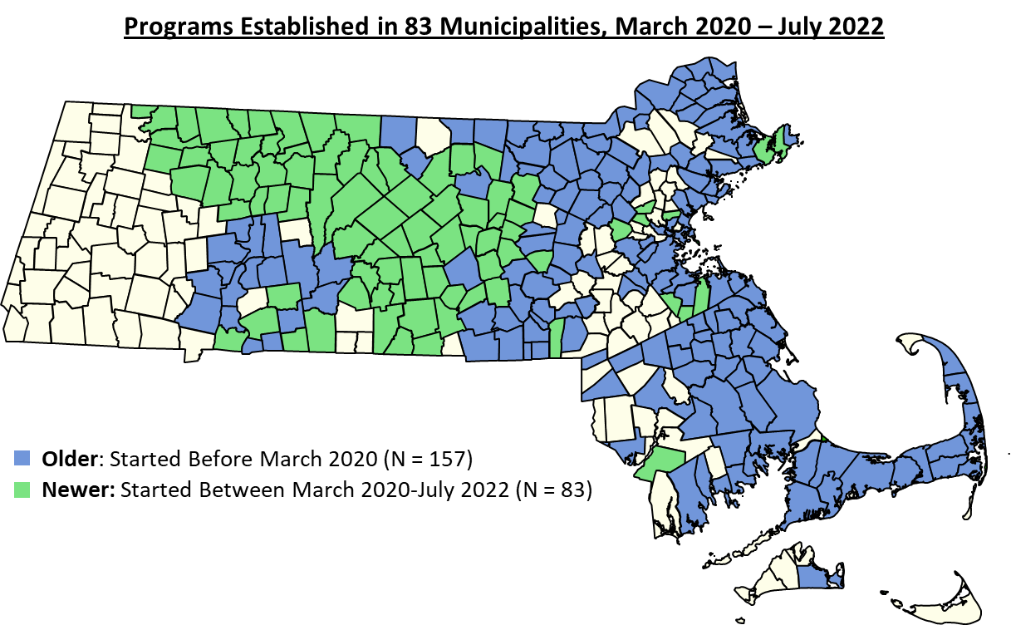
96 Programs Established in 83 Additional Municipalities

Slide 9
Changes and Adaptations to Outreach Preparation and Visits
Elements Suspended During the Pandemic | Older (N=160)
Continued all outreach activities uninterrupted | 16%
Suspended in-person outreach, continued remote | 67%
Suspended all outreach (both in-person and remote) | 10%
*Response categories were mutually exclusive. Other is not shown in table.

Slide 10
84% of Older, 95% of Newer Programs Rely on Grant Funding
Primary Recipient of Grant(s) | Older (N=135) | Newer (N=92)
Police department | 55% | 23%
Social Services, Health or Behavioral Health Organization | 15% | 33%
Municipal Health Department | 15% | 3%
Harm Reduction Organization | 14% | 4%
Fire Department | 1% | 0%
District Attorney | 1% | 1%
Sheriff's Department | 0% | 35%
Community Substance Use Coalition | 0% | 1%
*Response categories were mutually exclusive.
Notes:
AW: Which Sheriff’s Department’s received the Newer funding? Good to know this when explaining the growth on the maps.
CT: Franklin County Sheriff’s Department

Slide 11
Contacts Often First Made Virtually
Virtual Contact Before In-Person Visit | Older (N=160) | Newer (N=96)
Yes - by phone call | 88% | 63%
Yes - by text message | 40% | 58%
Yes - by video call | 0% | 1%
No | 13% | 36%
*Response categories were not mutually exclusive.

Slide 12
Services Directly Offered Vary Among Programs

Slide 13
Services Directly Offered Vary Among Programs

Slide 14
Trainings, Changes Since COVID-19 Onset to Reflect Evolving Drug Supply, Social Contexts
Training or Change | Older (N=160) | Newer (N=96)
De-escalation training | 40% | 9%
Training on contamination of cocaine, methamphetamine, or counterfeit prescription drugs with fentanyl | 58% | 72%
Changes to better reach Black, Latinx, Native, or youth populations* | 51% | 57%
Responses for only “Yes” are shown. *Changes include cultural humility and DEI trainings, diversifying team makeup, youth diversion programs
Notes:
AW: Need examples of the “new training not directly related to COVID-19” and “changes to better reach” … populations rows if we present this slide.

Slide 15
Differences in Sustained Supplies and Services Offered
Notes:
AW:
Q146 Since the COVID-19 pandemic (March 2020), what sustained adaptations, new approaches, or practices related to the way in which the team identifies overdose contacts, shares information among team members, or prepares for the initial post-overdose outreach have been implemented in ${Q9/ChoiceGroup/SelectedChoices}? Select all that are new since the onset of the pandemic. If your program started after March 2020, please answer for any changes made since the program began. for Older it is (N=160), whereas for Newer it is (N=96) – are any Newer missing?
Q176 Since the COVID-19 pandemic (March 2020), what sustained adaptations, new approaches, or practices related to the way in which the team conducts outreach has the program implemented in ${Q9/ChoiceGroup/SelectedChoices}? Select all that are new since the onset of the pandemic. If your program started after March 2020, please answer for any changes made since the program began. Older (N=157, Missing=3) Newer (N=65, Missing=31)
Consider a slide on this question that includes the write in answers.
Q205 Has the COVID-19 pandemic resulted in sustained adaptations, new approaches, or practices in the way the program uses Section 35? Newer (N=96)

Slide 16
Differences in Sustained Supplies and Services Offered
Notes:
AW:
Q146 Since the COVID-19 pandemic (March 2020), what sustained adaptations, new approaches, or practices related to the way in which the team identifies overdose contacts, shares information among team members, or prepares for the initial post-overdose outreach have been implemented in ${Q9/ChoiceGroup/SelectedChoices}? Select all that are new since the onset of the pandemic. If your program started after March 2020, please answer for any changes made since the program began. for Older it is (N=160), whereas for Newer it is (N=96) – are any Newer missing?
Q176 Since the COVID-19 pandemic (March 2020), what sustained adaptations, new approaches, or practices related to the way in which the team conducts outreach has the program implemented in ${Q9/ChoiceGroup/SelectedChoices}? Select all that are new since the onset of the pandemic. If your program started after March 2020, please answer for any changes made since the program began. Older (N=157, Missing=3) Newer (N=65, Missing=31)
Consider a slide on this question that includes the write in answers.
Q205 Has the COVID-19 pandemic resulted in sustained adaptations, new approaches, or practices in the way the program uses Section 35? Newer (N=96)

Slide 17
Conclusions
Post-overdose outreach programs continued to expand
Adaptations and innovations since pandemic onset included COVID-specific practices, resources to reduce harms from drug supply, more inclusive outreach
Notes:
AW: Conclusions in the abstract: “Post-overdose outreach programs continued to expand in Massachusetts following an initial lull in 2020 after the COVID-19 pandemic onset. Adaptations and innovations since pandemic onset included COVID-specific practices (e.g., face masks, virtual contact interactions and referrals), resources to reduce harms from drug supply (e.g., fentanyl test strips) and more inclusive outreach (e.g., tailored for people using cocaine and methamphetamine, and Black, Latinx, Native people).”

Slide 18
Limitations
Study conducted in a single state
Assessments drawn from other studies but not validated
Respondents may not be aware of all programs
Assessments self-reported – social desirability bias
Notes:
From the Formica 2021 PRONTO Aim 1 paper
First, it was conducted within a single state and may not generalize to other settings. There is evidence to suggest the emergence of these programs may vary by region of the country (Yatsco et al., 2020). Similarly, variation in state laws on data sharing, naloxone, and other factors may impact whether and how these programs emerge. Second, despite drawing on past studies, the instruments used were derived for this study, so we were not able to assess sensitivity, validity, or reliability. Third, although we sought multiple reporters from each municipality during the screener, it is possible that respondents were not aware of all programs operating in their community. Fourth, all measures were self-report, which is susceptible to social desirability bias. Lastly, we do not know specifics about the 12 % of programs that did not complete the detailed survey – although they did not differ from responding programs across multiple community-level indicators.

Slide 19
Next Steps
Qualitative interviews of staff and survivors to describe mechanisms of action
Toolkit that focuses on programs for people who use cocaine and methamphetamine and Native, Black, Latinx, and youth

Slide 20
Thank you!
We are grateful to the post-overdose outreach program staff who answered the survey and our partners at community-based programs and the state health department for their ongoing partnership!
A website detailing our “PRONTO” suite of projects can be accessed at prontopostoverdose.org.

Slide 21
Government Agencies are Primary Issuers of Grants
Agencies Issuing Grants | Older (N=135) | Newer (N=92)
US Department of Justice/Bureau of Justice | 47% | 39%
Massachusetts Department of Public Health | 33% | 10%
Massachusetts Department of Mental Health | 23% | 3%
Foundations | 22% | 3%
Substance Abuse and Mental Health Services Administration | 14% | 36%
Centers for Disease Control and Prevention | 12% | 3%
County District Attorney | 1% | 52%
Private donor | 0% | 0%
*Response categories were not mutually exclusive.
Notes:
AW: Which County District Attorney’s issued grants Newer? What was the source od this County District Attorney funding? Good to know this when explaining the growth on the maps.
CT: Worcester County DA’s Office got DOJ grant

Slide 22
Data Sources Identifying Potential Recipients Primarily Police-Based
Primary Data Source | Older (N=160) | Newer (N=96)
911 call data from the police department | 54% | 11%
Critical Incident Management Systems (CIMS) | 40% | 89%
911 call data from EMS | 2% | 0%
Other data from the police department | 2% | 0%
Local hospital emergency department data | 1% | 0%
911 call data from the fire department | 0.5% | 0%
Interagency community group | 0.5% | 0%
*Response categories were mutually exclusive.
Critical Incident Management Systems (CIMS): web-based, real-time opioid overdose incident and follow-up database used by police departments in Massachusetts

Slide 23
Variation in Wide Spread of Services Offered
Older
(N=159, Missing=1)
Newer
(N=96)
Notes:
AW: Is the data on this slide from:
Q185 Which of the following services does the post-overdose outreach team directly provide to overdose survivors or social network contacts? (Select all that apply.) Older (N=159, Missing=1)
If yes, then clarify in the header that this are services directly provided by outreach teams
SMB: for slides 15, 16, 18, and 19- I think that it might be too much to have two figures on one slide. Maybe see how practice goes and make a call then.

Slide 24
Variation in Wide Spread of Services Offered
Older
(N=159, Missing=1)
Newer
(N=96)
Notes:
AW: Is the data on this slide from:
Q185 Which of the following services does the post-overdose outreach team directly provide to overdose survivors or social network contacts? (Select all that apply.) Older (N=159, Missing=1)
If yes, then clarify in the header that this are services directly provided by outreach teams

Slide 25
Differences in Sustained Supplies and Services Offered
Older
(N=157, Missing=3)
Newer
(N=65, Missing=31)
Notes:
AW:
Q146 Since the COVID-19 pandemic (March 2020), what sustained adaptations, new approaches, or practices related to the way in which the team identifies overdose contacts, shares information among team members, or prepares for the initial post-overdose outreach have been implemented in ${Q9/ChoiceGroup/SelectedChoices}? Select all that are new since the onset of the pandemic. If your program started after March 2020, please answer for any changes made since the program began. for Older it is (N=160), whereas for Newer it is (N=96) – are any Newer missing?
Q176 Since the COVID-19 pandemic (March 2020), what sustained adaptations, new approaches, or practices related to the way in which the team conducts outreach has the program implemented in ${Q9/ChoiceGroup/SelectedChoices}? Select all that are new since the onset of the pandemic. If your program started after March 2020, please answer for any changes made since the program began. Older (N=157, Missing=3) Newer (N=65, Missing=31)
Consider a slide on this question that includes the write in answers.
Q205 Has the COVID-19 pandemic resulted in sustained adaptations, new approaches, or practices in the way the program uses Section 35? Newer (N=96)

Slide 26
Older Programs Sustaining Services Offered
Older
(N=157, Missing=3)
Newer
(N=65, Missing=31)
Notes:
AW: For this slide I wonder whether we should drop the Newer programs data?

