Slide 1
Postpartum Medication for Opioid Use Disorder Outcomes Associated With Prenatal Treatment and Neighborhood-Level Social Determinants of Health
Caitlin E. Martin, MD MPH
IVY (In Recovery) Lab, Obstetrics & Gynecology
Institute for Drug and Alcohol Studies, Virginia Commonwealth University
Co-authors: Erin Britton, Hannah Shadowen, Jasmine Johnson, Roy Sabo, and Peter Cunningham

Slide 2
The intersection of two crises
Opioid use disorder (OUD) is a leading cause of death through the year postpartum
Untreated OUD carries additional risks for the parent-child dyad & increased health care costs
Expanding utilization of medication treatment for OUD (MOUD) is the most effective public health path forward
Trost SL, et al. 2022 hrsa.gov
Gemmill A, et al. 2019. Am J Obstet Gynecol.
Goldman S, et al. 2019. Am J Obstet Gynecol.
CE Margerison, et al. 2022 Obstet Gynecol.
Smid MC. 2019. Obstet Gynecol.
Admon LK, et al. 2021 JAMA Netw Open.
Volkow ND, et al. 2014. N Engl Med.

Slide 3
MOUD utilization = initiation → retention
Stark disparities in MOUD outcomes exist for birthing people
Differences in patient-level MOUD outcomes are likely reflections of a culmination of higher order factors
Investigations aiming to uncover the drivers of disparities have largely focused on individual-level factors demarcating the social group burdened by the disparity (race, ethnicity)
Tan SD, et al. 2022. J Racial Ethn Health Disparities.
Entress RM. 2021. J Subst Abuse Treat.
Schuler MS, et al. 2021. Drug Alcohol Depend.
Peeler, et al. 2020. Am J Public Health.
Schiff DM, et al. 2020. JAMA Netw Open.
Martin CE. et al. 2023. J Subst Use Addict Treat.
Shim RS. 2021. Am J Psychiatry.
Notes:
(Structural and systemic racism, inequities in health care access)
rather than solely contributions by

Slide 4
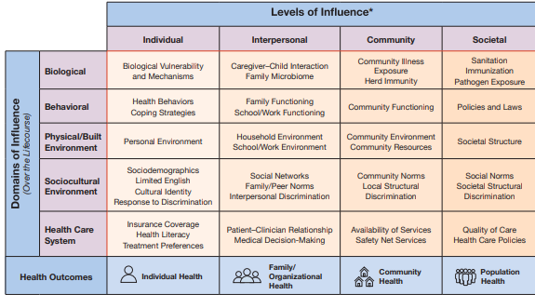
Socioecological framework
Designing clinical studies through a multi-level/disciplinary lens can achieve a more comprehensive understanding of the underlying contributors to inequities
Example: National Institute on Minority Heath and Health Disparities (NIMHD)
Research Framework
Gao YA, et al. 2022 J Addict Med.
Schiff DM, et al. 2022 Pediatrics.
Giuse NBMD, et al. 2017. AM J Prev Med.
Woolf SH, et al. 2007. Am J Public Health.
National Institute on Minority Health and Health Disparities, 2018; www.nimhd.nih.gov/about/overview/research-framework/nimhd-framework.html

Slide 5
Study objective
Identify the association of neighborhood-level social determinants of health and prenatal opioid use disorder treatment receipt with MOUD outcomes (duration, continuity) through the year postpartum among a cohort of birthing people

Slide 6
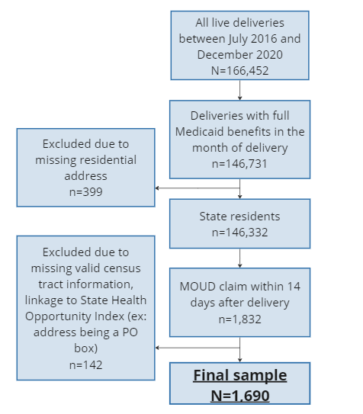
Data source and study sample
Retrospective cohort
Virginia Medicaid Claims linked with birth records, 2016- 2020
N=1,690
Receiving methadone or buprenorphine at time of delivery

Slide 7
MOUD treatment outcome measures
Time to MOUD discontinuation: number of days to first MOUD discontinuity after delivery through 12-months, allowing for up to a 30-day gap between MOUD claims
“MOUD duration”
Continuity of MOUD receipt: cumulative number of days covered by MOUD divided by the days enrolled in full benefits Medicaid within the 12 months after delivery
“Percentage of days covered”
Notes:
MOUD duration (allowed up to 30-day gap)
MOUD was captured by pharmacy claims (ie, buprenorphine) and procedure codes (ie, methadone).

Slide 8
Exposure of interest: Neighborhood-level social determinants of health
Virginia Department of Health’s HOI (Health Opportunity Index) Hierarchical aggregate of 13 community indicators → 4 profiles → composite HOI
Economic Opportunity Profile Employment Accessibility, Job Participation, Income Inequality
Community Environment Profile Population Density, Walkability, Air Quality, Population Churning
Wellness Disparity Profile Segregation, Access to Care
Consumer Opportunity Profile Education, Affordability, Food Accessibility
https://apps.vdh.virginia.gov/omhhe/hoi/
Notes:
that provides insight into the opportunity of the state to live long and health lives based on social determinants of health. It is derived from dozens of social, economic, educational, demographic, and environmental community variables combined into 13 community indicators that are grouped into four community profiles.
Economic Opportunity Profile Evaluates the capacity of community members to engage in the economy of their community.
Employment Accessibility Indicator Measures geographical access to paid work.
Job Participation Indicator The fraction of adults active in the labor force.
Income Inequality indicator Evaluates how wealth and earnings are distributed within a community.
Community Environment Profile Measures a community’s “natural, built, and social environment.”
Population Density Indicator Approximates resident density levels as experienced by most inhabitants of a community.
Walkability Indicator A measure of how walkable a community is taking in to account public transit accessibility, residential and employment density, rationality of street design, and land diversity.
Air Quality Indicator a community’s risk from pollution and incorporates various EPA measures of pollution and risk for related disease.
Population Churning Indicator Measures population turnover by assessing the rate that people move into and out of a community.
Wellness Disparity Profile Measures disparity in access to health-related services
Segregation Indicator Assesses the racial and ethnic diversity of communities
Access to Care Indicator Evaluates the availability of affordable primary care. It adjusts for the number of uninsured residents in a community and also the costs of care.
Consumer Opportunity Profile Measures a community’s access to consumer resources
Education Indicator The average years of schooling among community adults.
Affordability Indicator The proportion of a community’s income that is spent on transportation and housing. This also estimates disposable income left over.
Food Accessibility Indicator The proportion of the community with a grocery store within one mile in urban communities or 10 miles in rural communities.
Material Deprivation the private material resources available to community households. It includes measures for employment, vehicle and home ownership, and overcrowding.

Slide 9
Exposure of interest: Prenatal OUD treatment receipt
Duration of MOUD received prenatally: pharmacy and procedure claims in the 12 months preceding delivery
OUD treatment comprehensiveness: receipt of services in addition to MOUD (range 0-9) from peer support, case management, provider assessment, behavioral health, medication management, drug monitoring, health screening, family therapy, psychiatric evaluation
Martin CE, et al. 2023. J Subst Use Addict Treat.
Edwards JR, et al. 2011. J Behav Health Serv Res.
Notes:
OUD comprehensiveness categories based on work of Edwards et al > adapted to what Medicaid ARTS program reimburses for

Slide 10
Analyses
Linked HOI to patient-level data at census-tract level
Describe outcomes by HOI terciles
Stepwise multivariable models for MOUD outcomes
Cox proportional hazards (time to MOUD discontinuation)
Negative binominal (MOUD continuity)
Notes:
Terciles determined by statewide distribution of HOI, not just Medicaid population

Slide 11
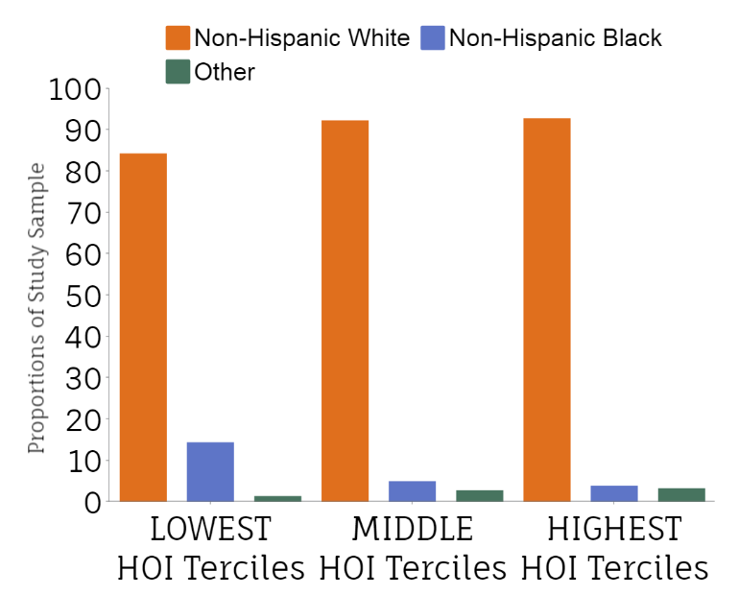
The majority of our cohort were in living in a low-middle HOI tercile
LOWEST Tercile = 771 (42%)
MIDDLE Tercile = 647 (38%)
HIGHEST Tercile = 332 (20%)
Notes:
= HIGH burden of negative social determinants of health
Among the sample of 1690 Medicaid-covered patients with deliveries occurring between July 1, 2016 and December 31, 2020 who were to receiving MOUD, 711 (42%) were birthing people in the lowest HOI tercile (indicating high burden of negative SDoH), 647 (38%) in the middle HOI tercile, and 332 (20%) in the highest HOI tercile (Table 1). Most deliveries were to White, non-Hispanic birthing people (89.0%), with less than a tenth to Black, non-Hispanic birthing people (8.7%) and people with other race/ethnicity. However, these proportions differed across HOI terciles, with 14.4% of deliveries in the lowest tercile being to Black, non-Hispanic birthing people, as opposed to only 3.9% in the highest tercile.

Slide 12
Postpartum MOUD continuity adjusted results
Percentage of days covered by MOUD
Models 1 & 2: Association with age & Black race (RR 0.70; 0.52-0.95)
Model 3: Race no longer demonstrated significance, prenatal MOUD duration (RR 2.39, 1.41-4.03) & OUD treatment comprehensiveness (RR 1.77, 1.29-2.42) were positively associated
Model 4: Prenatal OUD treatment variables remained positively associated with postpartum MOUD duration after accounting for neighborhood-level social determinants; HOI not significant (RR 1.02, 0.32-3.25)
Model 4
Model 3
Model 2
Model 1
Notes:
Similar to postpartum MOUD duration models, prenatal OUD treatment variables (MOUD duration and level of additional OUD treatment services received prenatally) remained significantly associated with the proportion of postpartum days covered by MOUD in both models 3 and 4. However, a dose–response relationship with prenatal MOUD duration was not as clearly demonstrated for this outcome.
In the negative binomial regression models for the outcome of postpartum MOUD continuity (Table 3), in addition to age, race/ethnicity also demonstrated an association with MOUD continuity in models 1 (individual-level) and 2 (parent–infant dyad), with deliveries by Black, non-Hispanic people having less days covered by MOUD in the year postpartum (relative risk, 0.704; 95% CI, 0.517–0.949). However, this association was no longer significant in models 3 (OUD treatment) and 4 (neighborhood-level SDoH). Similar to postpartum MOUD duration models, prenatal OUD treatment variables (MOUD duration and level of additional OUD treatment services received prenatally) remained significantly associated with the proportion of postpartum days covered by MOUD in both models 3 and 4. However, a dose–response relationship with prenatal MOUD duration was not as clearly demonstrated for this outcome. For example, only MOUD receipt of at least 9 months before delivery was positively associated with postpartum MOUD continuity, whereas prenatal MOUD durations of ≤8 months did not demonstrate a significant association.

Slide 13
Main study findings
Replicated findings from other states: longer duration of MOUD before delivery = better postpartum treatment outcomes
Prenatal availability of reimbursable services adjunctive to MOUD may also improve postpartum outcomes
The postpartum benefits gained from prenatal OUD care persisted across neighborhood-level social determinants

Slide 14
Take away points
Limitations exist on how to measure and quantify multi-level factors that impact health
However, that is not an excuse (anymore) to ignore them
As addiction researchers, we can be advocates for the incorporation of socioecological frameworks into investigations across the translational science spectrum
Notes:
We can all go beyond the race variable when documenting disparities and elucidating thei underlying mechanisms
It’s not easy, and you may be a pioneer in your space
But you can do it!

Slide 15
Acknowledgements
Thomas F. and Kate Miller Jeffress Memorial Trust
NIDA award No. K23 DA053507 (Martin)
Substance Use Disorder Prevention that Promotes Opioid Use Recovery and Treatment Act from the Virginia Department of Medical Assistance Service
Addiction and Recovery Treatment Services Program and Substance Use Disorder Prevention that Promotes Opioid Use Recovery and Treatment Act
Virginia Department of Medical Assistance Services
Co-authors: Erin Britton, Hannah Shadowen, Jasmine Johnson, Roy Sabo, and Peter Cunningham

Slide 16
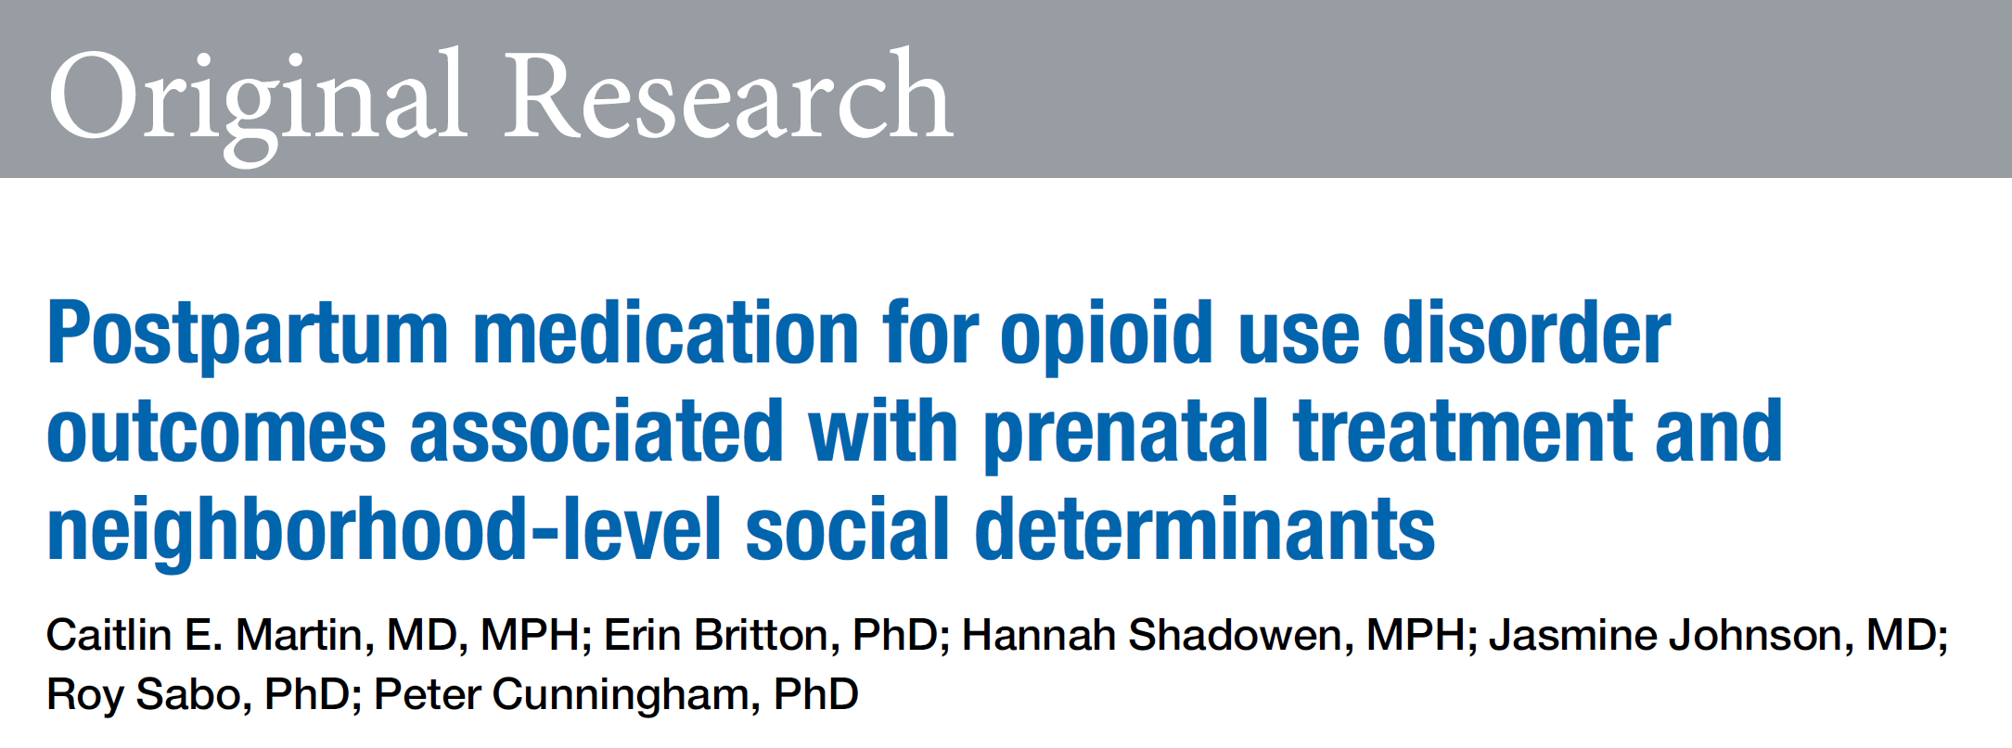

Slide 17
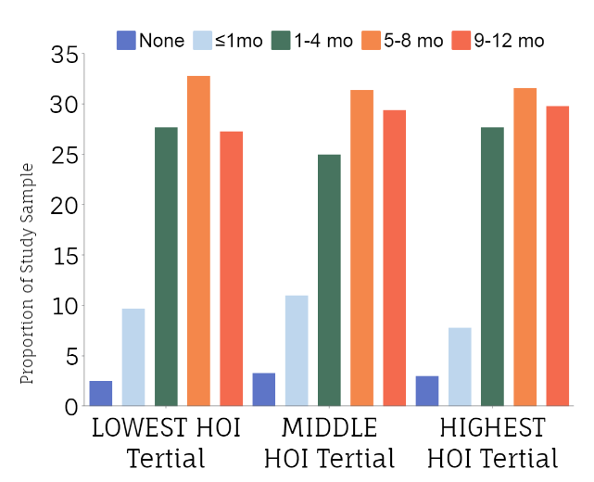
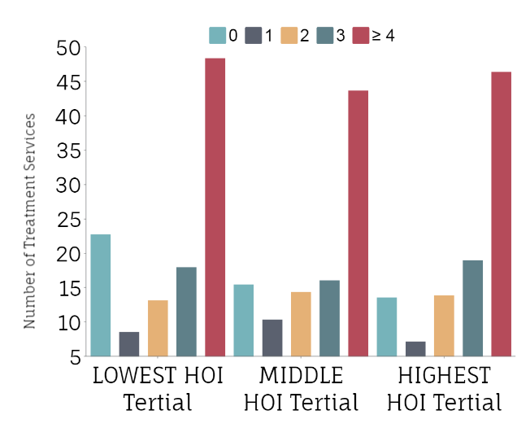
The distribution of our other exposures of interest generally did not differ across HOI terciles
Prenatal MOUD duration
Prenatal OUD treatment comprehensiveness
Notes:
FIRST BAR GRAPH
At the time of delivery, birthing people had been receiving MOUD for different durations that did not vary significantly across HOI terciles: 9.8% for <1 month, 26.7% for 1 to 4 months, 32.0% for 5 to 8 months, and 28.6 for at least 9 months.
SECOND BAR GRAPH
Similarly, almost half of the sample received at least 4 OUD treatment components, in addition to MOUD, during pregnancy (46.2%), with 13.6% receiving no additional OUD treatment services, 9.0% receiving 1 service, 13.8% 2 services, and 17.5% 3 services (Table 1).

Slide 18
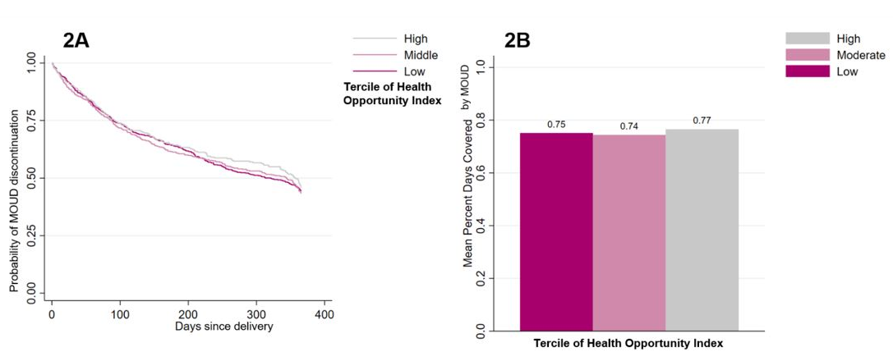
Postpartum MOUD outcomes were also similar across HOI terciles
Kaplan Meir curve of time to postpartum MOUD discontinuation, by Virginia HOI terciles
MOUD percentage of days covered postpartum, by Virginia HOI terciles
Notes:
Unadjusted study outcomes did not vary across HOI terciles. For postpartum MOUD duration, 61.5% of patients continued MOUD for at least 9 of 12 months after delivery (60.2% in the lowest tercile, 61.7% in the middle tercile, and 64.2% in the highest tercile) (eFigure 2, A). Similarly, for postpartum MOUD continuity, 75% of days in the year after delivery were covered by MOUD receipt for all deliveries (75% days in the lowest tercile, 74% days in the middle tercile, and 77% days in the highest tercile) (eFigure 2, B).

Slide 19
Postpartum MOUD duration adjusted results
Time to MOUD discontinuation
Models 1 & 2: Shorter duration with young age (HR 1.262; 1.1039–1.533)
Model 3: Individual-level variables no longer demonstrated significance, but prenatal MOUD duration (HR 0.39, 0.30-0.49) & OUD treatment comprehensiveness (HR 0.63, 0.50-0.81) demonstrated a dose-response relationship = better postpartum MOUD duration
Model 4: Prenatal OUD treatment variables remained positively associated with postpartum MOUD duration after accounting for neighborhood-level social determinants; HOI not significant (HR 1.39, 0.55-3.51)
Model 4
Model 3
Model 2
Model 1
Notes:
In the stepwise Cox proportional hazards models for the outcome of postpartum MOUD duration, models 1 (individual-level) and 2 (parent–infant dyad) demonstrated a positive association between young age and MOUD discontinuation (HR, 1.262; 95% CI, 1.1039–1.533). However, these associations no longer demonstrated significance in models 3 (OUD treatment) and 4 (neighborhood-level SDoH).
In model 3, both duration of prenatal MOUD receipt and the OUD Treatment Comprehensiveness Index were negatively associated with postpartum MOUD discontinuation, with a demonstrated dose–response relationship for MOUD duration; in other words, incremental increases in the duration of MOUD received prenatally were associated with longer MOUD durations in the year postpartum. Notably, these significant associations remained stable in model 4, with the HOI not demonstrating an association with the outcome of postpartum MOUD duration (HR, 1.39; 95% CI, 0.551–3.512).

