Slide 1
Preparing Colorado Health Professionals in Primary Care and School-Based Health Centers (SBHCs) to Intervene Early for Adolescent Substance Use through SBIRT
Nora M Marino, MPH; Tracy McPherson, PhD; Giana Calabrese, MPH; Carolyn Swenson, MSPH, MSN, RN; Elizabeth Pace, MSM, RN, CEAP, FAAN; Annie Klein, CPS II; Hannah Nibauer, MSW
Saturday, November 16, 2024
AMERSA Conference
Notes:
Hello! My name is Nora Marino and I’m a Senior Research Associate at NORC at the University of Chicago.
Today I will share findings from a survey that our team conducted of health professionals in primary care and school-based health center settings in Colorado.
This survey explored uptake of SBIRT, screening challenges encountered, knowledge and expertise in SBIRT, and training and technical assistance needs.

Slide 2
I have no conflicts of interest to disclose

Slide 3
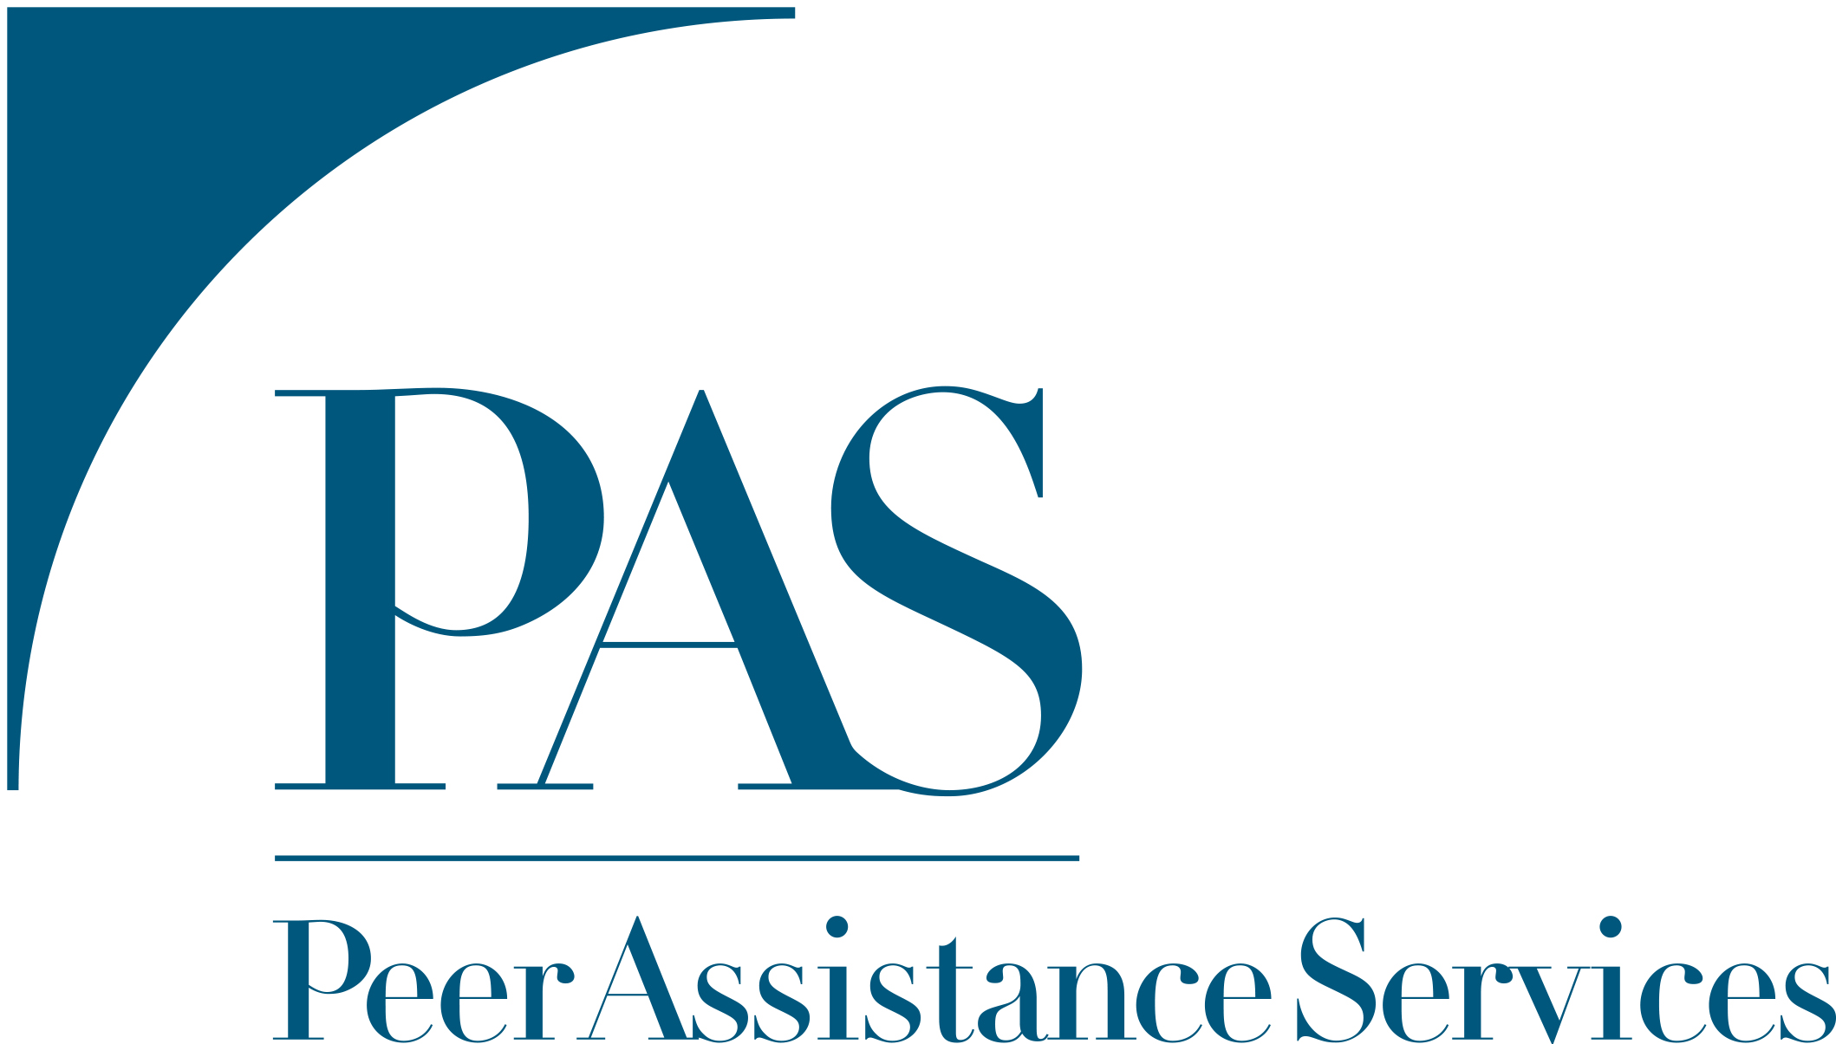
Acknowledgements
Notes:
First and foremost, I did not do this project alone. I’d like to thank my colleagues at NORC as well as our awesome partners – Peer Assistance Services and the SBIRT Advisory Council

Slide 4
Substance Use in Colorado
Alcohol and other substance use among adolescents in the U.S. remains a significant public health issue
Adolescents in Colorado are over 1/3 more likely to have used alcohol or other substances in the past month compared to other adolescents in the U.S.
Notes:
Alcohol or other substance use among adolescents in the U.S remains a significant public health issue. In 2023, nationally 14% of adolescents aged 12 to 17 consumed alcohol or other substances in the past month. Adolescents in Colorado are over one third more likely to have used alcohol or other substances in the past month compared to other adolescents in other parts of the U.S.
Given the higher rates of substance use among Colorado youth as well as the state’s strong commitment to address public health concerns, Colorado has been a national leader for decades on SBIRT implementation in various health care settings, including primary care and SBHCs.

Slide 5
Disparities in Substance Use and Treatment Access
Disparities in alcohol and other substance use exist between Colorado adolescents of different racial/ethnic groups and sexual orientations
Black and Latino adolescents are significantly less likely to receive substance use treatment compared to white adolescents
Notes:
Differences exist between demographic groups for consumption of alcohol or other substance use. As you all know, I could give an entire presentation focused on these disparities and inequities, but I will just share a few for the sake of time.
Among high school students in Colorado, Native Hawaiian and other pacific islander (42%), white (23.5%), and multiracial students (23%) reported higher rates of drinking alcohol in the past 30 days compared to students of other races and ethnicities (Hispanic students (18%), Black students (10%), and east/southeast Asian students (12%), American Indian/Alaska Native (12%), and middle eastern/north African students (12%). )
Colorado high school students who identify as bisexual (30%) reported higher rates of drinking alcohol in the past 30 days compared students who identify as gay (23%) or straight (20%).
Nationally, among adolescents with SUD, Black and Latinx adolescents were significantly less likely to receive SUD treatment than white adolescents. These differences were exacerbated after adjusting for family income and insurance status.

Slide 6
SBIRT Overview
Screening, Brief Intervention and Referral to Treatment (SBIRT) is one of the leading ways to help reduce the impact of alcohol and other substance use
Referral to Treatment and Follow-up
Screening
Linking the youth to specialized SUD treatment and other services, resources, and supports and regularly checking in to facilitate sustained access
Process of identifying youth who are at risk of negative consequences due to their substance use, including risk of a substance use disorder
Brief Intervention
A conversation that is intended to either prevent, stop, or reduce risky substance use
Notes:
As many of you likely know, SBIRT is a comprehensive, integrated, public health approach to help reduce the impact of alcohol and other substance use
Screening is the process of identifying youth who are at risk of negative consequences due to their substance use.
Brief intervention is a conversation that is intended to either prevent, stop, or reduce risky substance use.
Referral to treatment and follow up links the youth to specialized SUD treatment and other services, resources, and supports and regularly checking in to facilitate sustained success.

Slide 7
Methods
Web survey of primary care and SBHC health professionals who serve youth (11-25 years old)
SBIRT practice
Screening challenges
SBIRT knowledge, experience, and confidence
SBIRT training experience
Training and technical assistance needs
Analysis
Descriptive statistics
Bivariate analyses
Multivariate regression analyses
Key Informant Interviews (N=7)
Notes:
For this project, we surveyed health professionals in primary care and SBHCs who serve youth ages 11 – 25 years old.
Through the survey we examined SBIRT practice, screening challenges, self-rated SBIRT knowledge, SBIRT expertise, and confidence, prior SBIRT training experience, as well as training and technical assistance needs.
For the analysis, we conducted descriptive statistics, and binary analyses such as ANOVAs and Chi-Squares as well as multivariate regression analyses such as ordinary least squares, multinominal logistic regression, and logistic regressions.
We had a total of 107 participants who served youth in primary care and SBHC settings respond to this survey.
Finally, we also completed a handful of key informant interviews with behavioral health professionals, medical professionals, and decision-makers in primary care and SBHC settings. I won’t go into much detail of the findings from these interviews as that would be a whole other presentation, but will share a few powerful quotes to illustrate some of the themes from the survey.

Slide 8
Participant Characteristics
N=107
Notes:
Very quickly I will discuss a few characteristics of the individuals who completed this survey. The majority of survey participants were medical professionals such as physicians, nurses, and medical assistants. Just under a quarter of participants served youth as behavioral health professionals such as LCSWs, psychologists, and counselors, and a smaller proportion served youth in another role such as a clinic manager or front-desk staff personnel.
We also asked survey participants to respond to the location of the youth to whom they provided services – just over a quarter provided services to youth in frontier and/or rural communities, about 60% provided services to youth in urban and/or suburban communities, and about 8% provided services to youth in a different combination of urban, suburban rural, and frontier communities.

Slide 9
SBIRT Practices Screening
Currently screens youth for alcohol or other substance use
80.4%
Previously screened youth for alcohol or other substance use, but not currently
10.3%
Never screened youth for alcohol or other substance use
9.2%
N=107
Notes:
The majority of participants reported they currently screen youth for alcohol or other substance use with only 10% reporting they previously screened and 9% indicating they never screened youth.

Slide 10
SBIRT Practice Brief Intervention
76.6%
Uses brief intervention/motivational interviewing
Does NOT use brief intervention/motivational interviewing
23.4%
N=107
This Photo by Unknown Author is licensed under CC BY-ND
Notes:
When youth are identified at risk of substance use, over ¾ of participants conduct brief intervention or engage in motivational interviewing with youth.

Slide 11
SBIRT Practice Referral to Treatment
Refers youth to medical/BHP and/or arranges referral for treatment
66.4%
33.6%
Does NOT refer youth to medical/BHP and/or arrange referral for treatment
N=107
Notes:
Most participants also engage in referral to treatment with 66.4% indicating they refer youth to medical or behavioral health providers to address substance use and/or arrange a referral for treatment for further assessment for SUD.

Slide 12
Screening Challenges Overall
Top challenges of primary care and SBHC health professionals to screen youth for alcohol or other substance use included:
Patient-related concerns
Patient needs and resources
Competing priorities
49.5%
48.6%
64.5%
15%
Access to knowledge and information
25.2%
Access to implementation resources
32.7%
Leadership engagement and support
N=107
Notes:
Survey participants indicated from a list of several different challenges which they have experienced when screening youth for alcohol or other substance use.
The most commonly endorsed challenge was “patient-related concerns” with 64.5% of providers indicating that this was a challenge they experienced. This includes concerns related to confidentiality and privacy, lack of parental support for substance use screening, and concern that youth will not be truthful about their substance use.
A challenge that was less commonly endorsed by participants was leadership engagement and support.

Slide 13
The family fell off. I think they weren’t trusting that even though we went over HIPAA, they weren’t trusting that everybody in the community was not gonna know their stuff…I think that's a big challenge with the small rural population.
Primary Care
Behavioral Health Provider
Notes:
This quote is from a behavioral health provider in a primary care setting about the challenges of encouraging parents to consent to screening of their children because of fears of confidentiality and that the screening results would be known by the community.

Slide 14
Screening Challenges By Screening Status
Differences in reported screening challenges of primary care and SBHC health professionals by screening status
(currently screens n = 86, previously screened n = 11, never screened n = 10):
C: 69.8%
P: 45.5%
N: 40.0%
P-value: 0.07
Patient-related concerns
C: 46.5%
P: 81.8%
N: 40.0%
P-value: 0.07
C: 48.8%
P: 45.5%
N: 50.0%
P-value: 0.97
Patient needs and resources
Competing priorities
49.5%
48.6%
64.5%
C: 26.7%
P: 45.5%
N: 70.0%
P-value: 0.01
C: 22.1%
P: 18.2%
N: 60.0%
P-value: 0.03
Access to implementation resources
15%
Access to knowledge and information
C: 10.5%
P: 18.2%
N: 50.0%
P-value: 0.004
Leadership engagement and support
32.7%
25.2%
N=107
Notes:
While on the last slide, I showed the top challenges that were endorsed by all participants, on this slide I have it stratified by screening status.
The three challenges at the bottom of the slide show challenges that were endorsed significantly more by participants who never screened youth, which include access to knowledge and information, access to implementation resources, and leadership engagement and support.
If we flip back to the last slide, you’ll see that these were the lowest endorsed challenges overall.

Slide 15
SBIRT Training Experience Overall
60.6% reported receiving either brief and/or extensive SBIRT training
39.4% reported NOT receiving SBIRT training
N=99
Notes:
And speaking of access to knowledge, information, and resources - Most respondents reported they received SBIRT training – which included either brief and/or extensive training.
8 respondents indicated they did not remember if they received SBIRT training.

Slide 16
Knowledge, Expertise, and Confidence in SBIRT Overall
Primary care and SBHC health professionals reported on a scale of 0 to 10 their level of SBIRT knowledge, SBIRT expertise, and confidence in their ability to screen, conduct brief intervention, and refer youth to treatment.
6.8
Referral to Treatment Confidence
0
10
6.4
Screening Confidence
0
10
5.8
Brief Intervention Confidence
0
10
5.7
SBIRT Knowledge
0
10
4.8
SBIRT Expertise
0
10
N=107
Notes:
In the survey, we also asked participants to self rate their SBIRT knowledge, SBIRT expertise, screening confidence, brief Intervention confidence, and referral to treatment confidence on a scale of 0 – 10. On this slide you can see the mean scores for each variable. The lowest mean score was SBIRT expertise and the highest was referral to treatment confidence.

Slide 17
Participants who received SBIRT training reported higher
Participants who screen
2.3 times more likely to report higher screening confidence (p<.05)
SBIRT Expertise (+3.7)
SBIRT Knowledge (+3.3)
Screening Confidence (+3.0)
Brief Intervention Confidence (+2.3)
Referral to Treatment Confidence (+2.6)
Compared to participants who did not receive SBIRT training after controlling for profession. All significant at p<.001.
Compared to participants who did not screen after controlling for profession
Participants who conduct BI
1.5 times more likely to report higher BI confidence (p<.01)
Compared to participants who never conducted BI after controlling for profession
Notes:
After conducting separate OLS regression analyses, we found that participants who received training reported higher mean SBIRT expertise, SBIRT knowledge, screening confidence, brief intervention confidence, and referral to treatment confidence compared to participants who did not receive SBIRT training.
After conducting multinomial logistic regression, we found that participants who screen were 2.3 times more likely to report higher screening confidence compared to participants who did not screen. And after conducting logistic regression, we found that participants who conduct BI are 1.5 times more likely to report higher BI confidence compared to participants who did not conduct BI.
However, we did not find any significant differences between participants who currently screen, conduct BI, and refer to treatment and prior training experience. We also did not find any significant differences by professional role and SBIRT practice.
All analyses controlled for profession.

Slide 18
SBIRT Training/Technical Assistance & Resources
More than 50% reported the following would be helpful to support SBIRT with youth:
Online SBIRT Training
Resources for health professionals on SBIRT and youth substance use
Resources for patients and families on substance use
Information on youth substance use treatment services
Youth-friendly resources to address substance use
N=107
This Photo by Unknown Author is licensed under CC BY-SA-NC
Notes:
Finally, we asked participants about the SBIRT training, resources, and technical assistance opportunities that were of interest. On this slide you can see those that were endorsed by more than 50% of participants.
No significant differences existed by screening status for trainings, resources, or technical assistance opportunities requested.

Slide 19
Having a practice facilitator makes all the difference in the world. I don’t think that any of these quality improvement projects or major projects like SBIRT could be done without a facilitator.
School-Based Health Center
Decision-Maker
Notes:
This quote is from a decision-maker in a school-based health center and shows the benefit of working with a practice facilitator to implement SBIRT in their setting.

Slide 20
A lot of times the whole cultural aspect is overlooked by people who are maybe new to working with this community. We come in with our Western ideas and the things that we've been taught through our programs…we sometimes will come in as like the experts…I know what's going to fix you without even considering the cultural pieces
Primary Care
Behavioral Health Provider
Notes:
This quote is from a behavioral health provider in a primary care setting and illustrates the importance of tailoring trainings to certain communities.

Slide 21
Key Takeaways
Challenges to screening youth persist
Participants who received SBIRT training reported higher SBIRT knowledge, expertise, and confidence
Participants who report screening and/or conducting BI have higher screening and/or BI confidence, respectively
There is interest in training, technical assistance, and resource development
Notes:
Now let’s discuss some key takeaways:
As a I mentioned, challenges to screening youth persist in primary care and SBHC settings, particularly challenges related to patient related concerns. However, access to knowledge and information, access to implementation resources, and leadership engagement and support were endorsed more by participants who never screened youth – highlighting an opportunity.
Participants who received SBIRT training reported higher SBIRT knowledge, expertise, and confidence – illustrating that training does have an impact! However, participants who currently screen, conduct BI, or refer to treatment were NOT more likely to have received training. Future research could further investigate if other factors that play a role in uptake of SBIRT practice, for example organizational and leadership support as well as the type, duration, intensity and recency of training received.
Participants reported interest in training, technical assistance and resources in primary care and SBHC settings. Tailoring these types of resources to their specific needs could facilitate further uptake of SBIRT and continue to support the knowledge, expertise, and confidence of these health professionals.
While this study was based in Colorado, this same landscape assessment could be adapted for other states to explore their unique challenges, training and TA needs, and other opportunities to increase the uptake of SBIRT with youth across various settings. There has not been a comprehensive effort to understand state-by-state the uptake of SBIRT across multiple settings and this project is an opportunity to do so.

Slide 22
References
National Center for Drug Abuse Statistics. 2023. Teenage Drug Use Statistics: Data & Trends on Abuse. Retrieved from https://drugabusestatistics.org/teen-drug-use/
Colorado Department of Public Health & Environment (CDPHE). 2023. Healthy Kids Colorado Survey and Smart Source Information. Retrieved from https://cdphe.colorado.gov/hkcs
Alegria M, Carson NJ, Goncalves M, Keefe K. Disparities in treatment for substance use disorders and co-occurring disorders for ethnic/racial minority youth. J Am Acad Child Adolesc Psychiatry. 2011 Jan;50(1):22-31. doi: 10.1016/j.jaac.2010.10.005. Epub 2010 Nov 18. PMID: 21156267; PMCID: PMC3488852.
Notes:
Boom! References!

Slide 23
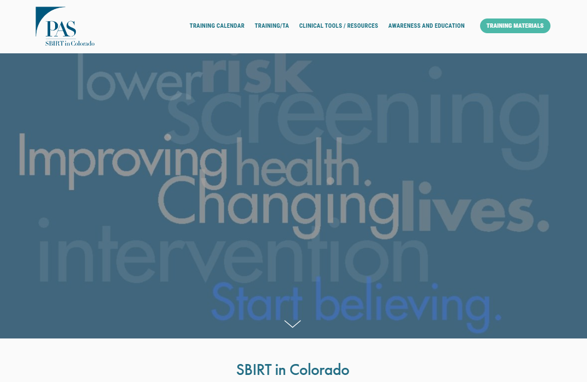
SBIRT Resources
Thank you!
Nora Marino, MPH
Senior Research Associate II
Health Sciences
marino-nora@norc.org
For any specific questions related to SBIRT, please contact SBIRTTeam@norc.org
https://sbirteducation.com
https://sbirtcolorado.org/
NORC’s curriculum includes:
Adolescent SBIRT Learner’s Guide
Adolescent SBIRT Trainer’s Guide
Adolescent SBIRT Trainer’s Slide Deck
4-Part On Demand Webinar Series
https://sbirteducation.com/adolescents/curriculum

Slide 24
Appendix

Slide 25
Bivariate Analysis: Role, Training, SBIRT Knowledge, Expertise, and Confidence
P<.05
P<.01
P<.001
 | Mean SBIRT Knowledge, Expertise, and Confidence (n=107)
 | SBIRT Knowledge (0 – 10) | SBIRT Expertise (0 – 10) | Screening Confidence (0 – 10) | Brief Intervention Confidence (0 – 10) | Referral to Treatment Confidence (0 – 10)
Overall | 5.69 | 4.82 | 6.39 | 5.84 | 6.60
Medical professional | 5.25 | 4.41 | 6.36 | 5.37 | 6.24
Behavioral health professional | 6.78 | 5.70 | 6.39 | 7.30 | 7.74
Other professional | 6.56 | 6.00 | 6.67 | 6.00 | 6.67
Received training¹ | 7.18 | 6.20 | 7.43 | 6.77 | 7.63
Did NOT receive training¹ | 3.46 | 2.85 | 4.69 | 4.31 | 5.00
¹8 participants reported “I do not remember” to a question about SBIRT training received. These participants were excluded from analyses.
Notes:
Through conducting separate ANOVAs, we found that participants with training experience reported higher knowledge, expertise, and screening, brief intervention, and referral to treatment confidence.
We also found no significant differences between professional role and screening confidence. However, behavioral health professionals reported higher BI confidence compared to medical and other professionals.

Slide 26
P<.05
P<.01
P<.001
Bivariate Analysis: Role, Training, SBIRT Knowledge, Expertise, and Confidence
 | Mean SBIRT Knowledge, Expertise, and Confidence (n=107)
 | Screening |  |  | Brief Intervention |  | Referral to Treatment
 | C | P | N | C | NC | C | NC
SBIRT Knowledge | 6.33 | 4.27 | 1.80 | 6.21 | 4.00 | 5.99 | 5.11
SBIRT Expertise | 5.35 | 3.82 | 1.40 | 5.35 | 3.08 | 5.21 | 4.06
Screening Confidence | 7.03 | 5.54 | 1.80
Brief Intervention Confidence |  |  |  | 6.55 | 3.52
Ref. to Treatment Confidence |  |  |  |  |  | 7.00 | 5.81
Medical professional | 76.00 | 12.00 | 12.00 | 72.00 | 28.00 | 65.33 | 34.67
Behavioral health professional | 91.30 | 4.35 | 4.35 | 95.65 | 4.35 | 56.52 | 43.48
Other professional | 88.89 | 11.11 | 0.00 | 66.67 | 33.33 | 100.00 | 0.00
Received training | 88.33 | 8.33 | 3.33 | 85.00 | 15.00 | 76.67 | 23.33
Did NOT receive training¹ | 66.67 | 15.38 | 17.95 | 61.54 | 38.46 | 58.97 | 41.03
¹8 participants reported “I do not remember” to a question about SBIRT training received. These participants were excluded from analyses. C=Current; P=Previous; N=Never; NC=Not Current
Notes:
Through Chi-square tests, we also found that participants with training experience were more likely to screen and conduct BI and through ANOVAs we found participants with higher screening, BI, and RT confidence were more likely to screen, conduct BI, and refer youth to treatment.

Slide 27
P<.05
P<.01
P<.001
After controlling for role, multivariate regression analyses showed the impact of training on SBIRT Knowledge, Expertise, and Confidence
 | Mean SBIRT Knowledge, Expertise, and Confidence (OLS; n=99)
 | SBIRT Knowledge (0 – 10) | SBIRT Expertise (0 – 10) | Screening Confidence (0 – 10) | Brief Intervention Confidence (0 – 10) | Referral to Treatment Confidence (0 – 10)
 | CoEff | CoEff | CoEff | CoEff | CoEff
Behavioral health professional¹ | 0.28 | 0.23 | -1.10 | 0.94 | 0.37
Other professional¹ | 0.29 | 0.67 | -.47 | .003 | -.33
Received training² | +3.65 | +3.26 | +3.00 | +2.26 | +2.58
¹Reference Category: Participants who identified as a medical professional ²Reference Category: Participants who reported not previously receiving SBIRT training
Notes:
After conducting separate OLS regression analyses, we found that participants who received training reported higher mean SBIRT expertise, SBIRT knowledge, screening confidence, brief intervention confidence, and referral to treatment confidence compared to participants who did not receive SBIRT training.

Slide 28
Multinomial Logistic Regression for Screening and Logistic Regression for Brief Intervention and Referral to Treatment
P<.05
P<.01
P<.001
 | Mean SBIRT Knowledge, Expertise, and Confidence (n=107)
 | Screening |  | Brief Intervention | Referral to Treatment
 | C | P | C | C
 | AOR | AOR | C | C
SBIRT Knowledge | 2.33 | 1.46 | 0.90 | 0.83
SBIRT Expertise | 1.04 | 1.28 | 1.17 | 1.20
Screening Confidence | 2.28 | 2.05 | -- | --
Brief Intervention Confidence | -- | -- | 1.45 | --
Referral to Treatment Confidence | -- | -- | -- | 1.25
Behavioral health professional¹ | 4.67 | 1.64 | 5.04 | 1.84
Received training² | 0.05 | 0.08 | 1.18 | 1.84
¹Reference Category: Participants who identified as a medical professional ²Reference Category: Participants who reported not previously receiving SBIRT training C=Current; P=Previous; N=Never; NC=Not Current; AOR=Adjusted Odds Ratios
Notes:
After conducting multinomial logistic regression, we found that participants who screen were 2.3 times more likely to report higher screening confidence compared to participants who did not screen. And after conducting logistic regression, we found that participants who conduct BI are 1.5 times more likely to report higher BI confidence compared to participants who did not conduct BI.
However, we did not find any significant differences between participants who currently screen, conduct BI, and refer to treatment and prior training experience. ADD PROFESSIONAL ROLE
All analyses controlled for profession.

