Slide 1
A Workshop
for Preparing Healthcare Workers
for Harm Reduction
Conversations
Patricia Moreno, B.S.
UCSF Addiction Care Team
AMERSA 2024
Notes:
make it more like a story
what are transition phrases to link story together, can be conversational- between each slides
practice as i'm conversating with more excited tone especially between question slides

Slide 2
Disclosure
I have no conflicts of interest to disclose
Notes:
PAUSE
before we dive in, for transparency sake, i have no conflicts of interest to disclose

Slide 3
Learning Objectives
1) Identify existing gaps in harm reduction education within healthcare and discuss the importance of addressing them
2) Assess the impact of a harm reduction workshop for medical trainees and staff
Notes:
Paraphrase in own words

Slide 4
Creating a Legacy of
Inclusion:
Honoring DEI(B)
Diversity
Equity
Inclusion
Belonging
Notes:
these harm reduction practices are rooted in the community

Slide 5
In-Hospital Patient Navigation
Residents
Community
Medical Students
ZSFG
Attendings
SW’s
ACT PN
Harm reduction counseling & resources
Nurses
Other PN’s
Notes:
and this is still something relatively new that's been implemented in hospital settings

Slide 6
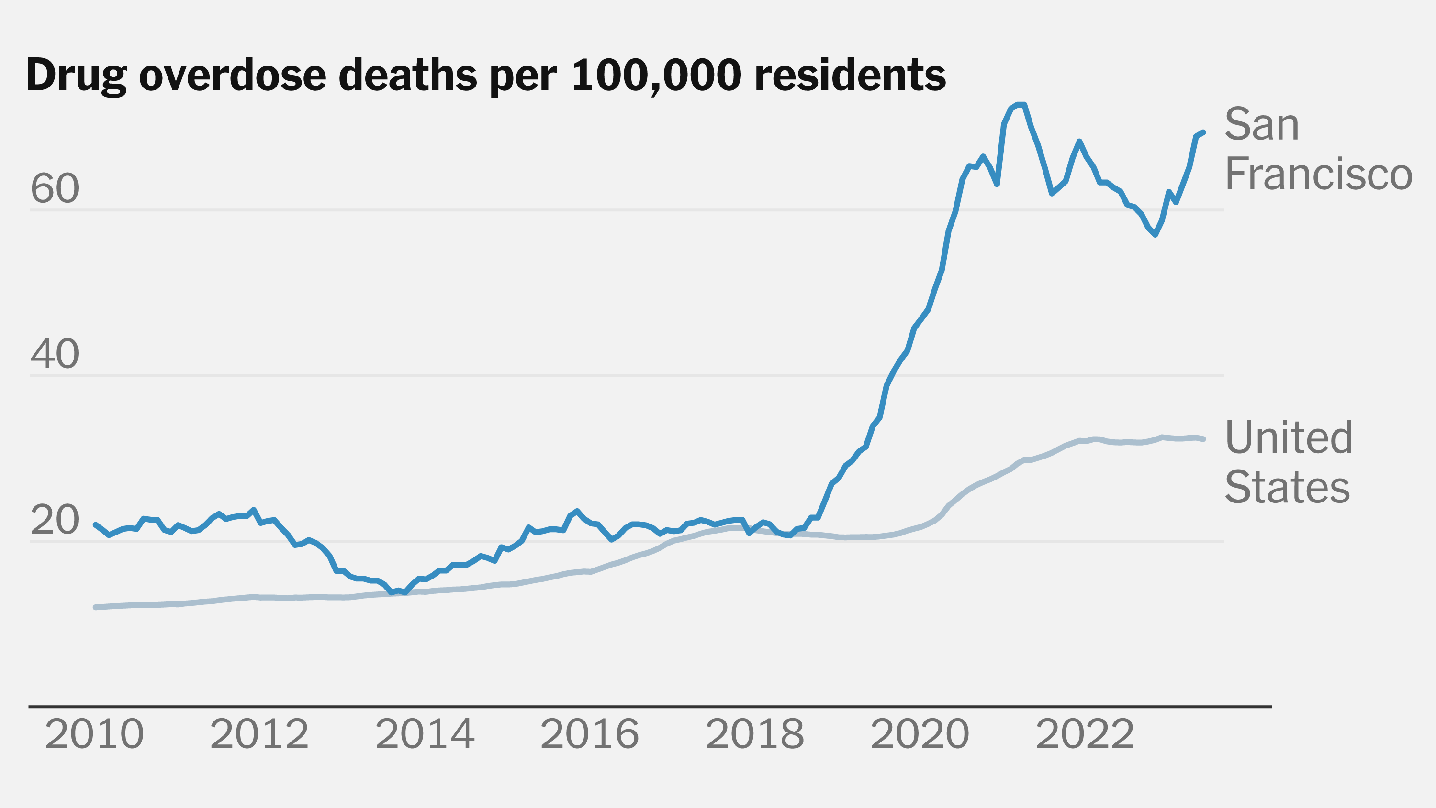
What Drives Harm Reduction Practices in Professional Training ?
Half of ZSFG patients have an SUD, unconnected to community care, low SES
SF: #1 county in CA (#5 city in the US) with highest accidental overdose deaths in 2019
CDC Wonder, 2024
SF Chronicle, 2024
ACT, 2024
Notes:
Don’t read the title, skip it and continue with what I was saying
as you can see there is a clear need to integrate evidence based harm reduction in medical settings
THROW IN RANDOM QUESTIONS TO KEEP AUDIENCE ENGAGED What’s special about SF general? We have been doing 150 years

Slide 7
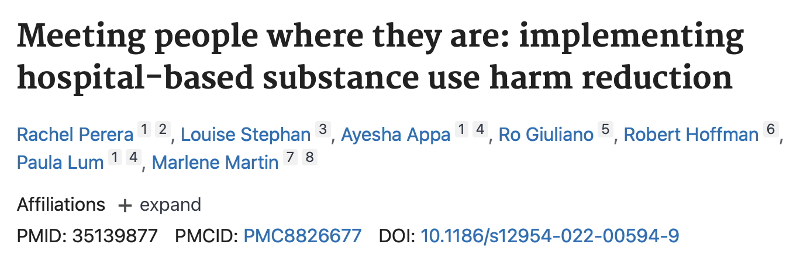
ZSFG Leads the Way in Hospital-Based Harm Reduction
Improve engagement with patients who use drugs (PWUD)
Teach
Feedback
Reduce stigma
Action

Slide 8
Hospital-Based Harm Reduction Enhances Provider Fulfillment & Prevents Burnout
“(…) integrating harm reduction services into hospital care increased access for populations unfamiliar with harm reduction, improved trust, and reduced stigma.”
L-Fraimow Wong, 2024, Karm Khan 2022
Notes:
Introduce last literature search better “and there is other literature out there that have highlighted benefits of harm reduction …”
The main takeaway of this study is “Paraphrase the quote”

Slide 9
Why aren’t healthcare workers fully prepared?
Notes:
PAUSE
Paraphrase this too “with all of this information at hand, why aren’t we seeing healthcare workers fully prepared to tackling “

Slide 10
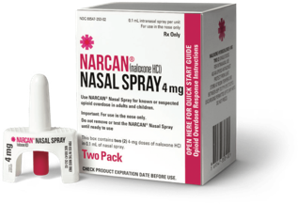
Harm Reduction Curricula is Not Well Integrated in Modern Medical Training
42 IM residents at
ZSFG surveyed
ZSFG
Residents did not feel comfortable discussing overdose prevention with their patients with SUD
60%

Slide 11
How can we address this learning gap?
Notes:
Paraphrase “so how do we tackle with learning gap”

Slide 12
Workshop for Diverse Cohorts
(1)
(2)
(3)
Module on harm reduction principles
A video on functions of specific safer-use supplies
Case-based practice on history taking and counseling
Notes:
This is where my work comes in

Slide 13
Workshop Participants
Medical Students
N=15
IM Residents
N=4
24%
3 Workshops
60%
Bedside Nurses
N=6
45 min. each
Total (N=25)
Notes:
3rd year medical students 60% 15/25
Internal medicine residents 16% 4/25
Bedside nurses 24% 6/25
Who were our workshop guests? We had…

Slide 14
How did medical professionals perform at baseline?

Slide 15
Measuring Pre-Workshop Baseline
67%
50%
7%
7%
0%
0%
0%
0%
(1) Understanding functions of safer
use supplies
(2) Knowledge of harm reduction resources
(3) Taking harm reduction focused histories
Notes:
How did we assess this and develop this survey tool? Think about why we designed this
What about the results was exciting to me? why particularly excited for bedside nurses "i was typically excited b/c they interface with our patients the most and often in front lines and get a lot of questions from our nurses, i provided HR resources on the unit and i get a lot of questions every day"

Slide 16
What was the outcome for this workshop?

Slide 17
Significant Improvements Across Cohorts
Notes:
coded responses as correct/incorrect and compared pre and post workshop answers using a a paired t-test
Understanding safer use supplies: increased from 20% to 93 %
Knowledge of harm reduction resources: Increased from 20% to 96%
Taking harm reduction focused histories: increased from 0% to 80%

Slide 18
Pre-Workshop
Post-Workshop
Notes:
Bottom Line: that singular modular workshop was effective for various group of healthcare workers

Slide 19
All Competencies Improved
Understanding safer use supplies:
20% 93%
***
***
Knowledge of harm reduction resources:
20% 96%
Taking harm reduction focused histories:
0% 80%
***P<0.001
Notes:
Improve the flow and summarize the data “ and eventually want to get this to 100%”
Practice with and without saying percentages
all 3 competencies are important but this one i want to highlight because we started at zero and were successful in increasing on average to 80% and eventually want to get 100% on average
overall rate of correct answers: 13.3% (pre) and 89.3% (post), p < 0.001).

Slide 20
In Summary
Addressing gaps in harm reduction is vital for improving SUD medical education and training
An interactive workshop improves harm reduction core knowledge and skills
There is a need to integrate harm reduction training more broadly
Notes:
Paraphrase
“and this is a building stone towards that”
One time intervention and it worked for nurses, students, and residents
Was this survey durable– we didn’t go back to survey at a later time, area for exploring in the future
What would be my next steps in this?
In summary:

Slide 21
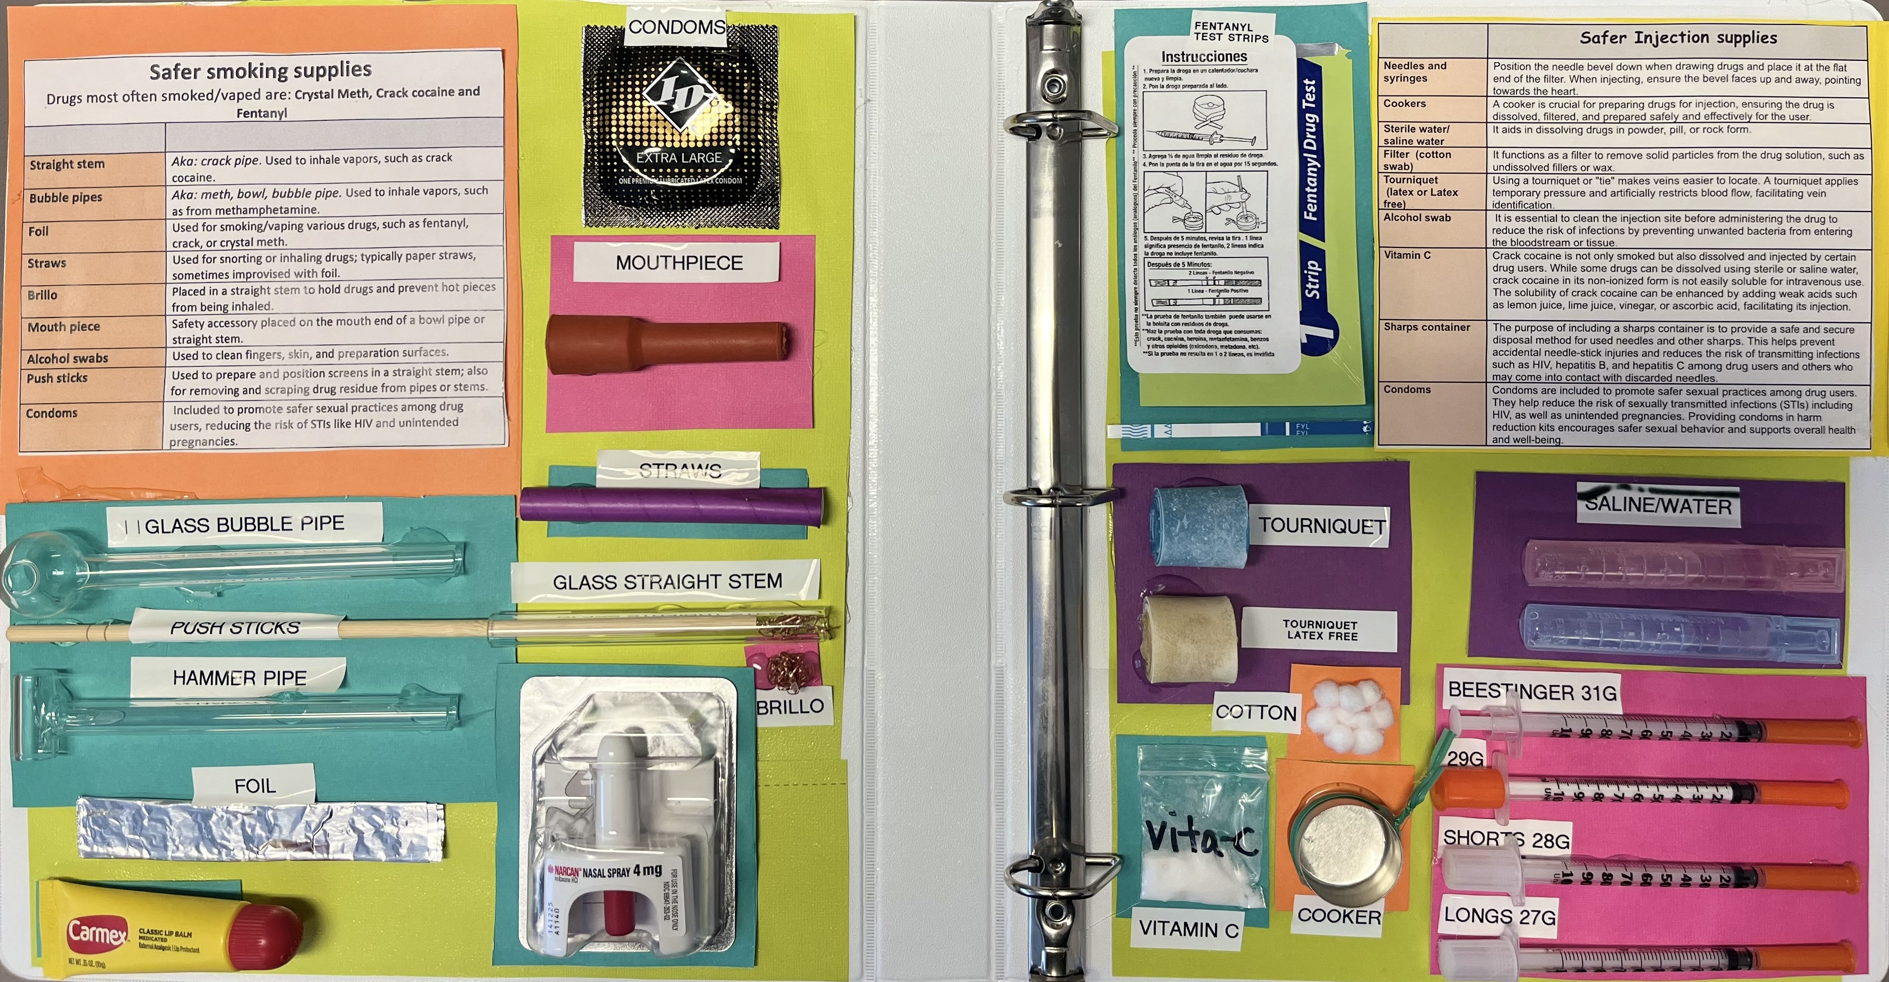
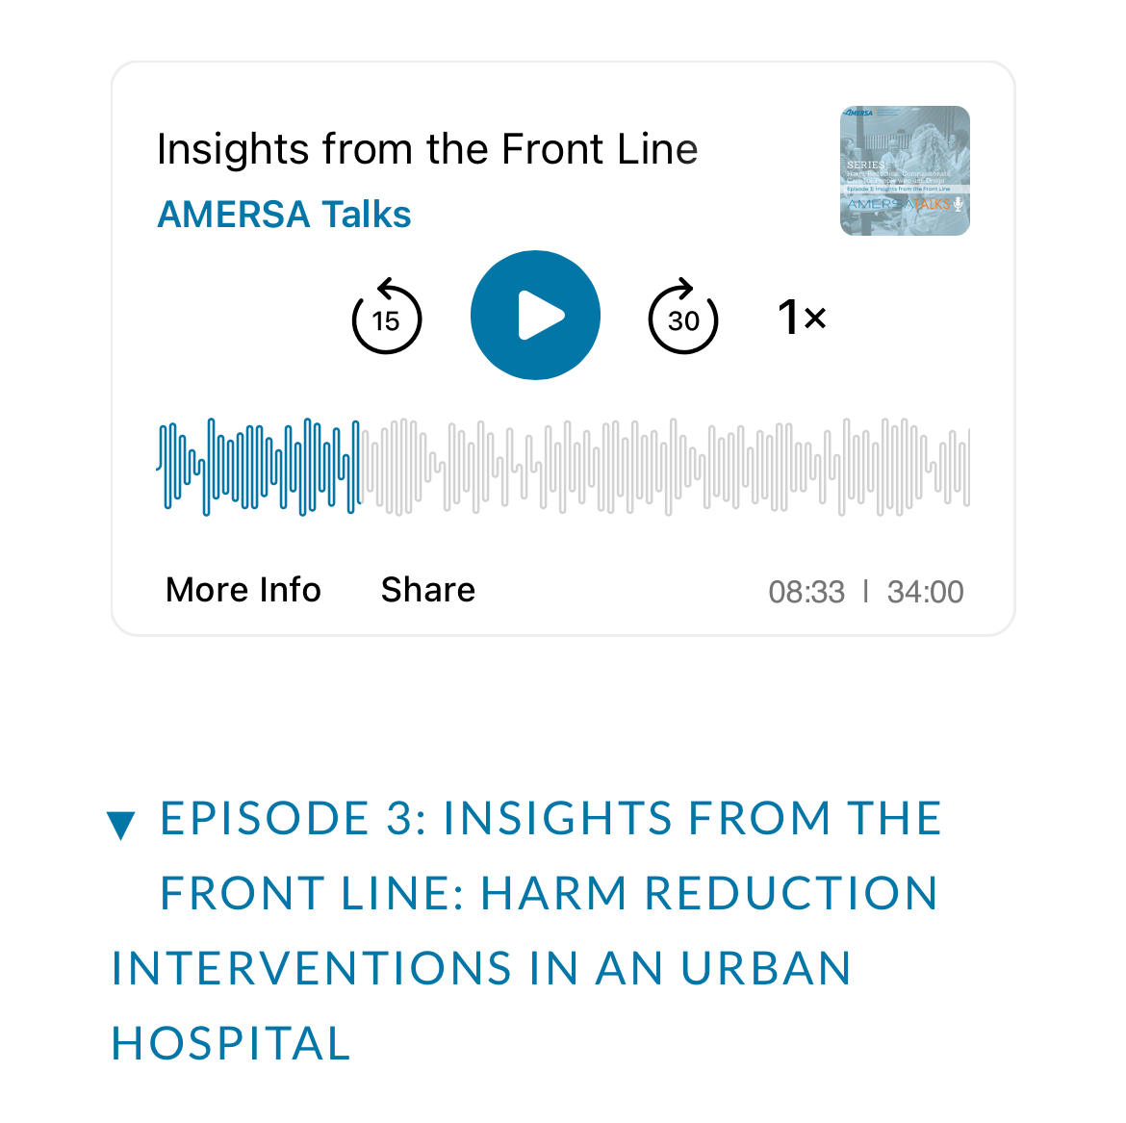
Check Out These Resources!
Patty.moreno@ucsf.edu
Notes:
PAUSE
Make this more natural
say my spiel before goodbye
Really sell this! If that sounds cool to you and do at your institution then click on this QR code

Slide 22
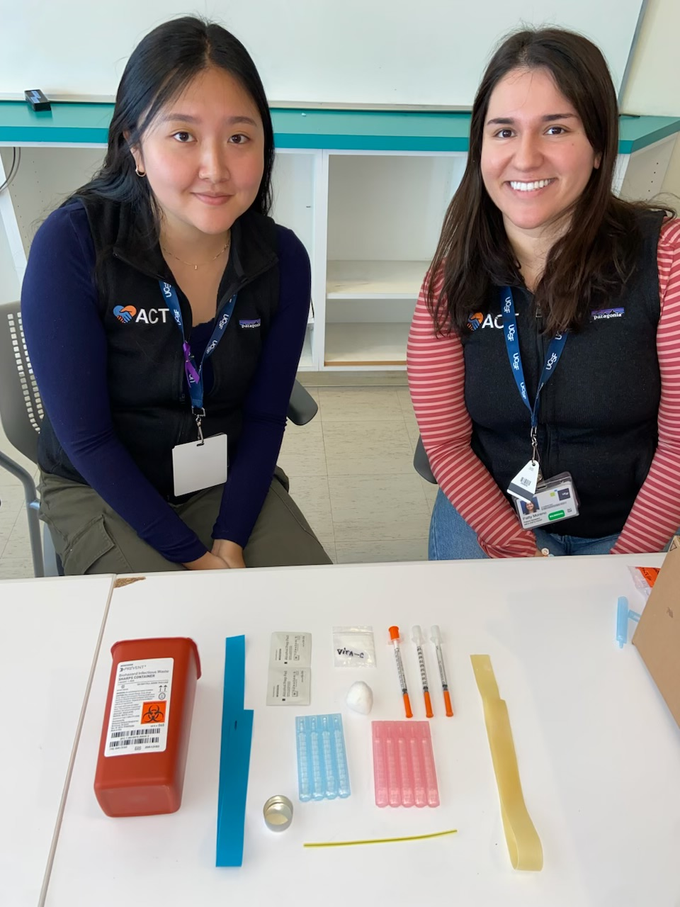
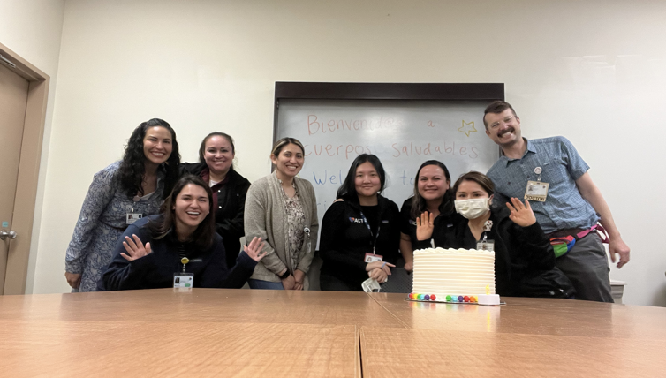
Thank You AMERSA!
Chicago, IL
SF, CA

Slide 23
Questions?
Chicago, IL

Slide 24
1) What is Vitamin C powder used for in safer injection practices?
2) What is the name of the overdose prevention hotline that anyone can call to reach a volunteer who will stay on the line while they use drugs?
3) When taking a substance use history, you can use the mnemonic DOPE. What does it stand for?

Slide 25
Harm Reduction enhances provider fulfillment & prevents burnout
Study 1 themes
Study 2 themes
Expanded access to harm reduction services
Stigma harms patients, specialists, and trust
Improve trust between patients and providers
Low-barrier referrals enhance harm reduction access
Catalyzes culture change
L Fraimow-Wong, 2024
Karim Khan, 2022

Slide 26
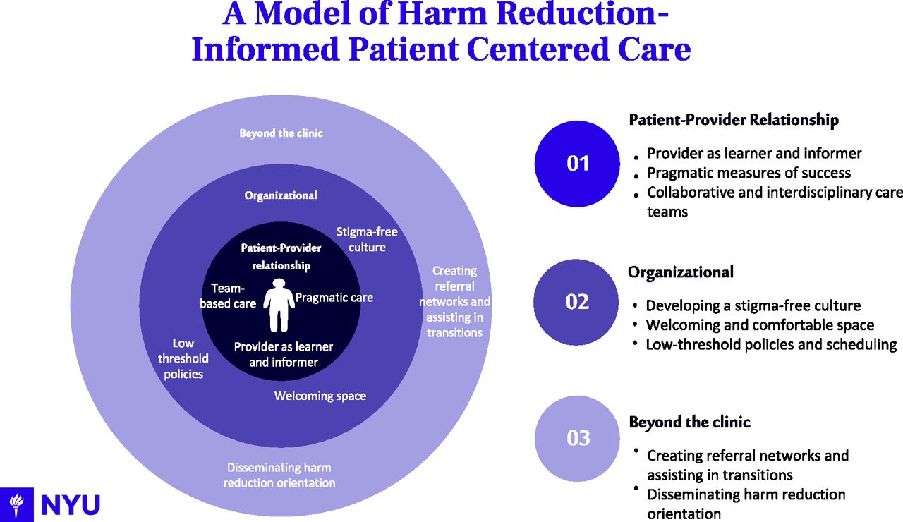
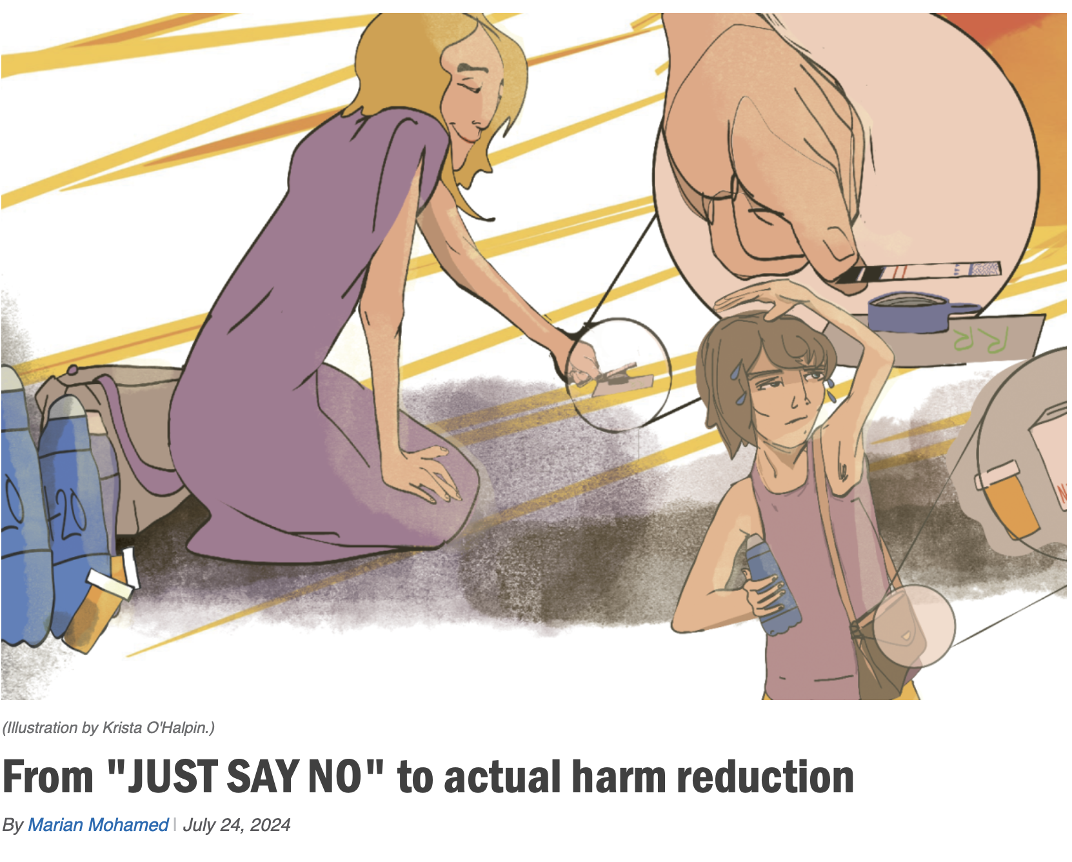
Extra

Slide 27
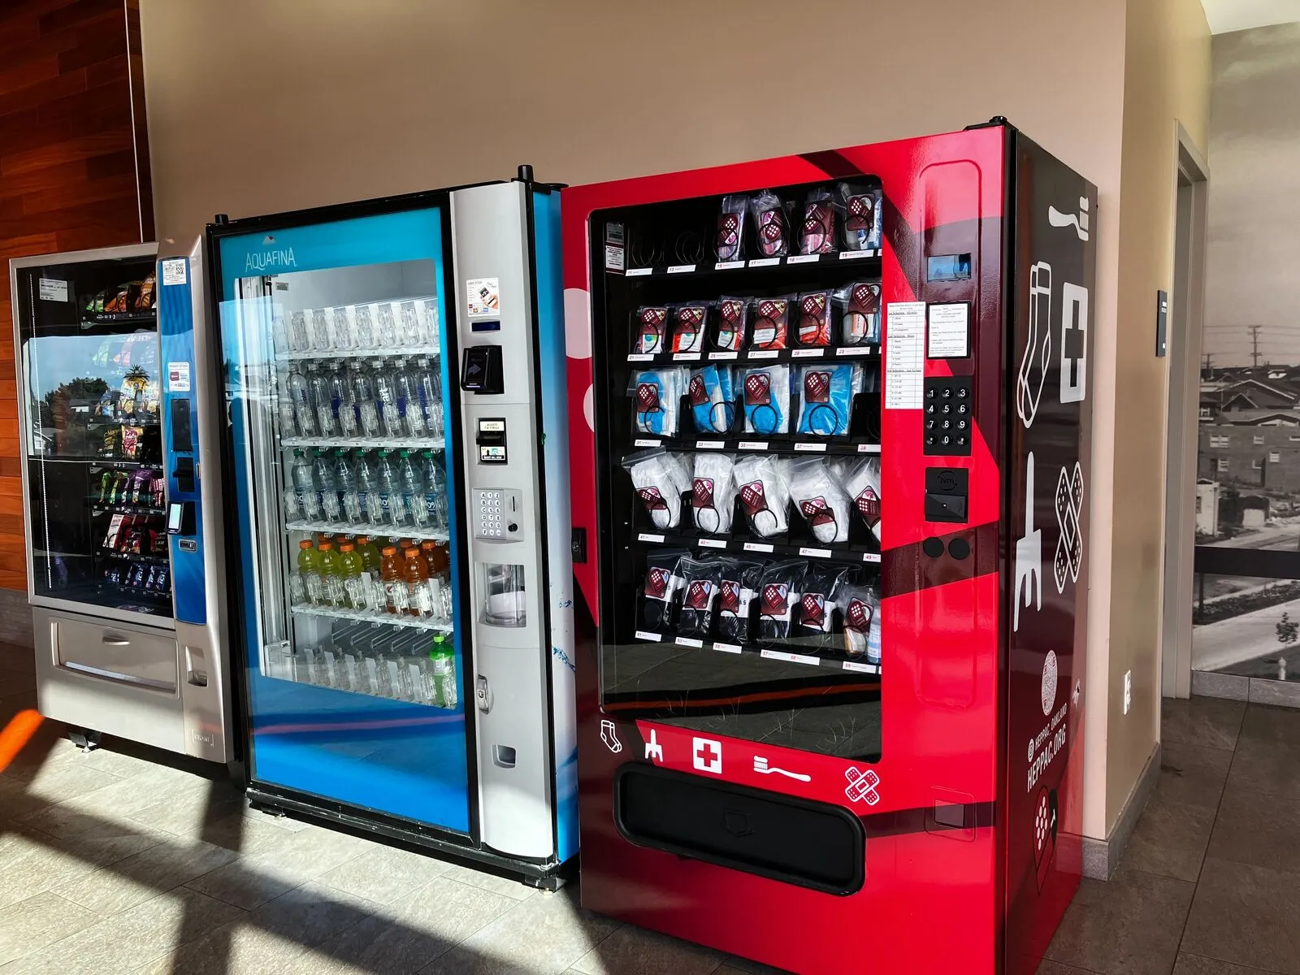
Elevating harm reduction with vending machines
Innovations!
Notes:
Dave Purchase Project funded, funded by CA DPH, not SFDPH
Learned a fun fact that Chicago piloted their first HRVM on November last year

Slide 28
Check out our episode on the AMERSA Podcast
Notes:
Bonus slide
Also, if ur interested, I encourage you all to check out…

Slide 29
Almost half of SFGH's patients have an addiction. People identified by our city as the most marginalized are individuals ACT prioritizes during emergency department visits and hospitalizations to reduce the harms of substance use while addressing the medical and psychosocial complications of addiction. Half of the patients with SUD we see are unconnected to community care.

Slide 30
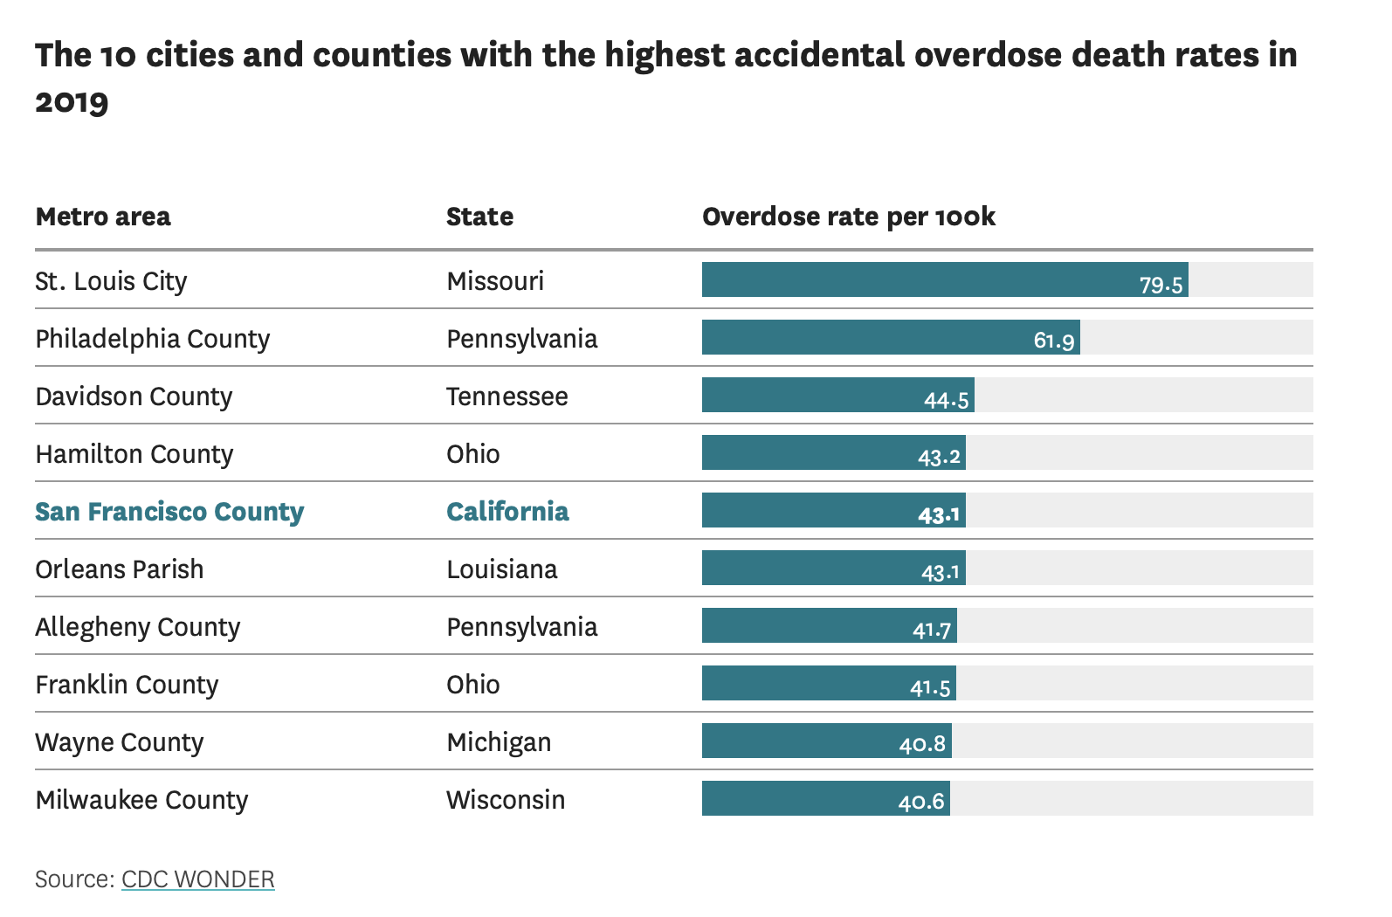
interdisciplinary collaboration
response to overdose crisis
patient-centered care
legal and policy changes
human rights and ethics
reducing stigma
public health
evidence-based practice

