Slide 1


Prevalence of fentanyl analogues in toxicology profiles of emergency department patients with untreated opioid use disorder
Ethan Cowan MD MS, Gail D’Onofrio MD MS, Jeanmarie Perrone MD, James Dziura PhD, Kathryn Hawk MD MHS, Andrew Herring MD, Ryan McCormack MD, Manali Phadke MS, David A. Fiellin MD
Notes:
I’ll be discussing…
This study is part of a clinical trials network study funded by NIDA under the HEAL initiative

Slide 2
Conflicts of Interest
None
Notes:
I have no

Slide 3
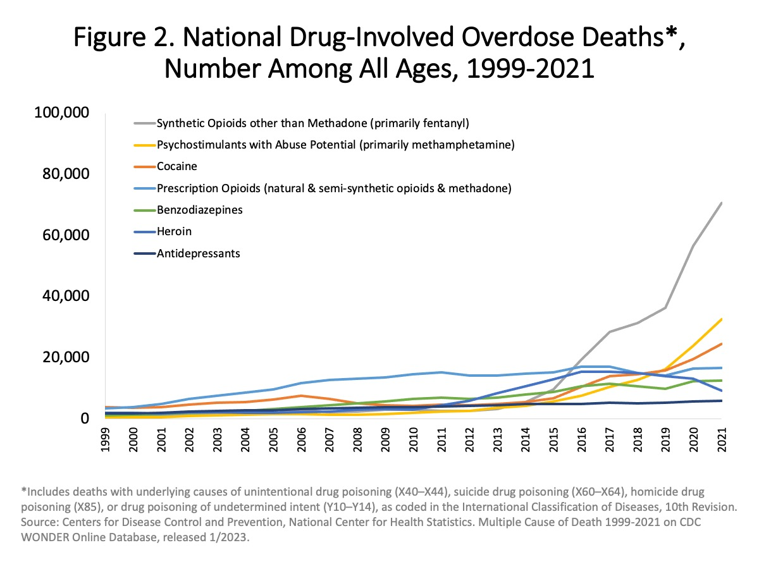
Background and Purpose
National Drug-Involved Overdose Deaths
Overdose deaths are at all time highs
Driven by synthetic opioids – primarily fentanyl
Small studies have shown escalating prevalence of high potency fentanyl analogues
Data on fentanyl analogues come from forensic studies of deceased persons or drug seizures
We sought to characterize the presence of fentanyl analogs as assessed by urine drug screens (UDS) in patients with untreated opioid use disorder (OUD) participating in the ED INNOVATION study at 28 Emergency Departments (EDs) in the U.S.
Drug Overdose Death Rates | National Institute on Drug Abuse (NIDA) (nih.gov)
Notes:
We all know this already but every time I give a talk the numbers seem to get worse and worse.
The current overdose crisis is primarily driven by powerful synthetic opioids, primarily fentanyl
There have been some recent data, mostly from drug seizure reports and forensic data, showing an increasing prevalence of fentanyl analogues of varying potency. There have been relatively few reports on the prevalence of fentanyl analogues in living persons across the united states.
In this study we…

Slide 4
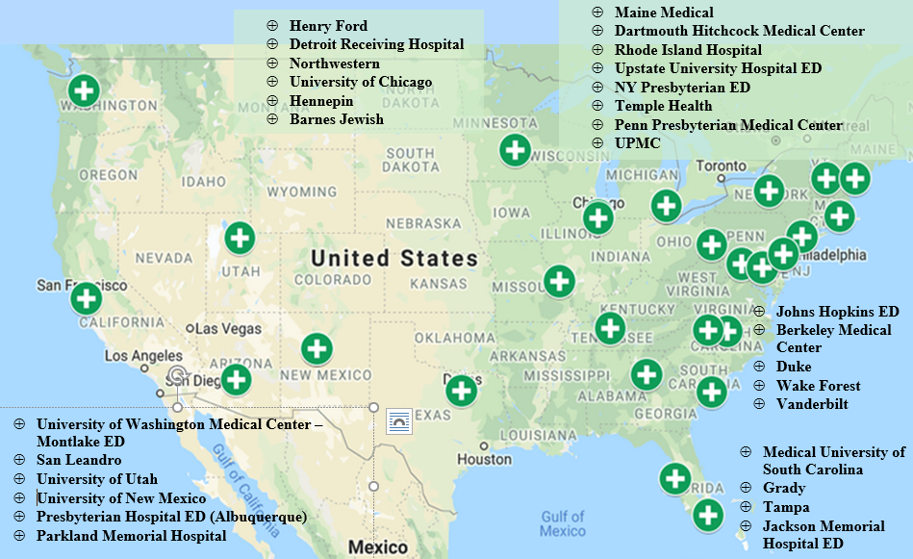
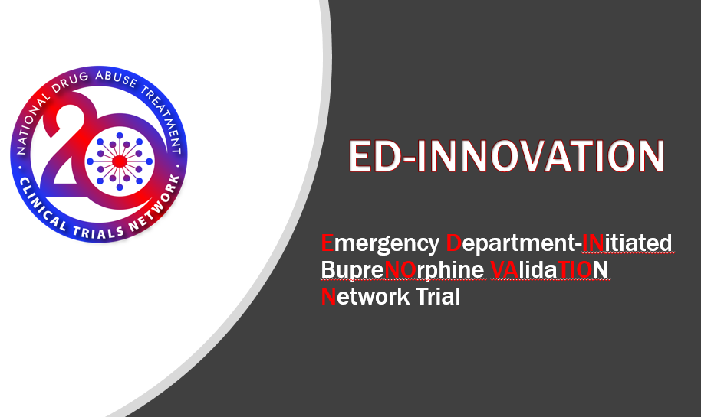
Methods
Notes:
ED INNOVATION is a Hybrid Type-1 Implementation-Effectiveness study with both implementation and effectiveness outcomes. The urine drug screens that were analyzed for this study come from participants in the randomized controlled trial portion of this study comparing the effectiveness of two BUP formulations, sublingual (SL-BUP) and 7-day extended-release injectable (CAM2038 now known as Brixadi).
All the sites participating in ED innovations are denoted in black print on the diagram on the right. Those sites participating in the RCT whose data is included in this sub analysis are denoted by green circles with the white plus sign.

Slide 5
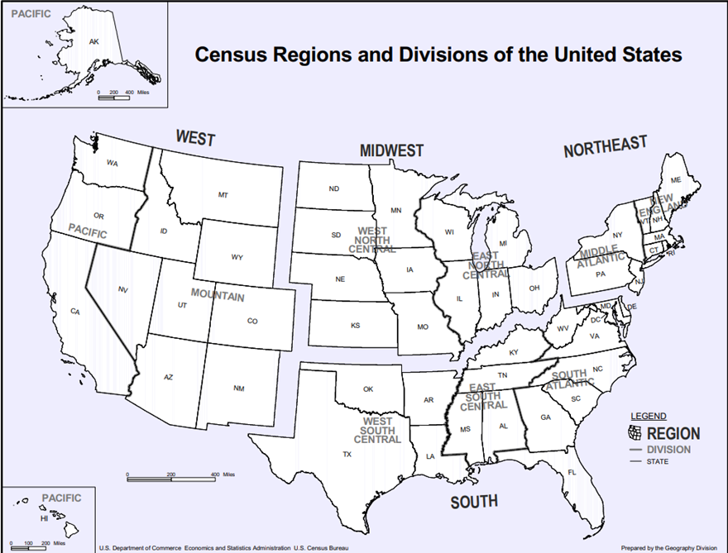
Methods
Study eligibility
    Adult ED patients
    Opioid use disorder (OUD) defined by DSM-5 criteria
    Not engaged in MOUD treatment
    Urine drug screen (UDS) with at least 1 opioid and no methadone
Initial UDS of enrolled participants between July 12, 2020 and November 1, 2022.
    Qualitative liquid chromatography tandem mass spectrometry (LC/MS)
  Data analyzed by census regions
Furanylfentanyl | Acrylfentanyl | Butyrylfentanyl
Cyclopropylfentanyl | Methoxyacetylfentanyl | Valerylfentanyl
4fluoroisobutyrylfentanyl | Parachlorofentanyl | Sufentanil
Remifentanil | Fentanyl* | Norfentanyl*
Carfentanil* | Acetylfentanyl*
*Quantitative LC/MS
Notes:
To participate in the patients had to be adults meeting DSM5 criteria for opioid use disorder who were not engaged in addiction treatment within 2-weeks of their ED visit. A baseline urine drug screen was collected to assess further study eligibility which includes a UDS with at least 1 opioid and no methadone. These baseline urines were then frozen and shipped by the sites to a central lab for analysis. The data being presented today is from participants enrolled in ED INNOVATION between July 12, 2020 and November 1, 2022.
We performed Qualitative liquid chromatography tandem mass spectrometry (LC/MS) analysis for the shown fentanyl analogues and metabolites. Quantitative LCMS was also available Fentanyl, Norfentanyl, Carfentanil and Acetylfentanyl. We examined the prevalence of analogues by site and by the census regions shown on the right. This geographic breakdown was chosen to match recent CDC reporting of fentanyl associated opioid overdose deaths.
*O’Donnell J, Tanz LJ, Gladden RM, Davis NL, Bitting J. Trends in and characteristics of drug overdose deaths involving illicitly manufactured fentanyls—United States, 2019–2020. Morbidity and Mortality Weekly Report. 2021 Dec 12;70(50):1740.

Slide 6
Methods
We report
Population demographics (slide 7)
UDS count by site (slide 8)
Fentanyl and fentanyl analogues prevalence by
    Region of the country (slide 9)
    Site (slide 10)

Slide 7
Study Population Characteristics
 | Overall (N = 948)*
Age(years) (Mean (SD)) | 39 (12)
Sex
Female | 317 (33%)
Male | 631 (67%)
Race
Black or African American | 278 (29%)
Other/Unknown | 130 (14%)
White | 540 (57%)
Ethnicity
Hispanic or Latino | 143 (15%)
Not Hispanic or Latino | 793 (83%)
Unknown | 12 (1%)
Any intravenous drug use-past 30 days | 275 (29%)
Housing insecurity (shelter, street, SRO, doubled up)-past 30-days | 476 (51%)
*12 participants missing demographic data
Notes:
These are some of the population characteristics. More extensive data will be available at the end of the study but a couple of things to notice. Approximately 1/3 are non-white, with a 2:1 male predominance. Most participants were not using drug intravenously. More than ½ of the participants had some degree of housing insecurity at the time of their enrollment. This could have included being on the street, in a shelter or SRO or being doubled up in apartment.

Slide 8
Urine Drug Screen Counts by Site
Summary Data
  960 Analyzed UDS – Unique participants
Site Contributions
  Range 2 – 116
  Median 28.5
West
Northeast
South
Midwest
Site Name and Region
Notes:
With regard to UDS counts by site there was significant variability. Some sites contributed very few urine drug screens to the analysis like Upstate Medical Center and Northwestern while others contributed many urines like university of Utah and Highland. These data are simply reflective of the differences in enrollment by site. A total of 960 urines analyzed for this report.

Slide 9
Fentanyl Analogue Prevalence
Substance | Region |  |  |  | Overall N=960
 | Northeast (N=256) | South (N=177) | Midwest (N=146) | West (N=381)
Fentanyl alone | 124 (48%) | 75 (42%) | 63 (43%) | 115 (30%) | 377 (39.3%)
Analogue alone | 9 (3.5%) | 12 (6.8%) | 6 (4.1%) | 63 (16.5%) | 90 (9.4%)
Fentanyl + Analogue | 95 (37.1%) | 47 (26.6%) | 55 (37.7) | 48 (12.6%) | 245 (25.5%)
Furanylfentanyl | 0 (0%) | 0 (0%) | 1 (0.7%) | 3 (0.8%) | 4 (0.4%)
Cyclopropylfentanyl | 0 (0%) | 0 (0%) | 0 (0%) | 4 (1%) | 4 (0.4%)
Acrylfentanyl | 0 (0%) | 1 (0.6%) | 0 (0%) | 0 (0%) | 1 (0.1%)
Butyrylfentanyl | 4 (1.6%) | 2 (1.1%) | 0 (0%) | 0 (0%) | 6 (0.6%)
Methoxyacetylfentanyl | 40 (15.6%) | 7 (4%) | 16 (11%) | 2 (0.5%) | 65 (6.8%)
Valefylfentanyl | 1 (0.4%) | 0 (0%) | 0 (0%) | 1 (0.2%) | 2 (0.2%)
4fluoroisobutyrylfentanyl | 4 (1.6%) | 0 (0%) | 0 (0% | 0 (0%) | 4 (0.4%)
Parachlorofentanyl | 27 (10.6%) | 3 (1.7%) | 9 (6.2%) | 0 (0%) | 39 (4.1%)
Sufentanil | 5 (2%) | 11 (6.2%) | 4 (2.7%) | 1 (4.8%) | 21 (2.2%)
Remifentanyl | 0 (0%) | 0 (0%) | 0 (0%) | 0 (0%) | 0
Acetylfentanyl | 59 (23.1%) | 33 (18.6%) | 34 (23.3%) | 74 (19.4%) | 200 (20.8%)
Carfentanil | 18 (7%) | 25 (14.1%) | 17 (11.6%) | 51 (13.4%) | 111 (11.6%)
Notes:
This is really the meat of the data so I’ll spend a little more time on this. Here you see all of percent of urines with each fentanyl analogue broken down by region and for the study as a whole.
A couple of things to point out. First, I’ve drawn boxes around all the analogues that were found in more than 5% of the urines analyzed.
Second, 9.4% of all urine drug screens had an analogue of fentanyl present but no fentanyl. That is shown in the first highlighted line.
Third, there is significant variability in prevalence between the different fentanyl analogue and even among the same analogue by region.
For example, Methoxyacetylfentanyl was found in 6.8% of all urines but when looked at by region it was found in 15.6% of urines in the Northeast but only 0.5% of urines in the West.
The same goes for parachlorofentanyl where the overall prevalence was 4.1% but when looked at by region it was found at a much high prevalence in the Northeast than in the West or South
Lastly, the two most common analogues were Acetylfentanyl being found in approximately 20% of all urines and Carfentanil being found in approximately 12% of all urines.
Can you say exactly which analogues the 9.4% alone were? All of them were present except for 4fluoroisobutyrlfentynl, parachlorofentanyl and remifentanyl

Slide 10
Distribution of Fentanyl Analogues - Overall Prevalence
Region | n/N (%)
Midwest | 61/146 (42%)
Northeast | 104/256 (41%)
South | 59/177 (33%)
West | 111/381 (29%)
Notes:
Here, the graph on the left is showing percent of total urines containing an analogue broken down by site. So just to interpret this here sites that contributed more specimens were likely to have also contributed a higher percentage to the total percent of analogues found. This is why graph skewed toward those sites that had a greater number of samples analyzed. Main Medical Center, University of Utah and Highland hospital are three of the top recruiting sites and make up the bulk of the number of fentanyl analogues detected. Probably more interesting is the prevalence of a fentanyl analogue in the urine by census region. Here we see variability in the % of urines with an analogue present with the lowest percentage in the Western region and higher percentages in Midwest and Northeast regions.

Slide 11
Summary
35% of UDS specimens had at least one fentanyl analogue present
9.4% of UDS specimens had a fentanyl analogue present without fentanyl
89% of sites had more than 20% of their UDS specimens with > 1 fentanyl analogue
29% of sites had > 50% of their UDS specimens with at least > 1 fentanyl analogue
Fentanyl analogues are common in all census regions
Most common (>5%) analogues:
    Methoxyacetylfentanyl
    Acytelfentanyl
    Carfentanil
    Parachlorofentanyl (Northeast)
    Sufentanil (South)
Wide geographic variations of specific analogues by region
Notes:
To summarize some of this data.
35% of all urine specimens analyzed had a least one fentanyl analogue present indicting that this is not a rare phenomenon.
9.4% of all urine specimens analyzed had a fentanyl analogue without fentanyl which could have some clinical impact if you were only testing for fentanyl.
At most sites a fentanyl analogue was found in at least 20% of the urines analyzed and at almost a 1/3rd of the sites a fentanyl analogue was found in more than 50% of the urines analyzed. Fentanyl analogues were detected at every site and were common in all census regions.
The most common analogues, those found in more than 5% of the urines are shown here with the two highest being Carfentanil and Acytelfentanyl.
Ultimately, what we see is that fentanyl analogues found commonly but the specific distribution of these analogues varies tremendously by region.

Slide 12
Discussion
Impact of fentanyl analogues on buprenorphine initiation and/or engagement in care is unknown
Impact on overdose risk due to variable fentanyl analogue potencies and geographic distributions are unclear
Role for street level drug testing for risk mitigation?
Quantitative data (fentanyl, norfentanyl, acetylfentanyl, carfentanil) needs further analysis
Other new psychoactive substances (Nitazenes, Xylazine) will be analyzed
Future Work
Notes:
Unfortunately, we don’t yet know what impact any of these analogues have on buprenorphine initiation or engagement in care but will be able to analyze some of those associations once we have all the outcome data.
For most of these analogues we also don’t know the concentrations of these analogues in the drug supply and what impact the presence of these analogues are having on overdose. Some of the analogues are clearly more potent than fentanyl like carfentanyl and sufentanil whereas the others are equally or less potent than fentanyl.
This uncertainty around concentrations makes it difficulty to know what impact street level drug testing might have on risk mitigation.
With regard to future work we plan to further analyze the quantitative data and test the samples for Nitazenes, Xylazine and Xylazine metabolites.

Slide 13

Contact Information
Ethan Cowan, MD, MS
Ethan.Cowan@mountsinai.org

Slide 14
Fentanyl, Norfentanyl and Analogues
Substance | Overall N=960
One fentanyl analogue | 229 (24%)
Two fentanyl analogues | 91 (10%)
More than two fentanyl analogues | 15 (2%)
Fentanyl+/Norfentanyl- | 184 (19%)
Fentanyl-/Norfentanyl+ | 30 (3%)
Notes:
of the 90 people that only had a fentanyl analogue in their UDS, 57 (63%) of them had another opioid (BUP, Methadone, Opiate, Oxy) in their urine (but not fentanyl) on their screening UDS.

Slide 15
