Slide 1
KEY INFORMANT Experiences of Substance Use-Related Disorder Management in Pediatric Hospitals
Adam Kronish, MD (he/him)
Zane MacFarlane, MD Candidate (he/him)
Victoria Miller, PhD (she/her)
Maria Christina Herrera, MD, MSHP (she/her)
Notes:
Good afternoon everyone! My name is Dr. Adam Kronish and I'm a senior adolescent medicine fellow at the Children's Hospital of Philadelphia
"And I'm Zane Macfarlane, a 3rd year medical student at the University of Pennsylvania School of Medicine".
We are here to present our qualitative study about how providers experience SUD-related care in pediatric hospitals on behalf of the rest of our research team with Dr. Miller and Dr. Herrera.

Slide 2
Support and Disclosures
No relevant financial relationships or disclosures
Diversity/Equity Statement:
Our authors make up a diverse group of racial, ethnic and sexual identities underrepresented in medicine.
Sources of Support:
This project was supported by the Health Resources and Services Administration (HRSA) of the U.S. Department of Health and Human Services (HHS) under T71MC30798 Leadership Education in Adolescent Health (LEAH), the Craig Dalsimer Division of Adolescent Medicine at the the Children's Hospital of Philadelphia (CHOP), and Clinical Addiction Research and Education (CARE) Program (NIDA: R25DA03582).
This information or content and conclusions are those of the authors and should not be construed as the official position or policy of, nor should any endorsements be inferred by HRSA, HHS, NIDA, or the U.S. Government.”
Notes:
We have no financial disclosures and our sources of support are listed here.
Our research team makes up a diverse group of minoritized identities that are underrepresented in medicine and we will include some statements of DEI within our presentation

Slide 3
Data on Substance Use in Youth
Notes:
For some quick background on this topic, according to recent Youth Risk Behavior Survey data, there has been an overall decrease in the rates of substance use & misuse in AYAs in the past decade
And despite this, as seen on the red line of this graph, unintentional Overdose Deaths have increased in the same time period. You can see here a substantial increase starting in 2020 with the rise of fentanyl in the drug supply and co-stimulant use during the 4th wave of the opioid epidemic.

Slide 4
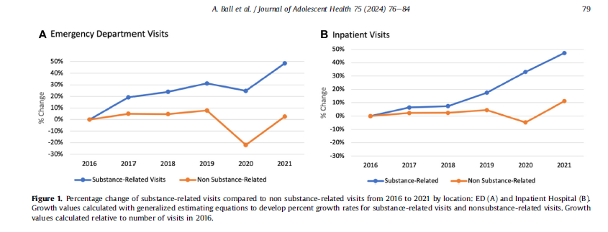
Children's Hospitals and Substance Use
Notes:
This past summer, some our colleagues in the room published a study in the Journal of Adolescent Health, quantifying the number of hospital visits in children's hospitals related to substance use and overdose. What is most striking here is that over the past 5 years, the rates of presentation to children's hospitals have gone up even during COVID-19 when other ER and inpatient visits were decreasing in children's hospitals.
Ball A, Hadland S, Rodean J, Hall M, Mendoza J, Ahrens K. Trends in Substance-Related Visits Among Youth to US Children's Hospitals, 2016-2021: An Analysis of the Pediatric Health Information System Database. J Adolesc Health. 2024;75(1):76-84. doi:10.1016/j.jadohealth.2024.02.016

Slide 5
The Research Question
Case reports/series describe individual institutions' experiences with care around specific substances
There is not yet a description of what happens in children's hospitals more broadly
Study Aim: to characterize the current state of substance use disorder (SUD) treatment for adolescents and young adults (AYAs) in pediatric hospitals and elucidate facilitators and barriers of care
What does care related to SUD in children's hospitals look like across the country and can we identify areas of improvement in substance-related care?
Notes:
There have been a few case reports and series describing individual hospital's experiences, particularly around diagnosis and screening of SUD. But there is little data on what happens when patients are admitted to children's hospitals. The aim of our study is to further characterize this research gap by talking to experts from a select number of academic children's hospitals who care for adolescents and young adults with SUD related concerns.

Slide 6
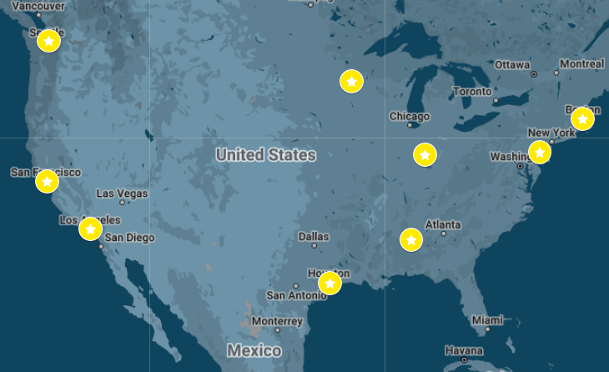
Recruitment
12 physicians from 9 academic children's hospitals in urban centers
All receive funding through the MCHB Leadership Education in Adolescent Health grant
Mix of adolescent medicine, addiction, and child/adolescent psychiatry providers
Notes:
We interviewed 12 physicians identified as key informants from 9 academic children's hospitals in urban centers in the US. Our strategy was to recruit from programs that received funding through the Maternal Child Health Bureau's Leadership Education in Adolescent Health grant, also known as LEAH. Our participants represented a broad geographic distribution as represented on this map and was a mix of adolescent medicine, addiction medicine and child/adolescent psychiatry physicians.

Slide 7
Methods
Interview Guide
Study on Addiction Consult Services by Priest & McCarty 2019 summarized responsibilities of addiction services in adult hospitals
4 domains of coding:
Education and Training
Clinical services
Systemic and Institutional Factors
Culture & Stigma
Qualitative Data Analysis
Semi-structured, key-informant interviews recorded and transcribed
Double-coding and thematic analysis was conducted to consensus and saturation
Member checking with 2 non-LEAH addiction medicine providers with expertise in AYA care
Notes:
We developed an interview guide to inquire in an evidence-based fashion what a hospital with formalized addition consultation services would provide. Based on a 2019 study from Priest & McCarty, we developed 4 preliminary themes of qualitative coding, which are listed here.
After our semi-structured interviews were recorded and transcribed, we double coded to consensus and conducted thematic analysis until there was thematic saturation. After ¾ of interviews were completed, our preliminary themes were member-checked by 2 non-LEAH affiliated addiction medicine providers with expertise in AYAs care.
Zane will now review our descriptive findings and the results of our thematic analysis...
Priest, K. C., & McCarty, D. (2019). Role of the Hospital in the 21st Century Opioid Overdose Epidemic: The Addiction Medicine Consult Service. Journal of addiction medicine, 13(2), 104–112. https://doi.org/10.1097/ADM.0000000000000496

Slide 8
Descriptive Findings
Of the 9 institutions represented:
Outpatient SUD Services
5 offer outpatient support for SUDs
2 offer no outpatient support for SUDs
2 offer limited support or is done through non-pediatric specialty
Inpatient SUD Services
6 offer inpatient support for SUD
3 offer variable amounts of support
None had zero support
Disciplines involved:
All adolescent medicine, SW, psychiatry
Variability across institutions of other medical and non-medical disciplines
Notes:
Our next two slides show our descriptive findings of the 9 institutions represented by our participants that were gathered through closed and open ended questions
We found that a majority offered outpatient SUD services, and all institutions offered some form of inpatient SUD service.
All sites mentioned having adolescent medicine, SW and psychiatry involved with care, and greater site variability among other disciplines involved.

Slide 9
Descriptive Findings
Medical Services Offered Inpatient (n and % of institutions who reported that the service was offered) | Psychosocial Services Offered Inpatient (n and % of institutions who reported that the service was offered)^{i}
Buprenorphine/Suboxone/Sublocade (7, 78%) | Social work (9, 100%)
Benzodiazepines (7, 78%) | Psychology (6, 67%)
Nicotine replacement (7, 78%) | Case Management (4, 44%)
Symptomatic medications (7, 78%) | Child life services (3, 33%)
Naltrexone (3, 33%) | Other behavioral health (3, 33%)
Psychotropic medications (3, 33%) | Art/Music/Animal therapy (3, 33%)
N-acetylcysteine (2, 22%) | Chaplaincy (2, 22%)
 | Family Relations (1, 11%)
 | Resource specialists (1, 11%)
 | Risk Reduction Clinic (1, 11%)
Notes:
In this table, the percentages represent how many of the institutions mentioned a particular service being offered.
On the left we see that a majority of institutions described offering medications for substance use disorder such as buprenorphine for OUD...along with symptomatic meds like antiemetics, antidiarrheals.
On the right we also categorized the psychosocial services offered inpatient

Slide 10
Qualitative Themes
Insufficient Training & Experience
Medical Needs > SUD
Access to Care
Champions promote positive change
Legal Factors
Institutional Factors
Lack of Data in Peds
Attitudes towards SUD and AYAs
Increasing Needs & Underrecognition
Systemic Factors
Pathways/Algorithms
Notes:
Represented here are the 8 themes that were generated after qualitative analysis [pause] – we'll go through them in the next slides with representative quotes.

Slide 11
Themes and Quotes
"I think there's probably provider uncertainty about what diagnosis to use. Many providers aren't trained to make DSM 5 diagnosis of that pertain to substance use, and so they're more comfortable putting in a general diagnosis, nausea and vomiting, something like that."
Insufficient Training & Experience
Notes:
The first theme was that there is insufficient training and experience in addiction care and systems of SUD care for younger populations.
Participants discussed pediatric providers and trainees not receiving adequate training leading to lack of experience and discomfort in SUD care and that the lack of training extended interdisciplinary teams like nursing and social work. On the flip side, adult addiction providers had discomfort due to lack of training in younger populations.

Slide 12
Themes and Quotes
Medical problems prioritized over SUD
Clinical Pathways & Algorithms
"So the current state is kids are admitted for a medical reason and then the addiction is something that we manage as a correlate to that so that they can reach their treatment goals from the medical problem"
Notes:
You can see here the representative quote aligns with the theme of the same color on the left.
The second theme is that clinical pathways/algorithms standardize practice – this was commonly mentioned in institutions whether they did or did NOT have pathways.
Third, medical problems are prioritized over SUD care during admission, for example focusing on treating vomiting rather than the underlying withdrawal.

Slide 13
Themes and Quotes
Lack of Data in Peds
Access to Care
Systemic Factors
Legal Factors
Institutional Factors
"Right now when we're asking for resources for addiction-related treatments from the health system, the answer we often get is that the need isn't that high and therefore it's hard to justify, you know, paying full time equivalents for staff when the need isn't that high. My caveat to that is I think that data collection for substance use related issues is very, very limited because oftentimes those […]substance use related diagnosis aren't placed in the problem list […]And I think that the data we have are probably under reporting that."
Notes:
More big picture themes included that access to SUD care has many facilitators/barriers. Systemic factors included insurance, geography, and availability of different levels of care. Legal factors such as consent, confidentiality, credentialing/licensure were cited as perceived barriers. And institution-specific issues around the EMR, formulary offerings and policies were also cited as factors impacting care.
The fifth theme is that there is a lack of data in children’s hospitals related to SUDs, and this lack of data perpetuates a lack of support within hospitals as well demonstrated by this quote on the right. [pause for a second or two]

Slide 14
Themes and Quotes
“some pediatric residents are really into youth, and some are really into babies and not into adolescent issues and don't really don't want to ask [about substance use]"
Attitudes towards SUD and AYAs
Increasing Needs & Underrecognition
Champions promote positive change
“I think people are realizing this is something we need to do much, much better… pediatric hospitals all over the country, they're like “we have had overdoses, we've had deaths in our community. We need to do this and, like, please tell us where to start.” And so there's a huge interest there”
Notes:
Sixth was that attitudes towards addiction and AYAs affect care. On one hand, the profound stigma of addiction as well as pediatric provider's negative perceptions of adolescents greatly hindered care, while alternatively pediatric hospitals were better suited to treat adolescents and their psychosocial needs compared to adult hospitals.
[click for second quote] Our penultimate theme is that SUD in AYAs has been underrecognized and the need for care is increasing
Our eighth and final theme is that individuals and/or collaborative champions promote positive change by pushing for new clinical services, implementing pathways, or spreading awarenesss of their cause to hospital leadership, leading to overall advancement

Slide 15
Key Study Findings:
High degree of variability in care - individual, institution, geography, discipline
No standard of AYA SUD care & lack of consistent data
Culture & stigma around adolescents, young adults and addiction impact medically necessary care
Differences between the intersectional identities of inpatient providers and their patients may impact systems of care; just as stigma related to SUD adds barriers to care, so too does systemic oppression.
More education, training, institutional support and data have high potential for positive change
Notes:
So taking a step back, here are our key findings.
-There is a high degree of variability in care depending on individuals, institutions, geography, and disciplines involved.
[Skip 2nd bullet point]
-Our next finding is that culture and stigma around our patient population impacts medically necessary care. We also recognized through these interviews that youth who have more underrepresented intersectional identities or identities that are not reflected in the people taking care of them face even more barriers to care, discrimination, and systemic oppression.
Lastly, we believe that this study highlights that there is great potential for positive change if we are able to implement more education, training, institutional support and data gathering related to inpatient pediatric SUD care.

Slide 16
Limitations
All are academic children's hospitals in urban centers
Potentially more resources
Not where all children/adolescents get their inpatient care
Sample of providers were self-designated and recruited via adolescent medicine leadership development grant
Overrepresentation of adolescent medicine providers when others may provide addiction care (addiction medicine, family or internal medicine, child/adolescent psychiatry, etc.)
Notes:
Thanks Zane – We also want to acknowledge were some limitations to our study. First, our participants represented children's hospitals in urban centers, which may have potentially more resources than other institutions that provide addiction care to AYAs, particularly those in more rural areas. Academic children's hospitals are also not where all youth get their care but we intentionally approached these centers thinking that if any pediatric institutions were to have formal resources for addiction related care in youth, they would be affiliated with academic leaders in the field.
Additionally, our sample of providers were either self-designated or delegated as "experts" in this subject matter based on an adolescent health-based grant program. Therefore adolescent medicine may be overly represented whereas other specialists may provide this care elsewhere, as listed here.

Slide 17
Next Steps
Explore feasibility of national survey of children's hospitals
May utilize pediatric hospitalist network
Quantify and develop training and education
Needs assessment of adolescent medicine fellowships
Curricular development at CHOP: clinical pathway and Motivational Interviewing for Trainees
Continue to advocate for inclusion of youth in policies and guidelines related to SUD
Notes:
Based on our findings we hope to move forward with additional steps in research. We are currently exploring taking a more quantitative approach to describing addiction services in children's hospitals, potentially by surveying pediatric hospitalists. To address the gap in training and education, we are conducting a Needs Assessment of adolescent medicine fellowships about their current training in addiction medicine and have started curricular development for pediatric trainees at CHOP. Finally, we will continue to use our findings and those of our colleagues to advocate that the experiences of youth are included in guidelines, research and policies related to addiction.

Slide 18
Acknowledgements
Appreciation to our colleagues, mentors, and role models in addiction and adolescent medicine at the Children's Hospital of Philadelphia and University of Pennsylvania
Thank you to AMERSA for including the voices of pediatricians and adolescent specialists!
Contact Information: Kronisha@chop.edu
Notes:
To conclude, we would like to express our appreciation for our support network in Philadelphia and would like to say thank you to AMERSA for including the voices of pediatric and adolescent specialists. Thank you and we look forward to your questions!
CDC. (2024). Provisional Drug Overdose Data. CDC. https://www.cdc.gov/nchs/nvss/vsrr/drug-overdose-data.htm
Operation Engage Philadelphia. (n.d.). Www.dea.gov. https://www.dea.gov/engage/operation-engage-philadelphia
Centers for Disease Control and Prevention. (2024, April 23). Understanding the Opioid Overdose Epidemic. Overdose Prevention. https://www.cdc.gov/overdose-prevention/about/understanding-the-opioid-overdose-epidemic.html
Centers for Disease Control and Prevention. Youth Risk Behavior Survey Data Summary & Trends Report: 2013–2023. U.S. Department of Health and Human Services; 2024.
Substance Abuse and Mental Health Services Administration. (2023). Key substance use and mental health indicators in the United States: Results from the 2022 National Survey on Drug Use and Health (HHS Publication No. PEP23-07-01-006, NSDUH Series H-58). Center for Behavioral Health Statistics and Quality, Substance Abuse and Mental Health Services Administration. https://www.samhsa.gov/data/report/2022-nsduh-annual-national-report
Ball A, Hadland S, Rodean J, Hall M, Mendoza J, Ahrens K. Trends in Substance-Related Visits Among Youth to US Children's Hospitals, 2016-2021: An Analysis of the Pediatric Health Information System Database. J Adolesc Health. 2024;75(1):76-84. doi:10.1016/j.jadohealth.2024.02.016
Priest, K. C., & McCarty, D. (2019). Role of the Hospital in the 21st Century Opioid Overdose Epidemic: The Addiction Medicine Consult Service. Journal of addiction medicine, 13(2), 104–112. https://doi.org/10.1097/ADM.0000000000000496
U.S. Department of Health and Human Services. (2024, February 13). Unintentional drug overdose death rates among us youth aged 15-19. National Institutes of Health. https://nida.nih.gov/research-topics/trends-statistics/infographics/unintentional-drug-overdose-death-rates-among-us-youth-aged-15-19

