Slide 1

Providers’ Knowledge and
Perception of Xylazine in Connecticut
Katie Hill, Rebecca Minahan-Rowley,
Emma T. Biegacki, Robert Heimer, Kimberly L. Sue

Slide 2
No conflicts of interest to declare.

Slide 3
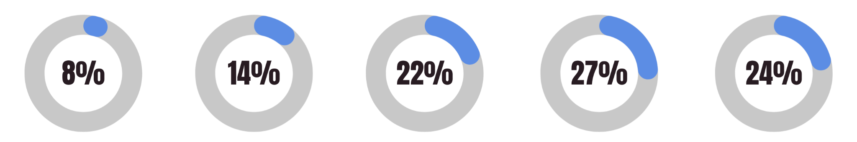
Frequency of Xylazine Detection In
Fentanyl Overdoses in Connecticut
2019
2020
2021
2022
2023
Cases: 73
Cases: 139
Cases: 290
Cases: 341
Cases: 282
Source: CT OCME Data

Slide 4
Sequential Explanatory Mixed-Methods Study
Study Aim:
Describing healthcare providers' experiences with treating patients who have been exposed to xylazine to improve healthcare education and best practices
Study Timeline:
October 2023 to February 2024
Quantitative (Phase 1):
Online survey utilizing convenience sample of healthcare providers in CT
Qualitative (Phase 2):
Semi-structured interviews utilizing purposive sampling

Slide 5
Phase 1: Survey (n=78)
 | Freq | %
Degree
MD | 61 | 78.2
NP | 7 | 9.0
DO | 5 | 6.4
Other Degree | 19 | 24.4
 | Freq | %
Specialty
Internal Medicine | 37 | 47.4
Addiction Medicine | 27 | 34.6
Emergency Medicine | 14 | 18.0
Other Specialty | 30 | 38.5
 | Freq | %
Years Treating Patients with SUDs
Mean (SD) | 8.2 | 9.4
Harm Reduction Acceptance
Favorable - Harm Reduction | 70 | 97.2
Favorable - Abstinence | 2 | 2.8
Source: Hill et al., 2024

Slide 6
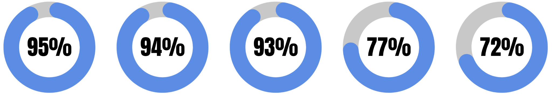
Provider Xylazine Knowledge
Had heard of
xylazine before survey
Knew xylazine can lead to severe wounds
Knew xylazine is added to fentanyl to prolong effects
Knew xylazine is almost exclusively
found w/ fentanyl
Knew xylazine is not a central-
acting opioid
Source: Hill et al., 2024

Slide 7
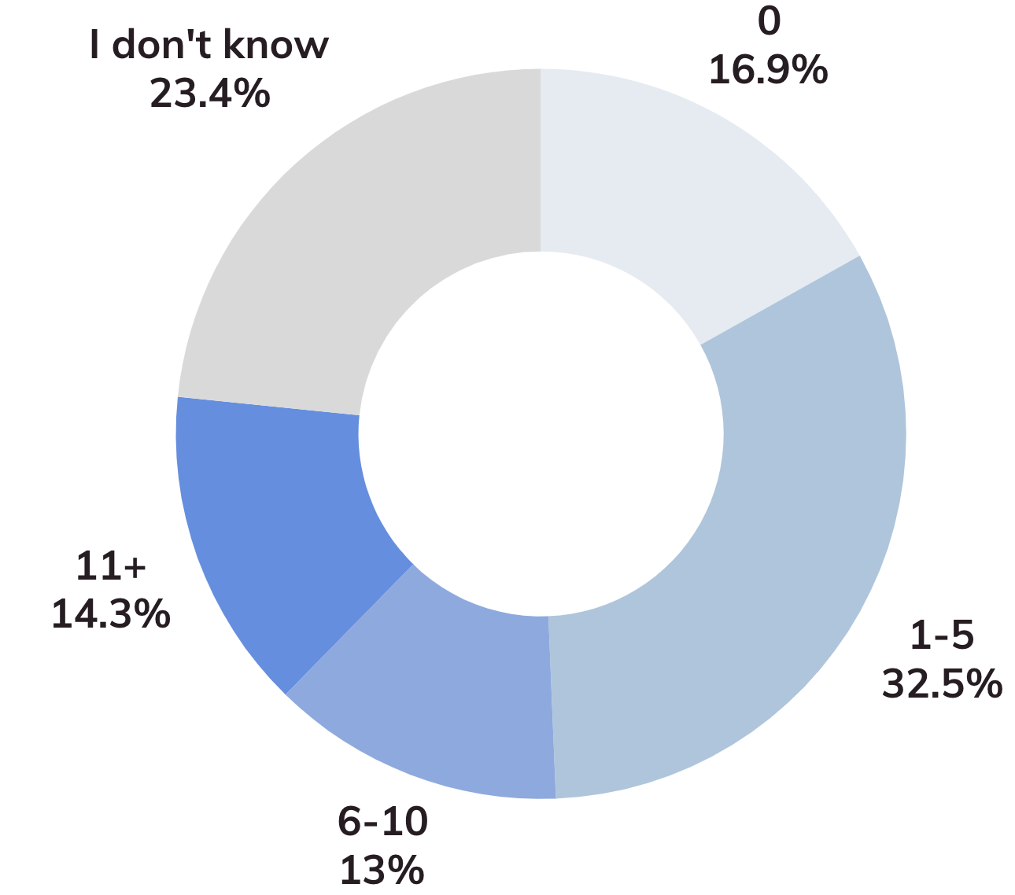
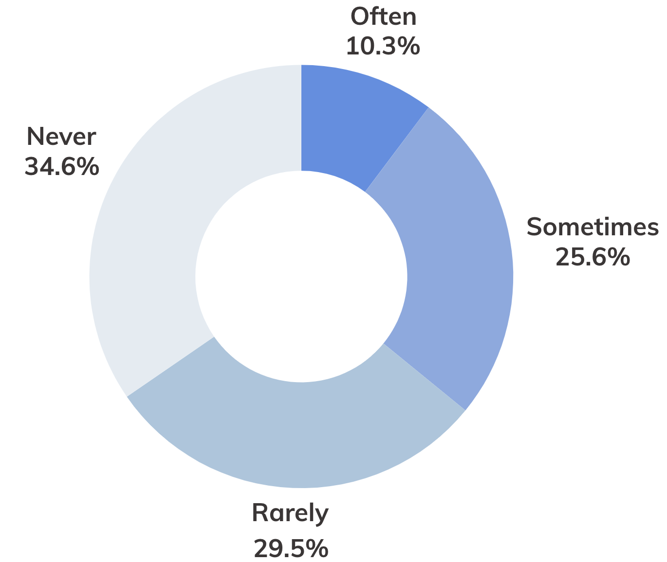
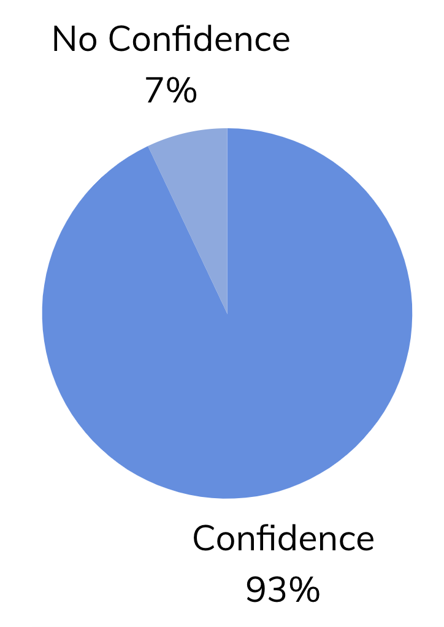
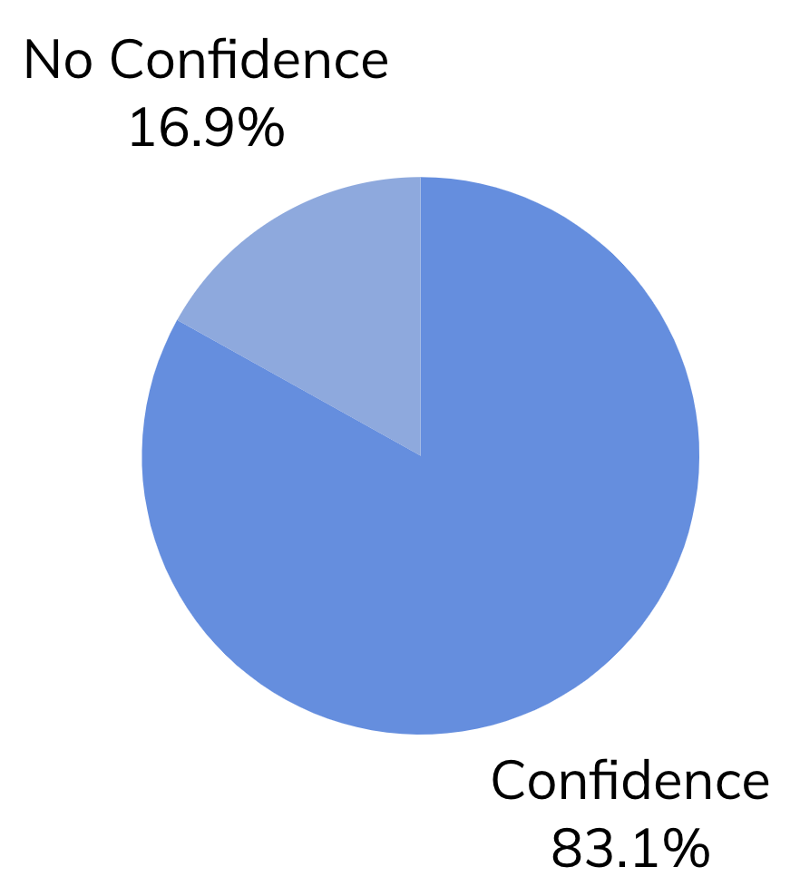
Number of Patients with a Known/Expected Xylazine Exposure
Frequency Discussed Xylazine with Patients
Confidence in Recognizing Xylazine-Related Complications in Patients
Confidence Treating Xylazine-Related Complications in Patients

Slide 8
Phase 2: Interviews (n=15)
Selected Among Those with Experience Treating Patients with Xylazine Exposure
 | Freq | %
Degree
MD | 13 | 86.7
NP | 2 | 13.3
RN | 1 | 6.7
MS | 3 | 20.0
 | Freq | %
Specialty
Internal Medicine | 9 | 60.0
Addiction Medicine | 8 | 53.3
Infectious Disease | 4 | 26.7
Other Specialty | 3 | 20.1
Source: Hill et al., 2024

Slide 9
Why are there knowledge/practice gaps for providers? → Xylazine is a unique substance
“Well, [xylazine] is odd… it can cause these scary complications. It doesn't neatly fit into the opioid category… [Clinicians] like to ‘bucket’ things. There is sort of a fentanyl / heroin bucket. We know what to do about that. Xylazine is in its own bucket. It's hard to kind of conceptualize what it is and how best to combat it.”
- Addiction Medicine Physician

Slide 10
Why are there knowledge/practice gaps for providers? → Patients know more than providers
“This is one of those examples in medical care where I think patients know more about it than we do. And so, whereas about maybe a year ago there were more like, 'Doc, what the heck is this?' types of conversations, now, oftentimes, I am learning from my patients about xylazine.”
- Addiction Medicine Physician

Slide 11
Why are there knowledge/practice gaps for providers? → Need for interdisciplinary teams
“We have excellent plastic surgeons who have been really good partners in kind of debriding the wounds as needed. And then if there is a wound, in addition to a general infectious disease follow up, we have a wound care center. And the nursing staff there is really meticulous. And there's a plastic surgeon in that clinic, there's a nurse practitioner who specializes in wound care. And then, of course, we have addiction medicine, so we really do have wraparound services…”
- Infectious Disease and Internal Medicine Physician

Slide 12
Why have providers not seen many patients with xylazine exposures? → Lack of testing
“The large, crater type wounds? Those we can definitely say are related to xylazine. The rest is often conjecture where somebody just appears to be having a much harder time… It's really only a suspicion… I think there's one that's available, but it's a ‘send up’ test… Which isn't really much help.”
- Addiction Medicine Physician

Slide 13
Why have providers not seen many patients with xylazine exposures? → Patients avoiding care
“Recently, I had a patient with xylazine wounds and abscesses. He was very sick, febrile, and needed to go to the hospital. He was coming into the clinic knowing that he was really sick and knowing he couldn't manage his wounds himself. But also, he was afraid to go to the hospital first because he didn't want to be sick and didn't want to not have that methadone in place before going.”
- Nurse Practitioner

Slide 14
Why do providers not frequently discuss xylazine with patients who might be exposed to it? → Premature Medical Discharge
“[This patient] would come into the ER when she was very sick, get some antibiotics, and then usually leave the ER not too long after. But she had the worst scarring I'd ever seen. And it was really getting to the point where a good proportion of her upper and lower limbs are now all pretty fairly scarred... [but] by the time I came back the next morning, she was already gone.”
- Infectious Disease Physician

Slide 15
Why do providers not frequently discuss xylazine with patients who might be exposed to it? → Patients have other pressing issues
“If I have a patient that's coming in who has very severe heart failure, and they are clearly having an exacerbation right in front of me, and I need to send them to the emergency room? That's something that I have to address right away. And it's not helpful to them for me to also sort of screen them for xylazine exposure. And it's very rare for me to just have a visit where there aren't acute issues happening... that wouldn’t be more threatening to their life than their xylazine exposure.”
- Internal Medicine Physician

Slide 16
Key Takeaways
+
There are key knowledge and practice gaps related to xylazine for healthcare providers, even if they are familiar with xylazine and have experience serving patients who have been exposed to this adulterant.
+
There is an urgent need to increase educational materials on how to treat and manage xylazine-related outcomes for a diverse group of providers.
+
Future research is needed to fill the information gaps that are impacting patient care best practices.
Source: Hill et al., 2024

Slide 17
Acknowledgments
Rebecca Minahan-Rowley
Emma T. Biegacki
Robert Heimer
Kimberly L. Sue
Participating
Providers in CT

Slide 18

Thank you!
Questions?
Katie Hill, MPH
Yale School of Public Health, New Haven, CT
@
k.hill@yale.edu

