Slide 1
Public Engagement and Program-Building Under Conditions of Skepticism
AMERSA 2023
Leah Leisch, Davis Bradford, Stefan Kertesz, Hannah Stone
Notes:
Attendees will plan and practice effective, diplomatic responses to questions or comments onaddiction or pain care that seem prejudicial or not based on evidence
Attendees will identify and evaluate a range of potential partners for public engagement andadvocacy including: national organizations, institutional authorities, clinical partners for purpose of
addressing a community or state, initiative
Attendees will plausible approaches for team-based analysis of proposed programs, rules, or initiatives where time is limited
Explain how key concepts of policy scholarship, such as "advocacy coalition" and "punctuated
equilibrium" influence the actual evolution of policy in a community, region or count

Slide 2
Disclosures and Caveats
Nothing said here represents formal views or positions of the US Department of Veterans Affairs, University of Alabama at Birmingham or the State of Alabama
No off-label discussion of medications is part of this talk
Dr. Kertesz attests to:
Receipt of royalty for an UpToDate chapter on Homelessness
Ownership of stock in Thermo Fisher, past ownership of Zimmer Biomet
Neither pertain to this discussion

Slide 3
Goals and Objectives
Attendees will:
plan and practice effective, diplomatic responses to questions or comments on addiction or pain care that seem prejudicial or not based on evidence
evaluate a range of potential partners for public engagement
consider examples of evaluation and response when time is limited
explain how key concepts of policy scholarship, such as "advocacy coalition" and "punctuated equilibrium" influence the actual evolution of policy

Slide 4
Agenda
Min 0-5: Introductions
Min 6-13: Team faculty will introduce key framing concepts.
Min 14-19: Team faculty will introduce tabletop exercise for small workgroups, supplemented by handouts.
Min 20-23: Tablemates introduce themselves
Min 24-39: Small group case example 1 with report back by Y (subset) groups
Min 39-54: Small group case example 2 with report back by Y (subset) groups
Min 54-79: Small group case example 3 with report back by Y (subset) groups
Min 79-90: Small group case example 4 with report back by Y (subset) groups
Reflections from Workshop Teachers with focus on self-care and mutual support needs in considerations of such public engagement
Notes:
What we wrote in submission:
Minutes 0-5: Introductions
Minutes 6-14: Framing concepts: "public skepticism" as it applies to policy deliberation concerning drug use disorder, opioids, pain care, and how such skepticism operates differently
in rural and so-called Red State environments. Additionally, the faculty will offer a thumbnail overview of policy scholarship on how policy is set, including "policy monopoly" and "advocacy coalition".
Minutes 15-21: Team faculty will share, in short-form, examples from recent public engagement or advocacy experiences under conditions of public or policymaker skepticism, including proposed sharp
restrictions on buprenorphine.
Minutes 22-29: Team faculty will introduce tabletop exercise for small workgroups, supplemented by handouts.
Minutes 30-52: Small group exercises.

Slide 5
Critical Disclaimer:
It is NOT required or expected that attendees adopt particular political viewpoints.

Slide 6
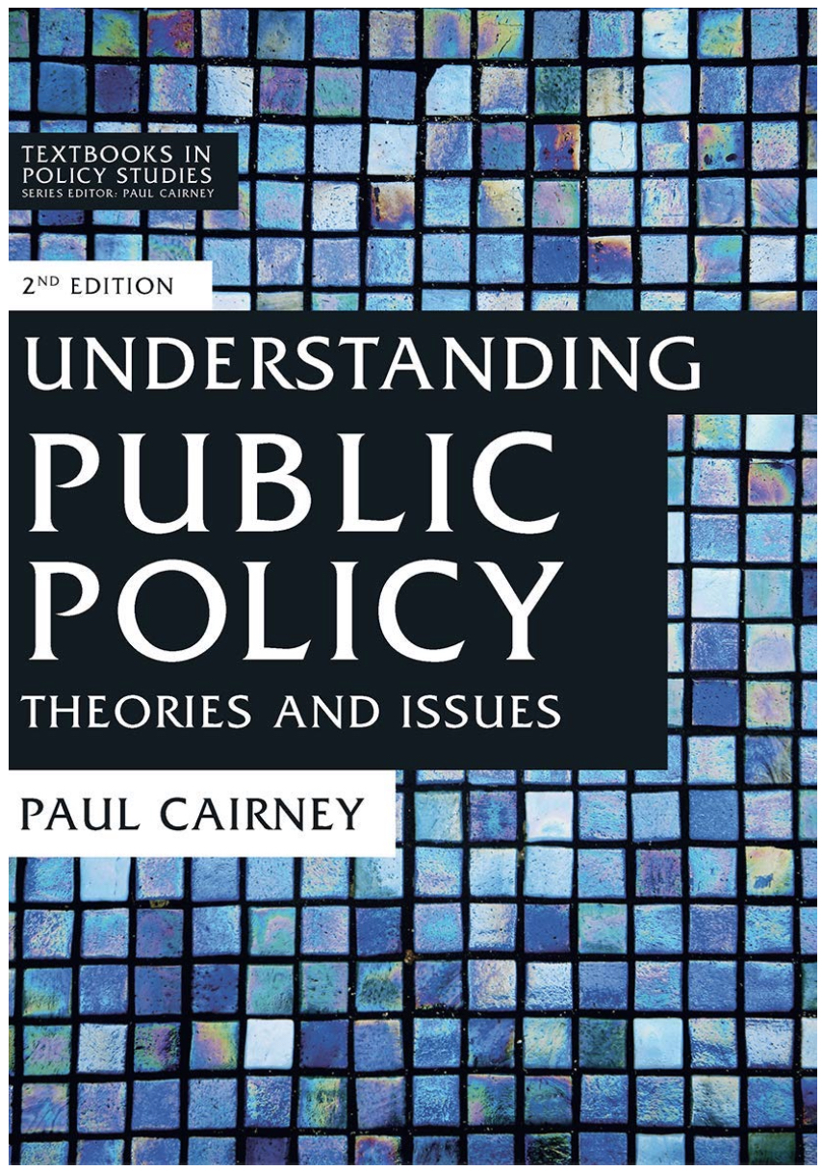
When we engage, it’s often to speak on policy
We might aspire that
Policies be rational
Policies align with our views & values
Policy scholarship explains why policies are “what they are”
4 key concepts:
Bounded rationality
Policy monopoly
Advocacy coalition
Punctuated equilibrium

Slide 7
Bounded Rationality
Policies emerge from multiple actors and agencies acting simultaneously, only some of whom are central or governmental
Rationality is always limited (“bounded”) by
degree to which leaders can assimilate complex data,
reality of having many problems
limited resources & prior traditions/resources/context
They may be open to influence by well-informed advocates who digest and share their understandings (not exclusively by this)

Slide 8
Stasis-> Change
Agents who control the definition of problems that deserve to be solved, voices that deserve to be heard, and the methods of response (stasis)
Policy monopoly
Advocacy Coalition
Punctuated Equilibrium
A “fixed” equilibrium of relationships & priorities may be “punctuated” and thus shifted to a new position
People from a variety of positions who share understandings and who have a nontrivial degree of coordinated activity

Slide 9
Potential Ways to Advocate
Public comment
Op eds
Journal publications (I.e. Letter to the Editor)
Calling and letter writing to politicians
Meeting with policymakers
Social media posting
Form or join a group

Slide 10
There are variable forms of Public Engagement
Activism
Advocacy
Build and Maintain
Facilitate
Collaborate
Critique
Confront
Claim
Reform
Mobilize
Gallagher, J. 2017 Comparative Political Studies
Notes:
Advocates and activists are dedicated to creating positive change in the world. An advocate is someone who works on behalf of an individual, group or an organization, and an activist works to spur broader social or political change.
Gallagher, J. (2017). The last mile problem: Activists, advocates, and the struggle for justice in domestic courts. Comparative Political Studies, 50(12), 1666-1698.
Under conditions of public skepticism, clinical leaders must seek constructive forms of publicengagement, based on respect for the community, while nonetheless offering a clear and compelling message about necessary policies or programs.
Advocacy is the core activity of all social movements: the “act of persuading or arguing in support of a specific cause, policy, idea or set of values” (Cox & Pezzullo, 2016, p.177).
Activism is defined as the use of direct and noticeable action to achieve a result, usually a political or social one (Cambridge Dictionary).

Slide 11
There are Different Times and Places for Activism and Advocacy
Activism may work better in some situations but misfire or alienate some in others.
Advocacy may be relationship building in others but may not be broad reaching enough in some situations.
You may “switch roles” or share duties with others

Slide 12
A Cognitive Framework for Advocacy
Critical Analysis
Your data
Experience
Patient stories
Collaboration
Respect
Flexibility
Creativity
Their data
Personal stories
Openness
Key Players
Expertise
Relationship
Confident Humility
Focus on being a scientist
Motivational Interviewing
Notes:
Key Players: policy makers district, personal hx, issues important to them, voting record
Their Data: situational awareness of other policies proposed and downstream effects of current policy
Flexibility: The key is not to let task conflict become relationship conflict by thinking about it as a debate rather than a disagreement; this way, the conflict feels less personal and easily overcome. people too often take an adversarial approach in persuasion and try to overwhelm their opponents; the better approach is to find common ground, ask questions, and limit arguments to a few key points.
Adam Grant: Think Again When you think like a scientist, "you favor humility over pride and curiosity over conviction," Grant explained. "You look for reasons why you might be wrong, not just reasons why you must be right."
Grant believes that we tend to adopt the style of a preacher, prosecutor, or politician. We preach to protect and promote our own ideas, prosecute to prove others wrong, and politick when we lobby for others’ approval.
https://advocacyguide.icpolicyadvocacy.org/431-decisionmakers-advisors-and-institutions-inside-government
■Your stories! Backed up by data.
■Defining an issue
■Policymaker and stakeholder mapping
■Issue tracking
■Building a coalition

Slide 13
Instructions for your Table Exercise
Pick one-person at the table and focus on their state. Practice helping that person speak with the skeptical people from their state.
Change people each case
Remember:
Critical Analysis
Experience
Flexibility
Collaboration

Slide 14
Mini-Case One: Identifying Partners
You are concerned about the increasing number of patients showing up in your clinic in opioid withdrawal or with suicidal ideation after having long-term opioid therapy for chronic pain stopped abruptly by other providers. It seems like great patient harm is occurring.
Who might potential partners be? What are the pros and cons of each partnership? How do you figure out what matters to them?
Notes:
Scenario A: Outreach to political or organizational partner or partners in light of a clinical or policy proposal. Attendees will practice the naming of potential partners, assessment of merits/demerits of engaging them, evaluation of partners in regard to power, and capacity to respond in timely fashion. They will be asked to weigh potential partners in response to a hypothetical "bad proposal" or "bad law".

Slide 15
Mini-Case Two: Devise Respectful Responses to Opposition
You have just finished a stellar presentation on rising overdose death rates in the state, the importance of naloxone and fentanyl test strips in preventing overdose and county initiatives to disseminate naloxone. You included impactful stories of lives saved by naloxone that was distributed by your organization and a petition for fentanyl test strips to be legalized.
You open the floor for question:
Dr. X…you gave an impressive presentation with moving information the rising overdose death rate and how important naloxone is in preventing those.
Since your organization has been working so hard to distribute these for the past two years, when might we begin to see the overdose deaths decline?
Propose a response
Be respectful
Can you imagine a similarly challenging question?
Notes:
Scenario B: Sharing a public conversation: attendees will practice anticipation and planning diplomatic responses for statements that may seem nonevidence based, prejudicial, shocking or harmful to the point of view held by the advocate.
Remember:
Critical Analysis
Experience
Flexibility
Collaboration
What data would you need to have prepared prior to this talk?
How would you establish your experience:
How can you create a collaborative approach to this question:
What are ways you can demonstrate flexibility in your thinking? How do you avoid becoming adversarial and stick with a scientific approach?

Slide 16
Mini-Case Three: Explore what it might be like to hold the other view
Think about a proposition that most addiction medicine research would support.
Pretend to advocate AGAINST that proposition.
Declare the problem.
Explain your understanding of the situation and what you are basing your stance on.
Be as respectful and professional as you would be if arguing for it in a normal situation.
Assess how you feel.
Notes:
Can we maybe move this to the end?
For example:
Advocate for sober permanent housing in a pro-Housing First environment
Advocate for a chemical endangerment law (i.e. legal intervention with drug using, possibly, pregnant persons) that you think most would oppose
For a syringe service program that you think most in your community would oppose
Remember:
Critical Analysis
Experience
Flexibility
Collaboration
What data would you need to have prepared prior to this talk?
How would you establish your experience:
How can you create a collaborative approach to this question:
What are ways you can demonstrate flexibility in your thinking? How do you avoid becoming adversarial and stick with a scientific approach?
Scenario D:
Advocating for what everyone else thinks is wrong. Attendees will be
asked to choose - solely for purpose of the exercise- an idea or objective that appears to be contradictory to
the values, perceptions and expectations of a community of which they are a part. The attendees are not
expected to be proponents of the idea in reality (i.e. monitored heroin administration; residential "abstinence
camps" for youth; pro-opioid-tapering; anti-opioid tapering). However, they will be asked to draft the
following steps in support of an advocacy plan for that idea: *A statement of the idea itself in 1-2
sentences *A 3-line summary of the argument for the idea *A short but real explanation of respect for
and understanding of the contradictory and (in the case example) dominant point of view *Assessment
of audiences and partners who might be engageable *A realistic assessment of the likely outcomes for
the idea itself, and for the advocate if they were to consider the idea.

Slide 17
Mini-Case Four: Digest Complex Information Quickly
You have just found out that your state board of medical examiners is considering passing a bill that will require 36 pages worth of regulations around buprenorphine prescribing.
Open comment ends in three days. You are out-of-town presenting at a regional conference this weekend so time is short and your team is far away.
How do you formulate a rapid response with multiple people who are geographically dispersed?
Are there people, methods of data analysis, that would help?
How do you frame this rapid response for biggest impact.
Notes:
C: Digesting complex information for action. Participants will evaluate potential plans to make sense of a complex state or federal rule regarding addiction care when time is short and every collaborator has competing demands
Remember:
Critical Analysis
Experience
Flexibility
Collaboration
What data would you need to have prepared prior to this talk?
How would you establish your experience:
How can you create a collaborative approach to this question:
What are ways you can demonstrate flexibility in your thinking? How do you avoid becoming adversarial and stick with a scientific approach?

Slide 18
Resources [group, technology, organization, model ordinance]
Not reinventing the wheel:
National Pain Advocacy Center: https://nationalpain.org/
Drug Policy Alliance: https://drugpolicy.org/resources/
https://www.asam.org/advocacy/state-advocacy
https://www.sgim.org/communities/advocacy
AMERSA Advocacy Committee
Identifying your elected officials: https://www.usa.gov/elected-officials
Finding legislation around topic:
•SUD Treatment Database: https://www.ncsl.org/health/substance-use-disorder-sud-treatment-database
•Rx Drug State Bill Tracking Database: https://www.ncsl.org/health/prescription-drug-state-bill-tracking-database-2015-present
Finding Data:
County/State Health Departments
State level syndromic surveillance data

Slide 19
Reflections
What discreet facts/resources did we learn in this discussion?
Are there meta-reflections or meta-insights we wish to share?
Notes:
develop generalizable questions and skills that can
sustain advocacy despite adversity

