Slide 1

ACCESSIBILITY OF METHADONE TREATMENT
VIA PUBLIC TRANSIT FOR
SYRINGE SERVICES PROGRAM PARTICIPANTS
IN MIAMI-DADE COUNTY, FLORIDA
Marina Plesons,* Eileen Malecki,* Katrina Ciraldo, Emilie Ashbes,
Edward Suarez, Jr., Hansel E. Tookes, Tyler S. Bartholomew
University of Miami Miller School of Medicine; *Equal contributors
AMERSA | November 2024

Slide 2



OUD CASCADE OF CARE
Treatment with a medication for opioid use disorder (MOUD) has been shown to
reduce rates of opioid overdose, all-cause mortality, and suicide by more than 50%.
While the number of facilities providing MOUD and the number of patients receiving MOUD have increased,
major gaps remain in the opioid use disorder (OUD) cascade of care.
Only 20% of people with OUD in the US receive specialty care in a given year
Less than 35% of those individuals receive evidence-based treatment with a MOUD
Most of those individuals discontinue treatment within months

Slide 3

METHADONE
  One of two opioid receptor agonist medications used in the treatment of OUD
  Tightly regulated by SAMHSA, DEA, and FDA as a Schedule II controlled medication
  In March 2020, SAMHSA approved temporary allowances for relaxed take-home protocols; made permanent in February 2024
  However, states still have authority to determine their own OTP regulations
Treatment duration | Take-home allowance
First 90 days | 1 dose per week
Second 90 days | 2 doses per week
Third 90 days | 3 doses per week
Remaining months of the first year | Maximum 6 day supply
After one continuous year | Maximum 2 week supply
After two continuous years | Maximum one month supply
Current take-home allowances under FL administrative code 65D-30.0142
Notes:
Methadone, a full m-opioid receptor agonist, is one of two opioid receptor agonist medications used in the treatment of OUD.
Despite being a life-saving medication, especially for the increasing number of patients who do not tolerate buprenorphine in the era of fentanyl and other high-potency synthetic opioids, it is tightly regulated by SAMHSA, the DEA, and the FDA as a Schedule II controlled medication.
In March 2020, SAMHSA made temporary allowances for relaxed take-home protocols, allowing OTPs to provide 27 take-homes to patients who were stable and 13 take-homes to those who were less stable.
In February 2024, these flexibilities were made permanent; however, states still have the authority to determine their own OTP regulations and decisions regarding take-home protocols, where permitted, are based on providers’ clinical judgment.

Slide 4

MEANWHILE, BUPRENORPHINE
  In April 2020, SAMHSA removed the requirement for an in-person assessment for the prescription of buprenorphine; also since made permanent
  In December 2022, US Congress removed the requirement for practitioners to apply for a special waiver prior to prescribing buprenorphine for OUD
  This has enabled progress in expanding low-threshold buprenorphine treatment through new models (e.g., telehealth) and in critical settings (e.g., SSPs).
Notes:
This regulatory environment stands in stark contrast to that of buprenorphine, a partial -opioid receptor agonist also used in the treatment of OUD.
In April 2020, SAMHSA removed the requirement for an in-person assessment for the prescription of buprenorphine, thereby enabling new telehealth-based models of care for OUD.
Based on evidence that this policy change increased patient engagement and satisfaction with care, it extended this flexibility in the post-pandemic era.
Likewise, in December 2022, US Congress removed the requirement for practitioners to apply for a special waiver prior to prescribing buprenorphine for OUD. Since then, there has been progress in expanding low-threshold buprenorphine treatment in critical settings like SSPs.

Slide 5

WONDERFUL, BUT...
Evidence demonstrates that:
  White patients are four times more likely to be prescribed buprenorphine as Black patients
  Buprenorphine patients are more likely than methadone patients to be employed, have higher levels of education, and use prescription opioids instead of heroin/fentanyl
Thus, this progress risks exacerbating existing racial and
socioeconomic inequities in treatment for OUD unless paired
with similar efforts to create low-threshold methadone treatment.

Slide 6


ACCESSIBILITY
  Availability and accessibility are 2 of the 5 dimensions of access to healthcare
  Geographic distance to OTPs, and associated time and financial costs, are major barriers that people face in accessing methadone
    Also negatively associated with methadone treatment retention
  However, nearly all studies have utilized geographic distance or driving time, rather than public transportation transit time
OBJECTIVE
To examine public transit access to methadone treatment for participants of an SSP in Miami-Dade County, Florida
Notes:
Important distinction since lower-income individuals, especially those in urban areas, are more likely to rely on public transportation,31 and access to efficient, well-functioning transportation systems is a notable social determinant of health equity.

Slide 7

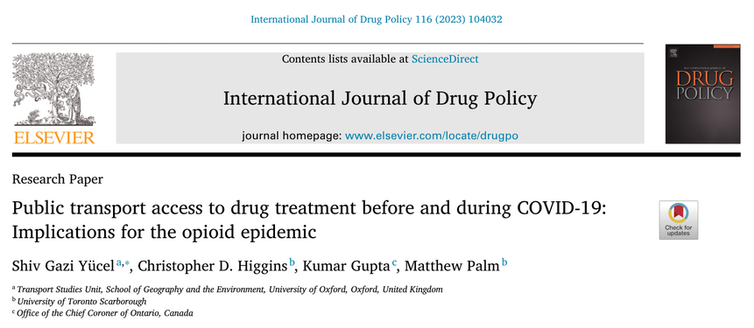
METHODS
1
We created a transit network for Miami-Dade County using:
  General Transit Feed Specification
  OpenStreetMap
2
We obtained the locations of OTPs in Miami-Dade County from the Florida Department of Children and Families and SAHMSA
3
We obtained the locations of the IDEA Miami SSP’s from using the SSP’s administrative data
  Specifically, the population-weighted centroids of their zip-codes
4
We used a statistical package in R called r5r which facilitates multi-modal transportation network routing to estimate the average transit time from the SSP’s clients locations to the nearest OTP
  Used 10 departure windows that aligned with the OTP service hours (8am and 10am Monday-Friday).

Slide 8
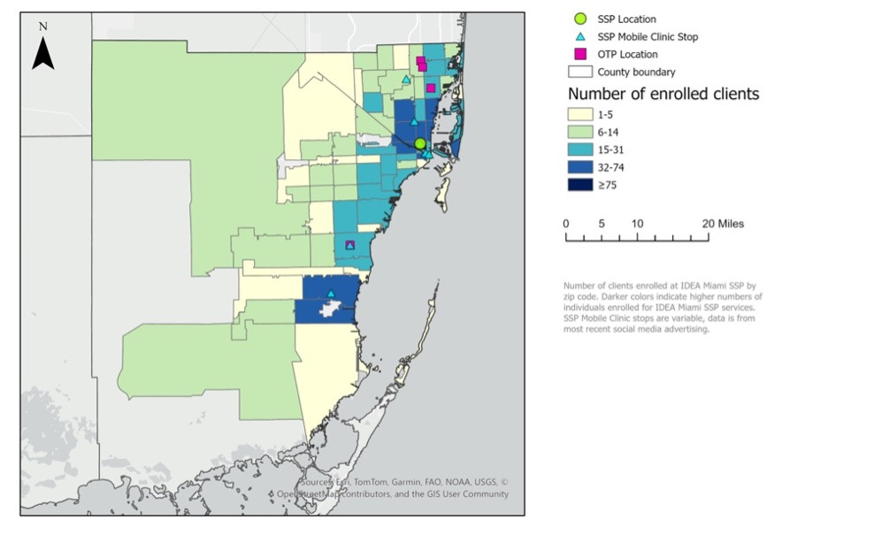
RESULTS | LOCATIONS OF OTPS
There are 4 registered OTPs in
Miami-Dade County:
  2 OTPs in a zip code with 7 SSP clients
  1 OTP in a zip code with 24 SSP clients
  1 OTP in a zip code with 25 SSP clients

Slide 9
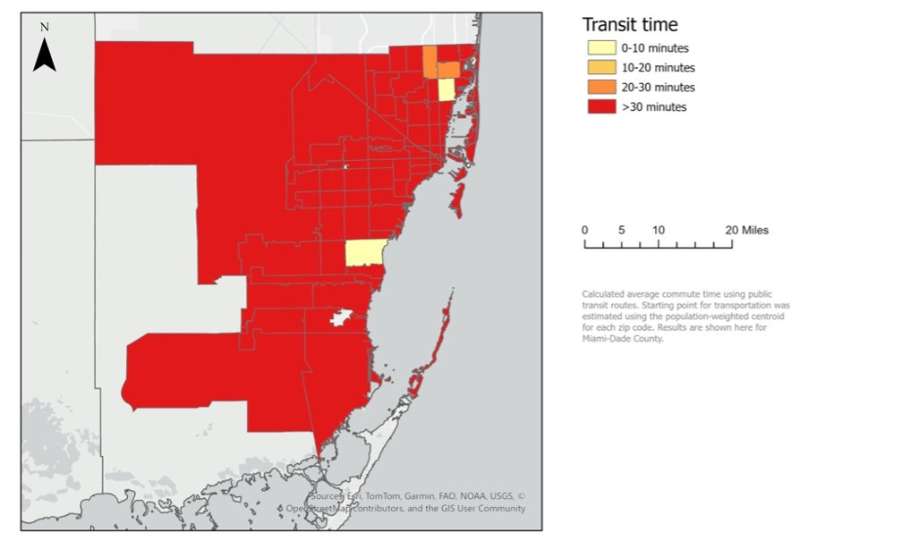
RESULTS | TRANSIT TIMES
An SSP client in
Miami-Dade County has a mean
80-minute one-way transit time
to the nearest OTP.
Assuming daily round trips 6 days per week,
individuals have to travel approximately
16 hours per week
to remain engaged in methadone treatment.
95% of the zip codes with
SSP clients in Miami-Dade County are
methadone treatment deserts.

Slide 10
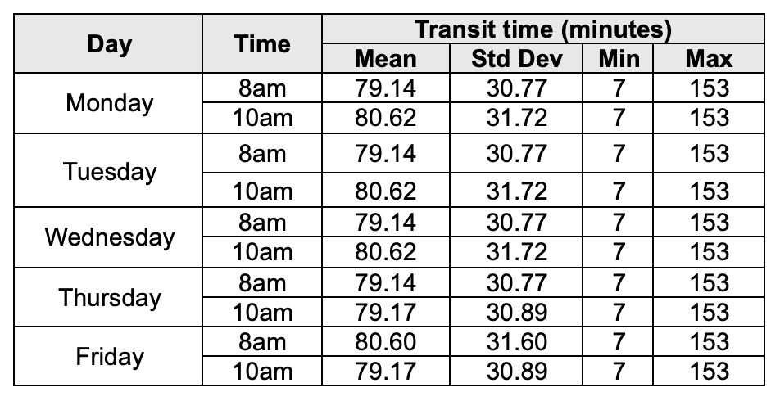
RESULTS | TRANSIT TIMES, CONT.
Transit times did not differ substantially between departure windows,
ranging from 79 to 81 minutes

Slide 11
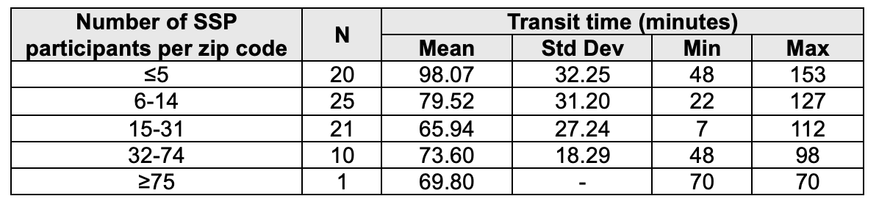
RESULTS | TRANSIT TIMES, CONT.
Transit times differed substantially between
zip codes with various numbers of SSP clients,
ranging from a minimum of 66 minutes from zip codes with 15-31 SSP clients
to a maximum of 98 minutes from zip codes with ≤5 SSP clients.

Slide 12
IMPLICATIONS
  The public transit times between the zip codes where SSP clients in Miami-Dade County live and the county’s OTPs represent a significant barrier to methadone treatment initiation and retention.
  This analysis points to a need for:
    general improvements in public transit
    establishment of additional OTPs and creation of mobile medication units
    use of exception requests that can be submitted to SAMHSA on an individual basis to permit additional take-home doses
While regulatory changes in recent years have enabled important progress in expanding
low-threshold buprenorphine treatment through novel models of care in new settings,
we risk exacerbating existing racial and socioeconomic inequities in
treatment for OUD unless similar progress is made for methadone treatment.

Slide 13
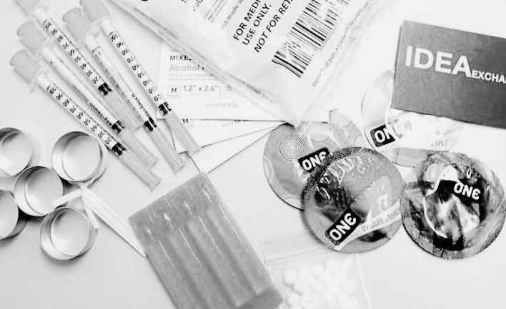
THANK YOU
QUESTIONS?
Acknowledgements
We would like to thank the clients of the IDEA Miami SSP for trusting us to be their home for harm reduction.
In addition, we would like to thank the staff of the IDEA Miami SSP for their dedication and support for this study.
REFERENCES
  Santo T, Jr., Clark B, Hickman M, et al. Association of Opioid Agonist Treatment With All-Cause Mortality and Specific Causes of Death Among People With Opioid Dependence: A Systematic Review and Meta-analysis. JAMA Psychiatry. Sep 1 2021;78(9):979-993. doi:10.1001/jamapsychiatry.2021.0976
  Mattick RP, Breen C, Kimber J, Davoli M. Buprenorphine maintenance versus placebo or methadone maintenance for opioid dependence. Cochrane Database Syst Rev. Feb 6 2014;(2):Cd002207. doi:10.1002/14651858.CD002207.pub4
  Alderks CE. Trends in the Use of Methadone, Buprenorphine, and Extended-Release Naltrexone at Substance Abuse Treatment Facilities: 2003-2015 (Update). The CBHSQ Report. Substance Abuse and Mental Health Services Administration (US); 2013:1-8.
  Williams AR, Nunes EV, Bisaga A, Levin FR, Olfson M. Development of a Cascade of Care for responding to the opioid epidemic. Am J Drug Alcohol Abuse. 2019;45(1):1-10. doi:10.1080/00952990.2018.1546862
  Florida Department of Children and Families. Rule Chapter 65D-30: Substance Abuse Services Office. Florida Department of State. 2024. https://www.flrules.org/gateway/ChapterHome.asp?Chapter=65d-30
  Lagisetty PA, Ross R, Bohnert A, Clay M, Maust DT. Buprenorphine Treatment Divide by Race/Ethnicity and Payment. JAMA Psychiatry. 2019;76(9):979-981. doi:10.1001/jamapsychiatry.2019.0876
  Hansen HB, Siegel CE, Case BG, Bertollo DN, DiRocco D, Galanter M. Variation in use of buprenorphine and methadone treatment by racial, ethnic, and income characteristics of residential social areas in New York City. J Behav Health Serv Res. Jul 2013;40(3):367-77. doi:10.1007/s11414-013-9341-3
  Hansen H, Netherland J, Herzberg D. Whiteout: How Racial Capitalism Changed the Color of Opioids in America. University of California Press; 2023.
  Penchansky R, Thomas JW. The concept of access: definition and relationship to consumer satisfaction. Med Care. Feb 1981;19(2):127-40. doi:10.1097/00005650-198102000-00001
  Yücel SG, Higgins CD, Gupta K, Palm M. Public transport access to drug treatment before and during COVID-19: Implications for the opioid epidemic. Int J Drug Policy. Jun 2023;116:104032. doi:10.1016/j.drugpo.2023.104032
Images courtesy of Canva and the IDEA Miami Syringe Services Program.

