Slide 1
Rapid transition from a continuous naloxone infusion to sublingual buprenorphine after an opioid overdose
Anthony Spadaro MD, Emily Gordon MD, Diane Calello MD, Christopher Counts MD, Trevor Cerbini MD, Lewis Nelson MD, Howard Greller MD

Slide 2
Rapid transition from a continuous naloxone infusion to sublingual buprenorphine after an opioid overdose
No Conflicts of interest to report
Patient provided written consent for this case to be presented and published

Slide 3
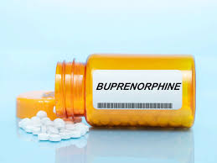
Rapid transition from a continuous naloxone infusion to sublingual buprenorphine after an opioid overdose
High affinity
Long acting
Partial-agonism
Great MOUD
Reversal Agent?

Slide 4
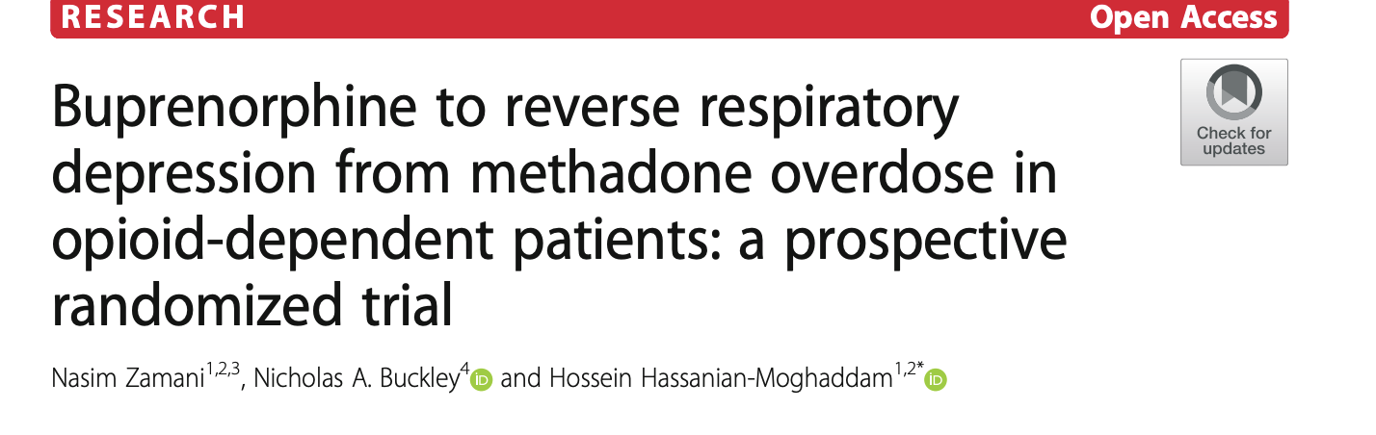
Rapid transition from a continuous naloxone infusion to sublingual buprenorphine after an opioid overdose
Safety and Effectiveness?
 | Naloxone (n=27) | Buprenorphine 10 ug/kg (n=27)
Response to treatment | Complete reversal 13/27 Partial reversal 13/27 No response 1/27 | Complete reversal 27/27 Partial reversal 0/27 No response 0/27
Opioid Withdrawal | 15/27 | 6/27
Apnea episodes | 6/27 | 3/27
Intubation | 8/30 | 1/27

Slide 5
Rapid transition from a continuous naloxone infusion to sublingual buprenorphine after an opioid overdose
Reversal with less withdrawal?

Slide 6
Rapid transition from a continuous naloxone infusion to sublingual buprenorphine after an opioid overdose
DEI
These cases occurred at University Hospital in Newark, NJ, which serves a historically underserved population with a high percentage of racial and ethnic minority groups.
While opioid overdose mortality is overall declining across the country, not all communities are seeing declines and disparities in overdose deaths may be increasing
We should aim to keep these disparities in mind when studying or designing interventions for the management of opioid overdose and the initiation of MOUD

Slide 7
The patient had a history of OUD and reportedly daily nasal insufflation of fentanyl, cocaine, and heroin. He received 2 mg of intranasal naloxone by EMS and on arrival to the ED was alert and oriented. The patient’s initial vitals were HR 104 bpm, RR 14 bpm, and BP 127/62 mmHg. Initial venous blood gas demonstrated a respiratory acidosis with pH of 7.34 and pCO2 63 mmHg. One hour after arrival he became somnolent with a slowed respiratory rate and had pinpoint pupils
The patient had a history of OUD and reportedly daily nasal insufflation of fentanyl, cocaine, and heroin. He received 2 mg of intranasal naloxone by EMS and on arrival to the ED was alert and oriented. The patient’s initial vitals were HR 104 bpm, RR 14 bpm, and BP 127/62 mmHg. Initial venous blood gas demonstrated a respiratory acidosis with pH of 7.34 and pCO2 63 mmHg. One hour after arrival he became somnolent with a slowed respiratory rate and had pinpoint pupils
The patient had a history of OUD and reportedly daily nasal insufflation of fentanyl, cocaine, and heroin. He received 2 mg of intranasal naloxone by EMS and on arrival to the ED was alert and oriented. The patient’s initial vitals were HR 104 bpm, RR 14 bpm, and BP 127/62 mmHg. Initial venous blood gas demonstrated a respiratory acidosis with pH of 7.34 and pCO2 63 mmHg. One hour after arrival he became somnolent with a slowed respiratory rate and had pinpoint pupils
Rapid transition from a continuous naloxone infusion to sublingual buprenorphine after an opioid overdose
Case Presentation
A 38-year-old man presented to the ED after a suspected opioid overdose.
He received 2 mg of intranasal naloxone by EMS and on arrival to the ED was alert and oriented.
The patient’s initial vitals were HR 104 bpm, RR 14 bpm, and BP 127/62 mmHg.
Initial venous blood gas demonstrated a respiratory acidosis with pH of 7.34 and pCO2 63 mmHg.
One hour after arrival he became somnolent with a slowed respiratory rate and had pinpoint pupils.
Dispo?

Slide 8
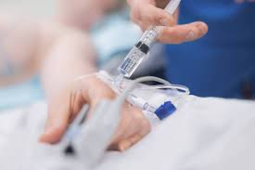
Rapid transition from a continuous naloxone infusion to sublingual buprenorphine after an opioid overdose
Case Presentation
One hour after arrival he became somnolent with a slowed respiratory rate
The patient received 11 bolus doses of IV naloxone for respiratory depression over the course of 6 hours, with doses ranging from 0.04 mg to 0.4 mg, totaling 1.96 mg.
He was started on a continuous naloxone infusion at 0.21 mg/hr.
7 hours after starting the naloxone infusion he was given buprenorphine.
Dispo?

Slide 9
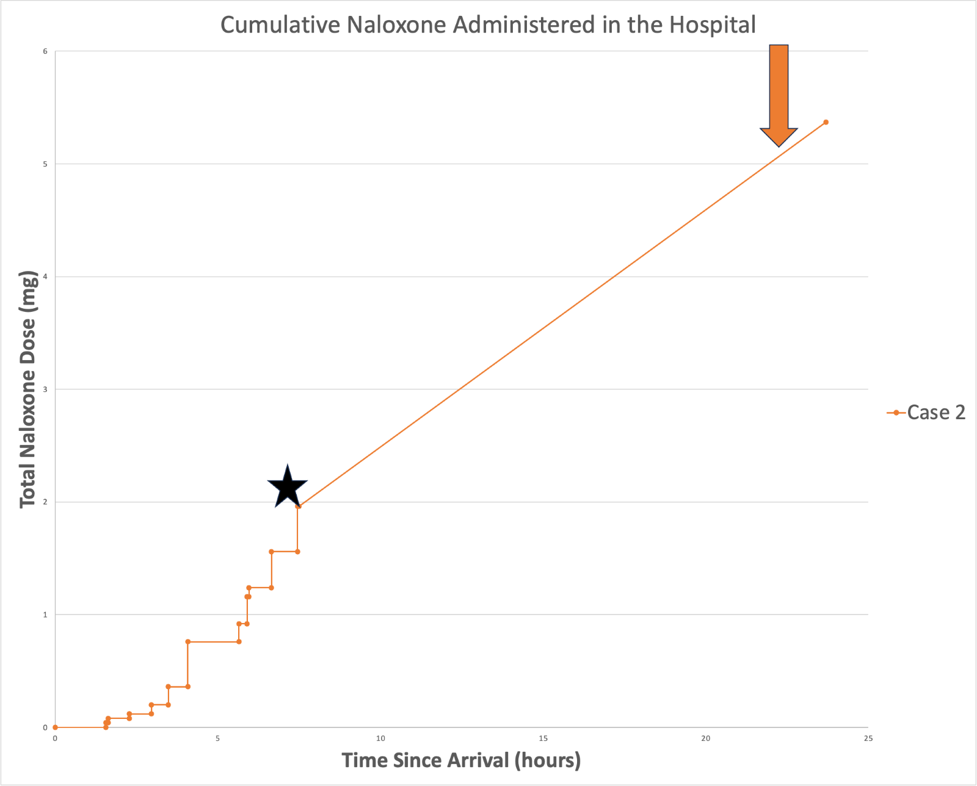
Rapid transition from a continuous naloxone infusion to sublingual buprenorphine after an opioid overdose
Figures
Star = start of continuous naloxone infusion
Arrow = buprenorphine administration

Slide 10
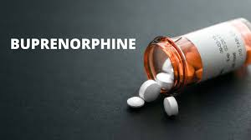
Rapid transition from a continuous naloxone infusion to sublingual buprenorphine after an opioid overdose
Case Conclusion
Did not develop precipitated withdrawal
Was maintained on buprenorphine 8mg three times daily afterwards
Discharged with addiction medicine follow up

Slide 11
Rapid transition from a continuous naloxone infusion to sublingual buprenorphine after an opioid overdose
Other cases and future directions
Two other cases:
1) Patient that was not opioid tolerant and was given buprenorphine 10 hours after being on a continuous naloxone infusion
2) Patient with OUD and COPD who were concerned about both precipitated withdrawal and respiratory depression
Future directions:
Predictors of who will need a continuous naloxone infusion
Identify patients who are safe to receive buprenorphine while on a continuous naloxone infusion
Prospectively study buprenorphine as a reversal agent

Slide 12
Rapid transition from a continuous naloxone infusion to sublingual buprenorphine after an opioid overdose
Questions?

